Slide 1

Viewing of Modules
Activities of Daily Living
Health & Safety
CR 11.3
Private and Confidential

Slide 2
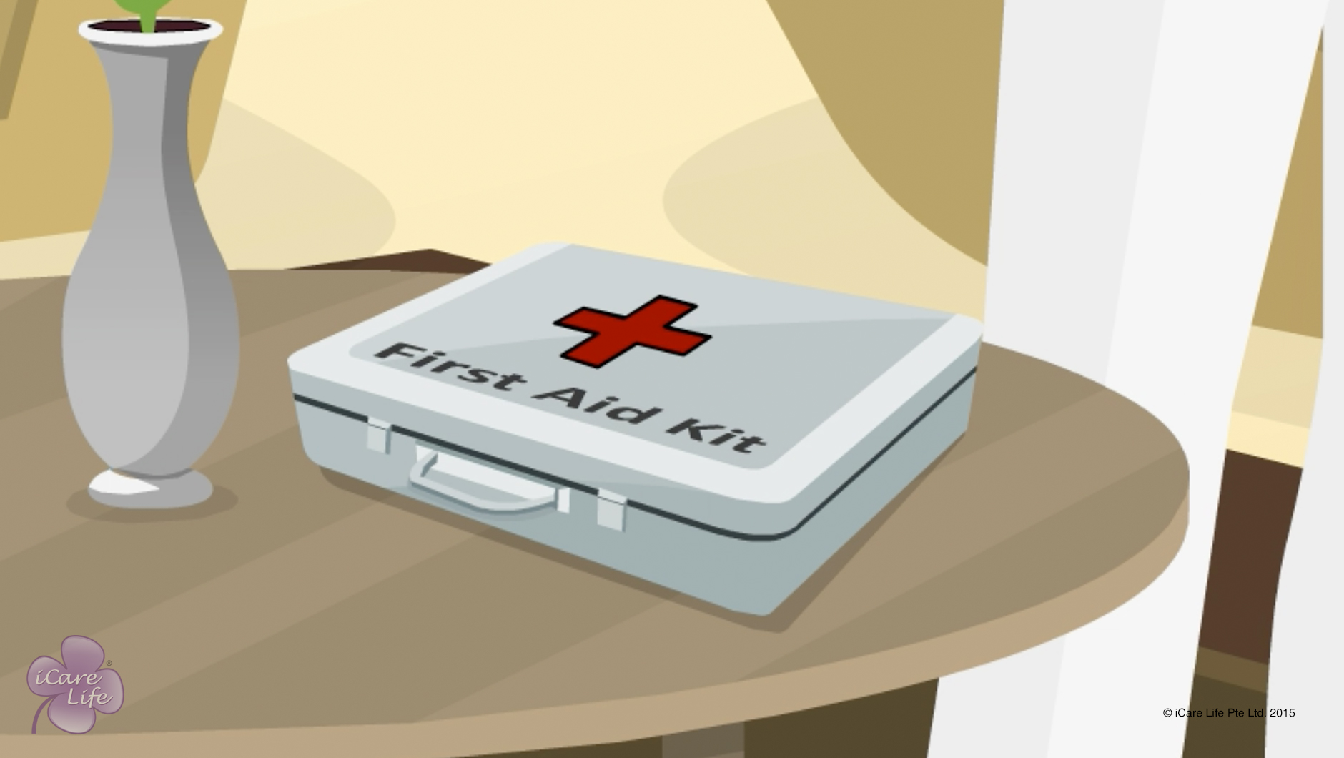
First Aid Kit
1
Copyright: iCare Life Pte. Ltd., Singapore : This document must not be copied or shared or circulated without the consent of iCare Life and/or its affiliates.

Slide 3
In this module, you will learn about:
What medicines and ointments should a first aid kit contain
What dressings and bandages should be included in a first aid kit
2

Slide 4

Let’s Watch
First Aid Kit
3
Copyright: iCare Life Pte. Ltd., Singapore : This document must not be copied or shared or circulated without the consent of iCare Life and/or its affiliates.

Slide 5

Providing common relief for Injuries
4
Copyright: iCare Life Pte. Ltd., Singapore : This document must not be copied or shared or circulated without the consent of iCare Life and/or its affiliates.

Slide 6
In this module, you will learn about:
What to do in case of common injuries, such as cuts, burns, sprains, and insect bites
5
Copyright: iCare Life Pte. Ltd., Singapore : This document must not be copied or shared or circulated without the consent of iCare Life and/or its affiliates.

Slide 7
Let’s Watch
Providing relief to common Injuries
6
Copyright: iCare Life Pte. Ltd., Singapore : This document must not be copied or shared or circulated without the consent of iCare Life and/or its affiliates.

Slide 8
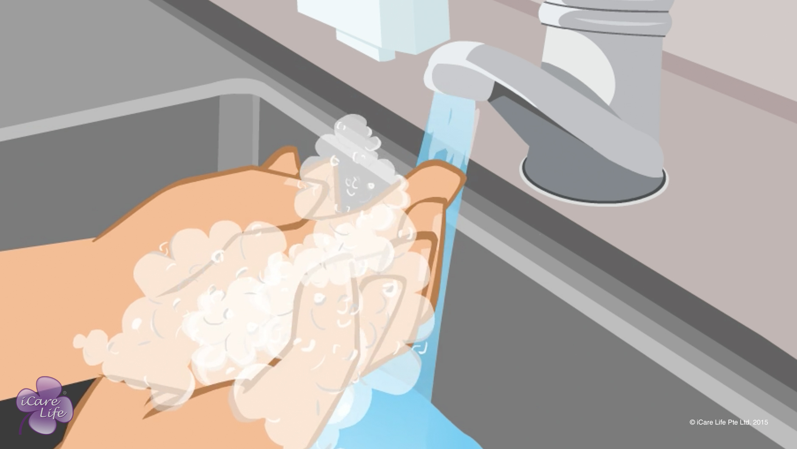
Hygienic handling of Food & Equipment
7
Copyright: iCare Life Pte. Ltd., Singapore : This document must not be copied or shared or circulated without the consent of iCare Life and/or its affiliates.

Slide 9
In this module, you will learn about:
Importance of handling food and equipment hygienically
How to handle food correctly
How to handle food equipment correctly
8
Copyright: iCare Life Pte. Ltd., Singapore : This document must not be copied or shared or circulated without the consent of iCare Life and/or its affiliates.

Slide 10
Let’s Watch
Hygienic handling of Food & Equipment
9
Copyright: iCare Life Pte. Ltd., Singapore : This document must not be copied or shared or circulated without the consent of iCare Life and/or its affiliates.

Slide 11
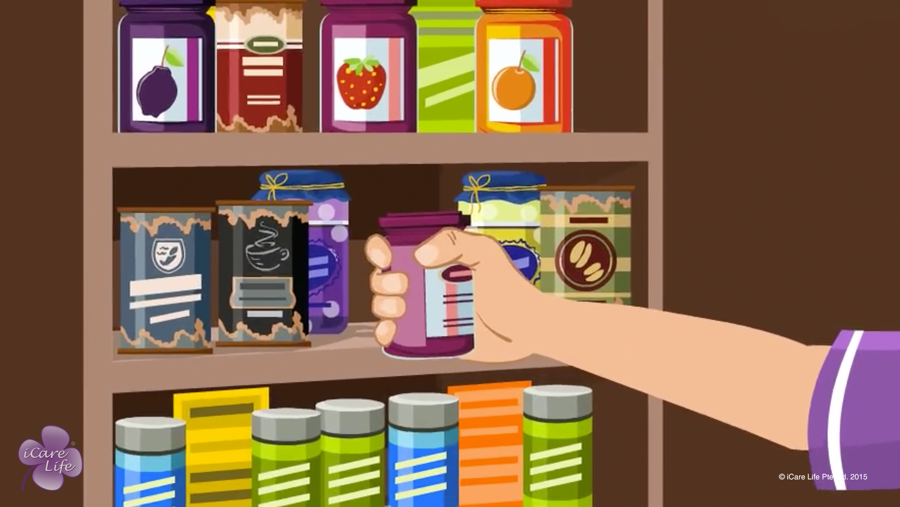
Safe Storage of Food
10
Copyright: iCare Life Pte. Ltd., Singapore : This document must not be copied or shared or circulated without the consent of iCare Life and/or its affiliates.

Slide 12
In this module, you will learn about:
Importance of storing food safely
How to store different types of food
How to identify if food is fit to eat
What to do if there is no electricity
11
Copyright: iCare Life Pte. Ltd., Singapore : This document must not be copied or shared or circulated without the consent of iCare Life and/or its affiliates.

Slide 13
Let’s Watch
Safe Storage of Food
12
Copyright: iCare Life Pte. Ltd., Singapore : This document must not be copied or shared or circulated without the consent of iCare Life and/or its affiliates.

Slide 14


