Slide 1

Modules Summary Discussion – Q&A
CR 11.4
Private and Confidential

Slide 2

Administering Medicines
1
Copyright: iCare Life Pte. Ltd., Singapore : This document must not be copied or shared or circulated without the consent of iCare Life and/or its affiliates.

Slide 3
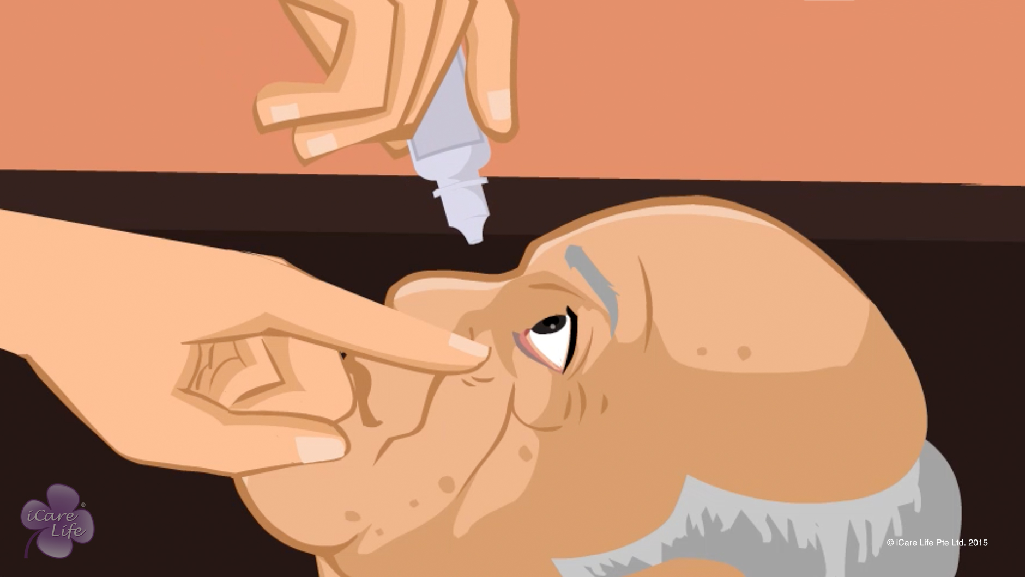
Administering Medicines
2
Copyright: iCare Life Pte. Ltd., Singapore : This document must not be copied or shared or circulated without the consent of iCare Life and/or its affiliates.

Slide 4
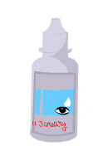
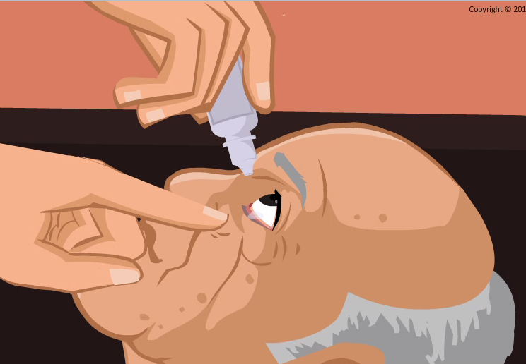

Post-Module Activity
Practice
Notes:
For the activity, you will need:
4-5 empty eye drops bottle (clearly labeled)
Cotton swabs
Arrange for and ask an expert to demonstrate how to administer eye drops.
Divide the class into pairs and give an eye drops bottle and a swab to each pair. For ‘administering eye drops’, in each pair, one participant will become the caregiver and the other, care receiver. Instruct the caregivers to administer eye drops. The empty eye drops bottle should be used for practice. Ask the care receiver to close their first eye for 2 minutes and the caregiver to wipe with a cotton swab. Ask the pairs to switch roles.
Ask the expert to offer feedback as required
Things to remember:
Make sure that the lower eyelid is opened properly so that it makes a well.
Appropriate distance should be maintained between the eye and the bottle’s tip.
The care receiver should look up while receiving eye drops.
The wiping motion should be made away from the eye
Make sure the eye drop bottles are empty

Slide 5
Summary
Study the doctor’s prescription thoroughly; clarify any doubts
Do not leave a pill outside its packaging for long.
Consume the pill as soon as you open its packaging
Measure the liquid accurately using a medicine measuring cup, when giving any liquid medicines
When putting eye drops for the person, observe good hygiene practices
Throw eye drop bottles after a week of opening
If the care receiver has a cold and congestion, instill nasal drops followed by steam inhalation
If prescribed, follow the correct procedures to help the person use an inhaler, a spacer, or a nebulizer
If putting ear drops for the person, forewarn them that their hearing may get temporarily impaired
Do not massage joint pain with ointments
4
Notes:
Study the doctor’s prescription thoroughly; clarify any doubts
Do not leave a pill outside its packaging for long.
Consume the pill as soon as you open its packaging
Measure the liquid accurately using a medicine measuring cup, when giving any liquid medicines
When putting eye drops for the person, observe good hygiene practices
Throw eye drop bottles after a week of opening
If the care receiver has a cold and congestion, instill nasal drops followed by steam inhalation
If prescribed, follow the correct procedures to help the person use an inhaler, a spacer, or a nebulizer
If putting ear drops for the person, forewarn them that their hearing may get temporarily impaired
Do not massage joint pain ointments

Slide 6
Any Questions?
5
Notes:
Q1. Is there a need to wear gloves while administering medicines?
Ans. Normally there is no need to wear gloves unless the person is suffering from some infection. There is however a great need of keeping one’s hands clean before and after administering the medicines. This is to prevent any kind of contamination of the medicine.
Q2. What should you do if you see any kind of reaction after having administering the medicine?
Ans. If a person has been taking the medicines for a long time, normally nothing adverse should happen. However before administering any new medicine, you should be sure of the dosage etc and in case some kind of reaction like breathlessness or uneasiness, you should immediately speak to the doctor and take action as per their advice.
Q.3. Why should I apply a pain relief ointment using a gauze and not by hand?
Ans. These ointments have very powerful ingredients. The burning sensation on the hand after applying the medicine may get transferred to your eyes or other sensitive areas if you happen to touch them accidentally.

Slide 7
Managing Medications
6
Copyright: iCare Life Pte. Ltd., Singapore : This document must not be copied or shared or circulated without the consent of iCare Life and/or its affiliates.

Slide 8
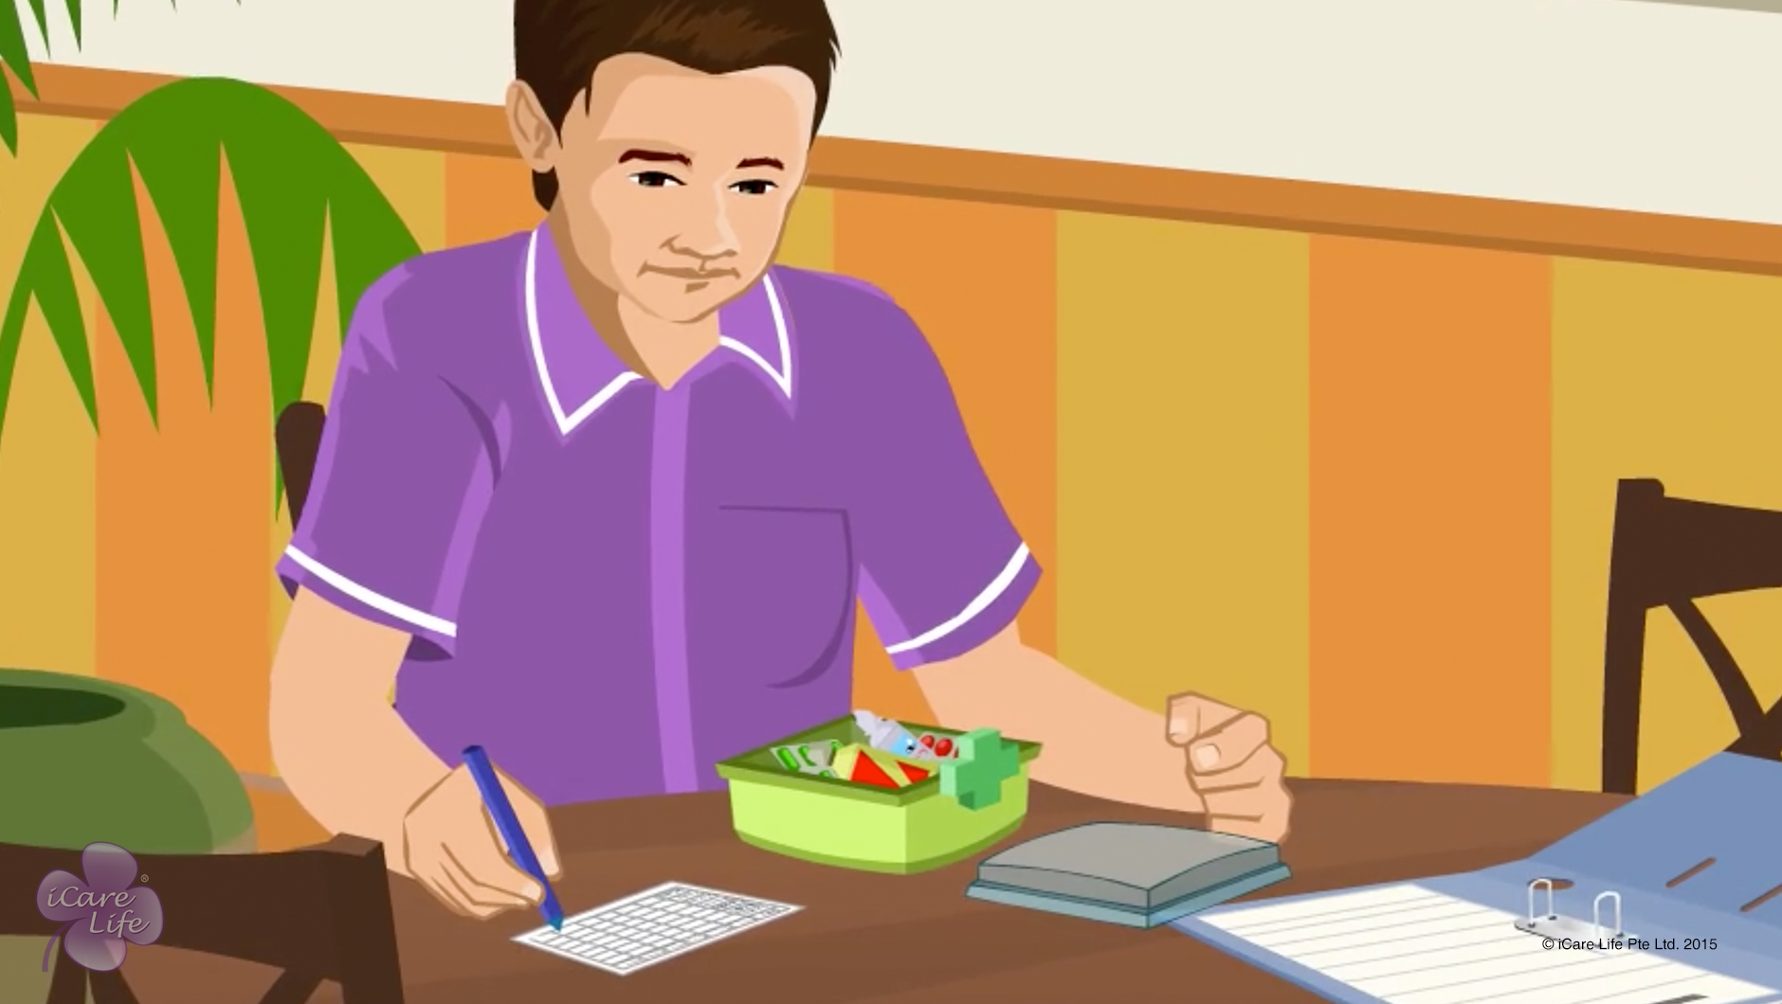
Managing Medications
7
Copyright: iCare Life Pte. Ltd., Singapore : This document must not be copied or shared or circulated without the consent of iCare Life and/or its affiliates.

Slide 9
Summary
Study the doctor’s prescription carefully
Tabulate and document the elder’ problem, name of the drugs, their strength, and dosage
Create a chart with the names of drugs listed according to the time of the day when they need to be taken
Stick this chart on top of the person’s medicine box
Never pull the pills out of their packing or bottle to place them in boxes
Discard all medicines that are expired, discolored, or have damaged packaging
Throw eye drop bottles after a week of opening
8
Notes:
Study the doctor’s prescription carefully
Tabulate and document the elder’ problem, name of the drugs, their strength, and dosage
Create a chart with the names of drugs listed according to the time of the day when they need to be taken
Stick this chart on top of the person’s medicine box
Never pull the pills out of their packing or bottle to place them in boxes
Discard all medicines that are expired, discolored, or have damaged packaging
Throw eye drop bottles after a week of opening

Slide 10
Any Questions?
9
Notes:
Q1. How important is it to read the doctor’s prescription carefully?
Ans. It is extremely important to carefully understand the prescription. Proper medication is very important to improve the health of the care receiver. Incorrect medicine or dosage can be detrimental to the care receiver’s health.
Q2. How should you discard the used medical disposables?
Ans. The procedure is the same as is followed in hospitals by segregating them into bio degradable, non- biodegradable and infectious type etc. If the equipment can not be disposed of locally, you could contact a nearby hospital or a clinic to do the same.
Q3. Is there a need to keep the medicines in refrigerator?
Ans. There are a few medicines which may degrade above certain temperatures. Such medicines must be kept in refrigerators. Normally such medicines are in liquid form and clear instructions are written on the label. The caregiver therefore must read the labels carefully specially when handling medicines.

Slide 11
First Aid Kit
10
Copyright: iCare Life Pte. Ltd., Singapore : This document must not be copied or shared or circulated without the consent of iCare Life and/or its affiliates.

Slide 12
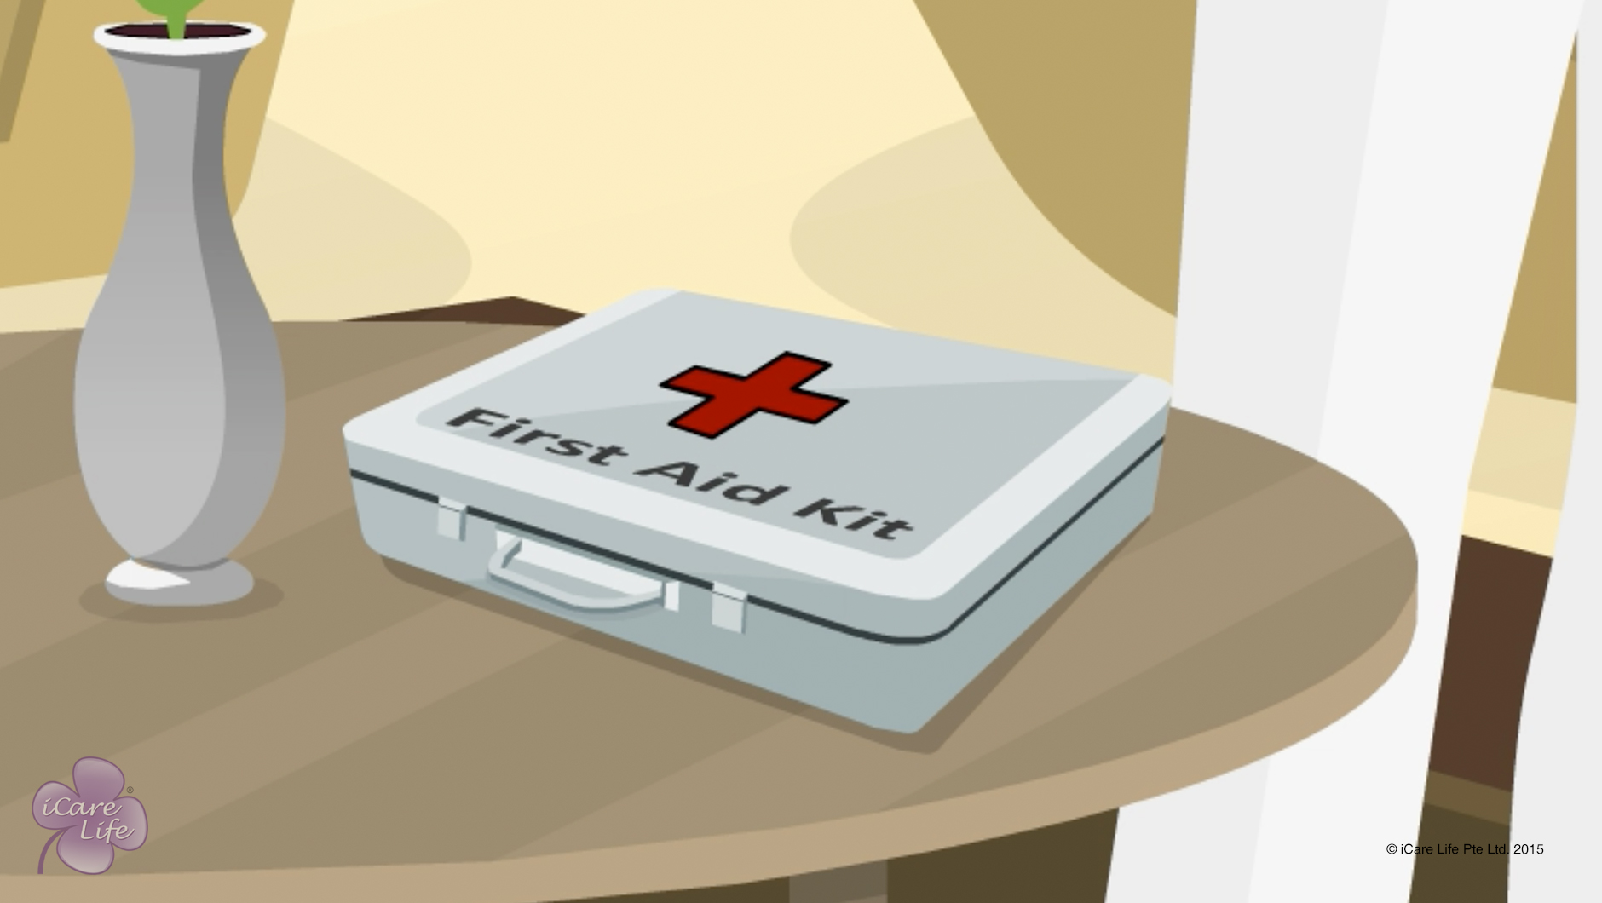
First Aid Kit
11
Copyright: iCare Life Pte. Ltd., Singapore : This document must not be copied or shared or circulated without the consent of iCare Life and/or its affiliates.

Slide 13
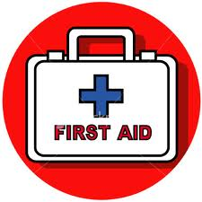
Post-Module Activity
First Aid Box
Notes:
Arrange for a visit by a First Aid trained professional. Ask the person to show the contents of their first aid kit, as well as when and how each item should be used.
Point out that professional’s kit may have different items as compared to what you have seen in the module. You should create the kit based on the specific requirements of your care receiver.

Slide 14
Summary
To provide timely and effective first aid, you must keep a first aid kit at the person’s home; carry this kit along when taking the person out
When creating a kit, consider the person’s age, lifestyle, and medical problems
The first aid kit may contain medicines, bandages, dressings, and fixings
13
Notes:
To provide timely and effective first aid, you must keep a first aid kit at the person’s home; carry this kit along when taking the person out
When creating a kit, consider the person’s age, lifestyle, and medical problems
The first aid kit may contain medicines, bandages, dressings, and fixings

Slide 15
Any Questions?
14
Notes:
Q1. Should anti-allergic medicines form part of the first aid kit?
Ans. Yes, preferably after consulting the doctor.
Q2. Should you keep replacing the expired medicines and bandages in the first aid kit?
Ans. Yes. You should check the first aid kit every month on a given day and throw away any medicines which have crossed their expiry date. Maintain a small log that anybody handling the kit can understand. Also, you should make it a point to replace the discarded medicines as soon as possible.
Q3. Should you carry the first aid kit when taking the care receiver out for an outing?
Ans. Yes but that would depend on the distance that you are away from the home. You may not carry it say when you are taking the care receiver just for a walk near the house or within the house.

Slide 16
Providing relief for Common Injuries
15
Copyright: iCare Life Pte. Ltd., Singapore : This document must not be copied or shared or circulated without the consent of iCare Life and/or its affiliates.

Slide 17
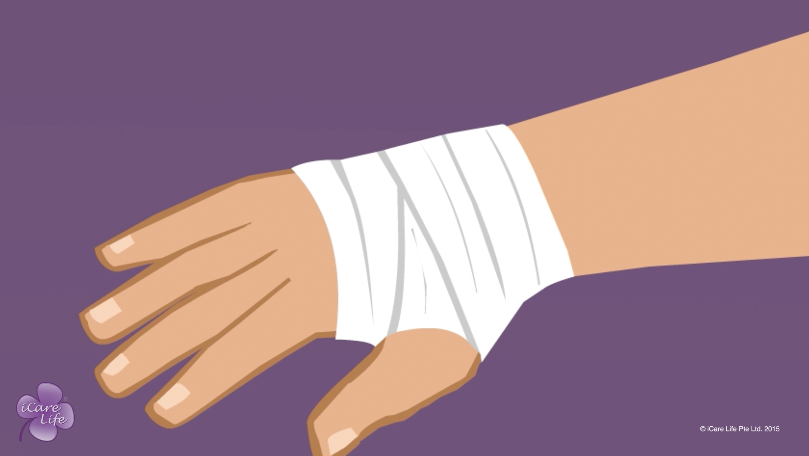
Providing relief for Common Injuries
16
Copyright: iCare Life Pte. Ltd., Singapore : This document must not be copied or shared or circulated without the consent of iCare Life and/or its affiliates.

Slide 18
Post-Module Activity
First Aid
17
Notes:
You will require setup an appointment with a hospital or a care center who can send a first-aid expert. Ask the expert to bring along an ideal first-aid box with contents for the demonstration. Ask them to give a live demonstration in the class of:
How to prepare yourself for first-aid
What materials should a home first-aid box contain
How to dress a cut
How to take care of a burn
How to handle sprains or fractures before the care receiver receives professional help
After the demonstration, invite the class participants to try the above activities on each other.

Slide 19
Summary
To treat a minor cut, wash the area thoroughly and cover it with a sterile dressing
A deep cut may need stitching; consult a doctor
In case of a nosebleed, ask the person to sit with their head bent forward over a bowl; pinch their nostrils together firmly for about 10 minutes.
For minor burns or scalds, hold the burnt area in cool, slowly running water
To take out a particle stuck to the white area of the eye, use the corner of a clean handkerchief
If an acid or alkali has entered the eye, wash the eye under cold running water
18
Notes:
To treat a minor cut, wash the area thoroughly and cover it with a sterile dressing
A deep cut may need stitching; consult a doctor
In case of a nosebleed, ask the person to sit with their head bent forward over a bowl; pinch their nostrils together firmly for about 10 minutes.
For minor burns or scalds, hold the burnt area in cool, slowly running water
To take out a particle stuck to the white area of the eye, use the corner of a clean handkerchief
If an acid or alkali has entered the eye, wash the eye under cold running water

Slide 20
Summary
Rest a sprained joint in a comfortable position
If you suspect a bone fracture, call the doctor. Till then, avoid moving the person and do not attempt to straighten the broken limb
If the person shows signs of acute distress due to an insect bite, call the doctor
Apply antihistamine cream on bee and wasp stings
In case of an animal bite, wash the wound thoroughly and put a dry dressing; show the wound to a doctor
9
Notes:
Rest a sprained joint in a comfortable position
If you suspect a bone fracture, call the doctor. Till then, avoid moving the person and do not attempt to straighten the broken limb
If the person shows signs of acute distress due to an insect bite, call the doctor
Apply antihistamine cream on bee and wasp stings
In case of an animal bite, wash the wound thoroughly and put a dry dressing; show the wound to a doctor

Slide 21
Any Questions?
20
Notes:
Q1. How should you procure the first aid kit for the care receiver?
Ans. Normally all homes have such kits. You could however ask for one separately for the care receiver.
Q2. In case of a fracture, what can you do?
Ans. First of all call for medical help. Next, try and immobilize the fractured limb with some kind of sticks and bandage. Apply ice to reduce swelling.
Q4. What other kind of situations could be there which may require first aid before medical help arrives?
Ans. Drowning, specially in case of children, poisoning, food poisoning, vomiting etc.

Slide 22
Hygienic handling of Food & Equipment
21
Copyright: iCare Life Pte. Ltd., Singapore : This document must not be copied or shared or circulated without the consent of iCare Life and/or its affiliates.

Slide 23
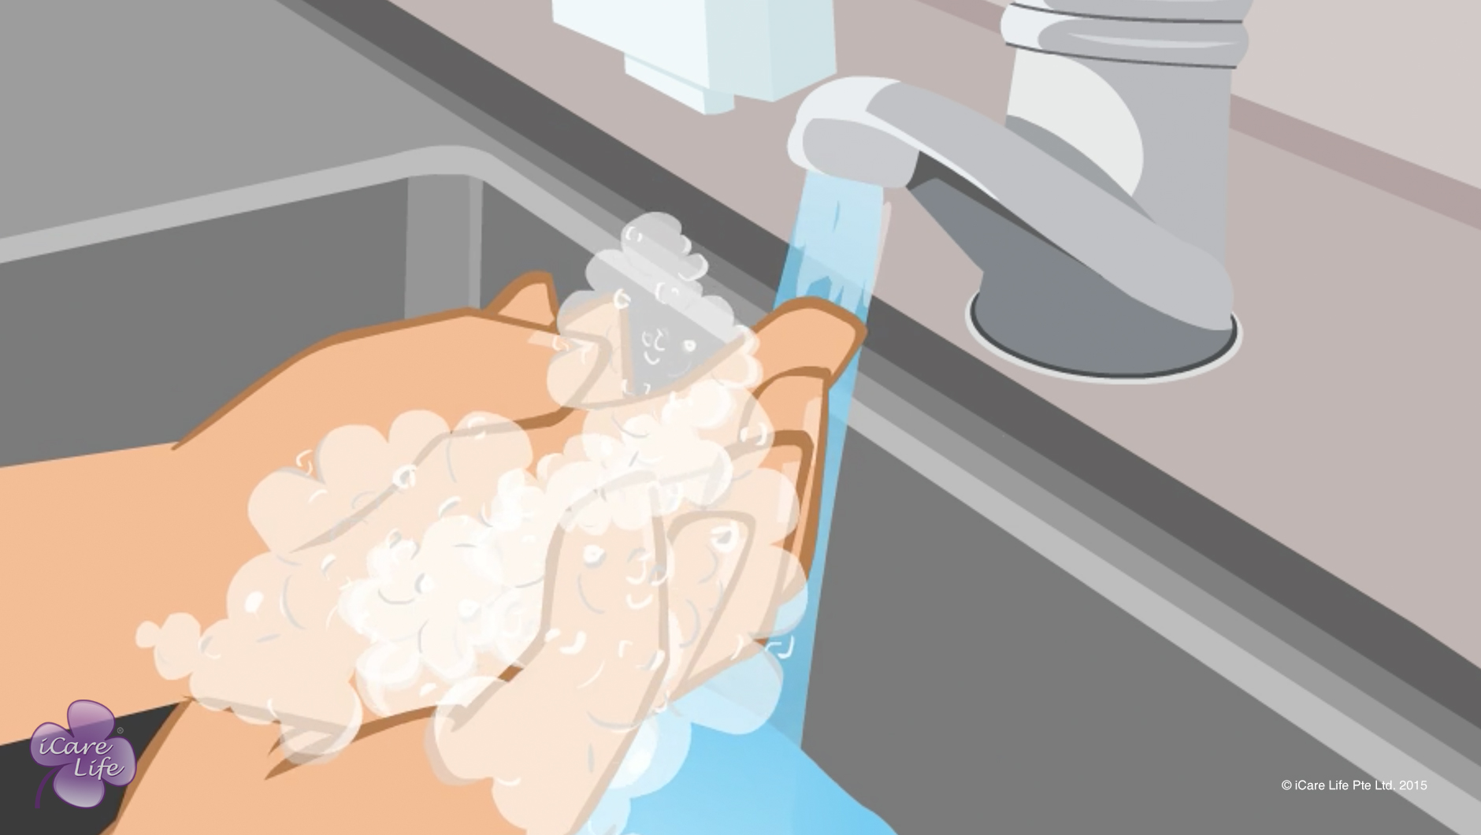
Handling of Food & Equipment
22
Copyright: iCare Life Pte. Ltd., Singapore : This document must not be copied or shared or circulated without the consent of iCare Life and/or its affiliates.

Slide 24
Post-Module Activity
Let’s Practice
Notes:
Hand Washing: Ask a volunteer to come forward and demonstrate the steps of hand washing. They have to explain what they are doing aloud. The others have to point out what they did correctly
Note to facilitator: Check whether they are washing their hands for 15 seconds. Also, whether they are washing their entire hand. Point out what they are doing incorrectly
Vegetable washing:
We will need some vegetables and fruits, a strainer, a soft brush
Ask two volunteers to come forward and demonstration the steps of washing vegetables. They have to explain what they are doing aloud. The others have to point out what they did correctly.
Note to facilitator: Check whether they are washing the vegetables/fruits. properly Point out what they are doing correctly/incorrectly.

Slide 25
Summary
To ensure hygienic handling of food and equipment:
Maintain good personal hygiene
Wash your hands properly before and after handling food and equipment
If possible, use gloves while handling food
To wash fruits and vegetables:
Put the strainer with the vegetables or fruits in the sink
Wash them under running water
If soil is stuck to the vegetables, use a soft brush to clean it
Check whether the vegetables or fruits are free of dirt
Cut and remove any bad portions
Always defrost frozen food before cooking
Do not defrost food on the kitchen counter
24
Copyright: iCare Life Pte. Ltd., Singapore : This document must not be copied or shared or circulated without the consent of iCare Life and/or its affiliates.
Notes:
To ensure hygienic handling of food and equipment:
Maintain good personal hygiene
Wash your hands properly before and after handling food and equipment
If possible, use gloves while handling food
To wash fruits and vegetables:
Put the strainer with the vegetables or fruits in the sink
Wash them under running water
If soil is stuck to the vegetables, use a soft brush to clean it
Check whether the vegetables or fruits are free of dirt
Cut and remove any bad portions
Always defrost frozen food before cooking
Do not defrost food on the kitchen counter

Slide 26
Summary
Never re-freeze defrosted food
Avoid using the same chopping board and knife for raw and cooked meat
Always wash food equipment after use
The area where you cook or serve food should be clean
Ensure that food is consumed within one hour of preparation
Wait for food to cool before placing in the fridge
Reheat food well to kill bacteria
Your hands must not come in contact with cooked food or drink
Do not use chipped cutlery, utensils, or glasses
Keep cleaning and disinfectant chemicals away from food and equipment
25
Copyright: iCare Life Pte. Ltd., Singapore : This document must not be copied or shared or circulated without the consent of iCare Life and/or its affiliates.
Notes:
Never re-freeze defrosted food
Avoid using the same chopping board and knife for raw and cooked meat
Always wash food equipment after use
The area where you cook or serve food should be clean
Ensure that food is consumed within one hour of preparation
Wait for food to cool before placing in the fridge
Reheat food well to kill bacteria
Your hands must not come in contact with cooked food or drink
Do not use chipped cutlery, utensils, or glasses
Keep cleaning and disinfectant chemicals away from food and equipment

Slide 27
Any Questions?
26
Notes:
FAQs
Q1: What causes food contamination?
A: Incorrect food handling, unhygienic practices, and incorrect storage cause food contamination.
Q2. Why is it incorrect to keep hot food in the fridge?
A: The hot food will increase the temperature in the fridge. This will put the rest of the food in the fridge at risk of food contamination.
Q3. How much should I reheat food to ensure that it reduces the risk of contamination?
A: You should reheat food to 75°C or higher to reduce the risk of contamination. If you do not have a food thermometer, you can check whether the food has heated all the way to the centre.
Q4. How should I defrost frozen food?
A: Reheat the frozen food in the microwave or keep it on the bottom shelf in the fridge.

Slide 28
Safe Storage of Food
27
Copyright: iCare Life Pte. Ltd., Singapore : This document must not be copied or shared or circulated without the consent of iCare Life and/or its affiliates.

Slide 29
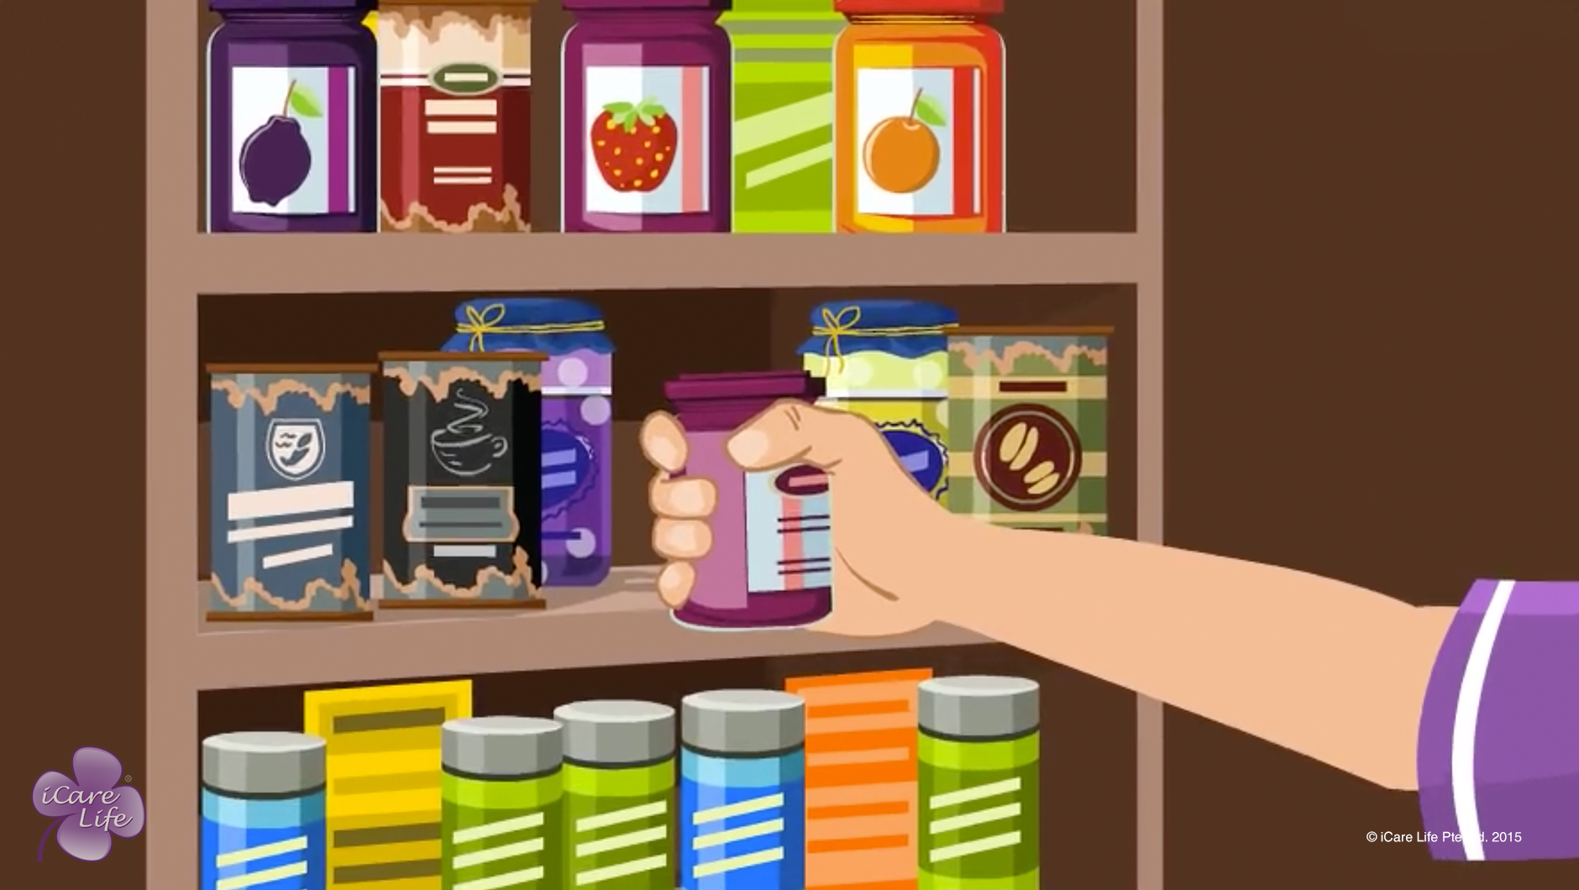
Safe Storage of Food
28
Copyright: iCare Life Pte. Ltd., Singapore : This document must not be copied or shared or circulated without the consent of iCare Life and/or its affiliates.

Slide 30
Post-Module Activity
Arranging Food in the Fridge
Notes:
Items required: Please use toys/paper cut outs with food drawings here. Please arrange for 3 sets of these cut outs. Nine small boxes/trays to hold a few cut-outs – 3 labeled “Cupboard”, 3 labeled “Fridge”, 3 labeled “Freezer”
Rice
Coffee
Tea
Sugar
Cornflakes
Raw meat
Milk
Cheese
Cooked meal
soup
eggs
Whole chicken
frozen fish
frozen vegetables
Frozen chicken nuggets
Ice cream
Divide the participants into groups of 3. Ask each group to segregate the items listed above into cupboard, freezer, fridge (give them small labeled boxes/trays for the segregation).
Let each group share how they have segregated the items and why. Discuss with the rest of the class.

Slide 31
Summary
Store dry foods like flour, tea, dried pasta, and uncooked grains in a cupboard
Cupboards where you store food should be dry, clean, and free of pests
Potatoes, onions, and tomatoes can be stored outside
Check the expiry date before using packaged food
Keep meat, milk, eggs, cheese, jams, salad dressing, sauces, and butter in the fridge
Always store food in air-tight containers
Allow the meal to cool before placing in the fridge or freezer
Keep the fridge clean
Do not overload the fridge
Do not keep the fridge door open for long
Keep frozen foods such as packaged vegetables, meat, seafood, and snacks like French fries in the freezer
Wrap meat before placing in the freezer
Throw away spoilt food
If there is no electricity, avoid opening fridge and freezer doors
30
Copyright: iCare Life Pte. Ltd., Singapore : This document must not be copied or shared or circulated without the consent of iCare Life and/or its affiliates.
Notes:
Store dry foods like flour, tea, dried pasta, and uncooked grains in a cupboard
Cupboards where you store food should be dry, clean, and free of pests
Potatoes, onions, and tomatoes can be stored outside
Check the expiry date before using packaged food
Keep meat, milk, eggs, cheese, jams, salad dressing, sauces, and butter in the fridge
Always store food in air-tight containers
Allow the meal to cool before placing in the fridge or freezer
Keep the fridge clean
Do not overload the fridge
Do not keep the fridge door open for long
Keep frozen foods such as packaged vegetables, meat, seafood, and snacks like French fries in the freezer
Wrap meat before placing in the freezer
Throw away spoilt food
If there is no electricity, avoid opening fridge and freezer doors

Slide 32
Any Questions?
31
Notes:
FAQs
Q1: How can I adjust the temperature in the fridge?
A: At the back of the fridge, you will find a knob or buttons to adjust the fridge temperature. In summer, adjust the temperature to coldest and in winter, adjust to cold.
Q2. If the food has a freezer burn, can I still use it?
A: Yes, you can cut out that portion and use it. The freezer burn makes the meat tough.
Q3. How long can I store cut fruit in the fridge?
A: Use cut fruit the same day when its fresh. Storing fresh fruit for long results in considerable loss of nutrients.
Q4. If the electrical power is switched off, how long will the food stay safe in the fridge and freezer?
A: The fridge will keep the food cold for 4 hours and the freezer will keep the food cold for 48 hours. You have to ensure that you avoid opening the doors often.

Slide 33


