Slide 1

Hot and Cold Application
CR 12.2

Slide 2
Learning outcomes
1. Knowing about heat and cold applications that serve as therapeutic measures and provides comfort
1.1 Heat & cold applications
1.2 Discuss the therapeutic uses of heat and cold therapy and their methods of application
1.3 Understand physiological reactions and untoward reactions resulting from these measures
1

Slide 3
Introduction
Application of heat and cold are commonly used in the hospital, and at home as therapeutic measures
In the hospital, these measures are carried out at the direction of the physician
Heat and cold applications serve as comfort measures
The caregiver, therefore must have knowledge of the physiological reactions resulting from these measures
And, also about any untoward reaction, which may occur due to improper application or even otherwise

Slide 4
Principles of Heat & Cold Therapy
The Fundamental Laws of Physics
Heat is always passed from a hotter body to a cooler one
Heat causes expansion and change of state
Heat is distributed throughout the body by the circulating blood and by direct conduction through the tissue
Heat is lost from the body chiefly through conduction, convection, radiation and evaporation
The amount of blood that circulates close to the surface of the skin is influenced by the dilatation, and constriction of the peripheral arterioles

Slide 5
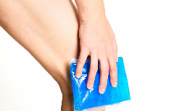
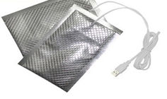
Principles of Heat & Cold Therapy
The Principles Apply to the Human Body
Application of heat & cold influences
Dilatation of and constriction of peripheral blood vessels
Moisture conducts heat better than air
Ability to tolerate heat and cold varies from person to person
Very old and very young people are very sensitive to heat & cold
People become less sensitive to repeated action of heat & cold

Slide 6
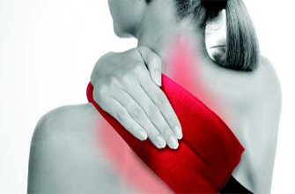
Application of Heat
Definition: Application of heat means the use of an agent warmer than the skin, which may be applied in either a moist or a dry form - to produce a local or systemic effect or both
Purpose:
To promote circulation
To relieve congestion and reduce oedema or inflammation
To increase suppuration
To promote tissue relaxation
To relieve pain
To soften the exudates
To provide warmth & comfort
To stimulate peristalsis
To dry casts, moist wounds & burns

Slide 7
Application of Heat
Classification
Hot Application
Local
General
Dry Heat
Moist Heat
Dry
Moist
1. Hot moist packs
2. Whirlpool baths
3. Immersion bath
Hot water bottle
Heating lamp
Heating cradle
Electric pad
Infra red lamp
Diathermy
1. Fomentations
Stupes
Soaks/baths
Wax bath
Sitz bath
Aquathermia pads
1. Sun bath
2. Hot pack

Slide 8
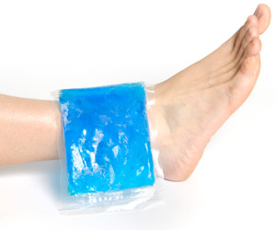
Application of Cold
Definition: Application of cold means using an agent on the skin - either moist or dry, and can be applied to produce a local or systemic effect or both
Purpose:
To reduce inflammation
To relieve pain
To prevent oedema and reduce inflammation
To control haemorrhage
To decrease metabolism and thus prevent gangrene
To reduce body temperature
To anaesthetise an area for a short period
To inhibit bacterial growth and prevent suppuration

Slide 9
Application of Cold
Classification
Cold Application
Local
General
Dry Cold
Moist Cold
Dry
Moist
Ice bag
Ice collar
Cold compress
Cold pack
Hypothermia warming blanket
Cold sponge
Cold pack
Cold bath

Slide 10
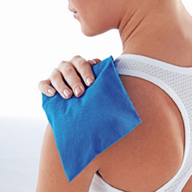
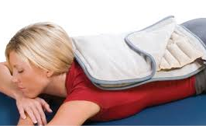
Effect of Heat & Cold Therapy
Factors to be considered
Application depends on number of factors and, some of these are:
The purpose of the application
The age of the patient, & the condition of the skin
The general physical health of the patient
The area of the body that is affected
The duration of the treatment
Intensity of the temperature of its application.

Slide 11
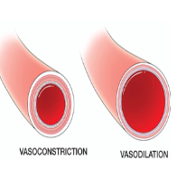
Effect of Heat & Cold Therapy
The effect of heat & cold application
Effect – Physiological Change of Heat Therapy
Vasodilatation: increased capillary permeability, increased local metabolism, increased oxygen requirement
Decreased blood viscosity: increased blood flow, increased lymph flow, increased motility of leukocytes, reduced muscle tension
Effect – Physiological Change of Cold Therapy
Vasoconstriction: decreased capillary permeability, decreased local metabolism, decreased oxygen requirement
Increased blood viscosity: decrease blood flow, decreased lymph flow, decreased mobility of leukocytes, decrease muscle tension

Slide 12
Effect of Heat & Cold Therapy
The effect of heat & cold application
Secondary Effect of Heat Therapy
If the heat is applied for one hour or more vasodilatation will be always followed by vasoconstriction due to the reflex action as the body attempts to control excessive heat from the area
Continuous exposure to heat also damages the epithelial cells, causing red ness, localised tenderness and even blistering
Secondary Effect of Cold Therapy
If the cold application is prolonged , it results in reflex vasodilatation to prevent tissue ischaemia. which occurs due to inability to receive an adequate flow of blood & nutrition in the cells. Initially , the skin appears reddened , followed by bluish purple with numbness & burning type of pain.

Slide 13
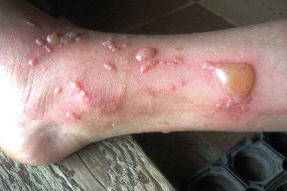
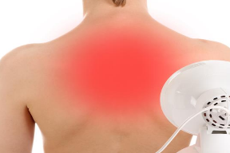
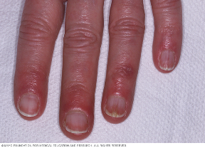
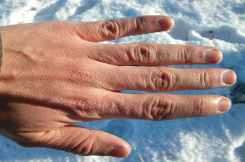
Effect of Heat & Cold Therapy
The effect of heat & cold application
Secondary Effect of Heat Therapy
Secondary Effect of Cold Therapy

Slide 14
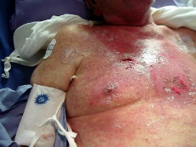
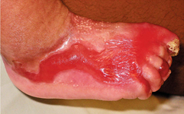
Effect of Heat & Cold Therapy
The effect of heat & cold application
Contradictory Indications in Adverse Situation
In malignancy
Oedema associated with venous & lymphatic disease e.g: arteriosclerosis, atherosclerosis which is common in Diabetes Mellitus (DM) patients, inhibits peripheral flow of blood
Cutaneous injuries e.g: stoma or scar tissues
Patients with paralysis
In abscessed tooth or in an inflamed appendix as heat might cause these areas to rupture , spreading infection in the blood stream
It should not be applied on very young or old patients or debilitated patients

Slide 15
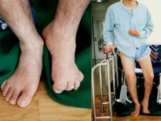
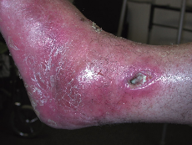
Effect of Heat & Cold Therapy
The effect of heat & cold application
Contradictory Indications in Adverse Situation
Disorders resulted in impaired circulation e.g: Diabetes
Cold may be applied initially to a burnt area to reduce pain and to decrease the effect of hypoxia but after 24 hrs it may be contra indicated as it may retard the healing process
Infected wounds
Patients with decrease sensation in the affected area e.g: paralysed patient

Slide 16
General Instructions for Therapy
Application of Hot & Cols Therapy must be done carefully
Assess the condition of the patient prior to, during and after the application of the heat & cold therapy
Maintain the correct temperature for the entire duration of the application
Never use any equipment unless you know its operation completely
There must be a recovery period between the application of heat & cold because continuous applications are detrimental to the health of the tissues
Expose the patient only to a safe temperature, and double check
Do not allow the patient to adjust the control of temperature of appliances such as short – wave diathermy electric heating pads, etc.

Slide 17
General Instructions for Therapy
Application of Hot & Cols Therapy must be done carefully
Never ignore the complaints of a patient, however small they may appear to be
The patient must have calling signal within his reach
Do not use electrical appliances close to open oxygen, or near water, or other fluid, or handle them with wet hands
After the procedure, dry the part gently by patting and not by rubbing to remove the moisture, thereby preventing maceration of the skin, and further cooling by evaporation
During hot & cold applications, protect the patient from getting chills - shivering can raise the temperature and also allows the patient to catch a cold
In hyperpyrexia, the temperature of the body should be brought down gradually and steadily - sudden cooling is dangerous to the patient

Slide 18


