Slide 1

Viewing of Modules
Activities of Daily Living – Age Related Issues
CR 13.3
Private and Confidential

Slide 2
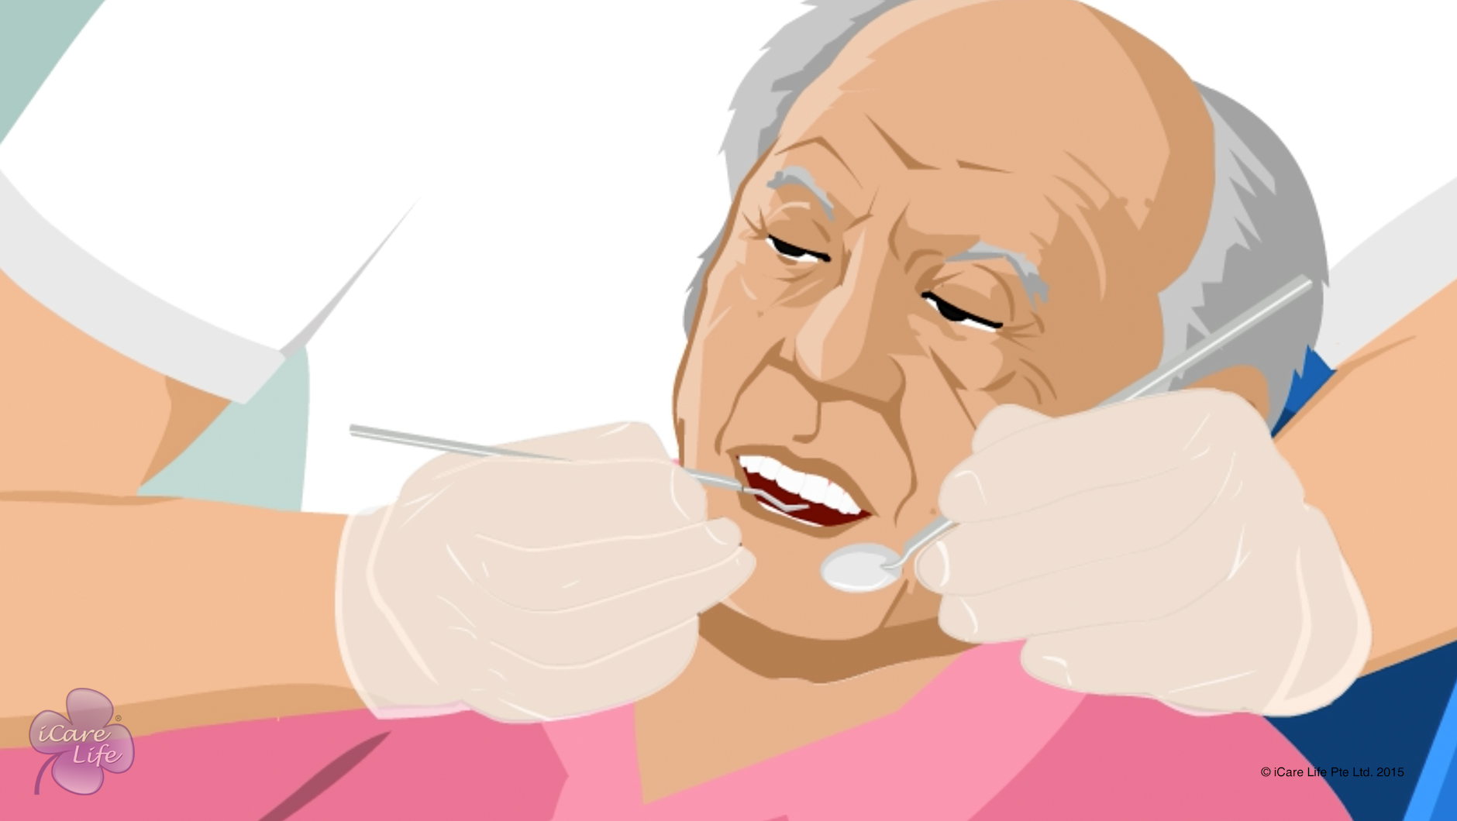
Issues Related to Elder’s Mouth
1
Copyright: iCare Life Pte. Ltd., Singapore : This document must not be copied or shared or circulated without the consent of iCare Life and/or its affiliates.

Slide 3
In this module, you will learn about:
The oral problems an elder can face
How to detect oral problems
What precautions should you take to help an elder avoid such problems
2

Slide 4

Let’s Watch
Issues Related to Elder’s Mouth
3
Copyright: iCare Life Pte. Ltd., Singapore : This document must not be copied or shared or circulated without the consent of iCare Life and/or its affiliates.

Slide 5
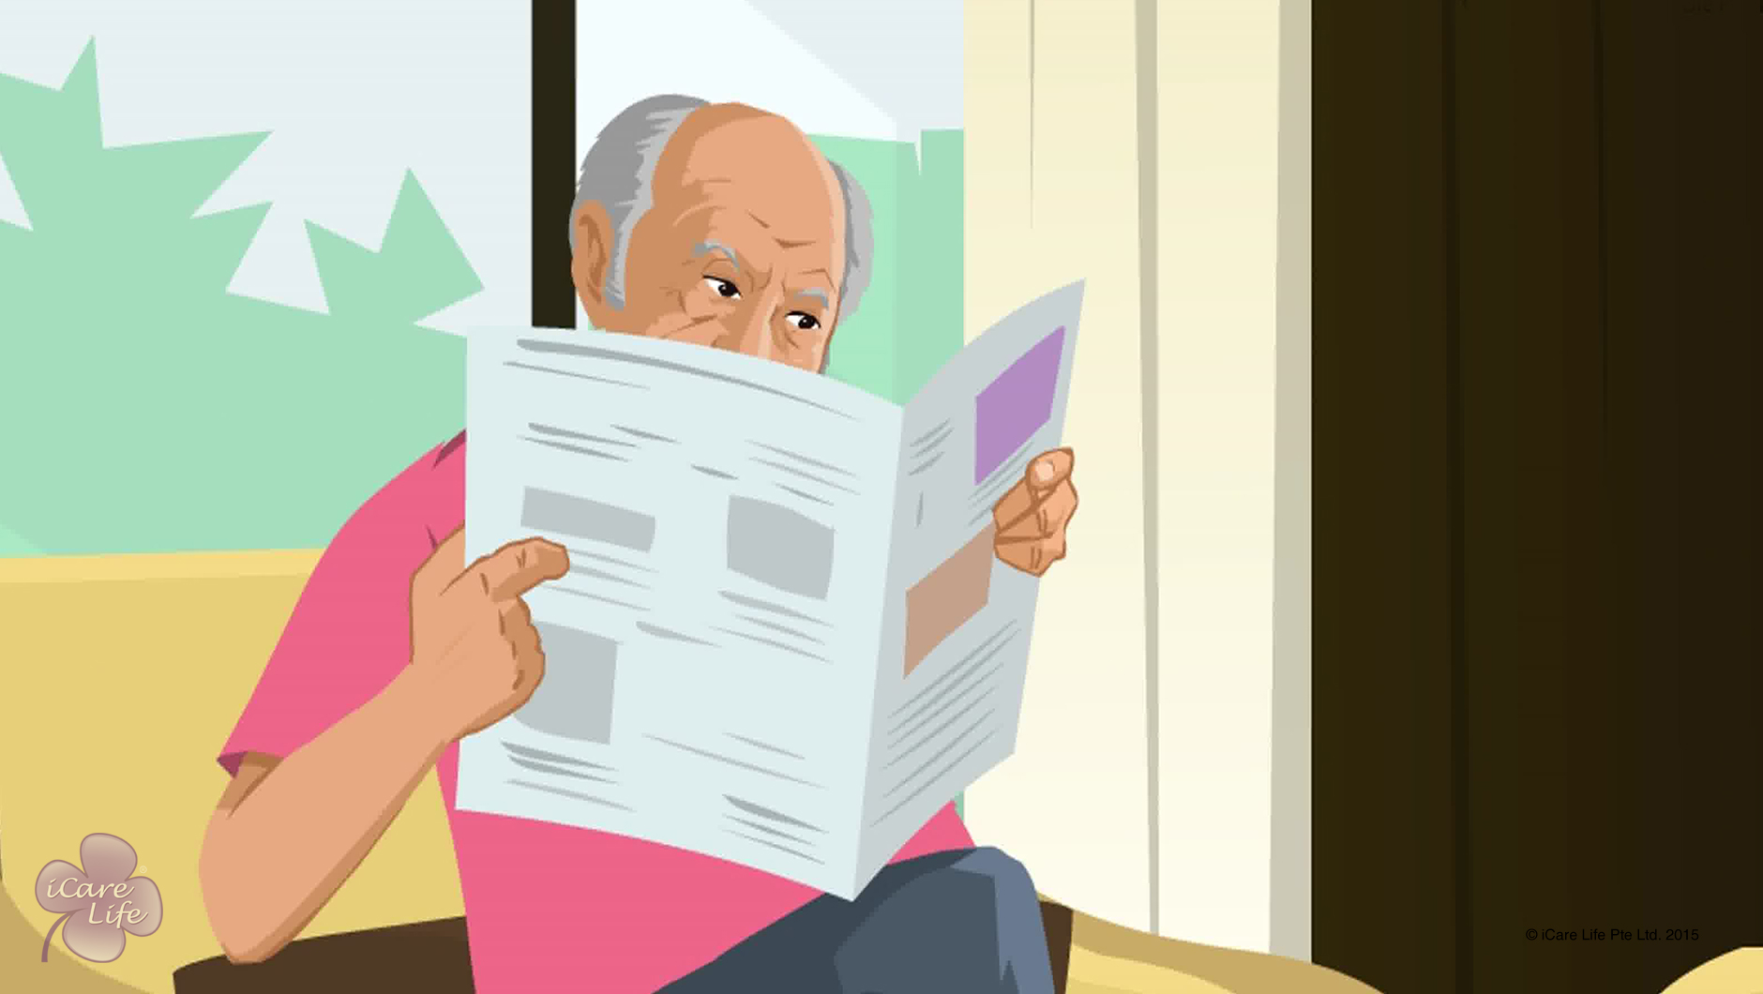
Issues Related to Vision in the Elder
4
Copyright: iCare Life Pte. Ltd., Singapore : This document must not be copied or shared or circulated without the consent of iCare Life and/or its affiliates.

Slide 6
In this module, you will learn about:
What are the various reasons due to which elders lose their vision
What should you keep in mind while caring for an elder’s vision
5
Copyright: iCare Life Pte. Ltd., Singapore : This document must not be copied or shared or circulated without the consent of iCare Life and/or its affiliates.

Slide 7
Let’s Watch
Issues Related to Vision in the Elder
6
Copyright: iCare Life Pte. Ltd., Singapore : This document must not be copied or shared or circulated without the consent of iCare Life and/or its affiliates.

Slide 8
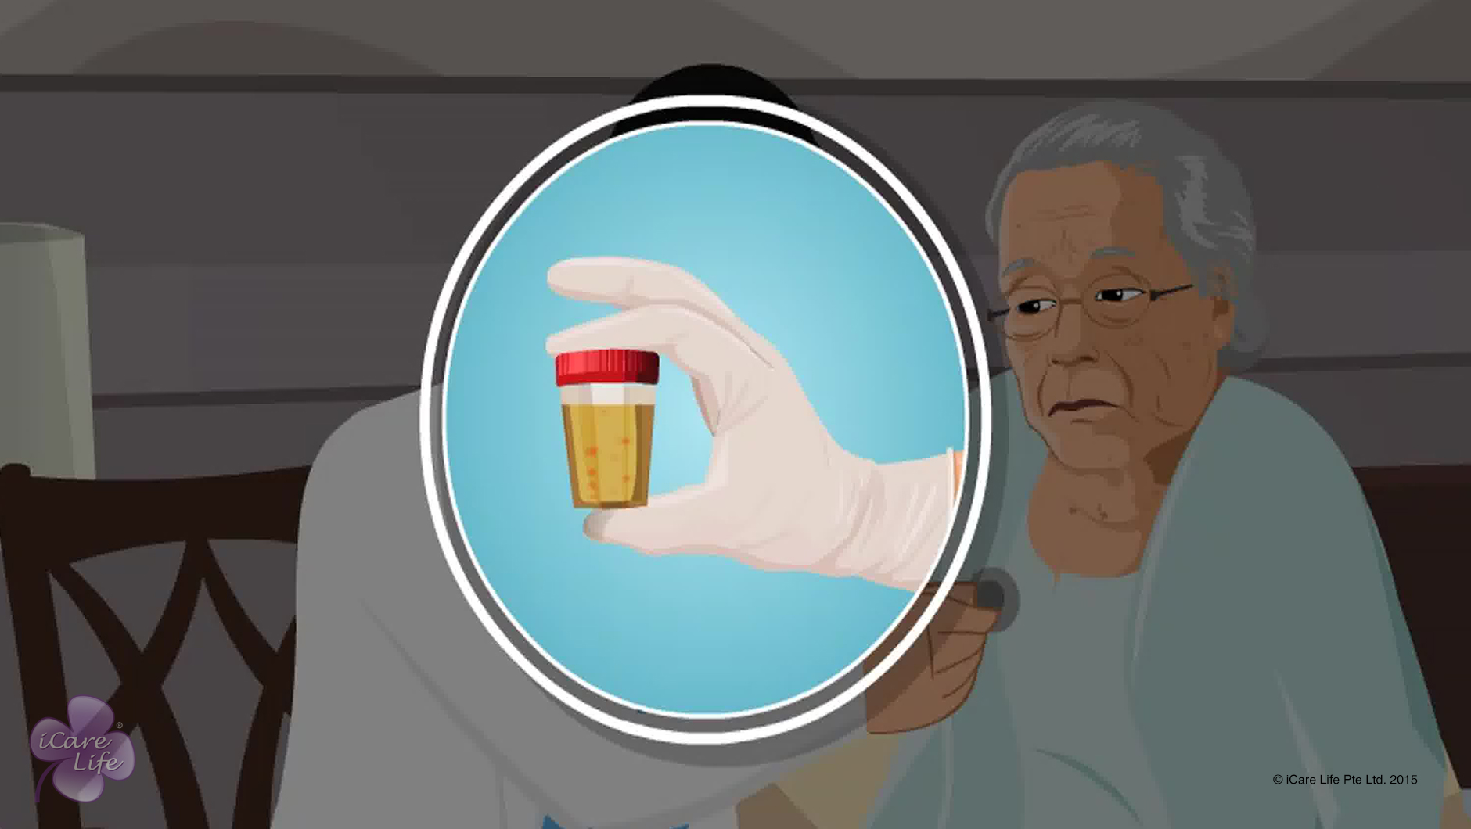
Urinogenital Related Issues of the Female Elder
7
Copyright: iCare Life Pte. Ltd., Singapore : This document must not be copied or shared or circulated without the consent of iCare Life and/or its affiliates.

Slide 9
In this module, you will learn about:
The common urinogenital problems faced by female elders
The symptoms of urinogenital problems faced by female elders
The situations when medical assistance is required
8
Copyright: iCare Life Pte. Ltd., Singapore : This document must not be copied or shared or circulated without the consent of iCare Life and/or its affiliates.

Slide 10
Let’s Watch
Urinogenital Related Issues of the Female Elder
9
Copyright: iCare Life Pte. Ltd., Singapore : This document must not be copied or shared or circulated without the consent of iCare Life and/or its affiliates.

Slide 11
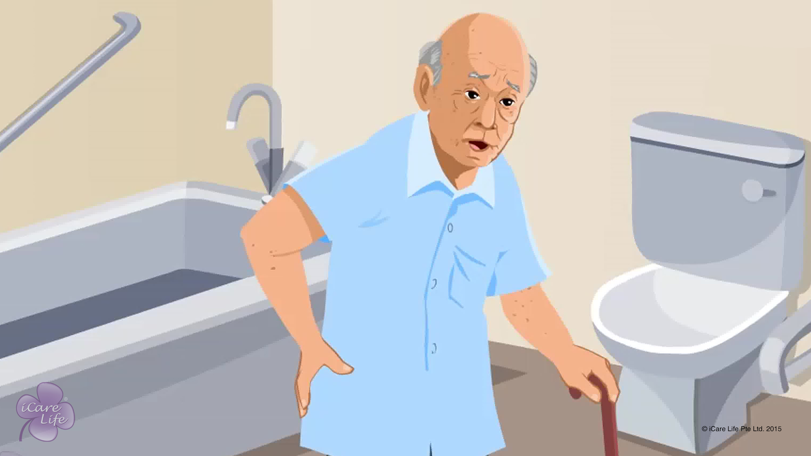
Urinogenital Related Issues of the Male Elder
10
Copyright: iCare Life Pte. Ltd., Singapore : This document must not be copied or shared or circulated without the consent of iCare Life and/or its affiliates.

Slide 12
In this module, you will learn about:
The common urinogenital problems faced by male elders
The symptoms of urinogenital problems faced by male elders
The situations when medical assistance is required
11
Copyright: iCare Life Pte. Ltd., Singapore : This document must not be copied or shared or circulated without the consent of iCare Life and/or its affiliates.

Slide 13
Let’s Watch
Urinogenital Related Issues of the Male Elder
12
Copyright: iCare Life Pte. Ltd., Singapore : This document must not be copied or shared or circulated without the consent of iCare Life and/or its affiliates.

Slide 14
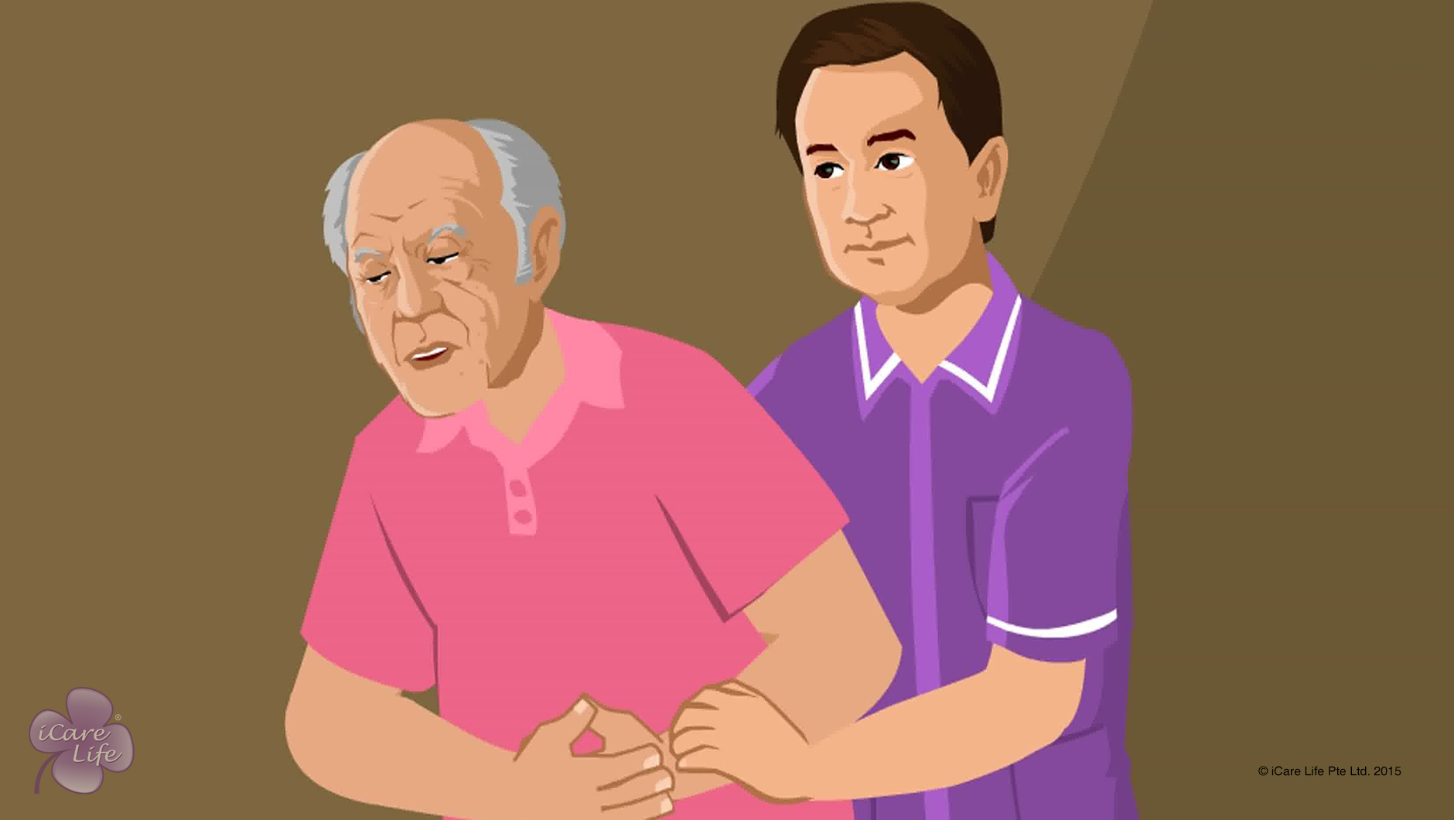
Gastrointestinal Issues in the Elder
13
Copyright: iCare Life Pte. Ltd., Singapore : This document must not be copied or shared or circulated without the consent of iCare Life and/or its affiliates.

Slide 15
In this module, you will learn about:
The common gastrointestinal issues faced by elders
How can you help the elders cope with such issues
14
Copyright: iCare Life Pte. Ltd., Singapore : This document must not be copied or shared or circulated without the consent of iCare Life and/or its affiliates.

Slide 16
Let’s Watch
Gastrointestinal Issues in the Elder
15
Copyright: iCare Life Pte. Ltd., Singapore : This document must not be copied or shared or circulated without the consent of iCare Life and/or its affiliates.

Slide 17


