Slide 1

Modules Summary Discussion – Q&A
CR 13.4
Private and Confidential

Slide 2

Issues Related to Elder’s Mouth
1
Copyright: iCare Life Pte. Ltd., Singapore : This document must not be copied or shared or circulated without the consent of iCare Life and/or its affiliates.

Slide 3
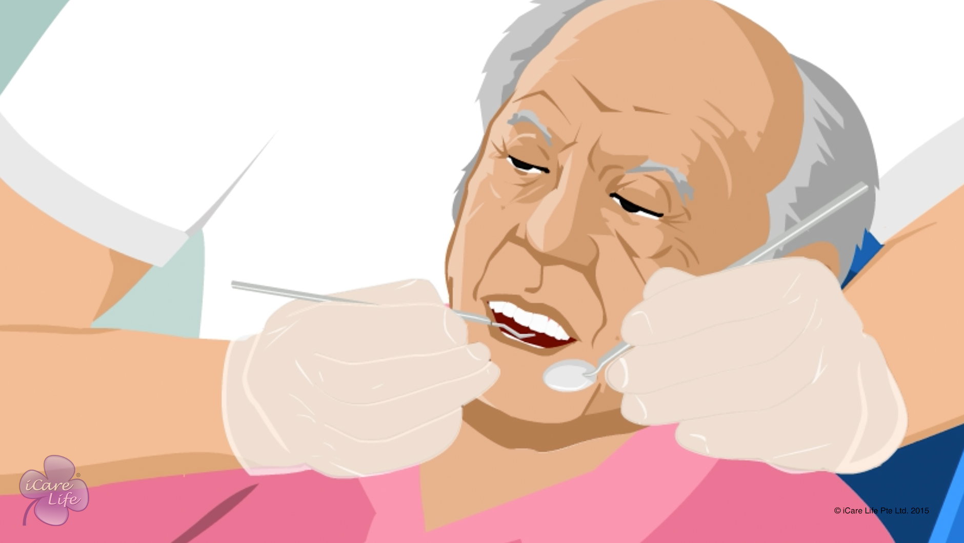
Issues Related to Elder’s Mouth
2
Copyright: iCare Life Pte. Ltd., Singapore : This document must not be copied or shared or circulated without the consent of iCare Life and/or its affiliates.

Slide 4
Post-Module Activity
Oral Care
Notes:
Set up an appointment with a medical professional who can teach the class about oral problems faced by elders.
Arrange for:
a) A model of a human mouth for the demonstration.
b) A set of full dentures
c) A toothbrush, a tongue cleaner, and a dental floss
The medical professional should explain the parts of a human mouth. Next they should demonstrate as to how should the teeth and tongue should be cleaned. The professional should also demonstrate flossing of teeth.
Now invite the class participants to try the activity on their own.

Slide 5
Summary
Scrape off white or yellow coating on the elder’s tongue
Inform the elder’s family to fix up an appointment with a doctor in case of a green, brown, or black coating on the elder’s tongue
Encourage an elder with bad breath to see a doctor or dentist
Prevent cavities by encouraging brushing and flossing regularly
Serve soft food to an elder whose dentures cause difficulty in eating
4
Notes:
Scrape off white or yellow coating on the elder’s tongue
Inform the elder’s family to fix up an appointment with a doctor in case of a green, brown, or black coating on the elder’s tongue
Encourage an elder with bad breath to see a doctor or dentist
Prevent cavities by encouraging brushing and flossing regularly
Serve soft food to an elder whose dentures cause difficulty in eating

Slide 6
Any Questions?
5
Notes:
Q1. Why is it important for the caregiver to pay attention to the bad breath of the elder?
Ans. Bad breath besides being a cause of discomfort for everyone who comes in contact with the elder may in fact indicate something more serious than simple poor oral hygiene. For example, a fruity breath may be a sign of uncontrolled diabetes, a urine like smell can sometimes indicate kidney failure. Bad breath may also indicate poor intestinal condition and likewise. A persistent bad breath should therefore not be taken lightly and properly investigated.
Q2. Are there any challenges before the caregiver in oral hygiene of elders with dementia?
Ans. Some of the challenges before the care givers are: -
(a) Elder would not open mouth
(b) Dentures cannot be taken out or put in elder’s mouth
(c) Elder may refuse oral hygiene care
(d) Elder bites toothbrush
(e) Elder kicks or hits out
(f) Elder does not understand caregiver’s directions about oral hygiene.
(g) Elder cannot rinse and/or spit and swallows all liquids/ toothpaste.
(h) Elder uses offensive language
(i) Elder is agitated/ tired/ sleepy
Q3. How can I care for the dentures of the elder?
Ans.
(a) Clean the dentures daily with a toothbrush
(b) You must change denture cup solution daily
(c) Do not use normal toothpastes on dentures since they are too abrasive
(d) You may use denture cleaner tablets
(e) Clean the storage container regularly; never use abrasive chemicals such as bleaching powder on dentures

Slide 7
Issues related to Vision in the Elder
6
Copyright: iCare Life Pte. Ltd., Singapore : This document must not be copied or shared or circulated without the consent of iCare Life and/or its affiliates.

Slide 8
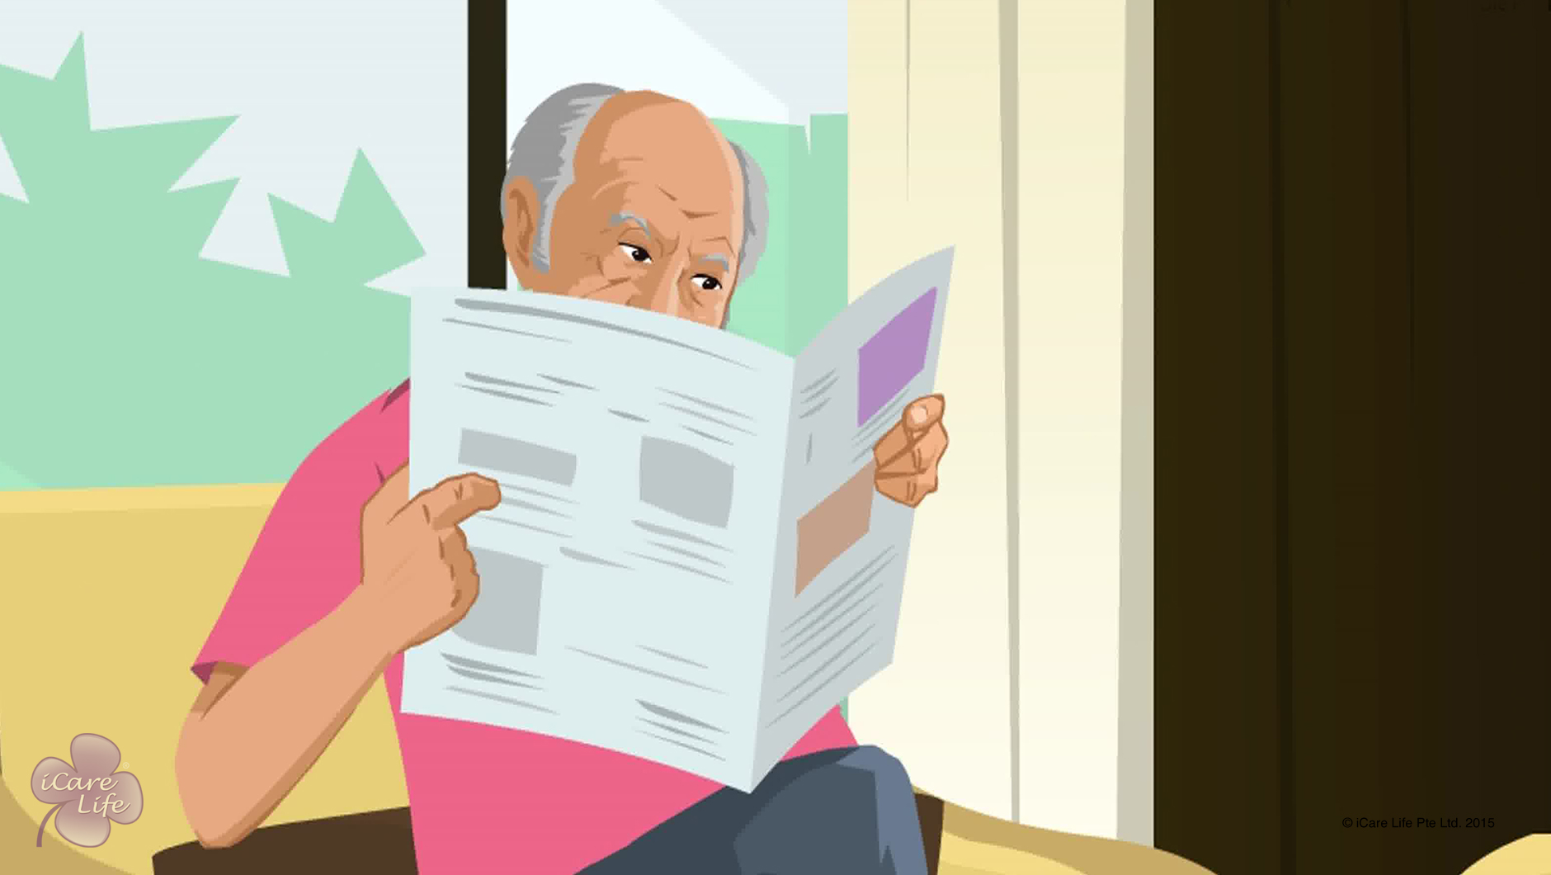
Issues Related to Vision in the Elder
7
Copyright: iCare Life Pte. Ltd., Singapore : This document must not be copied or shared or circulated without the consent of iCare Life and/or its affiliates.

Slide 9
Post-Module Activity
Demonstration
Notes:
You will require an appointment with a medical professional, who is an expert in human vision, a model of a human eye and a Snellen chart. The model’s parts should be such that they can be dismantled.
Ask the professional to explain various parts of the eye to the class and what is the function of each part. They should show how do various conditions such as myopia, hyperopia, and cataract affect the human eye. They should also explain what is a Snellen chart and how is it used. The medical professional can call some volunteers from the class to come and try reading the chart. The professional can also demonstrate how to put eye drops correctly (Make sure an empty eye drop bottle is used for the demonstration).
Ask the class participants to take notes of the discussion.

Slide 10
Summary
Elders:
May have problems quickly adapting to changes in light,
May develop cataract or reduced clarity of vision,
May not be able to differentiate similar colors easily,
May develop issues with the retina,
May find it difficult to move eyes in all directions and see sideways, or
May develop an issue with 3D or depth perception
To take care of an elder’s eyes:
Get the elder’s eyes checked by a doctor regularly
Make sure the elder wears glasses, if prescribed
Clean the glasses regularly
Do not assume that the elder will be able to see sideways
Encourage them to wear sunglasses when going out in the sun
Ensure that the elder wears dark glasses after a cataract surgery
9
Notes:
Elders:
May have problems quickly adapting to changes in light,
May develop cataract or reduced clarity of vision,
May not be able to differentiate similar colors easily,
May develop issues with the retina,
May find it difficult to move eyes in all directions and see sideways, or
May develop an issue with 3D or depth perception
To take care of an elder’s eyes:
Get the elder’s eyes checked by a doctor regularly
Make sure the elder wears glasses, if prescribed
Clean the glasses regularly
Do not assume that the elder will be able to see sideways
Encourage them to wear sunglasses when going out in the sun
Ensure that the elder wears dark glasses after a cataract surgery

Slide 11
Summary
If you need to put eye drops for the elder:
Wash your hands before and after putting the drops
Do not let the tip of the bottle touch any surface
Drop the first drop on your hand
Gently pull the lower eyelid to form a well
Ask the elder to keep the eye open and look up
Put the prescribed number of drops in the well
Wipe off the excess medicine
Ask the elder to keep the eyes closed for at least two to three minutes
Throw the bottle within seven days of opening it
10
Notes:
If you need to put eye drops for the elder:
Wash your hands before and after putting the drops
Do not let the tip of the bottle touch any surface
Drop the first drop on your hand
Gently pull the lower eyelid to form a well
Ask the elder to keep the eye open and look up
Put the prescribed number of drops in the well
Wipe off the excess medicine
Ask the elder to keep the eyes closed for at least two to three minutes
Throw the bottle within seven days of opening it

Slide 12
Any Questions?
11
Notes:
Q1. Are there any exercises to improve the vision?
Ans. Yes, there are some simple exercises to strengthen the vision but these should only be done as per the doctor’s guidance. Never ask the care receiver to try something which the doctor has not prescribed.
Q2. How do I help an elder if they have a foreign object in the eye?
Ans. Do not let the elder rub the eye. Flush the eye for several minutes with lukewarm water. If it still feels as though there is something in the eye, then be sure to see an eye specialist.
Do not, under any circumstance, try and remove the foreign object with a finger or a cloth. This can further harm the eye.
Q3. What does a 6/6 or a 20/20 vision mean?
Ans. 20/20 vision is a basic standard for perfect eyesight. It means that you will be clearly able to read certain sizes on a vision chart (Snellen chart) standing 20 feet away. 6/6 represents 6 meters and applies the same way.

Slide 13
Urinogenital Related Issues of the Female Elder
12
Copyright: iCare Life Pte. Ltd., Singapore : This document must not be copied or shared or circulated without the consent of iCare Life and/or its affiliates.

Slide 14
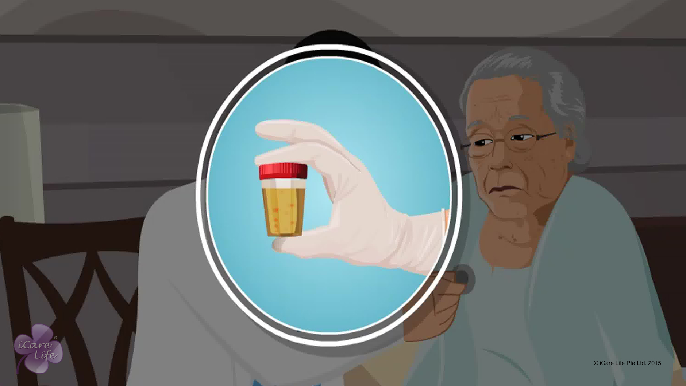
Urinogenital Related Issues of the Female Elder
13
Copyright: iCare Life Pte. Ltd., Singapore : This document must not be copied or shared or circulated without the consent of iCare Life and/or its affiliates.

Slide 15
Post-Module Activity
Practical Training
14
Notes:
Arrange for a visit to a nursing home or an old people’s home where female participants can observe elderly female patients suffering from urinary tract disorders and uterus problems. Provide opportunity to participants to interact with patients and inquire about their symptoms and the problems they face. At the end of the visit, arrange a short session with a qualified doctor or a trained caregiver to answer the participants’ queries and clarify their doubts.

Slide 16
Summary
Some of the common urinogenital problems in female elders are:
Urge for frequent urination,
Urinary tract infections, and
Prolapsed uterus
You must inform a doctor if the elder:
Suddenly starts to urinate more frequently
Feels difficulty and burning sensation while passing urine
Complains of constant abdominal or back pain
Has blood in urine
Experiences final stage of prolapsed uterus
15
Notes:
Some of the common urinogenital problems in female elders are:
Urge for frequent urination,
Urinary tract infections, and
Prolapsed uterus
You must inform a doctor if the elder:
Suddenly starts to urinate more frequently
Feels difficulty and burning sensation while passing urine
Complains of constant abdominal or back pain
Has blood in urine
Experiences final stage of prolapsed uterus

Slide 17
Any Questions?
16
Notes:
Q1. Should I contact the doctor if the elder under my care urinates frequently?
Ans: With growing age, it is normal for a person to feel an urge to urinate more frequently. This is because the bladder walls thicken and become less elastic. This results in decreased capacity to hold urine. So, it is not a serious issue if the elder feels a frequent urge to urinate. However, if the frequency of urination suddenly increases and becomes much more than usual, you should start keeping a note of it. Along with this, if the elder complains of any difficulty or burning sensation while passing urine, you must contact a doctor immediately.

Slide 18
Urinogenital Related Issues of the Male Elder
17
Copyright: iCare Life Pte. Ltd., Singapore : This document must not be copied or shared or circulated without the consent of iCare Life and/or its affiliates.

Slide 19
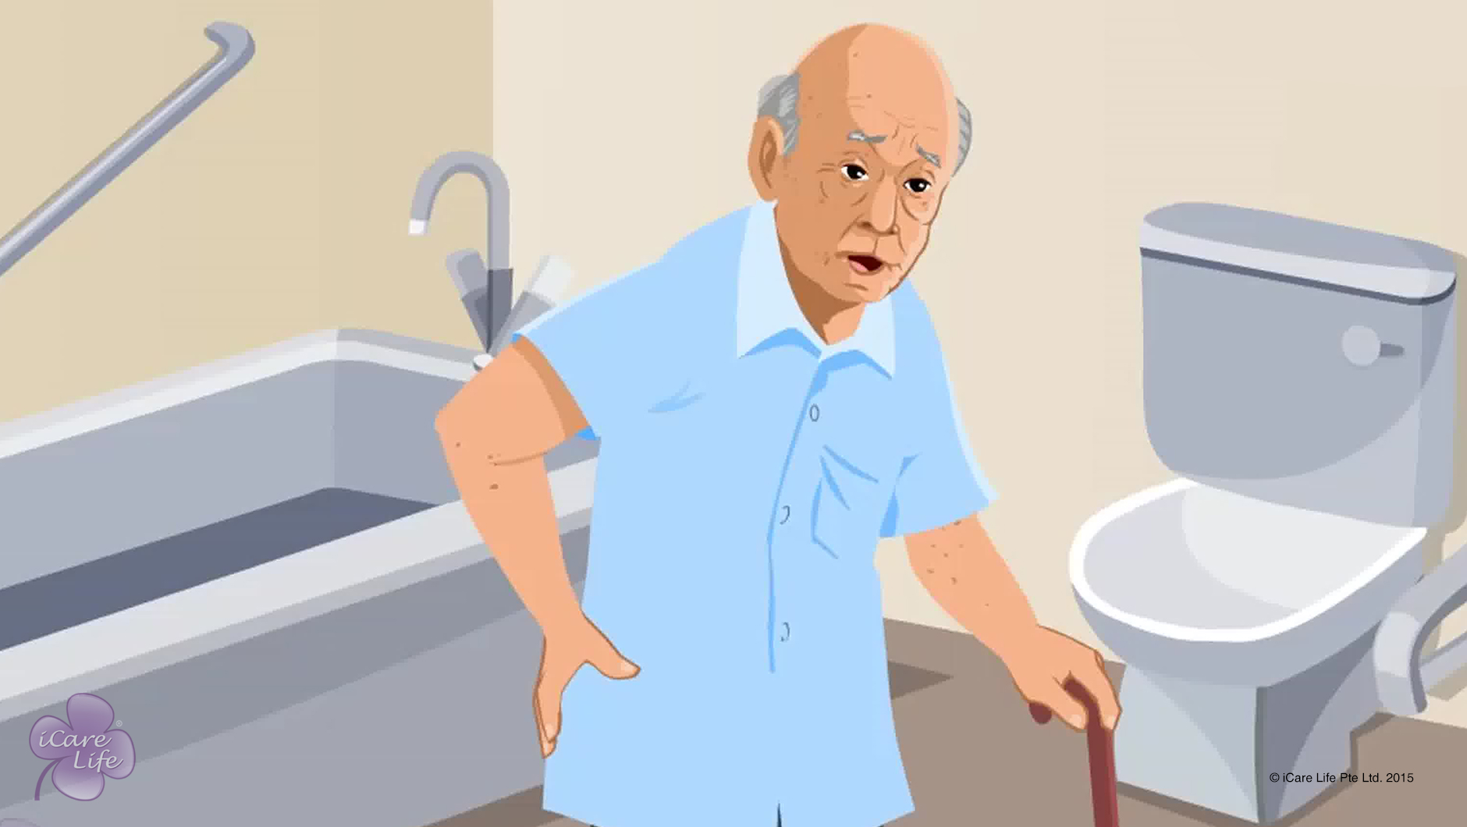
Urinogenital Related Issues of the Male Elder
18
Copyright: iCare Life Pte. Ltd., Singapore : This document must not be copied or shared or circulated without the consent of iCare Life and/or its affiliates.

Slide 20
Post-Module Activity
Practical Training
Notes:
Arrange for a visit to a nursing home or an old people’s home where male participants can observe elderly male patients suffering from urinary tract disorders and prostate problems. Provide opportunity to participants to interact with patients and inquire about their symptoms and the problems they face. At the end of the visit, arrange a short session with a qualified doctor or a trained caregiver to answer the participants’ queries and clarify their doubts.

Slide 21
Summary
Some of the common urinogenital problems in male elders are:
Urge for frequent urination
Urinary tract infections
Enlarged prostate, and
Incontinence
You must inform a doctor if the elder:
Suddenly starts to urinate more frequently
Feels difficulty and burning sensation while passing urine
Complains of constant abdominal or back pain
Has blood in the urine
20
Copyright: iCare Life Pte. Ltd., Singapore : This document must not be copied or shared or circulated without the consent of iCare Life and/or its affiliates.
Notes:
Some of the common urinogenital problems in male elders are:
Urge for frequent urination
Urinary tract infections
Enlarged prostate, and
Incontinence
You must inform a doctor if the elder:
Suddenly starts to urinate more frequently
Feels difficulty and burning sensation while passing urine
Complains of constant abdominal or back pain
Has blood in the urine

Slide 22
Summary
When assisting an elder in cleaning, use disposable gloves and clean the elder thoroughly
Empty the bedpan into a toilet and wash the bedpan for subsequent use
Wash hands with soap and water
Stay respectful in case the elder’s clothes get soiled
21
Copyright: iCare Life Pte. Ltd., Singapore : This document must not be copied or shared or circulated without the consent of iCare Life and/or its affiliates.

Slide 23
Any Questions?
22
Notes:
Q1. Should I contact the doctor if the elder under my care urinates frequently?
Ans: With growing age, it is normal for a person to feel an urge to urinate more frequently. This is because the bladder walls thicken and become less elastic. This results in decreased capacity to hold urine. So, it is not a serious issue if the elder feels a frequent urge to urinate. However, if the frequency of urination suddenly increases and becomes much more than usual, you should start keeping a note of it. Along with this, if the elder complains of any difficulty or burning sensation while passing urine, you must contact a doctor immediately.

Slide 24
Gastrointestinal Issues in the Elder
23
Copyright: iCare Life Pte. Ltd., Singapore : This document must not be copied or shared or circulated without the consent of iCare Life and/or its affiliates.

Slide 25
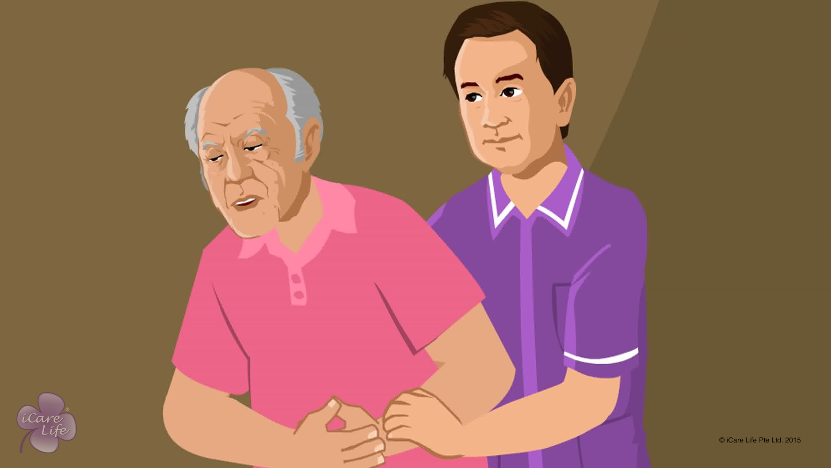
Gastrointestinal Issues in the Elder
24
Copyright: iCare Life Pte. Ltd., Singapore : This document must not be copied or shared or circulated without the consent of iCare Life and/or its affiliates.

Slide 26
Post-Module Activity
Understanding the Digestive System
Notes:
You will need to set up an appointment with a medical professional who is an expert in the human digestion system.
You will also have to arrange for a model of a human digestion system which can be dismantled and internal parts can be shown.
Ask the professional to show:
The parts of a human digestive system
What problems affect which areas
How can the symptoms be recognized
You can request the professional to take a look at the module’s content beforehand so that they can prepare accordingly.
Ask the class participants to make notes and ask questions as needed.

Slide 27
Summary
Give the elder a lot of water and vegetables and reduce non-vegetarian and grain-based food
Give the elder water to drink to help them vomit
To help an elder suffering from constipation, introduce fiber in the diet, involve them in exercise, watch out for side effects of medicines, and take care of the elder’s comfort in the use of the toilet
Give an elder suffering from diarrhea bananas, yogurt and rice, and water
Seek the doctor’s advice for piles, fistula in ano or fissures, appendicitis, and chronic pain in the abdomen
26
Copyright: iCare Life Pte. Ltd., Singapore : This document must not be copied or shared or circulated without the consent of iCare Life and/or its affiliates.
Notes:
Give the elder a lot of water and vegetables and reduce non-vegetarian and grain-based food
Give the elder water to drink to help them vomit
To help an elder suffering from constipation, introduce fiber in the diet, involve them in exercise, watch out for side effects of medicines, and take care of the elder’s comfort in the use of the toilet
Give an elder suffering from diarrhea bananas, yogurt and rice, and water
Seek the doctor’s advice for piles, fistula in ano or fissures, appendicitis, and chronic pain in the abdomen

Slide 28
Any Questions?
27
Notes:
Q1. There are many ayurvedic medicines available for gastrointestinal problems. Should these be trusted?
Ans. You should avoid taking any medication on your own as you might not be able to figure out the severity of the problem. A doctor’s advice should be sought. If the doctor advises the use of any such medication, only then you may use these. In case the elder wants to go in for some other kind of medication therapy like homeopathy or naturopathy, then you should first speak to the elder’s family.
Q2. Should the medicines be stopped as soon as the elder starts feeling normal?
Ans. No. You should always make sure that the elder completes the medication course suggested by the doctor. Completing the course helps in finishing the illness from its roots. It also makes sure that the illness does not grow again.

Slide 29


