Slide 1

Maintaining Confidentiality
11
CR 14.2
Standard
Source: Skills for Health – Website http://www.skillsforhealth.org.uk/
Skills for Care – Website http://www.skillsforcare.org.uk/

Slide 2
Learning outcomes
1. Handling information
Source: Skills for Health – Website http://www.skillsforhealth.org.uk/
Skills for Care – Website http://www.skillsforcare.org.uk/
1

Slide 3

Handling information
The information about an individual's care and support may be personal and sensitive
This information must be treated as confidential and only shared with people who need to know
Maintaining confidentiality is:
A legal requirement
Essential to promote the individual
An important part of building trust
Source: Skills for Health – Website http://www.skillsforhealth.org.uk/
Skills for Care – Website http://www.skillsforcare.org.uk/
2

Slide 4

Information sharing
Information can only be shared with people need-to-know basis
Which of the people below would ‘need-to-know’ about an individual’s care and support needs?
✓
Yes
X
No
The individual’s neighbour or friends
X
A health and social care worker who is involved in providing care
✓
The individual's family member(s) involved in taking care of the individual*
✓
The worker’s family or friends
X
A health and social care worker not involved in providing care
X
A worker in a different role who is involved in providing care to the individual
✓
Source: Skills for Health – Website http://www.skillsforhealth.org.uk/
Skills for Care – Website http://www.skillsforcare.org.uk/
3
Notes:
Activity: Ask learners which of the people identified in the table would ‘need-to-know’ about an individual's care and support needs.
Additional information
Care must be taken to store information carefully to avoid unauthorised people accessing personal or sensitive information.
Electronic information should be password protected
Consideration should be given to who can overhear information being shared verbally
Paper records should be stored in locked cupboards or filing cabinets
Consent should be sought from the individual before information is shared
In instances where an individual may come to harm information must be shared with the health and social care worker’s manager even when consent is not given

Slide 5

Social media
The internet enables sharing of information through social media such as ‘Facebook’ and ‘Twitter’
Mobile internet technology makes it possible to share information instantly increasing the risks of breaching confidentiality
Source: Skills for Health – Website http://www.skillsforhealth.org.uk/
Skills for Care – Website http://www.skillsforcare.org.uk/
4
Notes:
Additional information
Sharing an individual’s information on social media is as much of a breach of confidentiality as:
Leaving a record out of the locked filing system
Remaining logged in to a computer when workers are not present
Discussing an individual’s care and support where others can overhear.

Slide 6
Data Protection Act
The Data Protection introduces rules on the storage and use of information.
1. Must be processed in a fair and lawful way
2. Can only be processed for limited purpose, e.g. in a way previously specified that you have consented to
3. Have to be relevant, adequate to their intended use and kept to a minimum
4. Have to be accurate and up-to-date
5. Should not be kept for longer than necessary
6. Should be processed in accordance with your rights
7. Should be stored securely
8. Should not be transferred to other countries where there is no adequate protection in place.
Source: Skills for Health – Website http://www.skillsforhealth.org.uk/
Skills for Care – Website http://www.skillsforcare.org.uk/
5
Notes:
Additional information
The Data Protection Act covers data which can be used to identify a living person including:
Names
Birthday and anniversary dates
Addresses
Telephone numbers
Fax numbers
Email addresses etc.

Slide 7

Freedom of Information Act
The Freedom of Information and the Environmental Information Regulations allow members of the public to access recorded information held by public authorities.
Source: Skills for Health – Website http://www.skillsforhealth.org.uk/
Skills for Care – Website http://www.skillsforcare.org.uk/
6
Notes:
Additional Information
Public authority includes:
Central government and government departments
Local authorities
Hospitals, doctors’ surgeries, dentists, pharmacists and opticians
State schools, colleges and universities
Police forces and Law Enforcement Agencies

Slide 8
Handling information in health and social care
You must always work in agreed ways that protect information
Examples of policies and procedures which protect information include:
Computer firewalls
Secure storage of keys
Office security codes
Not sharing passwords with unauthorised people
Locked filing cabinets and cupboards
Password protection
Security to access in secure areas
Source: Skills for Health – Website http://www.skillsforhealth.org.uk/
Skills for Care – Website http://www.skillsforcare.org.uk/
7
Notes:
Activity: Ask learners to identify some security measures that are in place to protect personal and sensitive information.
Answers could include:
Computer firewalls
Password protection
Not sharing passwords with unauthorised people
Locked filing cabinets and cupboards
Secure storage of keys
Office security codes
Security fobs or cards to access secure areas

Slide 9
Care plans
Care plans are an important tool in good communication between those involved in providing care and support
In order to ensure quality and consistency of care they must be:
Kept up to date
Complete
Accurate
Legible
Factual (without opinion)
Free from jargon
Source: Skills for Health – Website http://www.skillsforhealth.org.uk/
Skills for Care – Website http://www.skillsforcare.org.uk/
8
Notes:
Additional information
They may become legal documents of evidence if at any point there is cause for concern
Someone in the workplace will have the responsibility for checking care plans regularly to ensure they are fit for purpose

Slide 10
Reporting concerns
Concerns about the recording, storing or sharing of information should be reported to your family member concern or manager
Confidential files being left around
A missing key to a cabinet containing confidential files
Passwords being shared with unauthorised people
Personally identifiable information being shared on social media
Workers discussing an individual in the pub.
If your concerns are not taken seriously you have a duty to report incompetent or unsafe practice to the concerned person (iCare Life)
Source: Skills for Health – Website http://www.skillsforhealth.org.uk/
Skills for Care – Website http://www.skillsforcare.org.uk/
9
Notes:
Activity: Ask learners to give some examples of practices relating handling information that should be reported to your manager.
Answers could include:
Confidential files being left around
A missing key to a cabinet containing confidential files
Passwords being shared with unauthorised people
Personally identifiable information being shared on social media
Workers discussing an individual in the cafeteria

Slide 11







Knowledge check
What type information does the ‘Data Protection Act’ apply to?
Click to reveal answer
Spoken information
Information which is given in training sessions
Electronic files and organised, paper filing systems
Information that does not identify individuals
Source: Skills for Health – Website http://www.skillsforhealth.org.uk/
Skills for Care – Website http://www.skillsforcare.org.uk/
10
Notes:
Trainer should ask class why they chose the correct answer
Feedback
A – The Data Protection Act 1984 as amended in 2003 applies to Electronic files and organised, paper filing systems that includes personally identifiable information. Spoken information is not included but confidentiality can be breached if personal or sensitive information is discussed where others can overhear.
B – The Data Protection Act 1984 as amended in 2003 applies to Electronic files and organised, paper filing systems that includes personally identifiable information.
C – The Data Protection Act 1984 applied to personal records and personally identifiable information. In 2003 it was extended to apply to organised, paper filing systems.
D – The Data Protection Act 1984 as amended in 2003 applies to Electronic files and organised, paper filing systems that includes personally identifiable information.

Slide 12


Knowledge check
Who would be your first point of call if you have concerns regarding confidentiality?
Click to reveal answer
My manager or supervisor
My colleague
The individual or their family
The local Police Authority
Source: Skills for Health – Website http://www.skillsforhealth.org.uk/
Skills for Care – Website http://www.skillsforcare.org.uk/
11
Notes:
Trainer should ask class why they chose the correct answer.
Feedback
A – If you have concerns about any aspect of your work you should speak to your manager or supervisor. They have the authority to speak to the worker who has breached confidentiality, remind all staff of the agreed ways of working, inform the person to whom the record relates and take any action possible to limit the damage caused.
B – You must report your concerns to someone who has the authority to deal with the confidentiality breach. Your manager or supervisor will have the authority to speak to the worker who has breached confidentiality, remind all staff of the agreed ways of working, inform the person to whom the record relates and take any action possible to limit the damage caused.
C – Your manager or supervisor will inform the person to whom the record relates and take any action possible to limit the damage caused. It is likely that they will speak to the worker who has breached confidentiality and remind all staff of the agreed ways of working.
D – In most cases the first point of call for concerns about confidentiality and any other aspects of your work will be your manager or supervisor. If your concerns are not taken seriously you should speak to a more senior manager or you could report your concerns to the Care Quality Commission (CQC).

Slide 13


Knowledge check
Which of the following people would be classed as an ‘authorised person’ or would ‘need-to-know’ personal information?
Click to reveal answer
A senior worker not involved in supporting the individual
A member of the family of the individual that you support
A colleague who is not involved in supporting care
Another worker from the care team providing support to an individual
Source: Skills for Health – Website http://www.skillsforhealth.org.uk/
Skills for Care – Website http://www.skillsforcare.org.uk/
12
Notes:
Trainer should ask class why they chose the correct answer.
Feedback
A – People who ‘need-to-know’ are those involved in the care and support of the individual. A senior worker who is not involved in the team providing care would not usually ‘need-to-know’ unless they are your manager or supervisor.
B – You should not share information about the individual with their family or friends unless you have their consent to do so. They would not be classed as being an ‘authorised person’ or ‘need-to-know’.
C – A colleague who is not involved in the team providing care is not considered to be an ‘authorised person’ and does not ‘need-to-know’.
D – ‘Authorised people’ are those who ‘need-to-know’ the information in order to provide effective care. Another worker who is involved in providing care and support to an individual would be classed as needing-to-know.

Slide 14
Viewing of Modules
Confidentiality, Integrity & Data Privacy
CR 14.2
Private and Confidential

Slide 15
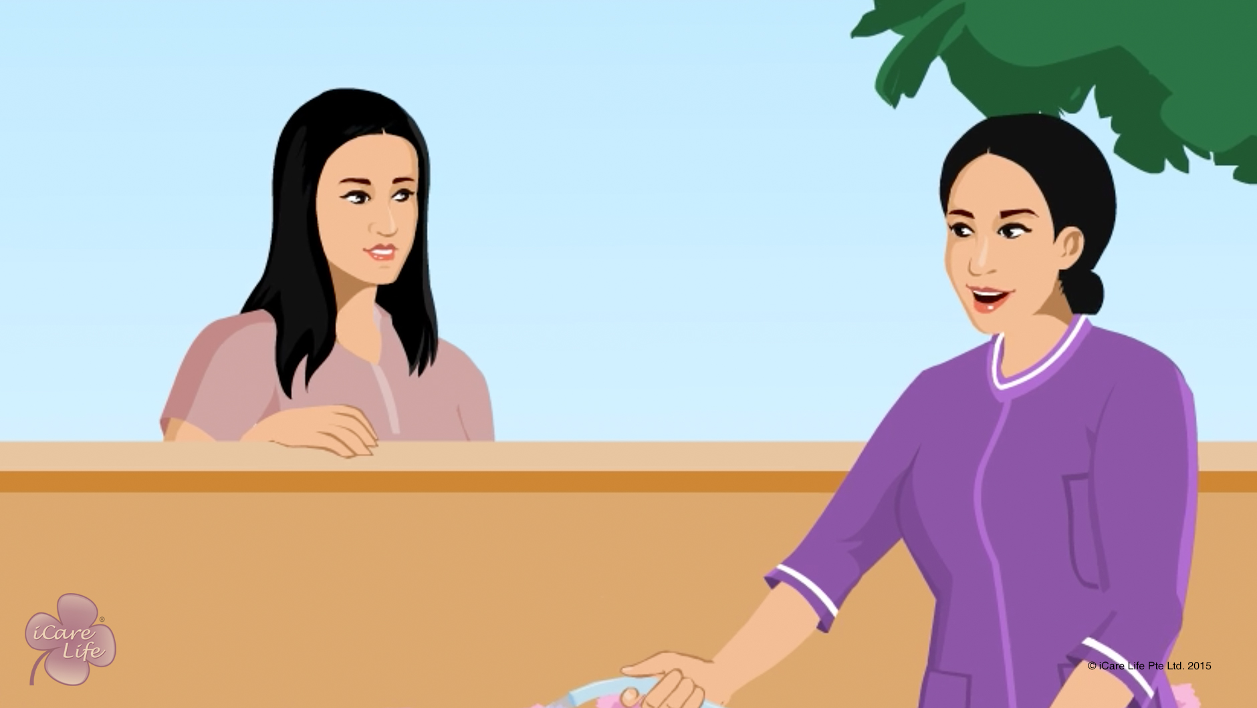
Integrity & Confidentiality
1
Copyright: iCare Life Pte. Ltd., Singapore : This document must not be copied or shared or circulated without the consent of iCare Life and/or its affiliates.

Slide 16
In this module, you will learn about:
The importance of maintaining trust of the caregiver’s family
The ways through which you can maintain the integrity of the professional relationship you have with the family
2

Slide 17

Let’s Watch
Integrity & Confidentiality
3
Copyright: iCare Life Pte. Ltd., Singapore : This document must not be copied or shared or circulated without the consent of iCare Life and/or its affiliates.

Slide 18


