Slide 1

Viewing of Modules
Confidentiality, Integrity & Data Privacy
CR 14.2
Private and Confidential

Slide 2
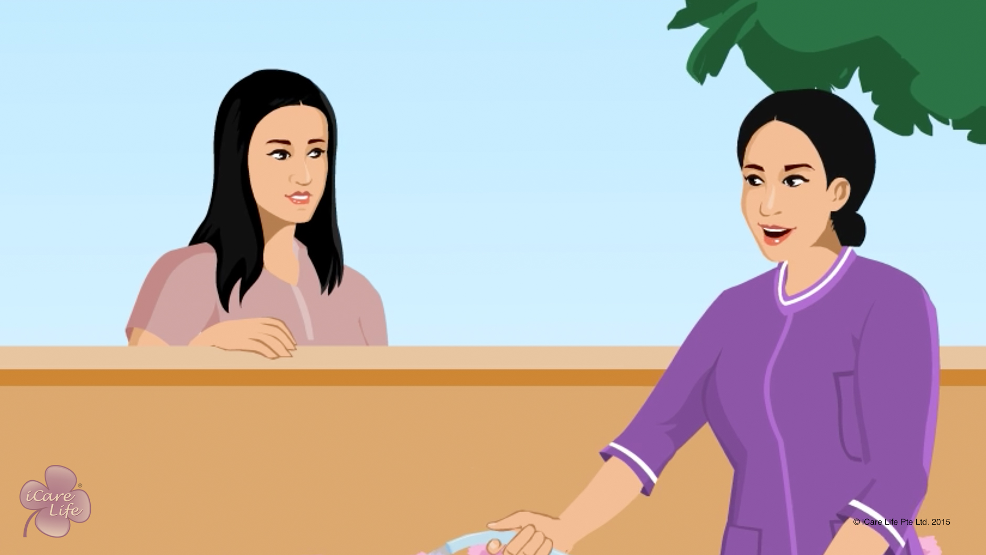
Integrity & Confidentiality
1
Copyright: iCare Life Pte. Ltd., Singapore : This document must not be copied or shared or circulated without the consent of iCare Life and/or its affiliates.

Slide 3
In this module, you will learn about:
The importance of maintaining trust of the caregiver’s family
The ways through which you can maintain the integrity of the professional relationship you have with the family
2

Slide 4

Let’s Watch
Integrity & Confidentiality
3
Copyright: iCare Life Pte. Ltd., Singapore : This document must not be copied or shared or circulated without the consent of iCare Life and/or its affiliates.

Slide 5


