Slide 1

Viewing of Modules
Activities of Daily Living – Age Related Issues
CR 14.3
Private and Confidential

Slide 2
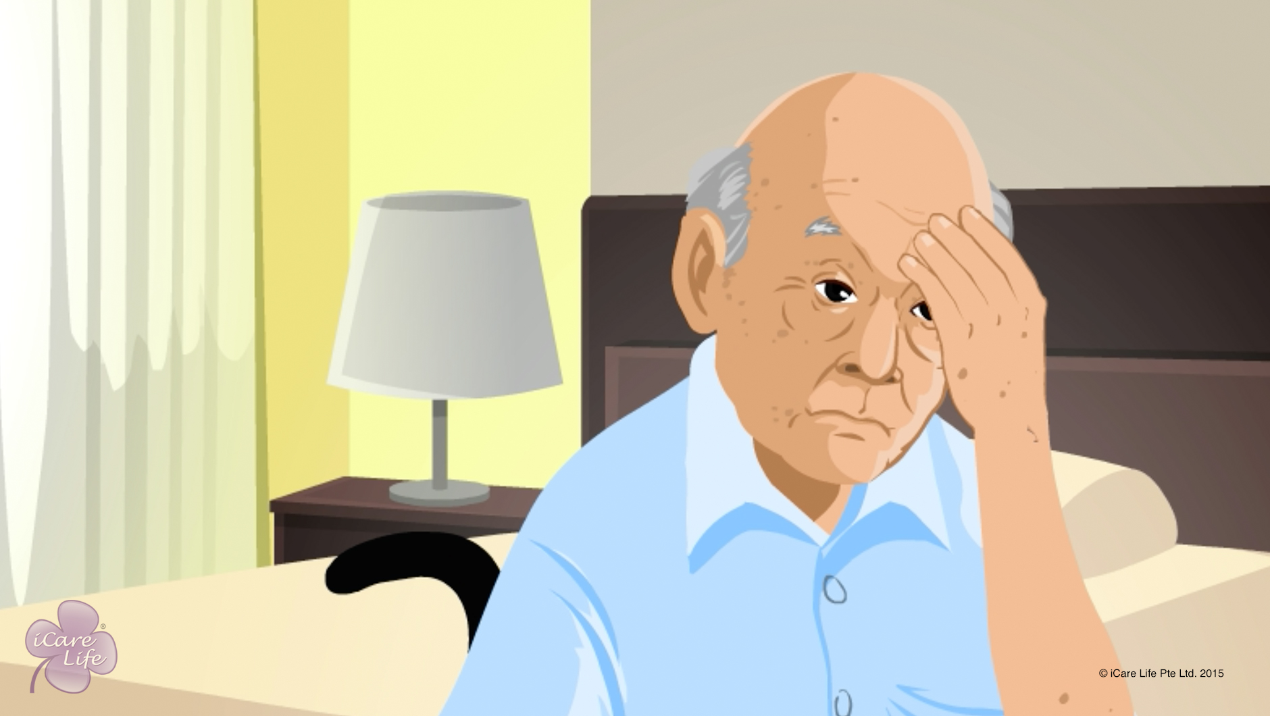
Issues of the Nervous System in Elders
1
Copyright: iCare Life Pte. Ltd., Singapore : This document must not be copied or shared or circulated without the consent of iCare Life and/or its affiliates.

Slide 3
In this module, you will learn about:
The common disorders of the nervous system faced by elders
The symptoms of nervous system disorders faced by elders
The steps for care for elders with nervous system disorders
2

Slide 4

Let’s Watch
Issues of the Nervous System in Elders
3
Copyright: iCare Life Pte. Ltd., Singapore : This document must not be copied or shared or circulated without the consent of iCare Life and/or its affiliates.

Slide 5
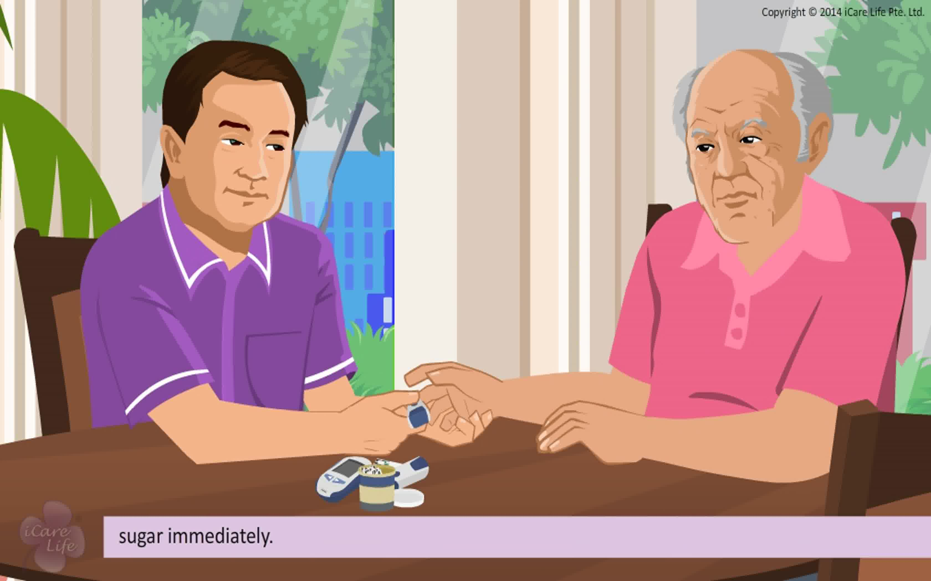
Managing Diabetes
4
Copyright: iCare Life Pte. Ltd., Singapore : This document must not be copied or shared or circulated without the consent of iCare Life and/or its affiliates.

Slide 6
In this module, you will learn about:
What is diabetes
Why does it occur
The effects of diabetes
The symptoms of diabetes
How you can help elders manage diabetes
5
Copyright: iCare Life Pte. Ltd., Singapore : This document must not be copied or shared or circulated without the consent of iCare Life and/or its affiliates.

Slide 7
Let’s Watch
Managing Diabetes
6
Copyright: iCare Life Pte. Ltd., Singapore : This document must not be copied or shared or circulated without the consent of iCare Life and/or its affiliates.

Slide 8
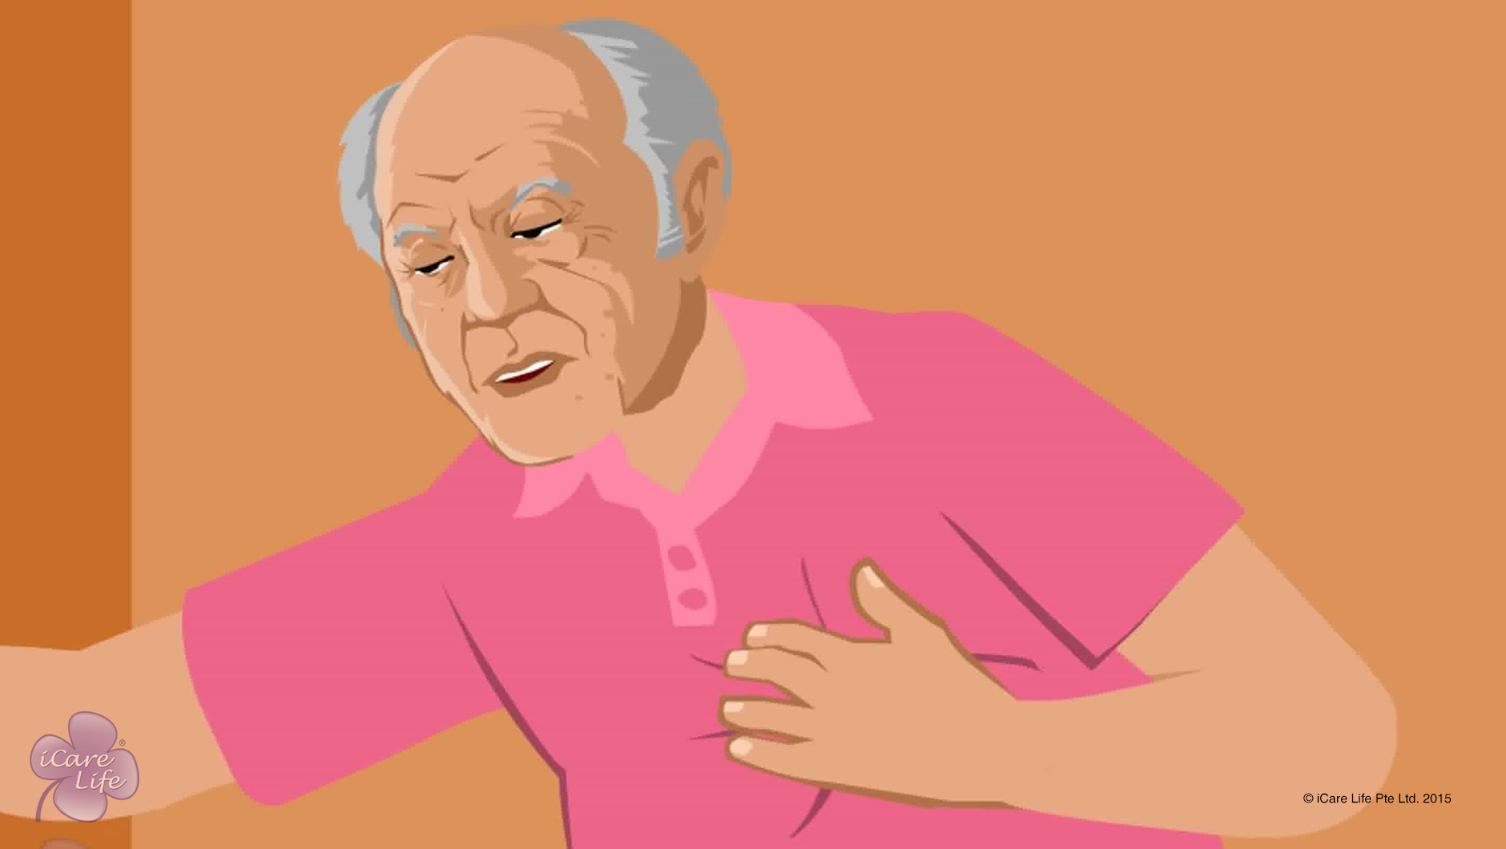
Managing Heart Conditions
7
Copyright: iCare Life Pte. Ltd., Singapore : This document must not be copied or shared or circulated without the consent of iCare Life and/or its affiliates.

Slide 9
In this module, you will learn about:
What are the common heart problems an elder may have
What are the characteristics and symptoms of a heart problem
How can you care for patients with heart problems
8
Copyright: iCare Life Pte. Ltd., Singapore : This document must not be copied or shared or circulated without the consent of iCare Life and/or its affiliates.

Slide 10
Let’s Watch
Managing Heart Conditions
9
Copyright: iCare Life Pte. Ltd., Singapore : This document must not be copied or shared or circulated without the consent of iCare Life and/or its affiliates.

Slide 11
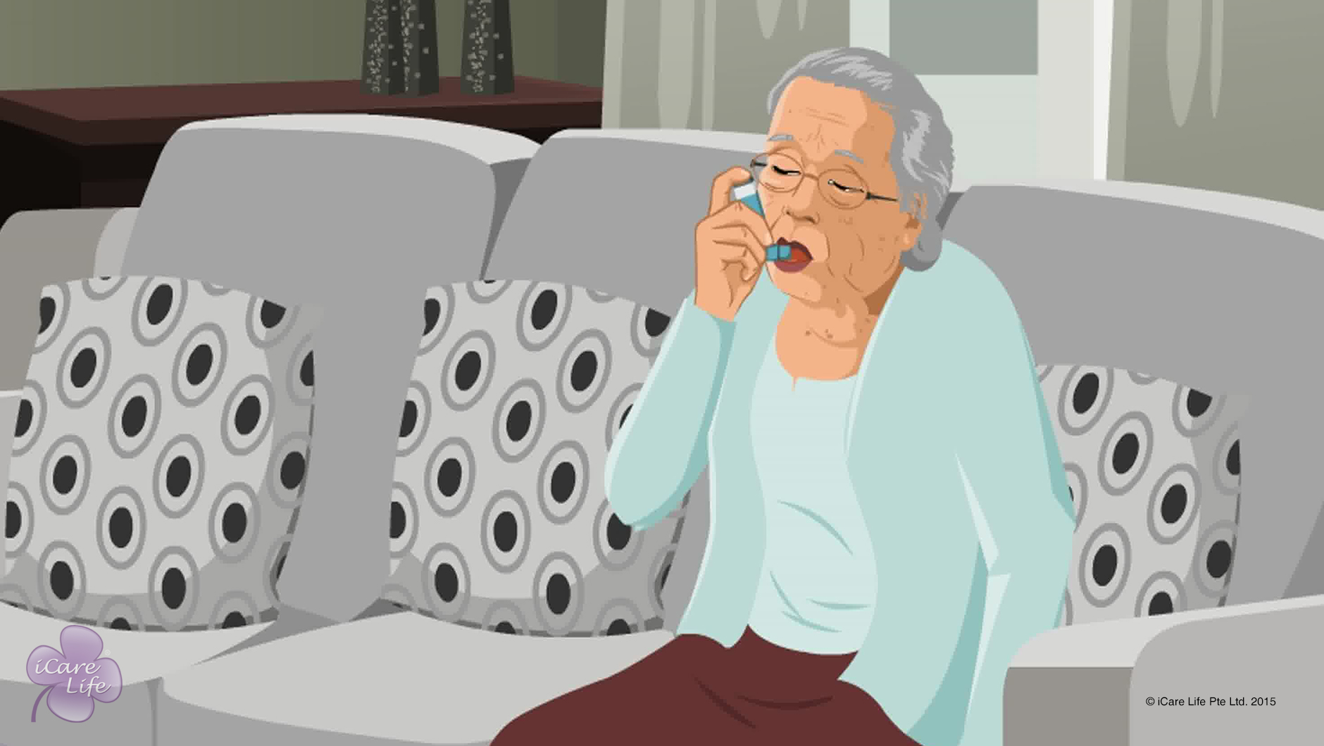
Respiratory Issues in the Elder
10
Copyright: iCare Life Pte. Ltd., Singapore : This document must not be copied or shared or circulated without the consent of iCare Life and/or its affiliates.

Slide 12
In this module, you will learn about:
The symptoms of respiratory problems
The different types of respiratory diseases which can affect an elder
How can infectious respiratory diseases be prevented from spreading
11
Copyright: iCare Life Pte. Ltd., Singapore : This document must not be copied or shared or circulated without the consent of iCare Life and/or its affiliates.

Slide 13
Let’s Watch
Respiratory Issues in the Elder
12
Copyright: iCare Life Pte. Ltd., Singapore : This document must not be copied or shared or circulated without the consent of iCare Life and/or its affiliates.

Slide 14
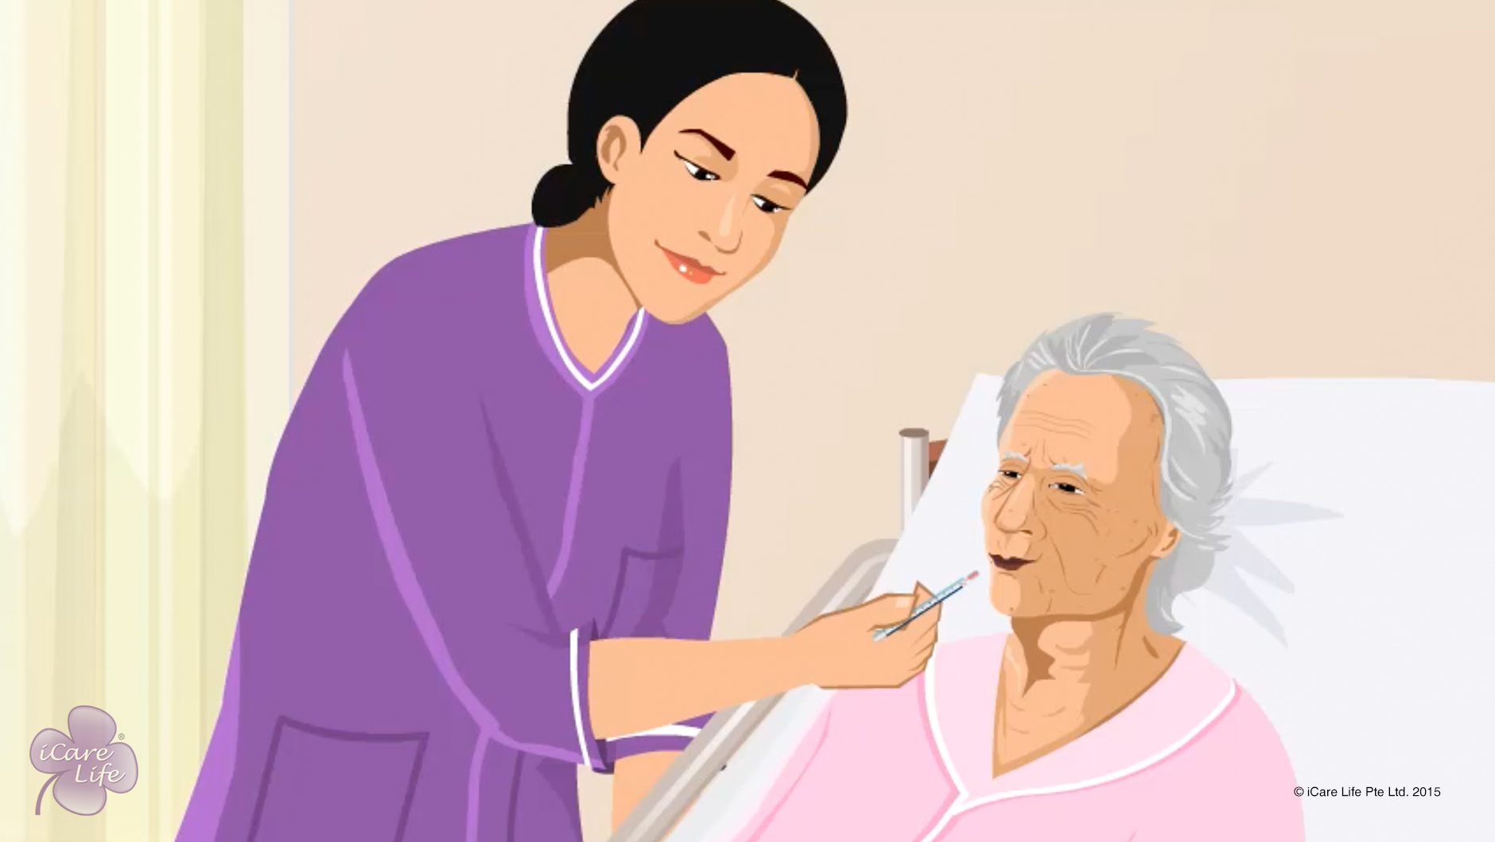
Helping the Elder & Family deal with Terminal Illness
13
Copyright: iCare Life Pte. Ltd., Singapore : This document must not be copied or shared or circulated without the consent of iCare Life and/or its affiliates.

Slide 15
In this module, you will learn about:
How to involve the family in case the elder is terminally ill
How to help the elder reach the stage of acceptance in their situation
How to keep the elder happy during their last days
14
Copyright: iCare Life Pte. Ltd., Singapore : This document must not be copied or shared or circulated without the consent of iCare Life and/or its affiliates.

Slide 16
Let’s Watch
Helping the Elder & Family deal with Terminal Illness
15
Copyright: iCare Life Pte. Ltd., Singapore : This document must not be copied or shared or circulated without the consent of iCare Life and/or its affiliates.

Slide 17


