Slide 1

Modules Summary Discussion – Q&A
CR 14.4
Private and Confidential

Slide 2

Integrity & Confidentiality
1
Copyright: iCare Life Pte. Ltd., Singapore : This document must not be copied or shared or circulated without the consent of iCare Life and/or its affiliates.

Slide 3
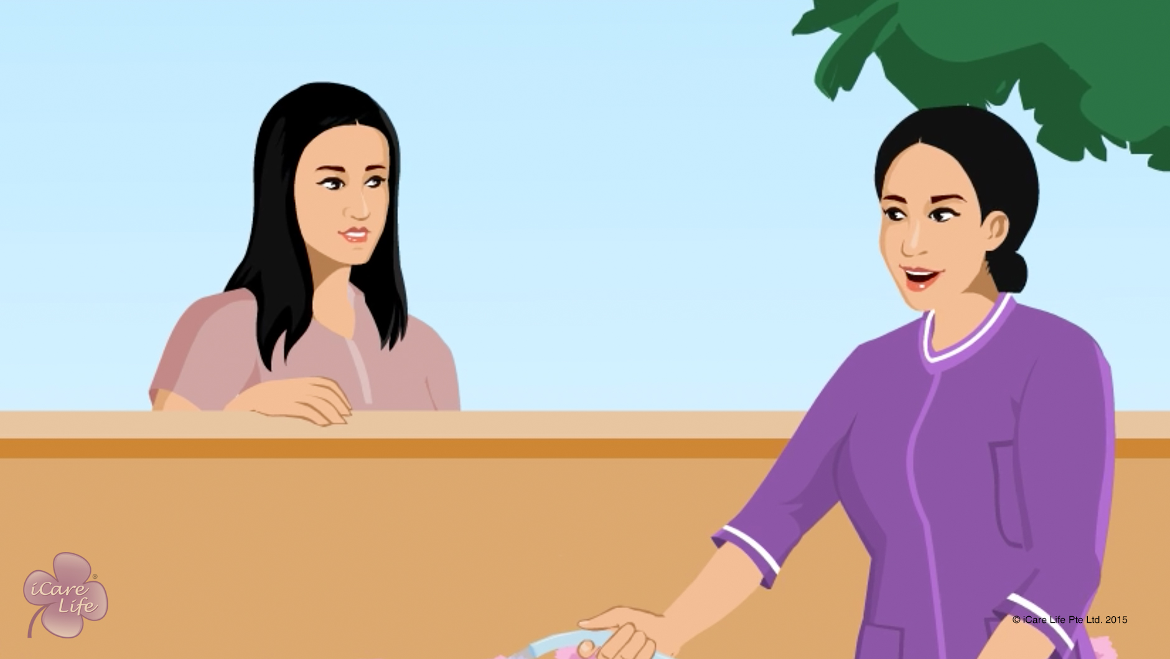
Integrity & Confidentiality
2
Copyright: iCare Life Pte. Ltd., Singapore : This document must not be copied or shared or circulated without the consent of iCare Life and/or its affiliates.

Slide 4
Post-Module Activity
Case Study
Notes:
Divide the class into 4 batches. Distribute following cases amongst the groups by printing each one. Allow 10 minutes to each group to study their case and come up with a relevant solution.
Case 1: Cathy is a caregiver to Jamie, who is 12 year-old boy with cerebral palsy. He lives with his parents. Jamie is sent to his uncle’s house for a day for a family celebration. When he returns in the evening, Cathy notices that he seems nervous and quieter than usual. While helping him get ready for bed, she notices bruises on his arms and legs. After assessing Jamie and talking with him privately, she believes he may have been physically abused. She knows she must make sure Jamie is safe and get him any needed medical assessment and treatment. What should Cathy do?
Model answer: Cathy should immediately speak to Jamie’s parents about this and get Jamie to a hospital. The medical attention should be the foremost thing to

Slide 5
Summary
Make sure your personal documents are in order and information you provide is correct
Do not repeat personal information about the person under your care to anyone else
If someone discusses money matters with you, discreetly change the topic
Do not share details about the person’s problems and illnesses with others
Do not gossip about the person under your care or their family
Do not listen to or become a part of the family conversations
Do not engage in personal entertainment activities during work hours
Avoid taking personal calls during work hours
Do not invite friends or family to your employer’s home
Perform your personal tasks on your off days
Never make excuses or tell lies to cover up for a lapse in your responsibility
Never try to short change your employer by making money from errands
4
Notes:
Make sure your personal documents are in order and information you provide is correct
Do not repeat personal information about the person under your care to anyone else
If someone discusses money matters with you, discreetly change the topic
Do not share details about the person’s problems and illnesses with others
Do not gossip about the person under your care or their family
Do not listen to or become a part of the family conversations
Do not engage in personal entertainment activities during work hours
Avoid taking personal calls during work hours
Do not invite friends or family to your employer’s home
Perform your personal tasks on your off days
Never make excuses or tell lies to cover up for a lapse in your responsibility
Never try to short change your employer by making money from errands

Slide 6
Any Questions?
5
Notes:
Q1. What type of credentials should you present to your employer?
Ans. Some of the documents that would instil confidence in an employer are your educational qualifications, certificates of professional care giving courses you have taken, your experience in caregiving, police verification, social security numbers, your address, recommendations of your previous employer and details of your family.
Q2. What is the best way to earn trust of your employer?
Ans. The best way to earn the trust of the employer is to work hard with professionalism, resourcefulness, and being truthful. One should stay away from the family matters and not meddle in their affairs. One also needs to take care not to bring personal affairs at the place of work.

Slide 7
Issues of the Nervous System in Elders
6
Copyright: iCare Life Pte. Ltd., Singapore : This document must not be copied or shared or circulated without the consent of iCare Life and/or its affiliates.

Slide 8
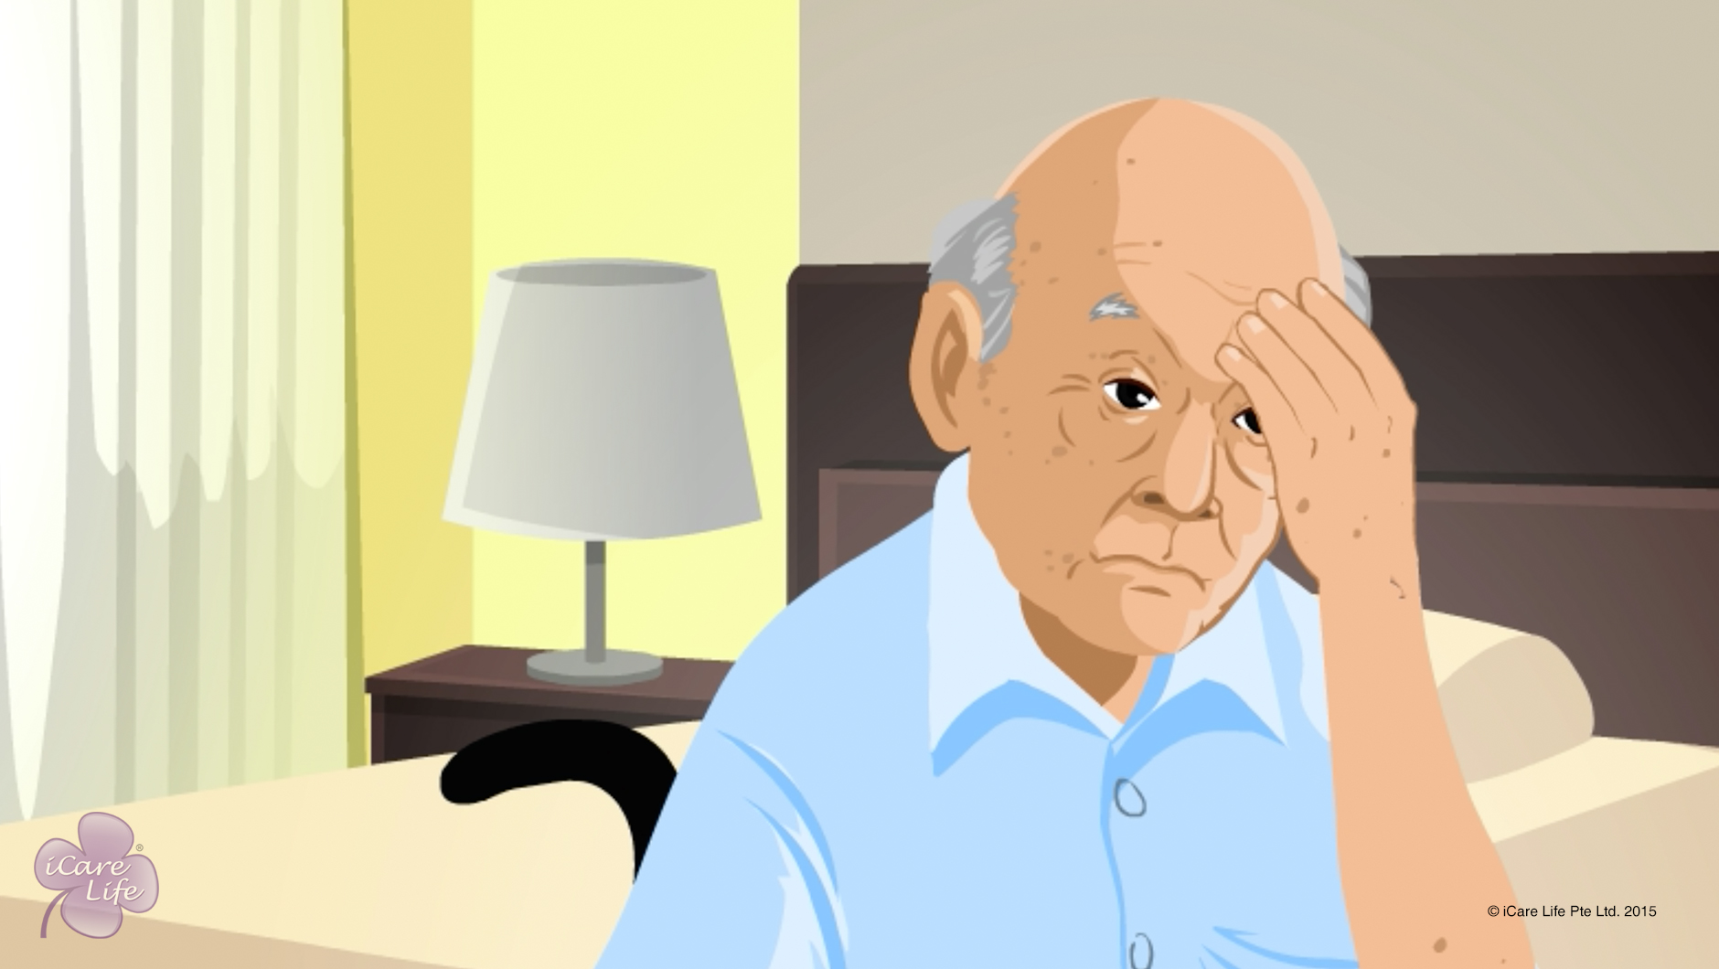
Issues of the Nervous System in Elders
7
Copyright: iCare Life Pte. Ltd., Singapore : This document must not be copied or shared or circulated without the consent of iCare Life and/or its affiliates.

Slide 9
Post-Module Activity
Practical Training
Notes:
Arrange for a visit to a nursing home or an old people’s home where participants can observe elderly patients suffering from various nervous system disorders. Provide opportunity to participants to interact with patients and inquire about their symptoms and the problems they face. At the end of the visit, arrange a short session with a qualified doctor or a trained caregiver to answer the participants’ queries and clarify their doubts.

Slide 10
Summary
Care for dementia or progressive loss of memory involves organizing the elder’s life and not letting the elder go out alone
Care for Parkinson’s disease or progressive loss of movement involves support in nearly all daily life activities
Care for epilepsy or seizures involves ensuring elder’s safety during a seizure and not leaving the person alone for long
When caring for an elder with intention tremor, limit intake of tea, coffee and alcohol and find ways to avoid using the trembling part of the body
Care for peripheral neuropathy or numbness and loss of sensation in hands and feet involves exercising and massaging the affected part, keeping the person away from hot objects and avoiding use of tight gloves, shoes, and stockings
9
Notes:
Care for dementia or progressive loss of memory involves organizing the elder’s life and not letting the elder go out alone
Care for Parkinson’s disease or progressive loss of movement involves support in nearly all daily life activities
Care for epilepsy or seizures involves ensuring elder’s safety during a seizure and not leaving the person alone for long
When caring for an elder with intention tremor, limit intake of tea, coffee and alcohol and find ways to avoid using the trembling part of the body
Care for peripheral neuropathy or numbness and loss of sensation in hands and feet involves exercising and massaging the affected part, keeping the person away from hot objects and avoiding use of tight gloves, shoes, and stockings

Slide 11
Summary
Care for ataxia or loss of muscle coordination involves support in nearly all daily life activities
Care for hemiplegia or paralysis of either left or right side of the body involves providing support whenever required
Care for paraplegia or paralysis of the lower half of the body involves providing bathing and toilet support in bed
You must call a doctor if:
The elder falls, is unable to get up, and complains of pain
The elder has an abnormally long or repeated seizures
The elder does not gain consciousness after a seizure
10
Notes:
Care for ataxia or loss of muscle coordination involves support in nearly all daily life activities
Care for hemiplegia or paralysis of either left or right side of the body involves providing support whenever required
Care for paraplegia or paralysis of the lower half of the body involves providing bathing and toilet support in bed
You must call a doctor if:
The elder falls, is unable to get up, and complains of pain
The elder has an abnormally long or repeated seizures
The elder does not gain consciousness after a seizure

Slide 12
Any Questions?
11
Notes:
Q1. Is it safe to have a person with a nervous system disorder at home?
Ans: Nervous system disorders are of many different types. A person with nervous system disorder is not necessarily mad or a threat to oneself or others. As discussed in this module, common nervous system disorders affect the body movements of a person more than the person’s ability to think. However, nervous system disorders can be emotionally draining for an elder. Therefore, elders with such problems usually suffer from anxiety and depression. Such elders need emotional support, love, and care. Isolation and distance from friends and family can only worsen their condition.

Slide 13
Managing Diabetes
12
Copyright: iCare Life Pte. Ltd., Singapore : This document must not be copied or shared or circulated without the consent of iCare Life and/or its affiliates.

Slide 14
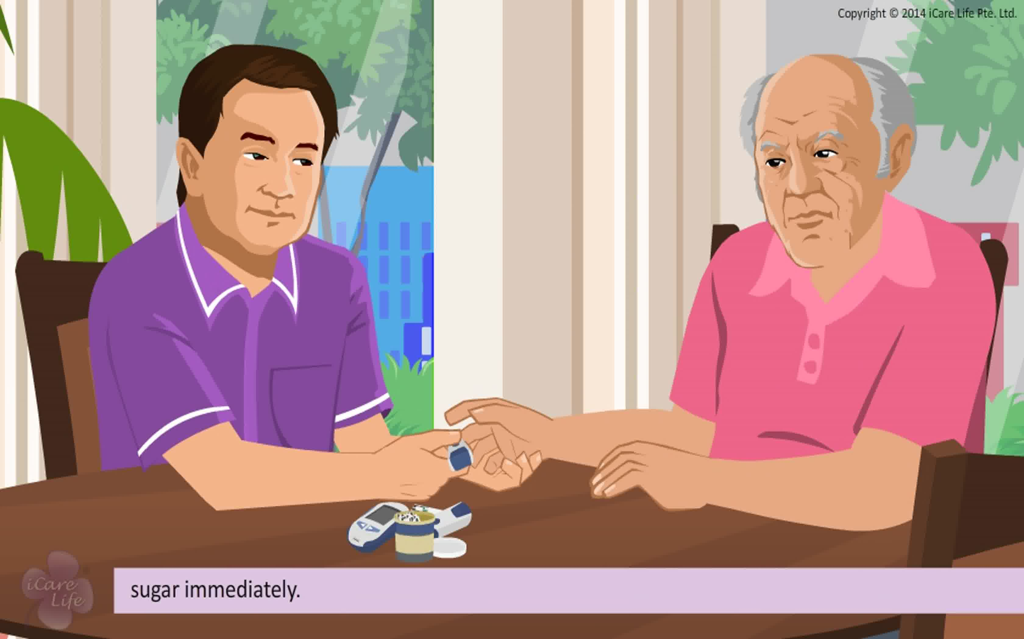
Managing Diabetes
13
Copyright: iCare Life Pte. Ltd., Singapore : This document must not be copied or shared or circulated without the consent of iCare Life and/or its affiliates.

Slide 15
Post-Module Activity
Visit
14
Notes:
Set up an appointment with an old age home or a nursing home where patients with diabetes are being taken care of.
Ask the class participants to speak to the trained caregiver/nurse and ask relevant questions on how to take care of the diabetic patient, what problems are faced and how they are managed. They can also speak to the patients around what difficulties do they face because of diabetes.
Ask the trained caregiver/nurse to demonstrate checking of the blood sugar using a glucose meter. If possible, get participants to practice the procedure on each other.

Slide 16
Summary
Be patient and sympathetic with an elder who has diabetes
Make sure the elder takes their medications on time
Check and record their blood sugar levels as advised by the doctor
Keep a close watch on any symptoms of low blood sugar levels
Check and record their blood pressure as advised by the doctor
Serve them a balanced diet as per the diabetes diet pyramid
Encourage them to exercise regularly and stay active
Take good care of the elder’s feet and examine them regularly for any problems
15
Notes:
Be patient and sympathetic with an elder who has diabetes
Make sure the elder takes their medications on time
Check and record their blood sugar levels as advised by the doctor
Keep a close watch on any symptoms of low blood sugar levels
Check and record their blood pressure as advised by the doctor
Serve them a balanced diet as per the diabetes diet pyramid
Encourage them to exercise regularly and stay active
Take good care of the elder’s feet and examine them regularly for any problems

Slide 17
Any Questions?
16
Notes:
Q1. Why are diabetic people prone to getting foot ulcers?
Ans. People with diabetes may have reduced nerve functioning due to peripheral diabetic neuropathy. This means that nerves that usually carry pain sensation to the brain from the feet do not function as well. Treading on something, wearing tight shoes, cuts, blisters and bruises can all develop into diabetes foot ulcers. Narrowed arteries can also reduce blood flow to the feet reducing chances of quick healing. The caregiver therefore must be extra cautious with diabetic care receivers.

Slide 18
Managing Heart Conditions
17
Copyright: iCare Life Pte. Ltd., Singapore : This document must not be copied or shared or circulated without the consent of iCare Life and/or its affiliates.

Slide 19
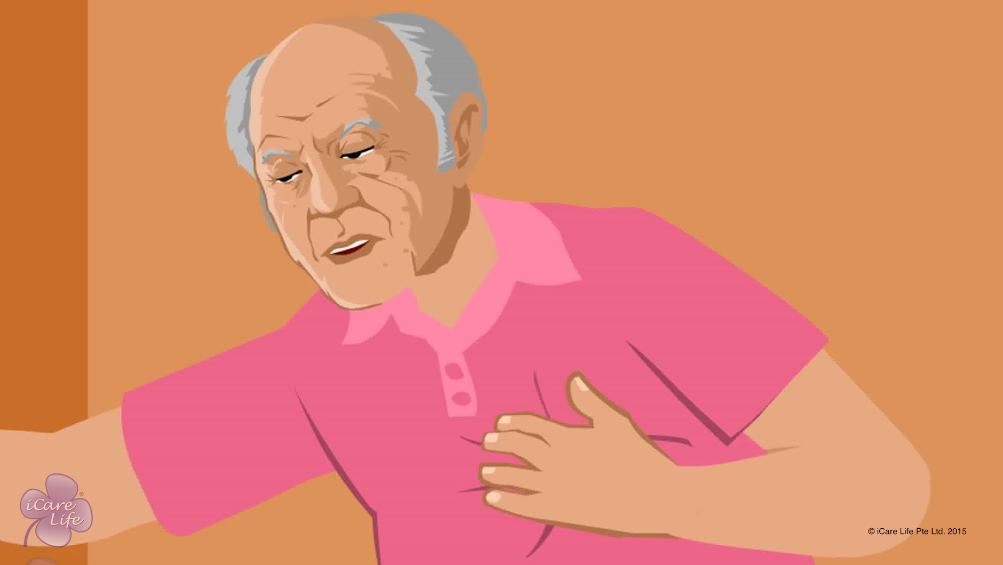
Managing Heart Conditions
18
Copyright: iCare Life Pte. Ltd., Singapore : This document must not be copied or shared or circulated without the consent of iCare Life and/or its affiliates.

Slide 20
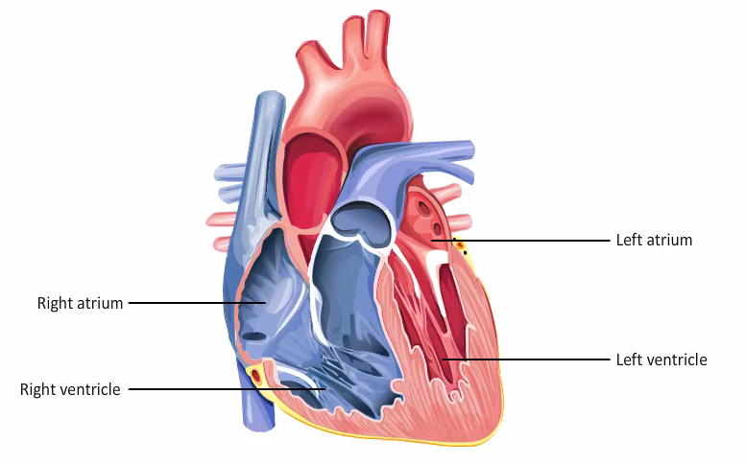
Post-Module Activity
How does the Heart Work?
Notes:
You will require an appointment with a medical professional and a model of the human heart. The model’s parts should be such that they can be dismantled.
Ask the professional to explain various parts of the heart to the class and how the heart functions. Also ask the professional to explain various heart conditions, such as a heart attack, as well as procedures such as a bypass surgery and angioplasty.
Ask the class participants to take notes of the discussion.

Slide 21
Summary
For an elder with hypertension:
Make sure the elder takes their medicines on time
Test and record their blood pressure levels
Help the person make the advised changes to their diet
Ensure that the elder is involved in some form of exercise on most days of the week
If the elder under your care has symptoms such as chest discomfort, dizziness, fatigue, nausea, anxiety, breathlessness, persistent cough, or sweating, they may be having a heart problem. Inform the elder’s family and doctor immediately
20
Copyright: iCare Life Pte. Ltd., Singapore : This document must not be copied or shared or circulated without the consent of iCare Life and/or its affiliates.
Notes:
For an elder with hypertension:
Make sure the elder takes their medicines on time
Test and record their blood pressure levels
Help the person make the advised changes to their diet
Ensure that the elder is involved in some form of exercise on most days of the week
If the elder under your care has symptoms such as chest discomfort, dizziness, fatigue, nausea, anxiety, breathlessness, persistent cough, or sweating, they may be having a heart problem. Inform the elder’s family and doctor immediately

Slide 22
Summary
For an elder who has suffered a heart attack or undergone a surgery:
Be patient and sympathetic
Ensure that they take their medicines on time
Assist them with their routine activities and gradually, encourage them to become more independent
Help the person make recommended changes to their diet
After checking with the family and the doctor, encourage the elder to exercise regularly
21
Copyright: iCare Life Pte. Ltd., Singapore : This document must not be copied or shared or circulated without the consent of iCare Life and/or its affiliates.

Slide 23
Summary
If the elder has undergone a surgery:
Keep the wound completely clean
Watch the site for any signs of infection and pus discharge
Inform the family and the doctor if you notice any signs of infection
If the elder has a pacemaker implant:
Remind the elder’s family to take the phone numbers of the pacemaker technician and the elder’s cardiologist
Make sure the elder does not go near any magnetic fields
If the elder dies, ask the family to consider getting the pacemaker removed by a doctor before the final rights of the elder are performed
22
Copyright: iCare Life Pte. Ltd., Singapore : This document must not be copied or shared or circulated without the consent of iCare Life and/or its affiliates.

Slide 24
Any Questions?
23
Notes:
Q1. What are the usual symptoms of a heart attack?
Ans. Usual symptoms of a heart attack are:
(a) Chest pain or discomfort in the center of the chest; also described as a heaviness, tightness, pressure, aching, burning, numbness, fullness, or squeezing feeling that lasts for more than a few minutes or goes away and comes back. It is sometimes mistakenly thought to be indigestion or heartburn.
(b) Pain or discomfort in other areas of the upper body including the arms, left shoulder, back, neck, jaw, or stomach
(c) Difficulty in breathing or shortness of breath
(d) Sweating or “cold sweat”
(e) Fullness, indigestion, or choking feeling (may feel like “heartburn”)
(f) Nausea or vomiting
(g) Light-headedness, dizziness, extreme weakness or anxiety
(h) Rapid or irregular heart beats
Women’s symptoms sometimes may sometimes differ and may include:
(a) Upper back or shoulder pain
(b) Jaw pain or pain spreading to the jaw
(c) Pressure or pain in the center of the chest
(d) Light headedness
(e) Pain that spreads to the arm
(f) Unusual fatigue for several days

Slide 25
Respiratory Issues in the Elder
24
Copyright: iCare Life Pte. Ltd., Singapore : This document must not be copied or shared or circulated without the consent of iCare Life and/or its affiliates.

Slide 26
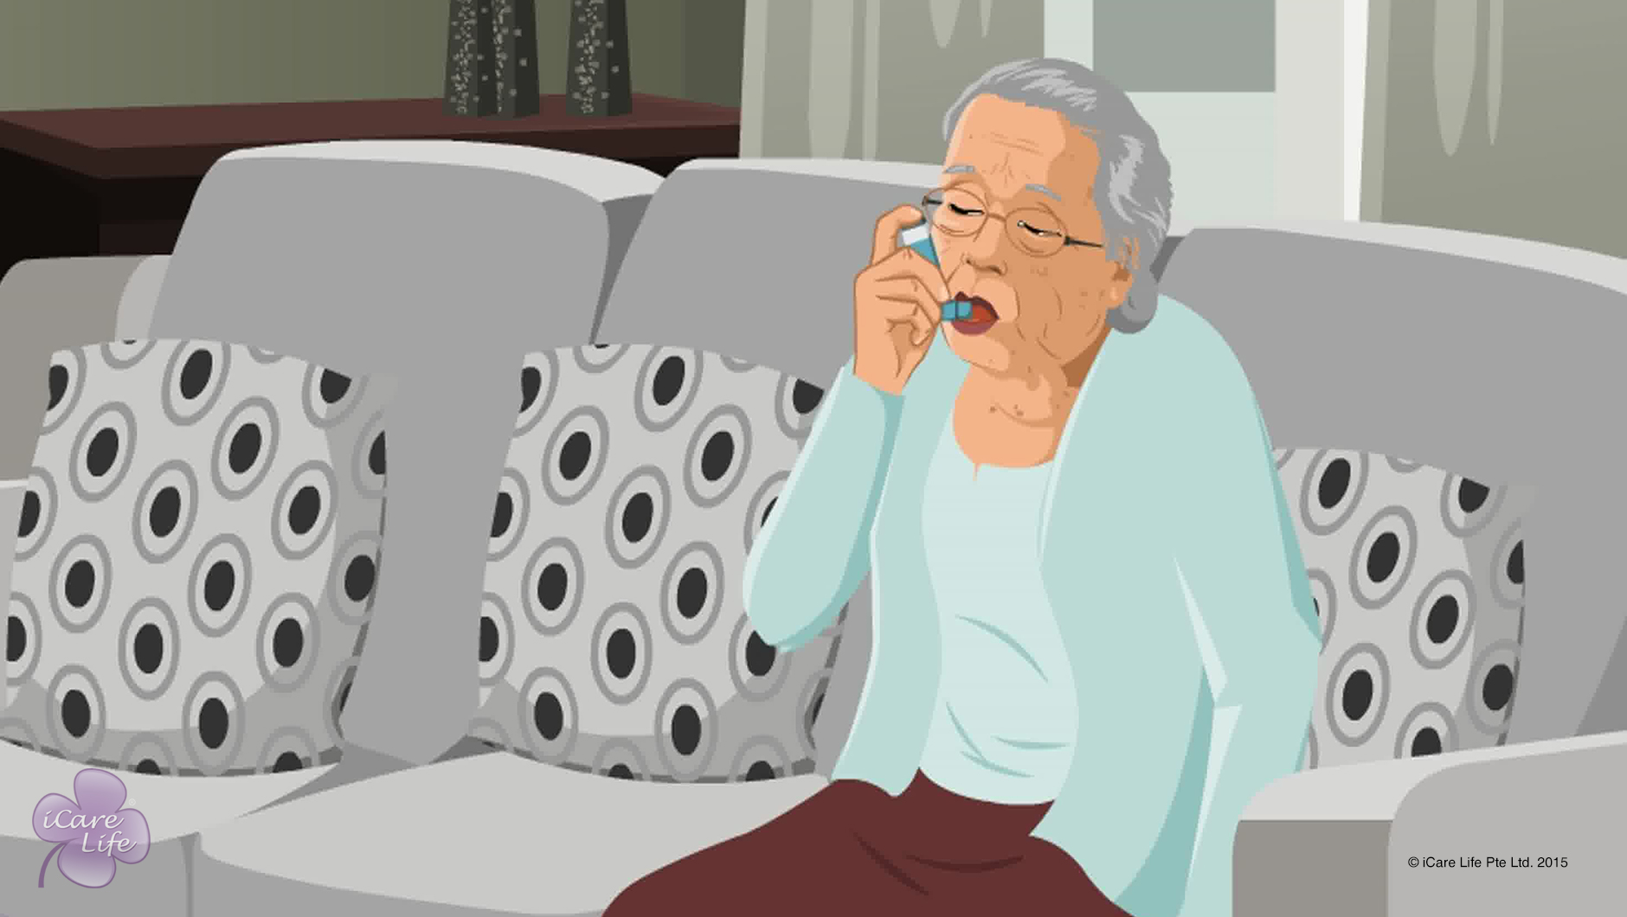
Respiratory Issues in the Elder
25
Copyright: iCare Life Pte. Ltd., Singapore : This document must not be copied or shared or circulated without the consent of iCare Life and/or its affiliates.

Slide 27


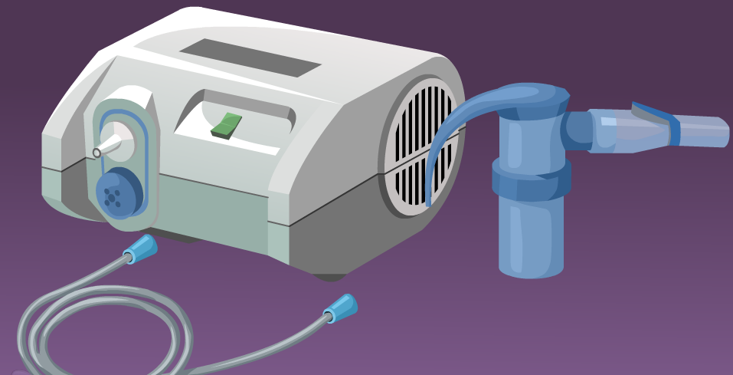
Post-Module Activity
Demonstration
Notes:
You will have to set an appointment with a medical professional who is an expert in the use of an asthma inhaler, a spacer, and a nebulizer.
You will also have to arrange for an asthma inhaler, a spacer, and a nebulizer.
Ask the medical professional to demonstrate as to how these are used. Volunteers from the class may also try using these.
MAKE SURE THAT THE CANISTER IS EMPTY AND HAS NO MEDICINE IN IT.

Slide 28
Summary
Recognize the most common symptoms of respiratory diseases
Give the elder vitamin supplements and food rich in Vitamin C to prevent a cold
Keep the elder away from people who may infect them with a cold
If you have a cold, wear a barrier mask and gloves when in contact of the elder
Clean the contact surfaces if someone in the house has a cold
Wash the elder’s dishes separately to prevent a cold
If you know what allergies an elder has, keep them away from the source of the allergy
If the elder displays an allergic reaction, give the elder an anti-allergy pill, as prescribed by the doctor
Give decongestant pills, as prescribed by the doctor, to elders suffering from cold, allergy or sinusitis
27
Copyright: iCare Life Pte. Ltd., Singapore : This document must not be copied or shared or circulated without the consent of iCare Life and/or its affiliates.
Notes:
Recognize the most common symptoms of respiratory diseases
Give the elder vitamin supplements and food rich in Vitamin C to prevent a cold
Keep the elder away from people who may infect them with a cold
If you have a cold, wear a barrier mask and gloves when in contact of the elder
Clean the contact surfaces if someone in the house has a cold
Wash the elder’s dishes separately to prevent a cold
If you know what allergies an elder has, keep them away from the source of the allergy
If the elder displays an allergic reaction, give the elder an anti-allergy pill, as prescribed by the doctor
Give decongestant pills, as prescribed by the doctor, to elders suffering from cold, allergy or sinusitis

Slide 29
Summary
Give nasal spray or drops followed by steam inhalation to the elder for decongestion
Get the elder with a sore throat to gargle
Help an elder who has laryngitis to take steam inhalation and gargle
Give steam inhalation and encourage deep breathing exercises for an elder with bronchitis
Give an elder with pneumonia plenty of fluids, rest, and follow the medication schedule as per the doctors’ orders
Prevent asthma by keeping the elder with known allergies away from exposure to the allergens
Help an elder suffering from chronic asthma or other respiratory diseases with using an inhaler, spacer, or nebulizer, as advised by the doctor
28
Copyright: iCare Life Pte. Ltd., Singapore : This document must not be copied or shared or circulated without the consent of iCare Life and/or its affiliates.
Notes:
Give nasal spray or drops followed by steam inhalation to the elder for decongestion
Get the elder with a sore throat to gargle
Help an elder who has laryngitis to take steam inhalation and gargle
Give steam inhalation and encourage deep breathing exercises for an elder with bronchitis
Give an elder with pneumonia plenty of fluids, rest, and follow the medication schedule as per the doctors’ orders
Prevent asthma by keeping the elder with known allergies away from exposure to the allergens
Help an elder suffering from chronic asthma or other respiratory diseases with using an inhaler, spacer, or nebulizer, as advised by the doctor

Slide 30
Any Questions?
29
Notes:
Q1. Are there more than one type of asthma inhalers?
Ans. Yes, there are. But use only that inhaler which the doctor has prescribed for the elder after assessing their asthma condition.
Q2. What should be kept in mind while wearing a face mask?
Ans. You should keep the following points in mind regarding wearing a face mask:
Wear a face mask when coming within six feet of a sick person.
Position the strings to keep the mask firmly in place over the nose, mouth, and chin. Try not to touch the mask again until you remove it.
Wear a facemask before going near other people if you have the flu.
If you have the flu and need to see the doctor, wear a facemask to protect others in the waiting room.
Consider wearing a mask in crowded settings if the flu is widespread in your locality or if you are at high risk for flu complications.
When you're done wearing the mask, throw it away and wash your hands. Do not reuse a facemask.
Wash your hands often.

Slide 31
Changing Adult Diapers
30
Copyright: iCare Life Pte. Ltd., Singapore : This document must not be copied or shared or circulated without the consent of iCare Life and/or its affiliates.

Slide 32
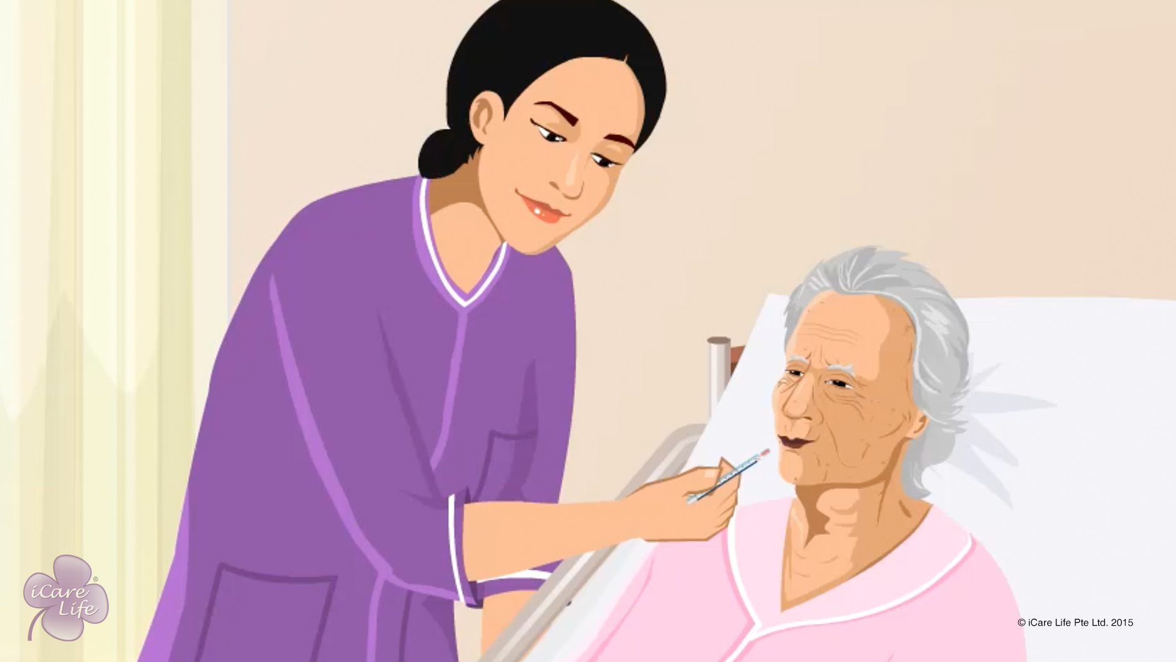
Helping the Elder & Family deal with Terminal Illness
31
Copyright: iCare Life Pte. Ltd., Singapore : This document must not be copied or shared or circulated without the consent of iCare Life and/or its affiliates.

Slide 33
Post-Module Activity
Classroom Discussion
32
Copyright: iCare Life Pte. Ltd., Singapore : This document must not be copied or shared or circulated without the consent of iCare Life and/or its affiliates.
Notes:
Discuss the following topics with the class. Ask them to avoid using personal experiences.
What is a terminal illness?
Any examples that they know of such illnesses
How do you think the elder would react if they knew that they are suffering from a terminal illness?
How will the family react?
What can be done to minimize the emotional distress in the elder?
Model answers:
A terminal illness is a disease that will result in the death of the patient regardless of any treatment intervention. A patient who has such an illness may be referred to as a terminal patient, terminally ill or simply terminal.
Advanced stages of cancer, tuberculosis, fevers like malaria or typhoid etc.
They may get depressed or angry. They may be worried and irritable all the time. They may become very quiet and aloof after some days of knowing. They may start bargaining with God to save their life.
Family members generally show sadness. They may also start bargaining with God. They are extra careful to be happy around the terminally ill elder.
Be cheerful around the elder. Encourage them to invest time in hobbies if their health allows. Fulfill small wishes of the elders. Encourage them to spend more time with the family.

Slide 34
Summary
Never bring up the topic of death yourself
Let the elder’s family members deal with issues regarding death
Consult the elder’s family on what to do if the elder wants to discuss their condition
Help the elder reach the stage of acceptance
Help the elder spend their last days with a positive outlook
Help them celebrate their life and count their blessings
Encourage them to do whatever brings them peace
33
Notes:
Never bring up the topic of death yourself
Let the elder’s family members deal with issues regarding death
Consult the elder’s family on what to do if the elder wants to discuss their condition
Help the elder reach the stage of acceptance
Help the elder spend their last days with a positive outlook
Help them celebrate their life and count their blessings
Encourage them to do whatever brings them peace

Slide 35
Any Questions?
34
Notes:
Q1. What are the common symptoms of an elderly going away?
Ans. Some of the symptoms are as follows: -
(a) Drowsiness
(b) Becoming unresponsive
(c) Confusion about time, place, and identity of loved ones
(d) Loss of appetite, decreased need for food and fluids
(e) Loss of bladder or bowel control
(f) Skin becoming cool to touch
(g) Irregular, shallow, or noisy breathing
Q2. How can you provide emotional support to an elder who knows about their terminal illness?
Ans. Some of the positive actions that you could take are: -
(a) Spend time with them
(b) Do not share your feelings of fear, sadness, and loss
(c) Allow the patient to express fears of death
(d) Allow them to reminisce
(e) Avoid withholding difficult information
(f) Honor their wishes
(g) Respect the person’s need for privacy

Slide 36


