Slide 1

Different Types of Beds and Bed Making
CR 2.2

Slide 2
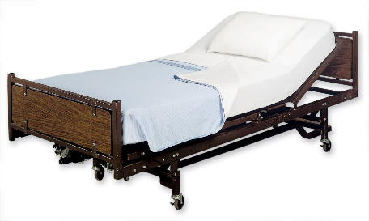
Introduction
Learning outcomes
The Caregivers will learn:
1. Providing a comfortable and wrinkle free bed
2. To make different kinds of beds as per the needs of the patient
1
Copyright: iCare Life Pte. Ltd., Singapore : This document must not be copied or shared or circulated without the consent of iCare Life and/or its affiliates.

Slide 3
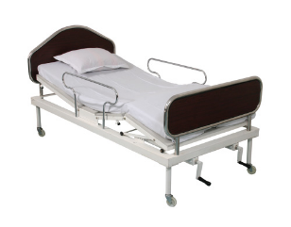
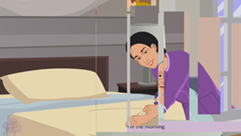
Introduction
As comfort, safety, rest and sleep are all important in healthcare for promoting wellness and recovery from disease, special care should be taken to provide comfortable beds to patients.
Making a comfortable bed is the responsibility of the caregiver
Care recipient should be provided clean, dry, wrinkle-free and comfortable bed
2
Copyright: iCare Life Pte. Ltd., Singapore : This document must not be copied or shared or circulated without the consent of iCare Life and/or its affiliates.

Slide 4
Purposes
To provide a clean and comfortable bed
To give a neat and tidy appearance
To prevent bed sores
To keep it ready for any emergency
To receive the patient comfortably
To provide active or passive exercise to the care receiver
To economise the time, material and energy
3
Copyright: iCare Life Pte. Ltd., Singapore : This document must not be copied or shared or circulated without the consent of iCare Life and/or its affiliates.

Slide 5
General Rules in Bed Making (1/2)
Keep all materials conveniently arranged to get them in the order of use
Wash hands before & after the procedure
Do not expose the patient unnecessary
Protect the patient from draught
Do not cover the patient’s face while placing the linen
Do not mix clean linen with soiled linen
Never place the woollen blanket directly on the patient’s body
Never allow the mackintosh to touch the patient
4
Copyright: iCare Life Pte. Ltd., Singapore : This document must not be copied or shared or circulated without the consent of iCare Life and/or its affiliates.

Slide 6
General Rules in Bed Making (2/2)
Fold dirty linen away from your uniform and body
Avoid placing dirty linen on the floor
Start work from head to foot, near to far & from clean to unclean area
Make the bed smooth, unwrinkled and firm
Avoid using torn linen
Periodical sunning and airing of mattress to be done
Maintain body mechanics
Keep reasonable distance from the face of the patient to prevent cross infection
5
Copyright: iCare Life Pte. Ltd., Singapore : This document must not be copied or shared or circulated without the consent of iCare Life and/or its affiliates.

Slide 7
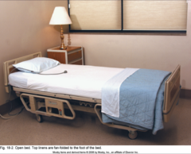
Different Types of Beds (1/3)
Generally there are three different types of bed :
Open Bed
Closed Bed
Occupied Bed
Open Bed: made when it is about to be occupied by either a new patient or an ambulatory patient
6
Copyright: iCare Life Pte. Ltd., Singapore : This document must not be copied or shared or circulated without the consent of iCare Life and/or its affiliates.
Notes:
Additional Information: The leaners may be told about other different types of specialized beds that are required for patient in special situation.

Slide 8
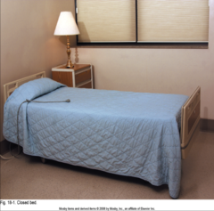
Different Types of Beds (2/3)
Closed Bed: It is an un-occupied or empty bed made to receive the patient, and is fully covered with counterpane to protect it from dust and dirt. On admission of the patient , the closed bed is covered in to an open bed.
Purpose:
To keep the bed ready for occupancy
To provide a neat and tidy appearance
7
Copyright: iCare Life Pte. Ltd., Singapore : This document must not be copied or shared or circulated without the consent of iCare Life and/or its affiliates.

Slide 9
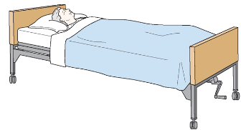
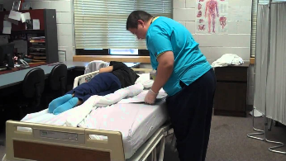
Different Types of Beds (3/3)
Occupied Bed: This bed is made with the patient lying on the bed.
Purpose:
To make a bed with least possible discomfort to the patient
To handle the bed clothes skilfully while the patient is on bed, with minimum disruption or disturbance
To provide a neat, clean and tidy appearance
8
Copyright: iCare Life Pte. Ltd., Singapore : This document must not be copied or shared or circulated without the consent of iCare Life and/or its affiliates.

Slide 10

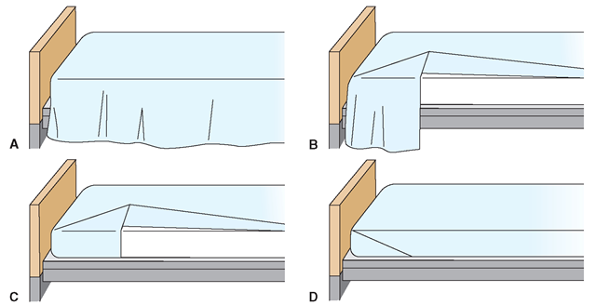
Bed-making Steps
Bed Making Steps
9
Copyright: iCare Life Pte. Ltd., Singapore : This document must not be copied or shared or circulated without the consent of iCare Life and/or its affiliates.

Slide 11
Viewing of Modules
CR 2.2
Private and Confidential

Slide 12
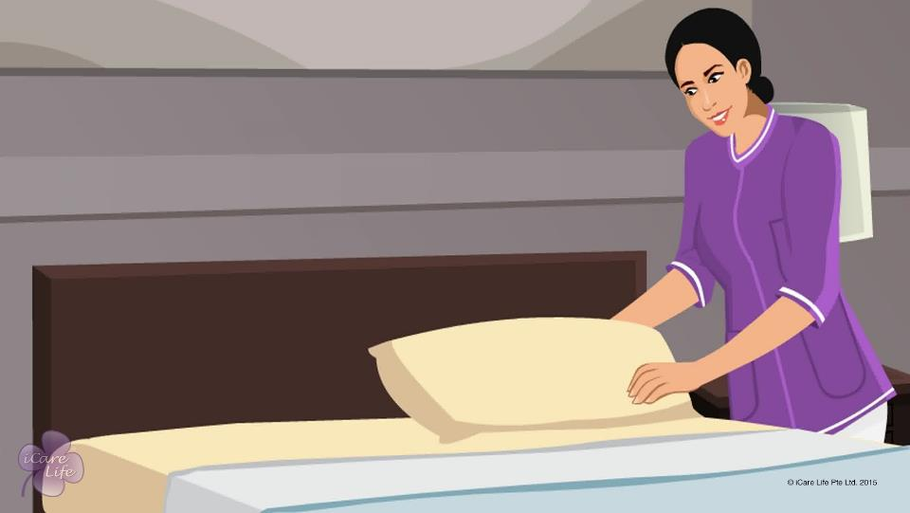
Making the Bed
1
Copyright: iCare Life Pte. Ltd., Singapore : This document must not be copied or shared or circulated without the consent of iCare Life and/or its affiliates.

Slide 13
In this module, you will learn about:
The items required to make a bed
How to make the bed of an independent and semi-dependent elder
How to make the bed of a bedridden elder
2
Copyright: iCare Life Pte. Ltd., Singapore : This document must not be copied or shared or circulated without the consent of iCare Life and/or its affiliates.

Slide 14

Let’s Watch
Making the Bed of the Elder
3
Copyright: iCare Life Pte. Ltd., Singapore : This document must not be copied or shared or circulated without the consent of iCare Life and/or its affiliates.

Slide 15
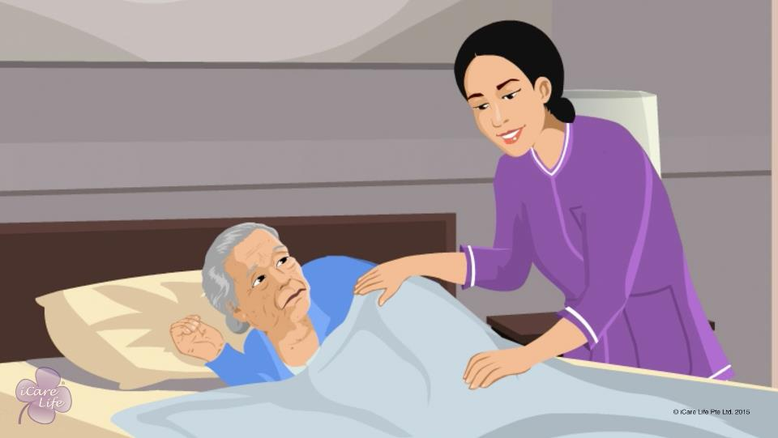
Wake Up and Evening Tuck In
4
Copyright: iCare Life Pte. Ltd., Singapore : This document must not be copied or shared or circulated without the consent of iCare Life and/or its affiliates.

Slide 16
In this module, you will learn about:
The activities involved in waking up an elder in the morning
The activities involved in putting an elder to bed at night
5
Copyright: iCare Life Pte. Ltd., Singapore : This document must not be copied or shared or circulated without the consent of iCare Life and/or its affiliates.

Slide 17
Let’s Watch
Assisting the Elder with Morning Wake Up and Evening Tuck In
6
Copyright: iCare Life Pte. Ltd., Singapore : This document must not be copied or shared or circulated without the consent of iCare Life and/or its affiliates.

Slide 18


