Slide 1

Duties and Responsibilities
3
CR 2.3
Standard
Source: Skills for Health – Website http://www.skillsforhealth.org.uk/
Skills for Care – Website http://www.skillsforcare.org.uk/

Slide 2
Learning outcomes
1. Understand how duty of care contributes to safe practice
2. Understand the support available for addressing dilemmas that may arise about duty of care
3.Deal with comments and complaints
4. Deal with incidents, errors and near misses
5. Deal with confrontation and difficult situations.
Source: Skills for Health – Website http://www.skillsforhealth.org.uk/
Skills for Care – Website http://www.skillsforcare.org.uk/
Copyright: iCare Life Pte. Ltd., Singapore
1

Slide 3

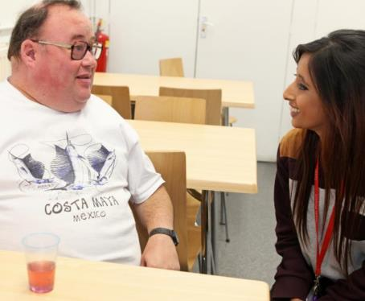

What is your duty of care?
You have a duty of care to all those receiving care and support in your workplace
A Duty of Care is the duty to promote wellbeing and make sure that people are kept safe from harm, abuse and injury
Wellbeing: Wellbeing could be defined as the positive way in which a person feels and thinks of themselves.
Source: Skills for Health – Website http://www.skillsforhealth.org.uk/
Skills for Care – Website http://www.skillsforcare.org.uk/
Copyright: iCare Life Pte. Ltd., Singapore
2
Notes:
Question: What do we mean by a “Duty of Care”?
Answers could include:
Promoting rights
Promoting wellbeing
Safeguarding/keeping safe the care receiver from harm, abuse and injury
Additional information
A Duty of Care is a legal requirement; workers cannot choose whether to accept it or not (Breaking this duty, for example through negligence, could result in legal action in many countries)
Workers have a duty to the people they provide support to and the people that they work with
The Duty of Care will usually be included in the worker’s job description in a medical eshtablishment

Slide 4

What do I need to do?
Workers must have the knowledge and skills to act on their duty of care, and must be able to:
Identify areas of concern
Report concerns in agreed ways
Your manager will be able to advise you of what to do if you are unsure
Source: Skills for Health – Website http://www.skillsforhealth.org.uk/
Skills for Care – Website http://www.skillsforcare.org.uk/
Copyright: iCare Life Pte. Ltd., Singapore
3
Notes:
Additional information
Examples of things which could cause concern include:
Poor working conditions
Unsafe equipment
Unsafe working practices
Suspected abuse

Slide 5

Supporting independence
Workers must:
Respect and protect individuals’ rights
Promote individuals’ independence
Enable the person to make an informed choice
Source: Skills for Health – Website http://www.skillsforhealth.org.uk/
Skills for Care – Website http://www.skillsforcare.org.uk/
Copyright: iCare Life Pte. Ltd., Singapore
4
Notes:
Additional information
Individuals have the right to be treated fairly, with dignity and to have some control of their lives
Workers must always work in ways that protect the legal rights of the individuals that they support
Individuals must be supported to live their lives as independently as possible, making informed decisions and being involved in decisions about their care
Workers should only act within their roles- if they are in any doubt about a situation they should speak to engager, the family or manager

Slide 6
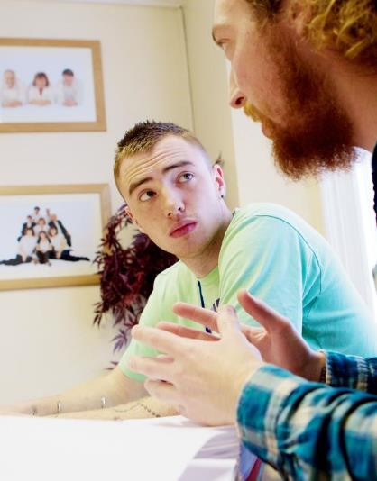
Dilemmas
There may be a conflict between protecting a person’s rights and independence and their safety and wellbeing, and this can lead to dilemmas
It may be necessary to balance:
Their right to make choices
The need to protect individuals from harm
Source: Skills for Health – Website http://www.skillsforhealth.org.uk/
Skills for Care – Website http://www.skillsforcare.org.uk/
Copyright: iCare Life Pte. Ltd., Singapore
5
Notes:
Discussion: Pick a scenario that is appropriate to the workplace (use one from the list or pick your own)
A person with a disability wants to take part in a new physical activity
A person chooses to eat a fatty and unhealthy diet
A person chooses not to take their medication
A person with dementia wants to go out alone
Question: What should you do if an individual you are supporting makes a decision that is unwise?
Suggested answers include (will depend on the scenario chosen):
Giving the person as much information about the decision as possible
Supporting the person to make an informed decision
Assessing the risks of each decision
Enabling the individual to make decisions that are risky by taking action to reduce the risks
Suggesting the individual discusses the decision with trusted people such as: friends, family, and advocate, their Doctor or their social worker
Recording the decisions on the individual’s care plan to make others aware
The worker discussing the matters of concern with their manager

Slide 7
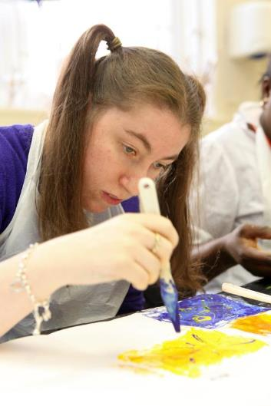
Mental capacity
Some individuals may not have the ability to:
Understand their choices
Make an informed decision
Understand what could happen
If decisions have to be made for an individual who lacks capacity, the decision made must be in their best interests
Source: Skills for Health – Website http://www.skillsforhealth.org.uk/
Skills for Care – Website http://www.skillsforcare.org.uk/
Copyright: iCare Life Pte. Ltd., Singapore
6
Notes:
Additional information
The individuals can make decisions unless they are unable to do one or more of the following;
• Understand information given to them
• Retain information for long enough to be able to make the decision
• Weigh up the information available to make the decision
• Communicate their decision- individuals must be supported to communicate through all possible means
A lack of capacity may not be permanent:
Infections can worsen symptoms of dementia meaning that they are temporarily unable to retain information for long enough to make and informed decision. When the infection clears they may be able to make a decision
A person in a coma will be unable to communicate any decisions they make - when they wake from the coma they may have the capacity to make decisions
An individual who is unable to make one decision may be able to make other decisions
The individual may be unable to make complex decisions about finances or medical treatment but may be able to make day to day decisions about what to wear or what to eat

Slide 8

Comments and complaints
The Duty of Care includes a duty to support individuals to make comments or complaints about their care
Guidance relating to comments and complaints may include:
Any Regulation or Law
Your employer’s agreed ways of working
Agreed way of working with the family
Source: Skills for Health – Website http://www.skillsforhealth.org.uk/
Skills for Care – Website http://www.skillsforcare.org.uk/
Copyright: iCare Life Pte. Ltd., Singapore
7
Notes:
Agreed ways of working sets out the ways in which you should deal with comments and complaints. This will be specific to the workplace and is likely to include the forms or paperwork that should be used to record comments and complaints and the person who is identified to deal with them.

Slide 9
Incidents, errors and near misses
Mistakes must be dealt with appropriately so that similar things do not happen again.
Mistakes can be:
Adverse events
Errors
Near misses
Action or lack of action that leads to unexpected, unintended and preventable harm
Not doing something as it should have been done, for example through bad planning or being forgetful
Situations where an
action could have harmed the individual but, either by chance or purpose, was prevented
Incidents
Specific negative events. In health and social care serious incidents are described as events which need investigation as they caused severe harm or damage to either the person receiving care or the organisation.
Source: Skills for Health – Website http://www.skillsforhealth.org.uk/
Skills for Care – Website http://www.skillsforcare.org.uk/
Copyright: iCare Life Pte. Ltd., Singapore
8
Notes:
Additional information
Mistakes can happen because of:
Lack of worker knowledge or understanding
Poor communication between workers
Not sharing information
Stress
Negligence
Being distracted
After an incident:
The first priority must be the meet the immediate needs of the individuals involved
An incident form should be completed giving the facts of what happened including date, time, who was involved and where the incident happened
Reports and incident forms SHOULD NOT include your opinions and should not blame anyone.

Slide 10
Legislation
When incidents happen, legislation sets out how to handle incidents in a particular country is relevant, that may include:
Health and Safety Regulations
Reporting of Injuries, Diseases and Dangerous Occurrences Regulations
Control of Substances Hazardous
Provisions and Use of Work Equipment Regulations
Note: There are many such regulations, that may exist in any country. Some examples may be given and explained.
Source: Skills for Health – Website http://www.skillsforhealth.org.uk/
Skills for Care – Website http://www.skillsforcare.org.uk/
Copyright: iCare Life Pte. Ltd., Singapore
9
Notes:
The Reporting of Injuries, Diseases and Dangerous Occurrences: This places duties on responsible persons in the workplace to report specific workplace accidents, occupational diseases and specific dangerous occurrences or near misses to the concerned authority including but not limited to your employer, the family or manager.
Anyone responsible for work equipment should ensure that it is suitable for the job, well maintained, inspected regularly and only operated by well-informed and trained staff.

Slide 11
Conflict in the workplace
Conflict or challenging behaviour often happens as a result of distress or because the individual’s needs are not being met.
Reasons could be:
Biological
Environmental
Psychosocial
Psychological
Source: Skills for Health – Website http://www.skillsforhealth.org.uk/
Skills for Care – Website http://www.skillsforcare.org.uk/
Copyright: iCare Life Pte. Ltd., Singapore
10
Notes:
Question: Statistics show that workers in health and social care have higher than average risk of experiencing threats or violence in the workplace.
Possible Answers (answers will depend on the specific workplace)
Health and social care workers work directly with people who may be:
Under stress
In pain
Feeling unwell
Experiencing side effects from medication or substance misuse
Having to wait for medical attention
Feeling frustrated because they are not in control of their lives or of a situation
Feeling frustrated because they are unable to communicate their needs
Feeling frustrated because they cannot move around freely
Feeling isolated or unable to take part in activities
Feeling lonely
Possible reasons for conflict can be classified as:
Biological for example because an individual is in pain or suffering the side effects of medication or substance misuse
Social for example because of being bored, wanting social contact, having a need to be in control, not being able to communicate or understand what is being said
Environmental for example because of loud noise or bad lighting or barriers in the room to mobility
Psychological for example because of feeling left out

Slide 12

Managing conflict
Acting on early signs of frustration and aggression can stop conflict developing into violence, and if possible and safe:
Take them to a quiet place
Ask questions and listen carefully
Take their feelings seriously
Try to agree a way forward
Always treat the individual with respect and dignity
Source: Skills for Health – Website http://www.skillsforhealth.org.uk/
Skills for Care – Website http://www.skillsforcare.org.uk/
Copyright: iCare Life Pte. Ltd., Singapore
11
Notes:
Additional information: Workplaces often have a policy that will set out how to deal with challenging behaviour.
Factual information about the incident will usually be recorded on a form. This is intended to be a factual account of the incident and SHOULD NOT include opinions or blame.
Details recorded will usually include:
The date and time of the incident
Where the incident happened
What happened
Who was involved
Whether anyone was injured
Whether medical assistance was required
Whether the police were called

Slide 13







Knowledge check
A meal that has peanuts in it is served to an individual with a known peanut allergy. The mistake is spotted and swapped. What type of mistake is this?
Click to reveal answer
Adverse event
Near miss
Error
Incident
Source: Skills for Health – Website http://www.skillsforhealth.org.uk/
Skills for Care – Website http://www.skillsforcare.org.uk/
Copyright: iCare Life Pte. Ltd., Singapore
12
Notes:
QUESTION: Ask group question then to answer A,B,C or D
Trainer should ask class why they chose the correct answer

Slide 14


Knowledge check
Which of the following most accurately defines what is meant by ‘Duty of Care’?
Restricting the rights of the individual to make sure that they are safe.
Click to reveal answer
The duty to put people into care when their family is not able to take care of them.
The duty to promote wellbeing and keep people safe from harm, abuse and injury.
Stopping people making decisions that you disagree with or that may be risky.
Source: Skills for Health – Website http://www.skillsforhealth.org.uk/
Skills for Care – Website http://www.skillsforcare.org.uk/
Copyright: iCare Life Pte. Ltd., Singapore
13
Notes:
QUESTION: Ask group question then to answer A,B,C or D
Trainer should ask class why they chose the correct answer
Feedback
A – The rights of individuals must always be respected when care is being provided
B – People must be supported to maintain their independence for as long as possible
C – A duty of care is the duty to promote wellbeing and to keep people safe from harm, abuse and injury
D – People who have the capacity to make decisions can choose to make risky decisions or choices that you think are unwise

Slide 15





Knowledge check
Which of the following statements about recording an incident is true?
Click to reveal answer
You should record factual information and not include opinions or allocate blame
You should record what you think happened as well as the date and location
To maintain confidentiality you should not include the names of people involved
You only need to record an incident if the emergency services were called
Source: Skills for Health – Website http://www.skillsforhealth.org.uk/
Skills for Care – Website http://www.skillsforcare.org.uk/
Copyright: iCare Life Pte. Ltd., Singapore
14
Notes:
QUESTION: Ask group question then to answer A,B,C or D
Trainer should ask class why they chose the correct answer
Feedback
A – When recording an incident the details recorded must be factual. Details should include the time and date of the incident, where it happened, what happened and who was involved. Opinions should not be included in a report.
B – What you think happened is not a fact and should not be included in a report.
C – It is important to record who was involved in an incident as they may need to be asked what happened if the incident is investigated. Records should be stored securely to ensure that access to confidential records is restricted.
D – All incidents should be recorded so that lessons can be learnt, similar incidents can be avoided and harm to individuals can be prevented.

Slide 16
Viewing of Modules
Duties and Responsibilities
CR 2.3
Private and Confidential

Slide 17
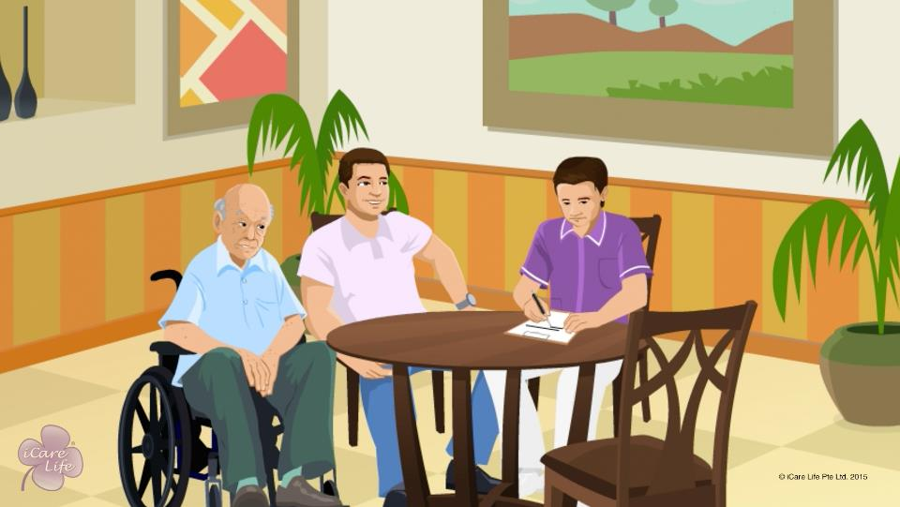
Caregiver’s Work Planner
1
Copyright: iCare Life Pte. Ltd., Singapore : This document must not be copied or shared or circulated without the consent of iCare Life and/or its affiliates.

Slide 18
In this module, you will learn about:
The various items that you may need to document when caring for a person
Information that should be included in a caregiver’s work planner
Some sample formats that can be used to document information
2
Copyright: iCare Life Pte. Ltd., Singapore : This document must not be copied or shared or circulated without the consent of iCare Life and/or its affiliates.

Slide 19

Let’s Watch
Caregiver’s Work Planner
3
Copyright: iCare Life Pte. Ltd., Singapore : This document must not be copied or shared or circulated without the consent of iCare Life and/or its affiliates.

Slide 20
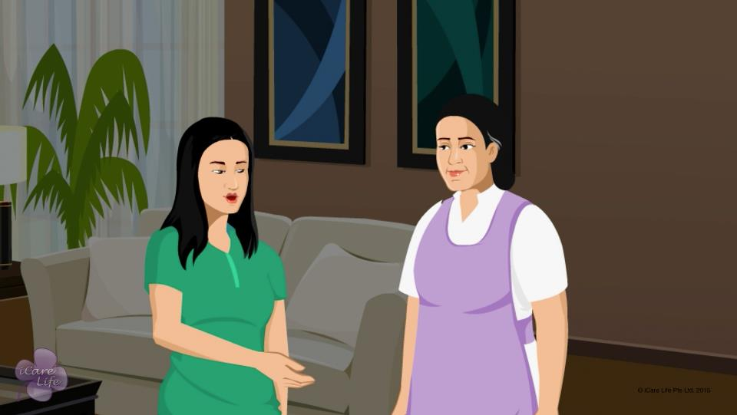
Communication Skills
4
Copyright: iCare Life Pte. Ltd., Singapore : This document must not be copied or shared or circulated without the consent of iCare Life and/or its affiliates.

Slide 21
In this module, you will learn about:
The importance of communicating effectively with the care receiver's family
How you can communicate effectively with the care receiver’s family
How you can listen effectively when interacting with the care receiver’s family
5
Copyright: iCare Life Pte. Ltd., Singapore : This document must not be copied or shared or circulated without the consent of iCare Life and/or its affiliates.

Slide 22

Let’s Watch
Communication and Listening Skills with the Family
6
Copyright: iCare Life Pte. Ltd., Singapore : This document must not be copied or shared or circulated without the consent of iCare Life and/or its affiliates.

Slide 23
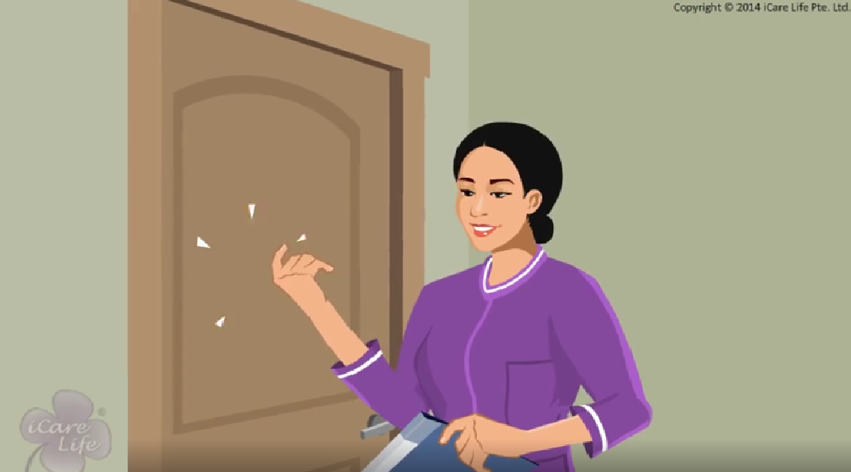
Giving Privacy
7
Copyright: iCare Life Pte. Ltd., Singapore : This document must not be copied or shared or circulated without the consent of iCare Life and/or its affiliates.

Slide 24
In this module, you will learn about:
Importance of giving privacy to the care receiver’s family
How to give privacy to the care receiver’s family
8
Copyright: iCare Life Pte. Ltd., Singapore : This document must not be copied or shared or circulated without the consent of iCare Life and/or its affiliates.

Slide 25
Let’s Watch
Giving Privacy to Care Receiver’s Family
9
Copyright: iCare Life Pte. Ltd., Singapore : This document must not be copied or shared or circulated without the consent of iCare Life and/or its affiliates.

Slide 26
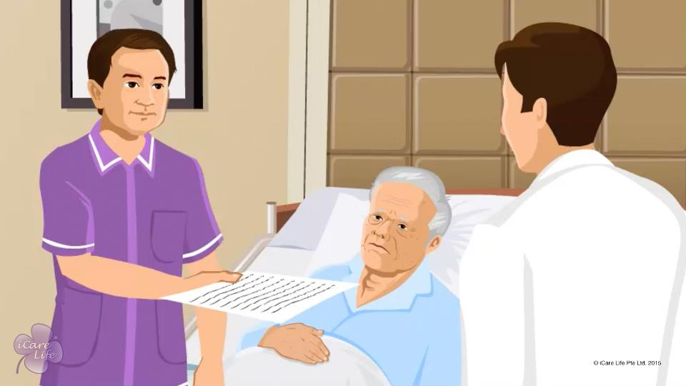
Working with Doctors
10
Copyright: iCare Life Pte. Ltd., Singapore : This document must not be copied or shared or circulated without the consent of iCare Life and/or its affiliates.

Slide 27
In this module, you will learn about:
How can you help a doctor understand the cause of the disease the person has, by providing the necessary information
What vitals should be checked daily
What information should be recorded on a daily basis
11
Copyright: iCare Life Pte. Ltd., Singapore : This document must not be copied or shared or circulated without the consent of iCare Life and/or its affiliates.

Slide 28
Let’s Watch
Working with Doctors
12
Copyright: iCare Life Pte. Ltd., Singapore : This document must not be copied or shared or circulated without the consent of iCare Life and/or its affiliates.

Slide 29


