Slide 1

Introduction to Healthcare Systems & Hospital
CR 3.2
Private and Confidential

Slide 2
Learning outcomes
1. Understand functioning of Health Care System
1.1 What is a Hospital
1.2 Different types of Hospitals
1.3 Services offered in the Hospital
1.4 Team Members in the healthcare system
1.5 Changing roles & functions of Hospital
1

Slide 3
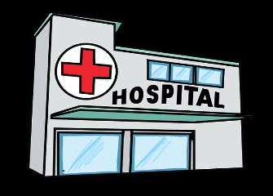
Usually funded by
What is a Hospital
A hospital is a health care institution providing patient treatment with specialized staff and equipment
The public sector
Health organizations (for profit or nonprofit)
Health insurance companies
Charities, including direct charitable donations
Historically, hospitals were often founded and funded by religious orders or charitable individuals and leaders
2

Slide 4
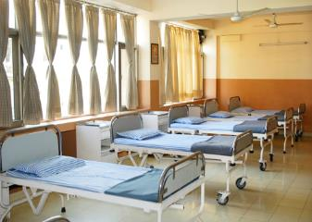
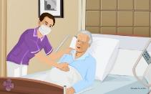
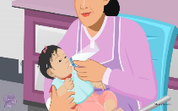
Types of Hospitals (1/3)
General Hospital: The best-known type of hospital is the general hospital, which is set up to deal with many kinds of disease and injury, and normally has an emergency department to deal with immediate and urgent threats to health
Specialized Hospitals: Various Types of specialized hospitals include -
Trauma Centers
Rehabilitation Hospitals
Children’s Hospitals
Seniors’ (geriatric) hospitals
Hospitals for dealing with specific medical needs such as, infectious disease or psychiatric patients, etc.
Certain disease categories such as cardiac, oncology, or orthopedic problems, etc.
3

Slide 5

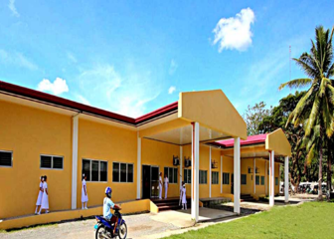
Types of Hospitals (2/3)
Health Clinics: The medical facility smaller than a hospital is generally called a clinic, and often is run by a government agency for health services or a private partnership of doctors/physicians
District Hospital: A district hospital typically is the major health care facility in its region, with large numbers of beds for intensive care and long-term care.
4

Slide 6
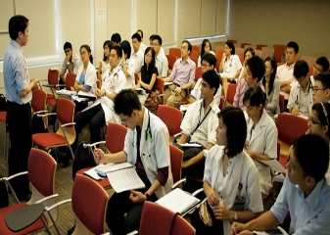
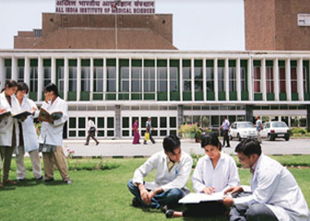
Types of Hospitals (3/3)
General Medical College Hospital: Combines teaching to medical students (doctors and nurses) and often is linked to a medical school, nursing school or university
In India there are
462 Medical Colleges – Approved by Medical Council of India (MCI), and
More than 1500 Nursing Colleges
5

Slide 7
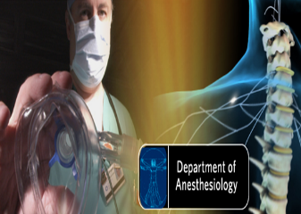
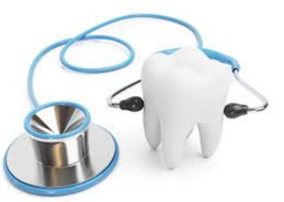
Specialized Departments (Example)
Types of Hospitals – Departments (1/2)
Critical Care
Dermatology
Endocrinology and Metabolism
Gastroenterology
Infectious Disease
Nephrology
Pediatrics
Neurology
Radiology
Physiotherapy
Rheumatology
Gynecology
Anesthesiology
Dentistry
6

Slide 8
Other Departments (Example):
Types of Hospitals – Departments (2/2)
Nuclear Medicine
Medical Oncology and Hematology
Physical Medicine and Rehabilitation
Pulmonary Disease
Nursing
Obstetrics and Reproductive Biology
Pathology and Laboratory Medicine
Psychiatry and Behavioral Health
Plastic surgery
7

Slide 9
Services offered in Hospitals
Accommodation and meals at the standard ward care
Nursing services
Laboratory, X-ray and diagnostic procedures, and interpretation
Drugs prescribed by a physician and administered in the hospital
Use of the operating room, case room, and anaesthetic facilities required for diagnosis and treatment
Radiotherapy treatment, occupational therapy, and physiotherapy.
Detoxification services in an approved health facility
Rehabilitation services
8

Slide 10
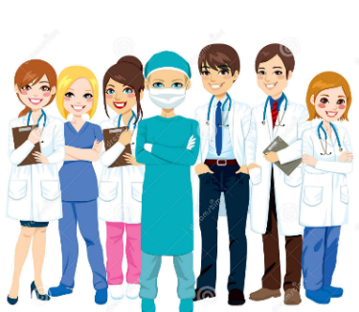
Hospital Team
Team Members - Healthcare System (1/7)
Multiple team members providing care for patients during the stay to
provide compassionate care that focuses on
provide the individual needs of patients and their families
9

Slide 11

Team Members - Healthcare System (2/7)
Important team member in the hospital Nurses have various categories according to their educational & professional preparation.
1. Registered Nurses
2. licensed Practical Nurses
3. Nursing Assistants
4. Each hospital also has a nursing
director who is responsible for
directing and coordinating nursing care
Nursing Staff
10

Slide 12


Housekeeping
Team Members - Healthcare System (3/7)
A member of housekeeping staff is responsible for cleanliness of the hospital, cleaning of utensils, linen & patient transportation
A registered dietitian (RD) is a food and nutrition expert who provides dietary support, counselling and/or education to patients, family
Dietitian
11

Slide 13
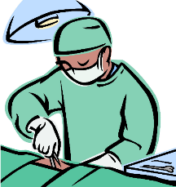

Team Members - Healthcare System (4/7)
Medical doctor , a surgeon or a specialist Examines the patient & writes the treatment for the patient which will be carried out by nurses and other members
PA provide diagnostic, therapeutic, and preventive healthcare services, with supervision from physicians
Physician
Physician Assistant (PA)
12

Slide 14
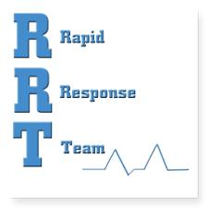

Team Members - Healthcare System (5/7)
In some hospitals, Rapid Response Team clinicians provide critical care expertise and respond to a patient's bedside to assist with a serious change in a patient's condition:
if appropriate, a change in treatment
all hospitals must have some method of rapid response
Rapid Response Team
13

Slide 15
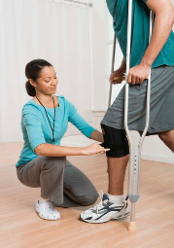

Physical Therapists (PT)
Team Members - Healthcare System (6/7)
Spend their time focusing on the large motor groups that contribute to walking, reaching, standing and physical activities
Offer skilled treatment to help individuals achieve independence in all facets of their lives
Occupational Therapists (OT)
14

Slide 16
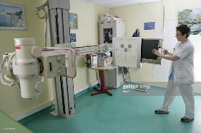
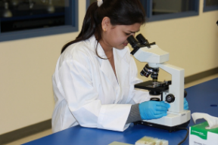
Team Members - Healthcare System (7/7)
X- Ray technicians
Lab technicians
MRI technicians
Respiratory technicians
ECG technicians
EEG technicians
EMG technicians
Clerical staffs
Technicians
15

Slide 17
The Changing Role of Hospitals (1/2)
Hospitals in India have come of age in the past decades, from a place for treatment of sickness to:
emphasis on physical, mental and social well-being
reaching out to community
training of health workers, the health care services
undergone a steady metamorphosis
The role of the hospitals has changed , with emphasis shifting from curative to preventive care:
In-patient care to out-patient & home care
Acute to chronic illness
Tertiary and secondary to primary healthcare
16

Slide 18
The Changing Role of Hospitals (2/2)
Factors led to changing role are:
Expansion of clientele from dying & destitute to all classes of people
Improved socio economic status
Increased health awareness
Government’s duty to provide comprehensive health care
Improved transportation & communication services
Rapid advances in medical science & technology
Aging population and longer life expectancy - leading to increase in demand for hospital beds
Reorientation of healthcare delivery system with an emphasis on primary health care
17

Slide 19
Summary
Hospital is an integral part of a social & medical organization which functions to provide complete health care comprising preventive, curative, and rehabilitative care and out-patient services reach out to the community
The functions of the hospital are not only within the hospital but also reach out to domiciliary and home care and outreach other services, etc.
18

Slide 20


