Slide 1

Viewing of Modules
Activities of Daily Living - Personal Care
CR 3.3
Private and Confidential

Slide 2
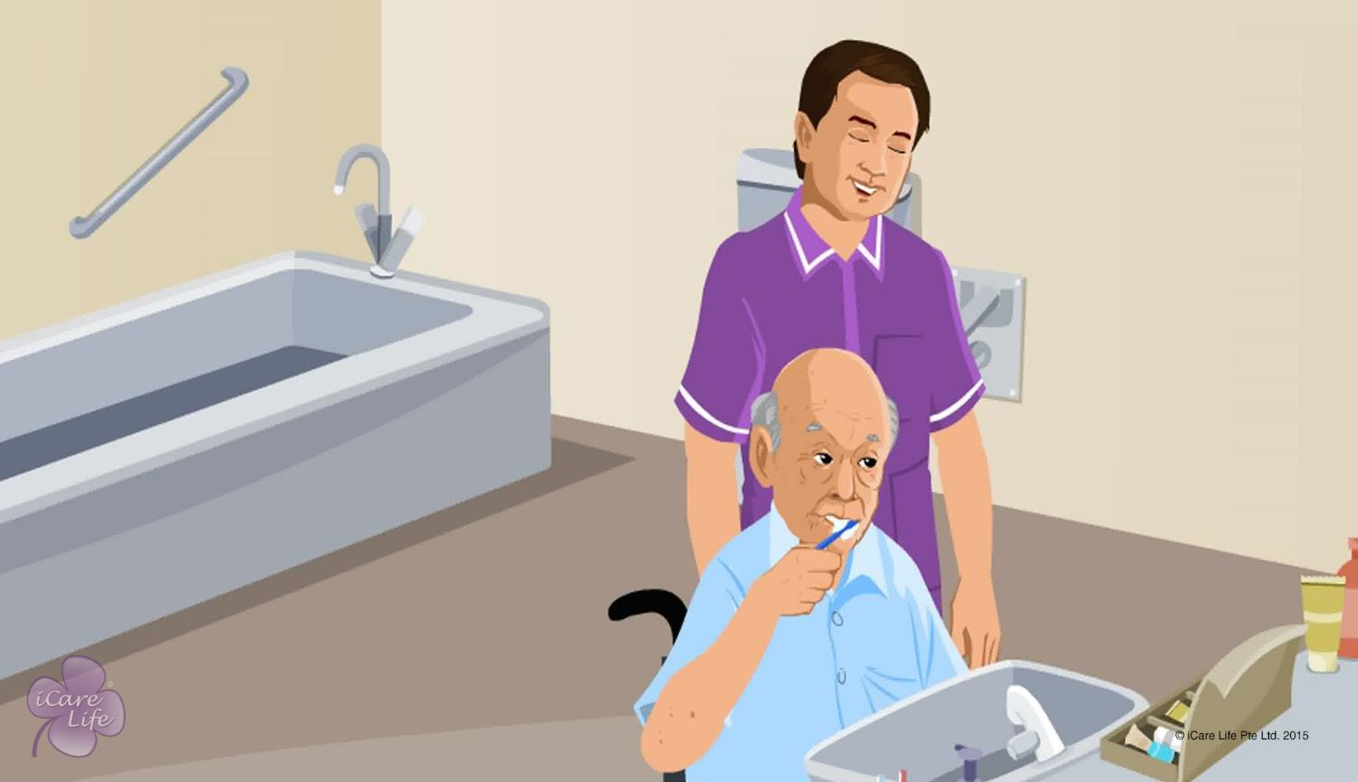
Helping the Elder Care for the Mouth
1
Copyright: iCare Life Pte. Ltd., Singapore : This document must not be copied or shared or circulated without the consent of iCare Life and/or its affiliates.

Slide 3
In this module, you will learn about:
How you can help an elder take care of his/her teeth and mouth
2

Slide 4

Let’s Watch
Helping the Elder Care for the Mouth
3
Copyright: iCare Life Pte. Ltd., Singapore : This document must not be copied or shared or circulated without the consent of iCare Life and/or its affiliates.

Slide 5
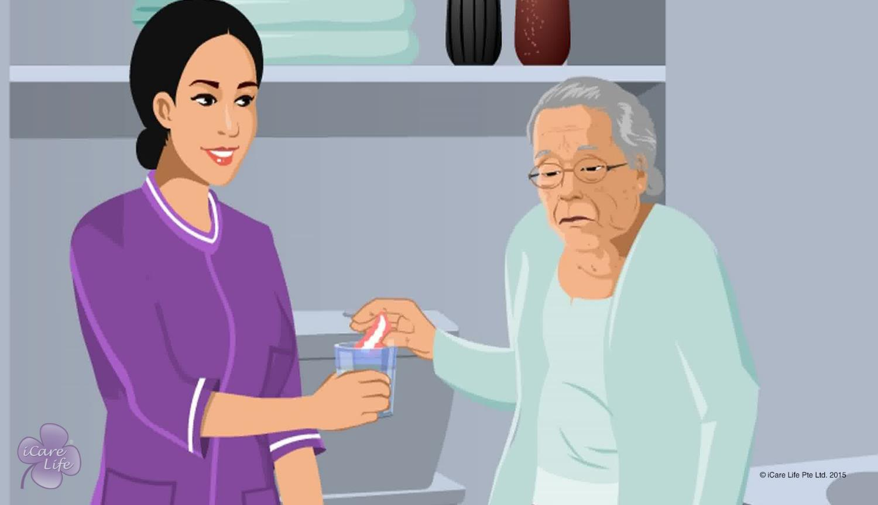
Caring for an Elder with Dentures
4
Copyright: iCare Life Pte. Ltd., Singapore : This document must not be copied or shared or circulated without the consent of iCare Life and/or its affiliates.

Slide 6
In this module, you will learn about:
How to care for an elder who wears dentures
5
Copyright: iCare Life Pte. Ltd., Singapore : This document must not be copied or shared or circulated without the consent of iCare Life and/or its affiliates.

Slide 7
Let’s Watch
Caring for an Elder with Dentures
6
Copyright: iCare Life Pte. Ltd., Singapore : This document must not be copied or shared or circulated without the consent of iCare Life and/or its affiliates.

Slide 8
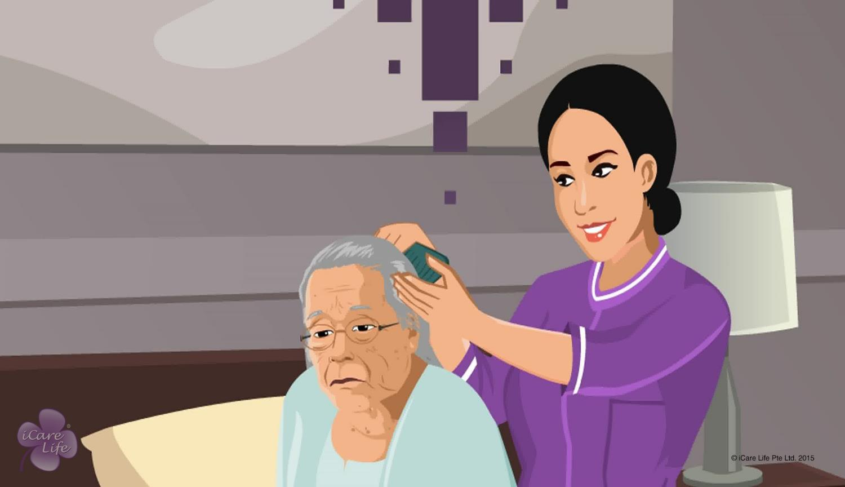
Hair Care for the Elder
7
Copyright: iCare Life Pte. Ltd., Singapore : This document must not be copied or shared or circulated without the consent of iCare Life and/or its affiliates.

Slide 9
In this module, you will learn about:
How to keep the elder’s hair clean
How to maintain hair so that the elder feels good and comfortable
8
Copyright: iCare Life Pte. Ltd., Singapore : This document must not be copied or shared or circulated without the consent of iCare Life and/or its affiliates.

Slide 10
Let’s Watch
Hair care for the Elder
9
Copyright: iCare Life Pte. Ltd., Singapore : This document must not be copied or shared or circulated without the consent of iCare Life and/or its affiliates.

Slide 11
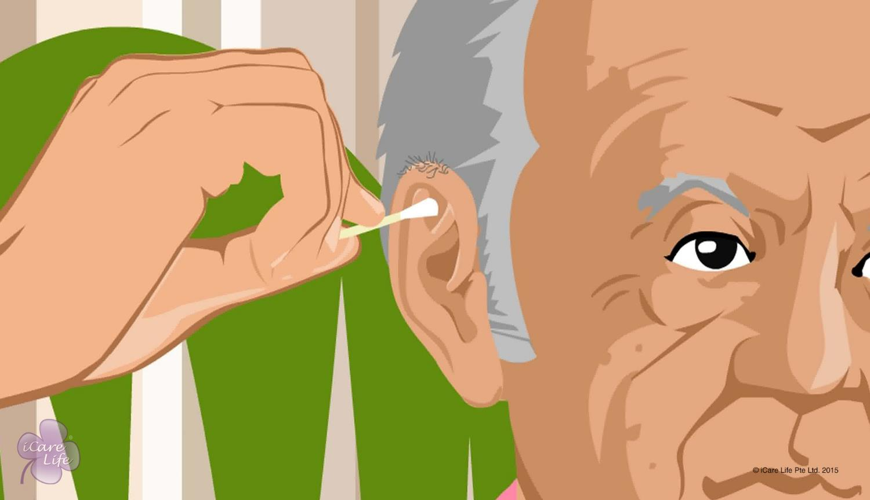
Care of Nails, Ears and Nose
10
Copyright: iCare Life Pte. Ltd., Singapore : This document must not be copied or shared or circulated without the consent of iCare Life and/or its affiliates.

Slide 12
In this module, you will learn about:
How to cut and take care of an elder’s nails
The common nail conditions that indicate a disease
How to take care of an elder’s ears
How to take care of an elder’s nose
11
Copyright: iCare Life Pte. Ltd., Singapore : This document must not be copied or shared or circulated without the consent of iCare Life and/or its affiliates.

Slide 13
Let’s Watch
Care of Nails, Ears and Nose
12
Copyright: iCare Life Pte. Ltd., Singapore : This document must not be copied or shared or circulated without the consent of iCare Life and/or its affiliates.

Slide 14
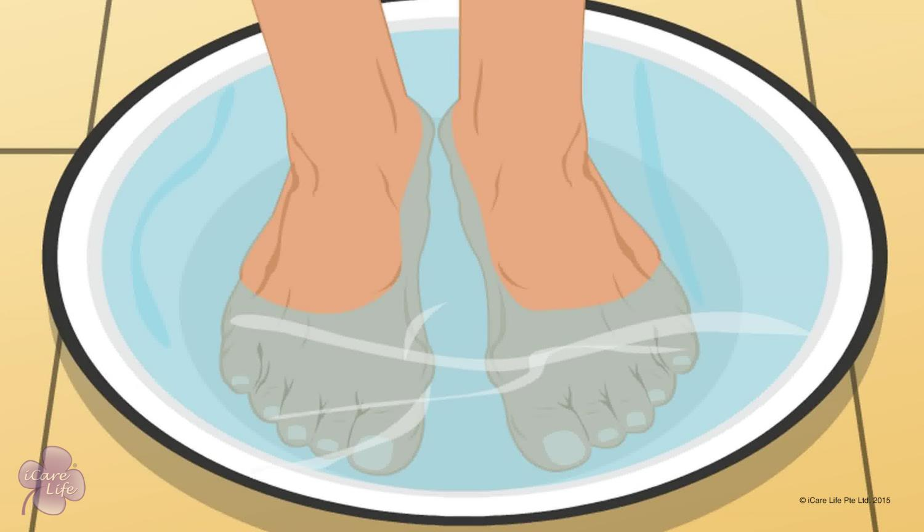
Caring for the Feet
13
Copyright: iCare Life Pte. Ltd., Singapore : This document must not be copied or shared or circulated without the consent of iCare Life and/or its affiliates.

Slide 15
In this module, you will learn about:
Some of the common foot problems which an elder can suffer from
How to prevent some common foot problems
How to take care of the elder’s feet
14
Copyright: iCare Life Pte. Ltd., Singapore : This document must not be copied or shared or circulated without the consent of iCare Life and/or its affiliates.

Slide 16
Let’s Watch
Caring for the Feet
15
Copyright: iCare Life Pte. Ltd., Singapore : This document must not be copied or shared or circulated without the consent of iCare Life and/or its affiliates.

Slide 17


