Slide 1

Modules Summary Discussion – Q&A
CR 3.4
Private and Confidential

Slide 2

Helping the Elder Care for the Mouth
1
Copyright: iCare Life Pte. Ltd., Singapore : This document must not be copied or shared or circulated without the consent of iCare Life and/or its affiliates.

Slide 3
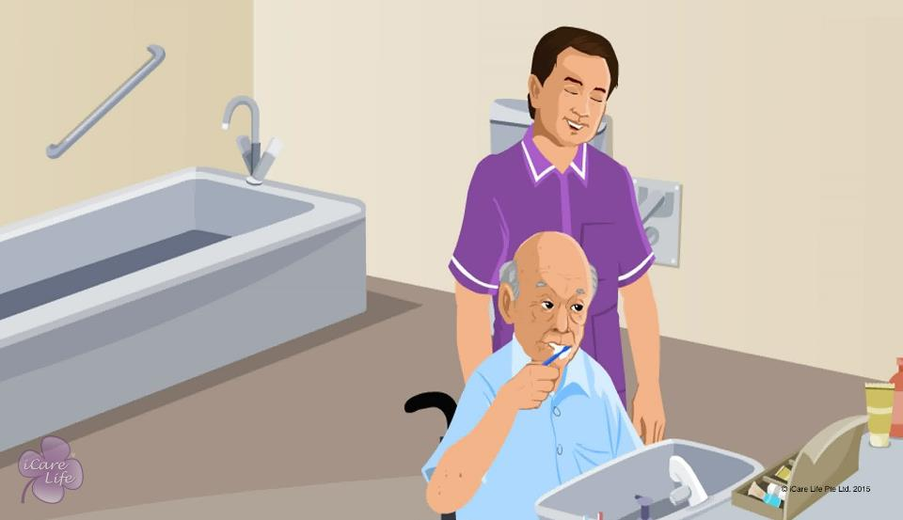
Helping the Elder Care for the Mouth
2
Copyright: iCare Life Pte. Ltd., Singapore : This document must not be copied or shared or circulated without the consent of iCare Life and/or its affiliates.

Slide 4
Let’s Practice!
Post-Module Activity
3
Copyright: iCare Life Pte. Ltd., Singapore : This document must not be copied or shared or circulated without the consent of iCare Life and/or its affiliates.
Notes:
Objective: To help the participants learn how to floss, brush, and mouthwash a semi/fully-dependent elder.
Pre-class preparation: Arrange for an area with a bathroom sink and a toothpaste, a few disposable brushes, dental floss, and mouthwash.
Activity: Make groups of two. Ask one to pose as a semi-dependent/fully dependent elder. Ask the other person to be the caregiver. Ask the caregiver to help the elder perform the following activities:
Floss
Brush
Mouthwash
Once a cycle completes, ask each pair to reverse their roles.

Slide 5
Summary
Ensure that the elder brushes teeth twice a day
Ensure that the elder has a soft-bristled toothbrush and toothpaste available
Replace the toothbrush every three months
Ensure the comfort of holding the toothbrush for an elder suffering from arthritis
Use the correct way to brush teeth
Use the correct way to floss teeth
Help the elder use mouth wash correctly
Encourage the elder to visit the dentist regularly
Clean the gums and tongue of an elder who does not have natural teeth
4
Notes:
Ensure that the elder brushes teeth twice a day
Ensure that the elder has a soft-bristled toothbrush and toothpaste available
Replace the toothbrush every three months
Ensure the comfort of holding the toothbrush for an elder suffering from arthritis
Use the correct way to brush teeth
Use the correct way to floss teeth
Help the elder use mouth wash correctly
Encourage the elder to visit the dentist regularly
Clean the gums and tongue of an elder who does not have natural teeth

Slide 6
Any Questions?
5
Notes:
Q.1. What should I do if the elder does not want to pick up new hygiene habits such as flossing, which they have never done before?
Ans. You can ask the elder’s dentist to explain the importance and benefits of such habits to the elder.

Slide 7
Caring for an Elder with Dentures
6
Copyright: iCare Life Pte. Ltd., Singapore : This document must not be copied or shared or circulated without the consent of iCare Life and/or its affiliates.

Slide 8
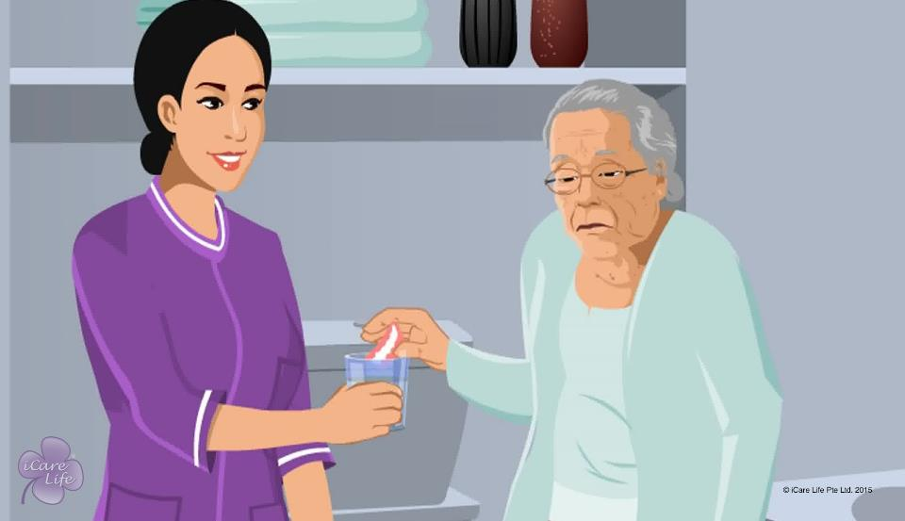
Caring for an Elder with Dentures
7
Copyright: iCare Life Pte. Ltd., Singapore : This document must not be copied or shared or circulated without the consent of iCare Life and/or its affiliates.

Slide 9
Let’s Practice!
Post-Module Activity
8
Copyright: iCare Life Pte. Ltd., Singapore : This document must not be copied or shared or circulated without the consent of iCare Life and/or its affiliates.
Notes:
Arrange for a full-teeth denture set and a disposable soft-bristled toothbrush. In the class, ask participants to take turns to practice brushing the denture set.

Slide 10
Summary
Encourage the elder with dentures to visit the dentist regularly
Serve food that is easy to eat
Remind elders to be careful when eating food that is hot or includes bones
Brush dentures twice a day with a soft bristled toothbrush
Do not use toothpaste on dentures
Remind elders to take dentures off before they sleep.
Soak the dentures in water overnight
Dry dentures after brushing them in the morning
9
Notes:
Encourage the elder with dentures to visit the dentist regularly
Serve food that is easy to eat
Remind elders to be careful when eating food that is hot or includes bones
Brush dentures twice a day with a soft bristled toothbrush
Do not use toothpaste on dentures
Remind elders to take dentures off before they sleep.
Soak the dentures in water overnight
Dry dentures after brushing them in the morning

Slide 11
Any Questions?
10
Notes:
Q.1. Why should I not use toothpaste to clean dentures?
Ans. Dentures are made of synthetic material. The chemicals in the toothpaste may spoil the dentures.

Slide 12
Hair care for the Elder
11
Copyright: iCare Life Pte. Ltd., Singapore : This document must not be copied or shared or circulated without the consent of iCare Life and/or its affiliates.

Slide 13
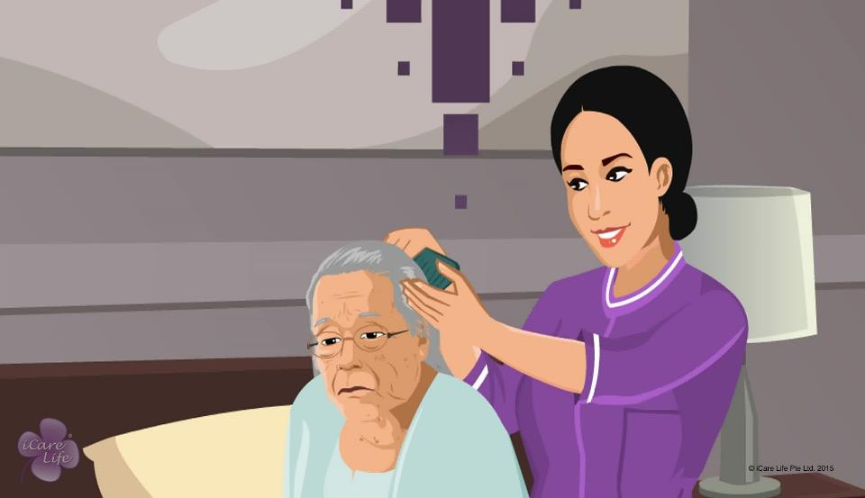
Hair Care for the Elder
12
Copyright: iCare Life Pte. Ltd., Singapore : This document must not be copied or shared or circulated without the consent of iCare Life and/or its affiliates.

Slide 14
Let’s Practice!
Post-Module Activity
13
Copyright: iCare Life Pte. Ltd., Singapore : This document must not be copied or shared or circulated without the consent of iCare Life and/or its affiliates.
Notes:
The participants are divided into small batches and given a live demonstration of washing an elder’s hair by trained caregivers. The ideal place for this would be an old people’s home or a nursing home. Fix a prior appointment for the activity and inform the participants of the location and timings for the demonstration.
During the demonstration, participants of each batch can be assigned tasks like setting up a hair washing tray and preparing for the hair wash. If additional subjects are available, one by one make the participants assist an elder in washing the hair under the supervision of a trained caregiver.

Slide 15
Summary
To help keep the elder’s hair clean:
Wash their hair regularly
Wash their hair in the bathroom sink if the elder is semi-dependent
Use a hair washing tray if the elder is bedridden
Use a dry shampoo when the hair cannot be washed
14
Notes:
To help keep the elder’s hair clean:
Wash their hair regularly – Twice a week or as directed by doctor
Wash their hair in the bathroom sink if the elder is semi-dependent
Use a hair washing tray if the elder is bedridden
Use a dry shampoo when the hair cannot be washed – Just needs to be sprayed on

Slide 16
Any Questions?
15
Notes:
FAQs
Q1. I know how to color hair. Can I color the elder’s hair?
No. An elder takes various medications and hence, they might experience an allergic reaction or the colour may not turn out the way it was expected to. It’s always best to call a professional to colour an elder’s hair.
Q2. What should I do if I see dandruff in the elder’s hair?
Check with the doctor on whether you can use a medicated shampoo.
Q3. How often should I comb the elder’s hair?
Comb their hair at least once and ideally, twice a day. This will make it easier to untangle and comb hair.
Q4. Can I use a hair dryer?
A. Avoid using a hair dryer if the elder has dry and brittle hair. Towel drying the hair is more gentle.

Slide 17
Care of Nails, Ears and Nose
16
Copyright: iCare Life Pte. Ltd., Singapore : This document must not be copied or shared or circulated without the consent of iCare Life and/or its affiliates.

Slide 18
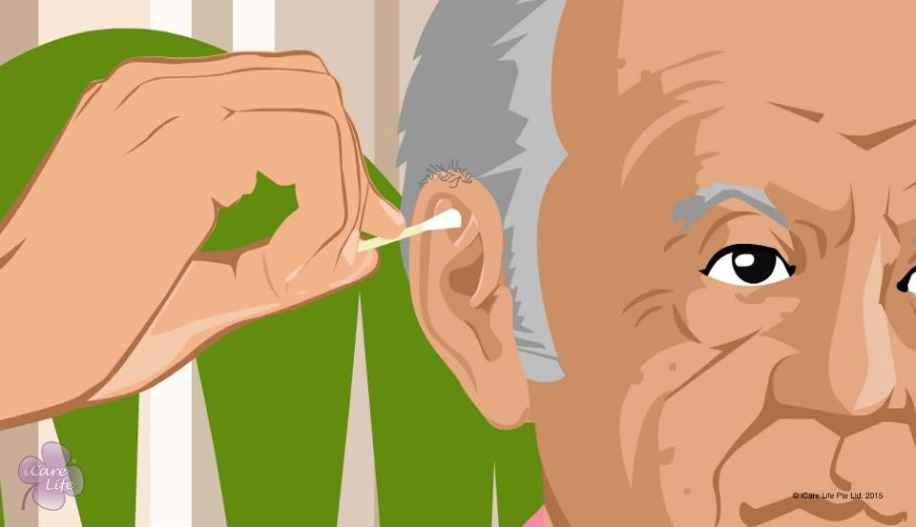
Care of Nails, Ears and Nose
17
Copyright: iCare Life Pte. Ltd., Singapore : This document must not be copied or shared or circulated without the consent of iCare Life and/or its affiliates.

Slide 19
Post-Module Activity
Let’s Practice!
18
Copyright: iCare Life Pte. Ltd., Singapore : This document must not be copied or shared or circulated without the consent of iCare Life and/or its affiliates.
Notes:
Ask a trained caregiver to give a demonstration of how to cut nails, clean external ear properly, and clean a person’s nose.
Divide the participants in groups of two. Give one participant from each group to play the role of a caregiver and perform the following tasks (to conduct on their partner, who acts as the elder). When they are done, ask them to switch roles and perform the same tasks.
Cut finger nails properly
Check the person’s nails and make note of any possible problems they may see
Clean the external ear using an ear bud
Ask participants to share their experience when posing as an elder and the difficulties they faced when posing as a caregiver. Discuss and provide relevant feedback.
If any participant has noticed any issues with their partner’s nails, ask them to share the same. Discuss and provide relevant feedback.

Slide 20
Summary
To help keep the elder’s hair clean:
Cut the elder’s nails on the fingers and toes once a week
Encourage the elder to clean their nails and wash hands after using the toilet, returning from a public place, touching door handles, elevators, or banisters as well as after handling money
Avoid using inferior quality nail polish
Avoid buffing the nails
Clean the external ear every day
Clean the external ear along the spiral of the ear with a moisturized cotton bud
Never put a cotton bud, sharp key, or hairpin inside the auditory canal to clean wax
Clean the area behind the ear everyday
19

Slide 21
Summary
You may trim the hair on the elder’s ear, but do not try to trim the hair inside the canal
Clean the part of the hearing aid that goes inside the ear every day
Clean the elder’s headphones; ask them not to share headphones
Ask the elder to gently blow the nose once or twice a day. Alternatively, you can clean the nose with the finger wound around a soft handkerchief
Trim the hair that is growing outside the nose with a small pair of scissors
Never trim the hair inside the nose
Clean the part of the Ryle’s tube coming out of nose
Adjust the nasal prongs and tubes such that they do not hurt the nose
In case of a nose bleed, pinch the nostril firmly for 5 to 10 minutes
Ask the elder to breathe from the mouth
20

Slide 22
Any Questions?
21
Notes:
FAQs
Q1. The elder wants to clean their nose and ears on their own. What should I do?
Ans. You should always encourage independence and let the elder perform tasks that they are confident of doing for themselves. However, you should regularly check if the elder’s ears and nose are clean.
Q2. The elder has a habit of putting objects such as a pen into their ears. What should I do?
Ans. Educate the elder about the dangers of putting sharp objects into their ears. Tell them that putting an object into the ear can even perforate their eardrum, causing hearing loss.

Slide 23
Caring for the Feet
22
Copyright: iCare Life Pte. Ltd., Singapore : This document must not be copied or shared or circulated without the consent of iCare Life and/or its affiliates.

Slide 24
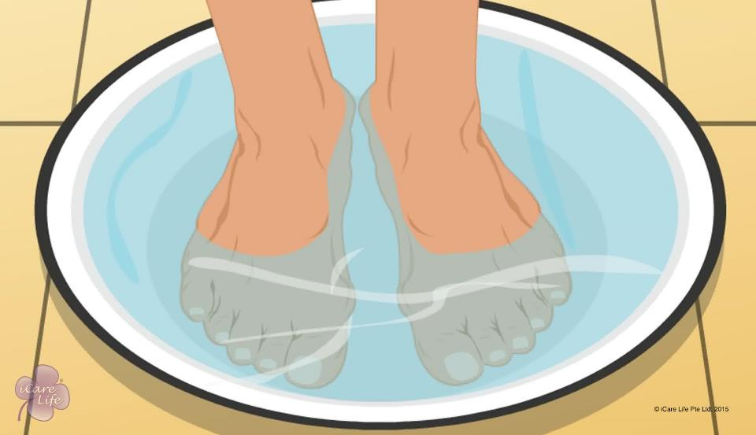
Caring for the Feet
23
Copyright: iCare Life Pte. Ltd., Singapore : This document must not be copied or shared or circulated without the consent of iCare Life and/or its affiliates.

Slide 25
Let’s Demonstrate
Post-Module Activity
24
Copyright: iCare Life Pte. Ltd., Singapore : This document must not be copied or shared or circulated without the consent of iCare Life and/or its affiliates.
Notes:
You will need to set up an appointment with a professional in foot care. Arrange for materials like a small tub, lukewarm water, towels, foot scrubber, foot-wash, moisturizer, nail cutter and socks. Ask the expert if anything else is needed and arrange for the same.
Ask the expert to give a demonstration of how to take care of feet well.
Ask the class participants to take notes for discussing later.
You can also ask one or two class participants to volunteer for the activity.

Slide 26
Summary
Some common foot problems are:
Athlete’s foot,
Blisters,
Corns and calluses,
Foot odor,
Ingrown nails,
Bunions,
Hammertoe,
And heel pain
25

Slide 27
Summary
To take care of the elder’s feet:
Make sure the elder washes their feet well with soap and lukewarm water
Ensure that the feet are dried well
Apply a moisturizing lotion
Ensure that the elder wears clean, soft socks
Make sure that the shoes and sandals fit the elder well
Examine the elder’s shoes every day
Trim nails straight across, slightly longer than the end of the toe
26

Slide 28
Any Questions?
27
Notes:
Q1. Does wearing heels affect feet?
Ans. Wearing high heels frequently can cause damage to the bones of the foot. They're fine every once in a while, but you should find a comfortable pair of shoes for every day wear.
Q2. Do the feet require extra care if the elder has diabetes?
Ans. Yes. Diabetes can damage the nerves and blood vessels in the elder’s feet. This damage can cause numbness and reduce feeling in feet. As a result, their feet may not heal well if they are injured. If they get a blister and is not noticed, and it may get worse.
Check the elder’s feet every day. Inspect the top, sides, soles, heels, and between the toes. Look for:
Dry and cracked skin
Blisters or sores
Bruises or cuts
Redness, warmth, or tenderness
Firm or hard spots
Q3. What all should I take care of while buying a new pair of shoes?
Ans. Some of the things you should keep in mind are:
Shoes must fit well. They should not be too tight or too loose. You should always buy shoes as per the elder’s current foot size.
You should also look for the right materials. Synthetics do not breathe well and trap heat and moisture. Natural materials like leather and cotton keep the feet cooler and release moisture.
You should also make sure that the elder’s toes are not scrunched up inside the shoe. It can cause hammertoe and blisters.

Slide 29


