Slide 1

Modules Summary Discussion – Q&A
CR 5.1
Private and Confidential

Slide 2

Assisting with Laundry & Ironing
1
Copyright: iCare Life Pte. Ltd., Singapore : This document must not be copied or shared or circulated without the consent of iCare Life and/or its affiliates.

Slide 3
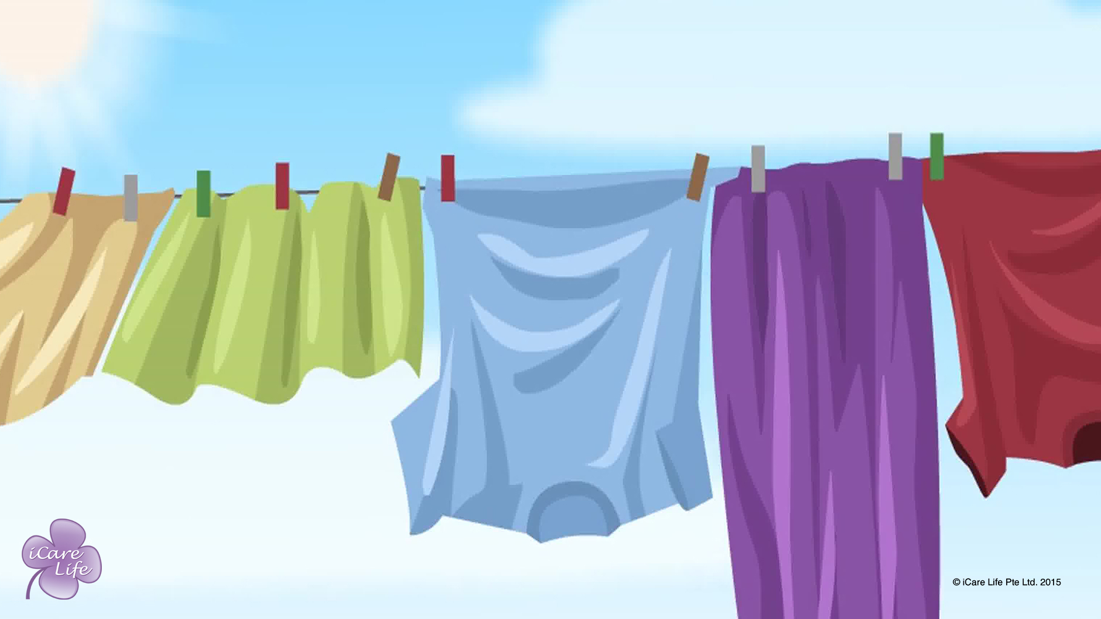
Assisting with laundry & Ironing
2
Copyright: iCare Life Pte. Ltd., Singapore : This document must not be copied or shared or circulated without the consent of iCare Life and/or its affiliates.

Slide 4
Post Module Activity
3
Copyright: iCare Life Pte. Ltd., Singapore : This document must not be copied or shared or circulated without the consent of iCare Life and/or its affiliates.
Notes:
The participants are divided into small batches and given a live demonstration of using a washing machine, dryer, and iron. The ideal place for this activity would be at a home with these appliances. Fix a prior appointment for the activity and inform the participants of the location and timings for the demonstration.
During the demonstration, participants of each batch can be assigned tasks like separating the clothes, washing the clothes, using the dryer, ironing some clothes etc.

Slide 5
Summary
When helping with laundry, always wear gloves
Check and separate soiled clothes
Rinse the soiled clothes thoroughly
Soak soiled clothes in a disinfectant for at least an hour before washing them with other clothes
If a person suffers from a contagious disease, handle their clothes separately
Before washing, separate the light colored clothes from the dark ones
Read the garment labels for wash instructions
Turn the clothes inside out and check the pockets
4
Copyright: iCare Life Pte. Ltd., Singapore : This document must not be copied or shared or circulated without the consent of iCare Life and/or its affiliates.
Notes:
When helping with laundry, always wear gloves
Check and separate soiled clothes
Rinse the soiled clothes thoroughly
Soak soiled clothes in a disinfectant for at least an hour before washing them with other clothes
If a person suffers from a contagious disease, handle their clothes separately
Before washing, separate the light colored clothes from the dark ones
Read the garment labels for wash instructions
Turn the clothes inside out and check the pockets

Slide 6
Any Questions?
5
Copyright: iCare Life Pte. Ltd., Singapore : This document must not be copied or shared or circulated without the consent of iCare Life and/or its affiliates.
Notes:
FAQs
Q1. There is a washing machine available at the home of the person under my care. Should I refuse to wash clothes by hand?
A. Sometimes there might be few clothes that require hand washing or the person under your care could be suffering from a contagious disease. Hence you might need to wash the clothes by hand even though there is a washing machine.
Q2. The person under my care refuses to change his clothes, even if they are soiled. What should I do?
You should explain the need for clean clothes to the person under your care and encourage them to change their clothes. If they refuse, you should consult their family.
Q3. I am very scared of handling electrical appliances. What should I do?
You should work towards overcoming your fears. In today’s day and age, all of us should be comfortable operating these appliances.
Q4. What should I do if I am not clear on the settings or how to operate the washing machine or dryer?
A. Ask the family of the person under your care to guide you if you need assistance with operating any of these machines.

Slide 7
Dusting Furniture
6
Copyright: iCare Life Pte. Ltd., Singapore : This document must not be copied or shared or circulated without the consent of iCare Life and/or its affiliates.

Slide 8
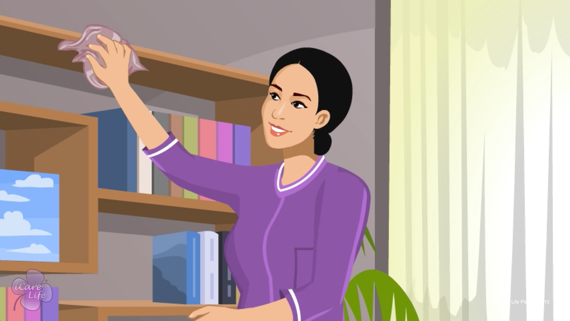
Dusting Furniture
7
Copyright: iCare Life Pte. Ltd., Singapore : This document must not be copied or shared or circulated without the consent of iCare Life and/or its affiliates.

Slide 9
Let’s Practice
Post Module Activity
8
Copyright: iCare Life Pte. Ltd., Singapore : This document must not be copied or shared or circulated without the consent of iCare Life and/or its affiliates.
Notes:
The participants are divided into small batches and given a live demonstration of dusting (if possible, using a vacuum cleaner) by trained caregivers. The ideal place for this would be a home similar to a care receiver’s home. Fix a prior appointment for the activity and inform the participants of the location and timings for the demonstration.
During the demonstration, participants of each batch can be assigned tasks like dusting furniture and cleaning glass or if possible, using a vacuum cleaner. One by one make the participants perform the tasks under the supervision of a trained caregiver.

Slide 10
Summary
To get rid of dust mites, soak bed covers in hot water
Avoid dust bunnies by dusting corners and under furniture and objects
To dust effectively:
Wet cloth
Wipe surface slowly
Dust around and then under the objects
Start dusting on top of shelves and then move to the lower shelves
Use microfiber cloths as they absorb oil and dirt
Dust every day or on alternate days
9
Copyright: iCare Life Pte. Ltd., Singapore : This document must not be copied or shared or circulated without the consent of iCare Life and/or its affiliates.
Notes:
To get rid of dust mites, soak bed covers in hot water
Avoid dust bunnies by dusting corners and under furniture and objects
To dust effectively:
Wet cloth
Wipe surface slowly
Dust around and then under the objects
Start dusting on top of shelves and then move to the lower shelves
Use microfiber cloths as they absorb oil and dirt
Dust every day or on alternate days

Slide 11
Summary
Clean the ceiling, mats, window frames, fans or air conditioners once a month
To clean glass, spray the glass with a glass cleaner spray and then use quick hand movements to wipe it with a microfiber cloth
Use the vacuum cleaner at least once a week to clean rugs, upholstery, windowsills, and carpets
To use a vacuum cleaner:
Attach appropriate nozzle
Use front-back movements
Change the direction occasionally
Clean the dust bag outdoors
10
Copyright: iCare Life Pte. Ltd., Singapore : This document must not be copied or shared or circulated without the consent of iCare Life and/or its affiliates.
Notes:
Clean the ceiling, mats, window frames, fans or air conditioners once a month
To clean glass, spray the glass with a glass cleaner spray and then use quick hand movements to wipe it with a microfiber cloth
Use the vacuum cleaner at least once a week to clean rugs, upholstery, windowsills, and carpets
To use a vacuum cleaner:
Attach appropriate nozzle
Use front-back movements
Change the direction occasionally
Clean the dust bag outdoors

Slide 12
Any Questions?
11
Copyright: iCare Life Pte. Ltd., Singapore : This document must not be copied or shared or circulated without the consent of iCare Life and/or its affiliates.
Notes:
Q.1. When I clean glass using a duster, sometimes the glass appears even more dirty. What should I do?
Ans. Make sure you use a very clean duster to wipe glass.

Slide 13
Organizing & Cleaning Elder’s Bathroom
12
Copyright: iCare Life Pte. Ltd., Singapore : This document must not be copied or shared or circulated without the consent of iCare Life and/or its affiliates.

Slide 14
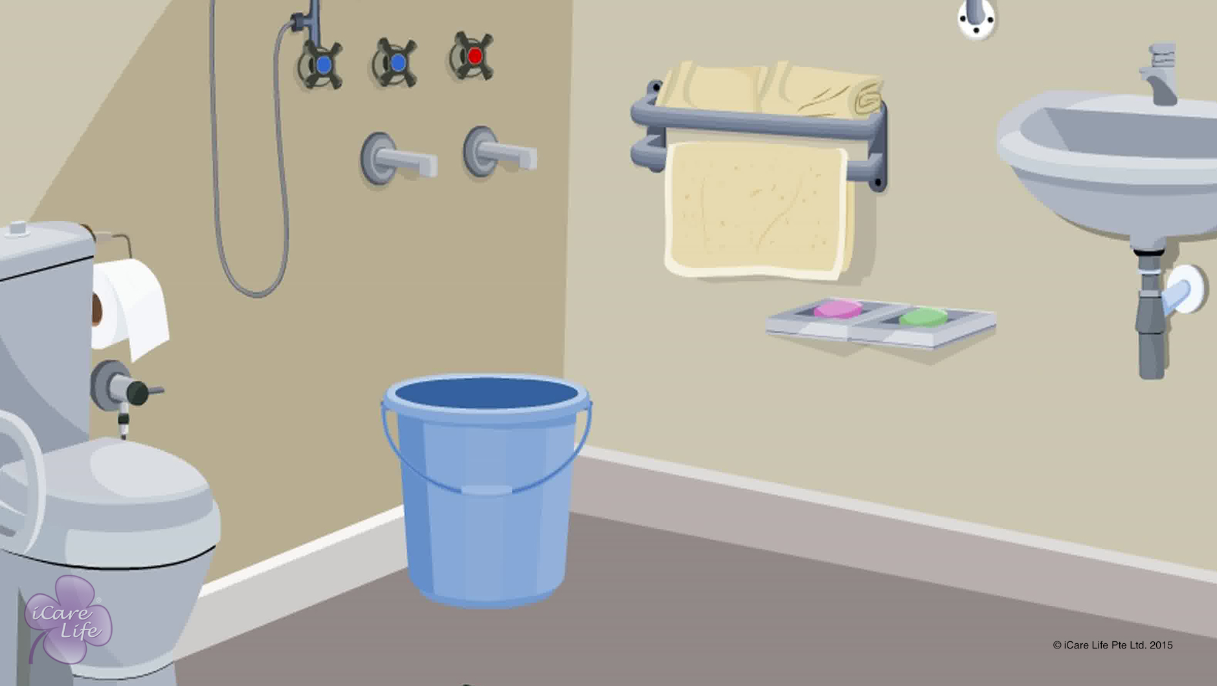
Organizing & Cleaning Elder’s Bathroom
13
Copyright: iCare Life Pte. Ltd., Singapore : This document must not be copied or shared or circulated without the consent of iCare Life and/or its affiliates.

Slide 15
Let’s Practice
Post Module Activity
14
Copyright: iCare Life Pte. Ltd., Singapore : This document must not be copied or shared or circulated without the consent of iCare Life and/or its affiliates.
Notes:
Objective: To learn how to clean and organize a bathroom.
Arrange for a visit to a person’s home or a nursing home. The participants are given a demonstration of cleaning and organizing a bathroom for an elderly person by a trained caregiver. The participants should be called upon to assist the trained caregiver in the task.
Later, each participants should be given an opportunity to clean and organize a bathroom. The bathroom should then be inspected by the trained caregiver and appropriate feedback should be given to the participant.

Slide 16
Summary
To clean the elder’s bathroom:
Discard all empty bottles and wrappers
Remove all soiled clothes into laundry
Once a week, clean the wall tiles, bathroom fittings and ceiling
Clean the bathroom floor, sink, bath tub, and commode every day
After cleaning, dry the bathroom floor completely
Wipe clean the sink, bathtub, and the toilet seat
Spray or keep a cake of a mild deodorant in the bathroom
15
Copyright: iCare Life Pte. Ltd., Singapore : This document must not be copied or shared or circulated without the consent of iCare Life and/or its affiliates.
Notes:
To clean the elder’s bathroom:
Discard all empty bottles and wrappers
Remove all soiled clothes into laundry
Once a week, clean the wall tiles, bathroom fittings and ceiling
Clean the bathroom floor, sink, bath tub, and commode every day
After cleaning, dry the bathroom floor completely
Wipe clean the sink, bathtub, and the toilet seat
Spray or keep a cake of a mild deodorant in the bathroom

Slide 17
Summary
To organize the elder’s bathroom:
Remove all unnecessary objects
Keep the bathroom area well lit
Replenish supplies like soap, shampoo, and toilet paper
Keep fresh towels in the bathroom
Make sure all required things are kept within easy reach of the elder
Get some assistive devices installed in the bathroom for the elder’s safety
16
Copyright: iCare Life Pte. Ltd., Singapore : This document must not be copied or shared or circulated without the consent of iCare Life and/or its affiliates.
Notes:
To organize the elder’s bathroom:
Remove all unnecessary objects
Keep the bathroom area well lit
Replenish supplies like soap, shampoo, and toilet paper
Keep fresh towels in the bathroom
Make sure all required things are kept within easy reach of the elder
Get some assistive devices installed in the bathroom for the elder’s safety

Slide 18
Any Questions?
17
Copyright: iCare Life Pte. Ltd., Singapore : This document must not be copied or shared or circulated without the consent of iCare Life and/or its affiliates.
Notes:
Q1. Why should I learn to clean a bathroom?
Ans: Depending on the type of help available in an elder’s house, you may or may not have to clean the bathroom. However, as a caregiver, you must know how to properly clean, disinfect, and organize the bathroom for an elderly person. Even if you are not be required to do the cleaning, you will be required to organize the bathroom for the elder. If you know the proper way of cleaning the bathroom, you can guide and supervise the person actually responsible for it. It is an added skill to your capabilities as a caregiver.

Slide 19
Organizing the Elder’s Closet
18
Copyright: iCare Life Pte. Ltd., Singapore : This document must not be copied or shared or circulated without the consent of iCare Life and/or its affiliates.

Slide 20
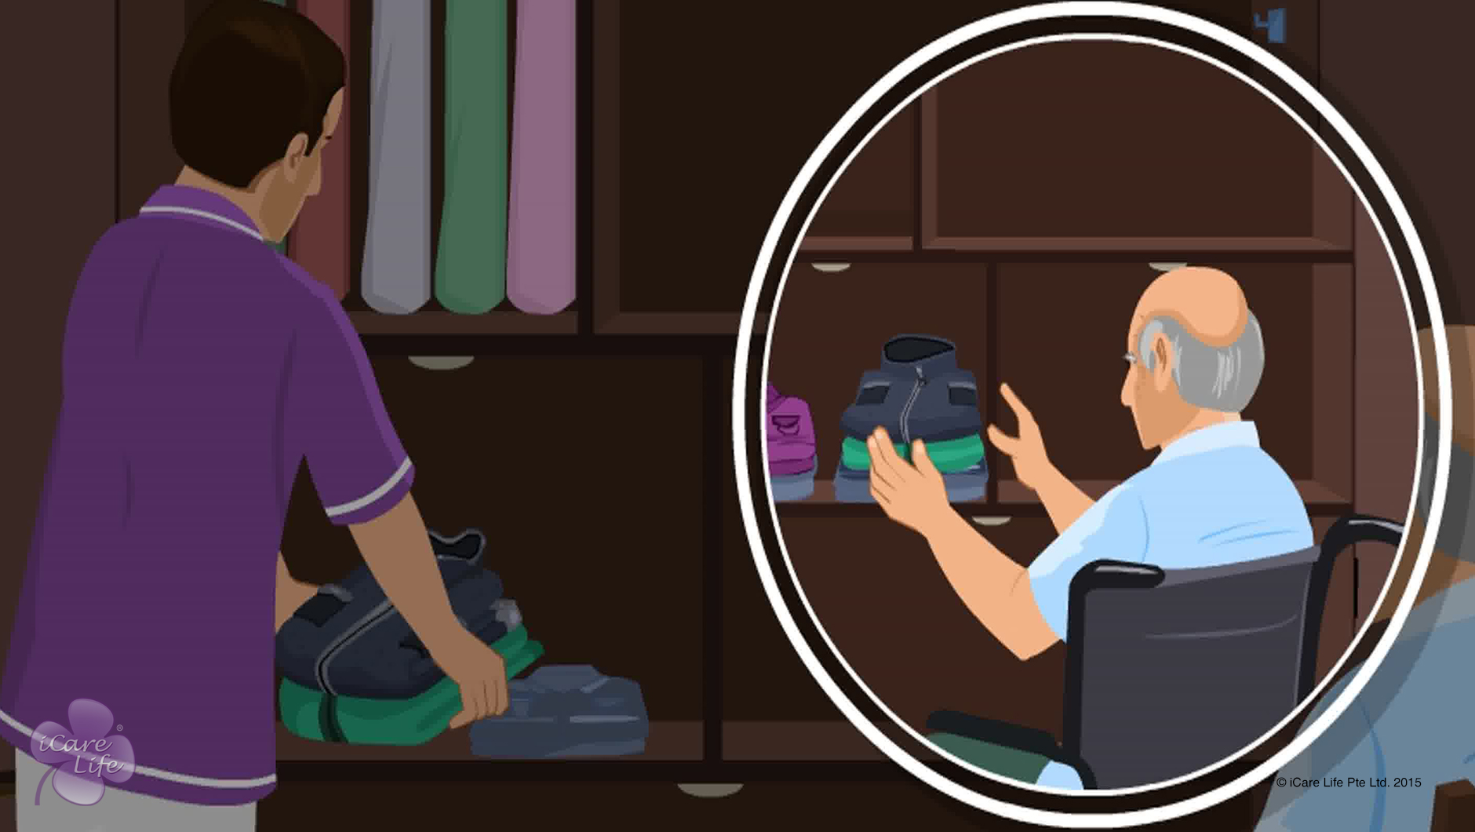
Organizing the Elder’s Closet
19
Copyright: iCare Life Pte. Ltd., Singapore : This document must not be copied or shared or circulated without the consent of iCare Life and/or its affiliates.

Slide 21
Let’s Practice
Post Module Activity
20
Copyright: iCare Life Pte. Ltd., Singapore : This document must not be copied or shared or circulated without the consent of iCare Life and/or its affiliates.
Notes:
Arrange for a visit to an old people’s home to give them practical training in cleaning and organizing an elder’s closet. Begin by a demonstration by a trained caregiver who shows the participants how to identify clutter and store it in less frequently used storage areas. The demonstration should also include cleaning the closet, identifying easy to reach areas, and using them to store items of daily use.
After identifying a few unwanted items and daily use items, the demonstrator can pick up the rest of the items one by one and ask for the participants’ opinion about where it should be stored. If the closet has enough items, the participants can be invited one by one to clean and organize different areas of the closet.

Slide 22
Summary
To organize an elder's closet:
Take permission from the elder or a family member
Discard all unwanted items or shift them to less used storage areas
Arrange items of daily use within easy reach
Store items at suitable height depending on how the elder uses the closet
Ask for elder's preference about how to store daily use items
Get a light installed in the closet and keep a chair nearby
21
Copyright: iCare Life Pte. Ltd., Singapore : This document must not be copied or shared or circulated without the consent of iCare Life and/or its affiliates.
Notes:
To organize an elder's closet:
Take permission from the elder or a family member
Discard all unwanted items or shift them to less used storage areas
Arrange items of daily use within easy reach
Store items at suitable height depending on how the elder uses the closet
Ask for elder's preference about how to store daily use items
Get a light installed in the closet and keep a chair nearby

Slide 23
Summary
To clean an elder's closet:
Set aside a time for the task every few weeks
Empty all the shelves
Ensure the elder is not exposed to dust
Dust all areas of the closet
Wipe the shelves using a suitable cleaner
Leave the closet open to remove dampness
Keep a deodorant in the closet
Arrange all items back in the closet on appropriate shelves
22
Copyright: iCare Life Pte. Ltd., Singapore : This document must not be copied or shared or circulated without the consent of iCare Life and/or its affiliates.
Notes:
To clean an elder's closet:
Set aside a time for the task every few weeks
Empty all the shelves
Ensure the elder is not exposed to dust
Dust all areas of the closet
Wipe the shelves using a suitable cleaner
Leave the closet open to remove dampness
Keep a deodorant in the closet
Arrange all items back in the closet on appropriate shelves

Slide 24
Any Questions?
23
Copyright: iCare Life Pte. Ltd., Singapore : This document must not be copied or shared or circulated without the consent of iCare Life and/or its affiliates.
Notes:
Q1. Why should I take permission before organizing the elder’s closet?
Ans: Many elderly people are very possessive about their space and belongings. Making changes in their living space or handling their belongings without permission can upset an elderly person. You must take permission from the elder and convince the elderly person that you will not throw away anything without taking approval. Also mention that your aim to is make the closet more organized so that the elder can find daily use items more conveniently.
Q2. What if I do not get permission to throw away any clutter?
Ans: Only the elder or a family member can take a decision about discarding an item. As a caregiver, you must respect the elder’s sentiments in such a situation. Shift all unwanted items to less frequently used storage areas to create space in the closet for daily use items.

Slide 25
Tidying up the Home Environment
24
Copyright: iCare Life Pte. Ltd., Singapore : This document must not be copied or shared or circulated without the consent of iCare Life and/or its affiliates.

Slide 26
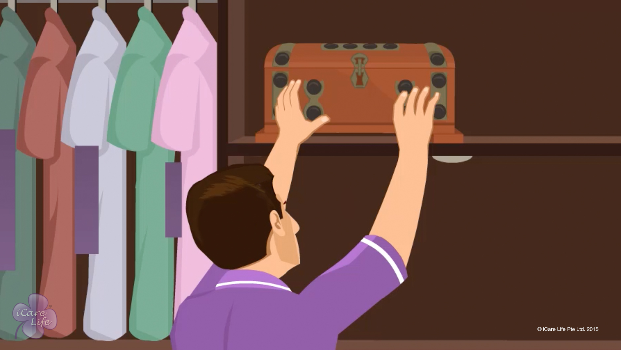
Tidying up the Home Environment
25
Copyright: iCare Life Pte. Ltd., Singapore : This document must not be copied or shared or circulated without the consent of iCare Life and/or its affiliates.

Slide 27
Visit
Post Module Activity
26
Copyright: iCare Life Pte. Ltd., Singapore : This document must not be copied or shared or circulated without the consent of iCare Life and/or its affiliates.
Notes:
Depending on the audience, arrange for a visit to an old age home or a nursing home OR the nursery of a play school. Assign each participant an area that they need to tidy up. Encourage each participant to take inputs from the caretaker at the facility – what needs to be done, how the caretaker keeps the place tidy after use, what techniques/tips of organizing things they use, etc.
Make sure you take prior appointment at the facility.

Slide 28
Summary
Take appropriate permissions before organizing the living area
Sort out any non-essential items that the person does not use every day
Take permission from the family or elder to discard these items
Otherwise, move these items to less frequently used storage areas
Define a place for everything; keep things in the defined place after use
Use baskets, containers, hooks, chest of drawers, and closet systems to organize things
27
Copyright: iCare Life Pte. Ltd., Singapore : This document must not be copied or shared or circulated without the consent of iCare Life and/or its affiliates.
Notes:
Take appropriate permissions before organizing the living area
Sort out any non-essential items that the person does not use every day
Take permission from the family or elder to discard these items
Otherwise, move these items to less frequently used storage areas
Define a place for everything; keep things in the defined place after use
Use baskets, containers, hooks, chest of drawers, and closet systems to organize things

Slide 29
Summary
Stack newspapers and magazines one over the other in a designated shelf; dispose them once in a week
Create a place to store books, DVDs, CDs, and stationery items
If there are babies in the house, ensure that the cabinets within their reach are baby proofed
For elders, store things they use daily at a comfortable height
Ask for the family’s or elder’s preference while storing the items; keep them out of reach of children
Keep a laundry basket to store used clothes
28
Copyright: iCare Life Pte. Ltd., Singapore : This document must not be copied or shared or circulated without the consent of iCare Life and/or its affiliates.
Notes:
Stack newspapers and magazines one over the other in a designated shelf; dispose them once in a week
Create a place to store books, DVDs, CDs, and stationery items
If there are babies in the house, ensure that the cabinets within their reach are baby proofed
For elders, store things they use daily at a comfortable height
Ask for the family’s or elder’s preference while storing the items; keep them out of reach of children
Keep a laundry basket to store used clothes

Slide 30
Summary
Store toys in a toy organizer
To keep the kitchen tidy:
Keep frequently-used things at a reachable distance and
Do not clutter the work surface
In the bathroom:
Organize the toiletries in cabinets and shelves,
Discard all empty bottles and wrappers, and
Put all dirty clothes in laundry every day
29
Copyright: iCare Life Pte. Ltd., Singapore : This document must not be copied or shared or circulated without the consent of iCare Life and/or its affiliates.
Notes:
Store toys in a toy organizer
To keep the kitchen tidy:
Keep frequently-used things at a reachable distance and
Do not clutter the work surface
In the bathroom:
Organize the toiletries in cabinets and shelves,
Discard all empty bottles and wrappers, and
Put all dirty clothes in laundry every day

Slide 31
Any Questions?
30
Copyright: iCare Life Pte. Ltd., Singapore : This document must not be copied or shared or circulated without the consent of iCare Life and/or its affiliates.
Notes:
FAQs
Q.1. What should I do if the person under my care keeps making their living space untidy as soon as I clean it?
Ans. Keep tidying up the place. Gradually, the care receiver will also see the benefits of keeping their space neat and tidy and start contributing to keeping it so.
Q.2. There is a lot of clutter in the care receiver’s room. What should I do?
Ans. Talk to the care receiver and their family. Try to convince them to removing the clutter – either by disposing some items of or moving them to another location in the house.

Slide 32
Using Home Appliances
31
Copyright: iCare Life Pte. Ltd., Singapore : This document must not be copied or shared or circulated without the consent of iCare Life and/or its affiliates.

Slide 33
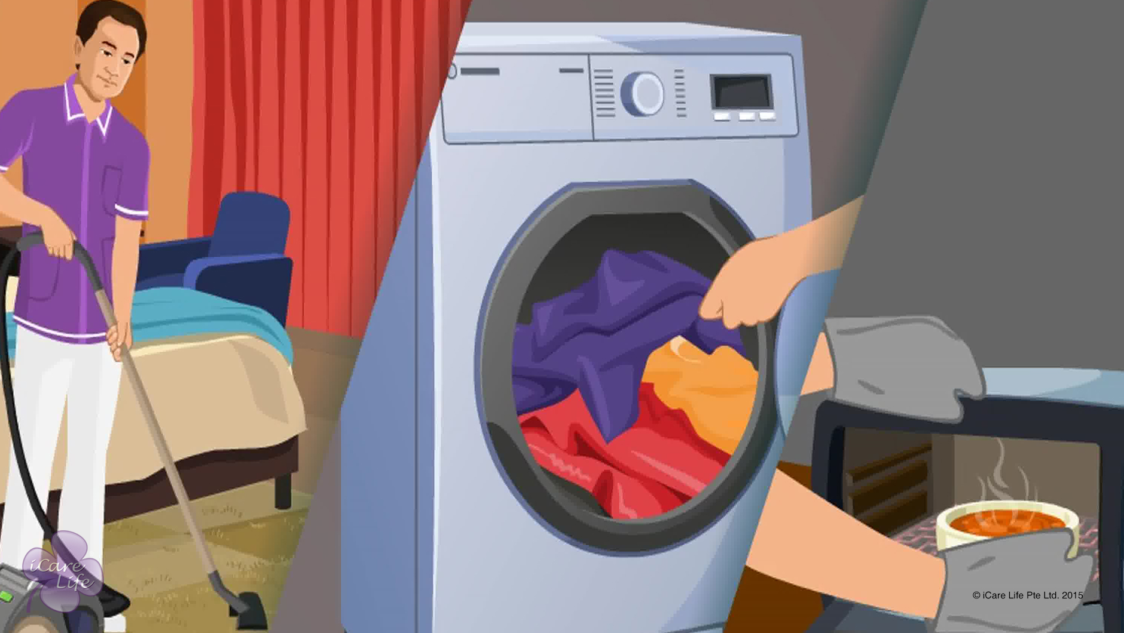
Using Home Appliances
32
Copyright: iCare Life Pte. Ltd., Singapore : This document must not be copied or shared or circulated without the consent of iCare Life and/or its affiliates.

Slide 34
Let’s Practice
Post Module Activity
33
Copyright: iCare Life Pte. Ltd., Singapore : This document must not be copied or shared or circulated without the consent of iCare Life and/or its affiliates.
Notes:
The participants are divided into small batches and given a live demonstration of using the kitchen appliances: juicer, toaster, microwave, dishwasher, food processor, induction gas stove, flame, hotplates, fridge by trained caregivers. This can be conducted in a location which has all appliances. Fix an appointment and inform participants of the time and location for this demonstration.
The participants are divided into small batches and given a live demonstration of using the other home appliances: washing machine, dryer, vacuum cleaner, air conditioner, heater. This can be conducted in location which has all appliances. Fix an appointment and inform participants of the time and location for this demonstration.
During the demonstration, participants of each batch can be assigned tasks such as making juice, toasting bread, heating food in microwave, boiling water on induction stove, chopping vegetables in food processors, clean a rug using vacuum cleaner, operate an air conditioner.

Slide 35
Summary
The common kitchen appliances include:
Reamer
Juicer
Popup toaster
Toaster oven
Sandwich toaster
Food processor
Stove
Induction stove
Hotplate
Microwave
Fridge
34
Copyright: iCare Life Pte. Ltd., Singapore : This document must not be copied or shared or circulated without the consent of iCare Life and/or its affiliates.
Notes:
The common kitchen appliances include:
Reamer
Juicer
Popup toaster
Toaster oven
Sandwich toaster
Food processor
Stove
Induction stove
Hotplate
Microwave
Fridge

Slide 36
Summary
Other home appliances include
Vacuum cleaner
Washing machine
Dryer
Air conditioner
Heater
35
Copyright: iCare Life Pte. Ltd., Singapore : This document must not be copied or shared or circulated without the consent of iCare Life and/or its affiliates.
Notes:
Other home appliances include
Vacuum cleaner
Washing machine
Dryer
Air conditioner
Heater

Slide 37
Any Questions?
36
Copyright: iCare Life Pte. Ltd., Singapore : This document must not be copied or shared or circulated without the consent of iCare Life and/or its affiliates.
Notes:
FAQs
Q1. How do I use an iron?
Ans: To iron clothes:
Set up the ironing board
If using a steam iron, add water
Plug the iron in and set it upright; wait until it heats up
If you are ironing many clothes, read the instructions on each one and follow the correct temperature settings
Place the piece of clothing on the board
Always keep the iron moving and cover all parts of the garment
If required, spray some water on and iron over; or use the steam feature
Turn the fabric and iron on the other side
Immediately after ironing, fold the clothes or hang them up on a hanger
Q2. How do I operate a non-electric toaster?
Ans. You will have to toast the bread over a flame.
Q3. Do I have to cut the fruit or vegetable before putting it in the juicer?
Ans. If the vegetable/fruit will fit in the inlet, you can put it in as is. But, fruits like apple that will not fit, will have to be chopped into smaller pieces.
Q4. Do I have to place anything in the microwave when it is switched off?
Ans. Yes, you can keep a glass of water. It will prevent a situation where the microwave is accidentally switched on with nothing inside.

Slide 38


