Slide 1

Respect, Privacy and Dignity
4
CR 5.2
Standard
Source: Skills for Health – Website http://www.skillsforhealth.org.uk/
Skills for Care – Website http://www.skillsforcare.org.uk/

Slide 2
Learning outcomes
1. Understand the principles that underpin privacy and dignity in care
2. Maintain the privacy and dignity of the individual(s) in their care
3. Support an individual’s right to make choices
4. Support individuals in making choices about their care
5. Understand how to support active participation
6. Support the individual in active participation in their own care
Source: Skills for Health – Website http://www.skillsforhealth.org.uk/
Skills for Care – Website http://www.skillsforcare.org.uk/
1

Slide 3

Privacy and dignity
Two important values when providing care and support are:
Privacy
Giving someone space where and when they need it
Treating personal information confidentially
Dignity
Focusing on the value of every individual
Respecting an individuals views, choices and decisions
Not making assumptions
Working with care and compassion
Communicating directly with the individual whenever possible
Source: Skills for Health – Website http://www.skillsforhealth.org.uk/
Skills for Care – Website http://www.skillsforcare.org.uk/
2
Notes:
Activity: Ask learners what is involved in providing care and support that promote privacy and dignity.
Possible answers
Privacy:
Giving someone space where and when they need it
Treating personal information confidentially
Dignity:
Focusing on the value of every individual
Respecting their views, choices and decisions
Not making assumptions about how they want to be treated
Working with care and compassion
Communicating directly with the individual whenever possible

Slide 4
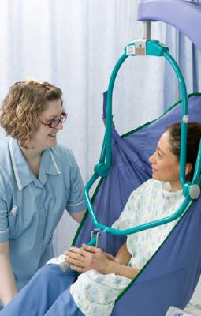
Privacy and dignity in care and support
Dignity and respect issues depends may be different in vary form place to place; some examples of ways in which you can work that respect individuals’ dignity are:
Ask individuals before touching them in any way
Knocking or speaking before entering the particular space or room they are in
Making sure curtains, screens or doors are properly closed before supporting a person to wash or dress
Arranging clothing or hospital gowns in a dignified way
Not making an individual wait to use the toilet or be left too long for you to return
Source: Skills for Health – Website http://www.skillsforhealth.org.uk/
Skills for Care – Website http://www.skillsforcare.org.uk/
3

Slide 5
Making choices
Choice and control are key defining aspects of dignity. Involving individuals in decisions that affect them helps to promote dignity
Day-to-day decisions
Wider decisions
Individuals must be supported to make informed decisions by explaining:
All available options
The risks associated with the options
Implications of making the choices
Source: Skills for Health – Website http://www.skillsforhealth.org.uk/
Skills for Care – Website http://www.skillsforcare.org.uk/
4
Notes:
Activity: Ask learners to think of some examples of day to day choices and decisions that the individual could be involved in.
Possible answers include:
When they want to get up
What they want to wear
What they want to eat
The activities they want to be involved in
Activity: Ask learners to think of some examples of decisions that the individual may not be involved in
Possible answers include:
Financial planning

Slide 6
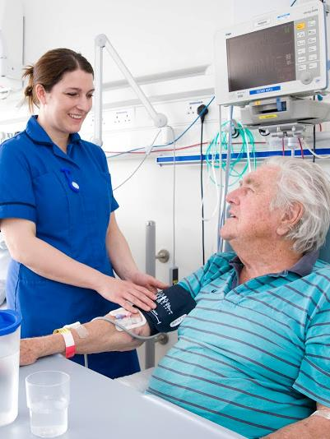
Mental Capacity Assessment
Individuals need to be able to understand and retain the information they need to make a decision and be able to communicate their choice
If they are not able to do this they may be assessed as lacking the capacity to make a decisions
Some individuals may have the capacity to make day-to-day decisions but not have the capacity to make more complex decisions
Source: Skills for Health – Website http://www.skillsforhealth.org.uk/
Skills for Care – Website http://www.skillsforcare.org.uk/
5
Notes:
Additional information
Every effort should be made to support an individual to understand information and to communicate their choices
Individuals can be supported to make decisions by involving other people they trust like friends or relatives
Learners who are not entirely sure that an individual has the capacity to make decision should seek advice and support from their manager or supervisor.
If individuals are assessed as lacking the capacity to make a decision, all decisions made on their behalf must be in their best interests.

Slide 7
Risk assessment
Risk assessment is a key part of care, support, rehabilitation or treatment plans
A five step process is recommended:
1
Identify the hazards
2
Decide who might be harmed and how
3
Evaluate the risks and decide on precautions
4
Record your findings and implement them
5
Review your assessment and update if necessary
Source: Skills for Health – Website http://www.skillsforhealth.org.uk/
Skills for Care – Website http://www.skillsforcare.org.uk/
6
Notes:
Additional information
The 5 step risk assessment model is taken from The Health and Safety Executive (HSE):
www.hse.gov.uk/risk/controlling-risks.htm
If a new activity is going to be introduced, the five steps of risk assessment must be followed first

Slide 8
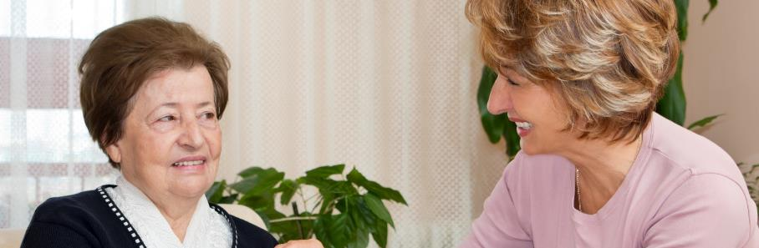
Risk enablement
It is the individual’s right to make choices and take risks once they understand the information available and are aware of the risks
Risk enablement involves supporting individuals to identify and assess risks and then supporting them to take the risks they choose
Source: Skills for Health – Website http://www.skillsforhealth.org.uk/
Skills for Care – Website http://www.skillsforcare.org.uk/
7
Notes:
Additional information
There might be times when someone is unhappy with decisions that have been made on their behalf or with the choices they are offered. If this is not within your power to change you should tell them about their right to complain and support them to follow the complaints procedure.

Slide 9

Supporting active participation
Individuals must be given as much control of their life as possible as this supports an individual to build their identity and self-esteem
Individuals have a right to participate in the activities and relationships of everyday life as independently as possible
Individual’s should be given equal opportunity of achieving their goals, valuing their diversity and finding solutions that work for them
Source: Skills for Health – Website http://www.skillsforhealth.org.uk/
Skills for Care – Website http://www.skillsforcare.org.uk/
8

Slide 10


Self-care
The ability to control and care for oneself contributes to privacy and dignity and individuals should be supported to develop self-care skills to enable them to live more independently
Self care skills include:
Finding information
Accessing appropriate training
Participating in support groups and networks
Self-care: The practices undertaken by people towards maintaining health and wellbeing and managing their own care needs.
Source: Skills for Health – Website http://www.skillsforhealth.org.uk/
Skills for Care – Website http://www.skillsforcare.org.uk/
9

Slide 11







Knowledge check
Which of the following is a practical way of promoting an individual's privacy and dignity at work?
Click to reveal answer
Touch the individual without asking them
Ensuring screens or doors are properly closed before supporting them to wash or get dressed
Make the individual wait to use the toilet
Walk into the room or space that they are in without knocking or speaking first
Source: Skills for Health – Website http://www.skillsforhealth.org.uk/
Skills for Care – Website http://www.skillsforcare.org.uk/
10
Notes:
Trainer should ask class why they chose the correct answer.
Feedback
A – To touch a person you must enter their personal space. You should always ask the individual before you touch them in any way.
B – If your role involves supporting individuals to wash or dress make sure you protect their dignity and privacy by making sure curtains, screens or doors are properly closed.
C – If someone needs support to go to the toilet they should not have to wait or be left too long for you to return.
D – Health and social care workers should knock on the door or speak before entering the particular space or room that the individual is in.

Slide 12


Knowledge check
How can you support an individual to make an informed decision?
Click to reveal answer
By explaining the least risky options, the risks and implications
By making the decision for the individual
By telling them what you would do
By explaining all choices, risks and implications
Source: Skills for Health – Website http://www.skillsforhealth.org.uk/
Skills for Care – Website http://www.skillsforcare.org.uk/
11
Notes:
Trainer should ask class why they chose the correct answer.
Feedback
A – Individuals have the right to make decisions that are risky or unwise. They should be aware of ALL options that are available to them as well as the risks and implications of each
B – Individuals must be involved in making decisions about the care and support they receive whenever possible. If a decision is difficult to make they could be supported by involving their support network or an advocate.
C – Choices are shaped by things like their background, values, culture, religion or past experiences. These are unique to the individual so a decision that is right for you may not be right for the individual. The individual should be given all available options, risks and implications and supported to make their own decisions whenever possible.
D – Health and social care workers can support individuals to make decisions by ensuring that they understand all their options and the risks and implications of making each decision.

Slide 13
Knowledge check
Which term is used to describe participation in the activities and relationships of everyday life as independently as possible?
Click to reveal answer
Self-care
Active participation
Risk assessment
Mental capacity
Source: Skills for Health – Website http://www.skillsforhealth.org.uk/
Skills for Care – Website http://www.skillsforcare.org.uk/
12
Notes:
Trainer should ask class why they chose the correct answer.
Feedback
A – Self-care is the term used to describe ways of working that support individuals to develop the skills to live more independently.
B – Active participation builds self-esteem and identity by working in ways that give then equality of opportunity in achieving their goals, valuing their diversity and finding solutions that work for them.
C – Risk assessment is the process of identifying risks, who could be harmed, evaluating risks and identifying precautions, recording and implementing findings and finally, reviewing the assessment and updating it when necessary
D – Mental capacity is the term used to describe an individual’s ability to retain and understand information for long enough to make a decision and to communicate their decision.

Slide 14
Viewing of Modules
Respect, Privacy & Dignity of Elders
CR 5.2
Private and Confidential

Slide 15
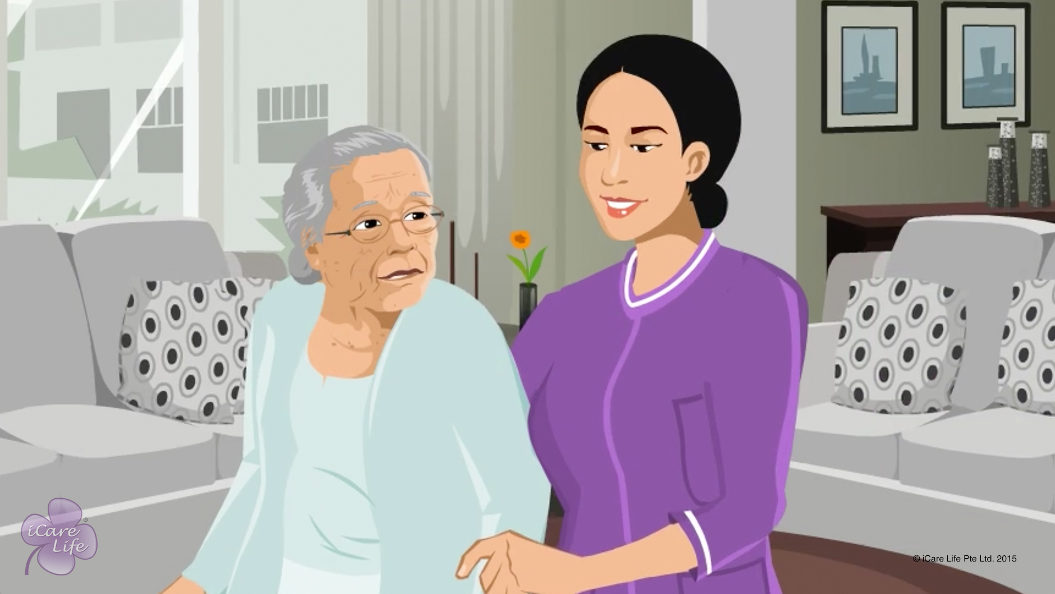
Respecting the Elder’s Dignity
1
Copyright: iCare Life Pte. Ltd., Singapore : This document must not be copied or shared or circulated without the consent of iCare Life and/or its affiliates.

Slide 16
In this module, you will learn about:
The ways to care for the elder while respecting the elder’s dignity
2
Copyright: iCare Life Pte. Ltd., Singapore : This document must not be copied or shared or circulated without the consent of iCare Life and/or its affiliates.

Slide 17
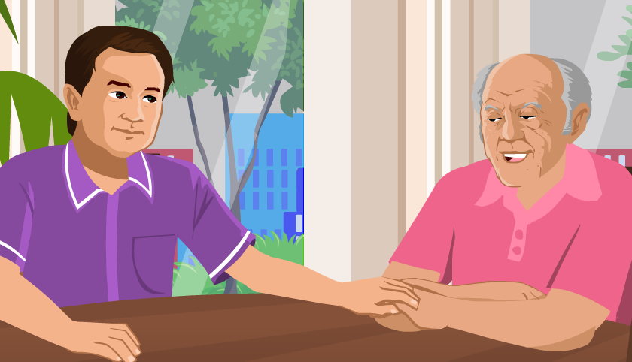
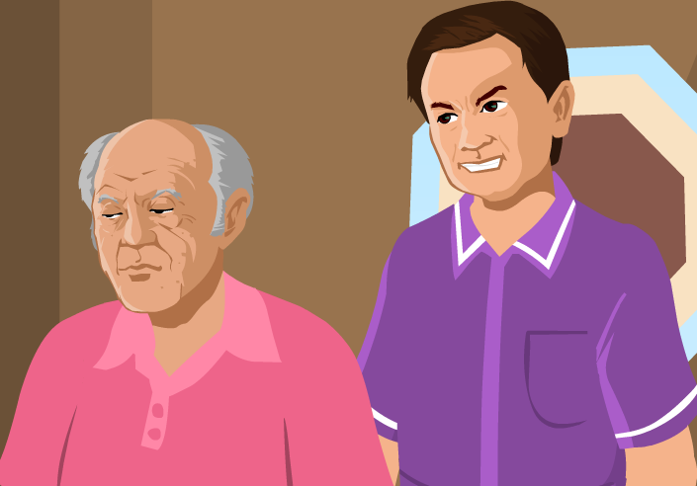
Pre-Module Activity
What is the difference between these two pictures?
3
Copyright: iCare Life Pte. Ltd., Singapore : This document must not be copied or shared or circulated without the consent of iCare Life and/or its affiliates.
Notes:
Draw the attention of the participants to the images on the screen. Read the question on the screen aloud – What is the difference between these two pictures?
Ask the participants to share what they feel is happening in these two pictures and how they are different. If no responses come from the participants, point to each picture in turn and ask the how the elder is being treated in that picture.
Possible answers for the picture on the left are: Respect, care, love
Possible answers for the picture on the right are: Disrespect, anger, hate
Make the participants realize that the picture on the left shows an elder being treated with respect and the picture on the right shows an elder being treated with disrespect. Now move on to the next slide.

Slide 18
Pre-Module Activity
How would you like to be treated?
Copyright: iCare Life Pte. Ltd., Singapore : This document must not be copied or shared or circulated without the consent of iCare Life and/or its affiliates.
Notes:
Ask the participants to imagine themselves in the position of the elder shown n the picture. Read the question on the screen aloud – How would you like to be treated?
If no responses come from the participants, ask the participants who would like to be treated with respect to raise their hands.
Explain that the elderly people also have the same requirement. They have self-respect and dignity, which they want to preserve. State that a caregiver should find ways to help the elder while respecting their dignity as discussed in the following module.

Slide 19

Let’s Watch
Respecting the Elder’s Dignity
5
Copyright: iCare Life Pte. Ltd., Singapore : This document must not be copied or shared or circulated without the consent of iCare Life and/or its affiliates.

Slide 20
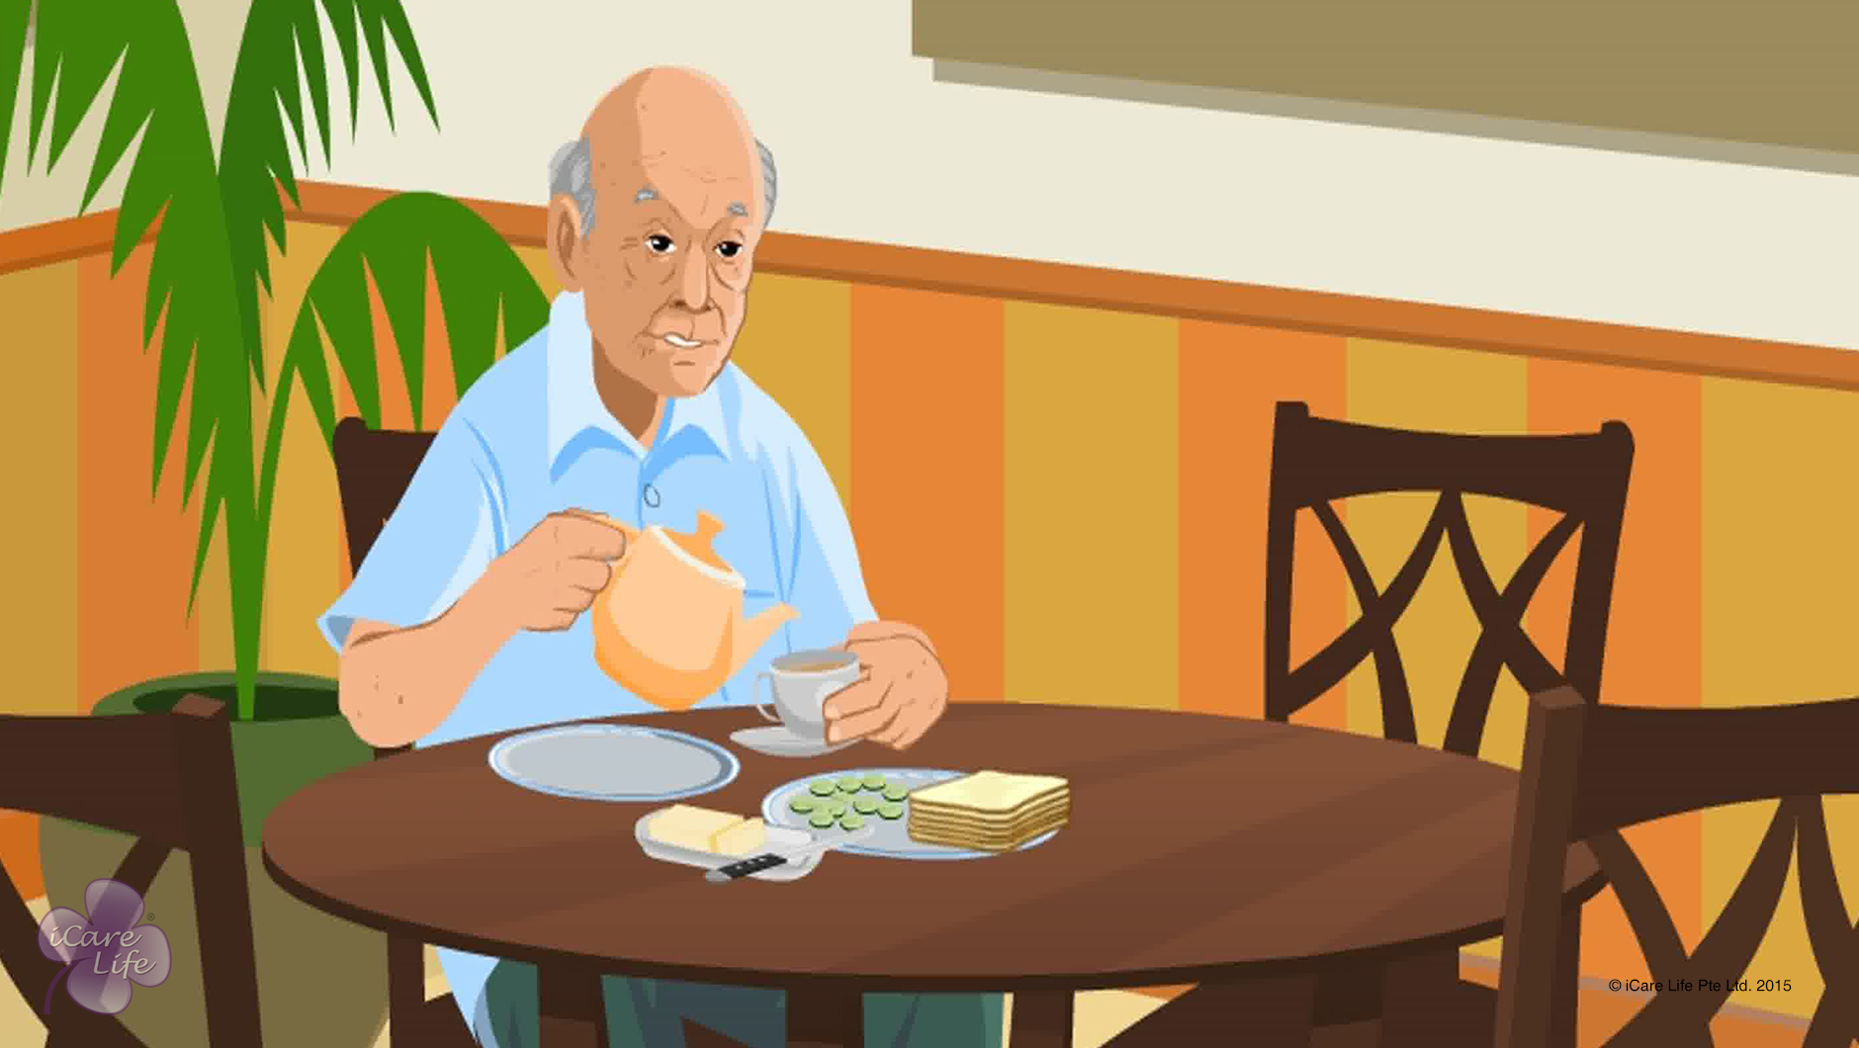
Encouraging Independence in the Elder
6
Copyright: iCare Life Pte. Ltd., Singapore : This document must not be copied or shared or circulated without the consent of iCare Life and/or its affiliates.

Slide 21
In this module, you will learn about:
The reasons for encouraging independence in the elder
A few ways to encourage independence in the elder
7
Copyright: iCare Life Pte. Ltd., Singapore : This document must not be copied or shared or circulated without the consent of iCare Life and/or its affiliates.

Slide 22
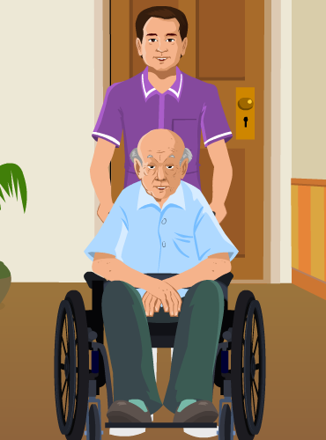
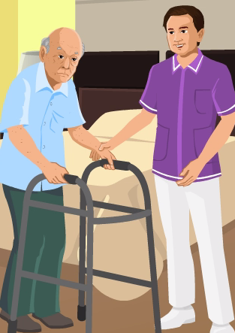
Pre-Module Activity
Who is being of more help?
Copyright: iCare Life Pte. Ltd., Singapore : This document must not be copied or shared or circulated without the consent of iCare Life and/or its affiliates.
Notes:
Draw the participants’ attention to the pictures shown on the screen. If required explain that the picture on the left shows a caregiver pushing an elder in a wheelchair and in the picture on the right the caregiver is helping an elder walk with the help of a walking aid.
Say aloud the question on eth screen – Which of these two caregivers is being of more help to the elder?
Invite the participants’ responses to the question. Accept all answers.
Next ask the following question – Which caregiver is making the elder feel more independent?
Accept all answers. Explain that both caregivers are helping the elder to perform an activity like going outdoors. However, the caregiver on the right is helping the elder perform that activity more independently. This way, the caregiver is not only helping the elder physically, but also emotionally. Explain that though elders require a lot of care, they do not like to be always dependent on others. A caregiver must try and encourage independence in an elder. Why this is necessary and how a caregiver can do this is explained in the module that follows.

Slide 23
Let’s Watch
Encouraging Independence in the Elder
9
Copyright: iCare Life Pte. Ltd., Singapore : This document must not be copied or shared or circulated without the consent of iCare Life and/or its affiliates.

Slide 24
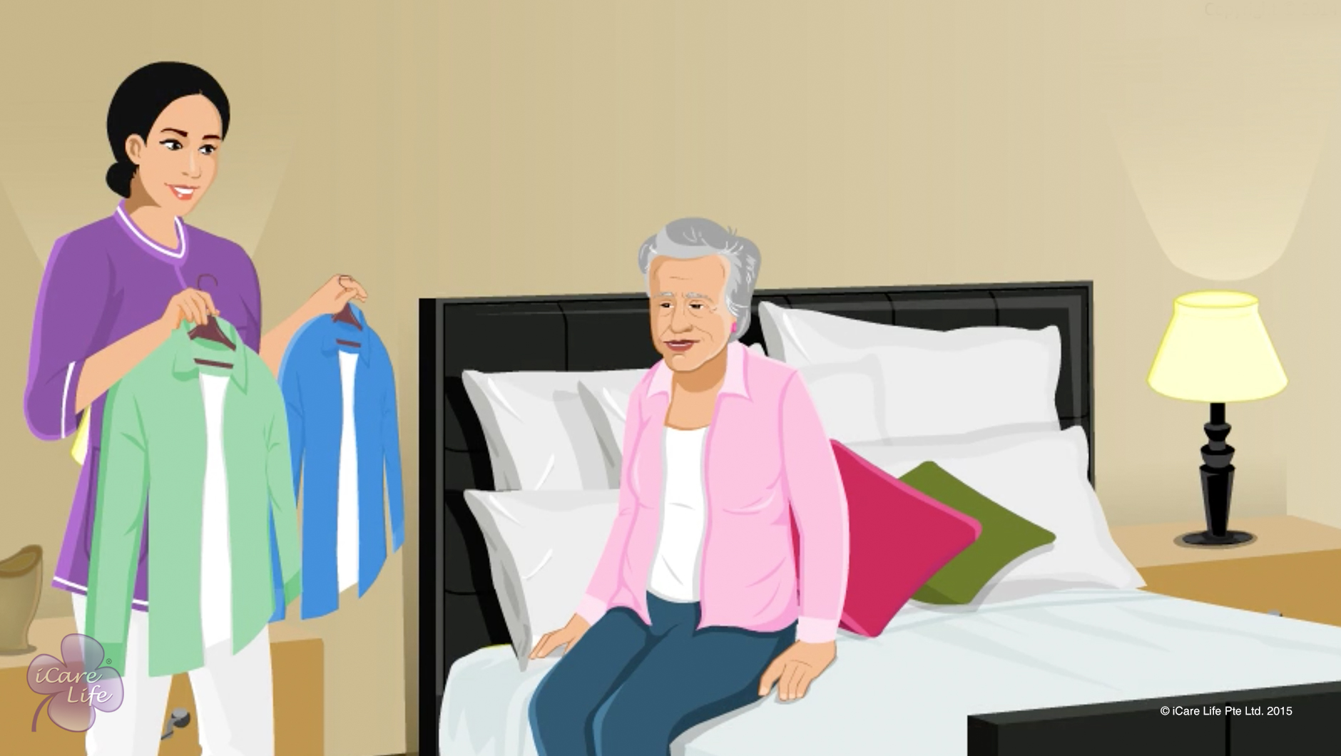
Giving the right of choice
10
Copyright: iCare Life Pte. Ltd., Singapore : This document must not be copied or shared or circulated without the consent of iCare Life and/or its affiliates.

Slide 25
In this module, you will learn about:
The ways to respect the elder’s right of choice
11
Copyright: iCare Life Pte. Ltd., Singapore : This document must not be copied or shared or circulated without the consent of iCare Life and/or its affiliates.

Slide 26
Let’s Watch
Giving the right of choice
12
Copyright: iCare Life Pte. Ltd., Singapore : This document must not be copied or shared or circulated without the consent of iCare Life and/or its affiliates.

Slide 27
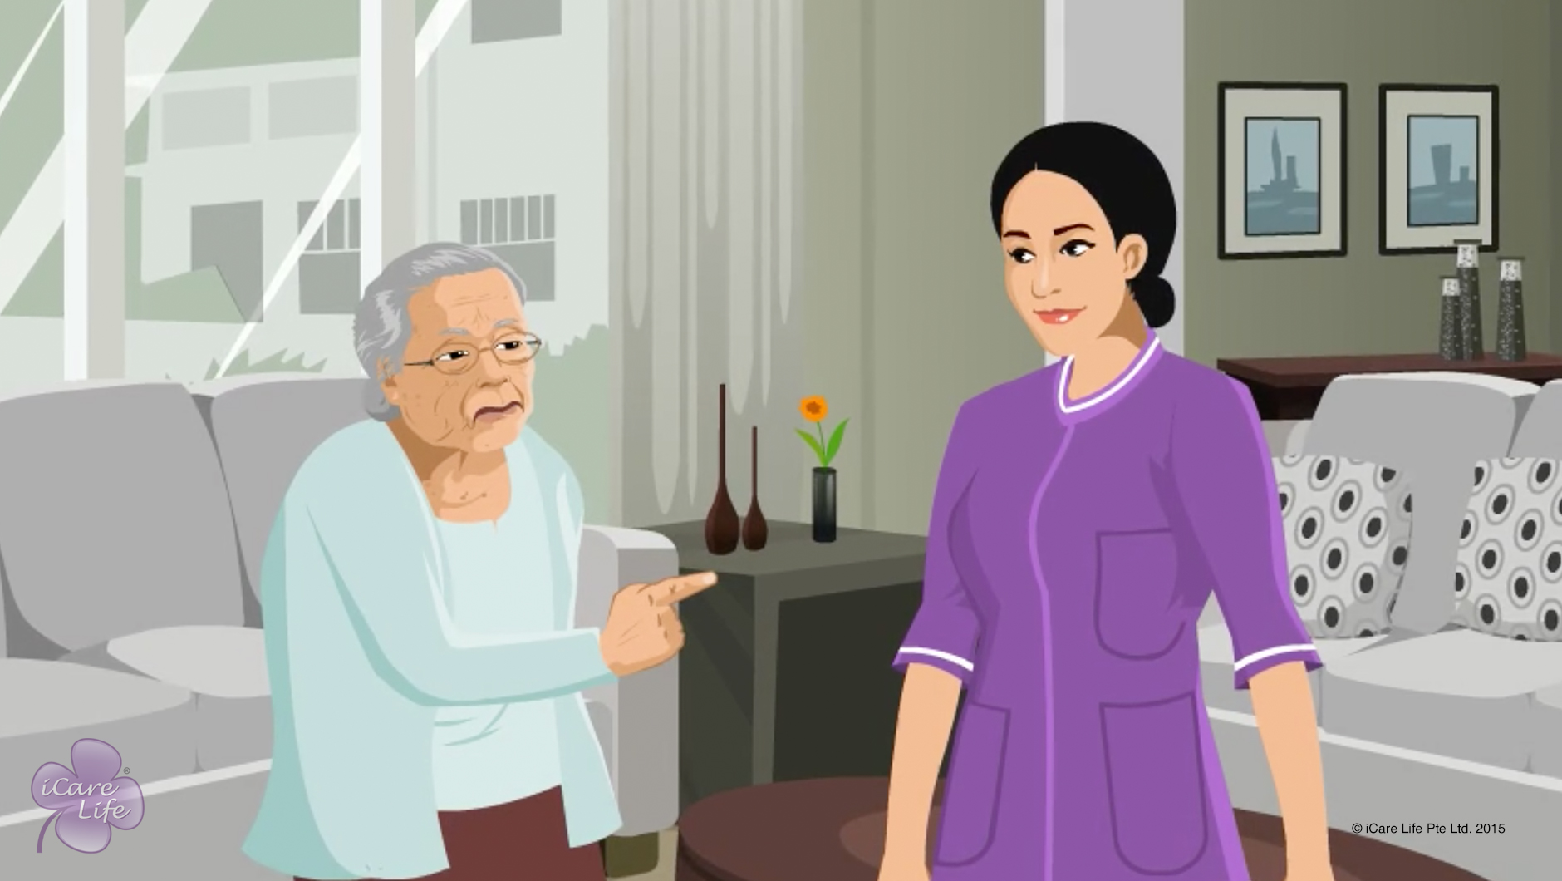
Handling Disagreements with the Elder
13
Copyright: iCare Life Pte. Ltd., Singapore : This document must not be copied or shared or circulated without the consent of iCare Life and/or its affiliates.

Slide 28
In this module, you will learn about:
A few reasons why disagreements happen with elders
How should you handle a disagreement with an elder
14
Copyright: iCare Life Pte. Ltd., Singapore : This document must not be copied or shared or circulated without the consent of iCare Life and/or its affiliates.

Slide 29
Let’s Watch
Handling Disagreements with the Elder
15
Copyright: iCare Life Pte. Ltd., Singapore : This document must not be copied or shared or circulated without the consent of iCare Life and/or its affiliates.

Slide 30
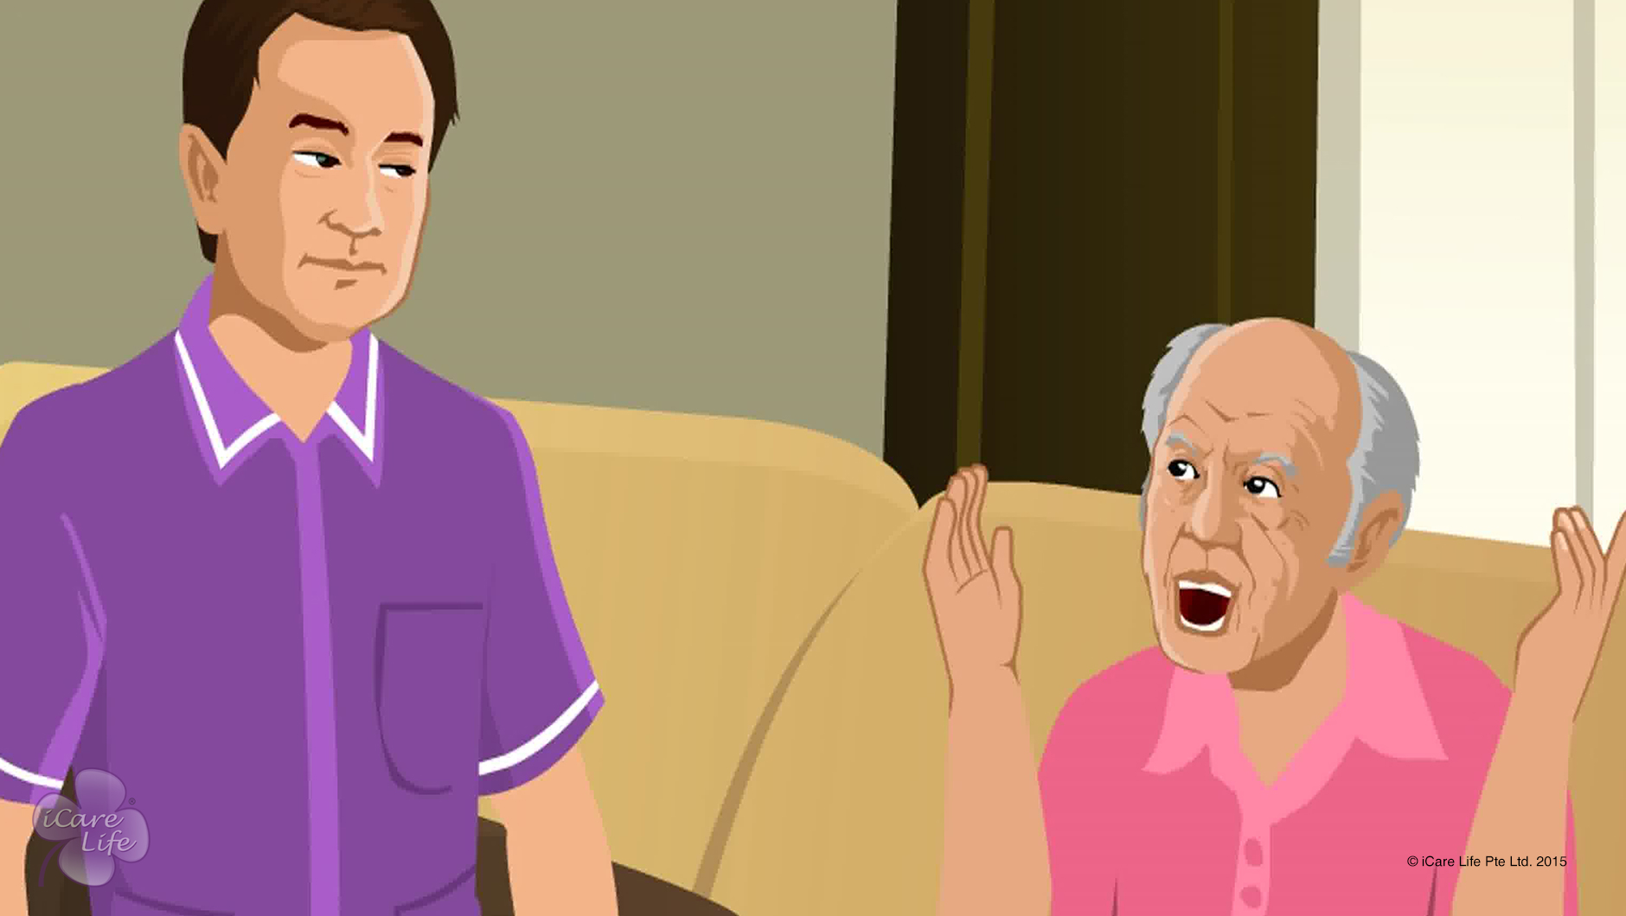
Handling disrespectful behavior
16
Copyright: iCare Life Pte. Ltd., Singapore : This document must not be copied or shared or circulated without the consent of iCare Life and/or its affiliates.

Slide 31
In this module, you will learn about:
Why the elder is disrespectful
The strategies to correct disrespectful behavior of the ward
The strategies to handle your own emotions in the situation
17
Copyright: iCare Life Pte. Ltd., Singapore : This document must not be copied or shared or circulated without the consent of iCare Life and/or its affiliates.

Slide 32
Let’s Watch
Handling disrespectful behavior
18
Copyright: iCare Life Pte. Ltd., Singapore : This document must not be copied or shared or circulated without the consent of iCare Life and/or its affiliates.

Slide 33


