Slide 1

Viewing of Modules
Activities of Daily Living – Personal Care
CR 5.3
Private and Confidential

Slide 2
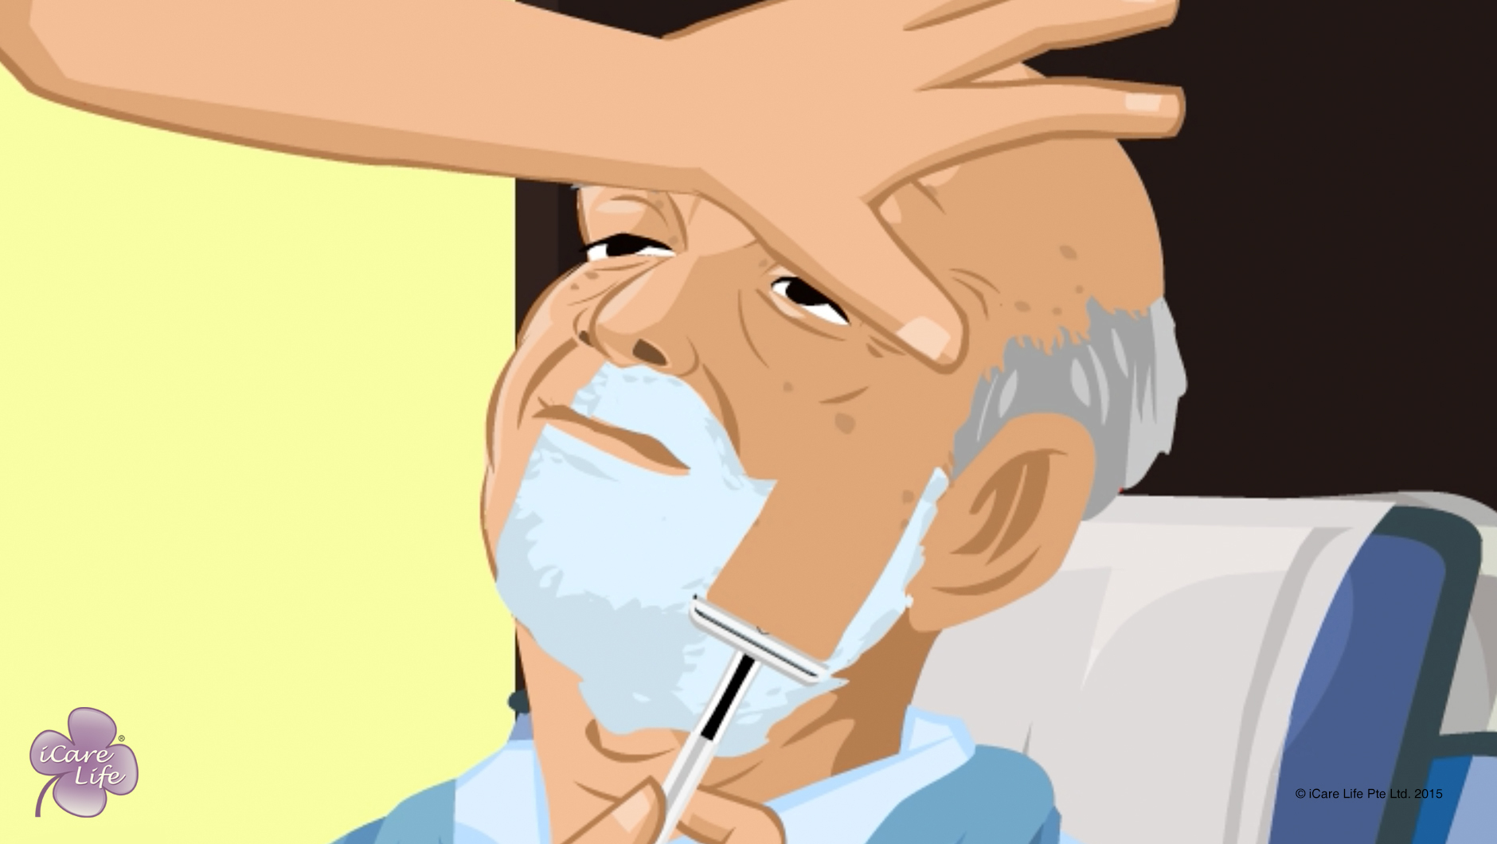
Shaving the Elder
1
Copyright: iCare Life Pte. Ltd., Singapore : This document must not be copied or shared or circulated without the consent of iCare Life and/or its affiliates.

Slide 3
In this module, you will learn about:
The various items required for shaving
The correct way of shaving an elder
The precautions to take while shaving an elder
2

Slide 4

Let’s Watch
Shaving the Elder
3
Copyright: iCare Life Pte. Ltd., Singapore : This document must not be copied or shared or circulated without the consent of iCare Life and/or its affiliates.

Slide 5
Post-Module Activity
Practical Training
4
Copyright: iCare Life Pte. Ltd., Singapore : This document must not be copied or shared or circulated without the consent of iCare Life and/or its affiliates.
Notes:
The participants are given a live demonstration of using different kinds of razors and shaving elderly people sitting up and lying down in bed by trained caregivers. The ideal place for this would be an old people’s home or a nursing home. Fix a prior appointment for the activity and inform the participants of the location and timings for the demonstration.
During the demonstration, participants can be assigned tasks like finding out an elder’s preference and collecting all the items required for shaving an elder. If additional subjects are available, one by one the participants can shave elderly people under the supervision of a trained caregiver.

Slide 6
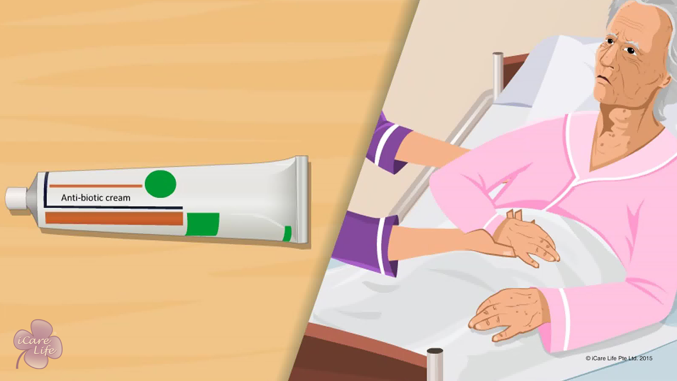
Caring for Bed Sores
5
Copyright: iCare Life Pte. Ltd., Singapore : This document must not be copied or shared or circulated without the consent of iCare Life and/or its affiliates.

Slide 7
In this module, you will learn about:
What is a bed sore?
Why do bed sores occur?
The parts of the body where bed sores can occur
How to prevent and treat bed sores
6
Copyright: iCare Life Pte. Ltd., Singapore : This document must not be copied or shared or circulated without the consent of iCare Life and/or its affiliates.

Slide 8
Let’s Watch
Caring for Bed Sores
7
Copyright: iCare Life Pte. Ltd., Singapore : This document must not be copied or shared or circulated without the consent of iCare Life and/or its affiliates.

Slide 9
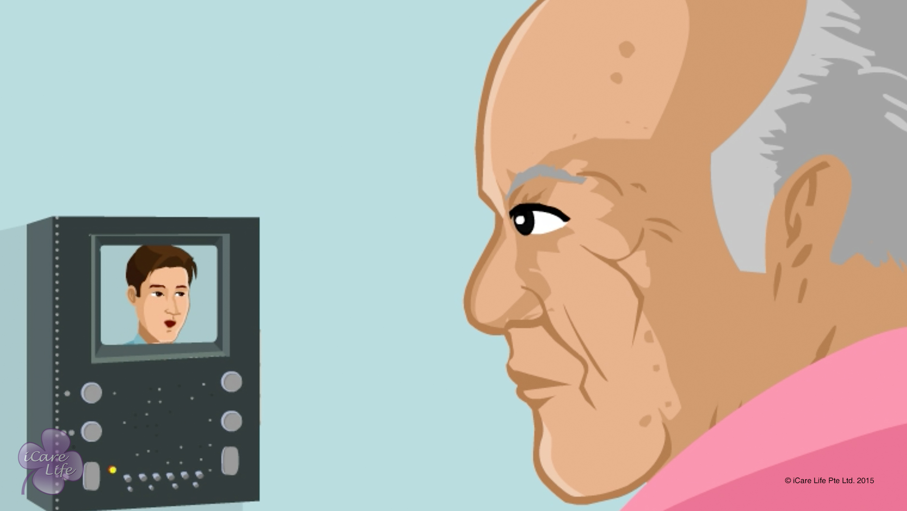
Home Safety of the Elder
8
Copyright: iCare Life Pte. Ltd., Singapore : This document must not be copied or shared or circulated without the consent of iCare Life and/or its affiliates.

Slide 10
In this module, you will learn about:
The common safety concerns for elders in the house
The problem areas in the house that can endanger an elder
The ways to make problem areas of the house safe for elders
9
Copyright: iCare Life Pte. Ltd., Singapore : This document must not be copied or shared or circulated without the consent of iCare Life and/or its affiliates.

Slide 11
Let’s Watch
Home Safety of the Elder
10
Copyright: iCare Life Pte. Ltd., Singapore : This document must not be copied or shared or circulated without the consent of iCare Life and/or its affiliates.

Slide 12
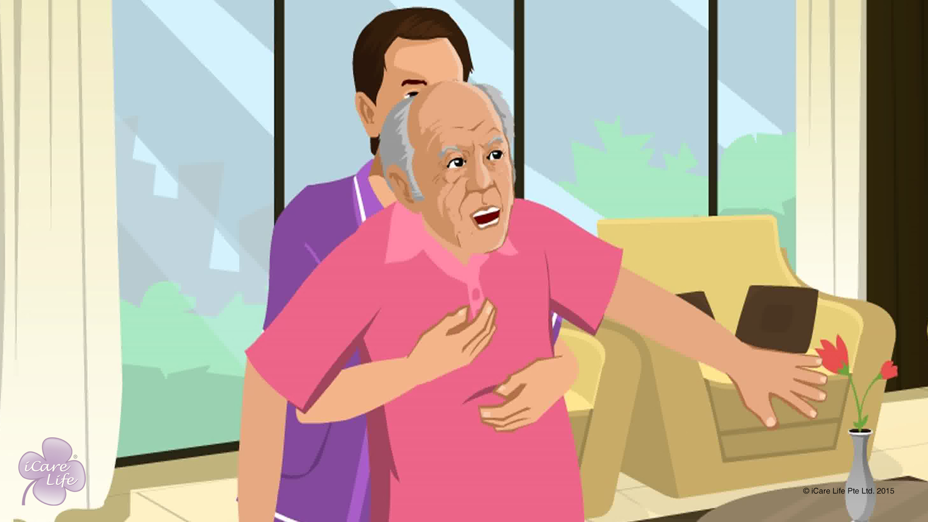
Handling falls of the Elder
11
Copyright: iCare Life Pte. Ltd., Singapore : This document must not be copied or shared or circulated without the consent of iCare Life and/or its affiliates.

Slide 13
In this module, you will learn about:
The steps to take if the elder is falling
The steps to take if the elder falls
12
Copyright: iCare Life Pte. Ltd., Singapore : This document must not be copied or shared or circulated without the consent of iCare Life and/or its affiliates.

Slide 14
Let’s Watch
Handling falls of the Elder
13
Copyright: iCare Life Pte. Ltd., Singapore : This document must not be copied or shared or circulated without the consent of iCare Life and/or its affiliates.

Slide 15
Post Module activity
Let’s Practice
14
Copyright: iCare Life Pte. Ltd., Singapore : This document must not be copied or shared or circulated without the consent of iCare Life and/or its affiliates.
Notes:
Material required: A thick mattress, a sturdy chair
If possible, arrange for two trained caregivers to demonstrate how to assist a person during and after a fall.
Next, invite participants in pairs to play the role of a caregiver and elderly person. Make sure the two participants at a time are both men or both women.
The person playing the part of the elder stands on the middle of the mattress and pretends to fall. The participant can choose the direction of fall. The participant playing caregiver needs to assist the elderly during the fall.
During this phase point out any attempt to grab the falling person. Also point out whether the caregiver has managed to support the falling person’s head or not.
After the fall, the participant playing the elderly person can choose to be injured, able to get up without help or require help to get up. Depending on the situation, the person playing caregiver’s role needs to take appropriate action.
Point out any mistake in the caregiver’s actions in calling for emergency services (if the person is injured), correct way of making the person get up (if the person can get up without help), or calling for additional help (if the person cannot get up without help).
Ensure all participants get a turn to play the role of a caregiver.

Slide 16
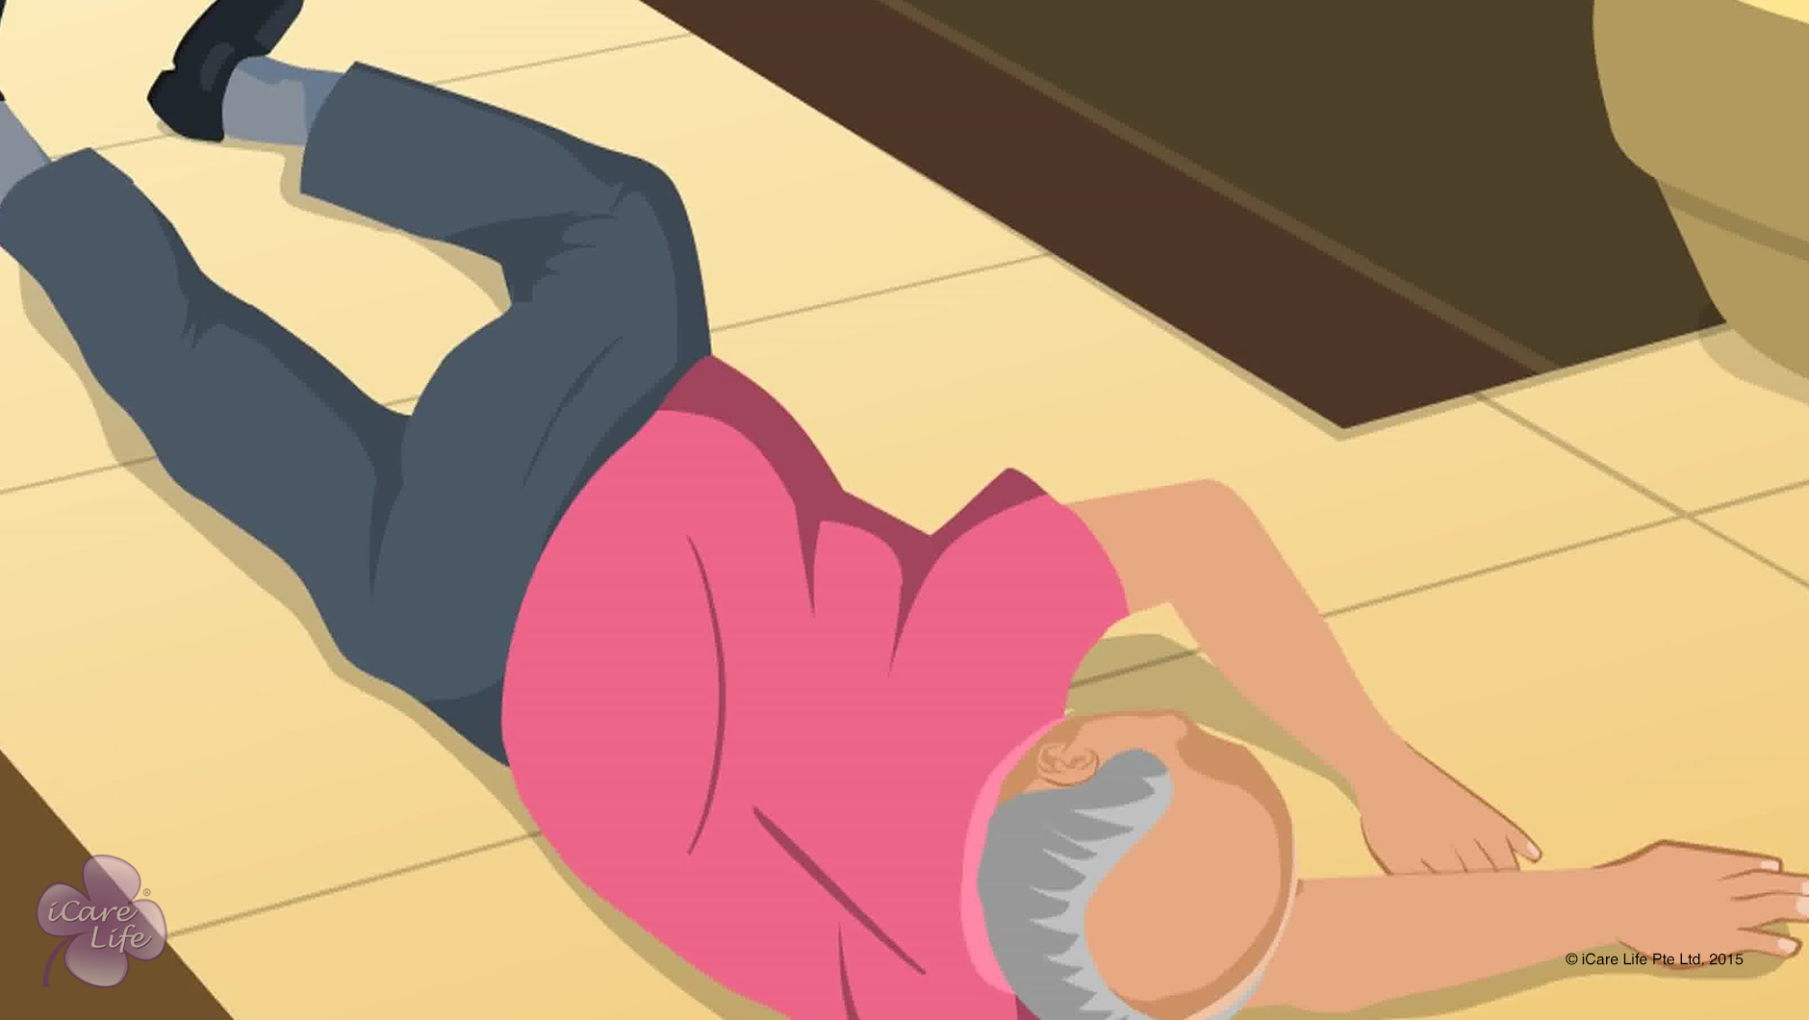
Preventing Falls of the Elder
15
Copyright: iCare Life Pte. Ltd., Singapore : This document must not be copied or shared or circulated without the consent of iCare Life and/or its affiliates.

Slide 17
In this module, you will learn about:
The common reasons for falls in elderly people
The safety precautions to prevent the elder from falling in the house
16
Copyright: iCare Life Pte. Ltd., Singapore : This document must not be copied or shared or circulated without the consent of iCare Life and/or its affiliates.

Slide 18
Let’s Watch
Preventing Falls of the Elder
17
Copyright: iCare Life Pte. Ltd., Singapore : This document must not be copied or shared or circulated without the consent of iCare Life and/or its affiliates.

Slide 19
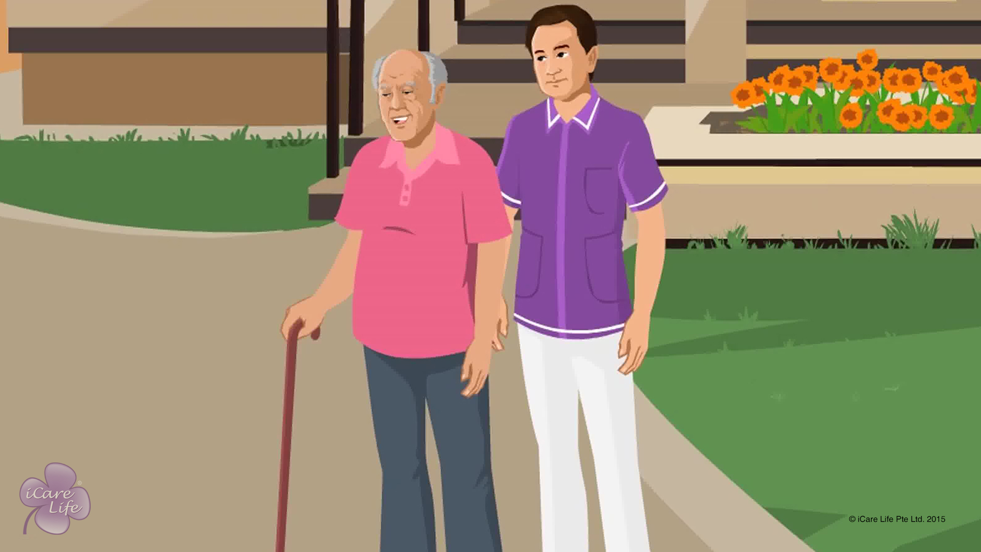
Support the Elder in Walking
18
Copyright: iCare Life Pte. Ltd., Singapore : This document must not be copied or shared or circulated without the consent of iCare Life and/or its affiliates.

Slide 20
In this module, you will learn about:
The medical conditions that may affect the ability of an elder to walk independently
The assistive equipment available for walking
The steps to support an elder while walking
The correct pace and position to support an elder while walking
19
Copyright: iCare Life Pte. Ltd., Singapore : This document must not be copied or shared or circulated without the consent of iCare Life and/or its affiliates.

Slide 21
Let’s Watch
Support the Elder in Walking
20
Copyright: iCare Life Pte. Ltd., Singapore : This document must not be copied or shared or circulated without the consent of iCare Life and/or its affiliates.

Slide 22


