Slide 1

Modules Summary Discussion – Q&A
CR 6.1
Private and Confidential

Slide 2

Importance of Outdoor Activities for the Elder
1
Copyright: iCare Life Pte. Ltd., Singapore : This document must not be copied or shared or circulated without the consent of iCare Life and/or its affiliates.

Slide 3
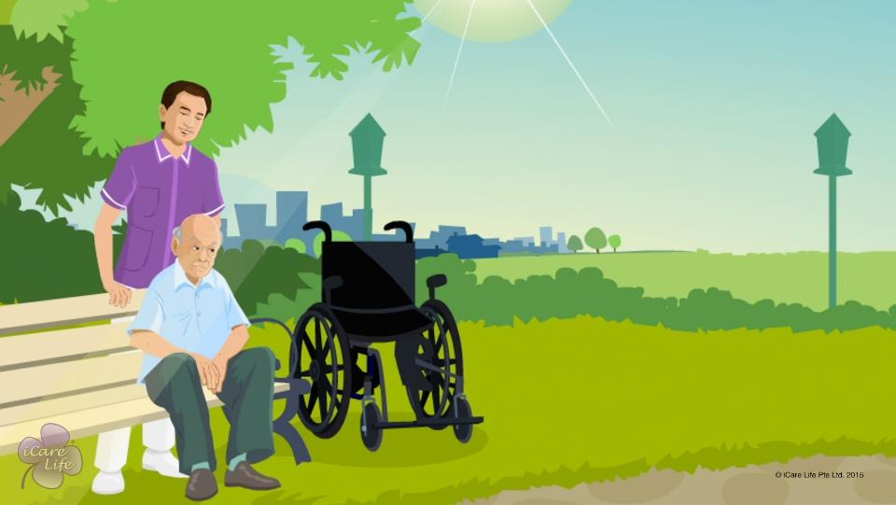
Importance of Outdoor Activities
2
Copyright: iCare Life Pte. Ltd., Singapore : This document must not be copied or shared or circulated without the consent of iCare Life and/or its affiliates.

Slide 4
Summary
Going outdoors helps the elders:
Get fresh air and sunshine
Relieve stress and anxiety
Meet people
Feel a sense of freedom
Improve self-confidence
Get a change in routine
When the weather is extremely hot or cold or the weather forecast shows rain, snow or thunderstorm, do not take the elder for an outdoor activity
Also avoid outdoor activity if the elder is not well or feel anxious about going out
3
Copyright: iCare Life Pte. Ltd., Singapore : This document must not be copied or shared or circulated without the consent of iCare Life and/or its affiliates.
Notes:
Going outdoors helps the elders:
Get fresh air and sunshine
Relieve stress and anxiety
Meet people
Feel a sense of freedom
Improve self-confidence
Get a change in routine
When the weather is extremely hot or cold or the weather forecast shows rain, snow or thunderstorm, do not take the elder for an outdoor activity
Also avoid outdoor activity if the elder is not well or feel anxious about going out

Slide 5
Any Questions?
4
Copyright: iCare Life Pte. Ltd., Singapore : This document must not be copied or shared or circulated without the consent of iCare Life and/or its affiliates.
Notes:
Q1: What should I do if the elder in my care always refuses to go out of the house for any activity?
Ans: As a caregiver, you should try and find the reason why the elder refuses to go outdoors. It may be the fear of leaving the safety and comfort of the house. It may also be anxiety about meeting other people. Find the reason and a solution to the elder’s problem. For example, you may share the list of all the things you plan to take along. Keep reassuring the elder that the experience will be good. Also explain the benefits of outdoor activities to the elder. Be patient and plan activities for shorter durations first. Once the elder feels more confident about going outdoors, you can increase the time for the outdoor activities.

Slide 6

Planning an Outing for the Elder
5
Copyright: iCare Life Pte. Ltd., Singapore : This document must not be copied or shared or circulated without the consent of iCare Life and/or its affiliates.

Slide 7
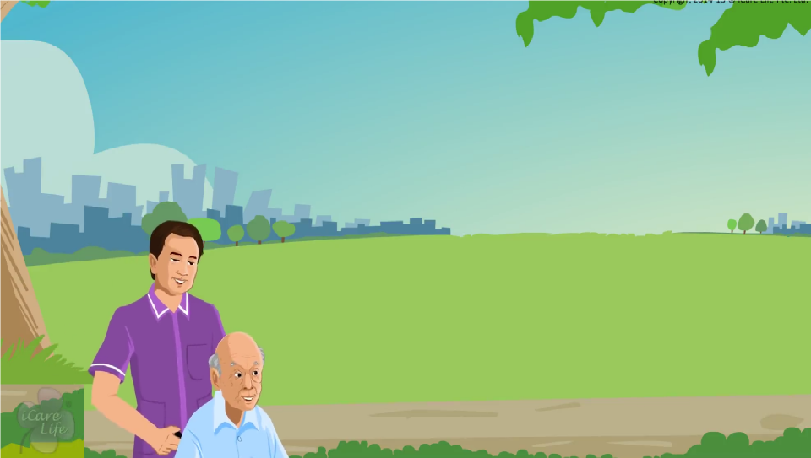
Planning an Outing for the Elder
6
Copyright: iCare Life Pte. Ltd., Singapore : This document must not be copied or shared or circulated without the consent of iCare Life and/or its affiliates.

Slide 8
Summary
Some outdoor activities suitable for elders are:
Visit to a park
A picnic
Visit to children’s playground
Sports like kite flying and fishing
Shopping
Gardening
Feeding birds
When planning the outing:
Visit the place before taking the elder there
Make sure the place has accessible paths, benches and toilets
Carry an outing bag with required medicines, light snacks and a water bottle
Ensure the elder is suitably dressed for the outing
Always be very alert on an outing
7
Copyright: iCare Life Pte. Ltd., Singapore : This document must not be copied or shared or circulated without the consent of iCare Life and/or its affiliates.
Notes:
Some outdoor activities suitable for elders are:
Visit to a park
A picnic
Visit to children’s playground
Sports like kite flying and fishing
Shopping
Gardening
Feeding birds
When planning the outing:
Visit the place before taking the elder there
Make sure the place has accessible paths, benches and toilets
Carry an outing bag with required medicines, light snacks and a water bottle
Ensure the elder is suitably dressed for the outing
Always be very alert on an outing

Slide 9
Any Questions?
8
Copyright: iCare Life Pte. Ltd., Singapore : This document must not be copied or shared or circulated without the consent of iCare Life and/or its affiliates.
Notes:
Q1: How do I know which outdoor activity is right for the elder in my care?
Ans: Talk to the elder about the idea of going out for an activity. Ask for elder’s suggestions about the type of activity. Find out which type of activities the elder enjoys or used to enjoy earlier. Based on this information, plan a suitable outdoor activity for the elder. If the outing involves any type of strenuous activity like walking or sitting for long periods of time, check with the elder’s doctor before going for the outing.

Slide 10

Importance of Social Connections for the Elder
9
Copyright: iCare Life Pte. Ltd., Singapore : This document must not be copied or shared or circulated without the consent of iCare Life and/or its affiliates.

Slide 11
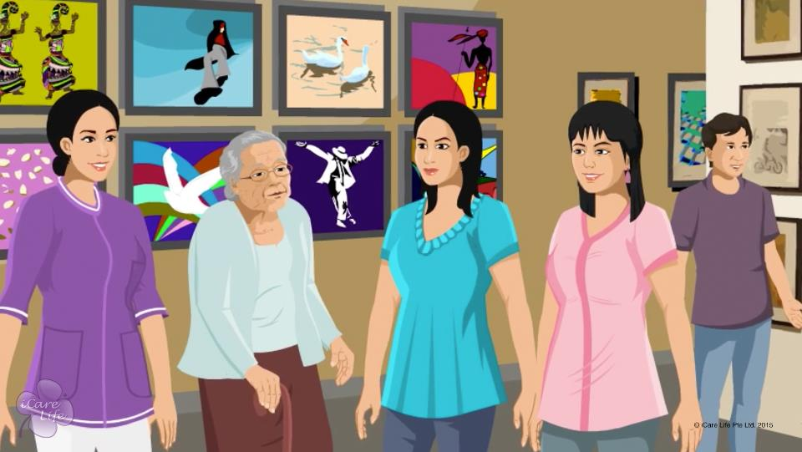
Importance of Social Connections for the Elder
10
Copyright: iCare Life Pte. Ltd., Singapore : This document must not be copied or shared or circulated without the consent of iCare Life and/or its affiliates.

Slide 12
Summary
Acknowledge the importance of social connections for the elder
Encourage the elder to stay abreast with the current times
Talk to the elder’s family and encourage them to spend time with the elder
Encourage elders to meet new people and make friends with those with similar interests
Listen to the elder patiently and try to keep them in good cheer
11
Copyright: iCare Life Pte. Ltd., Singapore : This document must not be copied or shared or circulated without the consent of iCare Life and/or its affiliates.
Notes:
Acknowledge the importance of social connections for the elder
Encourage the elder to stay abreast with the current times
Talk to the elder’s family and encourage them to spend time with the elder
Encourage elders to meet new people and make friends with those with similar interests
Listen to the elder patiently and try to keep them in good cheer

Slide 13
Any Questions?
12
Copyright: iCare Life Pte. Ltd., Singapore : This document must not be copied or shared or circulated without the consent of iCare Life and/or its affiliates.
Notes:
Q1. How do I help the elder spend more time with the family?
Ans. Speak to the family members and request them to spend time with the elder. Help the elder learn how to use latest technological gadgets like a mobile. Try and match the playing/walking schedules of the grandchildren with the elders so that interaction increases. Encourage the elders to watch news programs on TV regularly so that they find it easier to converse and connect with their friends.

Slide 14
Involving the Elder in Social Activities
13
Copyright: iCare Life Pte. Ltd., Singapore : This document must not be copied or shared or circulated without the consent of iCare Life and/or its affiliates.

Slide 15
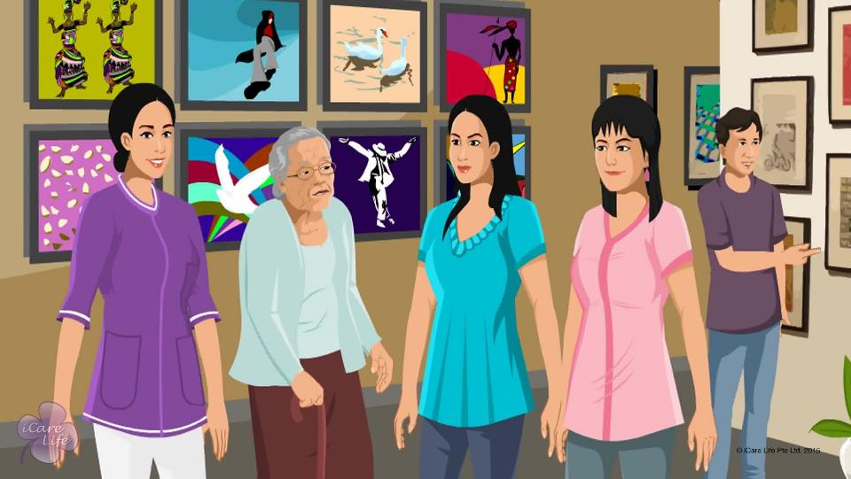
Involving the Elder in Social Activities
14
Copyright: iCare Life Pte. Ltd., Singapore : This document must not be copied or shared or circulated without the consent of iCare Life and/or its affiliates.

Slide 16
Case Study
Post Module Activity
15
Copyright: iCare Life Pte. Ltd., Singapore : This document must not be copied or shared or circulated without the consent of iCare Life and/or its affiliates.
Notes:
Divide the class into two groups. Give the following case study to both the groups and ask them to discuss and write answers for the questions. The time limit for this activity would be 10 minutes.
Case Study: John is a retired policeman and is 75 years old. He lives with his son, son’s wife, and 2 grandchildren. He enjoys spending time with animals and reading. He is open to learning new hobbies and making new friends. However, due to arthritis, his knees pain if he exercises too much.
Q1. What activities do you think will suit John and why?
Q2. Depending on his personality, what new hobbies/activities can he be introduced to?
Once, the discussion is over, call one participant from each group to present their answers to the rest of the class.

Slide 17
Summary
Understand the type of people the elder would like to spend time with and the type of activities they would like to do
Plan activities to facilitate elders to socialize with people of similar interests
Arrange for regular visits to a club
Encourage elders with work experience to work as an advisor with organizations doing social work
Ask the elder if they would like to engage in other social work such as teaching or working for hospitals
Plan periodic entertainment activities
Plan family activities
For elders who cannot go outdoors, arrange for visits by positive friends and relatives
16
Copyright: iCare Life Pte. Ltd., Singapore : This document must not be copied or shared or circulated without the consent of iCare Life and/or its affiliates.
Notes:
Understand the type of people the elder would like to spend time with and the type of activities they would like to do
Plan activities to facilitate elders to socialize with people of similar interests
Arrange for regular visits to a club
Encourage elders with work experience to work as an advisor with organizations doing social work
Ask the elder if they would like to engage in other social work such as teaching or working for hospitals
Plan periodic entertainment activities
Plan family activities
For elders who cannot go outdoors, arrange for visits by positive friends and relatives

Slide 18
Any Questions?
17
Copyright: iCare Life Pte. Ltd., Singapore : This document must not be copied or shared or circulated without the consent of iCare Life and/or its affiliates.
Notes:
Q1. What should I do if the elder remains very quiet and does not want to interact much?
Ans. You should:
Try and engage the elder in short conversations
Encourage the elder to read newspaper/books and watch television
Observe what interests does the elder have and speak to them about the same
Speak to the family and ask about the elders’ interests or if they have any close friends

Slide 19
Connecting with the Elder Socially
18
Copyright: iCare Life Pte. Ltd., Singapore : This document must not be copied or shared or circulated without the consent of iCare Life and/or its affiliates.

Slide 20
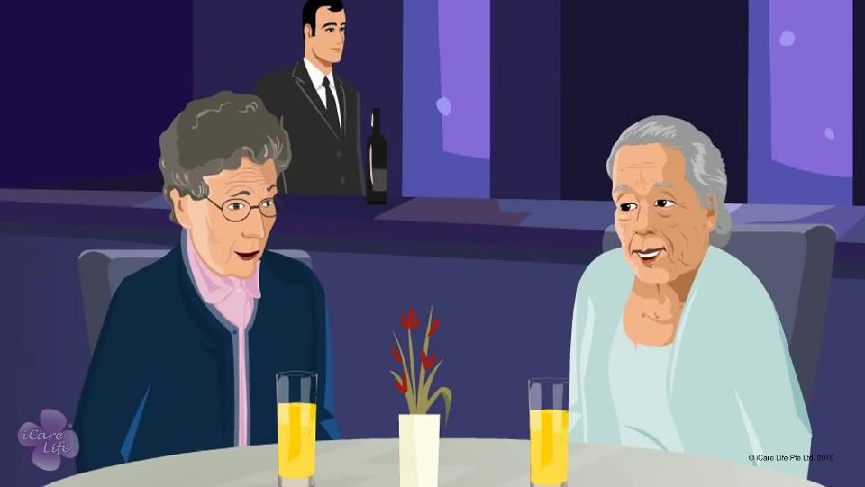
Connecting with the Elder Socially
19
Copyright: iCare Life Pte. Ltd., Singapore : This document must not be copied or shared or circulated without the consent of iCare Life and/or its affiliates.

Slide 21
Role Play
Post Module Activity
20
Copyright: iCare Life Pte. Ltd., Singapore : This document must not be copied or shared or circulated without the consent of iCare Life and/or its affiliates.
Notes:
Make 3 pairs out of the class participants (ask 6 participants to volunteer). Each pair should have one participant playing the role of an elder and the other should be a caregiver.
Give one situation to each pair and give them 10 minutes time to prepare a conversation to play-out in front of the class.
Situation 1: The elder wants to learn handling a mobile phone. Prepare a conversation which shows a caregiver teaching the elder.
Situation 2: The elder is a very quiet person. They are interested in current affairs and watching news. Prepare a conversation which shows a caregiver trying to get the elder to start a conversation with them about current affairs.
Situation 3: The elder is very fond of their grandson who stays in another country. Prepare a conversation which encourages the elder to talk about their grandson and then extend the conversation to other topics.
Ask the pairs to come forward and act-out the conversations in front of the class. Invite feedback on how the caregivers handled the conversations.

Slide 22
Summary
Listen to the stories about the elder’s life and appreciate their achievements
Learn more about subjects that interest the elder and try to engage in intellectually stimulating conversations
Encourage the elder to pursue their passions; appreciate any progress the elder makes
Patiently listen to their anxieties or negative feelings and try to show the positive aspects of their life
Share jokes and other positive anecdotes and try to keep the elder in good cheer
21
Copyright: iCare Life Pte. Ltd., Singapore : This document must not be copied or shared or circulated without the consent of iCare Life and/or its affiliates.
Notes:
Listen to the stories about the elder’s life and appreciate their achievements
Learn more about subjects that interest the elder and try to engage in intellectually stimulating conversations
Encourage the elder to pursue their passions; appreciate any progress the elder makes
Patiently listen to their anxieties or negative feelings and try to show the positive aspects of their life
Share jokes and other positive anecdotes and try to keep the elder in good cheer

Slide 23
Any Questions?
22
Copyright: iCare Life Pte. Ltd., Singapore : This document must not be copied or shared or circulated without the consent of iCare Life and/or its affiliates.
Notes:
Q1. How do I help the elder spend more time with the family and friends?
Ans. Speak to the family members and request them to spend time with the elder. Help the elder learn how to use latest technological gadgets like a mobile. Try and match the playing/walking schedules of the grandchildren with the elders so that interaction increases. Encourage the elders to watch news regularly so that they find it easier to converse and connect with their friends. You may also adjust the elder’s routine so that they are around during common family time (such as during dinner).

Slide 24
Aiding the Elder with Reading
23
Copyright: iCare Life Pte. Ltd., Singapore : This document must not be copied or shared or circulated without the consent of iCare Life and/or its affiliates.

Slide 25
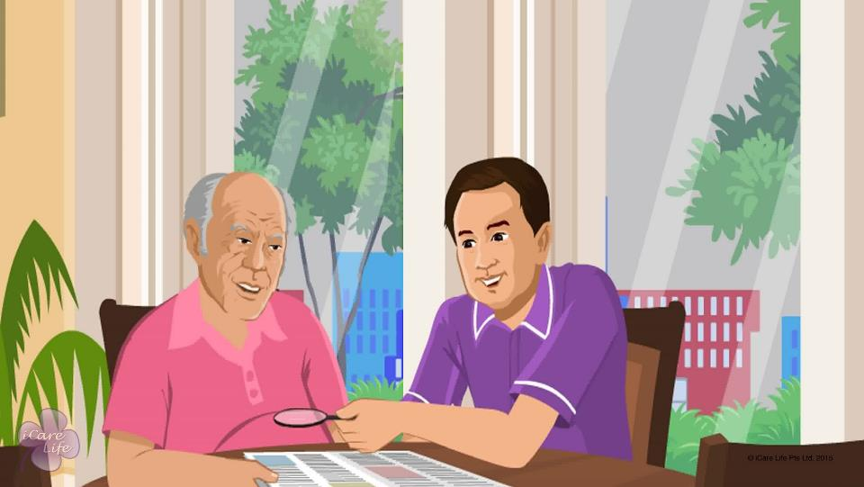
Aiding the Elder with Reading
24
Copyright: iCare Life Pte. Ltd., Singapore : This document must not be copied or shared or circulated without the consent of iCare Life and/or its affiliates.

Slide 26
Practical Training
Post Module Activity
25
Copyright: iCare Life Pte. Ltd., Singapore : This document must not be copied or shared or circulated without the consent of iCare Life and/or its affiliates.
Notes:
Arrange for a visit to an old people’s home. Arrange for newspapers, magazines, books and reading aids like magnifying sheets and magnifying glasses. On arrival, familiarize the participants with various reading aids. Next, make them observe a trained caregiver help elders use reading aids and read aloud to elderly people.
Later, assign each participant to a ward and ask the participant to help the ward read something. Participants’ behavior must be observed and feedback should be given on creating suitable environment for reading, choosing a suitable reading aid for the ward, if required, and making the ward comfortable while reading. Opportunity should also be given to each participant to read aloud to a ward.

Slide 27
Summary
To help an elder read comfortably:
Ensure the area is well lit
Ensure the elder is seated in a good, comfortable posture
Try to provide a quiet, peaceful environment
Ensure a regular supply of reading material of elder’s choice
Arrange for reading aids like magnifying sheet or glasses, if required
Help an elder with poor vision use appropriate reading aid
To read aloud to elders who cannot read themselves:
Face the elder while reading
Speak slowly and clearly
Make sure your voice is clearly audible to the elder
Be patient and re-read portions if required
26
Copyright: iCare Life Pte. Ltd., Singapore : This document must not be copied or shared or circulated without the consent of iCare Life and/or its affiliates.
Notes:
To help an elder read comfortably:
Ensure the area is well lit
Ensure the elder is seated in a good, comfortable posture
Try to provide a quiet, peaceful environment
Ensure a regular supply of reading material of elder’s choice
Arrange for reading aids like magnifying sheet or glasses, if required
Help an elder with poor vision use appropriate reading aid
To read aloud to elders who cannot read themselves:
Face the elder while reading
Speak slowly and clearly
Make sure your voice is clearly audible to the elder
Be patient and re-read portions if required

Slide 28
Any Questions?
27
Copyright: iCare Life Pte. Ltd., Singapore : This document must not be copied or shared or circulated without the consent of iCare Life and/or its affiliates.
Notes:
Q1. How can I improve my reading aloud skills?
Ans: To improve your reading aloud skills, you can practice reading aloud to your friends, colleagues, or your own self. Try and read different types of material such as newspapers, novels, story books, and magazines. Besides improving your skills to read aloud to others, this exercise will also help your improve your speaking and communication skills.

Slide 29
Oversee the Elder’s Activities
28
Copyright: iCare Life Pte. Ltd., Singapore : This document must not be copied or shared or circulated without the consent of iCare Life and/or its affiliates.

Slide 30
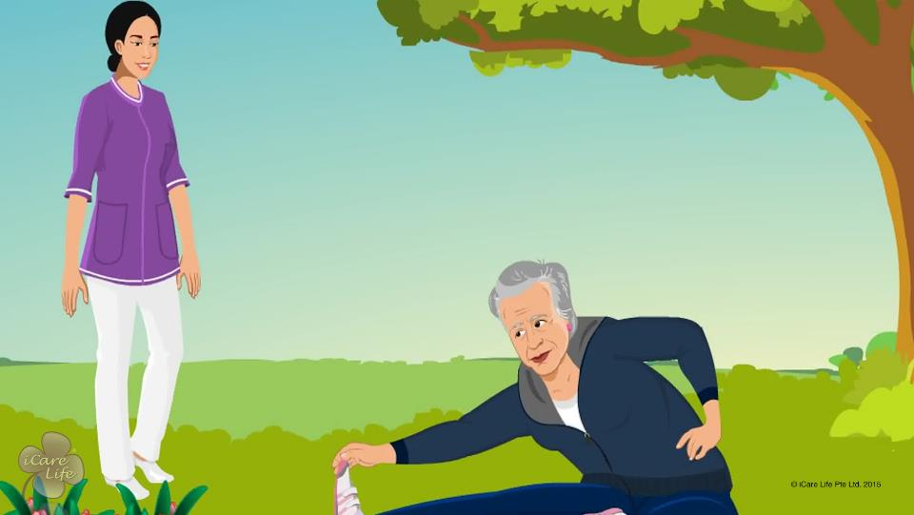
Oversee the Elder’s Activities
29
Copyright: iCare Life Pte. Ltd., Singapore : This document must not be copied or shared or circulated without the consent of iCare Life and/or its affiliates.

Slide 31
Practical Training
Post Module Activity
Pain relief spray | Gloves | Reading glasses | Adhesive bandages | Tissues
Cell phone | Shoes | Shawl or blanket | Pair of slippers | Water bottle
Sunglasses | Elastic bandages | Soft drink | Elbow support | Comb
Knee support | Book | Tracksuit | Towel | Chocolates
Packed food | Cigarettes | Light snack | Wrist-watch | Jacket
30
Copyright: iCare Life Pte. Ltd., Singapore : This document must not be copied or shared or circulated without the consent of iCare Life and/or its affiliates.
Notes:
Print the given table on 2 sheets. Make two separate sets of small chits by cutting along the dotted lines. Keep the jumbled sets aside. Now divide the class into two groups and give one set of chits to each group. Ask the group to go through all their chits and decide that which items would they like to put in an elder’s exercise kit under their care.

Slide 32
Summary
When you start caring for an elder, you may receive some specific inputs from your employer and the elder’s doctor
Note down the requirements and inputs and get them verified by your employer
Prepare and follow a daily routine for the elder keeping in mind these requirements
To ensure the health and safety of the elder, you must oversee all their activities, such as eating, resting, exercising, and going out
Allow them to deviate from the routine occasionally, if they wish
Encourage the elder to be independent as possible but ensure that they are safe by keeping a close watch on their activities
31
Copyright: iCare Life Pte. Ltd., Singapore : This document must not be copied or shared or circulated without the consent of iCare Life and/or its affiliates.
Notes:
When you start caring for an elder, you may receive some specific inputs from your employer and the elder’s doctor
Note down the requirements and inputs and get them verified by your employer
Prepare and follow a daily routine for the elder keeping in mind these requirements
To ensure the health and safety of the elder, you must oversee all their activities, such as eating, resting, exercising, and going out
Allow them to deviate from the routine occasionally, if they wish
Encourage the elder to be independent as possible but ensure that they are safe by keeping a close watch on their activities

Slide 33
Any Questions?
32
Copyright: iCare Life Pte. Ltd., Singapore : This document must not be copied or shared or circulated without the consent of iCare Life and/or its affiliates.
Notes:
Q1. Is it acceptable to ask the family about the general behavior of the elderly person and their outlook towards life so as to get an insight into the thinking of the elderly?
Ans. Yes, in fact besides other routine knowledge such a step would help you to look after the elderly better and be a good companion. Such an opinion of the family may however not be taken as final. You may have to make your own assessment of the elderly as you spend more time with them.
Q2. What if the elderly person wants to deviate from the normal routine as prescribed for them by the doctor?
Ans. Depending on the circumstances and their health issues, you could let the person deviate but only on certain occasions say, but not regularly. You would have to assert yourselves at times so as to not let the health of the elderly suffer.

Slide 34


