Slide 1

Fluid and Nutrition
5
CR 6.2
Standard
Source: Skills for Health – Website http://www.skillsforhealth.org.uk/
Skills for Care – Website http://www.skillsforcare.org.uk/

Slide 2
Learning outcomes
1. Understand the principles of hydration, nutrition and food safety
2. Support individuals to have access to fluids in accordance with their plan of care
3. Support individuals to have access to food and nutrition in accordance with their plan of care.
Source: Skills for Health – Website http://www.skillsforhealth.org.uk/
Skills for Care – Website http://www.skillsforcare.org.uk/
1

Slide 3
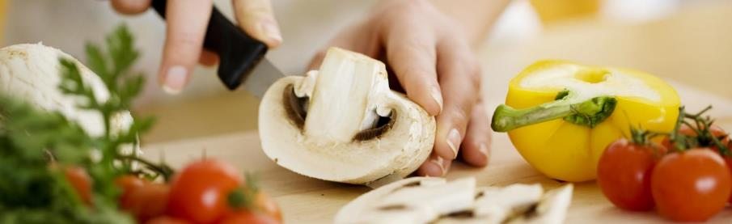
Food safety
Food safety is essential when preparing and handling food
Not all substances and objects that can cause harm or illness can be seen
People can become ill from eating food that tastes normal and looks safe
Source: Skills for Health – Website http://www.skillsforhealth.org.uk/
Skills for Care – Website http://www.skillsforcare.org.uk/
2
Notes:
Additional Information
It is important that whenever food is provided to individuals that it is handled, stored, prepared and delivered in a way that meets safety requirements. If the role of health and care workers includes preparing or handling food, they must have the knowledge and skills to do so safely.

Slide 4
Food hazards
Food must be prepared and stored in ways that prevent contamination. Contaminants could be:
Physical
Objects that could be in food when it is bought or introduced when preparing food e.g. bones or bits of packaging. Look for objects which should not be in the food.
Chemical
Chemicals that could be harmful if eaten such as pesticides, weed killers or cleaning chemicals. Wash fruit and vegetables before preparation and avoid spraying cleaning products near food.
Source: Skills for Health – Website http://www.skillsforhealth.org.uk/
Skills for Care – Website http://www.skillsforcare.org.uk/
3

Slide 5
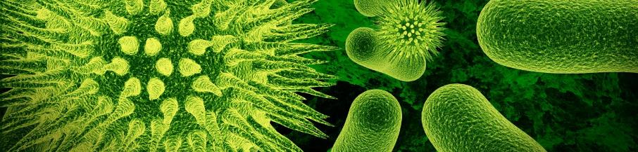
Food hazards
Allergenic
Substances which cause extreme reactions in individuals allergic to them. Examples include nuts, eggs, shellfish, gluten and milk. Foods containing allergens should be prepared and stored separately to those which don’t.
Bacterial
Pathogenic bacteria can be transferred to food during storage, handling and preparation. They can multiply to harmful levels if the conditions are right. Effective food safety principles should be followed to remove these risks.
Source: Skills for Health – Website http://www.skillsforhealth.org.uk/
Skills for Care – Website http://www.skillsforcare.org.uk/
4
Notes:
Additional information
Allergens
All organisations that provide food, including care and healthcare providers covering pre-packed and non-prepacked foods are legally required to provide a warning if foods contain 1 of the 14 allergenic substances that are covered by the legislation.
The 14 allergens are:
Eggs
Milk
Fish
Crustaceans (for example crab, lobster, crayfish, shrimp, prawn)
Molluscs (for example mussels, oysters, squid)
Peanuts
Tree nuts (almonds, hazelnuts, walnuts, cashews, pecans, brazils, pistachios, macadamia nuts or Queensland nuts)
Sesame seeds
Cereals containing gluten (wheat (such as spelt, Khorasan wheat/Kamut), rye, barley, oats, or their hybridised strains)
Soya
Celery and celeriac
Mustard
Lupin
Sulphur dioxide and sulphites (at concentration of more than ten parts per million)
Information on the changes can be found here: www.food.gov.uk/science/allergy-intolerance/label/labelling-changes

Slide 6

Vulnerable groups
Some groups of people are more vulnerable to food-related illnesses because of a weakened immune system. These groups can include:
Babies, toddlers, children and teenagers
Pregnant and breastfeeding women
Elderly people
Those who are living on a low income
People in prison
People in hospital
Source: Skills for Health – Website http://www.skillsforhealth.org.uk/
Skills for Care – Website http://www.skillsforcare.org.uk/
5
Notes:
Additional information
Some groups of people are more vulnerable to food-related illnesses because of a weakened immune system
These groups can include:
Babies, toddlers, children and teenagers: as immunity develops throughout our lives, the older we get the more immune we become to germs
Pregnant and breastfeeding women: as childbearing and breastfeeding uses up a lot of the body’s iron and zinc which are important for immunity
Elderly people: their immune system becomes less effective in recognising contaminated food
Those who are living on a low income: they find it difficult to afford a healthy and balanced diet
People in prison: through exposure to infectious diseases like tuberculosis and hepatitis C
People in hospital: as illness weakens the immune system, and some medication may also affect the immune system

Slide 7

Preparing food safely
Which of the following statements are true and which are false?
✓
True
X
False
Remove jewellery before preparing food
✓
Wash your hands thoroughly before touching food
✓
Wipe equipment with dry cloth between uses
X
Ensure food is cooked thoroughly
✓
Store food in sealed containers
✓
Food stored in a fridge should be labelled, dated and kept at or below 5ºC
✓
Store raw meat above ready-to-eat food
X
Prepare raw and cooked foods at the same time in the same area
X
Wash equipment in hot, soapy water or in a dishwasher if available
✓
Source: Skills for Health – Website http://www.skillsforhealth.org.uk/
Skills for Care – Website http://www.skillsforcare.org.uk/
6
Notes:
Activity: Ask health and social care worker/s to read each statement and decide whether it is true or false.
Feedback
Remove jewellery before preparing food: Jewellery can make hand washing less effective meaning that less bacteria are removed. It also means that small items cannot drop into food as it is being prepared and become physical contaminants.
Wash your hands thoroughly before touching food: Micro-organisms such as bacteria can live on the skin and be transferred to food during the preparation process. Effective hand washing before handling food helps to remove these micro-organisms.
Wipe equipment in hot water between uses: Wiping equipment is not an effective way of removing all contaminants. Equipment should be washed in hot soapy water between uses to remove traces of allergens and micro-organisms.
Ensure food is cooked thoroughly: Bacteria and micro-organisms are destroyed by heat. Thorough cooking will kill bacteria present in and on food making it safe to eat.
Store food in sealed containers: storing food in sealed containers stops it becoming accidentally contaminated by objects, chemicals or allergens.
Food stored in a fridge should be labelled, dated and kept at or below 5ºC: Storing foods at an appropriate temperature slows down bacterial multiplying, labelling foods properly and ensuring that it is used within the use by dates should ensure that food is safe to eat.
Store raw meat above ready to eat food: Raw food can drip juices onto whatever is stored underneath contaminating it with bacteria. If this food is intended to be eaten without cooking (e.g. salad or cooked foods) bacteria will not be destroyed before it is eaten. Raw meat should be stored below ready-to-eat foods.
Prepare raw and cooked foods at the same time in the same area: Raw and cooked foods should be prepared separately to ensure that raw foods do not contaminate ready to eat foods. If using the same area, it should be thoroughly cleaned and disinfected after preparing raw food.
Wash equipment in hot, soapy water or in a dishwasher if available: Washing equipment in hot soapy water removes bacteria. If temperatures are high enough bacteria will be killed. Higher temperatures are achievable in a dishwasher.

Slide 8
The importance of nutrition for health and wellbeing
To stay healthy we need a diet that includes the correct balance of the following:
Carbohydrates
Vitamins
Good sources include bread, potatoes, rice and pasta
Fruit and vegetables are good sources of vitamins
Protein
Fibre
Good sources of protein include milk products but also in meat, fish and beans
Fruit, vegetables, wholemeal bread, nuts and seeds are high in fibre
Minerals
Milk products are good providers of calcium and liver and shellfish are full of iron
Source: Skills for Health – Website http://www.skillsforhealth.org.uk/
Skills for Care – Website http://www.skillsforcare.org.uk/
7
Notes:
Additional information
A diet that does not include the right balance of everything we need can lead to illness and ill-health. A healthy, balanced diet will give an individual the nutrients their body needs to function properly.
Carbohydrates provide most of the energy we need including the basic actions that keep us alive (called the Basal Metabolic Rate). Good sources include bread, potatoes, rice and pasta.
Vitamins support many different functions including blood clotting, maintaining an effective immune system and allowing the body to absorb energy from food. Fruit and vegetables are good sources of vitamins.
Minerals e.g. Calcium, which helps to build strong bones and teeth and iron, which helps the blood to carry oxygen around the body. Milk products are good providers of calcium and liver and shellfish are full of iron.
Fibre promotes a healthy bowel and helps to remove waste products from the body. Fruit, vegetables, wholemeal bread, nuts and seeds are high in fibre.
Protein is important for the body’s cells and tissues to be repaired and replaced. You will find protein in milk products but also in meat, fish and beans.

Slide 9
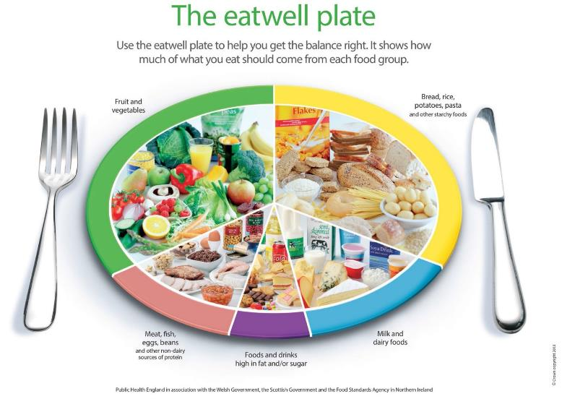
The eatwell plate
Source: Skills for Health – Website http://www.skillsforhealth.org.uk/
Skills for Care – Website http://www.skillsforcare.org.uk/
8
Notes:
Additional information
The eatwell plate has been developed by Public Health England in association with the Welsh and Scottish Governments and the Food Standards Agency in Northern Ireland. It is the model used widely in the UK to illustrate a healthy diet and is suitable for most groups of people. It shows the five main food groups and the proportions of each food group recommended as part of a daily healthy diet.
The food groups are:
33% - Fruit and vegetables
33% - Bread, rice, potatoes, pasta and other starchy foods
12% - Meat, fish, eggs, beans and other non-dairy sources of protein
15% - Milk and dairy foods
8% - Foods and drinks high in fat and/or sugar.

Slide 10

Identifying poor nutrition
Malnutrition is a common phenomenon, and many are at risk of becoming so; the symptom could be:
Muscle weakness
Feeling tired all the time
Increased infections
More falls
Constipation
Lack of energy
Gaining or losing weight
Changes in behaviour
Depression
Poor wound healing
Malnourished: An individual whose diet does not contain the right balance of nutrients can become malnourished. This could be under nutrition, when a person does not get enough nutrients or over nutrition, when a person has more nutrients than they need.
.
Source: Skills for Health – Website http://www.skillsforhealth.org.uk/
Skills for Care – Website http://www.skillsforcare.org.uk/
9
Notes:
Activity: Ask the learners to identify some signs that could indicate that an individual is malnourished.
Possible answers include:
- Muscle weakness - Feeling tired all the time
- Increased infections - More falls
- Constipation - Lack of energy
- Gaining or losing weight - Changes in behaviour
- Depression - Poor wound healing

Slide 11

Supporting people to eat
Equipment is available to support independent eating and drinking, and to promote dignity and respect
Technology such as clocks or reminder messages
Cutlery with shaped and padded handles
Two-handled mugs
Cups with lids
One-way straws that help people to drink
Non-slip mats
Plates and bowls with high sides
Source: Skills for Health – Website http://www.skillsforhealth.org.uk/
Skills for Care – Website http://www.skillsforcare.org.uk/
10
Notes:
Activity: Ask learners to think of some examples of equipment that can be used to support people to eat and drink independently.
Examples of possible answers include:
Technology such as clocks or reminder messages to tell someone when it is time to eat or drink
Cutlery with shaped and padded handles that can help with gripping
Two-handled mugs to help people with poor grip, tremors or weak wrists
Cups with lids to reduce the risk of spillage
One-way straws that help people to drink without the need to lift cups and glasses, even if muscle weakness has reduced their ability to suck
Non-slip mats which stop plates from moving around while people are cutting food
Plates and bowls with high sides to prevent food falling off the edges
Individuals should have plenty of time to eat, not be rushed and be able to choose whether they would like to use any equipment offered.
If health and social care workers have concerns that an individual is not eating or drinking enough despite being encouraged and supported, you should discuss your concerns with your manager.
Advice may be sought from a specialist such as a dietician or a nutritionist.

Slide 12
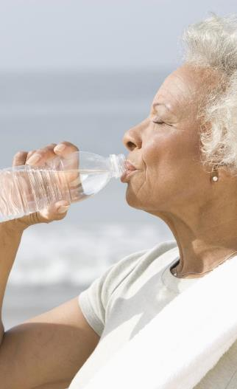
Fluid and hydration
The body needs fluids to carry out basic processes that enable it to function correctly. For example:
Digesting food and enabling nutrients to be absorbed
Enabling blood to circulate around the body
Removing waste products via urine and faeces
Keeping cells and tissues moist, helping to avoid infection
Controlling body temperature by perspiration
Maintaining brain function
Source: Skills for Health – Website http://www.skillsforhealth.org.uk/
Skills for Care – Website http://www.skillsforcare.org.uk/
11

Slide 13

Staying hydrated
An individual's fluid requirement will be included in their care plan
Most individuals should have about 1.5-2 litres of fluid each day
Individual’s with some medical conditions will need to drink less
Sometimes an individual must not eat or drink anything for a set period of time
Source: Skills for Health – Website http://www.skillsforhealth.org.uk/
Skills for Care – Website http://www.skillsforcare.org.uk/
12
Notes:
Additional information
Most individuals should have about 1.5-2 litres (6-8 cups or glasses) of fluid each day
Some medical conditions, such as certain types of heart condition or kidney disease will require individuals to drink less
There are times when an individual must not eat or drink anything for a set period of time, for example before an operation. This is known as nil-by-mouth and will be clearly shown in their care plan. This must be followed for their own safety
Types of fluid
Most ordinary drinks (for example, fruit juices, milk, tea and coffee in moderation and low sugar drinks) count towards a person’s fluid intake
Drinking a lot of alcohol can lead to dehydration
Water is the best fluid to rehydrate the body.

Slide 14

Identifying poor hydration
Untreated dehydration can lead to problems with blood circulation or kidney failure
Feelings of thirst
Dark coloured urine
Headaches, tiredness and confusion
Constipation
Kidney stones and infections
Poor wound healing
Urinary tract infections
Source: Skills for Health – Website http://www.skillsforhealth.org.uk/
Skills for Care – Website http://www.skillsforcare.org.uk/
13
Notes:
Activity: Ask the health and social care worker/s to identify some signs that could indicate that an individual is dehydrated
Early signs and symptoms of dehydration include:
Feelings of thirst as the body tries to increase fluid levels
Dark coloured urine as it tries to reduce fluid loss
Headaches, tiredness and confusion, as the flow of blood to the brain decreases. (These signs might also indicate an undiagnosed health problem, for example type 2 diabetes.)
Ongoing dehydration can contribute to:
Constipation
Urinary tract infections, which are prevalent in some groups in care
Kidney stones and infections
Poor wound healing
If dehydration remains untreated, it can have serious consequences. Blood circulation can be affected or kidneys can fail.

Slide 15

Promoting adequate nutrition and hydration
It is important to work in person centred ways to ensure that food and drinks provided meet individuals’ needs
Do they have beliefs or preferences that affect the foods that they eat?
Are there any foods they should not have because of health conditions or medication?
Do they need support to eat and/or drink?
Source: Skills for Health – Website http://www.skillsforhealth.org.uk/
Skills for Care – Website http://www.skillsforcare.org.uk/
14
Notes:
Activity: Ask the learners to consider each question in turn and think of some examples of circumstances that could affect the food and drink choices that an individual makes
Possible answers could include:
Do they have beliefs or preferences that affect the foods that they eat?
Religious requirements:
Fasting
Food restrictions
Fluid restrictions on stimulants (caffeine and alcohol)
REMEMBER: Do not make assumptions; each individual is different and even the ways that an individual observes their religion can vary. The individual should be asked about their specific needs and preferences.
Food preferences: an individual's likes and dislikes for example some people have a ‘sweet tooth’ and like desserts whilst other might prefer to finish a meal with a cheese platter.
Beliefs and ideology: Vegetarians not eating meat, vegans not eating meat or dairy products
Are there any foods they should not have because of health conditions or medication?
Some people on certain medications for depression should not have cheese
People with raised blood cholesterol levels may be advised not to have too much saturated fat such as butter, fried items and pastry
People with diabetes may be encouraged to avoid too much sugar found in sweets, chocolate, sugared breakfast cereals, cakes and puddings and encouraged to eat fewer of these or smaller portions.
Those who have high blood pressure may be advised to limit salt
Anyone who is obese should be encouraged to limit sugary and fatty foods
Do they need support to eat and/or drink?
Forgetting to eat (perhaps due to dementia)
Side effects of medication which may affect appetite or cause sickness
Poorly fitting false teeth
Physical illness such as a stroke which may have affected the individuals muscles around their mouth for chewing or hand for lifting drinks
Depression which may cause poor appetite
A visual impairment which may affect the way a person sees their food to eat it

Slide 16

Supporting good hydration
Individuals’ care plans will state how to support them to maintain their hydration.
Individuals should have access to fluid at all times, unless it is restricted for medical reasons
Individuals should be encouraged not to wait until they are thirsty to drink
Individuals should be offered drinks to remind them to drink
Drinks need to be refreshed regularly
Drinks should be within easy reach for those with restricted movement or mobility
Source: Skills for Health – Website http://www.skillsforhealth.org.uk/
Skills for Care – Website http://www.skillsforcare.org.uk/
15

Slide 17








Knowledge check
Which action below will help to prevent contamination with allergens, bacteria, physical objects and chemicals?
Click to reveal answer
Wiping equipment with a dry cloth between uses
Storing food in a fridge
Washing hands after preparing food
Storing food in covered containers
Source: Skills for Health – Website http://www.skillsforhealth.org.uk/
Skills for Care – Website http://www.skillsforcare.org.uk/
16
Notes:
Trainer should ask class why they chose the correct answer
Feedback
A – Wiping equipment with a dry cloth will only remove visible contaminants. Remember, people can become ill from eating foods that look completely normal
B – Storing food in the fridge can help to prevent bacteria from multiplying. It should be stored in covered containers to ensure that contaminants do not fall into it accidentally
C – Hands should be washed BEFORE handling and preparing food to prevent contamination with bacteria and allergens
D – Storing food in covered containers stops contaminants from accidentally falling into foods

Slide 18

Knowledge check
Which of the following is a sign that an individual is dehydrated?
Click to reveal answer
Dark coloured urine
Gaining weight
Depression
Muscle weakness
Source: Skills for Health – Website http://www.skillsforhealth.org.uk/
Skills for Care – Website http://www.skillsforcare.org.uk/
17
Notes:
Trainer should ask class why they chose the correct answer
Some medication also may produce dark coloured urine.
Feedback
A – An individual who is dehydrated may have urine which is dark coloured and strong smelling. This happens when the body tries to reduce the amount of water that is lost
B – Gaining weight can be a sign of over nutrition but is not usually a sign of dehydration
C – Depression can cause appetite to be reduced. This can lead to malnutrition
D – Muscle weakness is a sign of malnutrition

Slide 19

Knowledge check
Which of the following are the best sources of protein?
Click to reveal answer
Fruit and vegetables
Meat, fish and beans
Oils, butter and sugary drinks
Bread, pasta and potatoes
Source: Skills for Health – Website http://www.skillsforhealth.org.uk/
Skills for Care – Website http://www.skillsforcare.org.uk/
18
Notes:
Trainer should ask class why they chose the correct answer
Feedback
A – Fruit and vegetables are a good source of vitamins and minerals. They should make up about a third of a person’s diet. They are not the best source of protein.
B – Meat, fish, eggs and beans are the best sources of the protein that we need to repair and replace the body’s cells and tissues.
C – Individuals should only eat a small amount of foods and drinks high in fat and/or sugar. They are not the best source of protein.
D – Bread, rice, potatoes, pasta and other starchy foods are good sources of carbohydrates that give us the energy we need to live our lives. They are not the best source of protein.

Slide 20
Viewing of Modules
Fluid and Nutrition
CR 6.2
Private and Confidential

Slide 21
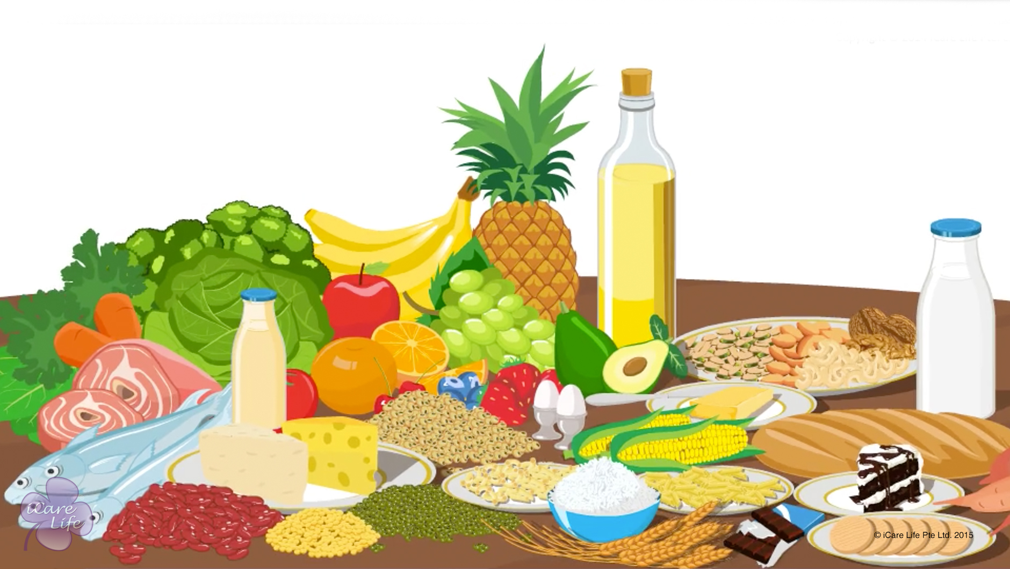
Importance of Nutrition
1
Copyright: iCare Life Pte. Ltd., Singapore : This document must not be copied or shared or circulated without the consent of iCare Life and/or its affiliates.

Slide 22
In this module, you will learn about:
The various nutrients and their importance
The definition of appetite
The importance of fluids for our bodies
2

Slide 23

Let’s Watch
Importance of Nutrition
3
Copyright: iCare Life Pte. Ltd., Singapore : This document must not be copied or shared or circulated without the consent of iCare Life and/or its affiliates.

Slide 24
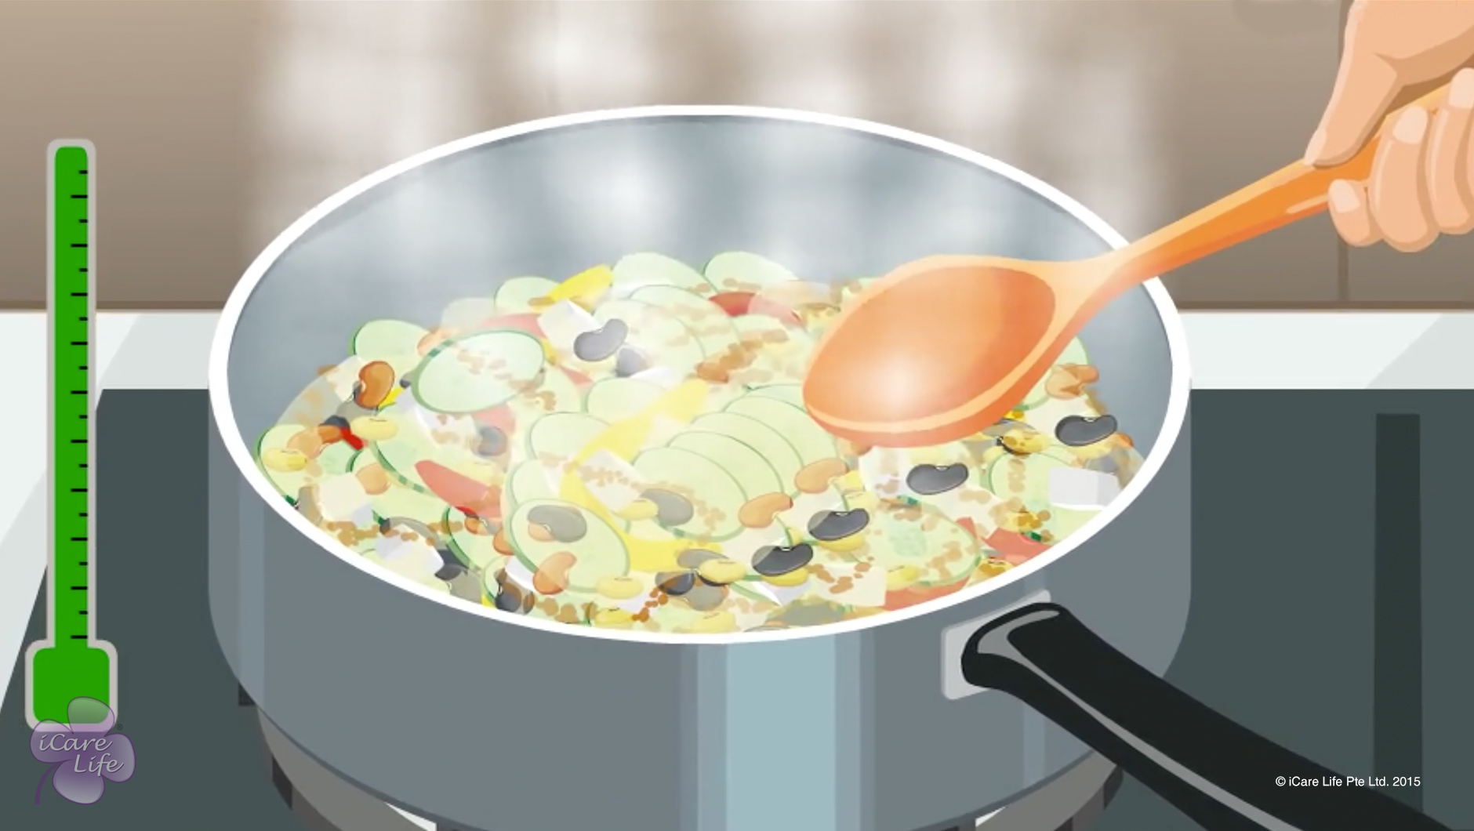
Maintaining Nutritional Food Value
4
Copyright: iCare Life Pte. Ltd., Singapore : This document must not be copied or shared or circulated without the consent of iCare Life and/or its affiliates.

Slide 25
In this module, you will learn about:
The ways in which nutrients are lost from food during transportation, storage, and cooking
A few healthy ways of consuming food
5
Copyright: iCare Life Pte. Ltd., Singapore : This document must not be copied or shared or circulated without the consent of iCare Life and/or its affiliates.

Slide 26
Let’s Watch
Maintaining Nutritional Food Value
6
Copyright: iCare Life Pte. Ltd., Singapore : This document must not be copied or shared or circulated without the consent of iCare Life and/or its affiliates.

Slide 27
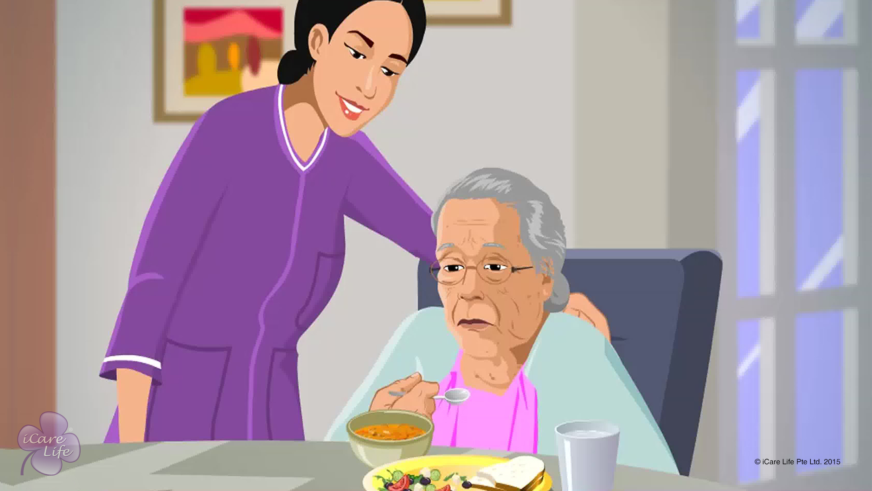
Nutritional Issues of the Elder
7
Copyright: iCare Life Pte. Ltd., Singapore : This document must not be copied or shared or circulated without the consent of iCare Life and/or its affiliates.

Slide 28
In this module, you will learn about:
A few nutritional issues in elderly people
The reasons for nutritional issues in elderly people
The solutions to nutritional issues in elderly people
8
Copyright: iCare Life Pte. Ltd., Singapore : This document must not be copied or shared or circulated without the consent of iCare Life and/or its affiliates.

Slide 29
Let’s Watch
Nutritional Issues of the Elder
9
Copyright: iCare Life Pte. Ltd., Singapore : This document must not be copied or shared or circulated without the consent of iCare Life and/or its affiliates.

Slide 30
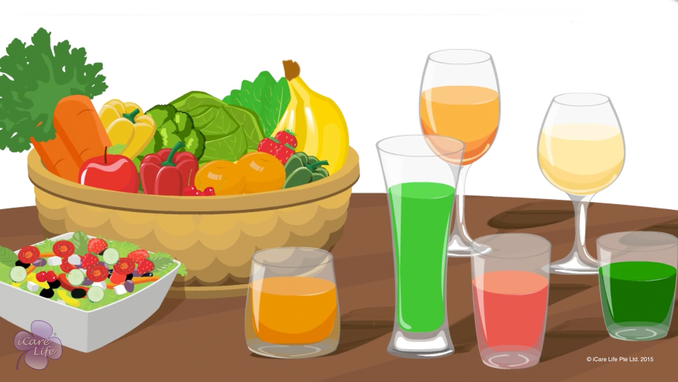
Food and Fluid intake
10
Copyright: iCare Life Pte. Ltd., Singapore : This document must not be copied or shared or circulated without the consent of iCare Life and/or its affiliates.

Slide 31
In this module, you will learn about:
The basic rules of eating healthy
The various healthy and unhealthy foods
11
Copyright: iCare Life Pte. Ltd., Singapore : This document must not be copied or shared or circulated without the consent of iCare Life and/or its affiliates.

Slide 32
Let’s Watch
Food and Fluid intake
12
Copyright: iCare Life Pte. Ltd., Singapore : This document must not be copied or shared or circulated without the consent of iCare Life and/or its affiliates.

Slide 33


