Slide 1

Viewing of Modules
Activities of Daily Living – Daily Care for a Bedridden Elder
CR 6.3
Private and Confidential

Slide 2
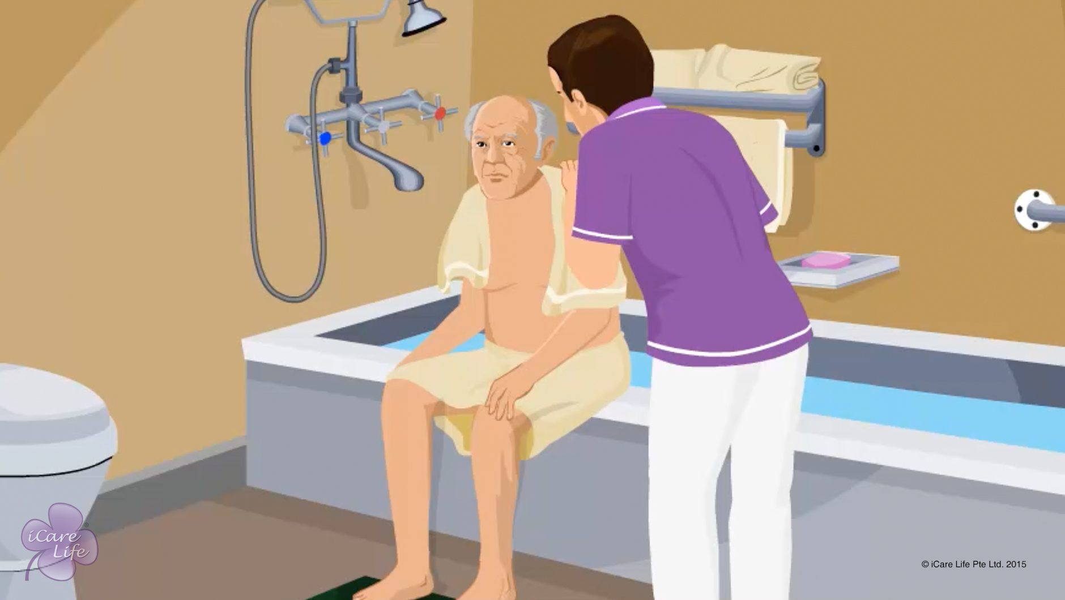
Body Hygiene of the Elder
1
Copyright: iCare Life Pte. Ltd., Singapore : This document must not be copied or shared or circulated without the consent of iCare Life and/or its affiliates.

Slide 3
In this module, you will learn about:
How you can help the elder maintain good body hygiene
2

Slide 4
Pre-Module Activity
Class discussion
3
Copyright: iCare Life Pte. Ltd., Singapore : This document must not be copied or shared or circulated without the consent of iCare Life and/or its affiliates.
Notes:
You will require a white board and a marker for noting down important points of the discussion.
Discuss the following with the class:
What is hygiene?
Why is hygiene important?
What practices do you follow to keep your body hygienic? (ask participants for the practices they follow)
Model answers:
Hygiene can be defined as “conditions or practices conducive to maintaining health and preventing disease, especially through cleanliness”.
Maintaining hygiene is important because it:
Prevents diseases from affecting us and others
Saves money and time which get wasted if one falls sick
Gives a good impression to others
Helps one look neat and tidy
Gives self confidence
Helps you maintain healthy personal and professional relationships
Possible answers which participants may give are:
Regularly bathing with soap and water
Taking care of the skin
Brushing twice daily
Washing hands several times a day
Using deodorants/fragrances
Washing and brushing hair regularly
Using a handkerchief while coughing or sneezing
Using a hand sanitizer
Keep noting down the important points on the white board so that the participants can refer to these as the module progresses.

Slide 5

Let’s Watch
Body Hygiene of the Elder
4
Copyright: iCare Life Pte. Ltd., Singapore : This document must not be copied or shared or circulated without the consent of iCare Life and/or its affiliates.

Slide 6
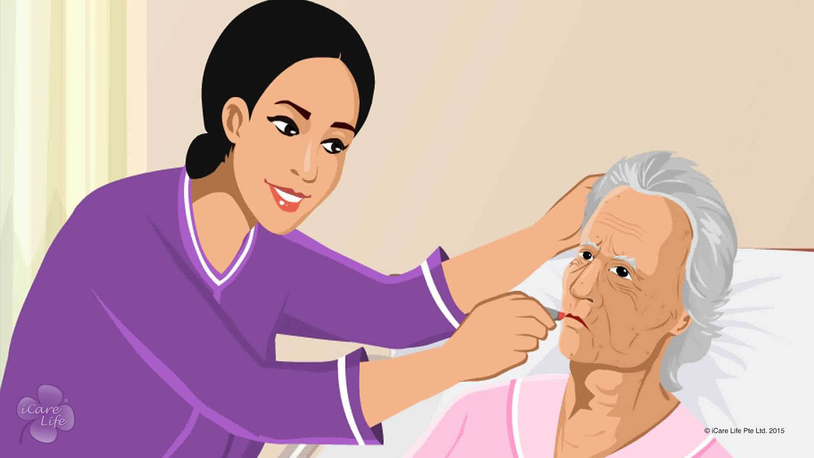
Caring for an Immobilised Elder
5
Copyright: iCare Life Pte. Ltd., Singapore : This document must not be copied or shared or circulated without the consent of iCare Life and/or its affiliates.

Slide 7
In this module, you will learn about:
The equipment required for helping an immobilized elder
How to help immobilized elders perform various tasks
6
Copyright: iCare Life Pte. Ltd., Singapore : This document must not be copied or shared or circulated without the consent of iCare Life and/or its affiliates.

Slide 8
Let’s Watch
Caring for an Immobilised Elder
7
Copyright: iCare Life Pte. Ltd., Singapore : This document must not be copied or shared or circulated without the consent of iCare Life and/or its affiliates.

Slide 9
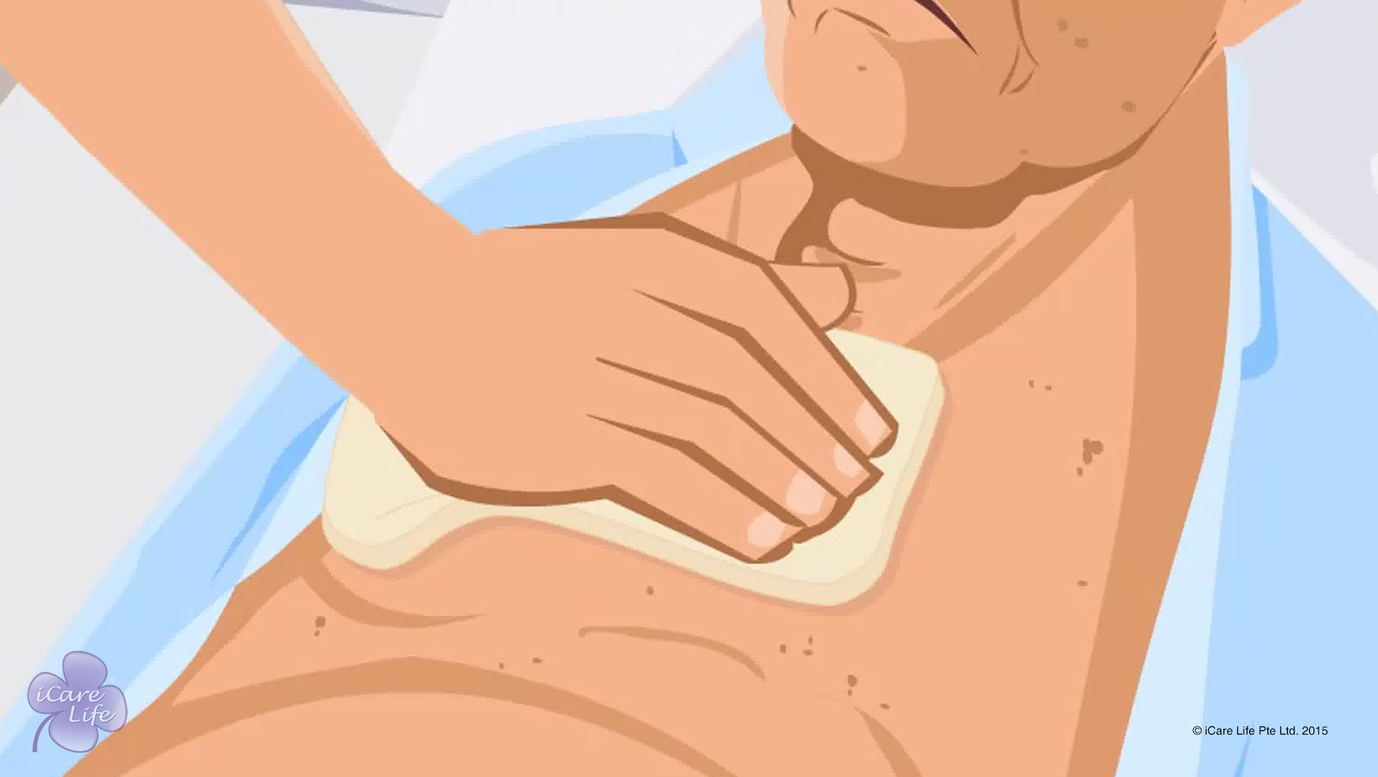
Giving a Bed Bath
8
Copyright: iCare Life Pte. Ltd., Singapore : This document must not be copied or shared or circulated without the consent of iCare Life and/or its affiliates.

Slide 10
In this module, you will learn about:
The important considerations while giving a bed bath
The steps to give a bed bath to a bedridden person
The steps to wash the hair of a bedridden person
9
Copyright: iCare Life Pte. Ltd., Singapore : This document must not be copied or shared or circulated without the consent of iCare Life and/or its affiliates.

Slide 11
Let’s Watch
Giving a Bed Bath
10
Copyright: iCare Life Pte. Ltd., Singapore : This document must not be copied or shared or circulated without the consent of iCare Life and/or its affiliates.

Slide 12
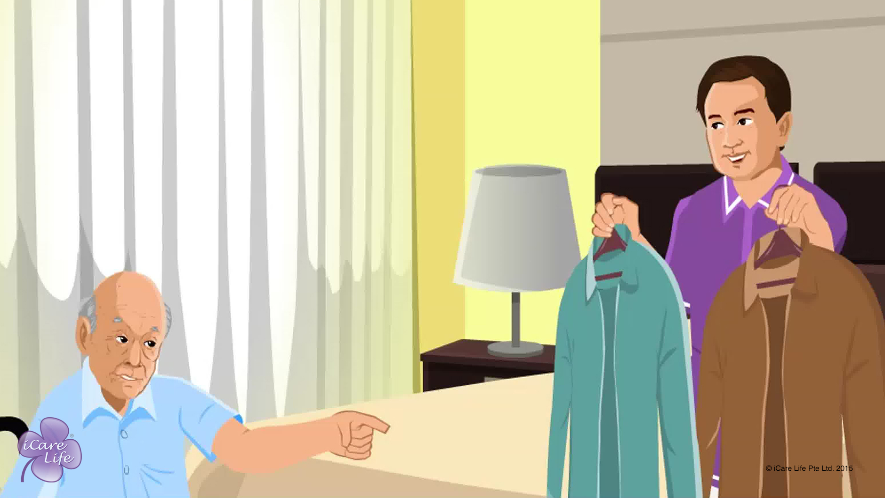
Dressing the Elder
11
Copyright: iCare Life Pte. Ltd., Singapore : This document must not be copied or shared or circulated without the consent of iCare Life and/or its affiliates.

Slide 13
In this module, you will learn about:
The basic rules for dressing an elder
The steps to help an independent elder dress on their own
The steps to support a partially dependent elder while dressing
The steps to dress a fully dependent elder
12
Copyright: iCare Life Pte. Ltd., Singapore : This document must not be copied or shared or circulated without the consent of iCare Life and/or its affiliates.

Slide 14
Let’s Watch
Dressing the Elder
13
Copyright: iCare Life Pte. Ltd., Singapore : This document must not be copied or shared or circulated without the consent of iCare Life and/or its affiliates.

Slide 15
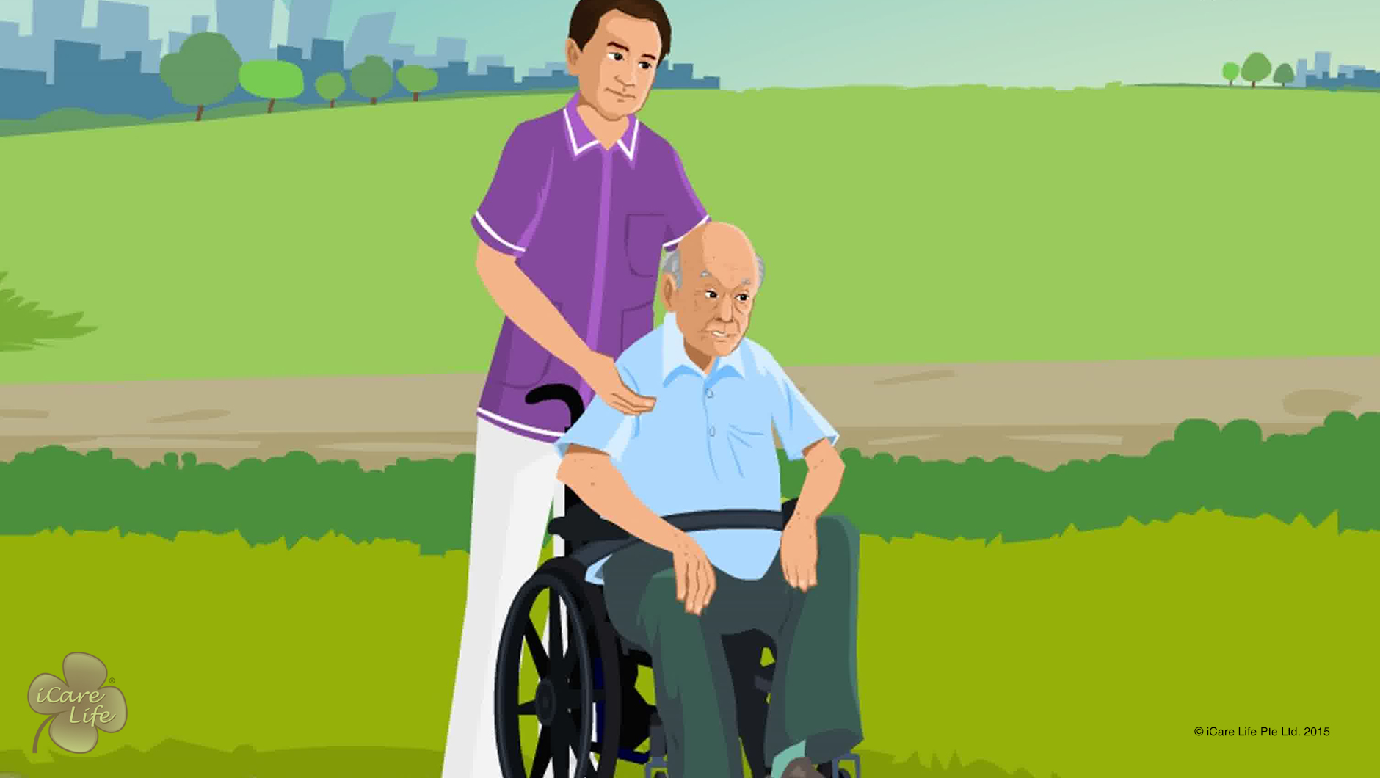
Providing Wheelchair Assistance
14
Copyright: iCare Life Pte. Ltd., Singapore : This document must not be copied or shared or circulated without the consent of iCare Life and/or its affiliates.

Slide 16
In this module, you will learn about:
How a wheelchair can help an elder
How to provide wheelchair assistance to an elder
15
Copyright: iCare Life Pte. Ltd., Singapore : This document must not be copied or shared or circulated without the consent of iCare Life and/or its affiliates.

Slide 17
Let’s Watch
Providing Wheelchair Assistance
16
Copyright: iCare Life Pte. Ltd., Singapore : This document must not be copied or shared or circulated without the consent of iCare Life and/or its affiliates.

Slide 18


