Slide 1

Modules Summary Discussion – Q&A
CR 7.1
Private and Confidential

Slide 2

The Importance of Recreational Activities for the Elder
1
Copyright: iCare Life Pte. Ltd., Singapore : This document must not be copied or shared or circulated without the consent of iCare Life and/or its affiliates.

Slide 3
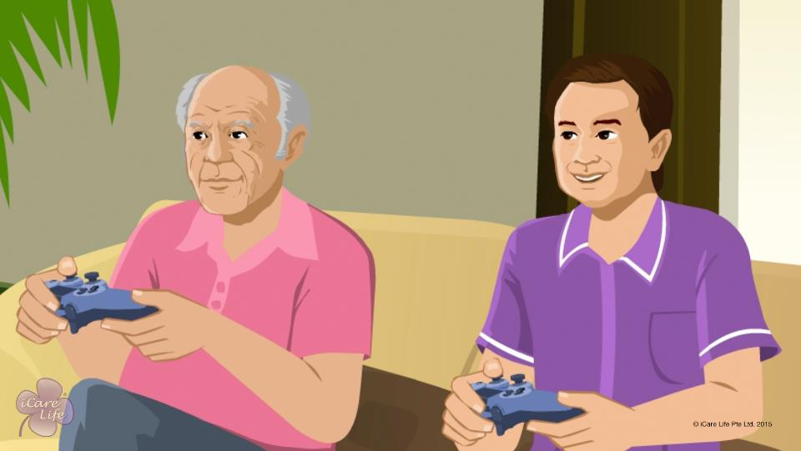
Importance of Recreational Activities
2
Copyright: iCare Life Pte. Ltd., Singapore : This document must not be copied or shared or circulated without the consent of iCare Life and/or its affiliates.

Slide 4
Active & Passive Recreational Activities
Post Module Activity
3
Copyright: iCare Life Pte. Ltd., Singapore : This document must not be copied or shared or circulated without the consent of iCare Life and/or its affiliates.
Notes:
Arrange for sheets of paper and writing material for al participants. Distribute the material and as the participants to divide the paper in two columns titled Active Recreational Activities and Passive Recreational Activities. Ask the participants to list as many activities as they can think of in the two columns. Allow the participants a fixed amount of time, say 10 minutes, to complete the activity.
Ask a few participants to read out their lists and compare them with other participants. A typical list may read as follows:
Active Recreational Activities: playing a sport, gardening, cooking, sewing, knitting, model making, kite flying, swimming, trekking, reading, caring for a pet, photography, fishing, painting, making a collection
Passive Recreational Activities: watching TV, listening to music, being read aloud to, watching photo album, bird watching, playing video games, Internet browsing

Slide 5
Summary
Recreational activities:
Should be chosen based on the elder’s interests,
Give the elder something to look forward to in a day,
Divert the elder’s mind from day to day problems,
Keep the elder mentally alert,
Can be active or passive,
Can include learning a new skill,
Should be planned for each day, and
Should not expose the elder to negative, depressing thoughts
4
Copyright: iCare Life Pte. Ltd., Singapore : This document must not be copied or shared or circulated without the consent of iCare Life and/or its affiliates.
Notes:
Recreational activities:
Should be chosen based on the elder’s interests,
Give the elder something to look forward to in a day,
Divert the elder’s mind from day to day problems,
Keep the elder mentally alert,
Can be active or passive,
Can include learning a new skill,
Should be planned for each day, and
Should not expose the elder to negative, depressing thoughts

Slide 6
Any Questions?
5
Copyright: iCare Life Pte. Ltd., Singapore : This document must not be copied or shared or circulated without the consent of iCare Life and/or its affiliates.
Notes:
Q1. What should I do if the elder in my care in not interested to engage in any recreational activity?
Ans: Many elders feel like a burden on others and think they are no longer entitled to any fun. They often require support in everything they do. So, they assume that by engaging in a pastime they are wasting someone else’s time. You must convince the elder that it is your pleasure to help the person engage in a relaxing, enjoyable activity. Do not make it sound like an extra burden or work. Encourage the elder to try an activity of choice for a short duration and extend the time as the elder starts enjoying the activity.

Slide 7

Involving the Elder in a Hobby
6
Copyright: iCare Life Pte. Ltd., Singapore : This document must not be copied or shared or circulated without the consent of iCare Life and/or its affiliates.

Slide 8
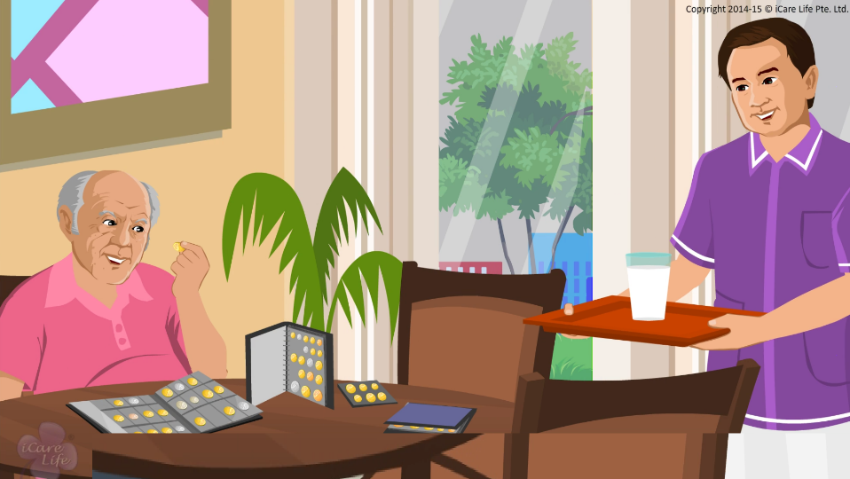
Involving the Elder in a Hobby
7
Copyright: iCare Life Pte. Ltd., Singapore : This document must not be copied or shared or circulated without the consent of iCare Life and/or its affiliates.

Slide 9
Summary
Hobby is something that nurtures our creativity
An activity through which we enjoy someone else’s creativity is a pastime
Based on the elder’s interest, encourage hobbies like:
Gardening
Model making
Writing
Cooking
Sewing and knitting
Playing a musical instrument
Painting
Ensure the elder remains safe and does not overexert while engaging in a hobby
Show interest in the elder’s hobby
Encourage the elder to work at a comfortable pace
Appreciate the elder’s effort
8
Copyright: iCare Life Pte. Ltd., Singapore : This document must not be copied or shared or circulated without the consent of iCare Life and/or its affiliates.
Notes:
Hobby is something that nurtures our creativity
An activity through which we enjoy someone else’s creativity is a pastime
Based on the elder’s interest, encourage hobbies like:
Gardening
Model making
Writing
Cooking
Sewing and knitting
Playing a musical instrument
Painting
Ensure the elder remains safe and does not overexert while engaging in a hobby
Show interest in the elder’s hobby
Encourage the elder to work at a comfortable pace
Appreciate the elder’s effort

Slide 10
Any Questions?
9
Copyright: iCare Life Pte. Ltd., Singapore : This document must not be copied or shared or circulated without the consent of iCare Life and/or its affiliates.
Notes:
Q.1. Should I discourage the elder from spending any time on pastimes?
Ans. While you should encourage hobbies, you should let the elder spend time on pastimes such as reading or watching television, if they wish to.

Slide 11

Involving the Elder in Brain Activities
10
Copyright: iCare Life Pte. Ltd., Singapore : This document must not be copied or shared or circulated without the consent of iCare Life and/or its affiliates.

Slide 12
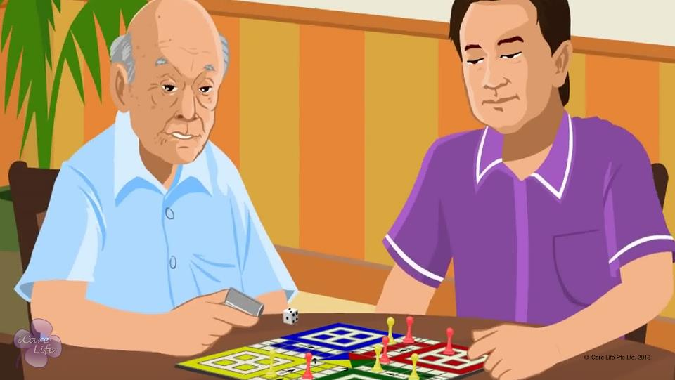
Involving the Elder in Brain Activities
11
Copyright: iCare Life Pte. Ltd., Singapore : This document must not be copied or shared or circulated without the consent of iCare Life and/or its affiliates.

Slide 13
Play Time !
Post Module Activity
12
Copyright: iCare Life Pte. Ltd., Singapore : This document must not be copied or shared or circulated without the consent of iCare Life and/or its affiliates.
Notes:
Arrange for several decks of cards (for playing memory, rummy and I Doubt It), several sets of board games like Ludo, Snakes and Ladders, Scrabble, Chess and Checkers and puzzles like Sudoku, crosswords and jigsaw puzzles.
For each game, ask which participants are familiar with the game and which are not. The participants who are familiar with a game should be asked to teach that game to other participants who are not familiar with it. Encourage the participants to play in groups.
Find a few links below for assistance in learning the rules for some of the above games:
Memory: http://boardgames.about.com/od/cardgames/a/concentration.htm
Rummy: http://rummy.com/rummyrules.html
I Doubt It: http://boardgames.about.com/od/cardgames/a/i_doubt_it.htm
Ludo: http://www.mazegames.biz/ludo.html
Snakes and Ladders: http://www.wikihow.com/Play-Snakes-and-Ladders
Scrabble: http://www.wikihow.com/Play-Scrabble
Chess: http://www.wikihow.com/Play-Chess
Checkers: http://www.wikihow.com/Play-Checkers
Chinese Checkers: http://www.wikihow.com/Play-Chinese-Checkers
Sudoku: http://www.wikihow.com/Solve-a-Sudoku

Slide 14
Summary
To engage an elder in brain activities:
Choose an activity based on the elder's ability and interests
Set aside a time for brain activities every day
Be patient and offer help when required
Appreciate the elder for a successful attempt
Allow the elder to quit if the person finds an activity too tough
Never ridicule the elder for failing to complete an activity
Some suitable brain activities for elderly people are:
Card games such as Memory, Rummy, and I Doubt It
Board games such as Ludo, Snakes and Ladders, Scrabble, Chess, and Checkers
Puzzles such as Sudoku, crossword, and jigsaw puzzles
13
Copyright: iCare Life Pte. Ltd., Singapore : This document must not be copied or shared or circulated without the consent of iCare Life and/or its affiliates.
Notes:
To engage an elder in brain activities:
Choose an activity based on the elder's ability and interests
Set aside a time for brain activities every day
Be patient and offer help when required
Appreciate the elder for a successful attempt
Allow the elder to quit if the person finds an activity too tough
Never ridicule the elder for failing to complete an activity
Some suitable brain activities for elderly people are:
Card games such as Memory, Rummy, and I Doubt It
Board games such as Ludo, Snakes and Ladders, Scrabble, Chess, and Checkers
Puzzles such as Sudoku, crossword, and jigsaw puzzles

Slide 15
Any Questions?
14
Copyright: iCare Life Pte. Ltd., Singapore : This document must not be copied or shared or circulated without the consent of iCare Life and/or its affiliates.
Notes:
Q1. How can playing a few games exercise an elder’s mind?
Ans: Our mind has several skills that we need all through our lives. Some of these are remembering things, problem solving, identifying patterns, and analyzing facts to make a decision. At a young age, when we are working and socializing with a lot of people, these brain skills get continuously used in our day to day work. However, at old age we find lesser opportunities to use our brain skills. The activities discussed in this module may appear like simple games and pastimes to you; but for an elderly person, they provide opportunities to exercise their memory and thinking skills which they otherwise get very few occasions to use.

Slide 16
Involving the Elder in Distance Communication
15
Copyright: iCare Life Pte. Ltd., Singapore : This document must not be copied or shared or circulated without the consent of iCare Life and/or its affiliates.

Slide 17





Logo Recognition
Pre Module Activity
16
Copyright: iCare Life Pte. Ltd., Singapore : This document must not be copied or shared or circulated without the consent of iCare Life and/or its affiliates.
Notes:
Print the logos on sheets of paper and distribute among the class participants.
Ask the class to recognize these logos and write the relevant answers. After they are done, reveal the answers in class.
The answer key is:
Twitter
Gmail
Whatsapp
Skype
Facebook

Slide 18
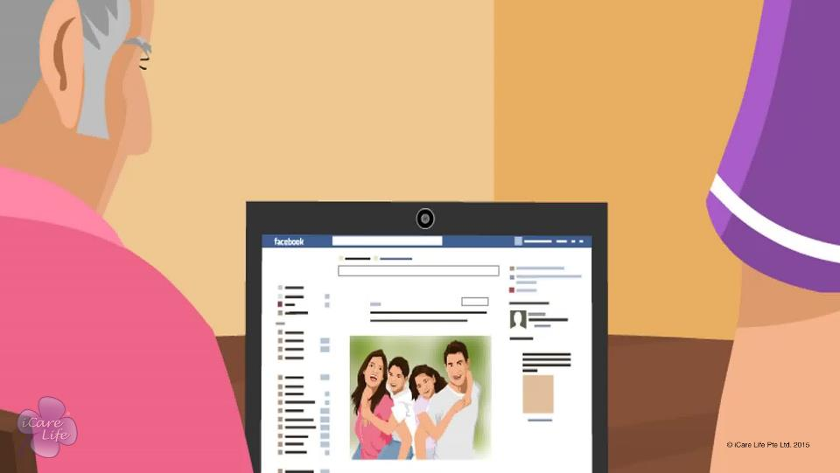
Involving the Elder in Distance Communication
17
Copyright: iCare Life Pte. Ltd., Singapore : This document must not be copied or shared or circulated without the consent of iCare Life and/or its affiliates.

Slide 19
Demonstration
Post Module Activity
18
Copyright: iCare Life Pte. Ltd., Singapore : This document must not be copied or shared or circulated without the consent of iCare Life and/or its affiliates.
Notes:
Arrange for a computer with Internet connection and a wall-projector. These will be needed for demonstrating how to use Gmail and Facebook.
You should know how to use Gmail and Facebook before you give a demonstration to the class. Otherwise, arrange for a person who can do so.
Start the demonstration with the help of the wall-projector.
While demonstrating how to use Gmail, show to create an email id, how to compose and send an email, how to open an unread email and reply, how to use the chat feature for text-chat and video-chat.
While demonstrating how to use Facebook, show how to make an account, find friends by name, put a status message, chat and upload photographs.
Make sure that you explain the specific terms used on these sites. E.g., Profile, Upload, Text-chat, Video-chat, Like, Comment, etc.

Slide 20
Summary
The various means of distance communication include:
Telephone,
Letters,
Email,
Social media websites,
Blogging,
Websites to share project ideas, and
Various applications on smart phones
To help an elder use different means of distance communication, you must:
Encourage the elder to connect with friends and family members
Help the elder get the required material and equipment
Know how to use a computer and computer accessories
Be familiar with using email and social media websites
Caution the elder against sharing personal information with strangers
19
Copyright: iCare Life Pte. Ltd., Singapore : This document must not be copied or shared or circulated without the consent of iCare Life and/or its affiliates.
Notes:
The various means of distance communication include:
Telephone,
Letters,
Email,
Social media websites,
Blogging,
Websites to share project ideas, and
Various applications on smart phones
To help an elder use different means of distance communication, you must:
Encourage the elder to connect with friends and family members
Help the elder get the required material and equipment
Know how to use a computer and computer accessories
Be familiar with using email and social media websites
Caution the elder against sharing personal information with strangers

Slide 21
Any Questions?
20
Copyright: iCare Life Pte. Ltd., Singapore : This document must not be copied or shared or circulated without the consent of iCare Life and/or its affiliates.
Notes:
Q1. What if I do not know how to use a gadget which the elder has?
Ans. Tell the elder about it and ask if anybody around can help you both learn how to use it, e.g. Somebody in the family or a neighbour. Also, you can call the company customer service and see if somebody can be sent to teach you how to use the gadget.

Slide 22
Involving the Elder in Spiritual Activities
21
Copyright: iCare Life Pte. Ltd., Singapore : This document must not be copied or shared or circulated without the consent of iCare Life and/or its affiliates.

Slide 23
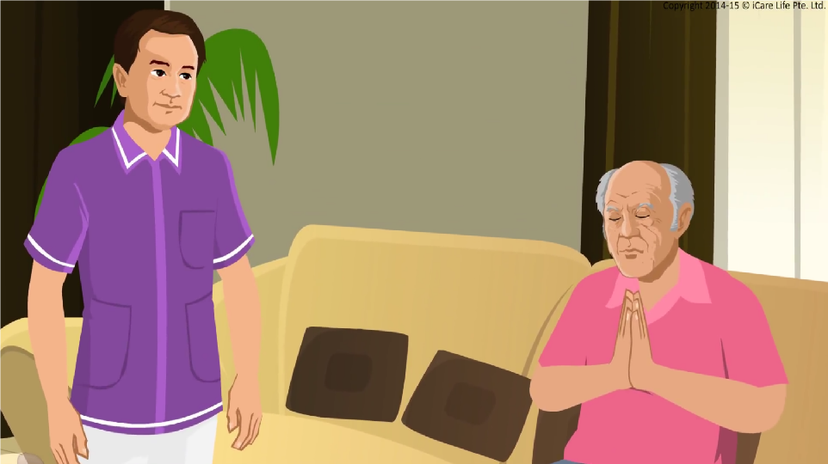
Involving in Spiritual Activities
22
Copyright: iCare Life Pte. Ltd., Singapore : This document must not be copied or shared or circulated without the consent of iCare Life and/or its affiliates.

Slide 24
Group Discussion
Post Module Activity
23
Copyright: iCare Life Pte. Ltd., Singapore : This document must not be copied or shared or circulated without the consent of iCare Life and/or its affiliates.
Notes:
Ask the participants to discuss answers to the following questions:
What is spirituality?
Name some ways through which people experience spirituality?
What benefits can be experienced through these activities?
Observe the discussion carefully and give inputs wherever needed. Do not let the discussion be just about one particular activity or venture into religions. Take care not to discuss religions or the good/bad points about any specific religion.
Model answers should revolve around spirituality involving ways and means to search for meaning in one’s life. It could be through praying, meditation, yoga, reading spiritual scriptures or any activity which really interests you, like cooking, gardening or sports. Basically the activity should be able to provide you inner peace and happiness. The benefits can include self-actualization, calmness, inner peace, happiness, a let-out for emotions.

Slide 25
Summary
Encourage and participate in spiritual activities with the elders
Do not impose your beliefs on the elders
Be careful not to judge the elder for their beliefs
24
Copyright: iCare Life Pte. Ltd., Singapore : This document must not be copied or shared or circulated without the consent of iCare Life and/or its affiliates.
Notes:
Encourage and participate in spiritual activities with the elders
Do not impose your beliefs on the elders
Be careful not to judge the elder for their beliefs

Slide 26
Any Questions?
25
Copyright: iCare Life Pte. Ltd., Singapore : This document must not be copied or shared or circulated without the consent of iCare Life and/or its affiliates.
Notes:
Q1. What if an elderly person is an atheist and does not believe in God?
Ans. In that case meditation is the best answer. There is no need to believe in the God yet a person can be spiritually inclined. Look for ways that can help the elder practice meditation, say audio/video CDs or a meditation class. Yoga can also make a person spiritually inclined.
Q2. Should one insist on a particular time frame in daily routine for such elderly persons?
Ans. One cannot do this but one can encourage the elderly person to take on such an activity in the mornings and in the evenings after freshening up.
Q3. How does one cope with the religious belief of the elderly person when such beliefs are different from yours?
Ans. One has to learn to be broadminded. Your main aim is to look after an elderly person in the best possible manner and all religions ultimately take you to God though different paths.

Slide 27
Involving the Elder in technology based Activities
26
Copyright: iCare Life Pte. Ltd., Singapore : This document must not be copied or shared or circulated without the consent of iCare Life and/or its affiliates.

Slide 28
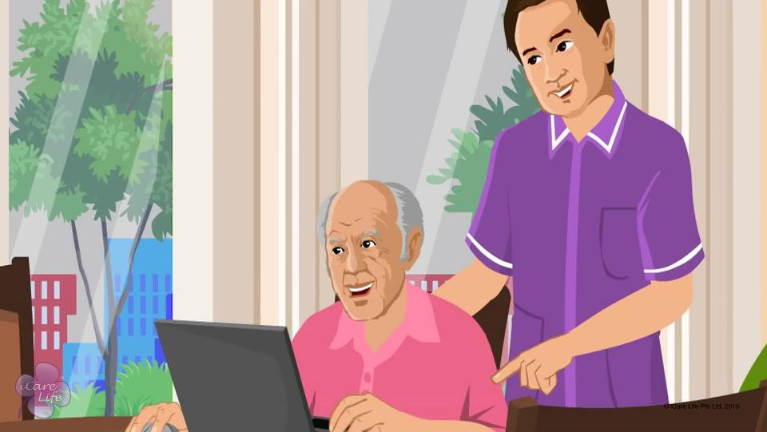
Involving the Elder in Technology based Activities
27
Copyright: iCare Life Pte. Ltd., Singapore : This document must not be copied or shared or circulated without the consent of iCare Life and/or its affiliates.

Slide 29
Play Time !
Post Module Activity
28
Copyright: iCare Life Pte. Ltd., Singapore : This document must not be copied or shared or circulated without the consent of iCare Life and/or its affiliates.
Notes:
Arrange for several computers/tablets/smart phones and a wifi connection that all the devices can use to connect to the Internet.
Give a demonstration of playing Candy Crush, Solitaire, Angry Birds, Word Search and a few Matching games to the participants. The participants who are familiar with a game should be asked to teach that game to other participants who are not familiar with it.
Find a few links below for playing the above games:
Candy Crush: http://www.candycrushsaga.com/
Solitaire: http://greenfelt.net/klondike
How to Play Solitaire: http://www.wikihow.com/Play-Solitaire
Angry Birds: http://www.angrybirdsgames.com/
Word Search: http://www.wordgames.com/word-search/
Matching Games: http://www.y8.com/tags/Matching_Game

Slide 30
Summary
Technology based brain activities help an elder:
Stay mentally alert
Play without a partner
Overcome hesitation of using modern gadgets
Improve hand-eye coordination and decision making skills
Some suitable technology based brain activities for an elder are:
Candy crush
Solitaire
Angry Birds
Word Search
Matching games
Internet versions of ludo, chess, checkers, Sudoku, crossword and jigsaw puzzles
29
Copyright: iCare Life Pte. Ltd., Singapore : This document must not be copied or shared or circulated without the consent of iCare Life and/or its affiliates.
Notes:
Technology based brain activities help an elder:
Stay mentally alert
Play without a partner
Overcome hesitation of using modern gadgets
Improve hand-eye coordination and decision making skills
Some suitable technology based brain activities for an elder are:
Candy crush
Solitaire
Angry Birds
Word Search
Matching games
Internet versions of ludo, chess, checkers, Sudoku, crossword and jigsaw puzzles

Slide 31
Any Questions?
30
Copyright: iCare Life Pte. Ltd., Singapore : This document must not be copied or shared or circulated without the consent of iCare Life and/or its affiliates.
Notes:
Q1. What should I do if the elder feels embarrassed about playing games on computer?
Ans: Many elderly people feel hesitant to use computers and tablets. Often this hesitation comes from a fear of not being able to use these gadgets or accidentally damaging them. The elder may also feel that playing games is meant for kids. You should convince the elder that such devices are quite easy to use and playing games is for entertainment that people of all ages can enjoy. Talk to the elder about the benefits of playing such games in terms on exercising their mind and increasing their alertness level. Encourage the elder to at least try playing some of the games. Start with some easy ones and appreciate the elder for every successful attempt. With your constant encouragement and support, gradually the elder will become comfortable and start enjoying such activities.

Slide 32


