Slide 1

Personalized Care and Attention
6
CR 7.2
Standard
Source: Skills for Health – Website http://www.skillsforhealth.org.uk/
Skills for Care – Website http://www.skillsforcare.org.uk/

Slide 2
Learning outcomes
1. Understand person centred values
2. Understand working in a person centred way
3. Demonstrate awareness of the individual’s immediate environment and make changes to address factors that may be causing discomfort or distress
4. Make others aware of any actions they may be undertaking that are causing discomfort or distress to individuals
5. Support individuals to minimise pain or discomfort
6. Support the individual to maintain their identity and self-esteem
7. Support the individual using person centred values
Source: Skills for Health – Website http://www.skillsforhealth.org.uk/
Skills for Care – Website http://www.skillsforcare.org.uk/
1

Slide 3


Values in Caregiving Work
Values are beliefs and ideas about how people should behave
Values: are central to work in health and social care. They are principles that guide workers to understand right from wrong and are about what is important when caring and supporting individuals
Source: Skills for Health – Website http://www.skillsforhealth.org.uk/
Skills for Care – Website http://www.skillsforcare.org.uk/

Slide 4

Values in Caregiving Work
Care
Commitment
Having someone’s best interests at heart and doing what you can to maintain or improve their wellbeing
Dedication to providing care and support but also understanding the responsibility you have as a caregiver
Compassion
Courage
Being able to feel for someone, to understand them and their situation
Not to have fear to try out new things or to say if you are concerned about anything
Competence
Communication
To understand what someone needs and have the knowledge and skills to provide it
To listen carefully but also be able to speak and act in a way that the person can understand
Source: Skills for Health – Website http://www.skillsforhealth.org.uk/
Skills for Care – Website http://www.skillsforcare.org.uk/
Notes:
Discussion: Ask Learners what they think are important in health and social care work.
Explain what is meant by each:
Care: having someone’s best interests at heart and doing what you can to maintain or improve their wellbeing.
Commitment: dedication to providing care and support but also understanding the responsibility you have as a worker.
Courage: not to have fear to try out new things or to say if you are concerned about anything.
Communication: to listen carefully but also be able to speak and act in a way that the person can understand.
Competence: to understand what someone needs and have the knowledge and skills to provide it.
Compassion: being able to feel for someone, to understand them and their situation.

Slide 5

Person Centred Values
Individuality
Each person has their own identity, needs, wishes, choices, beliefs and values. ‘One size fits all’ does not work when it comes to providing care and support
Choice
Each individual should be supported to make choices about their care and support
Rights
You should make sure an individual’s rights are respected, not only by yourself but by other people involved in their care
Source: Skills for Health – Website http://www.skillsforhealth.org.uk/
Skills for Care – Website http://www.skillsforcare.org.uk/
Notes:
Activity: Ask learners what they think is meant by the terms on the screen
Additional information
Individuality: Each person has their own identity, needs, wishes, choices, beliefs and values. ‘One size fits all’ does not work when it comes to providing care and support.
Choice: Each individual should be supported to make choices about their care and support. They should be given information in a way that they can understand so they can make informed choices. When working with individuals who cannot express their wants, needs and wishes in words, you must find other ways of communicating. Additional training and supervision can help you to develop these skills.
Rights: You have the right to speak your mind and be kept safe from harm, as well as the right to respect, dignity and equality. You should make sure an individual’s rights are respected, not only by yourself but by other people involved in their care.

Slide 6
Person Centred Values
Privacy
Everyone has a right to private space and time when they need it, and it also includes the individual’s private information
Dignity
Do not make assume an individual’s need; treating an individual in a dignified way shows respect, values their individuality and their ethical and moral beliefs
Respect
Recognising that individuals have their own opinions and feelings even if you do not agree with them, and showing importance to their opinion as an individual
Partnership
Successful partnership relies on communication and trust; valuing and respecting what others have to say while working with the individuals or their family
Source: Skills for Health – Website http://www.skillsforhealth.org.uk/
Skills for Care – Website http://www.skillsforcare.org.uk/
Notes:
Activity: Ask learners what they think is meant by the terms on the screen.
Additional information
Privacy: Everyone has a right to private space and time when they need it. Privacy affects how and where care and support is given, especially when it involves personal hygiene or intimate procedures. Privacy includes not talking to anyone about the individual’s private information unless they give permission and it is on a need-to-know basis to improve their care and support.
Dignity: Treating somebody in a dignified way means to treat someone with respect, valuing their individuality and their ethical and moral beliefs. In order to provide dignified care you need to have an open and positive attitude. Take time to do things their way, don’t make assumptions about how they want to be treated and be aware of how personal care may affect their dignity. You should never make assumptions about what they want or need.
Respect: Respecting someone means believing and showing that they have importance as an individual. It means that they have their own opinions and feelings and that even though you may not agree with them, you do respect them.
Partnership: You work in partnership when you involve the individual and their family and work alongside other workers. The key to a successful partnership is good communication and trust; valuing and respecting what others have to say.

Slide 7

Working in a person centred way
Person centred working puts the individual at the centre of their care and support and the key principles are:
1
The belief that individuals can plan for themselves
2
The care plan is written in the first person to make clear that it is the individual who owns it
3
The individual has as much control as possible over the choices they can make
4
The plan is there to make the individual’s life better, not to fit them into an existing service
Source: Skills for Health – Website http://www.skillsforhealth.org.uk/
Skills for Care – Website http://www.skillsforcare.org.uk/
Notes:
Discussion: Ask the learners for an example of each principle
The belief that an individual can plan for themselves
The focus needs to be on their strengths and abilities, e.g. an individual who wants to make their own decision about which mobility aids they would like to use to support them to walk short distances rather than use their wheelchair.
2. The care plan is written in the first person to make clear that it is the individual who owns it
e.g. ‘I would like to try a walking frame when I am moving around the house and for short distances outside rather than using my wheelchair’.
3. The individual has as much control as possible over the choices they can make
e.g. example, the individual is supported to try to use the walking frame.
4. The plan is there to make the individual’s life better, not to fit them into an existing service
e.g. the frame is sourced that is best for them within the resources available or they are able to find a frame from somewhere else if necessary.

Slide 8


Life history, preferences, wishes and needs
Taking time to find out about an individual’s personal history can help you to understand their likes and dislikes and this
will help to put an effective care plan together
Care plan: A required document that sets out in detail the way daily care and support must be
provided to an individual, and it is also be known as ‘plans of support’, ‘individual plans’, etc.
Source: Skills for Health – Website http://www.skillsforhealth.org.uk/
Skills for Care – Website http://www.skillsforcare.org.uk/

Slide 9

Changing needs
Care and support plans must be reviewed regularly to ensure that they are up to date and show the individual's current needs and preferences
An up-to-date care plan enables all workers to provide the best possible standard of person centred care
Source: Skills for Health – Website http://www.skillsforhealth.org.uk/
Skills for Care – Website http://www.skillsforcare.org.uk/
Notes:
Additional information
Reviews look at what is working, what doesn’t work and what might need to change.
e.g.an individual is unable to eat certain foods due to a new type of medication they are taking, their diet will need to change but still reflect the things they would like to eat.
Workers changing shifts, returning from holidays, temporary and agency workers will always have up-to-date information on the individual, enabling them to provide the best possible person centred care.
An up-to-date care plan enables workers to provide effective care and support those individuals new to them.
Care plans are legal documents which might be needed as evidence if an individual makes a complaint.

Slide 10

Planning for the future
Planning for the future can help to ensure an individual’s wellbeing and fulfilment, and it can be especially important for people who may not be able to:
Communicate their wishes, or
Make decisions
Source: Skills for Health – Website http://www.skillsforhealth.org.uk/
Skills for Care – Website http://www.skillsforcare.org.uk/
Notes:
Additional information
The wellbeing as relating to the following areas:
Personal dignity (including treating someone with respect)
Physical and mental health and emotional wellbeing
Protection from abuse and neglect
Control by the individual over day-to-day life (including over the way care and support is provided)
Participation in work, education, training or recreation
Social and economic wellbeing
Domestic, family and personal relationships
Suitability of living accommodation
The individual’s contribution to society
Planning for the future in this way is called advance care planning (ACP)

Slide 11
Minimising discomfort and distress
Environmental factors that can affect an individual’s comfort and wellbeing:
Lighting
Noise
Temperature
Odours
Ask the individual if they want you to change their environment to make them more comfortable - NEVER assume
Actions that can affect an individual’s comfort and wellbeing:
Changing a dressing
Moving a person who has stiff muscles or joints
Letting in bright light
Making a loud noise
Always warn the individual if something is going to be uncomfortable, and you MUST have consent to carry out the task
Notes:
Activity: Ask the learners to identify environmental factors that could affect an individual's comfort and wellbeing
Answers should include:
Lighting
Noise
Temperature
Odours/smells
Activity: Ask learners how they could change the person’s environment to make them more comfortable.
Possible changes to an environment:
Dimming bright lights
Providing additional lighting e.g. for reading
Closing windows or doors if it is noisy
Adjusting the volume of the TV or radio
Adjusting the heating in a room
Opening windows to cool a room down or get rid of unpleasant smells
Activity
Ask worker/s what care and support tasks they carry out that could be uncomfortable, unpleasant or painful.
Possible answers include:
Moving or assisting an individual
Changing a dressing
Opening the curtains and letting in bright light
Making a loud noise

Slide 12
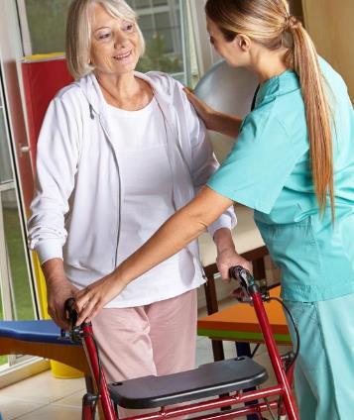
Supporting individuals to minimise pain or discomfort
You must able to identify when people are in pain but are less able to communicate or to move into a more comfortable position
Non-verbal signs of pain and discomfort
Doubling over
Gritted teeth
Pale complexion
Sweating
Tears or crying
Becoming quiet and withdrawn
Becoming aggressive
Furrowed brows
Environmental factors such as soiled clothes or bedlinen
Source: Skills for Health – Website http://www.skillsforhealth.org.uk/
Skills for Care – Website http://www.skillsforcare.org.uk/
Notes:
Activity: Ask the learners for examples of non-verbal signs that a person is uncomfortable or in pain
Answers should include:
Doubling over
Gritted teeth
Pale complexion
Sweating
Tears or crying
Becoming quiet and withdrawn
Becoming aggressive
Furrowed brows
Environmental factors such as soiled clothes or bedlinen.

Slide 13

Maintaining identity and self-esteem
The individual’s sense of wellbeing and identity are associated with many aspects of their life, including:
Political
Sexual
Physical
Mental
Spiritual
Emotional
Cultural
Religious
Social
Wellbeing: may include a person’s sense of hope, confidence and self-esteem, their ability to communicate their wants and needs, to make contact with others, to show warmth and affection, and to experience and show pleasure or enjoyment.
Identity: refers to our view of ourselves, who we are and what makes us who we are.
Source: Skills for Health – Website http://www.skillsforhealth.org.uk/
Skills for Care – Website http://www.skillsforcare.org.uk/
Notes:
Additional information
Spiritual - finding meaning and purpose in life (this could be through religious faith)
Emotional - how we feel about ourselves
Cultural - our sense of belonging
Religious - our faith and beliefs
Social - our relationships
Political - peace and stability in our homeland
Sexual - our intimacies
Physical - leading an active life
Mental - realising our potential and ability to contribute to society.

Slide 14







Knowledge check
Which of the following is an example of non-verbal communication of pain?
Click to reveal answer
Pale complexion
Talking
Shouting
Complaining
Source: Skills for Health – Website http://www.skillsforhealth.org.uk/
Skills for Care – Website http://www.skillsforcare.org.uk/
Notes:
Trainer should ask class why they chose the correct answer
Feedback
A – Non-verbal signs include pale complexion, sweating and gritted teeth
B – Talking is an example of verbal communication. People who are not able to communicate verbally may need support to make their needs and preferences known.
C – Shouting is an example of verbal communication. People who are not able to communicate verbally may need support to make their needs and preferences known.
D – Complaining is an example of verbal communication. People who are not able to communicate verbally may need support to make their needs and preferences known.

Slide 15

Knowledge check
Who is placed at the centre of person centred care and support?
Click to reveal answer
The worker
The individual
An advocate
The individual’s family and friends
Source: Skills for Health – Website http://www.skillsforhealth.org.uk/
Skills for Care – Website http://www.skillsforcare.org.uk/
Notes:
Trainer should ask class why they chose the correct answer
Feedback
A – Workers must work in ways that support the individual to play an active role in their care.
B – The individual is the expert in their own needs and preferences. They should be supported to make choices about their care and support and be placed at the centred of planning, delivering and reviewing their care package.
C – Advocates act on behalf of the individual, supporting them to speak out and to play an active part in planning their care.
D – Family and friends may be consulted about the individual's needs and preferences however, the interests of the individual will be placed at the heart of person centred care and the decisions that affect them.

Slide 16
Knowledge check
Which of the following are the values known as the 6Cs:
Click to reveal answer
Empathy, listening, support, respecting privacy, promoting dignity
Care, compassion, competence, communication, courage, commitment
Spiritual, emotional, cultural, religious, social, physical
Lighting, noise, temperature, odours
Source: Skills for Health – Website http://www.skillsforhealth.org.uk/
Skills for Care – Website http://www.skillsforcare.org.uk/
Notes:
Trainer should ask class why they chose the correct answer
Feedback
A – These are the skills that workers must have to effectively to support and care for individuals.
B – These are the 6Cs which are the values which should underpin the work of all workers in health and adult social care organisations.
C – These are aspects of a person’s identity that should be supported to maintain their self-esteem and sense of wellbeing.
D – These are examples of environmental factors that can cause an individual discomfort and distress.

Slide 17
Viewing of Modules
Avoiding Conflicts with Family Members
CR 7.2
Private and Confidential

Slide 18
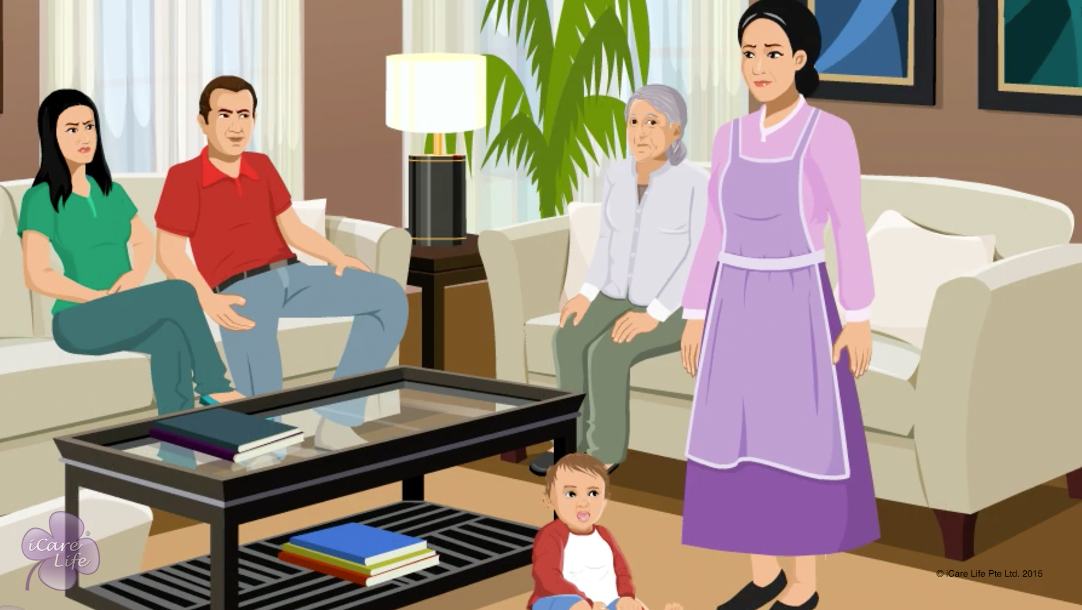
Avoiding Conflict with Family Members
1
Copyright: iCare Life Pte. Ltd., Singapore : This document must not be copied or shared or circulated without the consent of iCare Life and/or its affiliates.

Slide 19
In this module, you will learn about:
How to maintain a degree of mutual respect and formality with the family
How to avoid conflicts with the care receiver’s family
How to resolve conflicts with the care receiver’s family
2

Slide 20

Let’s Watch
Avoiding Conflict with Family Members
3
Copyright: iCare Life Pte. Ltd., Singapore : This document must not be copied or shared or circulated without the consent of iCare Life and/or its affiliates.

Slide 21


