Slide 1

Viewing of Modules
Avoiding Conflicts with Family Members
CR 7.2
Private and Confidential

Slide 2
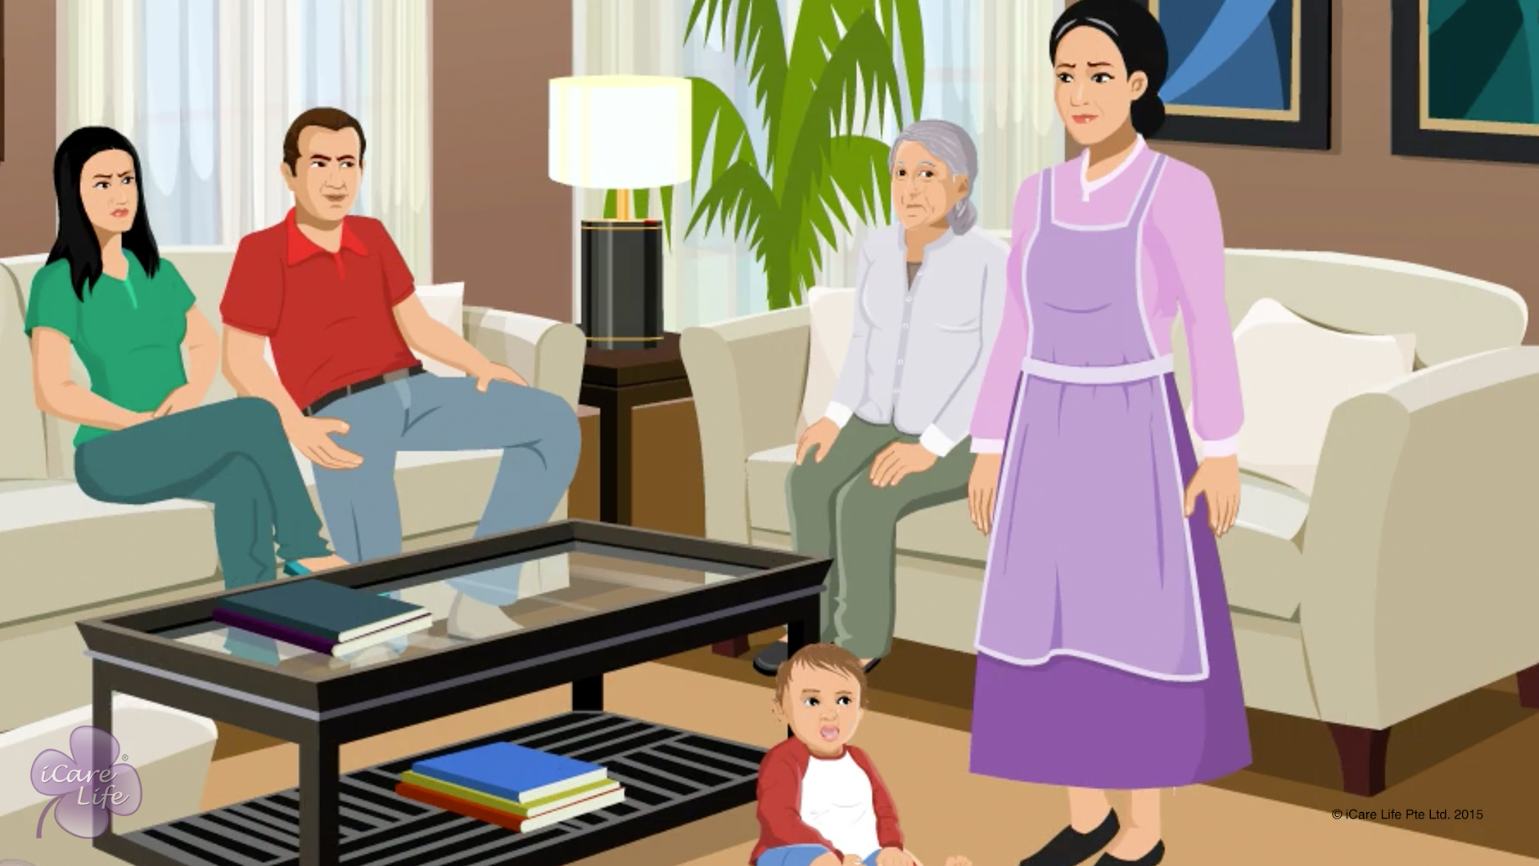
Avoiding Conflict with the Family
1
Copyright: iCare Life Pte. Ltd., Singapore : This document must not be copied or shared or circulated without the consent of iCare Life and/or its affiliates.

Slide 3
In this module, you will learn about:
How to maintain a degree of mutual respect and formality with the family
How to avoid conflicts with the care receiver’s family
How to resolve conflicts with the care receiver’s family
2

Slide 4

Let’s Watch
Avoiding Conflict with Family Members
3
Copyright: iCare Life Pte. Ltd., Singapore : This document must not be copied or shared or circulated without the consent of iCare Life and/or its affiliates.

Slide 5


