Slide 1

Viewing of Modules
Activities of Daily Living – Personal Care
CR 7.3
Private and Confidential

Slide 2
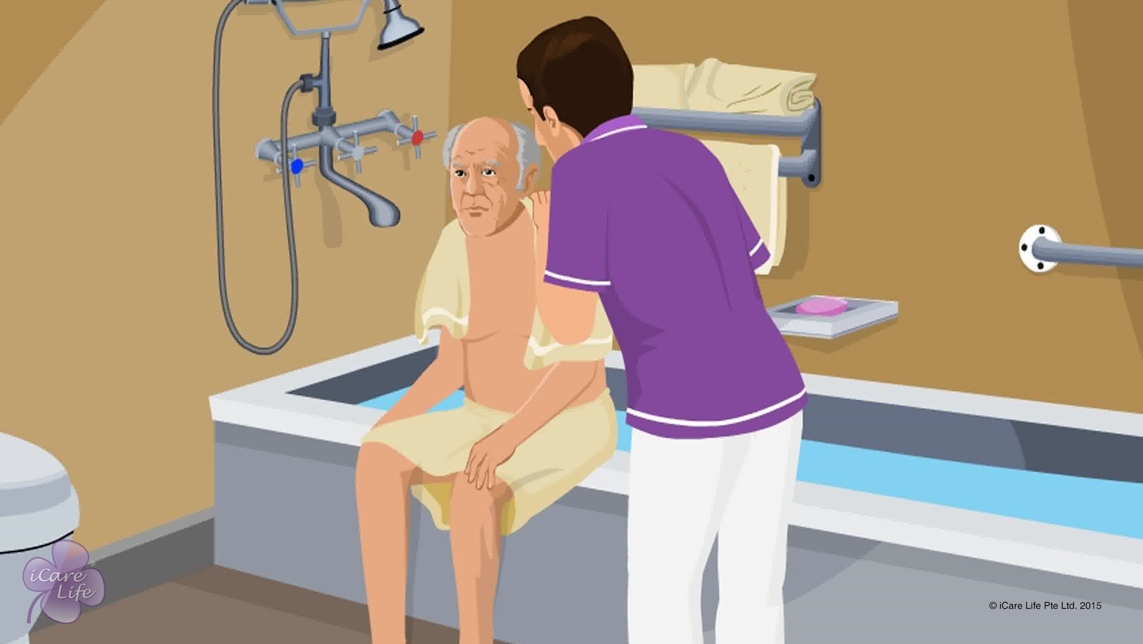
Helping the Elder bathe
1
Copyright: iCare Life Pte. Ltd., Singapore : This document must not be copied or shared or circulated without the consent of iCare Life and/or its affiliates.

Slide 3
In this module, you will learn about:
The steps to help the elder bathe using a bathtub, a shower, or a pail
The safety devices to ensure the elder’s safety while taking a bath
2

Slide 4

Let’s Watch
Helping the Elder Bathe
3
Copyright: iCare Life Pte. Ltd., Singapore : This document must not be copied or shared or circulated without the consent of iCare Life and/or its affiliates.

Slide 5
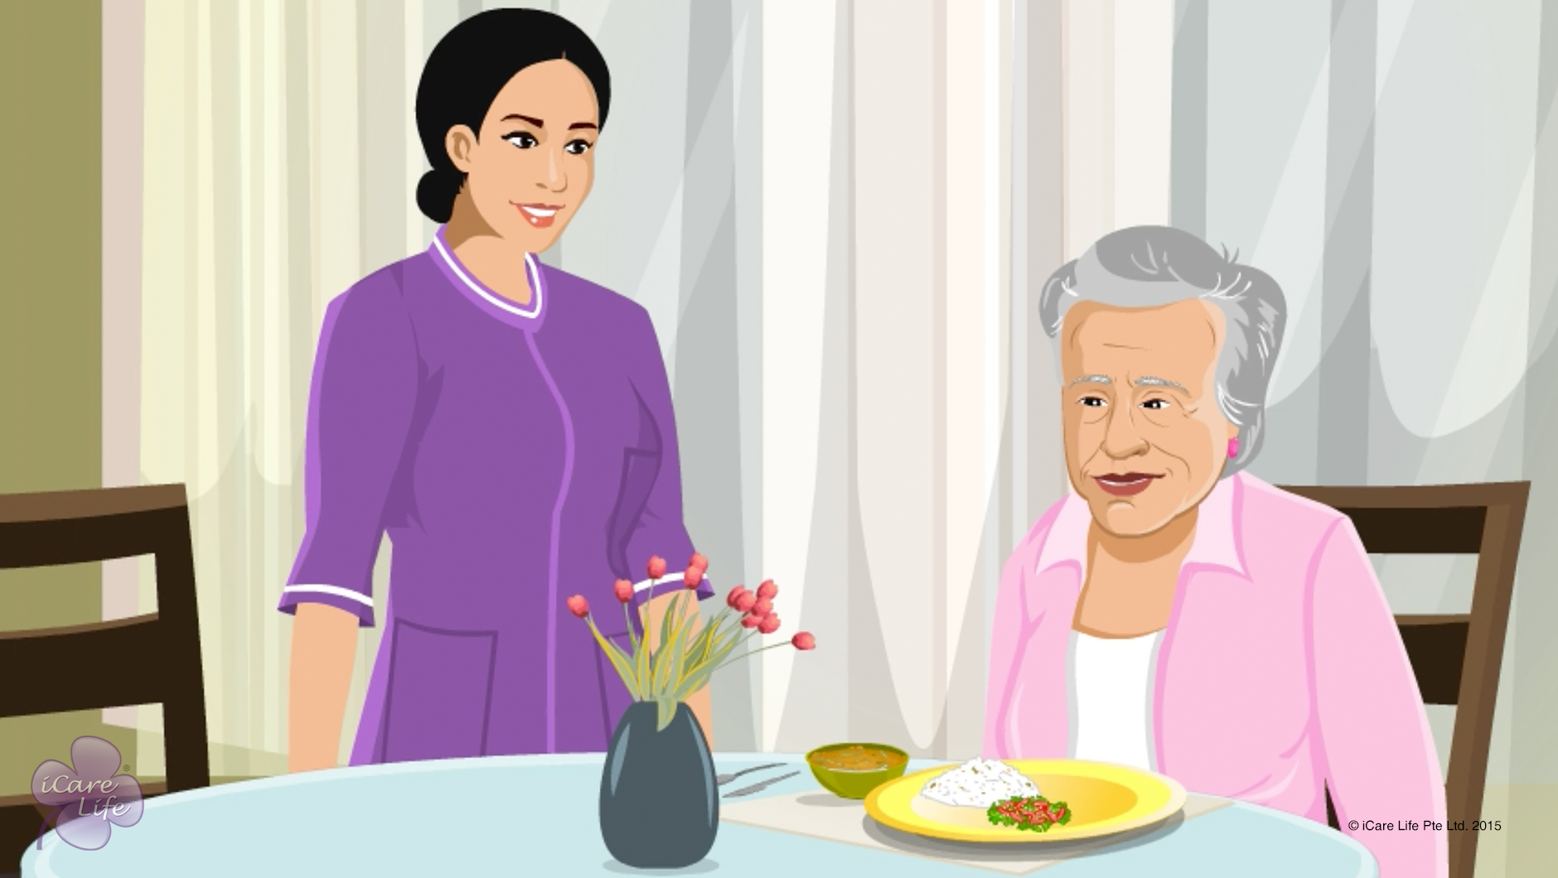
Planning Mealtimes
4
Copyright: iCare Life Pte. Ltd., Singapore : This document must not be copied or shared or circulated without the consent of iCare Life and/or its affiliates.

Slide 6
In this module, you will learn about:
The reasons why an elder may have difficulty eating and digesting food and getting proper nutrition
How you can plan mealtimes for an elder
5
Copyright: iCare Life Pte. Ltd., Singapore : This document must not be copied or shared or circulated without the consent of iCare Life and/or its affiliates.

Slide 7
Pre-Module Activity
You have served meal to the elder, but the elder refuses to eat.
What could be the reason?
What will you do now?
How will you avoid this situation in future?
6
Copyright: iCare Life Pte. Ltd., Singapore : This document must not be copied or shared or circulated without the consent of iCare Life and/or its affiliates.
Notes:
Notes to conduct the activity:
Read the situation aloud.
Then, read out the first question “What could be the reason?”
Ask the participants to share what they think the reasons for this.
The possible correct answers are:
The elder does not like what they cooked.
The elder has a physical problem and cannot eat what is cooked.
The elder does not feel like eating.
Then, read out the second question “What will you do now?”
Ask the participants to think and share what will they do in such a situation to have the elder eat.
The possible correct answers are:
Talk to them politely and persuade them to eat.
Tell them the benefits of eating what is cooked.
Now, read out the third question “How will you avoid this situation in future?
Ask the participants to think and share how they can avoid this situation.
The possible correct answers are:
Ask the elder what they would want to eat when planning their meals
Give them options and suggestions
Cook food according to their medical condition
11. Emphasize the importance of planning for mealtimes and tell the class that they will learn more about planning mealtimes in the session.
Total time for the activity: 15 – 20 minutes

Slide 8
Let’s Watch
Planning Mealtimes
7
Copyright: iCare Life Pte. Ltd., Singapore : This document must not be copied or shared or circulated without the consent of iCare Life and/or its affiliates.

Slide 9
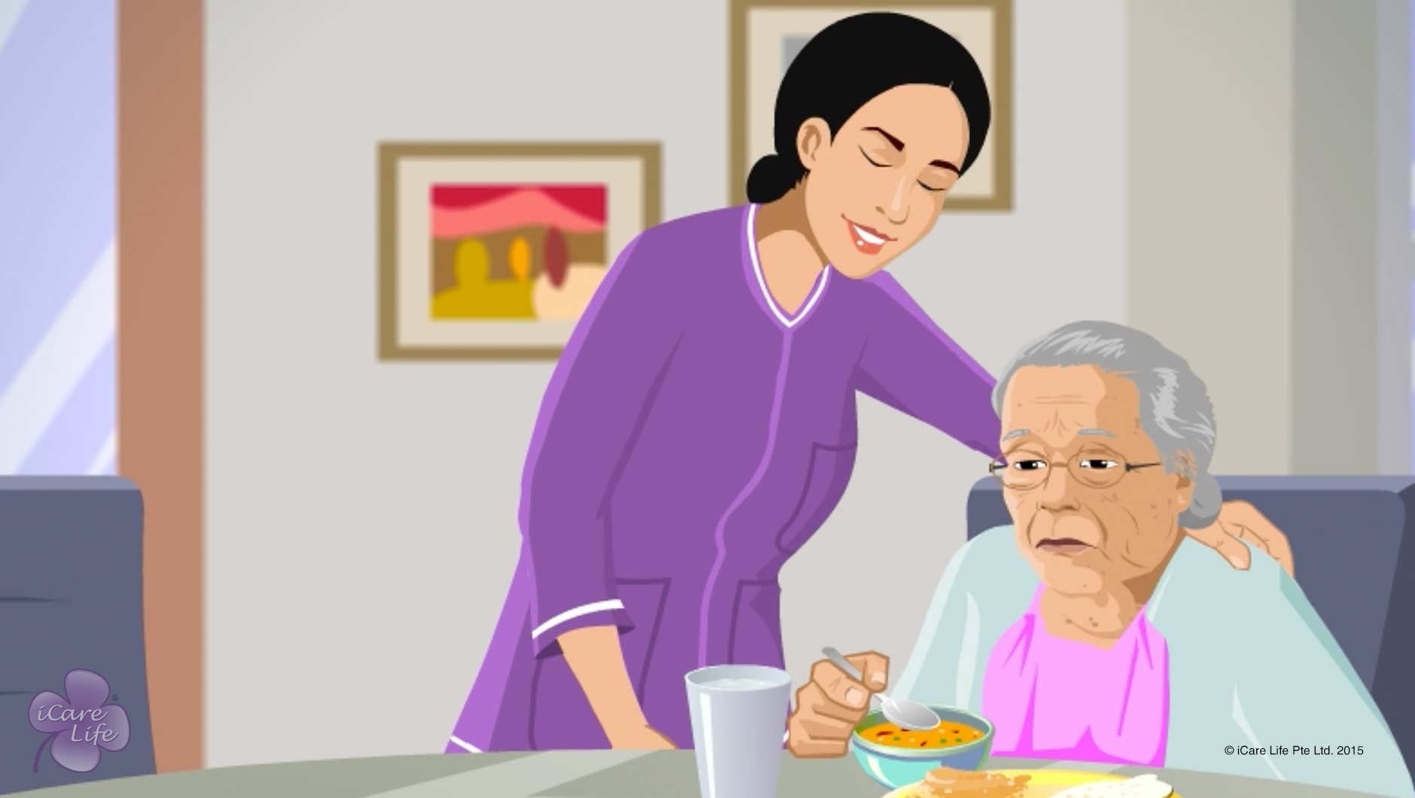
Helping the Elder Eat
8
Copyright: iCare Life Pte. Ltd., Singapore : This document must not be copied or shared or circulated without the consent of iCare Life and/or its affiliates.

Slide 10
In this module, you will learn about:
How to help the elder while eating
How to take care of the elder after eating
9
Copyright: iCare Life Pte. Ltd., Singapore : This document must not be copied or shared or circulated without the consent of iCare Life and/or its affiliates.

Slide 11
Let’s Watch
Helping the Elder Eat
10
Copyright: iCare Life Pte. Ltd., Singapore : This document must not be copied or shared or circulated without the consent of iCare Life and/or its affiliates.

Slide 12
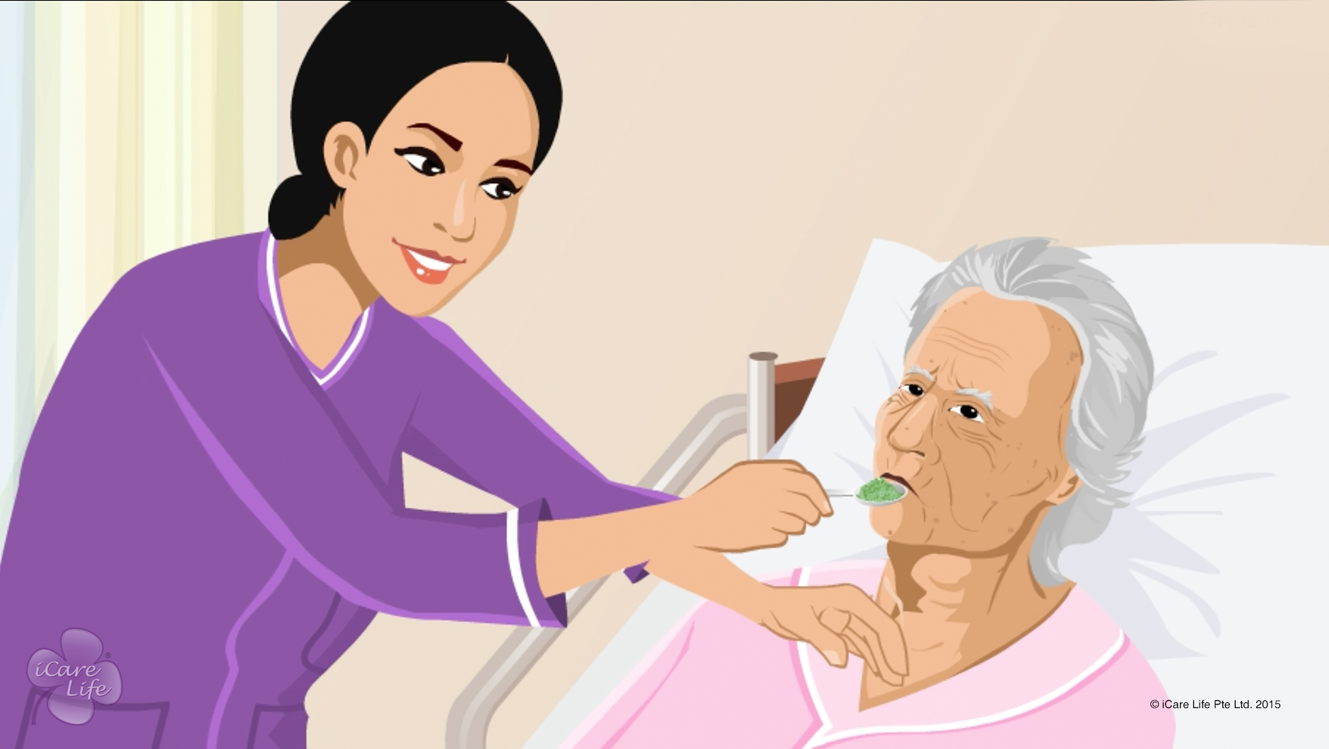
Helping Elders with Eating difficulty
11
Copyright: iCare Life Pte. Ltd., Singapore : This document must not be copied or shared or circulated without the consent of iCare Life and/or its affiliates.

Slide 13
In this module, you will learn about:
How to feed elders who are immobile, have poor sitting balance, or poor neck control
How to feed elders who have swallowing difficulties
12
Copyright: iCare Life Pte. Ltd., Singapore : This document must not be copied or shared or circulated without the consent of iCare Life and/or its affiliates.

Slide 14
Let’s Watch
Helping Elders with Eating difficulty
13
Copyright: iCare Life Pte. Ltd., Singapore : This document must not be copied or shared or circulated without the consent of iCare Life and/or its affiliates.

Slide 15
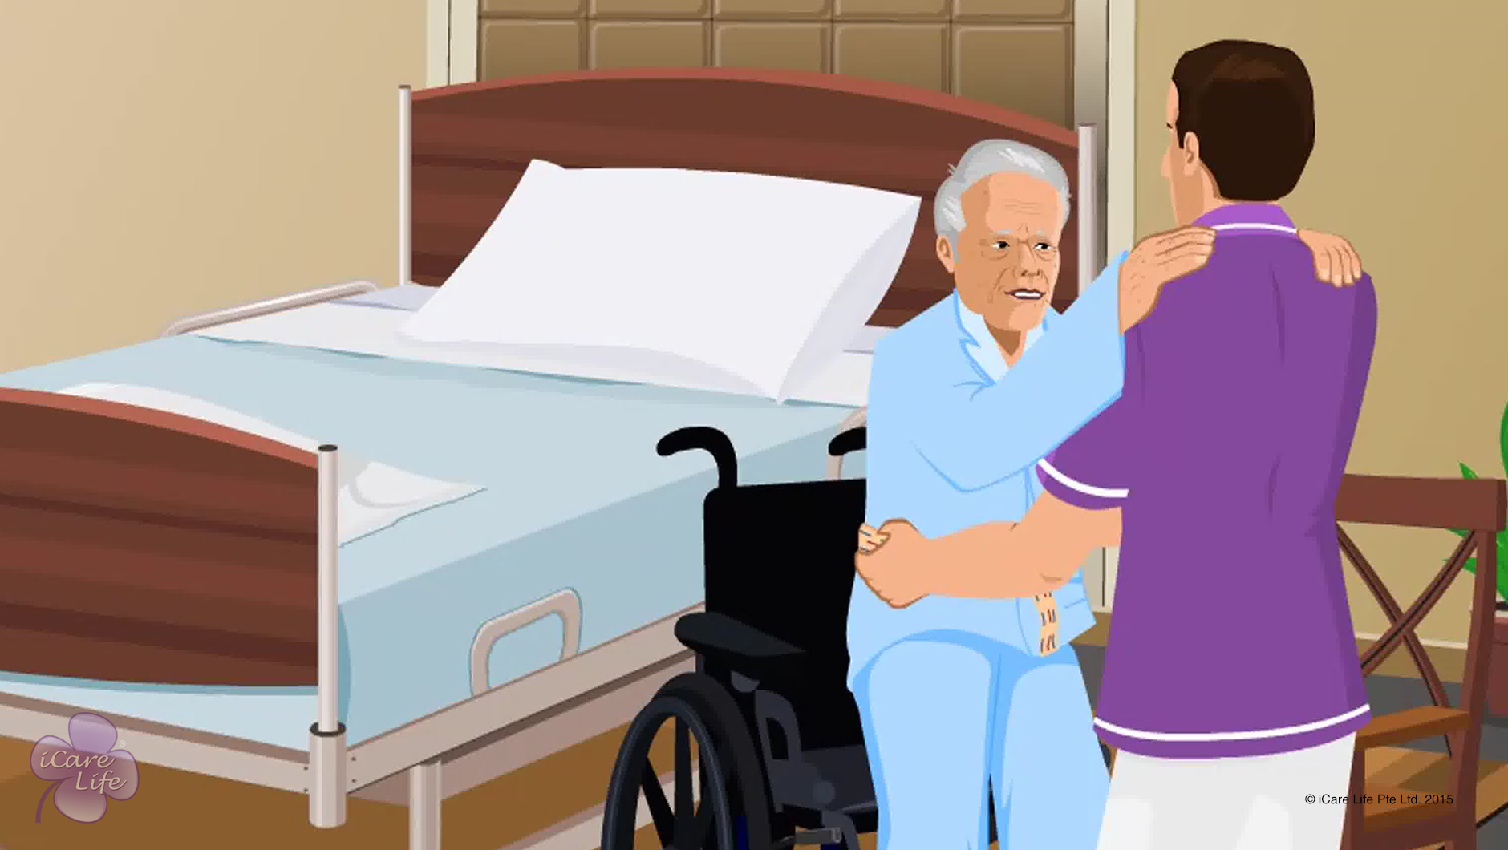
Transferring an Elder to the Wheelchair
14
Copyright: iCare Life Pte. Ltd., Singapore : This document must not be copied or shared or circulated without the consent of iCare Life and/or its affiliates.

Slide 16
In this module, you will learn about:
How to transfer an elder to a wheelchair using a gait belt
How to transfer an elder to a wheelchair using a mechanical lift
15
Copyright: iCare Life Pte. Ltd., Singapore : This document must not be copied or shared or circulated without the consent of iCare Life and/or its affiliates.

Slide 17
Let’s Watch
Transferring an Elder to the Wheelchair
16
Copyright: iCare Life Pte. Ltd., Singapore : This document must not be copied or shared or circulated without the consent of iCare Life and/or its affiliates.

Slide 18


