Slide 1

Modules Summary Discussion – Q&A
CR 7.4
Private and Confidential

Slide 2

Avoiding Conflict with Family Members
1
Copyright: iCare Life Pte. Ltd., Singapore : This document must not be copied or shared or circulated without the consent of iCare Life and/or its affiliates.

Slide 3
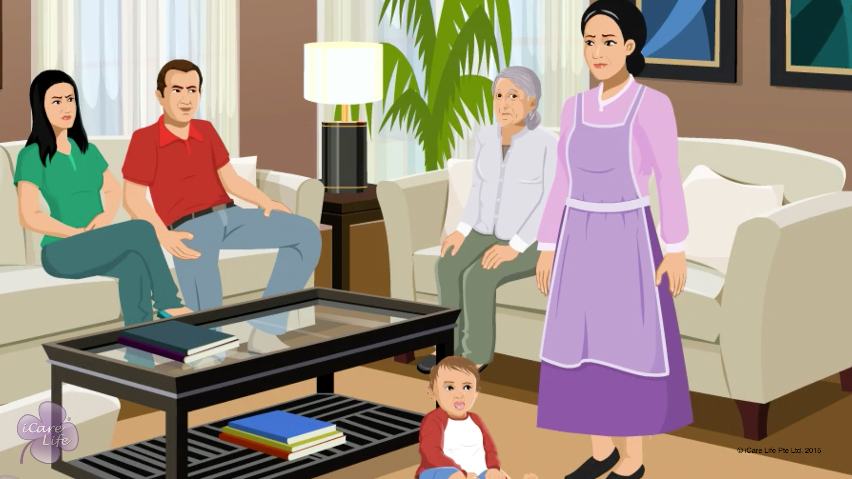
Avoiding Conflict with Family Members
2
Copyright: iCare Life Pte. Ltd., Singapore : This document must not be copied or shared or circulated without the consent of iCare Life and/or its affiliates.

Slide 4

Post-Module Activity
Chinese Whispers
Notes:
Involve the whole class to play the game. Ask them to stand in a circle.
Write down 3 lines on different sheets of paper, of approximately 10 words each. The sentence can be related to anything.
Call one class participant aside and ask them to memorize the first message.
Now ask them to go back to the circle and whisper the same in the ear of the person standing to their right.
The message is circulated from person to person only in whispers.
Once it has been given to the last person, the person should say it out aloud.
Compare it to what was written on the sheet. Show the class as to what was the original message.
Once the activity is over with all the three messages, talk to the class about the ill-effects of information passing from one person to another in form of gossip. Also, instruct them against involving in gossip with the members of care receiver’s family.

Slide 5
Summary
Be punctual
Practice good hygiene habits
Do not influence children with your beliefs or opinions about people or family members
Do not interfere in family’s matters
Do not gossip
Avoid discussing money matters with anyone
Always provide a valid receipt for any money spent
Do not engage in personal activities during work hours
Politely refuse if your employer asks you to follow their belief systems or try to give you additional work responsibilities
If there is a discrepancy in instructions about the care receiver, talk to and listen to your employer
4
Notes:
Be punctual
Practice good hygiene habits
Do not influence children with your beliefs or opinions about people or family members
Do not interfere in family’s matters
Do not gossip
Avoid discussing money matters with anyone
Always provide a valid receipt for any money spent
Do not engage in personal activities during work hours
Politely refuse if your employer asks you to follow their belief systems or try to give you additional work responsibilities
If there is a discrepancy in instructions about the care receiver, talk to and listen to your employer

Slide 6
Summary
In case of a conflict, talk to your employer; if that does not work, escalate the matter to your principal employer
In a conflict situation:
Behave professionally and in a balanced manner
Explain your point of view clearly and be open to feedback from your employer
Be assertive, but do not raise your voice
Talk in a non-complaining tone
Do not sound threatening in any way
5
Notes:
In case of a conflict, talk to your employer; if that does not work, escalate the matter to your principal employer
In a conflict situation:
Behave professionally and in a balanced manner
Explain your point of view clearly and be open to feedback from your employer
Be assertive, but do not raise your voice
Talk in a non-complaining tone
Do not sound threatening in any way

Slide 7
Any Questions?
6
Notes:
Q1. Which are normally the most common points of conflict with the family?
Ans. Coming late for work, not maintaining proper hygiene, and getting involved in the family matters may be some of the most common points of conflict.
Q2. What do you do in case the single point of contact in the family is not available to resolve any conflict?
Ans. Then one should try and talk to the senior most member of the family available at that particular moment.
Q3. What if the family makes you a kind of a judge while trying to resolve differences between their own members thinking that since you are an outsider you may be impartial in a particular situation?
Ans. You should stay away from family matters. You will have to clearly indicate that you may be asked to give opinion only about the care receiver and that you had no business to meddle into the family matters. Initially, this may not be to the liking of the family members but they would soon realize your prudence into the matter.
Q4. What if despite your best efforts, a conflict does not get resolved?
Ans. First think if you had behaved in a professional manner in a dispassionate manner. If you feel that there was any kind of lapse on your part, go back to the family and gracefully accept your mistake. If not, then you may have to raise the matter to your employer and then to the principal employer. You must understand that people are likely to see things through their own prisms and therefore one must remain calm all throughout the period of conflict.

Slide 8
Helping the Elder Bathe
7
Copyright: iCare Life Pte. Ltd., Singapore : This document must not be copied or shared or circulated without the consent of iCare Life and/or its affiliates.

Slide 9
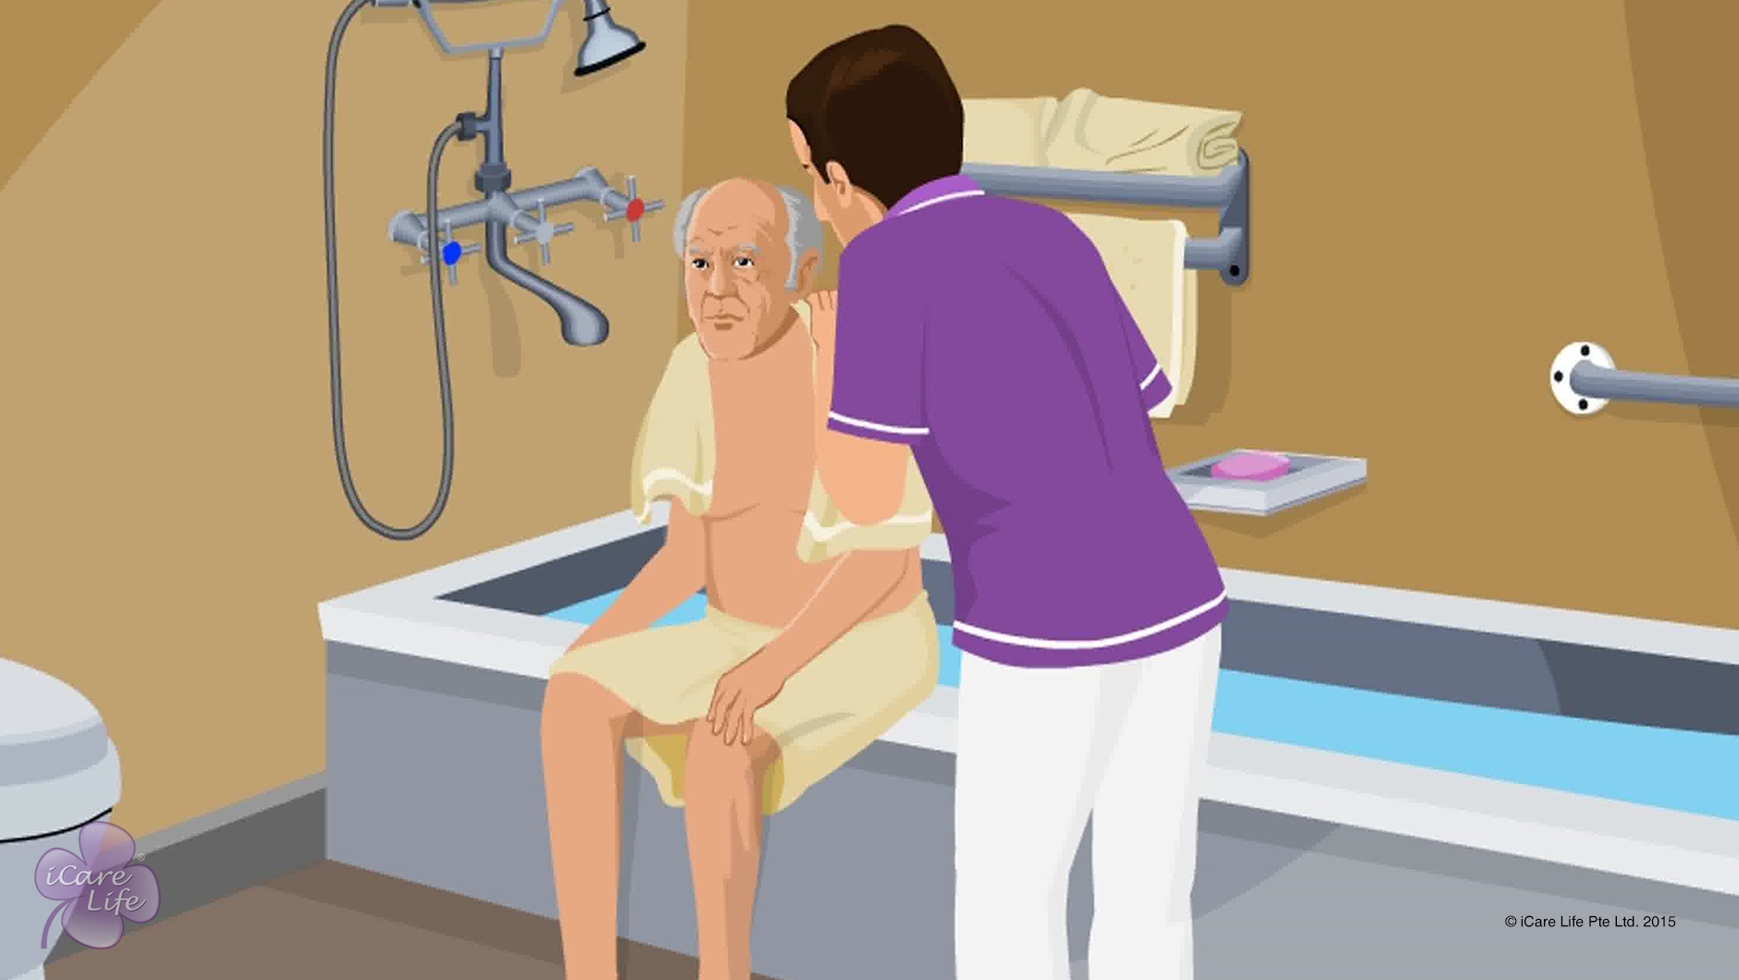
Helping the Elder Bathe
8
Copyright: iCare Life Pte. Ltd., Singapore : This document must not be copied or shared or circulated without the consent of iCare Life and/or its affiliates.

Slide 10
Post-Module Activity
Let’s Practice
Notes:
The participants are divided into small batches and arrange for a live demonstration of helping an elder (you could use dummies) take a bath by trained caregivers. The ideal place for this would be an old people’s home or a nursing home. Fix a prior appointment for the activity and inform the participants of the location and timings for the demonstration.
During the demonstration, participants of each batch can be assigned tasks like preparing the bathroom for bathing. If possible, one by one make the participants assist an elder (or dummy) in taking a bath under the supervision of a trained caregiver.

Slide 11
Summary
While the elder is taking bath:
Respect the elder’s privacy
Encourage the elder to be independent
Stay nearby to help when required
Before calling the elder for bath:
Ensure all required things are arranged in the bathroom at suitable height
Arrange for a seat if required
Check the temperature of water
To ensure elder’s safety:
Sweep away excess water from the floor
Use antiskid mats, long handled scrubbers, and grab bars
Use a soft towel to pat dry the elder’s skin. Do not scrub the elder’s skin hard
10
Notes:
While the elder is taking bath:
Respect the elder’s privacy – draw the curtains and keep the door closed when eth elder is taking a bath or changing clothes
Encourage the elder to be independent
Stay nearby to help when required
Before calling the elder for bath:
Ensure all required things are arranged in the bathroom at suitable height
Arrange for a bathing chair if required
Check the temperature of water
To ensure elder’s safety:
Sweep away excess water from the floor
Use antiskid mats, long handled scrubbers and grab bars
Use a soft towel to pat dry the elder’s skin; do not scrub the elder’s skin hard

Slide 12
Summary
To help an elder take a shower:
Adjust the flow and temperature of water
Be available to turn off the shower while soaping
To help an elder bathe using a pail:
Fill the pail with water of suitable temperature
Place the pail at a suitable height
Be available to refill the pail if required
To help an elder bathe using a bathtub:
Fill the tub with water of suitable temperature
Make the elder sit on the edge
Support the elder’s feet and move them inside the tub
Help the elder slide down in the tub or sit on a chair
11
Notes:
To help an elder take a shower:
Adjust the flow and temperature of water
Be available to turn off the shower while soaping
To help an elder bathe using a pail:
Fill the pail with water of suitable temperature
Place the pail at a suitable height
Be available to refill the pail if required
To help an elder bathe using a bathtub:
Fill the tub with water of suitable temperature
Make the elder sit on the edge
Support the elder’s feet and move them inside the tub
Help the elder slide down in the tub

Slide 13
Any Questions?
12
Notes:
Q.1. What should I do if the elder does not want to take bath on a particular day?
Ans. Do not force the elder. You could give them a sponge bath and help them change their clothes.
Q.2. The elder under my care is prone to falls. What should I do if the elder insists that I leave them alone while they are take a bath?
Ans. Get safety devices such as grab bars and anti-skid mats in bathrooms. Also ensure the bathroom floor is dry at all times. When the elder is taking a bath, give them privacy but stay outside the door to help the elder if required.

Slide 14
Planning Mealtimes
13
Copyright: iCare Life Pte. Ltd., Singapore : This document must not be copied or shared or circulated without the consent of iCare Life and/or its affiliates.

Slide 15
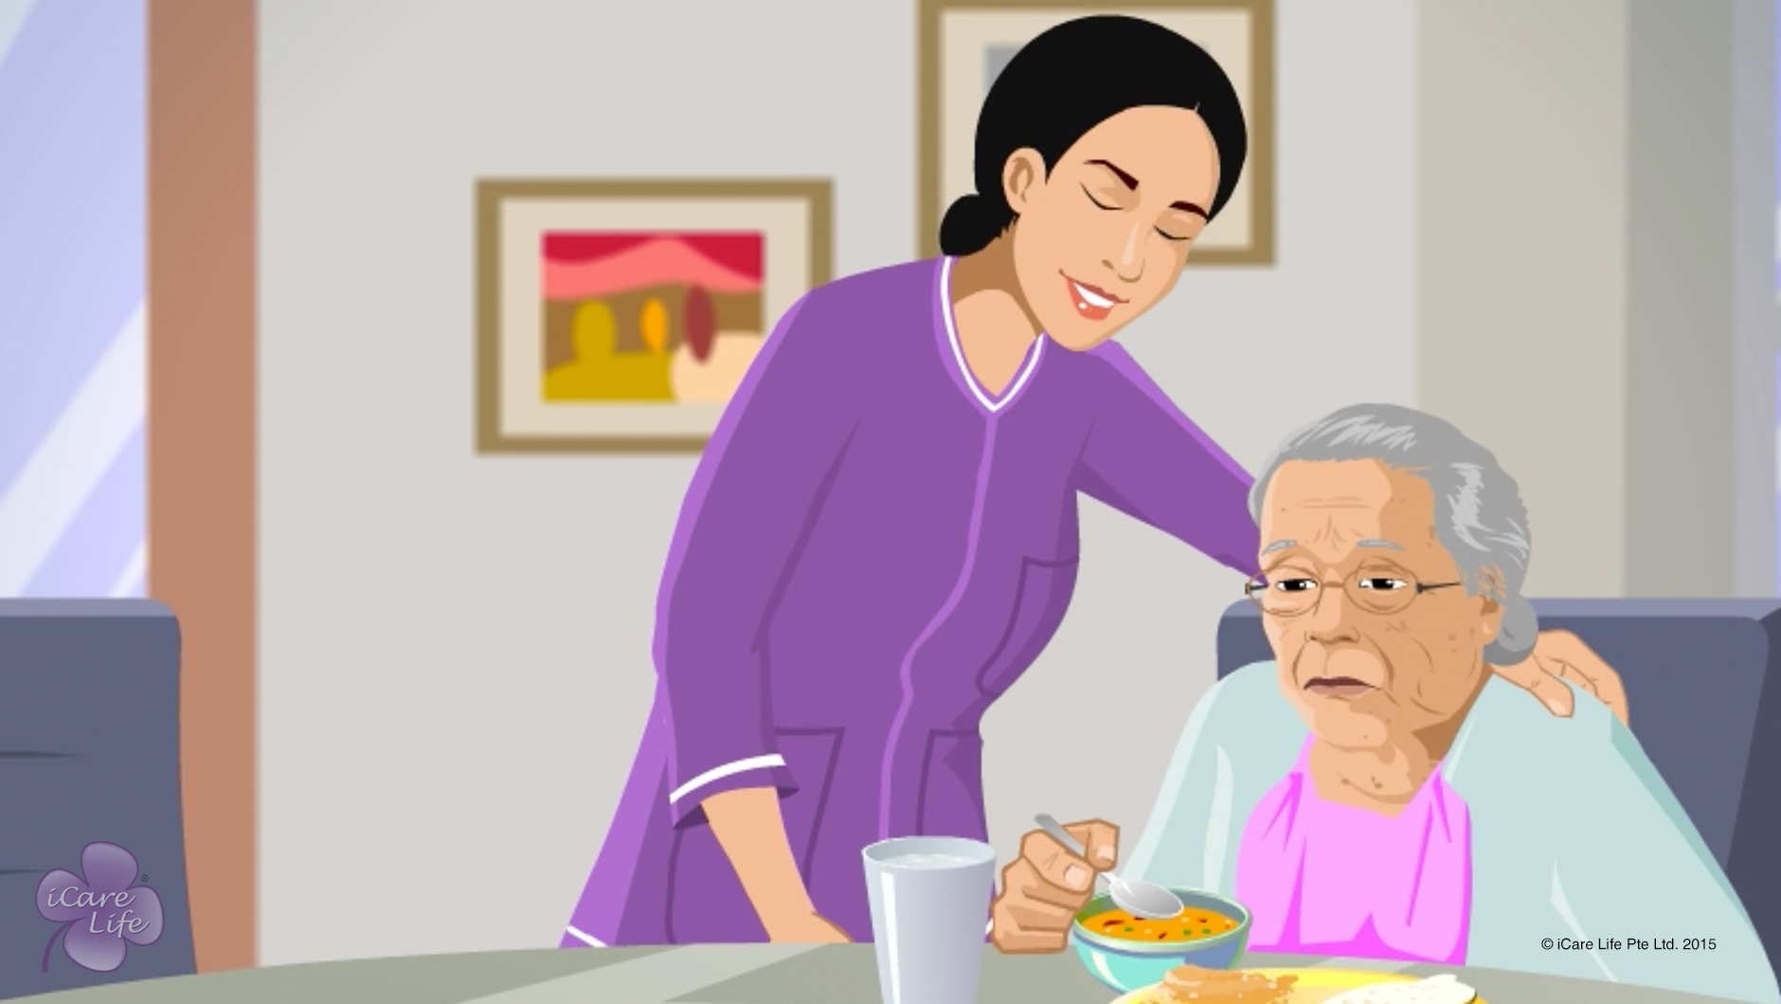
Planning Mealtimes
14
Copyright: iCare Life Pte. Ltd., Singapore : This document must not be copied or shared or circulated without the consent of iCare Life and/or its affiliates.

Slide 16
Summary
For an elder:
Plan for a balanced diet
Serve food as per their choice
Plan how many times and when to serve them
Serve small portions during meals
Serve snacks in-between meals
Keep appropriate gap in-between meals
Ensure good ambience at the eating place
Cut food, open containers, and butter the bread
Serve food and drinks at the right temperature
Arrange for appropriate equipment for eating
15

Slide 17
Any Questions?
16
Notes:
FAQs:
Question 1: What should I do if I am not able to understand why an elder is not eating?
Answer 1: Talk to the elder, the elder's family or doctor to understand any physical issues, which may be affecting the elder's ability to eat or digest. You may also be able to understand any mental or psychological problems, due to which the elder may not be interested in eating.
Question 2: If the elder person is suffering indigestion or constipation for a long time, can I give them a medicine?
Answer 2: You must not give them any medicines unless prescribed by the doctor. In this situation, you must consult the doctor attending to the elder or ask the elder or the elder's family to consult a doctor.
Question 3: What should I do if the elder is suffering from dementia and forgets that they have eaten and want to eat again?
Answer 3: Be patient and politely remind them of what they ate. Tell them that eating again will cause indigestion and you will be serving them snacks in sometime.
Question 4: What should I do if the doctor has asked to prepare food with no salt for an elderly person, but the elder insists on having salt?
Answer 4: Be patient and make the elder understand why the doctor has asked them to have no salt. Tell them about the problems they may have by having salt. Assure them that you will try to serve them the best food you can, without salt.
Question 5: What if an elderly person wants to have junk food instead of nutritious snacks?
Answer 5: If the medical condition of the elderly person permits, give them the food they want to eat in small quantity along with nutritious snacks. If their medical condition does not permit, then make them understand the reason politely or ask their family member’s to talk to make them understand.

Slide 18
Helping the Elder Eat
17
Copyright: iCare Life Pte. Ltd., Singapore : This document must not be copied or shared or circulated without the consent of iCare Life and/or its affiliates.

Slide 19
Helping the Elder Eat
18
Copyright: iCare Life Pte. Ltd., Singapore : This document must not be copied or shared or circulated without the consent of iCare Life and/or its affiliates.

Slide 20
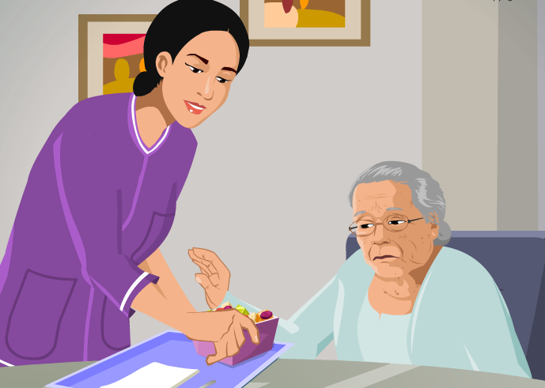
Post-Module Activity
I can eat myself! Please don't irritate me. Just leave me alone.
Why is the elderly woman frustrated?
How can a caregiver avoid this situation?
Notes:
Notes to conduct the activity:
Draw the attention of the participants to the image of the elder and the caregiver
Tell them that in the image the elder is frustrated and talking to the caregiver. Read the text in the talk bubble aloud “I can eat myself! Please don't irritate me. Just leave me alone.“
Ask them to think and share the reasons for the frustration of the elder.
Possible answers can be:
The elder feels that they can eat themselves.
It is difficult to accept help from someone when eating.
Elders find it difficult to accept that they are unable to even eat themselves.
The caregiver is trying to even help with the tasks which the elder can do.
4. Ask them how do they feel the caregiver could have avoided this situation?
Possible answers can be:
The caregiver should let the elderly woman eat with minimum assistance.
The caregiver should only provide assistance when truly needed or when the elder is not able to do something.
The caregiver should be patient and give the elder enough time.
If the elder can eat on their own and want to be left alone when eating, the caregiver should give them privacy, but keep watching from a distance.

Slide 21
Summary
To help an elder to eat:
Help them wear glasses and dentures
Seat them comfortably
Provide napkins and tissues
Offer food that can be eaten comfortably
Serve liquids with food
Ensure that they are fully alert
Ask discreetly to chew or swallow
Check for swallowing difficulty or choking
After the elder has finished eating:
Remove napkin and utensils
Help them clean hands, mouth, and dentures
Ask them not to lie down immediately
Observe signs of choking or uneasiness
20
Copyright: iCare Life Pte. Ltd., Singapore : This document must not be copied or shared or circulated without the consent of iCare Life and/or its affiliates.
Notes:
To help an elder to eat:
Help them wear glasses and dentures – Before moving to the eating place
Seat them comfortably - With head slightly tilted forward
Provide napkins and tissues – To protect clothing and wipe hands and mouth
Offer food that can be eaten comfortably – Food that they can eat using hands if they cant use spoons and forks
Serve liquids with food – Such as water, juice, soup, or tea
Ensure that they are fully alert – To prevent choking
Ask discreetly to chew or swallow – When they are unsure of what to do
Check for swallowing difficulty or choking – Such as, strain on face or neck, face turning blue or fainting
After the elder has finished eating:
Remove napkin and utensils
Help them clean hands, mouth, and dentures
Ask them not to lie down immediately
Observe signs of choking or uneasiness

Slide 22
Any Questions?
21
Notes:
FAQs:
Question 1: What if the elder refuses to take my help?
Answer 1: Do not take it personally. Politely tell them that you are around just in case they need any assistance. When you see them struggling, politely ask them and then help them.
Question 2: What do I do when I see them having breathing difficulty or choking?
Answer 2: Do not give the person anything to drink because fluids may take up space needed for the passage of air. Stay with the elder and encourage the elder to cough to clear the air passage. If the elder cannot answer by speaking and can only nod the head, emergency help may be needed. Immediately call the doctor or ambulance.
Question 3: What if the elder refuses to eat?
Answer 3: Politely ask them the reason and try to attend to any complains they may have. Ask them to eat slowly and make them understand that eating well will keep them healthy.
Question 4: What should I do if the elder wants to be eat on bed?
Answer 4: If the elder is not very unwell and is able to walk, ask the politely to move to the dining area to eat. Tell them that they will like the change and will be able to eat better.
Question 5: What if the elder insists on lying down immediately after eating?
Answer 5: Tell them politely of the risks of doing so. Try to talk to them, make them do something that they may be interested in or switch on the television to make them sit upright for 20-30 minutes after eating.

Slide 23
Helping Elders with Eating difficulty
22
Copyright: iCare Life Pte. Ltd., Singapore : This document must not be copied or shared or circulated without the consent of iCare Life and/or its affiliates.

Slide 24
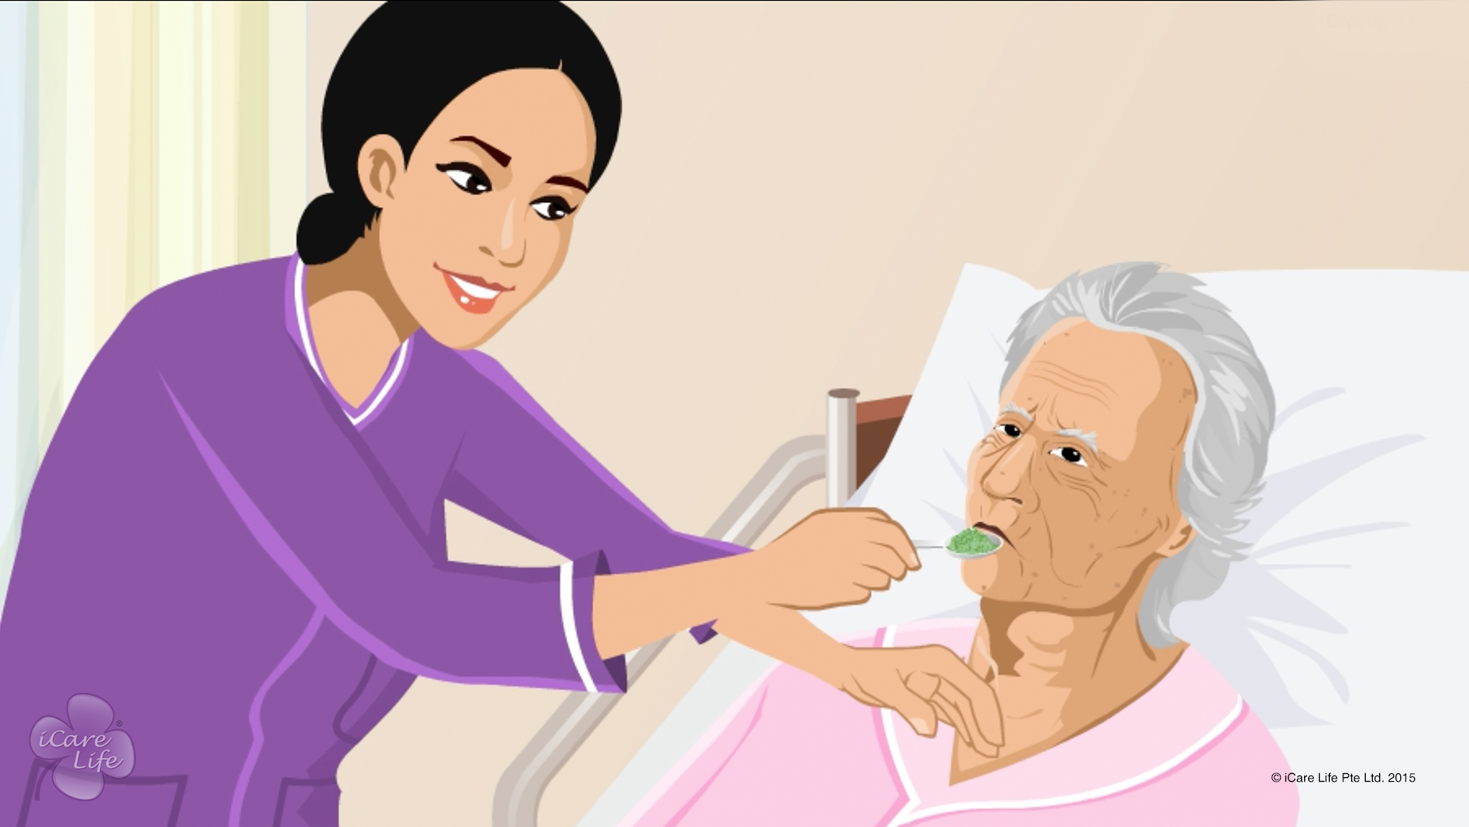
Helping Elders with Eating difficulty
23
Copyright: iCare Life Pte. Ltd., Singapore : This document must not be copied or shared or circulated without the consent of iCare Life and/or its affiliates.

Slide 25
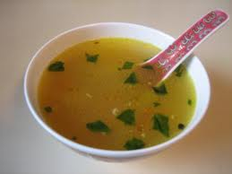
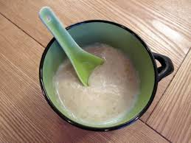



Post-Module Activity
Identify the food items shown
Which of the these can be easily consumed by an elder with swallowing difficulty?
Notes:
Notes to conduct the activity:
Show the slide and ask the learners to first identify the food items on the screen.
Answer is:
Food items:
Thin watery soup
Porridge
Custard
Thick tomato soup
Vegetable sandwich
Now, ask the learners to identify the food items that can be easily consumed by an elder with swallowing difficulty.
Answer is:
Food items:
Thin watery soup – difficult to consume
Porridge – easy to consume
Custard – easy to consume
Thick tomato soup – easy to consume
Vegetable sandwich – difficult to consume
Now, ask them the reason why porridge, custard and thick tomato soup can be consumed easily, but thin watery soup and sandwich is difficult to consume for an elder with swallowing difficulty.
(The answer – Solid food and thin liquids are difficult to consume for an elder with swallowing difficulty, but food items with smooth with the consistency of puree are easy to consume.)
4. Tell them that there are many such things which they will have to keep in mind while Helping Elders with Eating Difficulty, about which they will learn in the module.

Slide 26
Summary
To feed elders with poor sitting balance:
Decide on appropriate eating place and equipment
Make them sit with head tilted slightly forward
Place cushions behind their head and lower back
Use soft collars or neck braces, if advised
To feed elders with paralysis:
Tilt their head towards the stronger side
Check the weaker side of mouth for food getting collected
To feed elders with swallowing difficulty:
Serve food with consistency of a thick puree
Cook and liquidize each food item separately
Ask them to drink cold water before meals
Ask them to have a sip of liquid in-between
Ask them to throw the head back, if they cannot push the food with tongue
25
Copyright: iCare Life Pte. Ltd., Singapore : This document must not be copied or shared or circulated without the consent of iCare Life and/or its affiliates.
Notes:
To feed elders with poor sitting balance:
Decide on appropriate eating place and equipment
Make them sit with head tilted slightly forward
Place cushions behind their head and lower back
Use soft collars or neck braces, if advised
To feed elders with paralysis:
Tilt their head towards the stronger side
Check the weaker side of mouth for food getting collected
To feed elders with swallowing difficulty:
Serve food with consistency of a thick puree – elders have difficulty in swallowing solid food and liquids with very thin consistency
Cook and liquidize each food item separately – to let the elder taste each food item
Ask them to drink cold water before meals – having cold water encourages swallowing
Ask them to have a sip of liquid in-between – to clear food passage
Ask them to throw the head back, if they cannot push the food with tongue – to push the food down by movement of head
Follow all the other good practices for helping elders eat – such as cleaning hands and mouth, keeping the elder alert while eating and asking them to remain seated for about 20 to 30 minutes after eating

Slide 27
Any Questions?
26
Notes:
FAQs:
Question 1: What if the elder always wants to eat in the bed?
Answer 1: Do as the doctor has advised. If the doctor has advised not to move the elderly from bed, serve food on the bed. If not, then try to politely persuade the elderly to sit on a chair to eat, tell them that they will like the change and will be able to eat better. If the elder is not feeling well, then serve them on the bed, but ensure that they remain alert while eating and remain seated for 20-30 minutes after eating.
Question 2: How should I feed an elder who is paralyzed on both sides of the body?
Answer 2: If the elder can chew and swallow at least from one side of the mouth, you feed the elderly, but do consult with the doctor as well. If the elder cannot chew or swallow at all, tube feeding may be required, which will be decided by the doctor.
Question 3: What if the elder refuses to eat liquidised food?
Answer 3: Ensure that the food looks appetizing. Keep patience and explain them why they need to have liquidised food. Ask them if you should add any sauce or gravy to the food to improve its taste.

Slide 28
Transferring an Elder to the Wheelchair
27
Copyright: iCare Life Pte. Ltd., Singapore : This document must not be copied or shared or circulated without the consent of iCare Life and/or its affiliates.

Slide 29
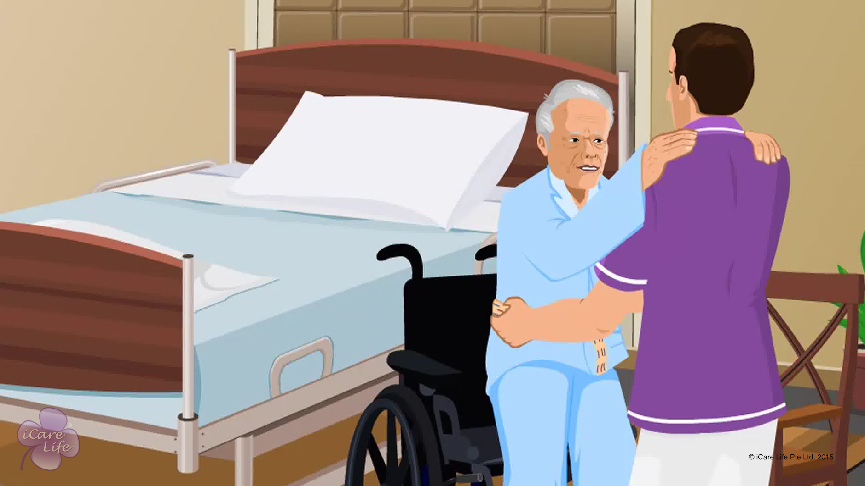
Transferring an Elder to the Wheelchair
28
Copyright: iCare Life Pte. Ltd., Singapore : This document must not be copied or shared or circulated without the consent of iCare Life and/or its affiliates.

Slide 30
Post-Module Activity
Let’s Practice
29
Copyright: iCare Life Pte. Ltd., Singapore : This document must not be copied or shared or circulated without the consent of iCare Life and/or its affiliates.
Notes:
The participants are divided into small batches and given a live demonstration of using a gait belt and (if available) a mechanical lift by trained caregivers. The ideal place for this would be an old people’s home or a nursing home/hospital. Fix a prior appointment for the activity and inform the participants of the location and timings for the demonstration.
During the demonstration, participants of each batch can be assigned tasks transferring the elder from bed to wheelchair and from bed to wheelchair. You may use a human dummy if required.

Slide 31
Summary
To tie a gait belt:
Help the elder to sit at the edge of the bed
Place gait belt around the waist and buckle the ends
Adjust the belt to ensure your palm can slip in between the belt and waist
Tuck the buckled end into the waistband
To transfer elder from the bed to the wheelchair, using a gait belt:
Position the wheelchair correctly
Remove the foothold
Lock the wheelchair
Ask the elder to place their feet on ground
Place your feet in front of the elder’s feet
Grasp the gait belt, lift, and transfer the elder to the wheelchair
30

Slide 32
Summary
To transfer the elder from the wheelchair to a chair:
Fasten the gait belt
Position the wheelchair at 45° to the chair
Remove the footrest and drop the armrest
Ask the elder to move to the edge of the chair
Ask the elder to hold your shoulders or waist
Grasp the gait belt and lift the elder
Move your feet to face the chair and ask the elder to move in baby steps
Ask the elder to place hands on the armrest and sit on the chair
31

Slide 33
Summary
To use mechanical lift:
Roll the elder to the side, place the sling, and then roll the elder back
Position the lift’s cradle above the elder
Attach the sling’s straps to the cradle
Use the pump handle to raise the elder
Rotate the elder to face the lift
Use steering handle to move closer to the wheelchair
Release the valve to lower the elder
Unhook straps and move the lift
32

Slide 34
Any Questions?
33
Notes:
FAQs
Q1. How do I know which equipment to use to transfer the elder?
Check with the elder’s doctor and follow their advice, after consulting with the elder’s family members.
Q2. What points should I keep in mind while positioning an elder on a wheelchair?
Make sure the elder is sitting upright. Head, shoulders, and hips must be positioned over the axle of the wheel.
Q3. Can I injure myself while transferring the elder?
A. Yes, if you do not use the correct postures while lifting and transferring the elder, you may get a back injury.

Slide 35


