Slide 1

Modules Summary Discussion – Q&A
CR 8.1
Private and Confidential

Slide 2
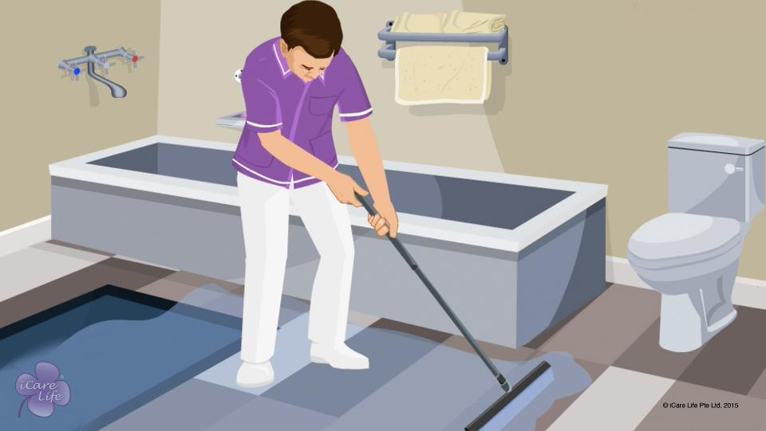
Etiquette & Courtesy
2
Copyright: iCare Life Pte. Ltd., Singapore : This document must not be copied or shared or circulated without the consent of iCare Life and/or its affiliates.

Slide 3
Let’s Practice
Post Module Activity
3
Copyright: iCare Life Pte. Ltd., Singapore : This document must not be copied or shared or circulated without the consent of iCare Life and/or its affiliates.
Notes:
You will have to set up appointments with a trained female and a male caregiver. (Note that a male caregiver is required only if there are male participants and a female caregiver is required only if there are female participants)
Request them to dress up formally for the demonstration and come to the class. They can come and teach:
How should caregivers dress up formally
How can they look neat and tidy
How should the hair be tied neatly (both long and short hair for women and combing neatly for men)
They can also talk about good manners which are essential for a caregiver, like wishing the family and care receiver according to the day, mobile phone etiquettes, giving privacy to the family, etc.

Slide 4

Etiquette & Courtesy
1
Copyright: iCare Life Pte. Ltd., Singapore : This document must not be copied or shared or circulated without the consent of iCare Life and/or its affiliates.

Slide 5
Summary
Make sure you are well-groomed at all times
Maintain good hygiene habits
Make sure you keep the living spaces you use clean and proper
Get rid of any bad habits, such as smoking or drinking during work hours
Do not engage in personal entertainment activities during work hours
Avoid taking personal calls during work hours
Do not invite friends or family to your employer’s home
Do not make noise while moving around the house
Be friendly and pleasant
Always greet family members
Maintain a degree of formality and mutual respect
Talk softly and in a pleasant tone
Be a good listener
Do not share personal information of anyone in the family with others
4
Copyright: iCare Life Pte. Ltd., Singapore : This document must not be copied or shared or circulated without the consent of iCare Life and/or its affiliates.
Notes:
Make sure you are well-groomed at all times
Maintain good hygiene habits
Make sure you keep the living spaces you use clean and proper
Get rid of any bad habits, such as smoking or drinking during work hours
Do not engage in personal entertainment activities during work hours
Avoid taking personal calls during work hours
Do not invite friends or family to your employer’s home
Do not make noise while moving around the house
Be friendly and pleasant
Always greet family members
Maintain a degree of formality and mutual respect
Talk softly and in a pleasant tone
Be a good listener
Do not share personal information of anyone in the family with others

Slide 6
Summary
Do not share details about the person’s problems and illnesses with others
If the person under your care is not able to do some tasks properly, do not make fun of them, shout at them, or shame them
Do not listen to or become a part of the family conversations
Do not participate in situations of conflict amongst family members
If you have made a mistake, apologize gracefully
Respect the religious practices, political views, and other beliefs of the family
Never ask a personal question to any of the family members or their guests
Never use bad language
Let the family have their privacy at special moments
Accompany the family on outings only if they invite you
If the person under your care is unwell, try to make them feel comfortable and cheerful
5
Copyright: iCare Life Pte. Ltd., Singapore : This document must not be copied or shared or circulated without the consent of iCare Life and/or its affiliates.
Notes:
Do not share details about the person’s problems and illnesses with others
If the person under your care is not able to do some tasks properly, do not make fun of them, shout at them, or shame them
Do not listen to or become a part of the family conversations
Do not participate in situations of conflict amongst family members
If you have made a mistake, apologize gracefully
Respect the religious practices, political views, and other beliefs of the family
Never ask a personal question to any of the family members or their guests
Never use bad language
Let the family have their privacy at special moments
Accompany the family on outings only if they invite you
If the person under your care is unwell, try to make them feel comfortable and cheerful

Slide 7
Any Questions?
6
Copyright: iCare Life Pte. Ltd., Singapore : This document must not be copied or shared or circulated without the consent of iCare Life and/or its affiliates.
Notes:
Q1. What types of family gatherings and discussions should you try and avoid?
Ans. You should avoid gatherings and discussions which may involve financial dealings, family reunions, any kind of unpleasant discussions, discussions about money, etc.
Q2. What if you are in a habit of smoking and are unable to quit?
Ans. Try and reduce smoking as much as you can. Avoid smoking in front of the care receiver or their family members. Also keep some mouth freshener handy so that the stale smell of the smoke does not offend the care receiver or their family members.
Q3. How can you use your free time while say the care receiver is sleeping or is just watching TV programmes in which you have no interest?
Ans. In this time, you can finish other chores that do not require you to be with the care receiver. These chores include cleaning the care receiver’s living space or organizing their closet. Another good idea is to read. This would not only help you spend your time fruitfully but also improve upon you personality and knowledge. Later, you could try and find something that you both mutually enjoy and spend time together thereby even further improving the relationship with the care receiver.
Q4. What should you do if someone comes to meet you at the home of the care receiver?
Ans. Try and keep the meeting as short as is possible. You could plan the meeting later on your off day at your own home.
Q5. What should you do if the care receiver is ill tempered?
Ans. You have to learn to be patient and win over the care receiver to mellow down. Do not lose control over your emotions in any circumstance. If things get out of your hands, then you might want to seek the family’s help.

Slide 8

Grooming
7
Copyright: iCare Life Pte. Ltd., Singapore : This document must not be copied or shared or circulated without the consent of iCare Life and/or its affiliates.

Slide 9
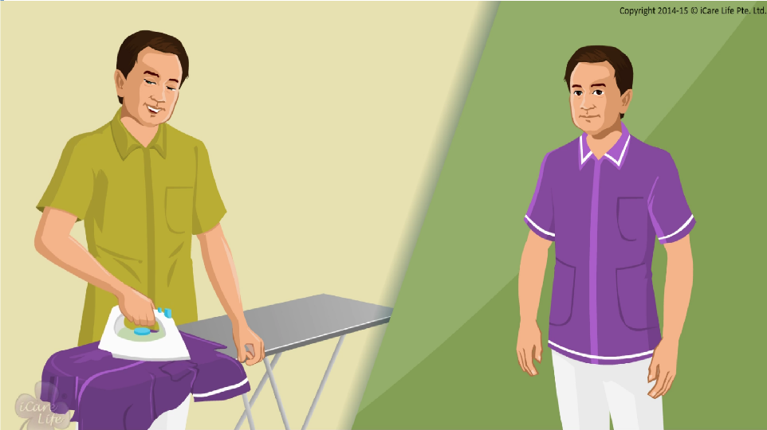
Grooming
8
Copyright: iCare Life Pte. Ltd., Singapore : This document must not be copied or shared or circulated without the consent of iCare Life and/or its affiliates.

Slide 10
Are you ready for work?
Post Module Activity
9
Copyright: iCare Life Pte. Ltd., Singapore : This document must not be copied or shared or circulated without the consent of iCare Life and/or its affiliates.
Notes:
Hand over a sheet of paper to each participant. Ask them to write/think of at least three things that they would decide do differently while getting ready for work. When they have finished writing, ask each participant to share their list.
Answers may include:
Shave every day (for men)
Iron clothes every day
Keep nails short and clean
Keep long hair tied, not paint nails (for women)
Wear minimal jewelry
Wear polished/clean, comfortable shoes
Encourage them to incorporate these activities into their routine.

Slide 11
Summary
Maintain good personal hygiene
If you are a man and keep a beard or moustache, keep it trimmed; otherwise, shave every day
Wear clean, ironed clothes
Wear clean, comfortable shoes
If you are a woman, keep your hair tied up
Avoid wearing chunky jewelry
Keep your nails clean, short and trimmed; do not paint your nails
10
Copyright: iCare Life Pte. Ltd., Singapore : This document must not be copied or shared or circulated without the consent of iCare Life and/or its affiliates.
Notes:
Maintain good personal hygiene
If you are a man and keep a beard or moustache, keep it trimmed; otherwise, shave every day
Wear clean, ironed clothes
Wear clean, comfortable shoes
If you are a woman, keep your hair tied up
Avoid wearing chunky jewelry
Keep your nails clean, short and trimmed; do not paint your nails

Slide 12
Any Questions?
11
Copyright: iCare Life Pte. Ltd., Singapore : This document must not be copied or shared or circulated without the consent of iCare Life and/or its affiliates.
Notes:
Q1. Does one end up spending a lot of money in keeping oneself well groomed?
Ans. No, one need not spend a large sum of money to look well groomed. Basic requirement is to look neat and clean devoid of any kind of shabbiness and remain hygiene alert. Simple clothes or uniform which are clean and ironed need to be worn, regular shave, trimmed hair, beard and moustaches with no bad smell arising out of the body would equally suffice.
Q2. How often should you bathe?
Ans. One should bathe at least once a day and in case one is caring for any infected person, one should go back home and bathe with hot water scrubbing himself well.

Slide 13

Personal Time Management
12
Copyright: iCare Life Pte. Ltd., Singapore : This document must not be copied or shared or circulated without the consent of iCare Life and/or its affiliates.

Slide 14
Terms related to Task Management
Pre Module Activity
13
Copyright: iCare Life Pte. Ltd., Singapore : This document must not be copied or shared or circulated without the consent of iCare Life and/or its affiliates.
Notes:
Ask the class as to what do they understand by the terms:
Schedule
To-do list
Priority
Urgent
Help the participants understand the importance of these terms with respect to managing their time better.

Slide 15
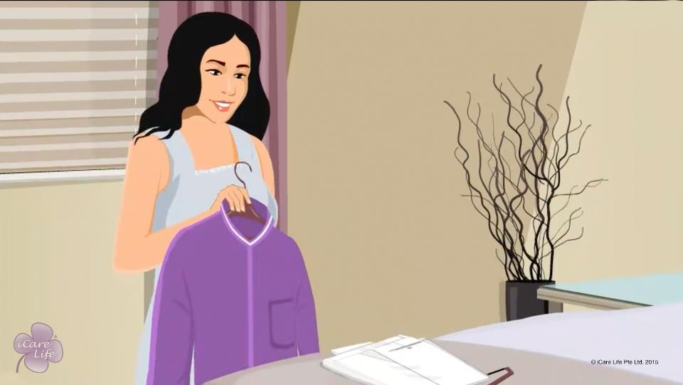
Personal Time Management
14
Copyright: iCare Life Pte. Ltd., Singapore : This document must not be copied or shared or circulated without the consent of iCare Life and/or its affiliates.

Slide 16
Summary
To work out a daily schedule, list down all the other tasks you need to do
Club tasks that together take lesser time to complete
Postpone some chores to your off days
Try to reduce wastage of time
If there is a personal task that you cannot do on your day off, seek prior permission of your employer
Know when to multi-task
Use waiting and travel time to make personal calls
At the end of each day, prepare for the next day
Maintain lists such as things to buy from the market
Make a ‘to do’ list for the next day’s tasks
Distinguish between urgent and important tasks and prioritize them accordingly
15
Copyright: iCare Life Pte. Ltd., Singapore : This document must not be copied or shared or circulated without the consent of iCare Life and/or its affiliates.
Notes:
To work out a daily schedule, list down all the other tasks you need to do
Club tasks that together take lesser time to complete
Postpone some chores to your off days
Try to reduce wastage of time
If there is a personal task that you cannot do on your day off, seek prior permission of your employer
Know when to multi-task
Use waiting and travel time to make personal calls
At the end of each day, prepare for the next day
Maintain lists such as things to buy from the market
Make a ‘to do’ list for the next day’s tasks
Distinguish between urgent and important tasks and prioritize them accordingly

Slide 17
Any Questions?
16
Copyright: iCare Life Pte. Ltd., Singapore : This document must not be copied or shared or circulated without the consent of iCare Life and/or its affiliates.
Notes:
Q1. What is a good way of making a good time management plan?
Ans. You can make a list for the next day and prioritise your tasks as must do, should do, and could do. This will help you club tasks together thus saving your precious time and leaving you with free time to take care of your personal work.
Q2. When you go out for some work for the person under your care, is it alright to take care some of your personal work if it is not much time consuming?
Ans. You should seek prior permission of your employer before doing so as this may require extra time away from your duty. This, however should not be made into a habit.
Q3. What if some of the tasks cannot be completed despite your best efforts?
Ans. One could re-draw the time plan for the next day and when one gets into practice of making such time plans, could fit it into the time plan prepared for the entire week. Diaries with dates and days can help you manage your time much better.

Slide 18
Professional Time Management
17
Copyright: iCare Life Pte. Ltd., Singapore : This document must not be copied or shared or circulated without the consent of iCare Life and/or its affiliates.

Slide 19





Logo Recognition
Pre Module Activity
18
Copyright: iCare Life Pte. Ltd., Singapore : This document must not be copied or shared or circulated without the consent of iCare Life and/or its affiliates.
Notes:
Print the logos on sheets of paper and distribute among the class participants.
Ask the class to recognize these logos and write the relevant answers. After they are done, reveal the answers in class.
The answer key is:
Twitter
Gmail
Whatsapp
Skype
Facebook

Slide 20
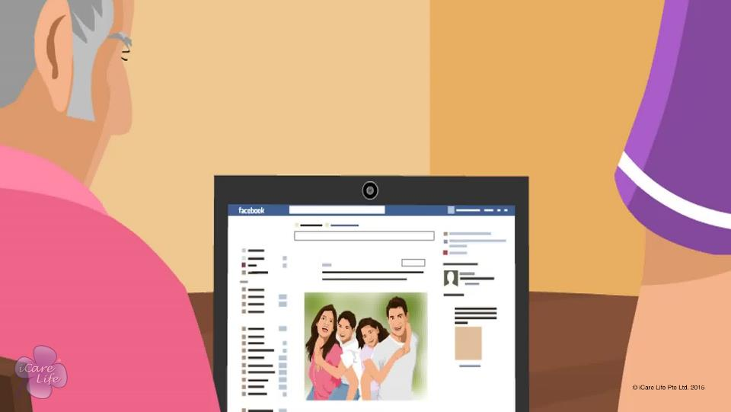
Professional Time Management
19
Copyright: iCare Life Pte. Ltd., Singapore : This document must not be copied or shared or circulated without the consent of iCare Life and/or its affiliates.

Slide 21
Time Table
Post Module Activity
Activity | Timings
Elder wakes up | 8 am
Bath and breakfast | 8 am – 9 am
Taking medicines | 9 am
Stroll in the garden | 9 am – 9:15 am
Bible reading sitting in the garden | 9:15 am – 10 am
Spends time with grandson in the drawing room | 10 am – 11 am
Sleeping | 11 am to 1 pm
Lunch | 1 pm to 1:30 pm
20
Copyright: iCare Life Pte. Ltd., Singapore : This document must not be copied or shared or circulated without the consent of iCare Life and/or its affiliates.
Notes:
Print and give the time table to class participants. Ask them to read it carefully plug in the to-do tasks in between wherever they find it possible.
Situation: You are a caregiver to 82 years old Mary. The table gives information about the general layout of Mary’s day. As a caregiver, you have other tasks as well. Plug-in the following tasks within Mary’s time-table, so that it allows you to plan the time well and take care of Mary.
Write these tasks on the white board:
Changing Mary’s bed-linen
Buying her medicines
Prepare her meal
Read a book
Ironing Mary’s clothes
After the activity is over, you can ask some participants to discuss their time-tables.

Slide 22
Time Table
Post Module Activity
Activity | Timings
Watches TV | 1:30 pm - 3 pm
Sleeps | 3 pm - 5 pm
Walk & Hobby Class in the Park | 5 pm - 7 pm
Dinner with Family | 7 pm - 8 pm
Medicines & Bath | 8 pm - 8:30 pm
Bible Reading | 8:30 pm - 9:30 pm
Bedtime | 9:30
21
Copyright: iCare Life Pte. Ltd., Singapore : This document must not be copied or shared or circulated without the consent of iCare Life and/or its affiliates.

Slide 23
Summary
Observe and record the food, rest, and activity timings for the person over a few days
Analyze records and look for similarities
Establish a daily food, rest, and activity routine for the person
Create your own daily plan
Maintain a daily to-do list
As you complete each task, put a check mark against it
During work hours, do not spend time on personal activities
Perform your personal tasks on your off days
Do not make multi-tasking a habit
22
Copyright: iCare Life Pte. Ltd., Singapore : This document must not be copied or shared or circulated without the consent of iCare Life and/or its affiliates.
Notes:
Observe and record the food, rest, and activity timings for the person over a few days
Analyze records and look for similarities
Establish a daily food, rest, and activity routine for the person
Create your own daily plan
Maintain a daily to-do list
As you complete each task, put a check mark against it
During work hours, do not spend time on personal activities
Perform your personal tasks on your off days
Do not make multi-tasking a habit

Slide 24
Any Questions?
23
Copyright: iCare Life Pte. Ltd., Singapore : This document must not be copied or shared or circulated without the consent of iCare Life and/or its affiliates.
Notes:
Q1.Why is time planning important?
Ans. Time planning is important as it will help you:
(a) Complete all your tasks without omitting anything
(b) Get some free time for yourself to de-stress
(c) Complete personal tasks like shopping, socialising, looking after yourselves mentally and physically.
(d) Plan things for the care receiver as well as yourselves
Q2. Should the time management plan be followed strictly?
Ans. The time management plan should be followed as far as is possible. However, caregiving being an uncertain job, allowance will have to be made for contingencies and therefore the caregiver has to be flexible.

Slide 25
Reducing Stress of Caregiver
24
Copyright: iCare Life Pte. Ltd., Singapore : This document must not be copied or shared or circulated without the consent of iCare Life and/or its affiliates.

Slide 26
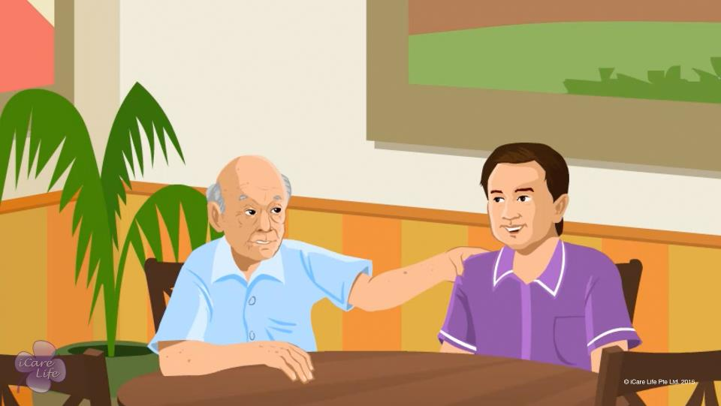
Reducing Stress of Caregiver
25
Copyright: iCare Life Pte. Ltd., Singapore : This document must not be copied or shared or circulated without the consent of iCare Life and/or its affiliates.

Slide 27
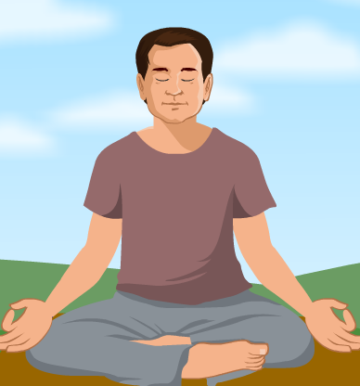
Belly Breathing to reduce Stress
Post Module Activity
26
Copyright: iCare Life Pte. Ltd., Singapore : This document must not be copied or shared or circulated without the consent of iCare Life and/or its affiliates.
Notes:
There are no materials required for this activity.
Explain to the class participants that they are about to do a breathing exercise which will help in stress reduction. It also helps in improving concentration.
Ask all students to be very quiet and concentrate only on your voice. Start with the following instructions:
Stand with comfortable space between each other with feet shoulder-width apart
Arms and hands are relaxed downward
Body is relaxed
Eyes closed
Focus on lower abdomen (belly) and imagine a small balloon in that space; place a hand over the lower abdomen to feel it go up and down
Breath in slowly and deeply through nostrils, imagining the balloon getting bigger slowly; hold a few seconds
Slowly exhale through the mouth, imagining the balloon gently getting smaller; blow out of the mouth as if blowing out a candle
Repeat this at least 10 times.
Do remember to
Speak in a soft tone
Give time to participants to follow each instruction
Do not hurry or the purpose of the activity will be defeated
The class should have absolute silence; ask the participants to switch off their phones
After the activity, ask students how different their bodies feel. Are they more relaxed/calm? Do they feel lighter? Great? Tired?

Slide 28
Summary
Eat healthy and exercise regularly
In a stressful situation, move away, compose yourself, and then get back to the situation
Involve yourself and the person under your care in fun, playful, activities
On a daily basis, connect back to your own life
Stay socially connected
Try to include more humor into your life
Pursue a hobby
Spend some time reading
Meditate or spend some time with yourself, every day
27
Copyright: iCare Life Pte. Ltd., Singapore : This document must not be copied or shared or circulated without the consent of iCare Life and/or its affiliates.
Notes:
Eat healthy and exercise regularly
In a stressful situation, move away, compose yourself, and then get back to the situation
Involve yourself and the person under your care in fun, playful, activities
On a daily basis, connect back to your own life
Stay socially connected
Try to include more humor into your life
Pursue a hobby
Spend some time reading
Meditate or spend some time with yourself, every day

Slide 29
Any Questions?
28
Copyright: iCare Life Pte. Ltd., Singapore : This document must not be copied or shared or circulated without the consent of iCare Life and/or its affiliates.
Notes:
Q1. Why does a person get stressed when caregiving?
Ans. Firstly, caregiving is an exhausting work. One has to be extremely vigilant all the time. Moreover, you perform a variety of tasks as part of your duty. Taking complete responsibility of an unknown person is not easy. As the care giving may be a real long drawn affair, doing same things again and again becomes difficult and one may start to become negligent.
Q2. How does a stressed out caregiver affect the care receiver?
Ans. A stressed out caregiver would not be a happy person. The person may start to become irritable. They may lose their efficiency and may tend to become negligent. A person with a foul mood affects not only the care receiver but also everyone in the family.

Slide 30
Showing Good Bedside Manners
29
Copyright: iCare Life Pte. Ltd., Singapore : This document must not be copied or shared or circulated without the consent of iCare Life and/or its affiliates.

Slide 31
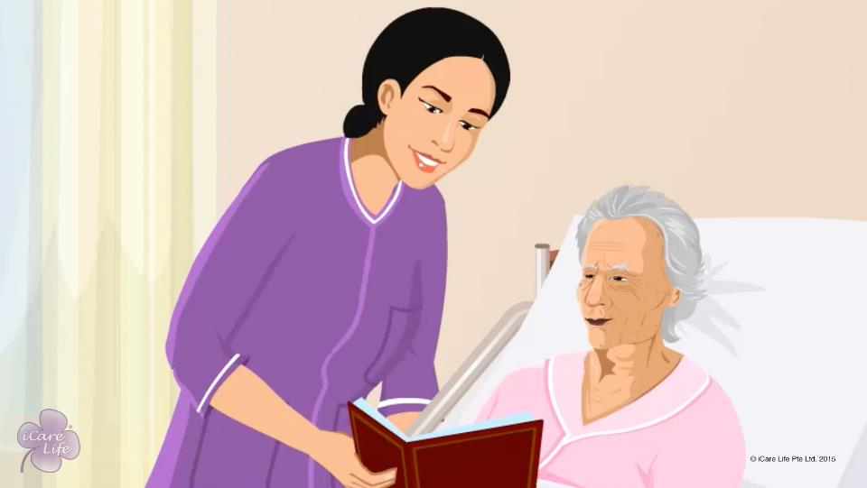
Showing Good Bed-Side Manners
30
Copyright: iCare Life Pte. Ltd., Singapore : This document must not be copied or shared or circulated without the consent of iCare Life and/or its affiliates.

Slide 32
Role Play
Post Module Activity
31
Copyright: iCare Life Pte. Ltd., Singapore : This document must not be copied or shared or circulated without the consent of iCare Life and/or its affiliates.
Notes:
Call two participants from the class and assign them roles of an elder and a caregiver.
Situation: The elder is not well and has fever. They do not want to get out of bed. The task of the caregiver is to encourage the elder to eat and converse with them.
You will need to oversee the activity and invite rest of the class participants to discuss the whole activity.

Slide 33
Summary
Make the person comfortable and cheerful
Make sure your clothes, hair, and appearance is neat
Greet the person cheerfully
Smile through the course of the day
Avoid using medical jargon
Speak in a soft voice and a reassuring tone
Encourage the person to have medicine
Avoid rushing the person if they slow down
Show a gentle touch
Do not ridicule the person’s complaints
Do not yell at them, even if they are disrespectful
32
Copyright: iCare Life Pte. Ltd., Singapore : This document must not be copied or shared or circulated without the consent of iCare Life and/or its affiliates.
Notes:
Make the person comfortable and cheerful
Make sure your clothes, hair, and appearance is neat
Greet the person cheerfully
Smile through the course of the day
Avoid using medical jargon
Speak in a soft voice and a reassuring tone
Encourage the person to have medicine
Avoid rushing the person if they slow down
Show a gentle touch
Do not ridicule the person’s complaints
Do not yell at them, even if they are disrespectful

Slide 34
Any Questions?
33
Copyright: iCare Life Pte. Ltd., Singapore : This document must not be copied or shared or circulated without the consent of iCare Life and/or its affiliates.
Notes:
Q1. How can I evaluate my bedside manner?
Ans. You can evaluate your bedside manner by the following cues:
If the patient/care receiver is friendly with you and greets you
If they feel happy and eager to see you and want to talk to you
If they maintain eye-contact with you
If they confide in you
You can also choose to speak to the family members and take feedback from them regarding your conduct around the care receiver.
Q2. How do I handle questions care receiver’s questions related to their illness if I do not have the right answers or information?
Ans. Tell the care receiver that you are not aware of the right answer. Assure them that you will get back with the right information. Speak to the family members and let them know about the questions. If you are not confident in answering the questions, request the family members to step in the situation and talk to the care receiver.
Be sure that you do not give incorrect answers in any situation.

Slide 35
Ensuring Safety from mentally Ill Patients
34
Copyright: iCare Life Pte. Ltd., Singapore : This document must not be copied or shared or circulated without the consent of iCare Life and/or its affiliates.

Slide 36
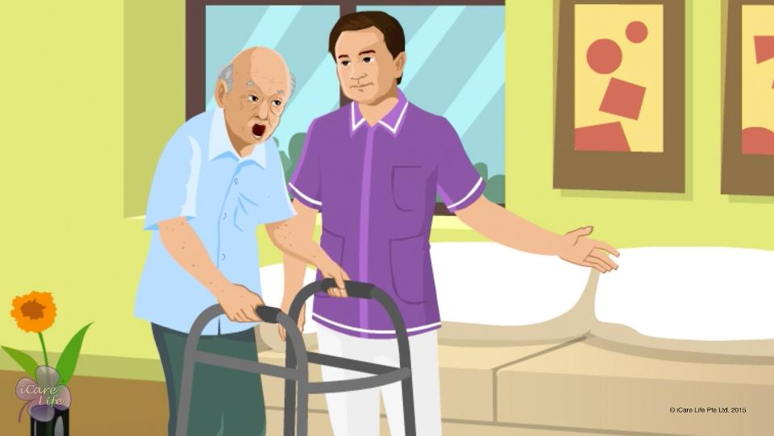
Ensuring Safety from mentally Ill Patients
35
Copyright: iCare Life Pte. Ltd., Singapore : This document must not be copied or shared or circulated without the consent of iCare Life and/or its affiliates.

Slide 37
Visit
Post Module Activity
36
Copyright: iCare Life Pte. Ltd., Singapore : This document must not be copied or shared or circulated without the consent of iCare Life and/or its affiliates.
Notes:
Arrange for a visit to a nursing home where a mentally ill person is being taken care of. The class participants can shadow the caregiver and make a note of their reactions in accordance to the care receiver’s activities. Make sure participants understand the complexity of taking care of a mentally ill person. Some class participants can help the caregiver with some regular activities.

Slide 38
Summary
When with a violent person, position yourself in the room such that you have a clear access to the door
Maintain about four times more personal space with the person than you usually keep
Make sure that there are no objects in the room that can hurt you
Avoid being with the person in the kitchen
Ask the person to sit down
Speak to the person in a calm, firm, but non-threatening voice
Avoid a power struggle
Avoid forcing the person to do anything they do not want to
Invite the person to sit with you or take a walk.
Report even a mild violent incident to the person’s family members
Flee from the room if you feel you are in danger
Report a violent incident to your principal employer
37
Copyright: iCare Life Pte. Ltd., Singapore : This document must not be copied or shared or circulated without the consent of iCare Life and/or its affiliates.
Notes:
When with a violent person, position yourself in the room such that you have a clear access to the door
Maintain about four times more personal space with the person than you usually keep
Make sure that there are no objects in the room that can hurt you
Avoid being with the person in the kitchen
Ask the person to sit down
Speak to the person in a calm, firm, but non-threatening voice
Avoid a power struggle
Avoid forcing the person to do anything they do not want to
Invite the person to sit with you or take a walk.
Report even a mild violent incident to the person’s family members
Flee from the room if you feel you are in danger
Report a violent incident to your principal employer

Slide 39
Any Questions?
38
Copyright: iCare Life Pte. Ltd., Singapore : This document must not be copied or shared or circulated without the consent of iCare Life and/or its affiliates.
Notes:
Q1. Are all mentally ill persons dangerous?
Ans. Not all mentally ill persons may be violent. Some could be very docile and always look up to the caregiver for assistance. The history of such persons must be read well to know if the person is violent and what causes them to be violent. One should thereafter try and avoid such situations.
Q2. When a person becomes violent, what medication could be given to calm them down?
Ans. That would depend on what the doctors advise. However, medicines that induce sleep should help.
Q3. What precautions could be taken to prevent a person from becoming violent?
Ans. Precautions that could be taken to prevent a person from becoming violent are as follows: -
(a)Avoid situations that irritate mentally ill persons. A thorough reading of history of the ailment of the person and close interaction with the family would be of help.
(b) Such persons should be kept away from any kind of intoxication specially liquor which may make a person extremely sensitive even to small things and possibly violent.
(c) Your own manner should be re-assuring, calm, and friendly. You should never convey any kind of threat to the mentally ill and violent person.
(d) Over a period of time you have to win the heart of the person so that they are assured that you mean no harm to them.

Slide 40


