Slide 1

Self-Development for a Caregiver
7
Standard
Source: Skills for Health – Website http://www.skillsforhealth.org.uk/
Skills for Care – Website http://www.skillsforcare.org.uk/

Slide 2
Learning outcomes
1. Agree a personal development plan
2. Develop knowledge, skills and understanding
Source: Skills for Health – Website http://www.skillsforhealth.org.uk/
Skills for Care – Website http://www.skillsforcare.org.uk/
1

Slide 3
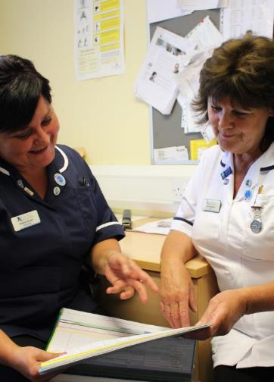
Skills, knowledge and competence
Skills, knowledge and competence need to be developed throughout your working life
A Personal Development Plan (PDP) sets out the areas you need to develop and how to go about achieving this
Personal Development Plans (PDPs) to identify:
The areas you need to develop
What you want to achieve
How and when you will achieve it
Source: Skills for Health – Website http://www.skillsforhealth.org.uk/
Skills for Care – Website http://www.skillsforcare.org.uk/
2
Notes:
Objectives - What you want to achieve
Objectives should be - SMART
Specific
Measurable
Achievable
Relevant
Time-based
How and when you will achieve your objectives
There are many different ways of developing knowledge and skills including:
Internal opportunities – training courses, mentoring and shadowing, guidance in supervision, team meetings
External opportunities – websites, online forums, social media, books, journals, training courses, online learning opportunities, speaking to workers in different roles

Slide 4
Contributing to your PDP
To get the most out of a PDP workers should be prepared to contribute to the discussion, and the workers should ask themselves the following:
Do I have the skills and knowledge that I need for my current role?
What development opportunities are available in my role?
What are my ambitions and goals?
Am I making the right choices to get me there?
Source: Skills for Health – Website http://www.skillsforhealth.org.uk/
Skills for Care – Website http://www.skillsforcare.org.uk/
3
Notes:
Skills and knowledge required for a role will be set out in:
The relevant standards for the role
The caregiver’s job description
A PDP is important to:
Ensure that a worker’s skills, knowledge and understanding meet the requirements of their role
Develop the caregiver’s skills and help their career progression

Slide 5

Agreeing a personal development plan
Step 1
Step 2
Step 3
Agreeing your aims and objectives
Plan activities to meet the objectives
Set timescale to achieve outcomes and review
The following people will be involved…
You
Your senior (iCare Life)
The following people will be involved…
You
Your colleagues
Trainers and mentors (iCare Life)
The following people will be involved…
You
Your colleagues
Your senior (iCare Life)
Source: Skills for Health – Website http://www.skillsforhealth.org.uk/
Skills for Care – Website http://www.skillsforcare.org.uk/
4
Notes:
QUESTION: Ask the group/individual to think about how to create a personal development.
Step 1. Agree objectives
Example: Be able to write and review care plans with the individuals who receive care and support in my workplace
Step 2. Plan activities to meet the objectives
Example:
Read the instructions and look at the layout for care planning in my workplace
Discuss these and ask questions of an identified more experienced worker
Examine and discuss three examples of care plans with the individuals concerned with their permission, and discuss any changes they might like to make
Report back to your manager and discuss any questions or learning points
Step 3. Set timescales to achieve outcomes and review
Timescales - one of the four activities listed will be achieved each week so this will take four weeks.
Outcome - Discuss the three steps and possibly update ‘care plans’ with your manager and review your learning

Slide 6
Core skills are…
Literacy
Numeracy
Communication skills
Reading and Writing
Recording data clearly
Filling out forms
Contributing to care plan
Taking notes
Understanding agreed ways of working
Recording a person’s Vitals
Monitoring weight loss or weight gain
Recording the amount of fluid intake and output
Measuring medicine dosage
Discussing care and support with individuals
Discussing tasks with seniors, family or with colleagues
Discussing and agreeing your Personal Development Plan with concerned persons
Participating in team meetings, supervision and appraisal
Source: Skills for Health – Website http://www.skillsforhealth.org.uk/
Skills for Care – Website http://www.skillsforcare.org.uk/
5

Slide 7

Reflection
Reflecting on past experiences can help to continually develop skills and understanding
Carry out a task
Look back on a situation or activity
Think about what was done and what happened
Think about what you could do differently
Source: Skills for Health – Website http://www.skillsforhealth.org.uk/
Skills for Care – Website http://www.skillsforcare.org.uk/
6
Notes:
Activity:
1. Ask the learners to think about a time when they did something (at work or at home) that didn’t work out quite as they would have liked it to
2. Ask the learners to think about exactly what they did and what happened
3. Ask them to consider how what they did/what they said/how they responded to others affected the situation
4. Ask them to think about what they would do differently if they were to come across a similar situation in the future
Explain that reflection and learning from past experiences is a form of development. Developing skills in this way is an example of how a learning activity has changed the way they work and improved their skills, knowledge and understanding of their role.

Slide 8
Feedback
Feedback from others can help you to understand what others think of the way that you work
Formal
Informal
Formal feedback is usually given in writing. This might be part of an assessment or appraisal or on a comments sheet by your engager.
Informal feedback happens in day-to-day discussion with work colleagues, seniors (iCare Life) or the individuals that you provide care and support for.
Feedback should be:
Timely
Positive
Constructive
Source: Skills for Health – Website http://www.skillsforhealth.org.uk/
Skills for Care – Website http://www.skillsforcare.org.uk/
7
Notes:
Feedback should be:
Timely – Given as soon as possible after the event when it is still fresh in the mind.
Positive – Focusing on improving work performance rather than on personal factors (e.g. intelligence or confidence).
Constructive – Based on facts and actual events

Slide 9

Continuing professional development
Continuing Professional Development (CPD) is the ongoing process of updating skills and knowledge:
Induction
Ongoing development
Refresher training
Completed development should be recorded in a CPD record.
Source: Skills for Health – Website http://www.skillsforhealth.org.uk/
Skills for Care – Website http://www.skillsforcare.org.uk/
8
Notes:
Ongoing development
Needed to enable workers to meet changing requirements because of:
Changes to legislation
Changes to agreed ways of working
Changes to their job role and what is required of them.
Specialist training – specific to the requirements of each role and workplace.
Reflective practice/Reflection – learning from experience
Refresher training
Some training needs to be repeated regularly to ensure that high-risk tasks are completed safely
Examples include:
Moving and Assisting, Moving and Handling, Moving and Positioning
First Aid Training
Medication training
Fire Safety

Slide 10







Knowledge check
Why is it important for workers to continually develop their skills, knowledge and understanding?
Click to reveal answer
It gives managers something to discuss in appraisal
It is a way of competing with colleagues
It ensures that skills and knowledge are up to date
It sets out learning goals and objectives
Source: Skills for Health – Website http://www.skillsforhealth.org.uk/
Skills for Care – Website http://www.skillsforcare.org.uk/
9
Notes:
Trainer should ask class why they chose the correct answer
Feedback
A – Managers will discuss often discuss a development plan in a worker’s appraisal but this is not the main reason for continually developing skills and knowledge.
B – Workers should cooperate and work together to provide the best standard of care to the individuals they support. Learning and development is not a way of competing with colleagues.
C – Developing skills, knowledge and understanding on a continuing basis is the best way for a worker to ensure that their skills and knowledge are up to date and that they can do their job safely and effectively.
D – A record Continuing Professional Development (CPD) is where a worker should record their completed learning and development activity. Learning goals and objectives should be recorded in a Personal Development Plan (PDP).

Slide 11


Knowledge check
What is the main way that a learning activity can improve your work?
Click to reveal answer
Using what you learn can improve the standard of care that you provide
Having a break from work helps you to manage your stress
It gives you an opportunity to get to know your colleagues
It confirms that you do not need to develop your skills and knowledge any further
Source: Skills for Health – Website http://www.skillsforhealth.org.uk/
Skills for Care – Website http://www.skillsforcare.org.uk/
10
Notes:
Trainer should ask class why they chose the correct answer.

Slide 12


Knowledge check
What does ‘reflection’ involve?
Click to reveal answer
Agreeing a Personal Development Plan with your manager
Asking your colleagues what they think of the way that you work
Giving constructive feedback to your colleagues
Learning from what you have done in the past to improve the way you will work in the future
Source: Skills for Health – Website http://www.skillsforhealth.org.uk/
Skills for Care – Website http://www.skillsforcare.org.uk/
11
Notes:
Trainer should ask class why they chose the correct answer
Feedback
A – Agreeing a PDP is part of an ongoing process of learning and development to improve your skills and knowledge which may be informed by you reflecting on your own practice.
B – Feedback from others can be helpful in developing your skills and knowledge but it is not part of reflection on your own work.
C – Giving constructive feedback to others can help them to improve the ways in which they work but it is not part of reflecting on your own work.
D – Reflection is a form of learning and development in which workers think about what they have done in the past. By thinking about how they could have done things differently to get a different result, they can learn from past experiences and improve the ways in which they work.

Slide 13
Viewing of Modules
Self Development
CR 8.2
Private and Confidential

Slide 14
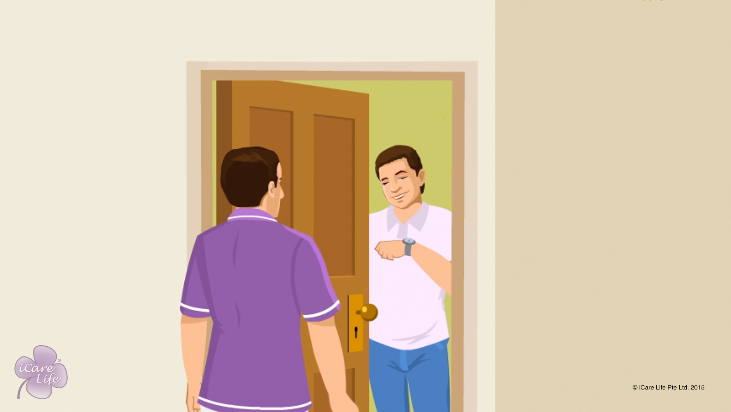
Being Punctual
1
Copyright: iCare Life Pte. Ltd., Singapore : This document must not be copied or shared or circulated without the consent of iCare Life and/or its affiliates.

Slide 15
In this module, you will learn about:
Why is it important to be punctual to work
What preparations should you make to be punctual
2

Slide 16

Let’s Watch
Being Punctual
3
Copyright: iCare Life Pte. Ltd., Singapore : This document must not be copied or shared or circulated without the consent of iCare Life and/or its affiliates.

Slide 17
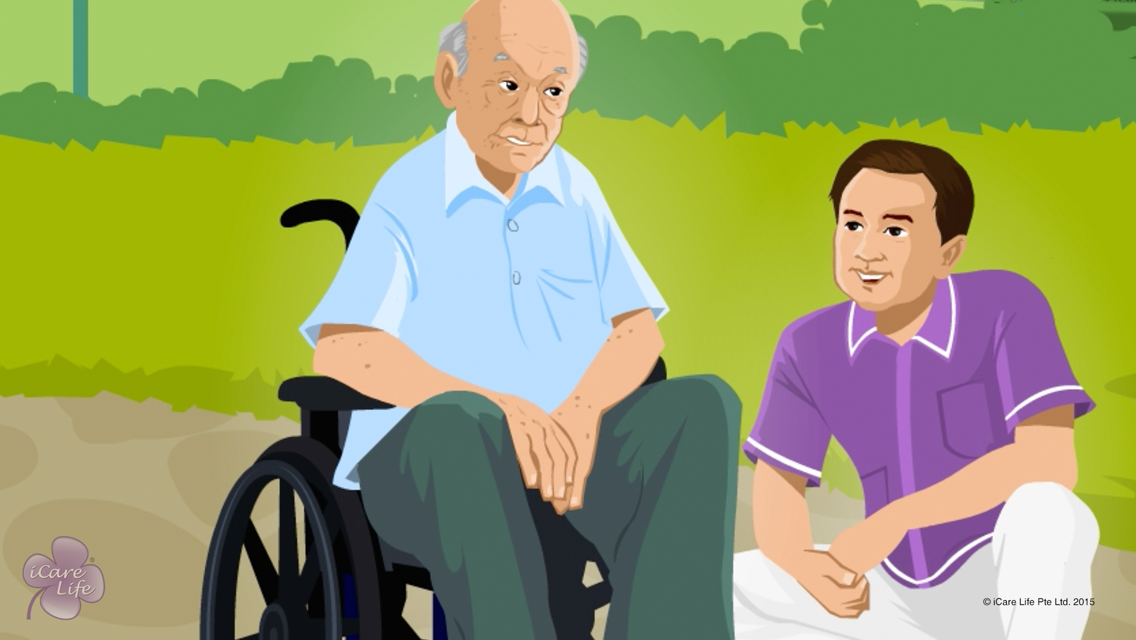
Developing Patience with an Elder
4
Copyright: iCare Life Pte. Ltd., Singapore : This document must not be copied or shared or circulated without the consent of iCare Life and/or its affiliates.

Slide 18
In this module, you will learn about:
The importance of patience for a caregiver
The benefits of patience
The ways to develop patience
5
Copyright: iCare Life Pte. Ltd., Singapore : This document must not be copied or shared or circulated without the consent of iCare Life and/or its affiliates.

Slide 19
Pre-Module Activity
General Discussion
6
Copyright: iCare Life Pte. Ltd., Singapore : This document must not be copied or shared or circulated without the consent of iCare Life and/or its affiliates.
Notes:
Ask each class participant what do they do to calm themselves when they are very angry or frustrated.
The class participants should respond with ways they practice to calm themselves down when they experience extreme anger or frustration, such as leaving the situation for a while, going for a walk or a jog, writing a diary, etc.

Slide 20
Let’s Watch
Developing Patience with an Elder
7
Copyright: iCare Life Pte. Ltd., Singapore : This document must not be copied or shared or circulated without the consent of iCare Life and/or its affiliates.

Slide 21


