Slide 1

Viewing of Modules
Self Development
CR 8.2
Private and Confidential

Slide 2
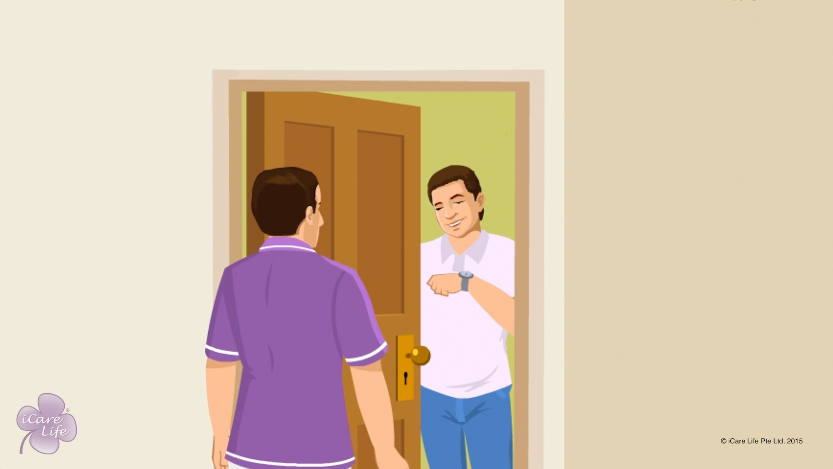
Being Punctual
1
Copyright: iCare Life Pte. Ltd., Singapore : This document must not be copied or shared or circulated without the consent of iCare Life and/or its affiliates.

Slide 3
In this module, you will learn about:
Why is it important to be punctual to work
What preparations should you make to be punctual
2

Slide 4

Let’s Watch
Being Punctual
3
Copyright: iCare Life Pte. Ltd., Singapore : This document must not be copied or shared or circulated without the consent of iCare Life and/or its affiliates.

Slide 5
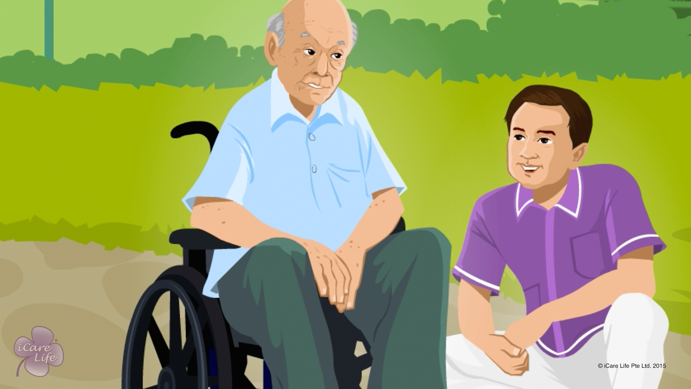
Developing Patience with an Elder
4
Copyright: iCare Life Pte. Ltd., Singapore : This document must not be copied or shared or circulated without the consent of iCare Life and/or its affiliates.

Slide 6
In this module, you will learn about:
The importance of patience for a caregiver
The benefits of patience
The ways to develop patience
5
Copyright: iCare Life Pte. Ltd., Singapore : This document must not be copied or shared or circulated without the consent of iCare Life and/or its affiliates.

Slide 7
Pre-Module Activity
General Discussion
6
Copyright: iCare Life Pte. Ltd., Singapore : This document must not be copied or shared or circulated without the consent of iCare Life and/or its affiliates.
Notes:
Ask each class participant what do they do to calm themselves when they are very angry or frustrated.
The class participants should respond with ways they practice to calm themselves down when they experience extreme anger or frustration, such as leaving the situation for a while, going for a walk or a jog, writing a diary, etc.

Slide 8
Let’s Watch
Developing Patience with an Elder
7
Copyright: iCare Life Pte. Ltd., Singapore : This document must not be copied or shared or circulated without the consent of iCare Life and/or its affiliates.

Slide 9


