Slide 1

Viewing of Modules
Activities of Daily Living – Personal Care
CR 8.3
Private and Confidential

Slide 2
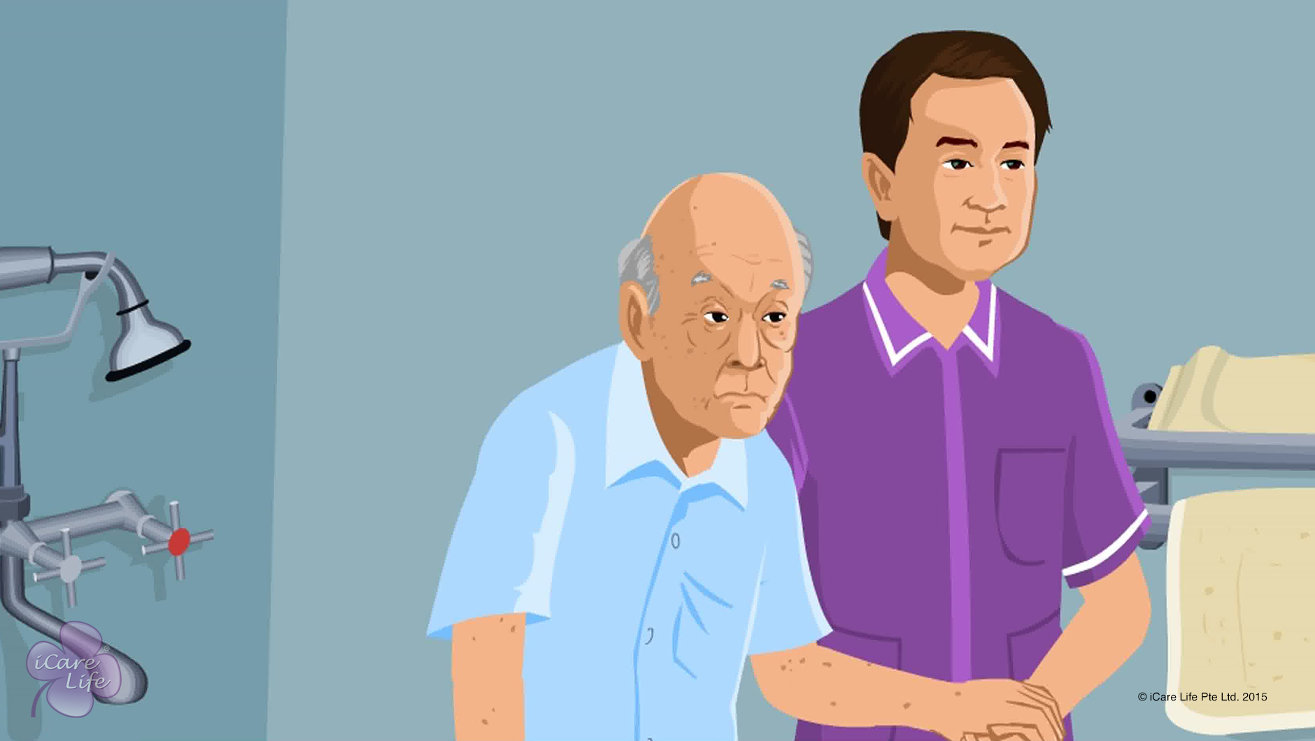
Toilet Assistance
1
Copyright: iCare Life Pte. Ltd., Singapore : This document must not be copied or shared or circulated without the consent of iCare Life and/or its affiliates.

Slide 3
In this module, you will learn about:
The important considerations while providing toilet assistance to an elder
The steps to provide toilet assistance to an elder
The hygiene considerations while providing toilet assistance to an elder
2

Slide 4

Let’s Watch
Toilet Assistance
3
Copyright: iCare Life Pte. Ltd., Singapore : This document must not be copied or shared or circulated without the consent of iCare Life and/or its affiliates.

Slide 5
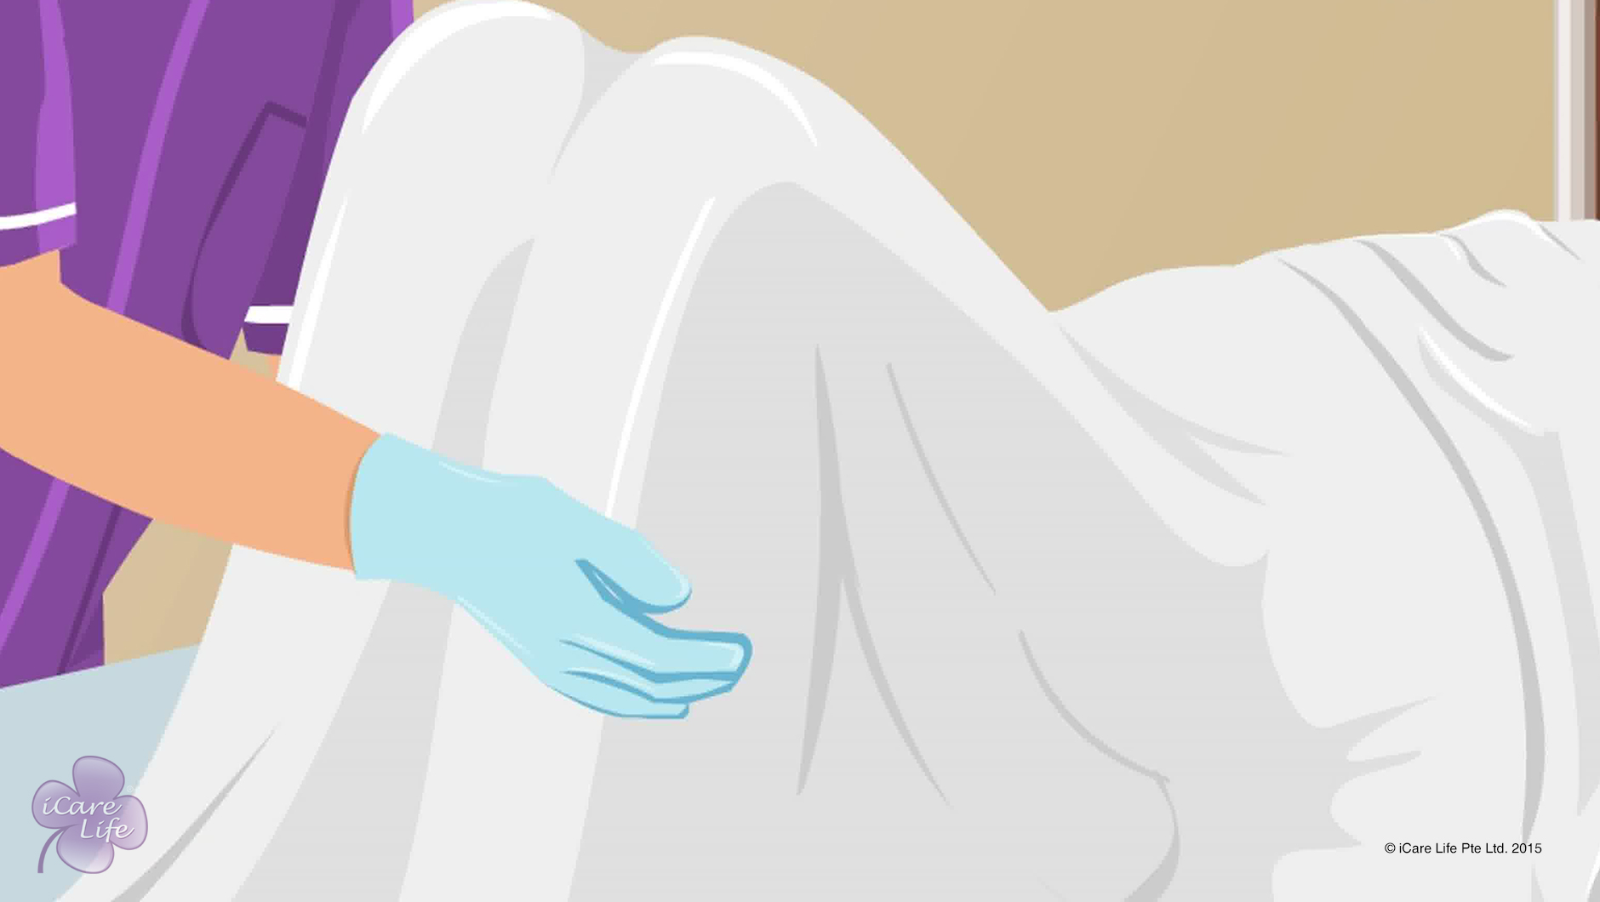
Bed Toileting
4
Copyright: iCare Life Pte. Ltd., Singapore : This document must not be copied or shared or circulated without the consent of iCare Life and/or its affiliates.

Slide 6
In this module, you will learn about:
The equipment required for bed toileting
The steps for bed toileting
The hygiene considerations while providing bed toileting support
5
Copyright: iCare Life Pte. Ltd., Singapore : This document must not be copied or shared or circulated without the consent of iCare Life and/or its affiliates.

Slide 7
Let’s Watch
Bed Toileting
6
Copyright: iCare Life Pte. Ltd., Singapore : This document must not be copied or shared or circulated without the consent of iCare Life and/or its affiliates.

Slide 8
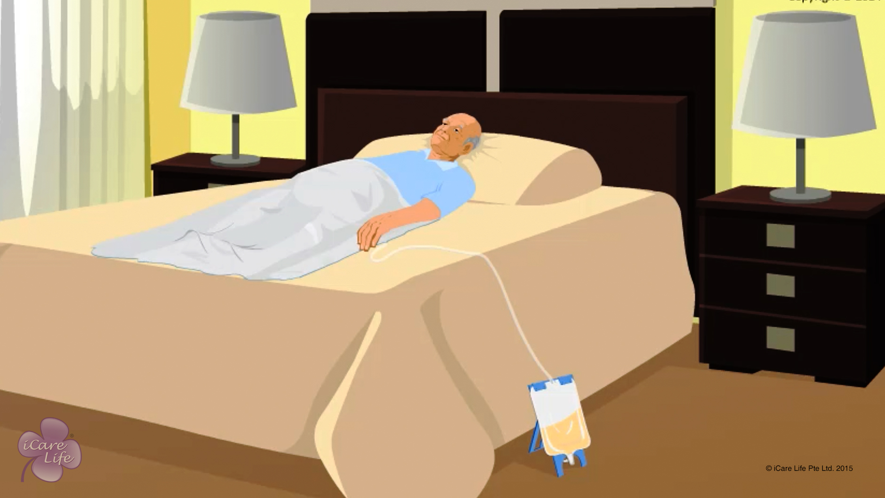
Incontinence & Toileting
7
Copyright: iCare Life Pte. Ltd., Singapore : This document must not be copied or shared or circulated without the consent of iCare Life and/or its affiliates.

Slide 9
In this module, you will learn about:
The steps to provide hygiene with incontinence and toileting
The steps to provide catheter care
8
Copyright: iCare Life Pte. Ltd., Singapore : This document must not be copied or shared or circulated without the consent of iCare Life and/or its affiliates.

Slide 10
Let’s Watch
Incontinence & Toileting
9
Copyright: iCare Life Pte. Ltd., Singapore : This document must not be copied or shared or circulated without the consent of iCare Life and/or its affiliates.

Slide 11
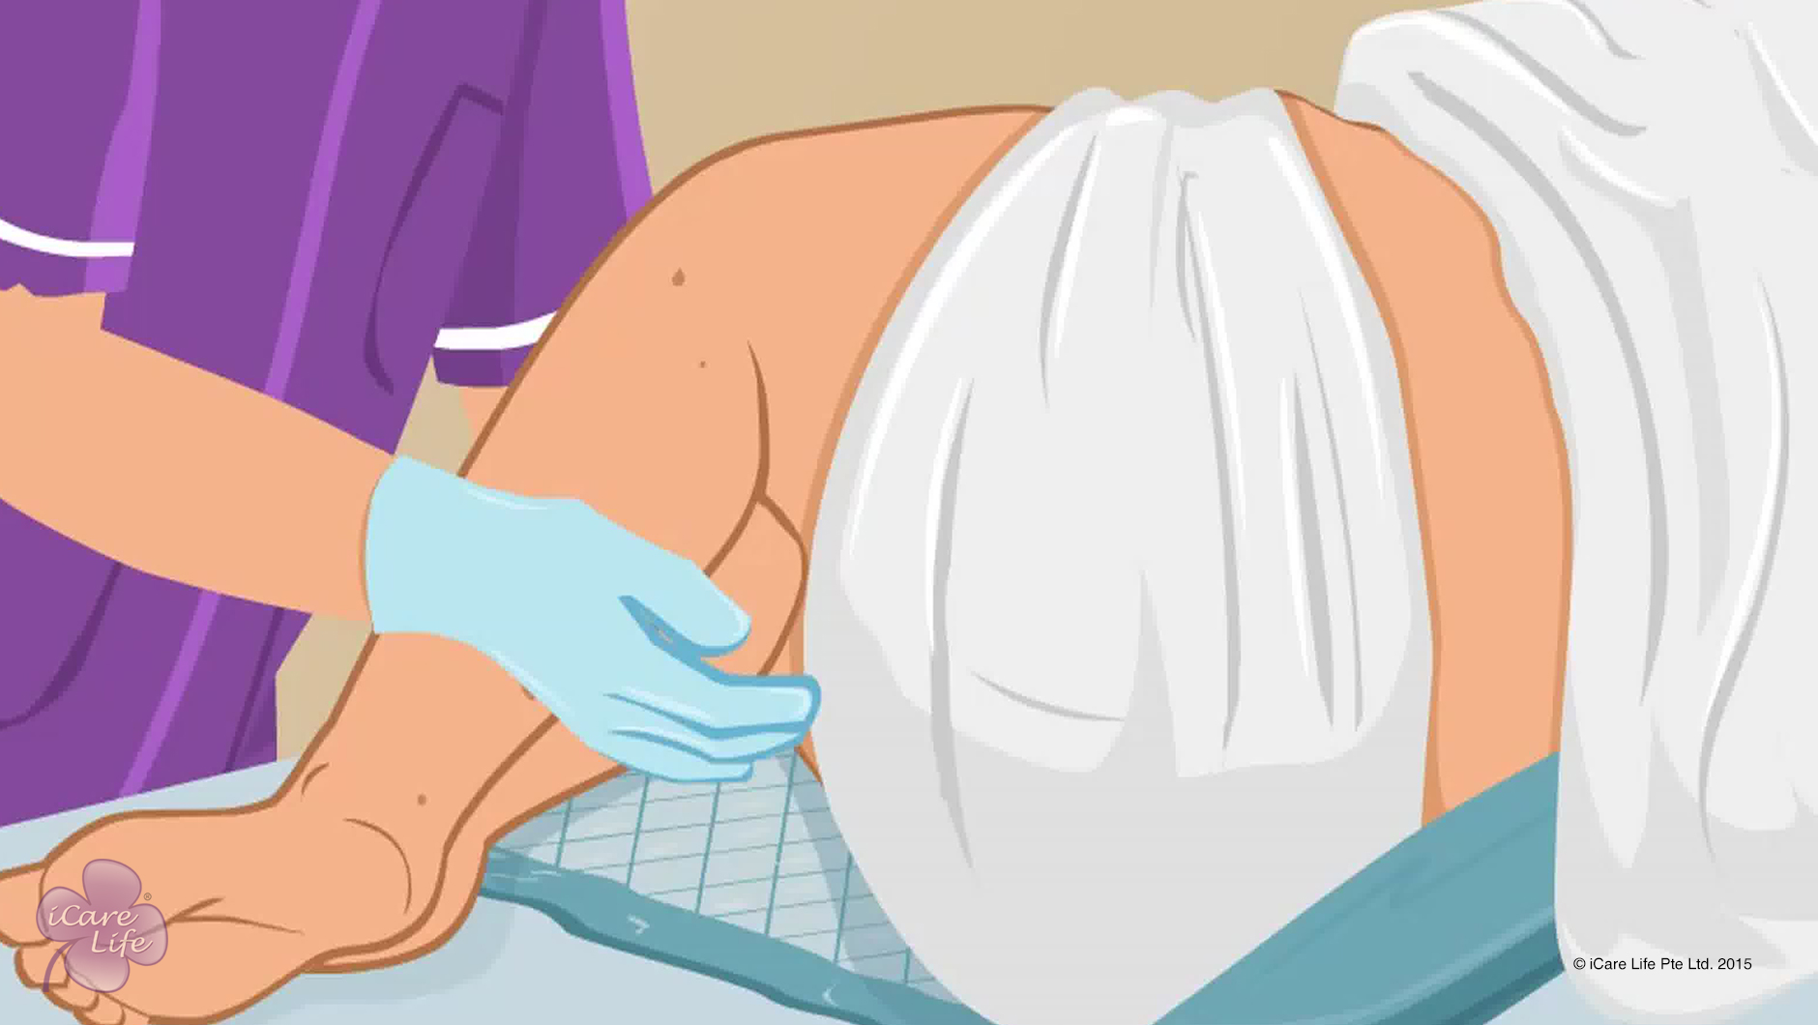
Changing Adult Diapers
10
Copyright: iCare Life Pte. Ltd., Singapore : This document must not be copied or shared or circulated without the consent of iCare Life and/or its affiliates.

Slide 12
In this module, you will learn about:
Why do elders need diapers and what are the advantages of adult diapers
How to convince the elder to use an adult diaper
How to change adult diapers
11
Copyright: iCare Life Pte. Ltd., Singapore : This document must not be copied or shared or circulated without the consent of iCare Life and/or its affiliates.

Slide 13
Let’s Watch
Changing Adult Diapers
12
Copyright: iCare Life Pte. Ltd., Singapore : This document must not be copied or shared or circulated without the consent of iCare Life and/or its affiliates.

Slide 14
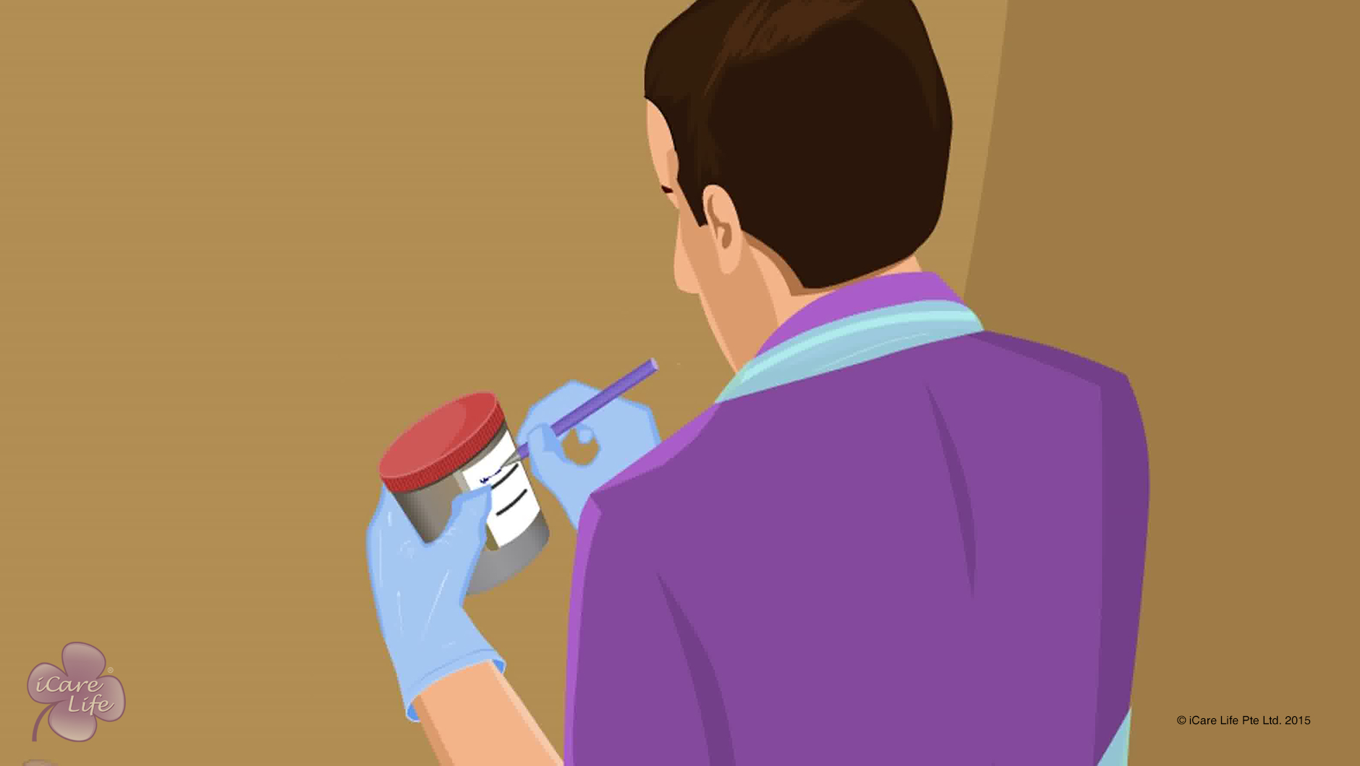
Helping the Elder take Stool & Urine Samples
13
Copyright: iCare Life Pte. Ltd., Singapore : This document must not be copied or shared or circulated without the consent of iCare Life and/or its affiliates.

Slide 15
In this module, you will learn about:
The methods of taking stool and urine samples at home
The precautions for taking each type of sample
14
Copyright: iCare Life Pte. Ltd., Singapore : This document must not be copied or shared or circulated without the consent of iCare Life and/or its affiliates.

Slide 16
Let’s Watch
Helping the Elder take Stool & Urine Samples
15
Copyright: iCare Life Pte. Ltd., Singapore : This document must not be copied or shared or circulated without the consent of iCare Life and/or its affiliates.

Slide 17


