Slide 1

Modules Summary Discussion – Q&A
CR 7.4
Private and Confidential

Slide 2

Being Punctual
1
Copyright: iCare Life Pte. Ltd., Singapore : This document must not be copied or shared or circulated without the consent of iCare Life and/or its affiliates.

Slide 3
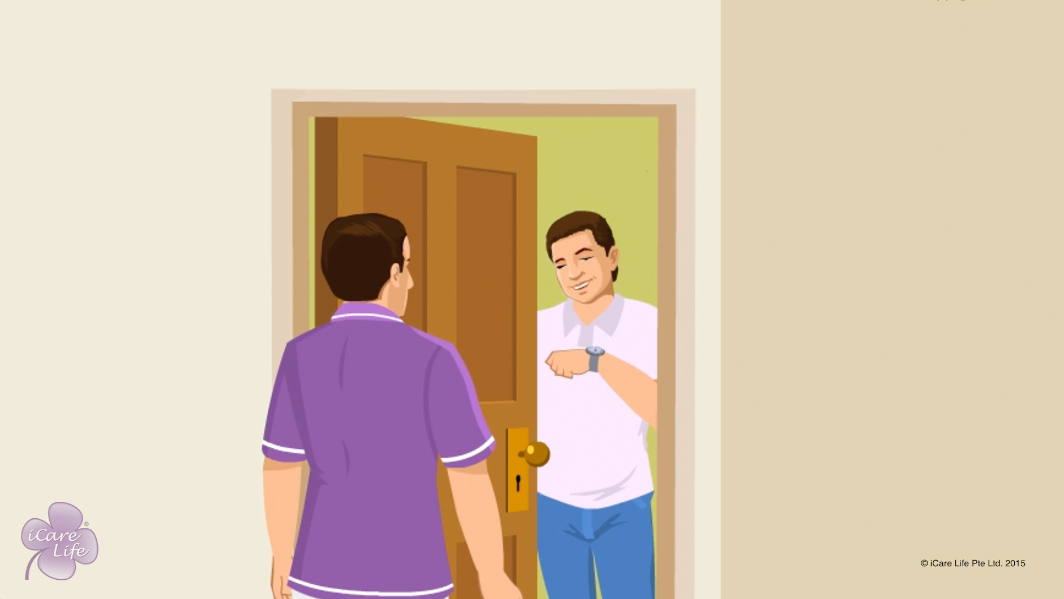
Being Punctual
2
Copyright: iCare Life Pte. Ltd., Singapore : This document must not be copied or shared or circulated without the consent of iCare Life and/or its affiliates.

Slide 4
Post-Module Activity
Class discussion
Notes:
You will need a white board and a marker.
Discuss the following topics with the class:
What is punctuality?
What are the advantages of being punctual?
Some tips to help you be punctual (these can be participants’ own experiences)
Model answers:
a) Punctuality is the characteristic of being able to complete a required task or fulfill an obligation before or at a previously designated time.
b) The advantages of punctuality include:
Show and earn respect: Punctuality speaks of a person’s respect of others and their time. When we do so, we earn it in turn too.
Reliability: An employee who is punctual is considered reliable by their employer.
Organized: A punctual person usually organizes their work well, thinks ahead of time, and prioritizes their tasks.
Ready for the day: Being early to work gives you time to collect your thoughts and prioritize your activities for the day.

Slide 5
Summary
On the first day, ask your employer what time you are expected to report for work every day
Reach 5 or 10 minutes before that time; a simple trick is to set your watch 5 to10 minutes ahead of time
Prepare for work the night before; your clothes should be washed and ironed a day in advance
If you plan to take public transport like bus or train, make sure you are aware of their timings
If you plan to travel by your own vehicle, make sure it has enough fuel and it is in good condition
Always keep buffer time
In an unforeseen circumstance such as a traffic jam, call your employer and inform them of the delay
4
Notes:
On the first day, ask your employer what time you are expected to report for work every day
Reach 5 or 10 minutes before that time; a simple trick is to set your watch 5 to10 minutes ahead of time
Prepare for work the night before; your clothes should be washed and ironed a day in advance
If you plan to take public transport like bus or train, make sure you are aware of their timings
If you plan to travel by your own vehicle, make sure it has enough fuel and it is in good condition
Always keep buffer time
In an unforeseen circumstance such as a traffic jam, call your employer and inform them of the delay

Slide 6
Any Questions?
5
Notes:
Q1. Can you suggest some tips to be punctual?
Ans. Some of the habits that you must inculcate to be punctual are: -
The previous night, prepare your clothes that you would wear the next day
Pack your work bag in advance
Plan your breakfast in advance
Organise yourselves so that you have fixed places for things like wallet, phone, handkerchief etc.
Keep some buffer time.
In case you travel by bus or train, keep change handy; make sure you know their timings
Keep reminding yourselves to be punctual till it become a part of your being.
Make a good time management plan and keep revising it to meet new requirements.
Q2. What will happen if I am not punctual to work?
Ans. Normally everyone appreciates a person who is punctual. Your employer may put up with a person who is a habitual late comer for a few days or on a few occasions but not thereafter. Not being punctual does not convey a feeling of you being a thorough professional and of confidence and reliability. You may even have to lose your job for such lapses.

Slide 7
Deceloping Patience with an Elder
6
Copyright: iCare Life Pte. Ltd., Singapore : This document must not be copied or shared or circulated without the consent of iCare Life and/or its affiliates.

Slide 8
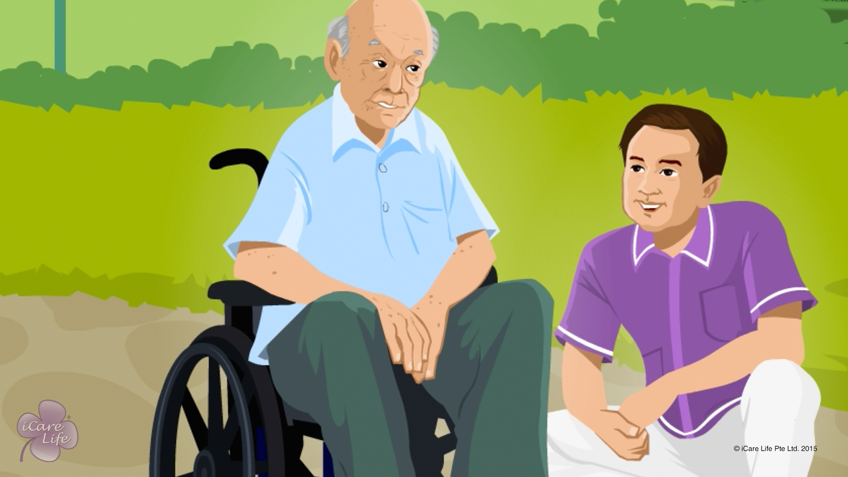
Developing Patience with an Elder
7
Copyright: iCare Life Pte. Ltd., Singapore : This document must not be copied or shared or circulated without the consent of iCare Life and/or its affiliates.

Slide 9

Post-Module Activity
House of Cards!
Notes:
Arrange for 3-4 pack of cards. Divide the class into 3-4 groups and hand one pack of card to each group.
Ask them to make a house of cards, as tall as they can make in 5 minutes time.
Once the time starts, observe the participants carefully and make a note of which group did the best. Also note that the participants of which group were the most calm and composed.
After the activity is finished, ask the groups as to how did they feel when their cards fell down and when the time was about to finish. Also ask if the participants were frustrated and what did they do about it.

Slide 10
Summary
In a situation where you feel frustrated:
Deep breathe and take a short break
Spend some time alone to compose yourself
Try taking a short walk or splashing cold water on your face
Ask yourself if saying something hurtful will take you close to your long-term goal of having a good relationship with the elder
Try to empathize with the elder and look at the situation from the their perspective
If you are struggling to complete all your tasks in a day, create a daily plan for yourself and see how you can complete the tasks more efficiently
Take good care of yourself – sleep well, eat a healthy diet, and exercise regularly
9
Notes:
In a situation where you feel frustrated:
Deep breathe and take a short break
Spend some time alone to compose yourself
Try taking a short walk or splashing cold water on your face
Ask yourself if saying something hurtful will take you close to your long-term goal of having a good relationship with the elder
Try to empathize with the elder and look at the situation from the their perspective
If you are struggling to complete all your tasks in a day, create a daily plan for yourself and see how you can complete the tasks more efficiently
Take good care of yourself – sleep well, eat a healthy diet, and exercise regularly

Slide 11
Any Questions?
10
Notes:
Q1. Is it often that elderly person loses patience and start throwing tantrums?
Ans. One has to learn to deal with all sorts of people. You may not find all people impatient all the time. One has to gauge mood changes and cope with the situation by remaining calm and not replying back at least on the spur of the moment.
Q2. Caregiving is a difficult and a stressful task. Is it possible to take leave in between?
Ans. Yes. Such a step will help you regain your control and freshen you up. However, make sure you plan the leave after consulting your employer, well in advance.
Q3. What else can you do to calm down in difficult situations?
Ans. Learn to meditate. Meditation helps soothe frayed nerves.
Q4. How can you let the elder know that you have felt bad about their behavior even though you do not show your displeasure by shouting etc?
Ans. Just be aloof for some time and not talk to them while going about your duties. The elder would most probably realize that they have hurt you and may try to mend their ways. But do not let such silence carry too far and do not let such feelings creep in performance of your duties.

Slide 12
Toilet Assistance
11
Copyright: iCare Life Pte. Ltd., Singapore : This document must not be copied or shared or circulated without the consent of iCare Life and/or its affiliates.

Slide 13
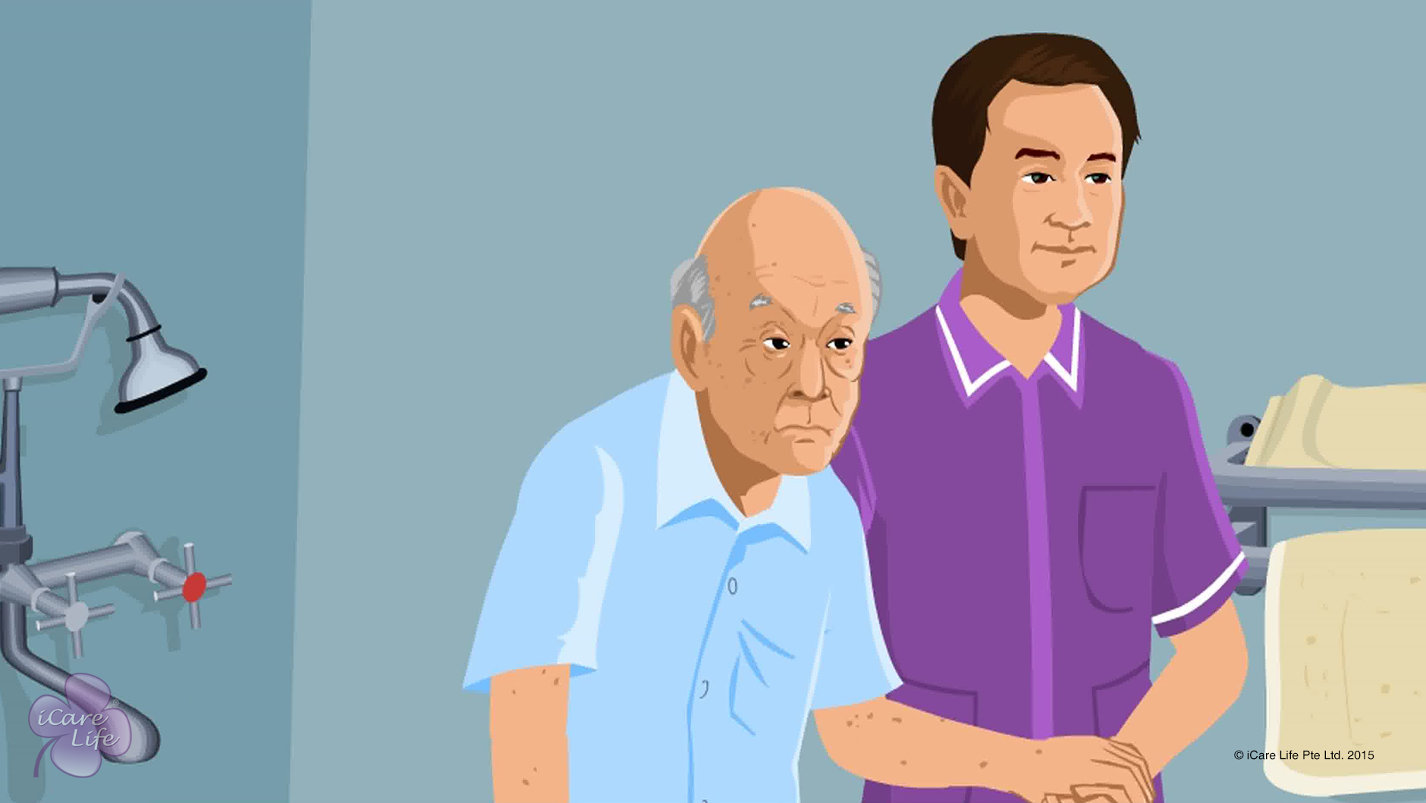
Toilet Assistance
12
Copyright: iCare Life Pte. Ltd., Singapore : This document must not be copied or shared or circulated without the consent of iCare Life and/or its affiliates.

Slide 14
Post-Module Activity
Let’s Practice!
13
Notes:
Arrange for a visit to an old people’s home or a nursing home. The participants are given a demonstration of providing toilet assistance by a trained caregiver using a human dummy.
Next, each participants should be given an opportunity to practice providing toilet assistance in terms of disrobing, supporting, and cleaning a person. Later, the participants may be assigned individual tasks to provide toilet assistance to actual wards.

Slide 15
Summary
To provide toilet assistance to an elder:
Provide assistance as soon as requested
Respect the elder’s privacy and dignity
Make sure the toilet is clean before use
Make sure supplies like toilet paper and soap are available
Help the person reach the toilet
If required, help in disrobing
Encourage the person to use the toilet as independently as possible
If required, support the person during toileting
Ensure proper hygiene after toilet use
Make sure the toilet is clean after use
Wash hands with soap and water after providing toilet assistance
Stay respectful in case of an accident or incontinence
14
Notes:
To provide toilet assistance to an elder:
Provide assistance as soon as requested
Respect the elder’s privacy and dignity
Make sure the toilet is clean before use
Make sure supplies like toilet paper and soap are available
Help the person reach the toilet
If required, help in disrobing
Encourage the person to use the toilet as independently as possible
If required, support the person during toileting
Ensure proper hygiene after toilet use
Make sure the toilet is clean after use
Wash hands with soap and water after providing toilet assistance
Stay respectful in case of an accident or incontinence

Slide 16
Any Questions?
15
Notes:
Q1. How can accidents such as soiling clothes be avoided while toileting?
Ans: You must understand the habits and and bowel problems of the elder in your care. Sometimes the elders make a request to go to the toilet a bit too late. At times, they are not able to handle their clothes properly while toileting. Make sure you offer toilet assistance to the elder at regular intervals of time. If the elder makes such a request, drop everything else and attend to the person. If handling of clothes is a problem, you can help the elder practice the correct procedure while sitting on a closed toilet seat or a chair. In spite of all the precautions, such accidents may happen. In such case, do not lose your cool and stay respectful towards the elder. You must realize it is a much bigger problem and cause of embarrassment for the elderly person than your inconvenience.

Slide 17
Bed Toileting
16
Copyright: iCare Life Pte. Ltd., Singapore : This document must not be copied or shared or circulated without the consent of iCare Life and/or its affiliates.

Slide 18
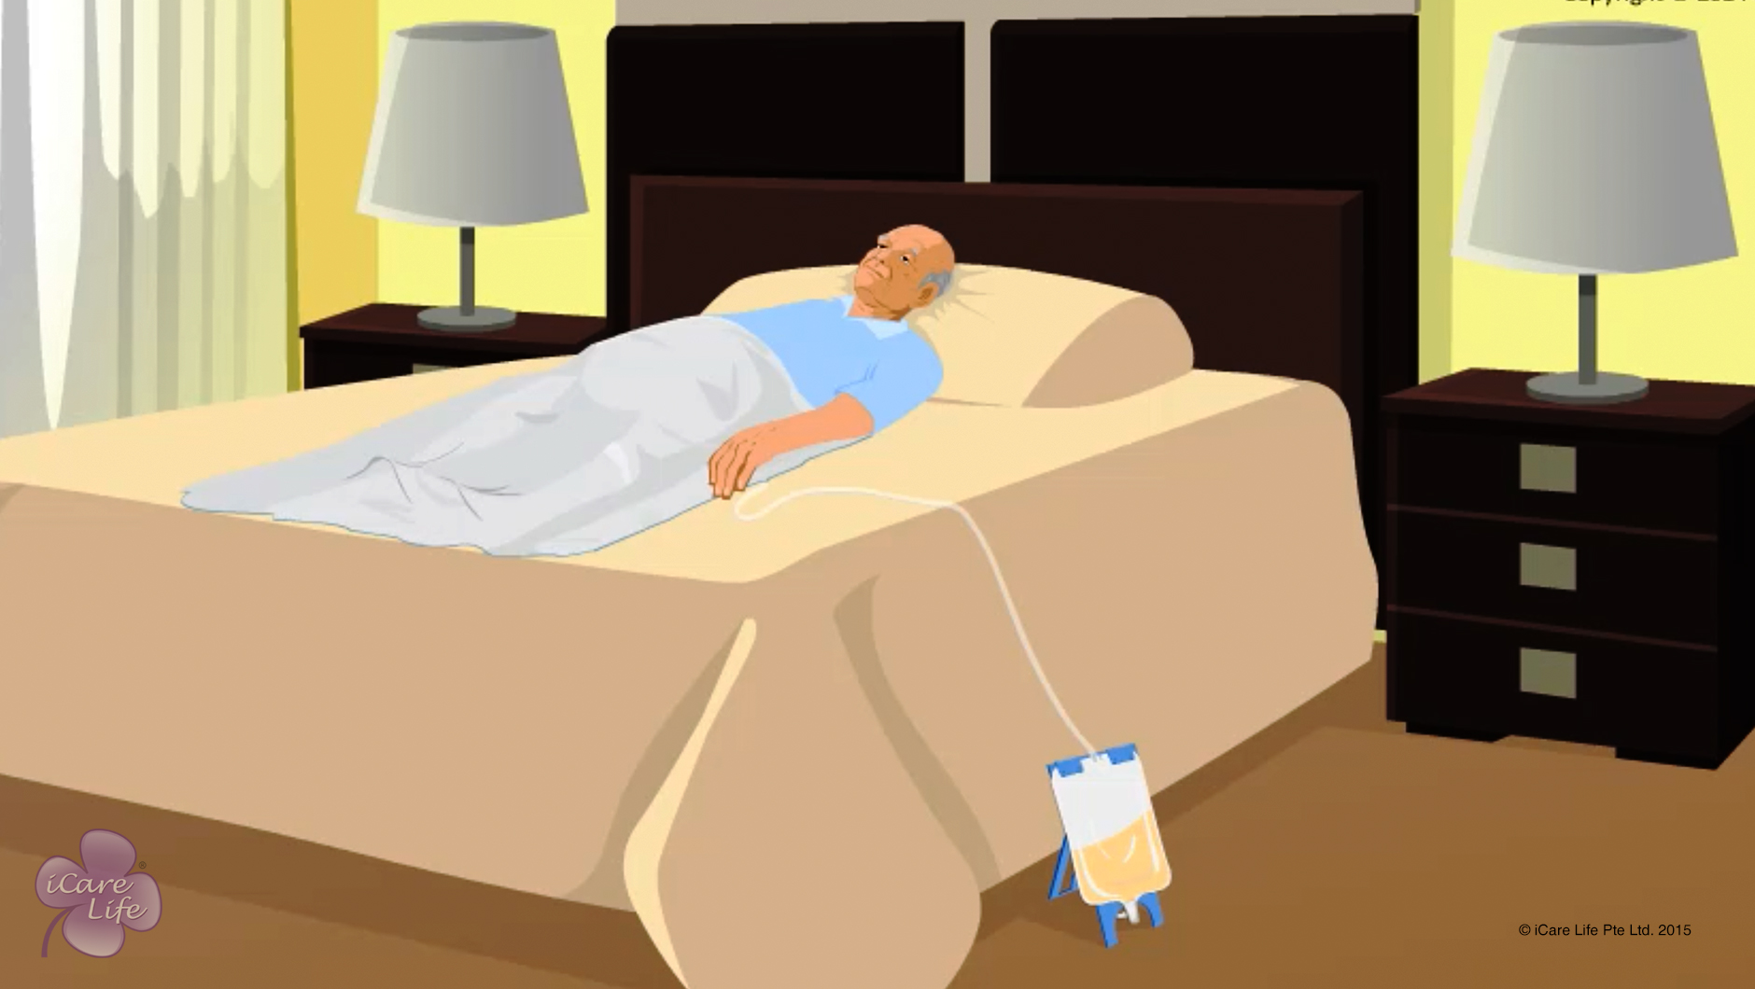
Bed Toileting
17
Copyright: iCare Life Pte. Ltd., Singapore : This document must not be copied or shared or circulated without the consent of iCare Life and/or its affiliates.

Slide 19
Post-Module Activity
Practical Training
Notes:
Arrange for a visit to an old people’s home or a nursing home. The participants are given a demonstration of providing bed toileting support to elderly people by a trained caregiver (using a human dummy).
Next, each participants should be given an opportunity to practice providing toile assistance in terms of disrobing, supporting, and cleaning the elderly person. Later, the participants may be assigned individual tasks to provide bed toileting support to actual wards.

Slide 20
Summary
To provide toilet assistance in bed to an elderly people who can raise their hips:
Raise the head of the bed
Ask the person to raise the hips and slide the bedpan in place
Cover the person with a sheet
Keep toilet paper within easy reach
If required, support the person during toileting
To provide toilet assistance in bed to an elderly people who cannot raise their hips:
Roll the person to a side
Hold the bedpan against the person’s buttocks
Roll the person back
Bend the person’s knees and raise the head of the bed a little
19
Copyright: iCare Life Pte. Ltd., Singapore : This document must not be copied or shared or circulated without the consent of iCare Life and/or its affiliates.
Notes:
To help an elder to eat:
Help them wear glasses and dentures – Before moving to the eating place
Seat them comfortably - With head slightly tilted forward
Provide napkins and tissues – To protect clothing and wipe hands and mouth
Offer food that can be eaten comfortably – Food that they can eat using hands if they cant use spoons and forks
Serve liquids with food – Such as water, juice, soup, or tea
Ensure that they are fully alert – To prevent choking
Ask discreetly to chew or swallow – When they are unsure of what to do
Check for swallowing difficulty or choking – Such as, strain on face or neck, face turning blue or fainting
After the elder has finished eating:
Remove napkin and utensils
Help them clean hands, mouth, and dentures
Ask them not to lie down immediately
Observe signs of choking or uneasiness

Slide 21
Summary
When assisting an elder in cleaning, use disposable gloves and clean the elder thoroughly
Empty the bedpan into a toilet and wash the bedpan for subsequent use
Wash hands with soap and water
Stay respectful in case the elder’s clothes get soiled
21
Copyright: iCare Life Pte. Ltd., Singapore : This document must not be copied or shared or circulated without the consent of iCare Life and/or its affiliates.

Slide 22
Any Questions?
22
Notes:
Q1. Can I refuse to provide assistance for bed toileting to the elder in my care?
Ans: There are some aspects of a caregiver’s job that may appear unpleasant. However, when you accept the job of a caregiver, you must be prepared to take on all the responsibilities it involves. Elders are prone to illnesses. Even an independent elder may require bed toileting when seriously ill. If required, you cannot refuse to provide such assistance. You must look at the elder as a patient who needs care and is dependent on you. During the training, you will get enough practice to become comfortable with providing such assistance.

Slide 23
Incontinence & Toileting
23
Copyright: iCare Life Pte. Ltd., Singapore : This document must not be copied or shared or circulated without the consent of iCare Life and/or its affiliates.

Slide 24
Incontinence & Toieting
24
Copyright: iCare Life Pte. Ltd., Singapore : This document must not be copied or shared or circulated without the consent of iCare Life and/or its affiliates.

Slide 25
Post-Module Activity
Practical Training
Notes:
Arrange for a human dummy and a bed. The participants are given live demonstration of:
Making an elder’s bed
Changing drawer sheet
Cleaning the elder after incontinence
Handling urinary catheters
Emptying the urine bag
After demonstration of each task, invite each participant to get hands-on practice in performing the task.

Slide 26
Summary
To care for an elder who suffers from incontinence:
Place a mackintosh under the buttocks area
Cover the mackintosh with a drawer sheet
Change the drawer sheet as often as required
Never leave the elder lying directly on mackintosh
Use adult diapers if the elder soils clothes frequently
Keep the elder clean and dry
To care for an elder using a urinary catheter:
Use intermittent insertion catheters to help the elder urinate every few hours
Periodically empty the urine bag attached to the continuous flow catheter
Do not touch the tip of the drain spout
Wash your hands with soap and water before and after emptying the urine bag
Ensure that the catheter does not get pulled
Periodically clean the tip of the urethra where the catheter enters the elder’s body
26
Copyright: iCare Life Pte. Ltd., Singapore : This document must not be copied or shared or circulated without the consent of iCare Life and/or its affiliates.
Notes:
To care for an elder who suffers from incontinence:
Place a mackintosh under the buttocks area
Cover the mackintosh with a drawer sheet
Change the drawer sheet as often as required
Never leave the elder lying directly on mackintosh
Use adult diapers if the elder soils clothes frequently
Keep the elder clean and dry
To care for an elder using a urinary catheter:
Use intermittent insertion catheters to help the elder urinate every few hours
Periodically empty the urine bag attached to the continuous flow catheter
Do not touch the tip of the drain spout
Wash your hands with soap and water before and after emptying the urine bag
Ensure that the catheter does not get pulled
Periodically clean the tip of the urethra where the catheter enters the elder’s body

Slide 27
Any Questions?
27
Notes:
Q1. Why does incontinence happen?
Ans: Incontinence is an involuntary action. An adult never does it on purpose or to knowingly create trouble for anyone. Incontinence happens due to temporary or permanent loss of control over bladder and bowel movement. It may happen due to several diseases associated with old age. As a caregiver, you must treat an elder suffering from such condition with patience. You must never ridicule the elder or get angry with them. Stay respectful and do what you can to make life more comfortable for the elder in your care.

Slide 28
Changing Adult Diapers
28
Copyright: iCare Life Pte. Ltd., Singapore : This document must not be copied or shared or circulated without the consent of iCare Life and/or its affiliates.

Slide 29
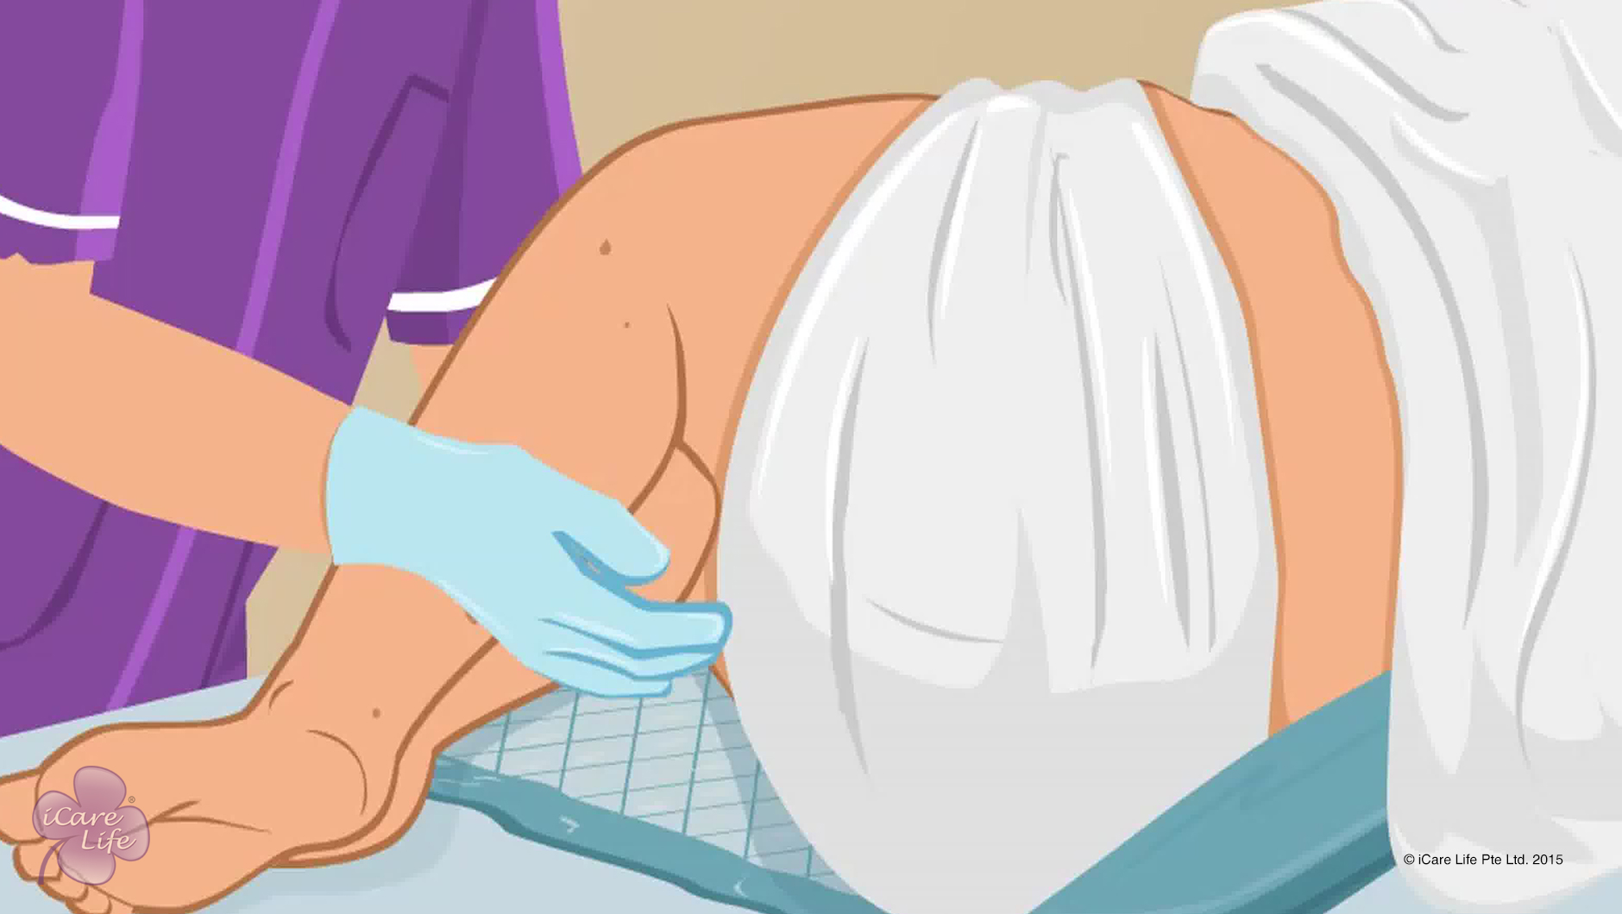
Changing Adult Diapers
29
Copyright: iCare Life Pte. Ltd., Singapore : This document must not be copied or shared or circulated without the consent of iCare Life and/or its affiliates.

Slide 30
Post-Module Activity
Let’s Practice
30
Copyright: iCare Life Pte. Ltd., Singapore : This document must not be copied or shared or circulated without the consent of iCare Life and/or its affiliates.
Notes:
Arrange for a location with a bed, an adult human dummy, wipes, water, and a towel.
Divide the participants into small batches and ask a trained caregiver to give a demonstration of placing a pad and changing a diaper on a dummy (as a bedridden elder).
After the demonstration, invite participants one by one to place a pad and change diaper for the dummy.

Slide 31
Summary
Convince the elder to wear adult diapers if required
If the elder is sensitive, use the word briefs
Share diaper samples
Before changing diaper, place a pad under the elder
If soiled, change the diaper immediately; else change it in every six hours
Always treat the elder with dignity and respect
31
Notes:
Convince the elder to wear adult diapers if required
If the elder is sensitive, use the word briefs
Share diaper samples
Before changing diaper, place a pad under the elder
If soiled, change the diaper immediately; else change it in every six hours
Always treat the elder with dignity and respect

Slide 32
Any Questions?
32
Notes:
FAQs:
Q1: Why do we apply protective barrier before applying diapers?
Ans. The protective barrier helps prevent rashes that may come due to regular use of diapers.
Q2. How do I know which diaper will work best for the elder?
Ans. Based on your elder’s preference you can try and decide on a brand. Remember diapers come in various sizes and styles. Choose one that will fit the elder comfortably.

Slide 33
Helping the Elder take Stool & Urine Samples
33
Copyright: iCare Life Pte. Ltd., Singapore : This document must not be copied or shared or circulated without the consent of iCare Life and/or its affiliates.

Slide 34
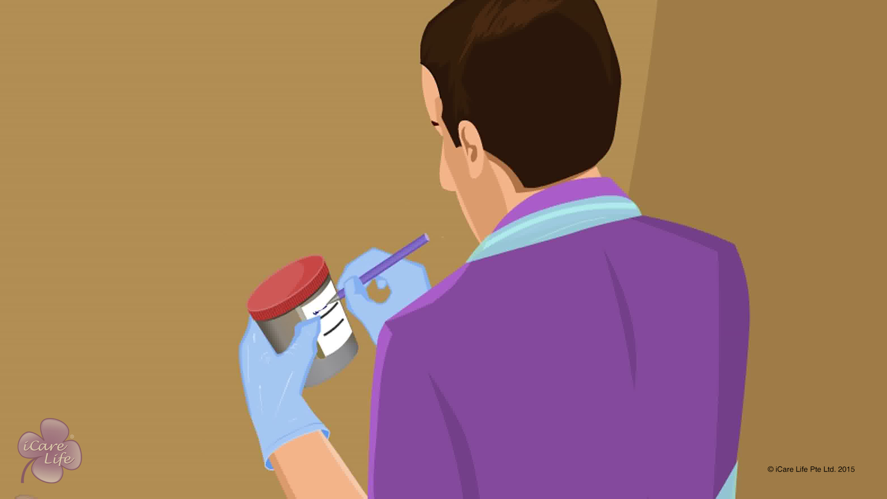
Helping the Elder take Stool & Urine Samples
34
Copyright: iCare Life Pte. Ltd., Singapore : This document must not be copied or shared or circulated without the consent of iCare Life and/or its affiliates.

Slide 35
Post-Module Activity
Demonstration
35
Copyright: iCare Life Pte. Ltd., Singapore : This document must not be copied or shared or circulated without the consent of iCare Life and/or its affiliates.
Notes:
Take prior appointment and arrange for a visit to a test lab. Ask the laboratory technician to explain (talk about) the correct methods of taking urine and stool samples. The demonstration may not involve actual sample collection.
Ask participants to take notes as appropriate.

Slide 36
Summary
To avoid contamination of stool sample:
Store the sample as advised by the doctor
Wash hands with soap and wear gloves
Ask elder to urinate before stool collection
For stool collection:
Explain procedure
Ask the elder their preference of toilet location
Keep materials ready
Place bedpan on the toilet seat
Label the container
Wash hands and wear gloves and apron
36

Slide 37
Summary
To collect stool sample:
Help the elder into position
Ensure that the elder has privacy
Once the elder is done, help them get clean
Open the container and use a spoon to collect the sample
Fill one-third of the container and screw on the lid
Dispose remaining stool, gloves, and apron
Wash hands with soap
Place container in specimen bag and send to laboratory
37

Slide 38
Summary
To collect urine sample for elders who need assistance:
Explain the procedure
Wash hands and wear gloves and apron
Label the specimen container
Help the elder into position
Ask the elder to wash first and then start urinating
After the initial urine has passed, collect the sample
Remove container before the elder finishes
Screw on the container lid
Dispose gloves and apron and wash hands
Help the elder out of the toilet
Send the sample to the laboratory
38

Slide 39
Summary
To collect urine sample from an elder with catheter:
Explain the procedure to the elder
Wash hands, apply alcohol hand rub, and wear gloves and apron
Place the clamp on the tube just below the catheter port for 30 minutes
After 30 minutes, clean the port with alcohol swab
Disconnect the tube end connected with the urobag and direct it towards the sterile container
Remove the clamp and collect the required urine sample
Close and label the container
Remove apron and wash hands with soap
Send the sample to the laboratory
If the elder needs minimal or no assistance, explain the procedure clearly
39

Slide 40
Any Questions?
40
Notes:
FAQs
Q1. Can I store the stool specimen bag in the fridge?
Yes, but it is better to check with the doctor before you do so.
Q2. Will the elder feel any discomfort, when urine is collected from the catheter port?
No, the elder will not feel any discomfort.
Q3. Why is it important to wash before urinating?
This will help remove external bacteria and prevent it from being collected in the sample.
Q4. Why is it important to hand the sample immediately to the laboratory?
A. The bacteria in the sample will multiply if stored for longer durations. This will affect the test results.

Slide 41


