Slide 1

Modules Summary Discussion – Q&A
CR 9.1
Private and Confidential

Slide 2

Communicating about a Problem with an Elder
1
Copyright: iCare Life Pte. Ltd., Singapore : This document must not be copied or shared or circulated without the consent of iCare Life and/or its affiliates.

Slide 3
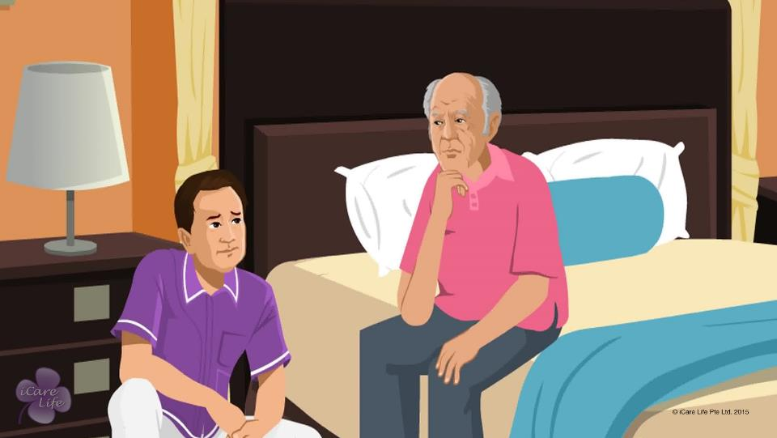
Communicating with a Problem with an Elder
2
Copyright: iCare Life Pte. Ltd., Singapore : This document must not be copied or shared or circulated without the consent of iCare Life and/or its affiliates.

Slide 4
What’s my Problem?
Post Module Activity
3
Copyright: iCare Life Pte. Ltd., Singapore : This document must not be copied or shared or circulated without the consent of iCare Life and/or its affiliates.
Notes:
Arrange for a chair and a box with folded chits bearing following words: Health, Loneliness, Anxiety, Lack of Confidence, Neglect, Safety
Invite a participant to play the role of an elder. The participant takes out a chit, reads the type of problem, folds it and puts it back in the box. Allow the participant a few minutes to think about a problem related to the type mentioned on the chit. When the person is ready, invite another participant to play the role of a caregiver.
The caregiver has to find out the exact problem that the elder is facing and state it in a sentence. The caregiver is allowed to ask questions. The person playing the role of the elder must answer the questions and tell about the problem without stating the problem clearly.
The caregiver’s behavior must be observed and any mistakes should be pointed out like interrupting the elder, offering (not suggesting) solutions, laughing at the elder’s problem or not showing sympathy.
If the caregiver fails to identify the actual problem, another person is invited to play the role of eth caregiver. If the caregiver identifies the problem clearly, another person is invited to play the role of an elder and the activity is repeated for a new problem.

Slide 5
Summary
Encourage the elder to speak about the problem the elder is facing
Listen carefully when the elder is speaking
Clarify the problem by asking questions
Help the elder state the problem clearly
Do not get tempted to offer solutions
Offer suggestions to help the elder solve the problem
Be sympathetic to the elder's problem
Share the elder's problem with a family member:
If the elder cannot solve that problem or
If the problem is related to the elder's safety or health
4
Copyright: iCare Life Pte. Ltd., Singapore : This document must not be copied or shared or circulated without the consent of iCare Life and/or its affiliates.
Notes:
Encourage the elder to speak about the problem the elder is facing
Listen carefully when the elder is speaking
Clarify the problem by asking questions
Help the elder state the problem clearly
Do not get tempted to offer solutions
Offer suggestions to help the elder solve the problem
Be sympathetic to the elder's problem
Share the elder's problem with a family member:
If the elder cannot solve that problem or
If the problem is related to the elder's safety or health

Slide 6
Any Questions?
5
Copyright: iCare Life Pte. Ltd., Singapore : This document must not be copied or shared or circulated without the consent of iCare Life and/or its affiliates.
Notes:
Q1. Why shouldn't I offer solutions to the elder's problem?
Ans: Elderly people often feel dependent on others. This makes them lose their self-confidence which is another main problem faced by the elders. As a caregiver, you must try to make the elders feel independent and capable of solving their own problems. This is essential to keep them happy and positive about their lives. So, instead of offering a solution, you should make suggestions for possible solutions. This makes the elderly people feel more in control of their lives. This also makes them value your suggestions more.

Slide 7

Communicating with Elders having Special Needs
6
Copyright: iCare Life Pte. Ltd., Singapore : This document must not be copied or shared or circulated without the consent of iCare Life and/or its affiliates.

Slide 8
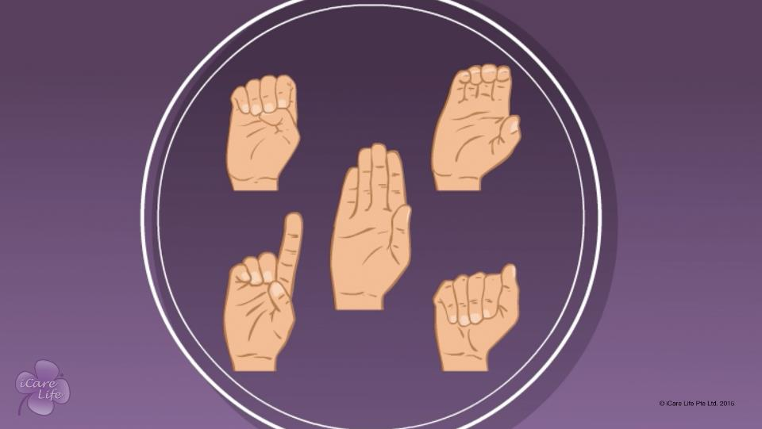
Communicating with Elders having Special Needs
7
Copyright: iCare Life Pte. Ltd., Singapore : This document must not be copied or shared or circulated without the consent of iCare Life and/or its affiliates.

Slide 9
Pass the Message
Post Module Activity
8
Copyright: iCare Life Pte. Ltd., Singapore : This document must not be copied or shared or circulated without the consent of iCare Life and/or its affiliates.
Notes:
Arrange for a chair, a notepad, a pen and a box filled with folded chits having following messages:
I want a glass of water.
I want to go out.
I am sleepy.
I want something to eat.
Where are my spectacles?
I am feeling cold.
What is the time?
I want a book.
I wish to change my clothes.
Bring me my eye drops.
Help me get up from my chair.
My stomach is paining.
Call my doctor.
Find my walking stick.
I want a cup of tea.
Divide the participants into groups of three. One participant sits in the chair and picks a chit out of the box. The participant reads the chit (not aloud), folds it and hands it over to the you. Next this participant uses gestures to convey the message to the second participant. The third participant has the notepad and pen and needs to look away while the gestures are being used to communicate. The second participant then speaks silently with exaggerated lip movements to convey the message to the third participant who writes it down and shows it to you. Read out the message on the chit and on the notepad.
Repeat the activity with other groups of participants.
At the end ask the participants how did they feel communicating this way. Draw their attention to the fact that seeing, hearing and speaking are gifts that we use daily in communicating with each other. Ask them to imagine how well they communicate if any of these gifts is taken away from them. It can be very frustrating and elderly people often suffer from this frustration. Therefore, caregivers must be sympathetic to elderly people’s problems of communication and find ways to overcome them.

Slide 10
Summary
If the elder has a hearing problem:
Ensure the elder uses a hearing aid, if advised to do so
Keep your face at the same level as the elder
Lower all unwanted noises so that the elder can hear better
Speak slowly and a little loudly
Exaggerate your lips movements to help the elder understand what you are saying
If the elder has a speech problem:
Ensure the elder uses dentures, if advised to do so
Make the elder comfortable
Be patient
Ask simple questions that have short answers
Encourage the person to write the message
9
Copyright: iCare Life Pte. Ltd., Singapore : This document must not be copied or shared or circulated without the consent of iCare Life and/or its affiliates.
Notes:
If the elder has a hearing problem:
Ensure the elder uses a hearing aid, if advised to do so
Keep your face at the same level as the elder
Lower all unwanted noises so that the elder can hear better
Speak slowly and a little loudly
Exaggerate your lips movements to help the elder understand what you are saying
If the elder has a speech problem:
Ensure the elder uses dentures, if advised to do so
Make the elder comfortable
Be patient
Ask simple questions that have short answers
Encourage the person to write the message

Slide 11
Summary
If required, use gestures or sign language to communicate
If the elder has poor vision:
Move around so that the elder is facing you when talking
Make your presence felt to the elder
Bring objects close to the person to identify and choose
Talk to family members to find out which method of communication works best with the elder
Never ridicule the person
Always be respectful and patient
10
Copyright: iCare Life Pte. Ltd., Singapore : This document must not be copied or shared or circulated without the consent of iCare Life and/or its affiliates.
Notes:
If required, use gestures or sign language to communicate
If the elder has poor vision:
Move around so that the elder is facing you when talking
Make your presence felt to the elder
Bring objects close to the person to identify and choose
Talk to family members to find out which method of communication works best with the elder
Never ridicule the person
Always be respectful and patient

Slide 12
Any Questions?
11
Copyright: iCare Life Pte. Ltd., Singapore : This document must not be copied or shared or circulated without the consent of iCare Life and/or its affiliates.
Notes:
Q.1. Communicating with an elder with a hearing or speech problem is very difficult in the beginning. What should I do?
Ans. Take help from the elder’s family members to help you communicate with the elder. Observe the elder’s communication with their family members carefully. As you spend more time with the elder, you will learn how to talk to and understand them.

Slide 13

Understanding & Handling Lack of Trust in an Elder
12
Copyright: iCare Life Pte. Ltd., Singapore : This document must not be copied or shared or circulated without the consent of iCare Life and/or its affiliates.

Slide 14
Class Discussion
Pre Module Activity
13
Copyright: iCare Life Pte. Ltd., Singapore : This document must not be copied or shared or circulated without the consent of iCare Life and/or its affiliates.
Notes:
Tell the class participants to assume that the most valuable object to them is a special ring. Suppose they had to travel and could not take the ring along:
Who would they leave it with to be taken care of?
Why do they trust that person?

Slide 15
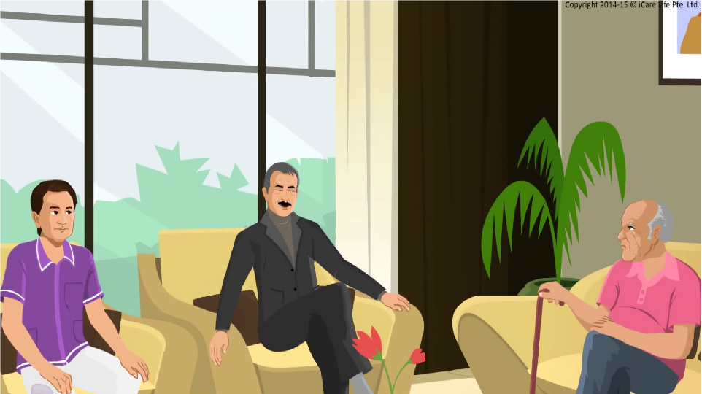
Understanding Lack of Trust
14
Copyright: iCare Life Pte. Ltd., Singapore : This document must not be copied or shared or circulated without the consent of iCare Life and/or its affiliates.

Slide 16
Let’s Play Minefield
Post Module Activity
15
Copyright: iCare Life Pte. Ltd., Singapore : This document must not be copied or shared or circulated without the consent of iCare Life and/or its affiliates.
Notes:
You will need:
Class furniture
Random objects of smaller size like cardboard boxes, shoes, markers etc. These objects should not be pointed or they could hurt the player.
Blindfolds
Steps:
Divide the class into two groups, say group A and B. Make pairs with one participant from group A and one from B. Send group B outside the class.
Ask group A to make a maze inside the class using class furniture and place obstacles like shoes and markers for the hurdles. There should be a starting point and an end point of the maze.
Make sure that group B does not see the maze.
Explain to group A that they will be responsible for each of their group B counterparts. The group B participants will be blindfolded one at a time and group A participant has to guide them through the maze just by giving verbal instruction. The blindfolded partner cannot speak. This has to be done in the least possible time.
The group A participant can now blindfold their partner, explain the activity to them and bring them to the class. The partners may discuss their strategies or signals and words they will use to make their expectations clear.
Start the activity and note down the time of every pair.
Once all the pairs have completed the activity, ask group B participants about their fears and strengths in the game and if they trusted their partner.
Also ask how important was the trust factor in the game.

Slide 17
Summary
When caring for elders who display lack of trust, show trust in their abilities by encouraging them to be independent
Be reliable and dependable
If you make a mistake, do not make excuses to cover it up
When sharing some information with the elder, do not omit important details
If the elder or their family members confide in you about their personal matters, do not repeat this information
16
Copyright: iCare Life Pte. Ltd., Singapore : This document must not be copied or shared or circulated without the consent of iCare Life and/or its affiliates.
Notes:
When caring for elders who display lack of trust, show trust in their abilities by encouraging them to be independent
Be reliable and dependable
If you make a mistake, do not make excuses to cover it up
When sharing some information with the elder, do not omit important details
If the elder or their family members confide in you about their personal matters, do not repeat this information

Slide 18
Any Questions?
17
Copyright: iCare Life Pte. Ltd., Singapore : This document must not be copied or shared or circulated without the consent of iCare Life and/or its affiliates.
Notes:
Q1. Why do the elderly people not trust others easily?
Ans. They probably believe that others may take advantage of their reducing physical and mental capabilities.
Q2. What if, despite your best effort, the elderly person is not able to trust you?
Ans. There can not be any clear-cut answer to this question except that one has to keep trying and prove one’s credentials and professional integrity.
Q3. How does the personal relationship between the two help the care receiver?
Ans. A positive relationship will always be in the interest of the two as trust, mutual respect, and professional integrity will help the elder feel more positive about life.

Slide 19
Understanding Ego of the Elder
18
Copyright: iCare Life Pte. Ltd., Singapore : This document must not be copied or shared or circulated without the consent of iCare Life and/or its affiliates.

Slide 20





Logo Recognition
Pre Module Activity
19
Copyright: iCare Life Pte. Ltd., Singapore : This document must not be copied or shared or circulated without the consent of iCare Life and/or its affiliates.
Notes:
Print the logos on sheets of paper and distribute among the class participants.
Ask the class to recognize these logos and write the relevant answers. After they are done, reveal the answers in class.
The answer key is:
Twitter
Gmail
Whatsapp
Skype
Facebook

Slide 21
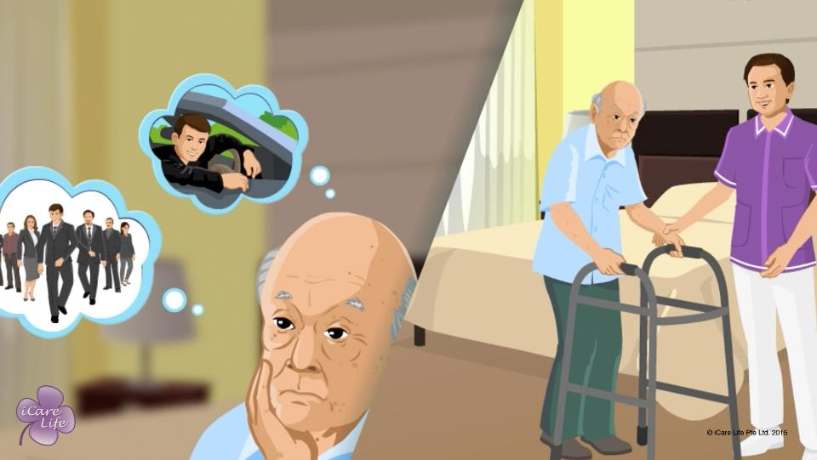
Understanding Ego of the Elder
20
Copyright: iCare Life Pte. Ltd., Singapore : This document must not be copied or shared or circulated without the consent of iCare Life and/or its affiliates.

Slide 22
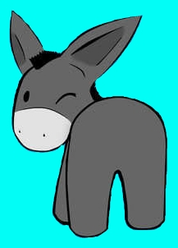
Pin the Tail on the Donkey
Post Module Activity
21
Copyright: iCare Life Pte. Ltd., Singapore : This document must not be copied or shared or circulated without the consent of iCare Life and/or its affiliates.
Notes:
You will need:
A volunteer from the class
A white board with a picture of a donkey drawn on it. The donkey should be drawn without a tail.
A marker to draw the tail
A blind-fold
Steps:
a) Invite a participant to volunteer for the activity and send them out of the classroom for some time.
b) Explain to the rest of the class that the volunteer will be blindfolded and asked to draw a tail on the donkey. Two more class participants have to confuse the blindfolded volunteer as to where the right spot is. The rest of the class has to purposely laugh on the blindfolded volunteer.
c) Now call the participant inside the classroom and blindfold the person. Make sure that the person does not see the whiteboard. Hand them the marker and tell them that there is a picture of a tail-less donkey on the board and they must draw a tail at the right spot.
d) Cue the other two participants to give confusing instructions to the blindfolded participant and the rest of the class to make fun of him.
e) Stop this after two minutes. Now take the blindfold off and ask the volunteer:
As to how did they feel with the handicap and why (vulnerable, inefficient)
As to how did they feel when there were many instructions at the same time (confused, difficult to follow, difficult to think clearly)
As to how did they feel when the class was laughing at them (humiliated, vulnerable)
After the answers, speak to the class about elders feeling the same when they are ridiculed, ignored, scolded, or given many instructions at the same time. Instruct the class accordingly. Highlight the importance of supporting the elder (instead of ridiculing/making fun/scolding them) when they feel they are not able to do something correctly and their ego is hurt.

Slide 23
Summary
Acknowledge the elder’s ego and its need to protect the person’s identity
If the elder makes excuses to hide an inability, do not argue with them
Empathize and try to find the real reason behind their discomfort
Resolve the elder’s problem as best as possible
Observe if your resolution is satisfactory to the elder
If not, then try another way of resolving the elder’s discomfort
If the elder finds it difficult to accept their changed role in society or accept the change in their appearance:
Appreciate how well they have led their life
Talk to them about the positive things that they still have in life
Encourage them to do activities that they are passionate about
22
Copyright: iCare Life Pte. Ltd., Singapore : This document must not be copied or shared or circulated without the consent of iCare Life and/or its affiliates.
Notes:
Acknowledge the elder’s ego and its need to protect the person’s identity
If the elder makes excuses to hide an inability, do not argue with them
Empathize and try to find the real reason behind their discomfort
Resolve the elder’s problem as best as possible
Observe if your resolution is satisfactory to the elder
If not, then try another way of resolving the elder’s discomfort
If the elder finds it difficult to accept their changed role in society or accept the change in their appearance:
Appreciate how well they have led their life
Talk to them about the positive things that they still have in life
Encourage them to do activities that they are passionate about

Slide 24
Any Questions?
23
Copyright: iCare Life Pte. Ltd., Singapore : This document must not be copied or shared or circulated without the consent of iCare Life and/or its affiliates.
Notes:
Q1. How does one comfort an elderly person with their inability to look after themselves but finds it difficult to accept?
Ans. One has to be patient and tell as many times as required about the natural degradation of the body that takes place with age. You may also cite examples of other elderly people who may be in similar situation. Such a step may lead the elderly person to believe that they are not alone with such physical or mental disabilities and make it easier for them to accept.
Q2. One of the problems that the elderly face is lack of interaction specially with their family members in which they start to feel that they are no more required. How does one cope with such situation?
Ans. You can try the following: -
(a) Encourage the family members to spend more time with the elderly.
(b) Try and tell them to make a roster when a particular member would come and meet the elder which may even be for a short time.
(c) You yourself should spend as much time as is possible with the elderly.
(d) If the elderly can do something useful even by means of advice, one could encourage them to do so or maybe get them involved in some kind of social obligations.
(e) You could keep re-affirming the faith of the elderly that they were a very capable person in their younger days and remind them of their achievements.

Slide 25
Being Assertive with the Elder
24
Copyright: iCare Life Pte. Ltd., Singapore : This document must not be copied or shared or circulated without the consent of iCare Life and/or its affiliates.

Slide 26
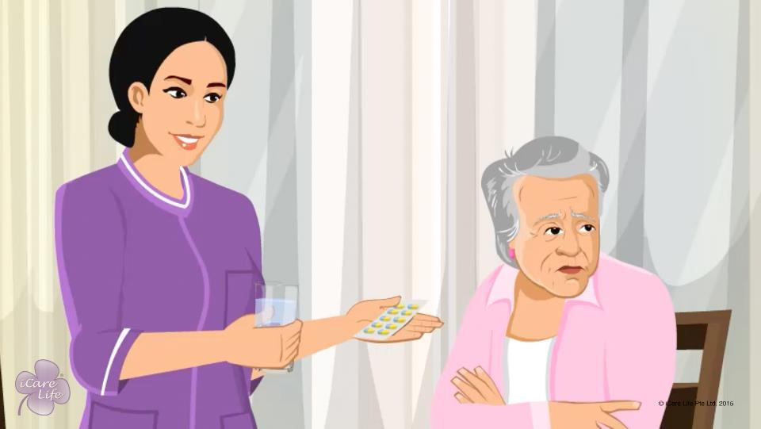
Being Assertive with the Elder
25
Copyright: iCare Life Pte. Ltd., Singapore : This document must not be copied or shared or circulated without the consent of iCare Life and/or its affiliates.

Slide 27
Role Play
Post Module Activity
26
Copyright: iCare Life Pte. Ltd., Singapore : This document must not be copied or shared or circulated without the consent of iCare Life and/or its affiliates.
Notes:
Ask two volunteers from the class to play the elder and the caregiver.
The situation is that the elder is being difficult to the caregiver. The elder is refusing to eat their meal and wants to go out to have an ice-cream. The elder is even angry because the caregiver is not giving into their demands.
The caregiver has to manage elder’s anger by being assertive. They should be polite and in no circumstance should the caregiver become angry himself. They should reason with the elder and not fight.

Slide 28
Summary
When opposing the elder’s decision, respect the elder and acknowledge their requirements
State politely but clearly why you cannot allow the elder to do something
If the elder wants to have a food item that the doctor has advised them to avoid, do not let the elder cross the permissible limit
Refuse to give cigarettes to the elder
Do not let the elder skip medicines
Do not let them over-exert their body
Explain clearly that for their own security, the elder should not share personal information with strangers
27
Copyright: iCare Life Pte. Ltd., Singapore : This document must not be copied or shared or circulated without the consent of iCare Life and/or its affiliates.
Notes:
When opposing the elder’s decision, respect the elder and acknowledge their requirements
State politely but clearly why you cannot allow the elder to do something
If the elder wants to have a food item that the doctor has advised them to avoid, do not let the elder cross the permissible limit
Refuse to give cigarettes to the elder
Do not let the elder skip medicines
Do not let them over-exert their body
Explain clearly that for their own security, the elder should not share personal information with strangers

Slide 29
Any Questions?
28
Copyright: iCare Life Pte. Ltd., Singapore : This document must not be copied or shared or circulated without the consent of iCare Life and/or its affiliates.
Notes:
Q1. Is the statement, “Sorry, but I cannot let you do this” polite and firm?
Ans. Yes
Q2. Is it ok to bargain with the elder to allow them something in limited quantities to make them do something like taking medicine?
Ans. Yes, bargaining is one of the ways to deal with the elders but it cannot be made a routine.
Q3. What happens in case you lose your temper while dealing with the elders?
Ans. Well, after sometime you should apologize to them and try and explain that you wanted only the best for the elder and that you were trying to follow the instructions of the doctor and the family.
Q4. What can you do to prevent the elderly from talking to strangers which you feel may compromise their safety or security?
Ans. You may like to initially explain to them, not let them be alone with the person whom you may feel as a threat and if nothing works you may like to inform the family about it.

Slide 30


