Slide 1

Mental Health and Wellbeing
8
CR 9.2
Standard
Source: Skills for Health – Website http://www.skillsforhealth.org.uk/
Skills for Care – Website http://www.skillsforcare.org.uk/

Slide 2
Learning outcomes
1. Understand the needs and experiences of people with mental health conditions, dementia or learning disabilities
2. Understand the importance of promoting positive health and wellbeing for an individual who may have a mental health condition, dementia or a learning disability
3. Understand the adjustments that may be necessary in care delivery relating to an individual who may have a mental health condition, dementia or learning disability
4. Understand the importance of early detection of mental health needs, dementia and learning disabilities
5. Understand legal frameworks, policy and guidelines relating to mental health needs, dementia and learning disabilities
6. Understand the meaning of mental capacity in relation to how care is provided
Source: Skills for Health – Website http://www.skillsforhealth.org.uk/
Skills for Care – Website http://www.skillsforcare.org.uk/
1

Slide 3
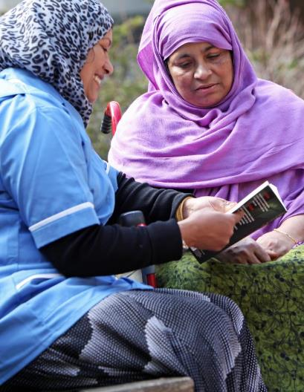
Awareness of Mental Health, Dementia & Learning Disability
Your role may not include providing direct support to individuals with mental ill- health, dementia or learning disabilities
Having an awareness of the experiences of others can help you to identify any signs and symptoms as well as enabling you to work in ways that show compassion and understanding
Source: Skills for Health – Website http://www.skillsforhealth.org.uk/
Skills for Care – Website http://www.skillsforcare.org.uk/
2

Slide 4


Mental Health Conditions
1 in 4 adults experience at least one mental health need in any year
Examples of mental health problems include:
Depression
Anxiety
Psychosis
Mental health: Mental health can be seen positively to identify a positive state of mental wellbeing or negatively, to identify a negative state of mental wellbeing, for example, experiencing mental health problems that cause distress and affect an individual’s functioning.
Source: Skills for Health – Website http://www.skillsforhealth.org.uk/
Skills for Care – Website http://www.skillsforcare.org.uk/
3

Slide 5
Depression
An individual experiencing depression will feel emotions such as hopelessness and negativity that don’t go away
The symptoms of depression:
Can last weeks, months or longer
Affects how individuals see themselves
Can lead to people stopping engagement in social life, family life or work
Source: Skills for Health – Website http://www.skillsforhealth.org.uk/
Skills for Care – Website http://www.skillsforcare.org.uk/
4
Notes:
Additional Information
Symptoms of depression can last for a couple of weeks, a number of months or longer.
Living with depression can affect how an individual sees themselves. This can lead to them not engaging in a social life, with family or their work.
Depression is a treatable illness with recognised symptoms.
Having the opportunity to talk and share how they feel can help some people.

Slide 6

Anxiety
Individuals living with anxiety find it hard to control their worries. Symptoms can be:
Physical
Psychological
Cognitive
Behavioural or social.
Psychological
Psychological symptoms relate to feelings and emotions, it includes how the mind looks at things and how this can affect behaviour.
Cognitive
Cognitive or cognition refers to our brains and how we think about things; how we process, use and store information we take in through our senses.
Source: Skills for Health – Website http://www.skillsforhealth.org.uk/
Skills for Care – Website http://www.skillsforcare.org.uk/
5
Notes:
Additional Information
Physical symptoms such as increased heart rate, difficulty breathing and dizziness
Psychological symptoms such as feeling a loss of control, thinking that you might die or have a heart attack, and feelings of wanting to escape or run away
Cognitive symptoms such as changes to your thought processes, thinking negative thoughts repeatedly
Behavioural or social symptoms such as not wanting to leave the house, abusing substances such as alcohol or drugs or behaving in ways that affect your relationships. Individuals may stop going out with friends, or to places such as the supermarket, as they are worried about how they might feel when they are there.
There are treatments which help alleviate the symptoms of anxiety such as cognitive behavioural therapy (CBT). This helps someone to talk about their condition and manage the effects by trying to change the way they think.

Slide 7

Psychosis
Psychosis is a symptom of conditions such as schizophrenia and bipolar disorder
Two significant signs of psychosis are:
Hallucinations
Delusions
Experiencing these symptoms can be frightening
Reassure the individual that you are safe
Source: Skills for Health – Website http://www.skillsforhealth.org.uk/
Skills for Care – Website http://www.skillsforcare.org.uk/
6
Notes:
Additional Information
As per the study around 3 in 100 people will have at least one experience of psychosis.
Schizophrenia: This condition can be described as having a break from reality, when it is difficult to understand what is real and what is in their own thoughts. Symptoms could include: hallucinations, delusions and changes in behaviour.
Bipolar disorder: This condition affects a person’s moods and means they can go from one extreme mood to another alongside having feelings of depression.
Hallucinations: where a person sees or hears things that aren’t real but are very real to them. They can also include feeling, smelling or tasting things that aren’t real.
Delusions: where a person believes things that aren’t true, for example believing that someone is spying on them.

Slide 8
Causes of mental health problems
An individual may experience a mental health need as a result of:
a traumatic event
a chemical imbalance in the brain
genetics
Chemical imbalance: The chemicals or hormones that affect our emotions and behaviour may be lower or higher than they should be.
Source: Skills for Health – Website http://www.skillsforhealth.org.uk/
Skills for Care – Website http://www.skillsforcare.org.uk/
7
Notes:
Additional Information
A traumatic event, such as an accident, a death in the family or as a result of war (Post Traumatic Stress Disorder (PTSD)
A chemical imbalance in the brain
Genetics, for example, a person’s additional needs may be due to their DNA.

Slide 9

Dementia
A word commonly used to cover many different conditions that affect the brain
These conditions cause a decline or reduction in abilities, including:
memory
thinking
reasoning
communicating
Source: Skills for Health – Website http://www.skillsforhealth.org.uk/
Skills for Care – Website http://www.skillsforcare.org.uk/
8
Notes:
Additional information
The Alzheimer’s Society estimate there are over 100 different conditions that fall under the dementia umbrella.
Someone who experiences dementia may feel confused, frustrated and frightened. A common symptom is short term memory loss; the individual finds it difficult to remember recent events or conversations. This can lead to them repeating stories or asking the same question over and over again.
Dementia is often thought to be a condition that only affects older people. However, dementia can affect anyone, at any age.

Slide 10

Supporting individuals with dementia
There is currently no cure for dementia, and individual’s experience of living with the condition can be affected by the attitudes and views of others
If people view living with dementia as a constant loss of abilities…
…that there is nothing that can be done to support the person…
…the person living with dementia is likely to experience feelings of ill-being…
…that can then contribute to a negative experience of living with the condition
Source: Skills for Health – Website http://www.skillsforhealth.org.uk/
Skills for Care – Website http://www.skillsforcare.org.uk/
9
Notes:
Activity: Ask the learners to consider how the support provided could affect the experience of a person who has dementia. Use one of the scenarios below or use one of your own.
Scenario 1
Josie has dementia. She values her independence but is finding it increasingly difficult to remember where things are in her home and when to take her medication.
a) The worker supporting her tells her that living with dementia is a slippery slope and things are only going to get worse for her.
b) The worker supporting her suggests that they arrange for her to have an assessment of her needs and research ways of supporting her to remain in her own home for longer such as labelling cupboards and using dosette boxes.
Scenario 2
William has been living with dementia for some years. He is admitted to hospital after a fall.
Workers supporting William don’t ask him about what he wants. They tell him not to worry, that he will be looked after and that the medical professionals know what to do for the best. They do not involve him in day to day decisions or in decisions about his care.
Workers supporting William talk to him about what he wants and what he needs. He and his support network are involved in all decisions from his rehabilitation treatment and adaptations to support him to live as independently as possible to day-to-day decisions about what to eat and what to wear.
Answers should include:
Working in negative ways could lead to the individual experiencing feelings of despair and depression. Ignoring the individual’s wishes means that the worker is not working in a person centred way. The individual may feel that they are no longer in control of her own life or of the care that they receive. They may have feelings of hopelessness, worthlessness and experience a loss of a loss of self esteem.
Working in positive ways that show respect for the individual’s wishes will help to promote the individual's feeling of self-worth, dignity and self-esteem. They will be more likely to engage in therapies and support groups that can improve their experience of living with the condition.

Slide 11
Types of dementia
The two most common types of dementia are:
Alzheimer’s disease
Vascular dementia
In individuals with Alzheimer’s
disease a bad protein develops in the brain causing damage to the brain cells and their connections
Vascular dementia is caused by
oxygen failing to get to the brain cells as a result of problems with the blood supply (the vascular system)
Dementia will affect each individual differently depending on the type of dementia they have and the support they receive
Source: Skills for Health – Website http://www.skillsforhealth.org.uk/
Skills for Care – Website http://www.skillsforcare.org.uk/
10

Slide 12
Learning disabilities
The cause of learning disabilities is not always known but they can be due to:
Complications during birth
Genetic conditions
Illness or injury in childhood
An individual with a learning disability may have difficulty
Understanding information
Learning new skills
Communicating
Living independently
Source: Skills for Health – Website http://www.skillsforhealth.org.uk/
Skills for Care – Website http://www.skillsforcare.org.uk/
11
Notes:
Additional Information
The cause of learning disabilities is not always known but they can be due to:
Complications during birth which can lead to lack of oxygen
Genetic conditions such as Down’s Syndrome which happens as a result of an extra chromosome. This leads to impairments in both cognitive ability and physical growth that range from mild to moderate developmental disabilities
Illness or injury in childhood which has affected the brain such as meningitis.
In most cases living with a learning disability will have a lifelong impact but this will vary depending on the type of learning disability and the severity of the condition.

Slide 13
The impact of learning disabilities
An individual’s experience of living with a learning disability and the support they need will depend on the severity of the condition
People with a mild learning disability may only need a little support to be independent
Someone with a severe learning disability may not be able to verbally communicate
Individuals may communicate in ways that others find difficult to understand, and this can affect how others see and respond to them
Source: Skills for Health – Website http://www.skillsforhealth.org.uk/
Skills for Care – Website http://www.skillsforcare.org.uk/
12

Slide 14
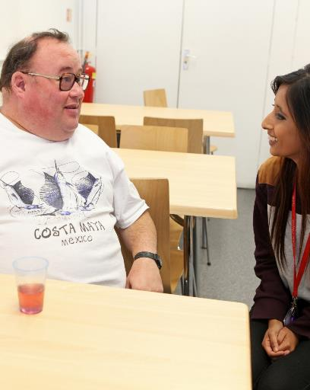
Supporting people with learning disabilities
Every individual is unique with different needs, preferences, life history and experiences
The support provided must:
Be person centred to meet their specific needs
Develop and enable them to develop their skills and become more independent
Source: Skills for Health – Website http://www.skillsforhealth.org.uk/
Skills for Care – Website http://www.skillsforcare.org.uk/
1 3

Slide 15
Promoting positive attitudes
The stigma associated with mental health problems, dementia or learning disabilities can lead to feelings of loneliness and being left out of society
Positive attitudes can be promoted by:
Reducing stigma by ensuring that individuals are not isolated in social situations
Promoting wellbeing for those living with the condition
Identifying and building on the individual’s skills and abilities
Providing opportunities for individuals to feel empowered and in control
Source: Skills for Health – Website http://www.skillsforhealth.org.uk/
Skills for Care – Website http://www.skillsforcare.org.uk/
14
Notes:
Activity: Ask the learners for examples of how they can promote positive attitudes in their own workplace.

Slide 16
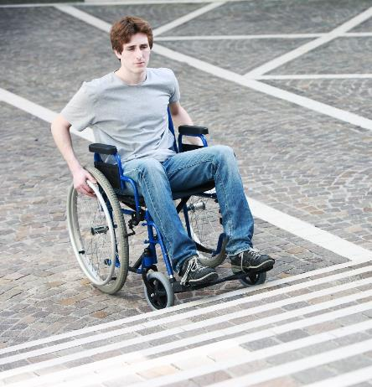
The social model of disability
The social model of disability says that disability is caused by
the way society is organised, rather than by a person’s
impairment or difference
The social model looks for ways of removing barriers that limit life choices
When barriers are removed, people can work towards being as independent as they can be and be included and equal in society
Source: Skills for Health – Website http://www.skillsforhealth.org.uk/
Skills for Care – Website http://www.skillsforcare.org.uk/
15
Notes:
Activity: Ask the learners for some examples of barriers that could limit an individual’s choices and stop them being included in society.
Possible answer include:
The environment, for example, is a building accessible for a person who uses a wheelchair?
The impact of people’s attitudes, for example, stereotyping all people with dementia as the same and assuming they will all be affected in the same way
The impact of an organisation’s approach, for example, ways of working that are set to meet the needs of the organisation rather than the individual.

Slide 17
Barriers
The barriers could include:
The environment – such as signs for information
The impact of people’s attitudes such as stereotyping
The impact of an organisation’s approach such as ways of working that are set to meet the needs of the organisation rather than the individual
Source: Skills for Health – Website http://www.skillsforhealth.org.uk/
Skills for Care – Website http://www.skillsforcare.org.uk/
16
Notes:
Additional Information
Environmental support: such as adding handrails for support in the bathroom, labelling rooms and cupboards and dosette systems to remind people to take medication.
Emotional support: for both the person living with the condition and their family or carers. This might involve arranging a befriender or a counselling service.
Practical information or additional services: about an individual’s condition, illness, financial and legal issues and opportunities to plan ahead should also be available. Forums, charities, helplines or support groups are all useful sources of support and information.

Slide 18
Adaptations
The individual’s changing needs may need to be assessed to identify adaptations which can support them to live their lives more independently
Adaptations could include:
environmental support
emotional support
practical information or additional services
Source: Skills for Health – Website http://www.skillsforhealth.org.uk/
Skills for Care – Website http://www.skillsforcare.org.uk/
17
Notes:
Additional Information
Environmental support: such as adding handrails for support in the bathroom, labelling rooms and cupboards and dosette systems to remind people to take medication.
Emotional support: for both the person living with the condition and their family or carers. This might involve arranging a befriender or a counselling service.
Practical information or additional services: about an individual’s condition, illness, financial and legal issues and opportunities to plan ahead should also be available. Forums, charities, helplines or support groups are all useful sources of support and information.

Slide 19
Reporting concerns
If you think someone is developing symptoms of a mental health problem or dementia, or if their care and support needs have changed and need reassessing, you should record this information and pass it on
It is important to follow your agreed ways of working on recording to reduce lost or misinterpreted information
Agreed ways of working: This refers to organisational policies and procedures. This includes those less formally documented by individual employers and the self-employed as well as formal policies such as the Dignity Code and Compassion in Practice.
Source: Skills for Health – Website http://www.skillsforhealth.org.uk/
Skills for Care – Website http://www.skillsforcare.org.uk/
18
Notes:
Additional Information
When recording information there are a number of points to consider:
Ensure the information is accurate
It should be clear, concise, and legible
It should be non-ambiguous and state facts not opinions or assumptions
The person involved should be given the opportunity to contribute
Apply the principles of the Data Protection Act and maintain confidentiality.

Slide 20
Early diagnosis
Similarities between conditions can mean that conditions are sometimes mistaken
Psychosis
Depression/ mood disorders
Anxiety
Dementia
Learning disabilities
Confusion as a result of hallucinations and delusions
Lack of insight and self-awareness
Problems with sleeping
Change in mood/ personality
Problems with sleeping
Change in mood/ personality
Problems with sleeping
Confusion as a result of memory loss
Change in mood/ personality
Problems with verbal
communication
Problems with sleeping
Confusion due to difficulties with memory or relating to information
Lack of insight and self-awareness
Problems with verbal
communication
Source: Skills for Health – Website http://www.skillsforhealth.org.uk/
Skills for Care – Website http://www.skillsforcare.org.uk/
19
Notes:
Activity: Ask the learners to think about why it is important that conditions are diagnosed as early as possible.
Answers should include:
Clear up uncertainty. It can be upsetting living with symptoms like memory loss and changes in personality, particularly if you don’t understand why they are happening. As there are a number of conditions that have similar symptoms it is important that an accurate diagnosis is made. Whilst this can be difficult to hear it can clear up uncertainty and help someone to feel more in control.
Help the individual and their family and friends to plan. Planning for the future provides the opportunity to consider, discuss and record wishes and decisions. This is known as advance care planning; the individual makes plans about what they wish to happen while they are most able to be involved and make decisions.
Identify possible treatments and therapies. An individual may want to consider taking medication such as anti-dementia drugs or anti-depressants. They may also benefit from therapies such as counselling or cognitive behaviour therapy.
Provide the right information, resources and support. Through accessing information at an early stage someone can make best use of what is available such as support groups. They can also identify financial support that they may be entitled to.

Slide 21
Adapting care and support
Care and support must be person centred and will need to be reviewed and adapted to meet the changing needs of the individual
It may be necessary to develop your skills so that you can provide effective care and support. For example:
Developing skills to support people to communicate such as Makaton
Learning how to use assistive technology
Individuals also need support to learn how to use this technology in order to live independently
Legislation: polices to promote human rights, inclusion, equal life chances and citizenship of individuals with mental health needs, dementia or learning disabilities are a part of legislation in many countries.
Source: Skills for Health – Website http://www.skillsforhealth.org.uk/
Skills for Care – Website http://www.skillsforcare.org.uk/
20
Notes:
Additional information
Those living with mental health needs, dementia or a learning disability are more vulnerable to abuse. You should follow your agreed ways of working to make sure each individual is best protected from harm or abuse.

Slide 22
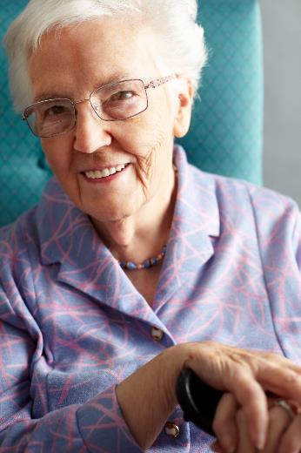
Mental capacity
Mental capacity is a term used to describe an individual's
ability to make their own decisions
When assessing a person's capacity ask yourself:
Does the person have an impairment, or a disturbance in the functioning of their mind or brain?
Does the impairment or disturbance mean that the person is unable to make a specific decision when they need to?
Source: Skills for Health – Website http://www.skillsforhealth.org.uk/
Skills for Care – Website http://www.skillsforcare.org.uk/
21
Notes:
Additional Information
Does the person have an impairment, or a disturbance in the functioning of their mind or brain? This can include, for example, conditions associated with mental illness, concussion, or symptoms of drug or alcohol abuse.
If so,
Does the impairment or disturbance mean that the person is unable to make a specific decision when they need to? You should offer appropriate and practical support to achieve this before applying this stage of the test.

Slide 23







Knowledge check
Which of the answers below describes the emotions experienced by someone living with major depression?
Click to reveal answer
Hallucinations and delusions
Feelings of sadness that don’t last long
Feelings of hopelessness that do not go away
Extreme happiness followed by sadness
Source: Skills for Health – Website http://www.skillsforhealth.org.uk/
Skills for Care – Website http://www.skillsforcare.org.uk/
22
Notes:
Trainer should ask class why they chose the correct answer.
Feedback
A – Hallucinations and delusions are symptoms which are associated with psychosis and psychotic episodes.
B – Most people experience feelings of sadness at some point in their life however major depression is characterised by long term feelings of hopelessness and negativity.
C – Feelings of hopelessness and negativity that do not go away quickly are a symptom of major depression
D – Extremes of emotion are common symptoms of bipolar disorder.

Slide 24


Knowledge check
What should you do if you are concerned that an individual’s needs have changed and need to be reassessed?
Click to reveal answer
Raise your concerns following reporting procedures and agreed ways of working
Do nothing, the matter is confidential
Discuss your concerns with your family or friends
Contact the local police to report your concerns immediately
Source: Skills for Health – Website http://www.skillsforhealth.org.uk/
Skills for Care – Website http://www.skillsforcare.org.uk/
23
Notes:
Trainer should ask class why they chose the correct answer.
Feedback
A – It is important that the individual’s care and support meets their individual, changing needs. You should raise your concerns with the people who need to know following agreed ways of working to reduce lost or misinterpreted information.
B – If you are concerned that an individual's care and support needs are not being met you should report your concerns
C – You should only share information with those who ‘need to know’ that is, those who are involved in providing care and support
D – You should follow the agreed ways of working for your organisation. If the needs of the individual remain unmet you may need to follow the whistleblowing procedure.

Slide 25
Knowledge check
Which of the following is a benefit of the early diagnosis of a mental health condition, dementia or a learning disability important?
It allows people to develop stigma and stereotypes
Click to reveal answer
It enables the social model of disability to be put in place
It enables the individual and their family to plan for their future care and support needs
It allows the individual to get a second opinion
Source: Skills for Health – Website http://www.skillsforhealth.org.uk/
Skills for Care – Website http://www.skillsforcare.org.uk/
24
Notes:
Trainer should ask class why they chose the correct answer.
Feedback
A – Stigma and stereotypes should be challenged whenever they are identified. Early diagnosis enables the individual to get appropriate care and support and enables them and their families to make plans for the future.
B – The social model of disability states that disability is caused by the way society is organised, rather than by a person’s impairment or difference. Early diagnosis enables the individual to get appropriate care and support and enables them and their families to make plans for the future.
C – Early diagnosis enables the individual to get appropriate care and support and enables them and their families to make plans for the future. It also ends uncertainty and enables people to find appropriate therapies and treatments.
D – The individual could get a second opinion however, some of the major benefits of early diagnosis are getting appropriate care and support and making plans for the future.

Slide 26
Viewing of Modules
Mental Health and Wellbeing
CR 9.2
Private and Confidential

Slide 27
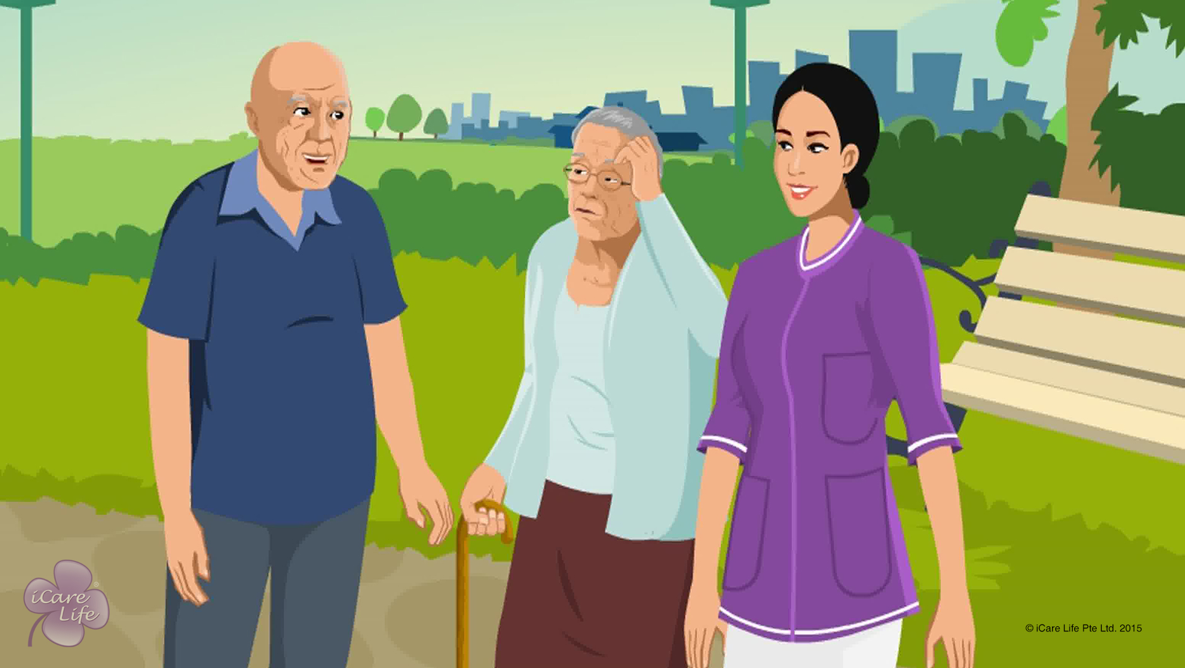
Identifying & Handling Dementia
1
Copyright: iCare Life Pte. Ltd., Singapore : This document must not be copied or shared or circulated without the consent of iCare Life and/or its affiliates.

Slide 28
In this module, you will learn about:
What is dementia
The symptoms of early stage of dementia
How elders react with the onset of dementia
The symptoms of severe dementia
How you should react while taking care of a person with dementia
2

Slide 29

Let’s Watch
Identifying & Handling Dementia in Elders
3
Copyright: iCare Life Pte. Ltd., Singapore : This document must not be copied or shared or circulated without the consent of iCare Life and/or its affiliates.

Slide 30
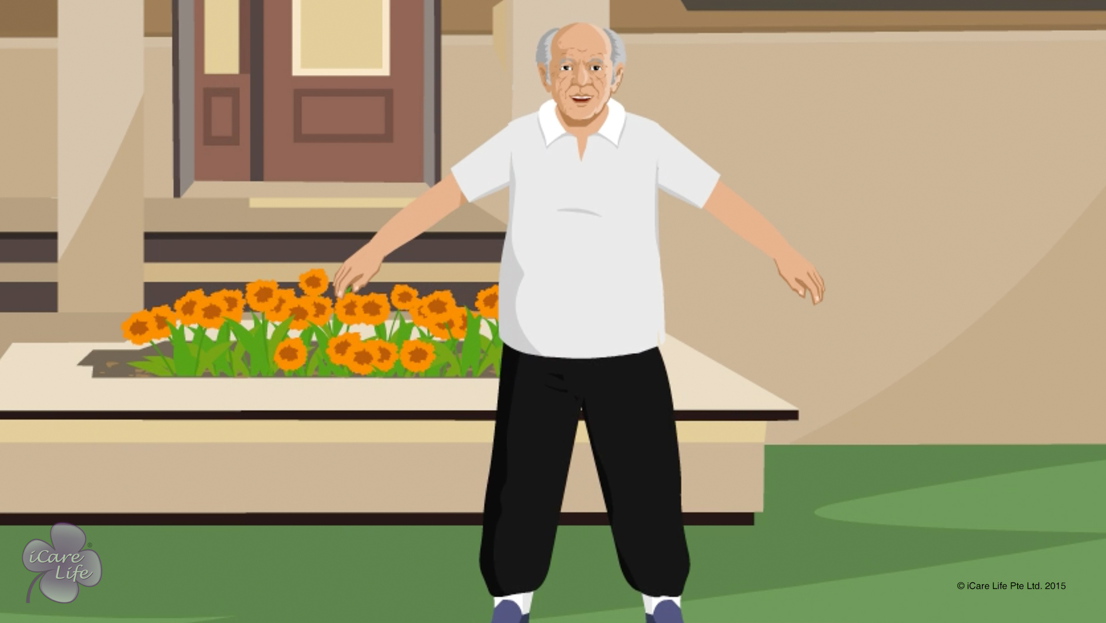
Importance of Exercise for an Elder
4
Copyright: iCare Life Pte. Ltd., Singapore : This document must not be copied or shared or circulated without the consent of iCare Life and/or its affiliates.

Slide 31
In this module, you will learn about:
How exercise is related to joint movement and functioning of organs in an elder’s body
The ill effects of lack of exercise on an elder’s body
The benefits of exercising for an elder
5
Copyright: iCare Life Pte. Ltd., Singapore : This document must not be copied or shared or circulated without the consent of iCare Life and/or its affiliates.

Slide 32
Let’s Watch
Importance of Exercise for an Elder
6
Copyright: iCare Life Pte. Ltd., Singapore : This document must not be copied or shared or circulated without the consent of iCare Life and/or its affiliates.

Slide 33
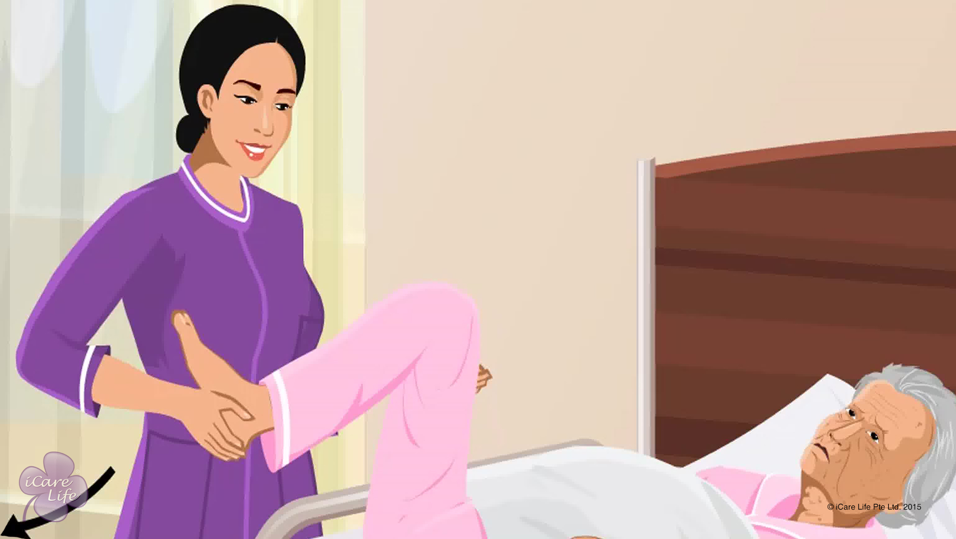
Various types of Exercise for an Elder
7
Copyright: iCare Life Pte. Ltd., Singapore : This document must not be copied or shared or circulated without the consent of iCare Life and/or its affiliates.

Slide 34
In this module, you will learn about:
The exercises suitable for independent elders
The exercises suitable for partially dependent elders
The exercises suitable for fully dependent elders
8
Copyright: iCare Life Pte. Ltd., Singapore : This document must not be copied or shared or circulated without the consent of iCare Life and/or its affiliates.

Slide 35
Let’s Watch
Various types of Exercise for an Elder
9
Copyright: iCare Life Pte. Ltd., Singapore : This document must not be copied or shared or circulated without the consent of iCare Life and/or its affiliates.

Slide 36
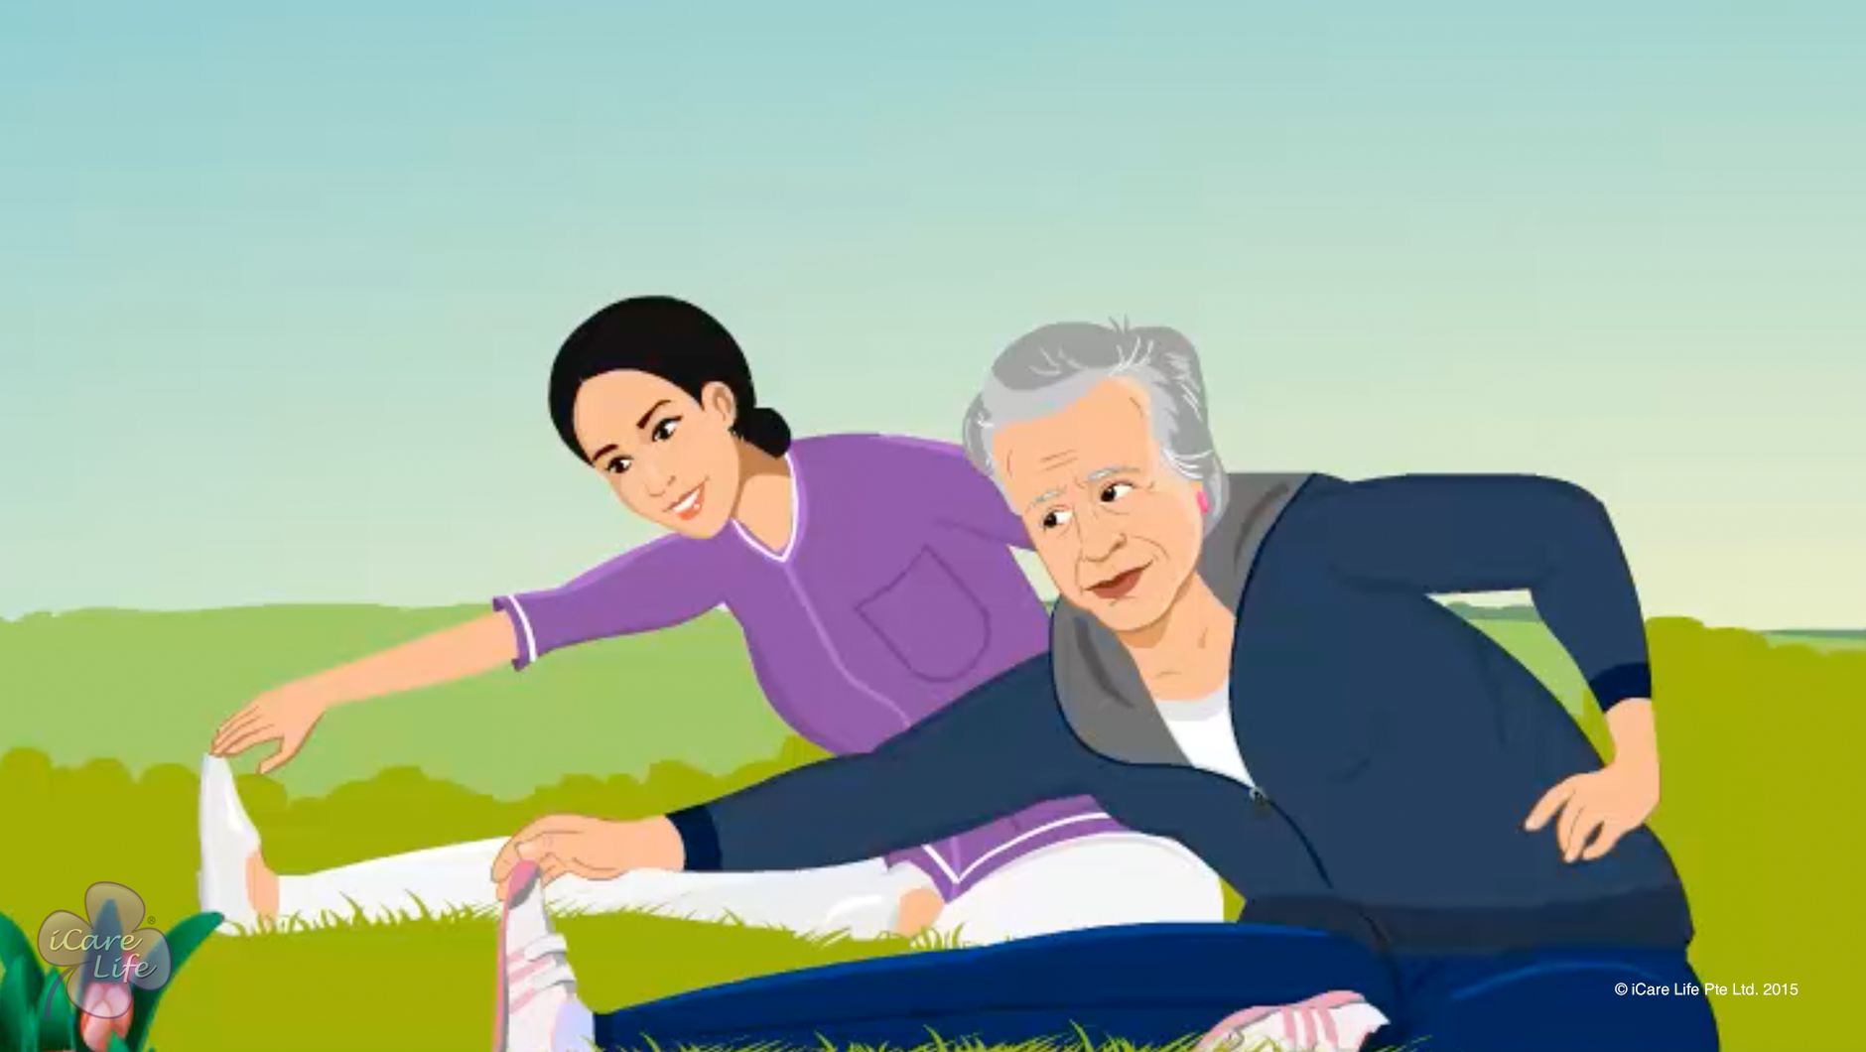
Precautions with Exercise
10
Copyright: iCare Life Pte. Ltd., Singapore : This document must not be copied or shared or circulated without the consent of iCare Life and/or its affiliates.

Slide 37
In this module, you will learn about:
The essential items of an elder’s exercise kit
The precautions to take when the elder is exercising
The way in which an elder’s body reacts to exercising
11
Copyright: iCare Life Pte. Ltd., Singapore : This document must not be copied or shared or circulated without the consent of iCare Life and/or its affiliates.

Slide 38
Let’s Watch
Precautions with Exercise
12
Copyright: iCare Life Pte. Ltd., Singapore : This document must not be copied or shared or circulated without the consent of iCare Life and/or its affiliates.

Slide 39


