Slide 1

Viewing of Modules
Mental Health and Wellbeing
CR 9.2
Private and Confidential

Slide 2
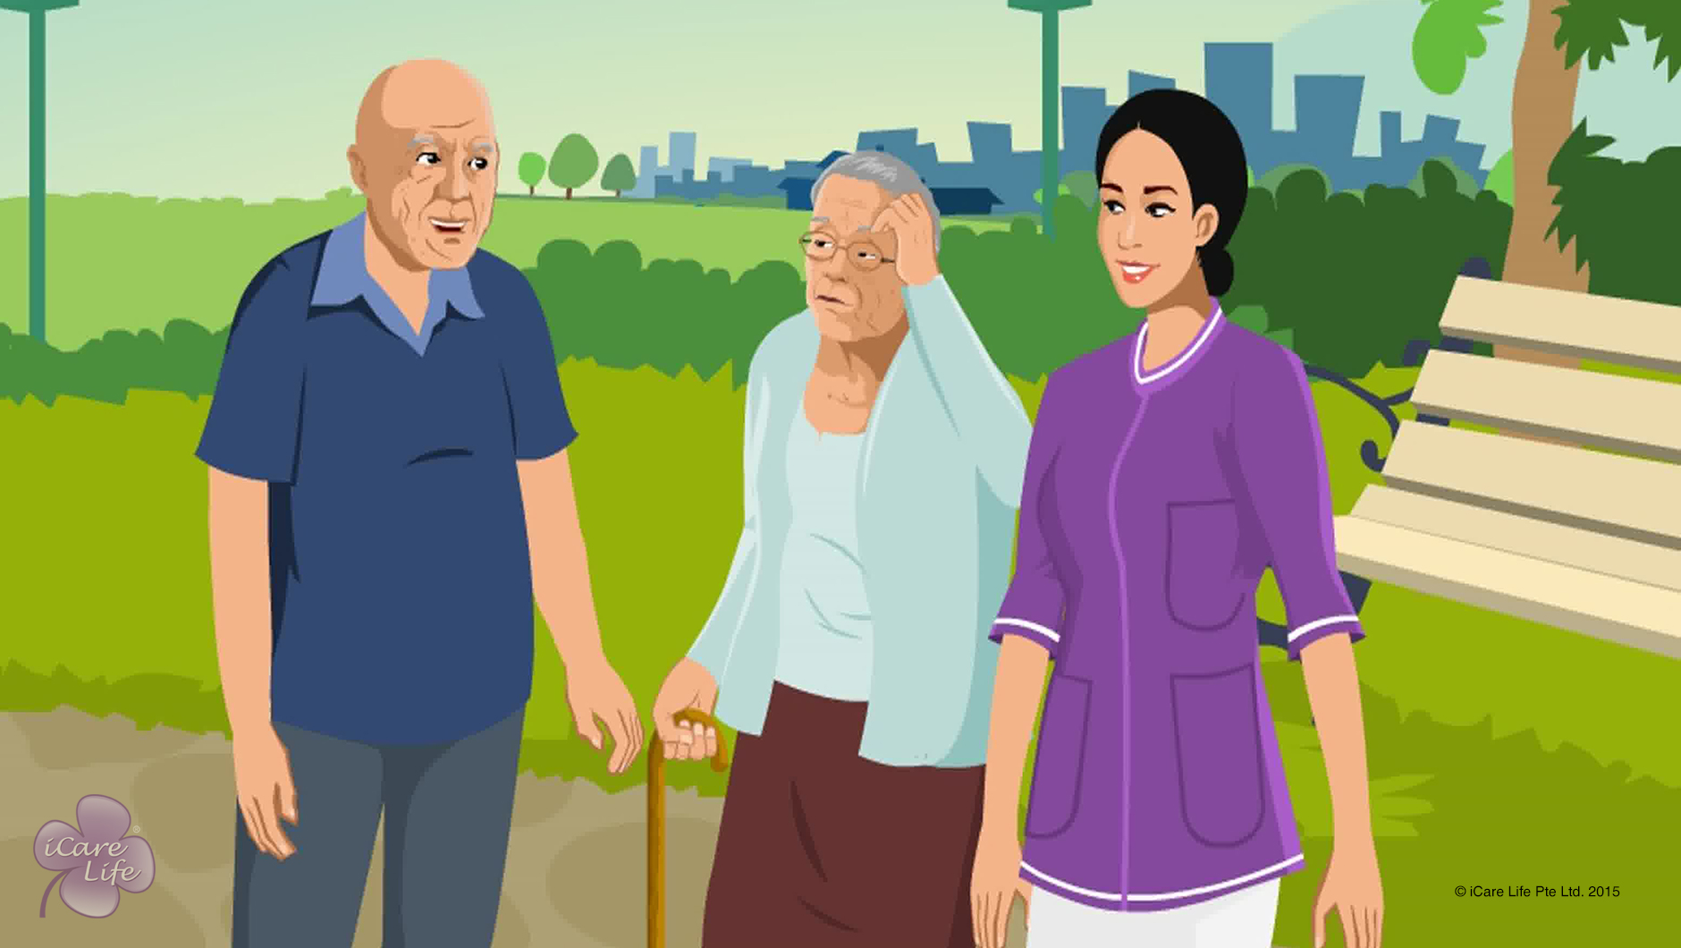
Identifying & Handling Dementia
1
Copyright: iCare Life Pte. Ltd., Singapore : This document must not be copied or shared or circulated without the consent of iCare Life and/or its affiliates.

Slide 3
In this module, you will learn about:
What is dementia
The symptoms of early stage of dementia
How elders react with the onset of dementia
The symptoms of severe dementia
How you should react while taking care of a person with dementia
2

Slide 4

Let’s Watch
Identifying & Handling Dementia in Elders
3
Copyright: iCare Life Pte. Ltd., Singapore : This document must not be copied or shared or circulated without the consent of iCare Life and/or its affiliates.

Slide 5
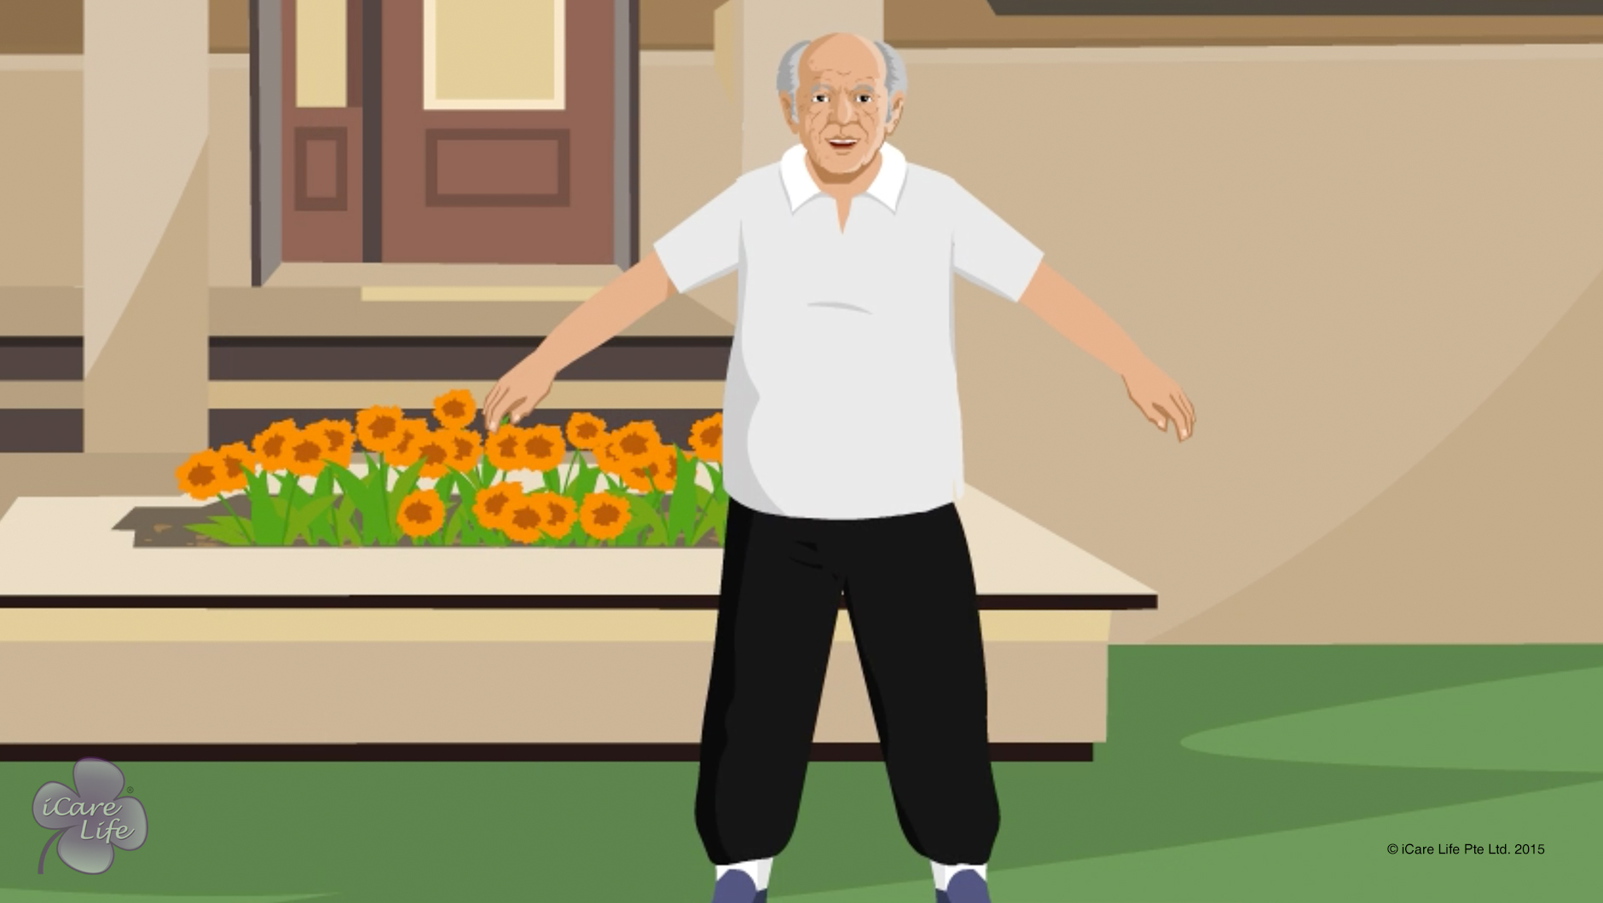
Importance of Exercise for an Elder
4
Copyright: iCare Life Pte. Ltd., Singapore : This document must not be copied or shared or circulated without the consent of iCare Life and/or its affiliates.

Slide 6
In this module, you will learn about:
How exercise is related to joint movement and functioning of organs in an elder’s body
The ill effects of lack of exercise on an elder’s body
The benefits of exercising for an elder
5
Copyright: iCare Life Pte. Ltd., Singapore : This document must not be copied or shared or circulated without the consent of iCare Life and/or its affiliates.

Slide 7
Let’s Watch
Importance of Exercise for an Elder
6
Copyright: iCare Life Pte. Ltd., Singapore : This document must not be copied or shared or circulated without the consent of iCare Life and/or its affiliates.

Slide 8
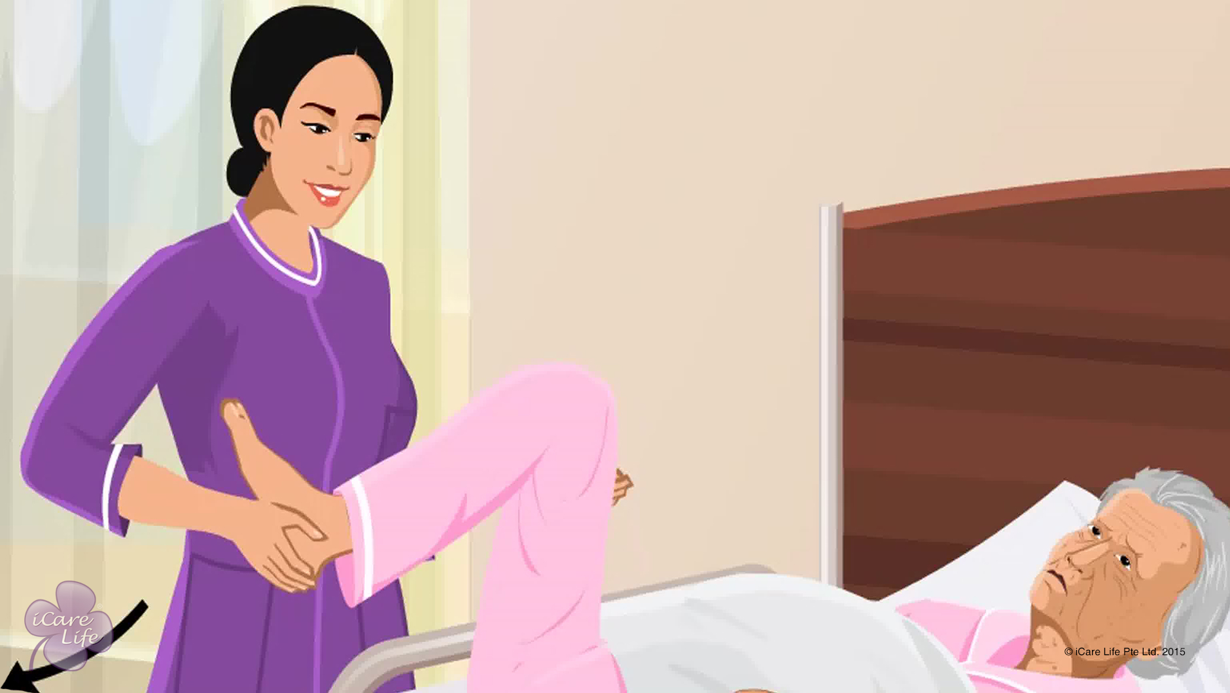
Various types of Exercise for an Elder
7
Copyright: iCare Life Pte. Ltd., Singapore : This document must not be copied or shared or circulated without the consent of iCare Life and/or its affiliates.

Slide 9
In this module, you will learn about:
The exercises suitable for independent elders
The exercises suitable for partially dependent elders
The exercises suitable for fully dependent elders
8
Copyright: iCare Life Pte. Ltd., Singapore : This document must not be copied or shared or circulated without the consent of iCare Life and/or its affiliates.

Slide 10
Let’s Watch
Various types of Exercise for an Elder
9
Copyright: iCare Life Pte. Ltd., Singapore : This document must not be copied or shared or circulated without the consent of iCare Life and/or its affiliates.

Slide 11
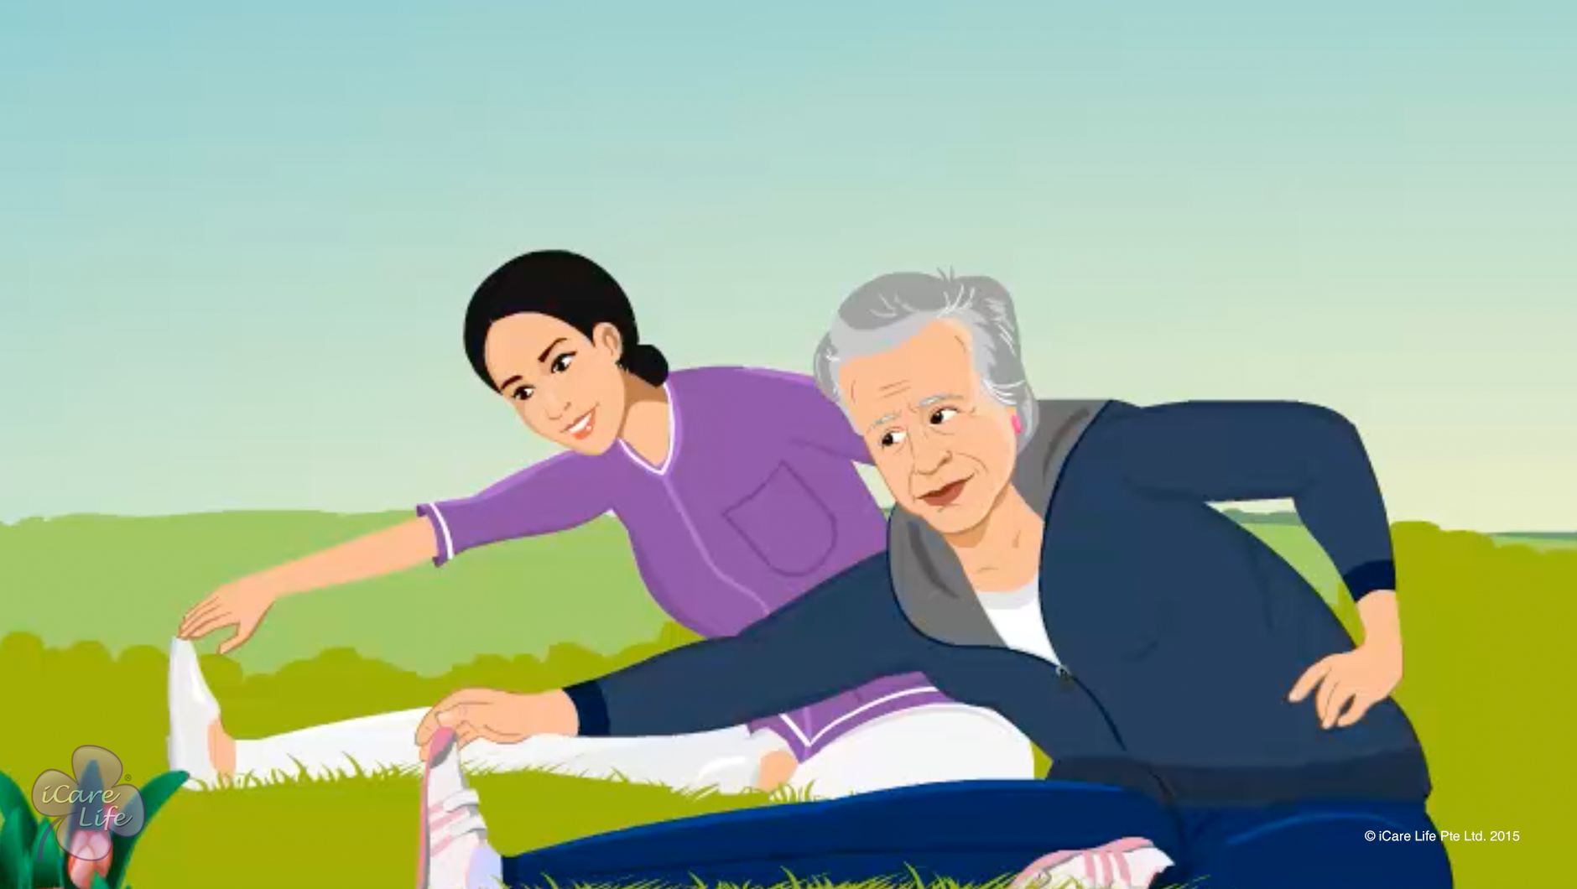
Precautions with Exercise
10
Copyright: iCare Life Pte. Ltd., Singapore : This document must not be copied or shared or circulated without the consent of iCare Life and/or its affiliates.

Slide 12
In this module, you will learn about:
The essential items of an elder’s exercise kit
The precautions to take when the elder is exercising
The way in which an elder’s body reacts to exercising
11
Copyright: iCare Life Pte. Ltd., Singapore : This document must not be copied or shared or circulated without the consent of iCare Life and/or its affiliates.

Slide 13
Let’s Watch
Precautions with Exercise
12
Copyright: iCare Life Pte. Ltd., Singapore : This document must not be copied or shared or circulated without the consent of iCare Life and/or its affiliates.

Slide 14


