Slide 1

Communication
9
CR 9.3
Standard
Source: Skills for Health – Website http://www.skillsforhealth.org.uk/
Skills for Care – Website http://www.skillsforcare.org.uk/

Slide 2
Learning outcomes
9.1 Understand the importance of effective communication at work
9.2 Understand how to meet the communication and language needs, wishes and preferences of individuals
9.3 Understand how to promote effective communication
9.4 Understand the principles and practices relating to confidentiality
9.5 Use appropriate verbal and non-verbal communication
9.6 Support the use of appropriate communication aids/ technologies
Source: Skills for Health – Website http://www.skillsforhealth.org.uk/
Skills for Care – Website http://www.skillsforcare.org.uk/
1

Slide 3


The importance of communication
Good communication develops your knowledge and understanding about individuals and the part played by other workers. It helps to ensure that each person’s views are valued and taken into account
Communication: To listen carefully but also be able to speak and act in a way that the person can understand.
Source: Skills for Health – Website http://www.skillsforhealth.org.uk/
Skills for Care – Website http://www.skillsforcare.org.uk/
2
Notes:
Discussion: Ask learners what values they think are important in health and social care work.
Explain what is meant by each (again):
Care: having someone’s best interests at heart and doing what you can to maintain or improve their wellbeing.
Compassion: being able to feel for someone, to understand them and their situation.
Competence: to understand what someone needs and have the knowledge and skills to provide it.
Communication: to listen carefully but also be able to speak and act in a way that the person can understand.
Courage: not to have fear to try out new things or to say if you are concerned about anything.
Commitment: dedication to providing care and support but also understanding the responsibility you have as a health and social care worker.

Slide 4

Types of communication
Written communication
Written communication is a method of communication that is used to send messages, keep records and provide information that is permanent
Verbal communication
Communication using spoken words, like tone, pitch, volume and the words that you use can affect meaning
Body language
Non-verbal communication where facial expressions, gestures, body positioning and movements can give clues about our attitude and how we feel
Gestures
Hand or arm movements that emphasise what is being said or used as an alternative to speaking
Source: Skills for Health – Website http://www.skillsforhealth.org.uk/
Skills for Care – Website http://www.skillsforcare.org.uk/
3
Notes:
Activity: Ask the learners to think of as many different ways of communicating as they can and when they might be useful to support individuals.
Answers should include:
Written communication: This method is used to send messages, keep records, or provide evidence.
Verbal communication: Differences in how you speak, including the tone, pitch and volume of your voice could change how your messages are taken in. Try to avoid using jargon or abbreviations and complicated words and terminology. Make sure you always speak in a respectful way, adjusting your speech to suit the individual.
Body language: This is a type of non-verbal communication. There are many different aspects of body language, including gestures, facial expressions (showing reactions and feeling), eye contact, body positioning and body movements. Each of these will communicate information about an individual or a worker often without them realising it. The way that we stand, sit or hold our arms when we are talking will provide others with clues about our feelings, attitude and emotions.
Gestures: These are hand or arm movements that emphasise what is being said or used as an alternative to speaking.

Slide 5
Types of communication
Eye contact
Good eye contact shows that a person is listening
Sign language
A way of communicating which uses hand shapes and movements to get the message across
Makaton
A form of language that uses signs and symbols to convey meaning
Braille
A code of raised dots read by touch
Source: Skills for Health – Website http://www.skillsforhealth.org.uk/
Skills for Care – Website http://www.skillsforcare.org.uk/
Source: Skills for Health – Website http://www.skillsforhealth.org.uk/
Skills for Care – Website http://www.skillsforcare.org.uk/
4
Notes:
Eye contact: Maintaining good eye contact is an important way for a health and social care worker to show that they are engaged and listening.
Sign language: This is a recognised language throughout the world. British Sign Language (BSL) is used by individuals in this country and there are variations of sign language in different regions.
Makaton: This is a form of language that uses a large collection of signs and symbols. It is often used with those who have learning and physical disabilities, or hearing impairment.
Braille: Is a code of raised dots that are ‘read’ using touch. For people who are visually impaired or who are blind, the system supports reading and writing.

Slide 6

Communication and relationships
Relationships are based on trust and understanding
Good communication
Understanding individuals’ needs
Effective team working
Clarity
Trust
Poor communication
Misunderstanding individuals’ needs
Ineffective team working
Confusion
Distrust
Source: Skills for Health – Website http://www.skillsforhealth.org.uk/
Skills for Care – Website http://www.skillsforcare.org.uk/
5
Notes:
Additional information
Successful two-way communication is crucial in identifying the care and support needs of individuals as well as to work effectively with carers and other workers who are part of the team providing care.
If the information shared is inaccurate, unclear or misleading mistakes can be made.
The Learners should be sure to notice non-verbal communication which may indicate when an individual is confused or may be becoming angry, upset, stressed or anxious. This can enable health and social care worker/s to ask the following questions:
Do I need to change the type of communication I am using to help the individual understand?
Do I need to be aware of how the conversation is affecting them?
Is there something that the individual is not communicating to me that may help?

Slide 7
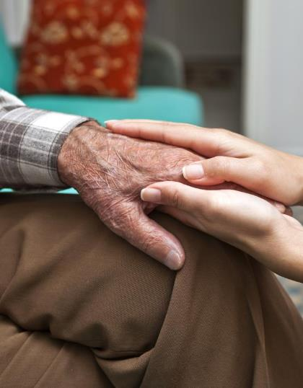
Communication needs and preferences
Individuals’ communication needs may be unique and talking may not be the best method of communication for all individuals
Other methods include:
Touch
Technological aids
Word or symbol boards
Speech synthesisers
Source: Skills for Health – Website http://www.skillsforhealth.org.uk/
Skills for Care – Website http://www.skillsforcare.org.uk/
6
Notes:
Additional information
The learners will need to find out the best ways of communicating with individuals. Effective ways of communicating will be included in the individual’s care plan. The best source of information about communication needs and preferences is the individual themselves. Where this is not possible friends and family can be a useful source of information.
Touch is used to communicate with people who are deaf and visually impaired. Health and social care workers sign information onto the individual’s hands as a way of passing on information.
Technological aids such as hearing aids, hearing loops, text phones, text messaging and magnifiers to communicate with those whose ability to communicate is impaired.
Word or symbol boards may be used to support speech. The listener is able to associate the picture or word with the verbal communication in order to understand what is being said.
Speech synthesisers replace speech either by producing a visual display of written text or synthesised speech. Voice recognition software can be purchased for any computer to translate speech to written text.

Slide 8
Barriers to communication
A barrier is anything that can get in the way of communication
Attitude
Poor or negative body language
Limited use of technology
Lack of privacy
Culture
Body positioning
Stereotyping
Environmental factors
Emotions
Sensory impairments
Language
Physical
Not enough time
Substance misuse
Source: Skills for Health – Website http://www.skillsforhealth.org.uk/
Skills for Care – Website http://www.skillsforcare.org.uk/
7
Notes:
Activity: Ask the learners to come up with examples of things that can make it difficult to communicate effectively and some ways to reduce each of the barriers.
Answers should include:
Attitude: When a health and social care worker is abrupt due to time limits, not having enough resources or their mood, the person they are speaking to may feel intimidated or frustrated and not want to communicate. Allow enough time for each meeting and never let a bad mood affect the standard of care and support provided.
Limited use of technology: When the technological aids known to be the best way for someone to communicate are not available. Find alternative ways to support communication and raise the issue with a manager or supervisor if necessary.
Body positioning: Sitting too close could be intimidating and would make an individual feel uncomfortable. Sitting too far away could show lack of interest or concern. Respect the individual’s personal space but ensure that you are close enough for them to see and hear you.
Emotions: When someone is depressed, angry or upset their emotions may affect their ability to think and communicate in a sensible way. Consider whether there would be a better time to communicate or leave information in a different format to consider when they are less upset.
Physical: When someone has physical conditions that create communication difficulties, for example, being breathless, not having any teeth or being in pain. Ensure that they are receiving the care and support they need to alleviate pain and manage their condition, communicate in ways that enable them to express themselves, allow plenty of time for the person to communicate, find out if they feel better at a particular time of day.
Not enough time: Not giving individuals time to say what they want to may make them feel rushed and reluctant to express their true wishes. Allow plenty of time. If you run out of time it is better to arrange another meeting than to rush.
Poor or negative body language: Crossed arms or legs, poor facial expressions, poor body positioning, constant fidgeting or looking at a watch or mobile phone can all make someone less likely to communicate.
Lack of privacy: Think carefully about where and when private and confidential conversations should take place. Find a private location to discuss issues which are personal or sensitive. Remember, speaking quietly can be a barrier for individuals with impaired hearing.
Stereotyping: Generalisations about a group of people that are wrong and misleading. An example would be that ‘all older people are hard of hearing’. Work in ways that meet the communication needs of the individual- their care plan will tell you the most effective ways of communicating with them.
Sensory impairments: Health and social care workers should think about whether the individual can see and hear them when they are communicating. Not being able to see or hear the person speaking can be a barrier to effective communication. When you are communicating with individuals who have impaired hearing, make sure the individual can see your face, speak clearly and think about providing written information to help them understand. Consider using large text documents for individuals with impaired vision.
Language: This could mean the style of language that the health and social care worker chooses (for example technical terminology and jargon) or could refer to the health and social care worker and individual having different preferred languages. Avoid using jargon. Consider interpreters and translators.
Environmental factors: Noise can make it difficult to hear what the other person is saying. Lighting can mean that a person can not see the communicator’s face which can affect lip-reading and mean that they are not able to read facial expressions. Ensure the light is not behind you when talking to a person. Move to a quieter area.
Substance misuse: Substance misuse can affect a person’s ability to understand and to retain information. Provide information which can be accessed when the person is not affected by substances. Reschedule the meeting when a person is less affected by the substances.

Slide 9
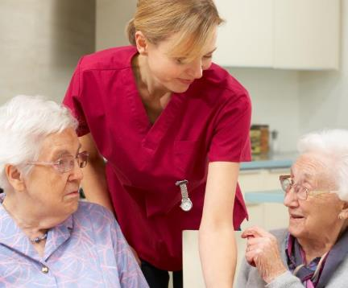

Checking understanding
You can check that you have understood what you have been told by summarising the conversation
You can check that the individual has understood what you have said by asking questions
Summarise: This means to think about the main points of the conversation or communication and shorten or simplify them in order to repeat them back to the individual. This will help to check your and their understanding.
Source: Skills for Health – Website http://www.skillsforhealth.org.uk/
Skills for Care – Website http://www.skillsforcare.org.uk/
8
Notes:
Additional information
Summarising allows the individual to correct you if necessary.
Questions to check understanding should generally require the individual to give a detailed response, rather than ‘yes’ or ‘no’. E.g. ‘Okay, tell me what you understand about what we’ve just discussed’.
Questions that can be answered with ‘yes’ or ‘no’ can be more suitable in some situations.

Slide 10
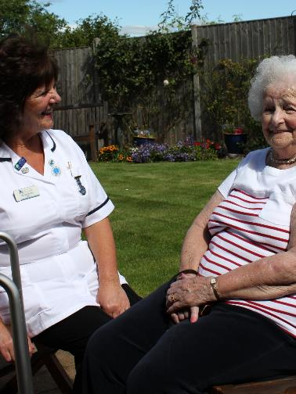
Information and support
Sources of information include:
Specialist charities and associations
Websites and online forums
Local services or groups
Your manager or supervisor (iCare Life)
Sources of support include:
Befrienders, advocates and mentors (iCare Life)
Speech and language therapists
Interpreters and translators
Clinical psychologists
Counsellors
Source: Skills for Health – Website http://www.skillsforhealth.org.uk/
Skills for Care – Website http://www.skillsforcare.org.uk/
9
Notes:
Additional information
A befriender could support an individual in overcoming emotional difficulties that are a barrier to their communication

Slide 11
Confidentiality
Personal and sensitive information must be treated confidentially
Sharing relevant information with other workers who ‘need to know’
Storing information securely
Information should not usually be disclosed without the person’s informed consent
Information should not be discussed where others can overhear
REMEMBER
In some circumstances information MUST be shared without consent.
10
Notes:
Activity: Ask the learners for examples of confidentiality in practice
Examples should include:
Sharing relevant information with other workers who ‘need to know’
Storing information securely; filing cabinets and cupboards should be kept locked and electronic files should be password protected.
Information should not usually be disclosed without the person’s informed consent.
Private and sensitive information about individuals should not be discussed where others can overhear.
Additional Examples of when information can be shared without consent:
A person is likely to harm themselves
A person has been, or is likely to be, involved in a serious crime
A person is likely to harm others
Your safety is placed at risk
A child or vulnerable adult has suffered, or is at risk of suffering, significant harm.

Slide 12

Communication in practice
You should always try to match your method of communication to the individual’s needs and be aware of confidentiality
Communication can be:
Face-to-face
By telephone or text
By email, internet or social networks
By written reports or letters
Source: Skills for Health – Website http://www.skillsforhealth.org.uk/
Skills for Care – Website http://www.skillsforcare.org.uk/
11

Slide 13







Knowledge check
Which form of communication uses signs and symbols to convey meaning?
Click to reveal answer
Makaton
Sign language
Braille
Eye contact
Source: Skills for Health – Website http://www.skillsforhealth.org.uk/
Skills for Care – Website http://www.skillsforcare.org.uk/
12
Notes:
Trainer should ask class why they chose the correct answer
Feedback
A – Makaton is a form of language that uses a large collection of signs and symbols. It is often used with those who have learning and physical disabilities, or hearing impairment.
B – Sign language is a way of communicating which uses hand shapes and movements to get a message across.
C – Is a code of raised dots that are ‘read’ using touch. For people who are visually impaired or who are blind, the system supports reading and writing.
D – Maintaining good eye contact is an important way for a health and social care worker to show that they are engaged and listening.

Slide 14

Knowledge check
Which of the following is a result of poor communication?
Click to reveal answer
Understanding individual’s needs
Confusion
Effective team working
Clarity and trust
Source: Skills for Health – Website http://www.skillsforhealth.org.uk/
Skills for Care – Website http://www.skillsforcare.org.uk/
13
Notes:
Trainer should ask class why they chose the correct answer
Feedback
A – Poor communication can lead to misunderstandings about an individual’s specific need and support. Understanding the individual's needs is more likely to result from good communication.
B – Poor communication can lead to mixed messages and confusion both between other workers who provide care and support and between the health and social care worker and the individual.
C – Poor communication can lead to misunderstandings and poor teamwork between teams of workers providing care. Effective team working of more likely to be a result of good communication.
D – Poor communication tends to lead to confusion and misunderstandings that can undermine trust. Clarity and trust are more commonly the result of good communication.

Slide 15
Knowledge check
A health and social care worker is talking to an individual about their needs. What is the best way to check that they have understood?
Click to reveal answer
Body language
Summarising
Touch
Stereo-typing
Source: Skills for Health – Website http://www.skillsforhealth.org.uk/
Skills for Care – Website http://www.skillsforcare.org.uk/
14
Notes:
Trainer should ask class why they chose the correct answer
Feedback
A – The health and social care worker should be aware of body language and use it to get clues about how the individual is feeling but this is not the best way to check that you have understood what they have told you.
B – By summarising the key points of what have been discussed and repeating this back to the individual, the health and social care worker can check that they have fully understood what the individual has said. The individual has the opportunity to correct them if necessary.
C – Touch is a way of communicating with an individual who has a hearing impairment. It is unlikely that a health and social care worker would communicate through touch to confirm understanding if they had been having a verbal conversation.
D – Stereo-typing involves making assumptions about an individual based on their appearance or characteristics. This is not an effective way for a health and social care worker to check that they have understood what has been said.

Slide 16
Viewing of Modules
Communication
CR 9.3
Private and Confidential

Slide 17
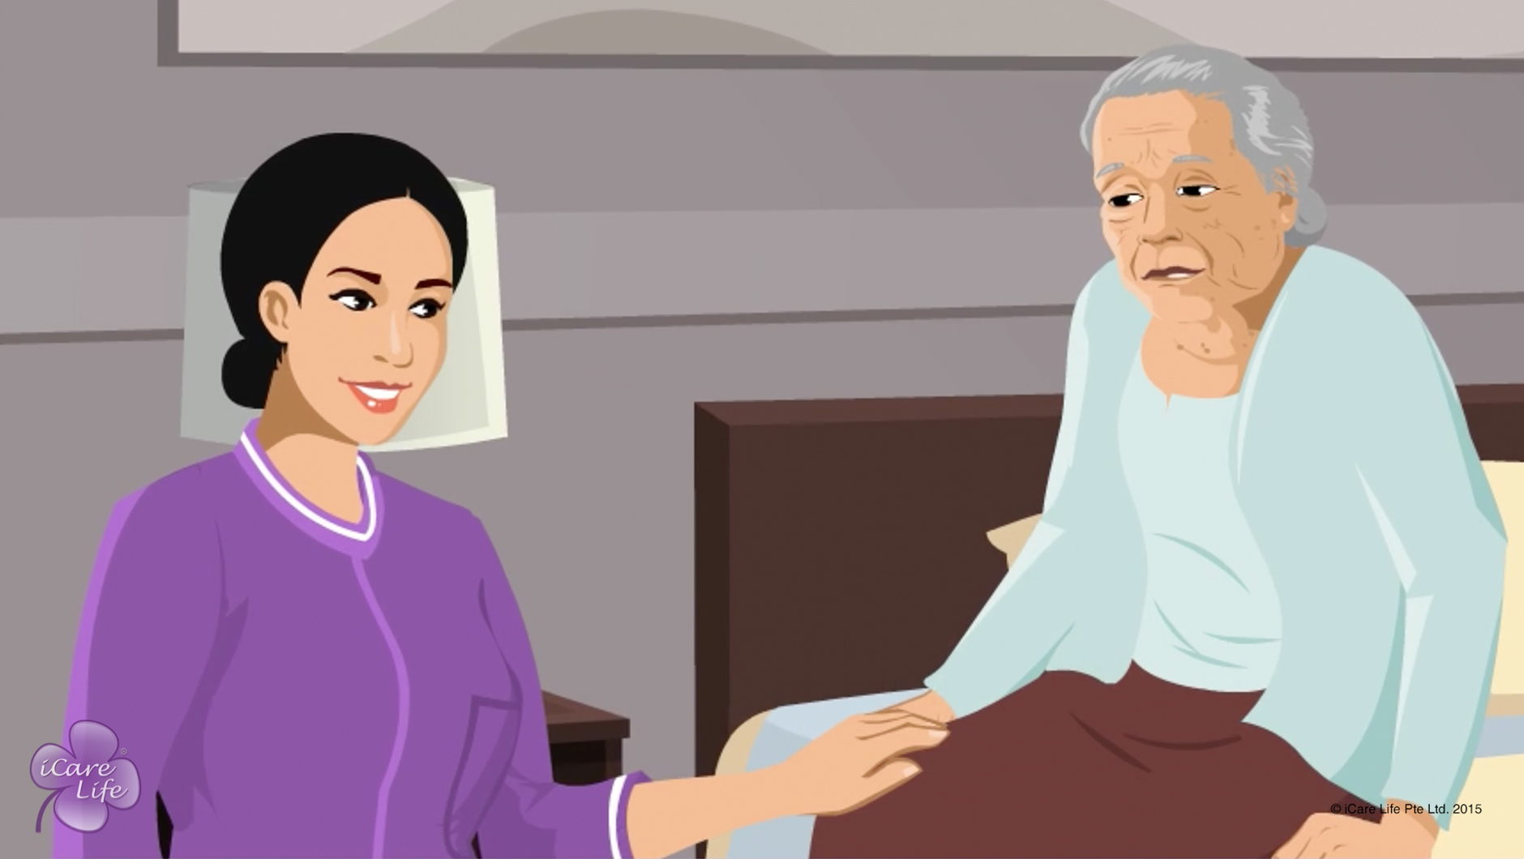
Being a Good Listener to the Elder
1
Copyright: iCare Life Pte. Ltd., Singapore : This document must not be copied or shared or circulated without the consent of iCare Life and/or its affiliates.

Slide 18
In this module, you will learn about:
The ways to be a good and attentive listener to the elder
2

Slide 19
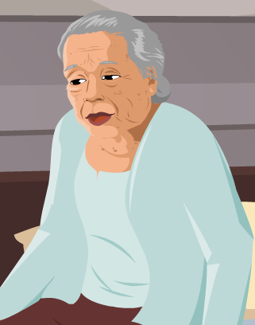
Pre-Module Activity
I am really worried these days. I am not keeping too well and there is this sense of fear that is bothering me. I wish someone…
What does this person expect?
3
Notes:
Arrange for a whiteboard and a whiteboard marker.
Draw the attention of the participants to the image and the callout on the screen. Ask the participants to read the text in the callout and imagine the elder is saying it to them. Read the question on the screen aloud – What does this person expect/want?
Ask for responses from the participants. Write all unique responses on the whiteboard. In case no response comes, suggest a few responses like the person expects someone to:
Provide medical care
Ensure better health
Lessen the elder’s fear
Provide a solution to their problems
Accept all responses and move on to the next slide.

Slide 20
Pre-Module Activity
I am really worried these days. I am not keeping too well and there is this sense of fear that is bothering me. I wish someone…Just listens to me!
4
Notes:
If ‘listen’ is on the whiteboard, circle it. If not, write ‘Listen’ in caps on the whiteboard. Explain that when an elder speaks to you, the person is not always complaining or expecting you to solve a problem. Most importantly, that person wants you to listen to what the person wants to say.
Explain that like eating, walking and taking care of someone, listening is also a skill. This skill is required very often when you are caring for an elderly person. Most elderly people are lonely. They may be capable of solving their own problems, but they need someone to talk to about them. By being a good listener, you can not only understand the elder’s problems better, but also form a strong emotional bond with the elder. The following module explains a few simple ways to become a good, attentive listener.

Slide 21

Let’s Watch
Being a Good Listener to the Elder
5
Copyright: iCare Life Pte. Ltd., Singapore : This document must not be copied or shared or circulated without the consent of iCare Life and/or its affiliates.

Slide 22
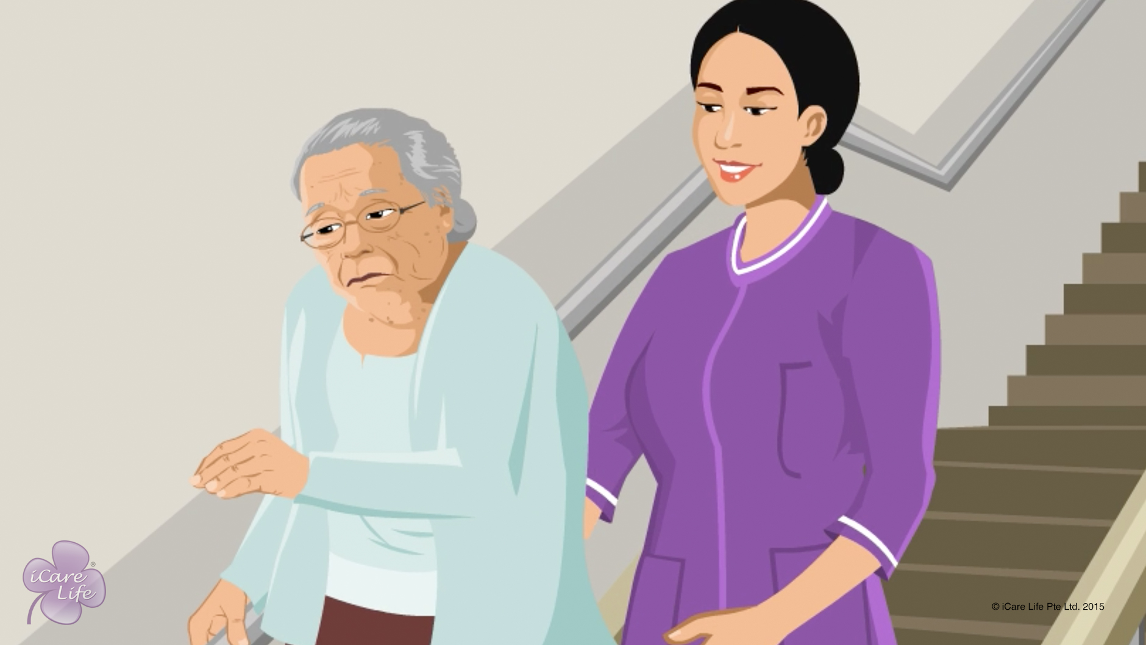
Handling Refusal for Help
6
Copyright: iCare Life Pte. Ltd., Singapore : This document must not be copied or shared or circulated without the consent of iCare Life and/or its affiliates.

Slide 23
In this module, you will learn about:
Why an elderly person refuses help
The strategies to get the person to accept help
The strategies to handle your own emotions in these situations
7
Copyright: iCare Life Pte. Ltd., Singapore : This document must not be copied or shared or circulated without the consent of iCare Life and/or its affiliates.

Slide 24
Let’s Watch
Handling Refusal for Help
8
Copyright: iCare Life Pte. Ltd., Singapore : This document must not be copied or shared or circulated without the consent of iCare Life and/or its affiliates.

Slide 25
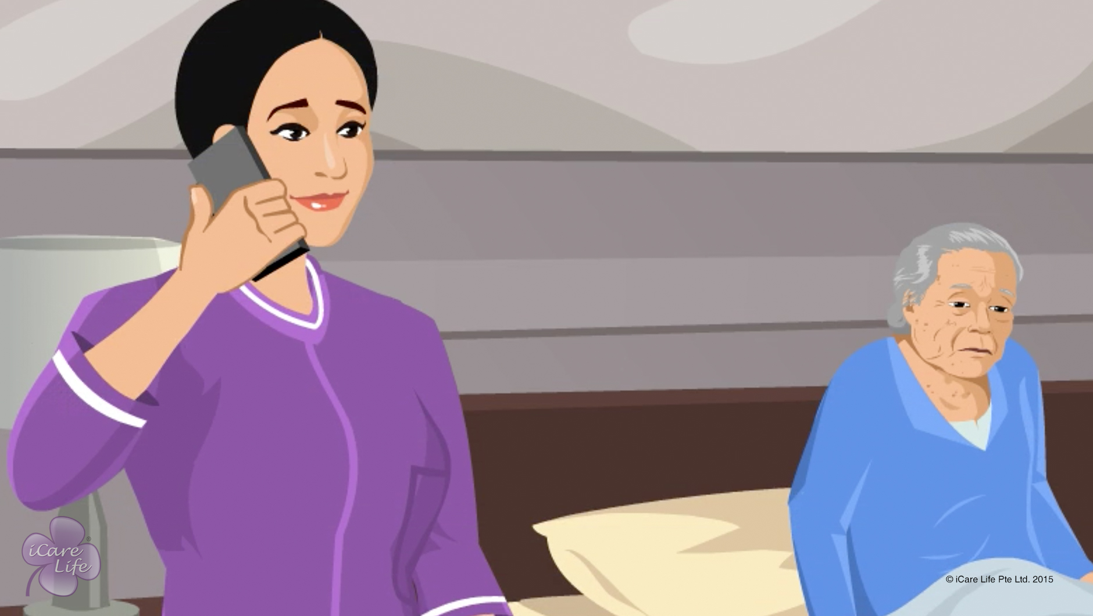
Handling Anxious Behavior
9
Copyright: iCare Life Pte. Ltd., Singapore : This document must not be copied or shared or circulated without the consent of iCare Life and/or its affiliates.

Slide 26
In this module, you will learn about:
The signs of anxious behavior
Understanding why the elder is anxious
The strategies to calm down an anxious elder
10
Copyright: iCare Life Pte. Ltd., Singapore : This document must not be copied or shared or circulated without the consent of iCare Life and/or its affiliates.

Slide 27
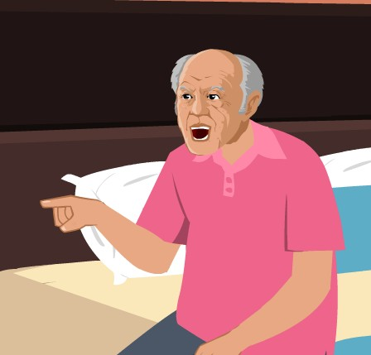
Pre-Module Activity
What types of emotions is this Elder showing?
11
Copyright: iCare Life Pte. Ltd., Singapore : This document must not be copied or shared or circulated without the consent of iCare Life and/or its affiliates.

Slide 28
Let’s Watch
Handling Anxious Behavior
12
Copyright: iCare Life Pte. Ltd., Singapore : This document must not be copied or shared or circulated without the consent of iCare Life and/or its affiliates.

Slide 29
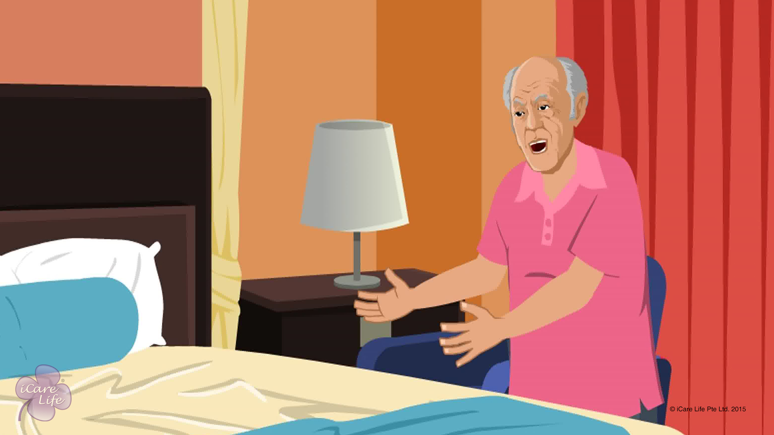
Handling Angry Behavior
13
Copyright: iCare Life Pte. Ltd., Singapore : This document must not be copied or shared or circulated without the consent of iCare Life and/or its affiliates.

Slide 30
In this module, you will learn about:
The reasons for angry behavior
The strategies to calm down an elderly person showing angry behavior
The strategies to control your own emotions in the situation
14
Copyright: iCare Life Pte. Ltd., Singapore : This document must not be copied or shared or circulated without the consent of iCare Life and/or its affiliates.

Slide 31

Pre-Module Activity
How do you feel when someone gets angry with you?
15
Notes:
Arrange for a whiteboard and whiteboard markers.
Draw the participants’ attention to the visual and read aloud the question on the screen: How do you feel when someone gets angry with you?
Invite the participants responses to the question. If there are no responses, ask the following questions aloud:
Do you feel angry yourself?
Do you feel insulted?
Do you feel afraid?
Do you feel hurt?
Do you feel sad?
If any of the participant replies in affirmative to a question, ask all others to raise their hands who feel the same. Write the heading Emotions on the white board and under it write the emotions – angry, insulted, afraid, hurt, sad or any other that the participants come up with – on the whiteboard.
Now move on to the next slide.

Slide 32
Pre-Module Activity
What do you do when someone gets angry with you?
16
Notes:
Read aloud the question on the screen: What do you do when someone gets angry with you?
Invite the participants responses to the question.
If there are no responses, ask the following questions aloud:
Do you show your own anger?
Do you walk away from the situation?
Do you pick up a fight?
Do you ignore the person?
Do you find the reason why the person is angry?
Do you stay calm and try to calm the other person?
If any of the participant replies in affirmative to a question, ask all others to raise their hands who feel the same. Write the heading Actions on the whiteboard and under it write the actions – show anger, walk away, fight, ignore, find the reason, stay calm, calm the person or any other that the participants come up with – on the whiteboard.
Next tick all the emotions – angry, insulted, afraid, hurt, sad or any other – listed while the previous slide was shown. Say – “All these emotions are correct. You may feel one or more of them when someone gets angry with you.”
Next, tick ‘find the reason, stay calm and calm the person’ under the heading Actions on the whiteboard. Say – “No matter which emotion you feel when a person gets angry with you, these are the recommended actions that you should take – find the reason for the person’s anger, stay calm yourself, and try to calm down the other person. This is all the more important in your role as a caregiver. Let us watch the module and find out why?”

Slide 33
Let’s Watch
Handling Angry Behavior
17
Copyright: iCare Life Pte. Ltd., Singapore : This document must not be copied or shared or circulated without the consent of iCare Life and/or its affiliates.

Slide 34


