Slide 1

Viewing of Modules
Communication
CR 9.3
Private and Confidential

Slide 2
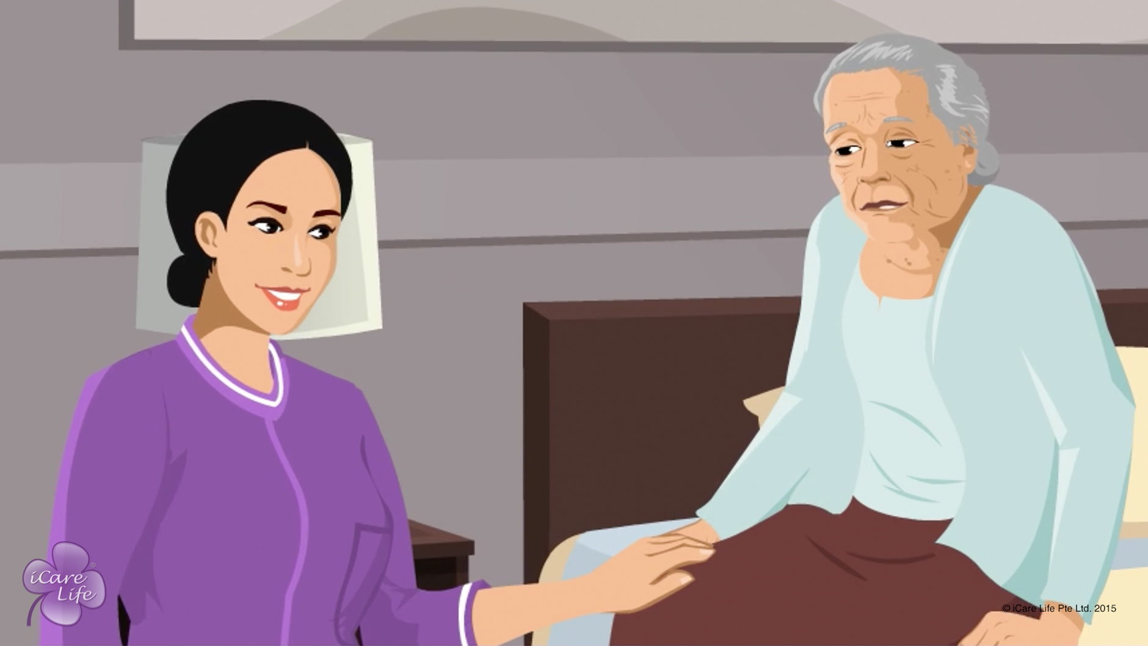
Being a Good Listener to the Elder
1
Copyright: iCare Life Pte. Ltd., Singapore : This document must not be copied or shared or circulated without the consent of iCare Life and/or its affiliates.

Slide 3
In this module, you will learn about:
The ways to be a good and attentive listener to the elder
2

Slide 4
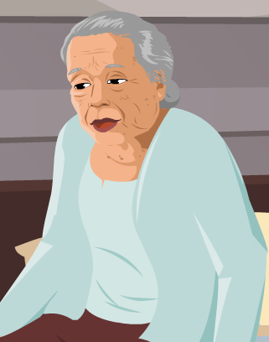
Pre-Module Activity
I am really worried these days. I am not keeping too well and there is this sense of fear that is bothering me. I wish someone…
What does this person expect?
3
Notes:
Arrange for a whiteboard and a whiteboard marker.
Draw the attention of the participants to the image and the callout on the screen. Ask the participants to read the text in the callout and imagine the elder is saying it to them. Read the question on the screen aloud – What does this person expect/want?
Ask for responses from the participants. Write all unique responses on the whiteboard. In case no response comes, suggest a few responses like the person expects someone to:
Provide medical care
Ensure better health
Lessen the elder’s fear
Provide a solution to their problems
Accept all responses and move on to the next slide.

Slide 5
Pre-Module Activity
I am really worried these days. I am not keeping too well and there is this sense of fear that is bothering me. I wish someone…Just listens to me!
4
Notes:
If ‘listen’ is on the whiteboard, circle it. If not, write ‘Listen’ in caps on the whiteboard. Explain that when an elder speaks to you, the person is not always complaining or expecting you to solve a problem. Most importantly, that person wants you to listen to what the person wants to say.
Explain that like eating, walking and taking care of someone, listening is also a skill. This skill is required very often when you are caring for an elderly person. Most elderly people are lonely. They may be capable of solving their own problems, but they need someone to talk to about them. By being a good listener, you can not only understand the elder’s problems better, but also form a strong emotional bond with the elder. The following module explains a few simple ways to become a good, attentive listener.

Slide 6

Let’s Watch
Being a Good Listener to the Elder
5
Copyright: iCare Life Pte. Ltd., Singapore : This document must not be copied or shared or circulated without the consent of iCare Life and/or its affiliates.

Slide 7
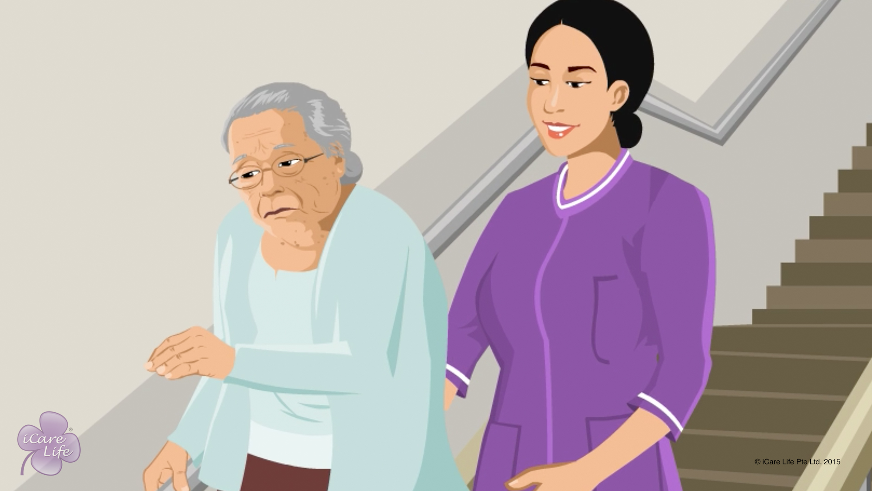
Handling Refusal for Help
6
Copyright: iCare Life Pte. Ltd., Singapore : This document must not be copied or shared or circulated without the consent of iCare Life and/or its affiliates.

Slide 8
In this module, you will learn about:
Why an elderly person refuses help
The strategies to get the person to accept help
The strategies to handle your own emotions in these situations
7
Copyright: iCare Life Pte. Ltd., Singapore : This document must not be copied or shared or circulated without the consent of iCare Life and/or its affiliates.

Slide 9
Let’s Watch
Handling Refusal for Help
8
Copyright: iCare Life Pte. Ltd., Singapore : This document must not be copied or shared or circulated without the consent of iCare Life and/or its affiliates.

Slide 10
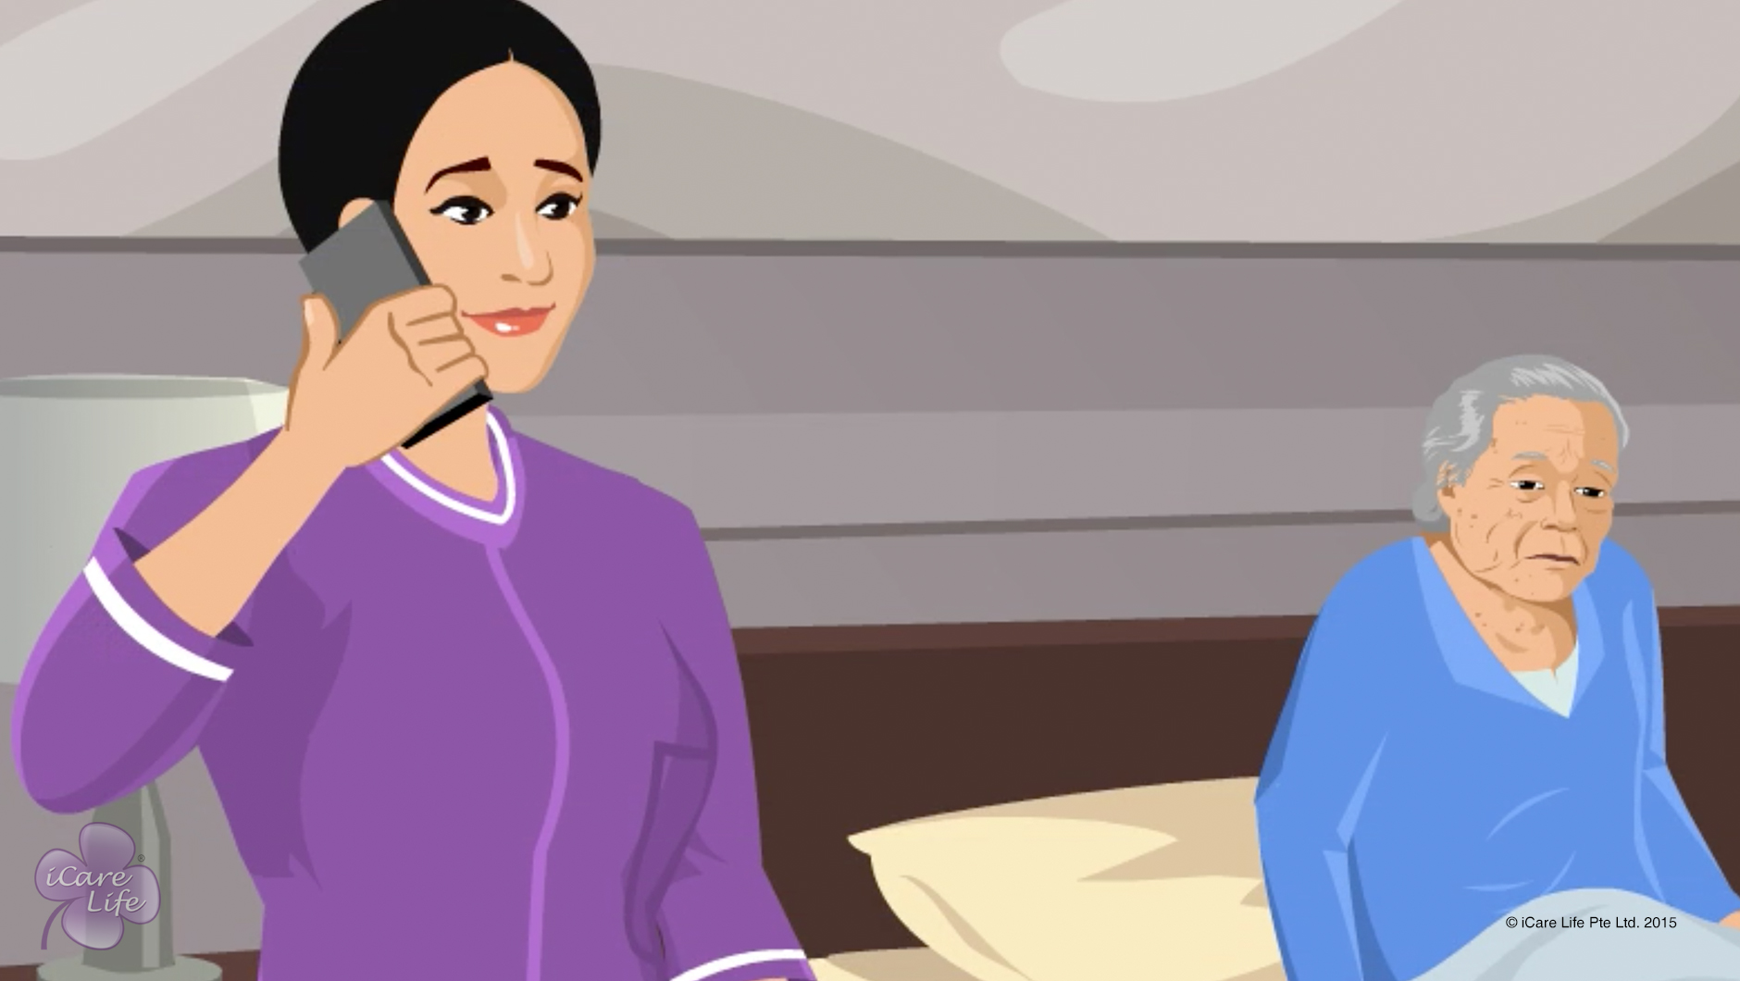
Handling Anxious Behavior
9
Copyright: iCare Life Pte. Ltd., Singapore : This document must not be copied or shared or circulated without the consent of iCare Life and/or its affiliates.

Slide 11
In this module, you will learn about:
The signs of anxious behavior
Understanding why the elder is anxious
The strategies to calm down an anxious elder
10
Copyright: iCare Life Pte. Ltd., Singapore : This document must not be copied or shared or circulated without the consent of iCare Life and/or its affiliates.

Slide 12
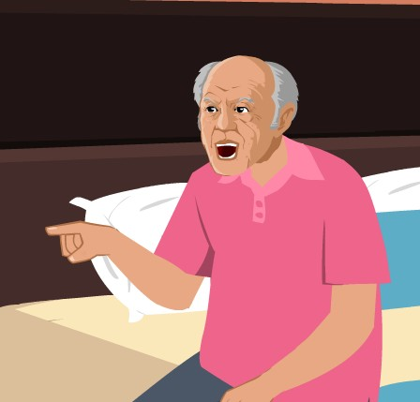
Pre-Module Activity
What types of emotions is this Elder showing?
11
Copyright: iCare Life Pte. Ltd., Singapore : This document must not be copied or shared or circulated without the consent of iCare Life and/or its affiliates.

Slide 13
Let’s Watch
Handling Anxious Behavior
12
Copyright: iCare Life Pte. Ltd., Singapore : This document must not be copied or shared or circulated without the consent of iCare Life and/or its affiliates.

Slide 14
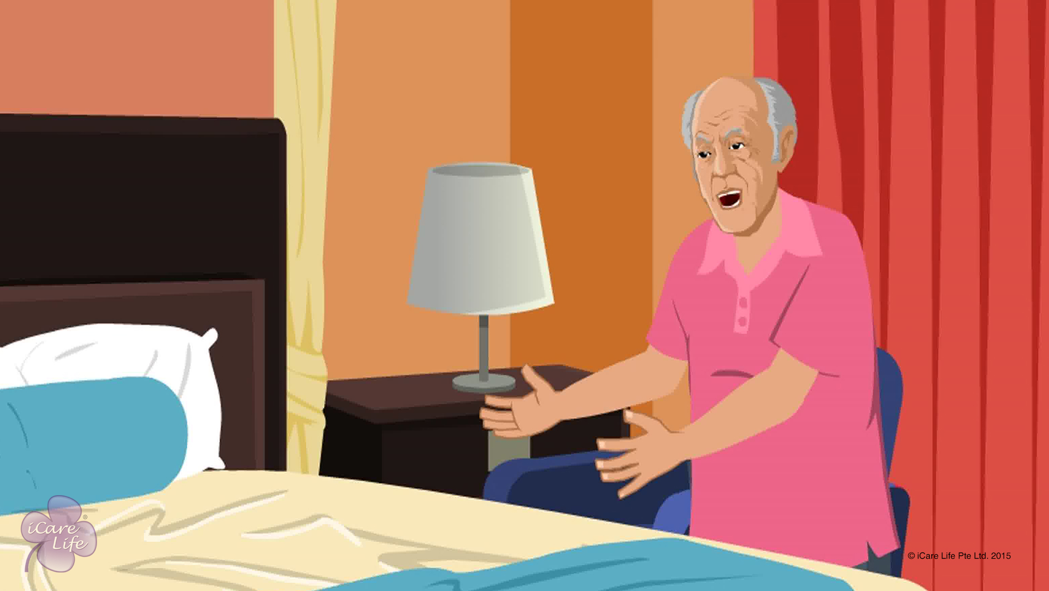
Handling Angry Behavior
13
Copyright: iCare Life Pte. Ltd., Singapore : This document must not be copied or shared or circulated without the consent of iCare Life and/or its affiliates.

Slide 15
In this module, you will learn about:
The reasons for angry behavior
The strategies to calm down an elderly person showing angry behavior
The strategies to control your own emotions in the situation
14
Copyright: iCare Life Pte. Ltd., Singapore : This document must not be copied or shared or circulated without the consent of iCare Life and/or its affiliates.

Slide 16

Pre-Module Activity
How do you feel when someone gets angry with you?
15
Notes:
Arrange for a whiteboard and whiteboard markers.
Draw the participants’ attention to the visual and read aloud the question on the screen: How do you feel when someone gets angry with you?
Invite the participants responses to the question. If there are no responses, ask the following questions aloud:
Do you feel angry yourself?
Do you feel insulted?
Do you feel afraid?
Do you feel hurt?
Do you feel sad?
If any of the participant replies in affirmative to a question, ask all others to raise their hands who feel the same. Write the heading Emotions on the white board and under it write the emotions – angry, insulted, afraid, hurt, sad or any other that the participants come up with – on the whiteboard.
Now move on to the next slide.

Slide 17
Pre-Module Activity
What do you do when someone gets angry with you?
16
Notes:
Read aloud the question on the screen: What do you do when someone gets angry with you?
Invite the participants responses to the question.
If there are no responses, ask the following questions aloud:
Do you show your own anger?
Do you walk away from the situation?
Do you pick up a fight?
Do you ignore the person?
Do you find the reason why the person is angry?
Do you stay calm and try to calm the other person?
If any of the participant replies in affirmative to a question, ask all others to raise their hands who feel the same. Write the heading Actions on the whiteboard and under it write the actions – show anger, walk away, fight, ignore, find the reason, stay calm, calm the person or any other that the participants come up with – on the whiteboard.
Next tick all the emotions – angry, insulted, afraid, hurt, sad or any other – listed while the previous slide was shown. Say – “All these emotions are correct. You may feel one or more of them when someone gets angry with you.”
Next, tick ‘find the reason, stay calm and calm the person’ under the heading Actions on the whiteboard. Say – “No matter which emotion you feel when a person gets angry with you, these are the recommended actions that you should take – find the reason for the person’s anger, stay calm yourself, and try to calm down the other person. This is all the more important in your role as a caregiver. Let us watch the module and find out why?”

Slide 18
Let’s Watch
Handling Angry Behavior
17
Copyright: iCare Life Pte. Ltd., Singapore : This document must not be copied or shared or circulated without the consent of iCare Life and/or its affiliates.

Slide 19


