Slide 1

Modules Summary Discussion – Q&A
CR 9.4
Private and Confidential

Slide 2

Identifying & Handling Dementia in Elders
1
Copyright: iCare Life Pte. Ltd., Singapore : This document must not be copied or shared or circulated without the consent of iCare Life and/or its affiliates.

Slide 3
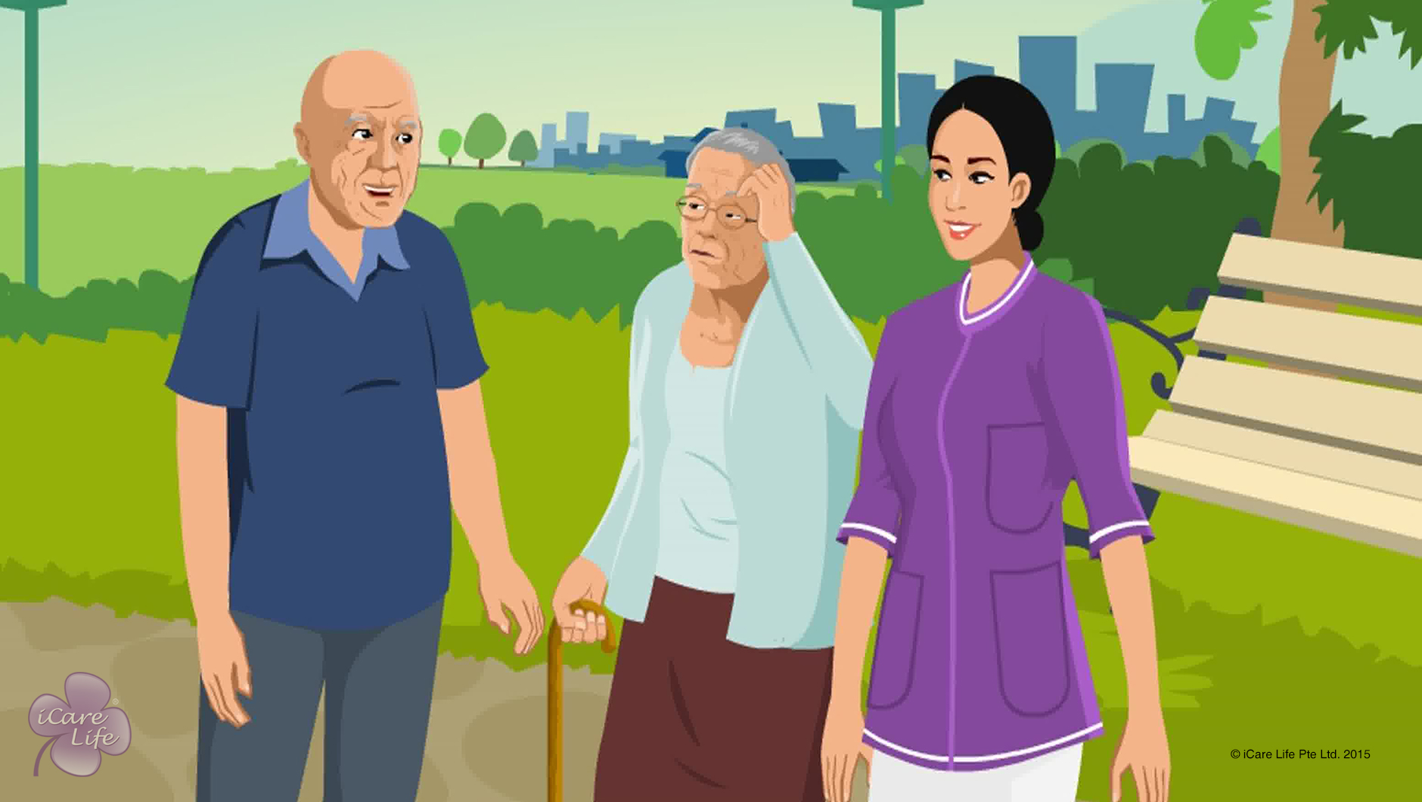
Identifying & Handling Dementia in Elders
2
Copyright: iCare Life Pte. Ltd., Singapore : This document must not be copied or shared or circulated without the consent of iCare Life and/or its affiliates.

Slide 4
Post-Module Activity
Case Study
Notes:
Divide the class into two groups.
Print the following case study on two sheets of paper and give it to both the groups.
The activity has to be completed in 25 minutes time
5 for reading and understanding the case
next 10 for group A’s solution
next 10 for group B to study group A’s answers and carry out their activity
Case Study:
Harry is an 85 year old man who has been suffering from dementia for a year. He lives with his wife, Alice, in their own home. Harry’s forgetfulness started around the age of 70. Since then, the dementia has been worsening. It has reached a point where he has difficulty recognizing his wife. He becomes restless when he cannot remember who his wife is and why is she there in the house. He has difficulties in basic activities like introducing himself as he forgets his own details, recognizing food items, and wearing clothes. He has been shifted to a care home and you are his caregiver.
Activity for group A: What information will you seek from his wife? Also give hypothetical answers for the questions.
Activity for group B: Take the questions and answers from group A and make a list of activities you, as a caregiver, would like to carry out around Harry and a list of activities which you would involve Harry in.
Group A’s activity: the questions should be around Harry’s favorite food, hobbies, favorite people, favorite time of the day, sleeping pattern, allergies, favorite colors, general mood, etc.
Group B’s activity: once group B has received answers from group A, they can plan activities for themselves as caregivers and activities for Harry to participate in.

Slide 5
Summary
Early signs of dementia include:
Frequently forgetting names of people
Forgetting about routine activities
Forgetting the details of recent activities
Losing their way within their home
Being unable to take care of their personal hygiene
When caring for an elder with dementia:
Always respond with affection and reassurance; respect the elder’s dignity
Use simple words and sentences; speak slowly and clearly
Break down activities into smaller tasks; assist them with the ones they can no longer perform
Gently remind them if they forget something
To make conversation, try to talk about the elder’s distant past
If you notice any new symptoms, inform the elder’s family and doctor
Support the elder retain their sense of identity and self-worth
Remember to take care of yourself physically and mentally
4
Notes:
Early signs of dementia include:
Frequently forgetting names of people
Forgetting about routine activities
Forgetting the details of recent activities
Losing their way within their home
Being unable to take care of their personal hygiene
When caring for an elder with dementia:
Always respond with affection and reassurance; respect the elder’s dignity
Use simple words and sentences; speak slowly and clearly
Break down activities into smaller tasks; assist them with the ones they can no longer perform
Gently remind them if they forget something
To make conversation, try to talk about the elder’s distant past
If you notice any new symptoms, inform the elder’s family and doctor
Support the elder retain their sense of identity and self-worth
Remember to take care of yourself physically and mentally

Slide 6
Any Questions?
5
Notes:
Q1. Is dementia reversible?
Ans. No, it is a gradually deteriorating state of mind. Its pace can however be controlled with proper care of the elderly.
Q2. Can encouraging the elderly to keep notes of daily activities help the elderly in recalling and organizing themselves better?
Ans. Yes, such aids can go a long way in helping the elderly.

Slide 7
Importance of Exercise for an Elder
6
Copyright: iCare Life Pte. Ltd., Singapore : This document must not be copied or shared or circulated without the consent of iCare Life and/or its affiliates.

Slide 8
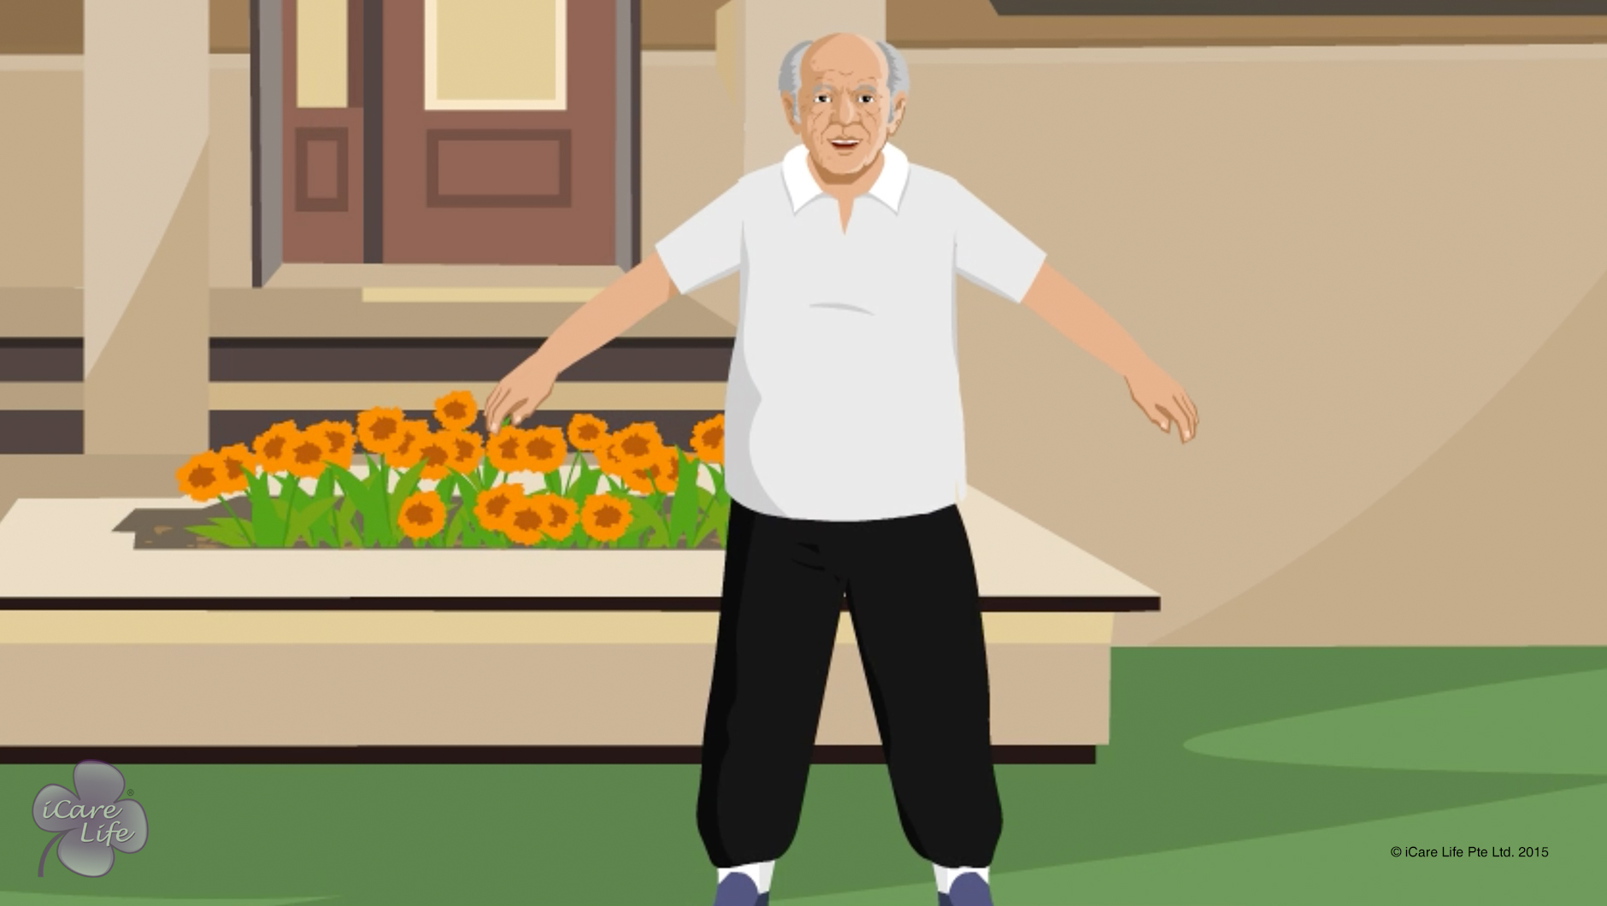
Importance of Exercise for an Elder
7
Copyright: iCare Life Pte. Ltd., Singapore : This document must not be copied or shared or circulated without the consent of iCare Life and/or its affiliates.

Slide 9
Post-Module Activity
How are you feeling?
Without Exercising | With Exercising
Notes:
Invite participants to come forward one by one and share how will they feel without exercising for a few days and what difference will they feel with exercising for a few days. Each participant is allowed to make only one point.
Ask the participants to use their creative in how they state their point – using songs, short poems and expressions. Invite feedback and comments from other participants.

Slide 10
Summary
For an elder, exercising helps:
Maintain proper functioning of muscles, joints, and internal organs
Increase appetite and energy level
Make the elder more independent
Prevent and delay several diseases
Reduce medication and chances of hospitalization
Reduce stress and anxiety
Provide opportunity for socializing
9
Notes:
For an elder, exercising helps:
Maintain proper functioning of muscles, joints, and internal organs
Increase appetite and energy level
Make the elder more independent
Prevent and delay several diseases
Reduce medication and chances of hospitalization
Reduce stress and anxiety
Provide opportunity for socializing

Slide 11
Any Questions?
10
Notes:
Q1. How can exercise help in keeping an elder’s internal organs healthy?
Ans: Many of our internal organs like heart, stomach, and intestines are also muscles. Like other muscles of our body, they also need to be exercised for proper functioning. When an elder exercises, the body movements increase the blood circulation in the person’s body. This makes the person’s heart work faster and supply more blood to other internal organs. Activities in exercising also provides a gentle massage to the elder’s internal organs like stomach and intestines. This helps the other internal organs of the elder’s body to work better and remain healthy.

Slide 12
Various types of Exercise for an Elder
11
Copyright: iCare Life Pte. Ltd., Singapore : This document must not be copied or shared or circulated without the consent of iCare Life and/or its affiliates.

Slide 13
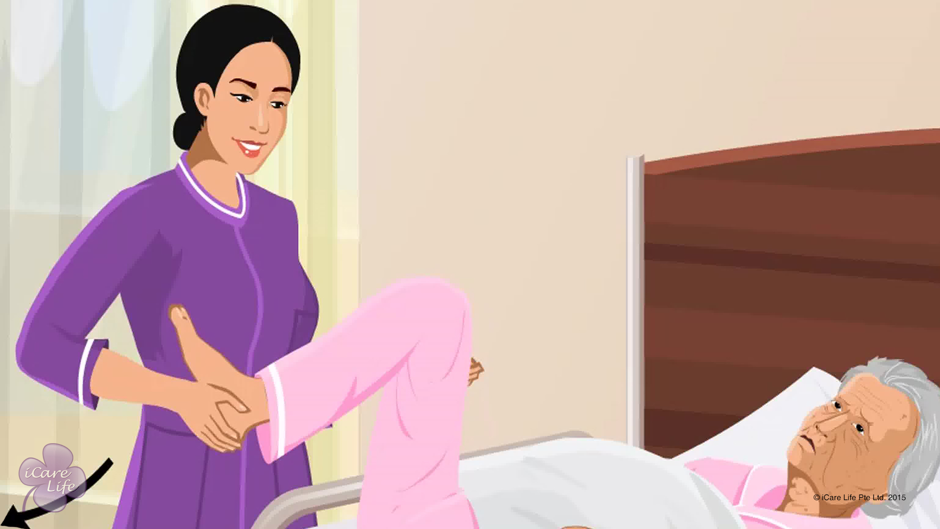
Various types of Exercise for an Elder
12
Copyright: iCare Life Pte. Ltd., Singapore : This document must not be copied or shared or circulated without the consent of iCare Life and/or its affiliates.

Slide 14
Post-Module Activity - 1
Let’s learn some exercises for partially dependent elders
13
Notes:
Objective: Demonstrate and practice some exercises for partially dependent elders.
Invite a physiotherapist. Arrange for a sturdy wooden chair with backrest but no armrests or wheels.
Click the link on the screen to open the webpage (http://www.nhs.uk/Tools/Pages/Exercises-for-older-people.aspx) showing different chair and wall support exercises. For each exercise, invite participants to sit on the chair and perform the exercise correctly under the supervision of the physiotherapist.
Note: If Internet is not available, invite the physiotherapist to demonstrate some exercises for partially dependent elders (using a chair).

Slide 15
Post-Module Activity - 2
Let’s learn some exercises for fully dependent Elders
14
Notes:
Objective: Demonstrate some simple exercises for fully dependent elders.
Arrange for a human dummy and a bed to lay the dummy on.
Activity: Invite the physiotherapist to demonstrate some suitable passive exercises for both upper and lower body and the correct way to support the elder’s body while performing such exercises using the human dummy. Later invite participants to perform passive exercises on the human dummy under the supervision of the physiotherapist.

Slide 16
Summary
For independent elders:
Walking, gentle swimming or cycling, calisthenics and yoga are suitable
Independently done routine activities also provide exercise
For partially dependent elders:
Chair exercises work out both upper and lower body
Use a sturdy chair that has back support but no wheels or armrests
Several exercises can be done by taking support of a wall
For fully dependent elders:
Passive exercises are usually recommended
Support the elder's hands and feet to perform bending and stretching exercises
Allow the person to independently exercise the active side of the body
Take advice from the elder's doctor and physiotherapist
15
Notes:
For independent elders:
Walking, gentle swimming or cycling, calisthenics and yoga are suitable
Independently done routine activities also provide exercise – Routine activities include bathing, cooking and gardening
For partially dependent elders:
Chair exercises can be used to exercise both upper and lower body
Use a sturdy chair that has back support but no wheels or armrests
Several exercises can be done by taking support of a wall
For fully dependent elders:
Passive exercises are recommended
Support the elder's hands and feet to perform bending and stretching exercises
Allow the person to independently exercise active side of the body
Take advice from the elder's doctor and physiotherapist

Slide 17
Any Questions?
16
Notes:
Q1. How do passive exercises help fully dependent elders?
Ans: Even if an elder has lost use of a part of body, the joints and muscles of the person need to be moved for proper blood circulation and maintenance of movement. If the joints of such a person are not moved for a long time, they may become permanently locked. If the muscles of such an elder are not stretched for a long time, they may lose all their remaining strength. Passive exercises help in maintaining proper movement of joints and muscle strength in fully dependent elders. Also, a person may become fully dependent temporarily after a stroke, accident, or temporary paralysis. For the elder’s recovery, it is important that the person’s body is exercised to regain movement in paralyzed body parts. Passive exercises are very important for a fully dependent elder as the person does not get any exercise even from the daily routine activities.

Slide 18
Precautions with Exercise
17
Copyright: iCare Life Pte. Ltd., Singapore : This document must not be copied or shared or circulated without the consent of iCare Life and/or its affiliates.

Slide 19
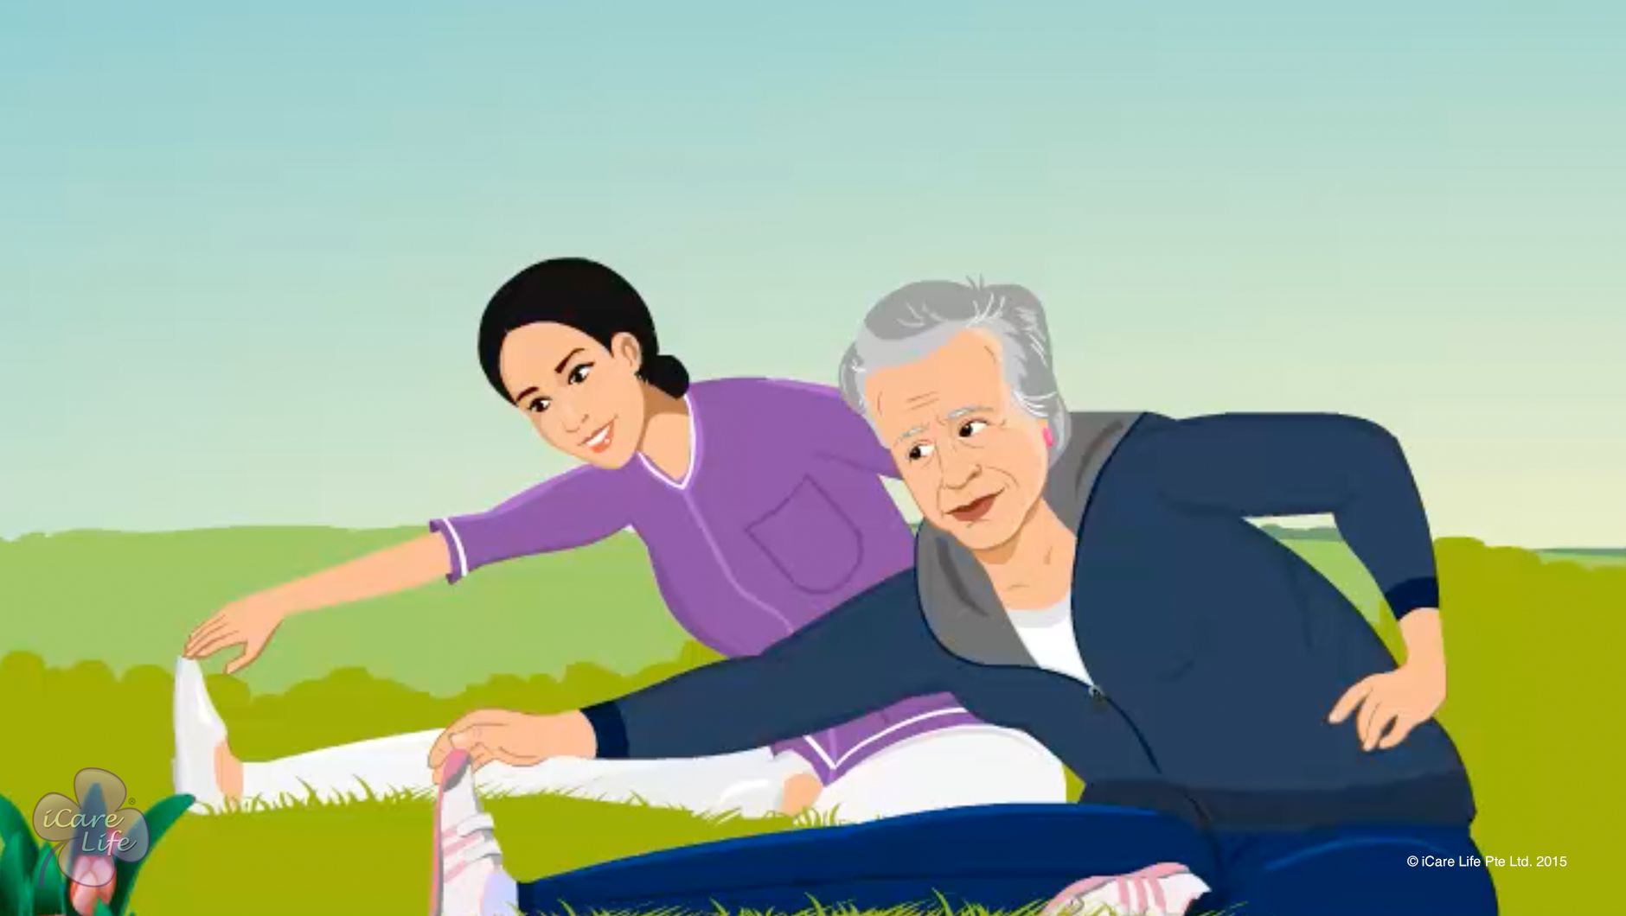
Precautions with Exercise
18
Copyright: iCare Life Pte. Ltd., Singapore : This document must not be copied or shared or circulated without the consent of iCare Life and/or its affiliates.

Slide 20
Post-Module Activity
Time | Activity | Elder’s Condition
8:00 AM | Bath and heavy breakfast | A little tired
10:30 AM | Tea with biscuits | Alert
1:30 PM | Lunch and rest | Tired and sleepy
5:00 PM | Evening tea and reading | Alert
7:00 PM | Watching TV | Alert
8:30 PM | Dinner | Tired and sleepy
Weather Forecast
6:00 Am-9:00 AM | 9:00 AM-2:00 PM | 2:00 PM-10:00 PM
Bright and Sunny | Sunny with Light Breeze | Cloudy and Rainy
Identify a suitable time for the elder to exercise.
Notes:
Draw the participants' attention to the tables on the screen. Explain that the table on the top shows a few activities in the daily routine of an elder and how the elder feels after that activity. The table at the bottom shows the weather prediction for a day. Read out the question aloud - "Observe the elder's routine and weather prediction for a day and identify a suitable time for the elder to exercise outdoors."
Invite responses from the participants and discuss them with the group based on following facts:
Best time to exercise for the elder: 11:00 AM – 12:00 Noon
Reasons: The elder’s condition is alert, weather is moderate and the timing is a little while after a light meal
Before 10:30 AM: Not suitable since the elder feels tired after having a bath and heavy breakfast
10:30 Am – 11:00 Am: Not suitable as timing is immediately after a meal
12:00 Noon – 1:30 PM: Not suitable as by then the elder might start feeling hungry again
1:30 Pm – 2:00 PM: Not suitable as timing is immediately after a meal and the elder feels tired and sleepy after having lunch
After 2:00 PM: Not suitable as the weather is expected to become cloudy and rainy

Slide 21
Summary
The exercise kit should contain:
A pair of good shoes
Loose comfortable clothing like a tracksuit
Some warm clothing like a jacket
Elbow and knee supports
Pain relief spray, elastic and adhesive bandages
Water bottle and light snack
20
Copyright: iCare Life Pte. Ltd., Singapore : This document must not be copied or shared or circulated without the consent of iCare Life and/or its affiliates.
Notes:
The exercise kit for an elder should contain:
A pair of good shoes
Loose comfortable clothing like a tracksuit
Some warm clothing like a jacket
Elbow and knee supports
Pain relief spray; elastic and adhesive bandages
Water bottle and light snack

Slide 22
Summary
To ensure the elder's safety while exercising:
Never make the elder exercise empty stomach or immediately after a big meal
Do not make the elder exercise in extreme weather
Choose level ground for exercising
Encourage the elder to do warm up and cool down activities
Ask the elder to begin slowly and exercise at a comfortable pace
Do not let the elder over-exert
Make the elder stop exercising if signs of pain or fatigue appear
Make the elder wear warm clothing immediately after exercising
Make the elder exercise regularly
After a gap, encourage the elder to start like a beginner again
21
Copyright: iCare Life Pte. Ltd., Singapore : This document must not be copied or shared or circulated without the consent of iCare Life and/or its affiliates.
Notes:
To ensure the elder's safety while exercising:
Never make the elder exercise empty stomach or immediately after a big meal
Do not make the elder exercise in extreme weather
Choose level ground for exercising
Encourage the elder to do warm up and cool down activities
Ask the elder to begin slowly and exercise at a comfortable pace
Do not let the elder over exert
Make the elder stop exercising if signs of pain or fatigue appear
Make the elder wear warm clothing immediately after exercising
Make the elder exercise regularly
After a gap, encourage the elder to start like a beginner again

Slide 23
Any Questions?
22
Notes:
Q1. Why should I make an elder wear warm clothes after exercising?
Ans: When we stop exercising, the body starts cooling down. This drop in body temperature is faster if we are sweating and a breeze is blowing. Such sudden drop in body temperature can cause an elder to have problems related to breathing, blood pressure and stiffness in joints. Wearing some warm clothes slows down the rate of cooling and helps in avoiding such problems.
Q2. Why should an elder start exercising like a beginner after a gap in exercising?
Ans: When we exercising regularly, our body gets used to physical effort and we start finding it easier to exercise. This is called conditioning of the body. When elderly people do not exercise for a long time their bodies lose the flexibility and stamina to exercise. We say their bodies become de-conditioned to exercising. In such a case, if an elder suddenly starts exercising again like before, there are great chances of injury to the elder. Therefore, after a gap, an elder must resume exercising very slowly and for short duration like a beginner.

Slide 24
Being a Good Listener to the Elder
23
Copyright: iCare Life Pte. Ltd., Singapore : This document must not be copied or shared or circulated without the consent of iCare Life and/or its affiliates.

Slide 25
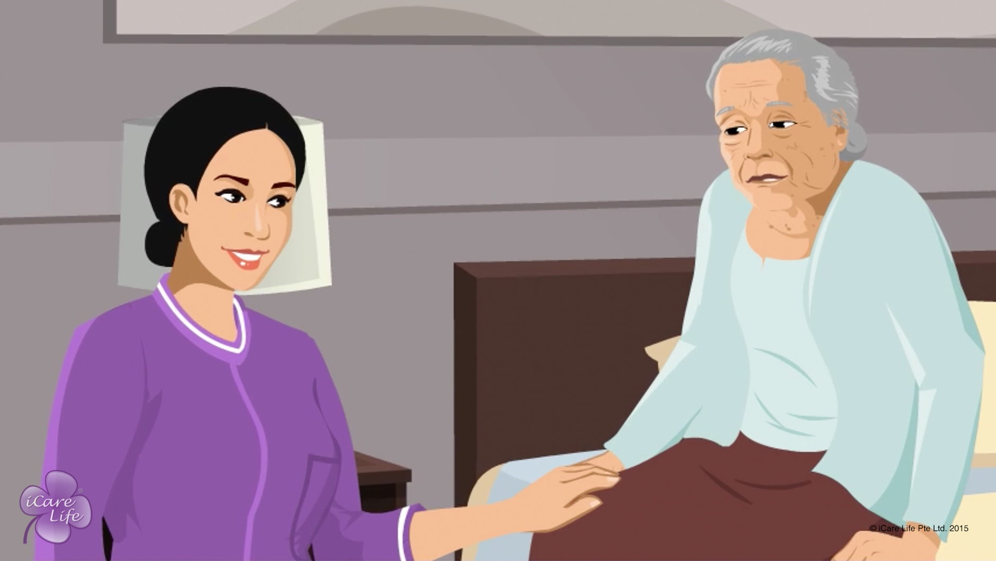
Being a Good Listener to the Elder
24
Copyright: iCare Life Pte. Ltd., Singapore : This document must not be copied or shared or circulated without the consent of iCare Life and/or its affiliates.

Slide 26
Summary
When an elder is talking:
Pay attention to them
Do not get distracted
Do not interrupt the elder
Focus on what is being said and not your response
Acknowledge what is being said
Do not hurry to form opinions
Maintain eye contact and open body posture
Do not change the subject of the conversation
Do not offer solutions until asked
Be patient, sympathetic, and respectful
25
Copyright: iCare Life Pte. Ltd., Singapore : This document must not be copied or shared or circulated without the consent of iCare Life and/or its affiliates.
Notes:
To be a good listener:
Pay attention to the elder
Do not get distracted
Do not interrupt the elder
Focus on what is being said and not your response – first pay attention to what the elder is saying to understand the elder’s problem. After that think of what to say in response
Acknowledge what is being said – you can do this by nodding your head and saying “ok” or “yes”
Do not hurry to form opinions – wait till the elder has finished speaking before forming an opinion about what the elder is saying
Maintain eye contact and open body posture
Do not offer solutions until asked
Do not change the subject of the conversation
Be patient, sympathetic and respectful

Slide 27
Any Questions?
26
Notes:
Q.1. When the elder is talking and my mind is thinking about my next task, say planning the meals for the next day, what should I do?
Ans. When the elder is talking, they should know that they have your complete attention. You will not be able to do this unless your focus is completely on them. Rid your mind of other thoughts and try to focus on what the elder is talking. You can always get back to your next task when the conversation is complete.

Slide 28
Handling Refusal for Help
27
Copyright: iCare Life Pte. Ltd., Singapore : This document must not be copied or shared or circulated without the consent of iCare Life and/or its affiliates.

Slide 29
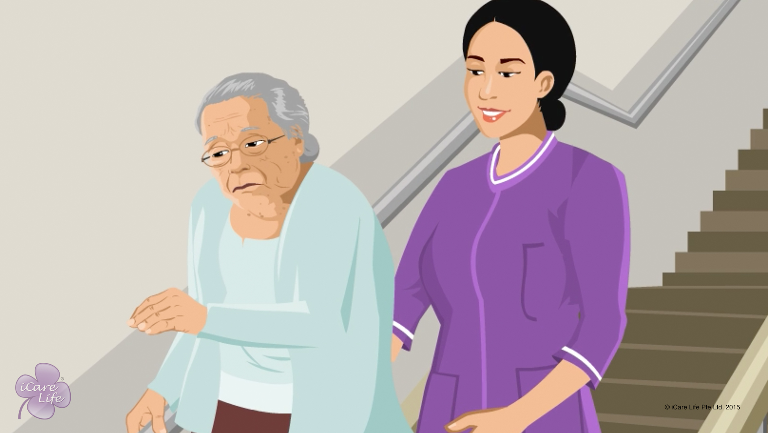
Handling Refusal for Help
28
Copyright: iCare Life Pte. Ltd., Singapore : This document must not be copied or shared or circulated without the consent of iCare Life and/or its affiliates.

Slide 30
Post-Module Activity
Happy to Help!
29
Copyright: iCare Life Pte. Ltd., Singapore : This document must not be copied or shared or circulated without the consent of iCare Life and/or its affiliates.
Notes:
Arrange for the following props in the presentation room: An adult walker/walking stick, a wheel chair, a pullover, and a recliner.
Introduce the activity by its title – Happy to Help! Ask for two volunteers from the participants. Assign the role of a caregiver to one person and the other one plays the role of the elder. Make sure that both the volunteers are of the same gender, that is either both are males or both are females. If required, another volunteer can be called upon to play the role of a doctor or family member of the person under care. The person under care sits on a chair. The task of the caregiver is to persuade the person under care to accept help using one of the props.
The tasks will be:
To make the person accept using a walker/walking stick
Take help from the caregiver to shift to a wheelchair
Take help from the caregiver to wear a pullover
Take help from the caregiver to walk up to the recliner and lie down
For each task, explain the condition of the person under care. The profile of the person under care for the above tasks will be:
A person who often falls while walking
A person who has lost use of one or both feet
A person with severe pain in shoulders and hand joints
A person with severe pain in knees
The person under care refuses help and it is up to the person playing the role of caregiver to make the other person agree to take help.
Explain to the participants that in real life situation they may have more time, but for the sake of demonstration, each participant playing caregiver will be allowed 5-10 minutes to complete the task.
If one person playing the caregiver fails to complete the task, invite another volunteer to complete the task. If a task is completed, invite another pair of volunteers for the next task. After each successful or unsuccessful attempt, briefly discuss what the caregiver did right or wrong.

Slide 31
Summary
Identify the reason why the elder refuses to accept your help
Use suitable strategies to make the elder accept help
While you do this, keep your own emotions in control
Reasons for refusal to accept help can be emotional or financial
To make the elder accept help:
Give the elder time to consider your offer of help
Make the elder feel in control of the final decision
Find more cost-effective options for help
Explain how accepting help can lead to more convenience
Take help from another trusted person
To keep your emotions in control:
Remind yourself to be patient
Excuse yourself from the situation for a few minutes
Try deep breathing, saying a small prayer, or looking at a photograph of a loved one
30
Notes:
Identify the reason why the elder refuses to accept your help
Use suitable strategies to make the elder accept help
While you do this, keep your own emotions in control
Reasons for refusal to accept help can be emotional or financial
To make the elder accept help:
Give the elder time to consider your offer of help
Make the elder feel in control of the final decision
Find more cost-effective options for help
Explain how accepting help can lead to more convenience
Take help from another trusted person
To keep your emotions in control:
Remind yourself to be patient
Excuse yourself from the situation for a few minutes
Try deep breathing, saying a small prayer, or looking at a photograph of a loved one

Slide 32
Any Questions?
31
Notes:
Q1: What should I do if all my attempts fail to make the person under my care accept help?
Ans: You cannot help someone unless that person allows you to help. Do not set a time limit for the person under care to accept your help. Concentrate on making that person understand the benefits of accepting help. You may ask the person’s doctor to advise them to accept help as part of the treatment and care process.
Q2: Should I always ask before helping a person?
Ans: Yes. You should first make an offer to help. Let the person under your care take the decision of accepting your help. However, in circumstances which can endanger the person under your care – for example if the person is about to fall – you should first help and then explain why it was necessary.

Slide 33
Handling Anxious Behavior
32
Copyright: iCare Life Pte. Ltd., Singapore : This document must not be copied or shared or circulated without the consent of iCare Life and/or its affiliates.

Slide 34
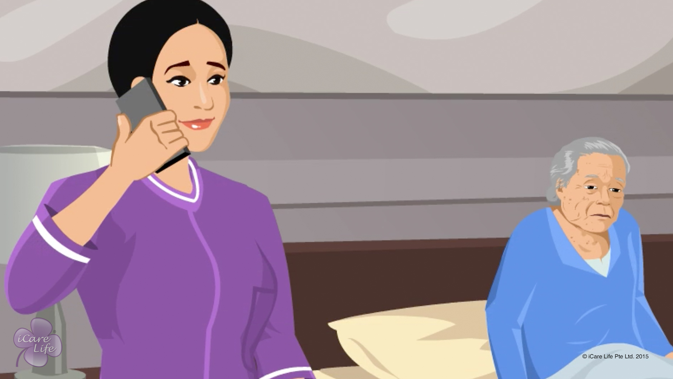
Handling Anxious Behavior
33
Copyright: iCare Life Pte. Ltd., Singapore : This document must not be copied or shared or circulated without the consent of iCare Life and/or its affiliates.

Slide 35
Summary
Excessive worry, fear, restlessness and inability to sleep, and constant repetitive actions or speech are some of the common signs of anxious behavior
To calm down an anxious person:
Do not argue or say the elder is worrying unnecessarily
Be patient, sympathetic, and reassuring with the elder
Remove factors that contribute to the elder’s anxiety
Encourage the elder to take a few deep breaths and have something to drink
Distract the elder’s attention to an enjoyable activity
Try alternative therapies like music therapy and aromatherapy
If nothing helps, contact the elder’s doctor for suitable medication for the person’s anxiety
34

Slide 36
Any Questions?
35
Notes:
Q1: What should I say or not say to a person showing signs of anxious behavior?
Ans:
Avoid saying things like:
- Stop being afraid
- You are overreacting
- There is nothing wrong
- Everything is going to be fine
You are not the only one with problems
Instead, try saying things like:
This is a temporary problem
I understand it can be worrying
We have enough time to deal with this
Let us think of a way out of this problem
If you let me help, we can find a solution

Slide 37
Handling Angry Behavior
36
Copyright: iCare Life Pte. Ltd., Singapore : This document must not be copied or shared or circulated without the consent of iCare Life and/or its affiliates.

Slide 38
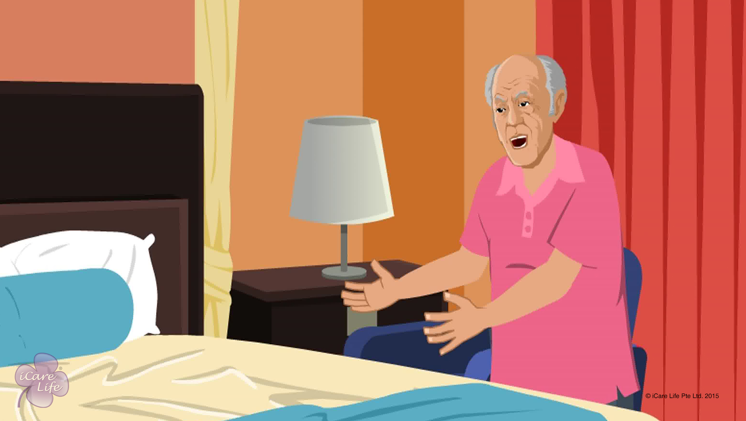
Handling Angry Behavior
37
Copyright: iCare Life Pte. Ltd., Singapore : This document must not be copied or shared or circulated without the consent of iCare Life and/or its affiliates.

Slide 39
Summary
Irritability, anxiety, and behavioral issues are some of the common reasons for angry behavior
To calm down an angry person:
Ask what has offended the elder
Take corrective action for your mistakes
Identify and relieve the elder’s fears
Break behavioral patterns responsible for anger
To keep your emotions in control:
Do not take the elder’s anger personally
Focus on the reasons behind the anger
Excuse yourself from the situation for a while
Find ways to calm yourself
38
Notes:
Irritability, anxiety, and behavioral issues are some of the common reasons for angry behavior
To calm down an angry person:
Ask what has offended the elder
Take corrective action for your mistakes
Identify and relieve the elder’s fears
Break behavioral patterns responsible for anger
To keep your emotions in control:
Do not take the elder’s anger personally
Focus on the reasons behind the anger
Excuse yourself from the situation for a while
Find ways to calm yourself

Slide 40
Any Questions?
39
Notes:
Q1: How can I prevent the elder from getting angry at all?
Ans: Anger is a natural emotion like being happy or sad. We all experience these emotions at different times. So, it is not fair to expect an elder to never get angry. However, you can try following measures:
Keep a record of what made the elder angry and avoid repetition of such mistakes or situations.
Avoid sudden changes or surprises in the elder’s daily routine.
Involve the elder in planning the daily routine. For example, some people feel extremely hungry immediately after taking a bath and any delay in serving food makes them angry. In such a case, ask if the elder would prefer to eat something half an hour before taking a bath.
Encourage the elder to practice some relaxation techniques like deep breathing, meditation, or light exercise everyday. This will keep the elder more calm throughout the day.

Slide 41


