Slide 1
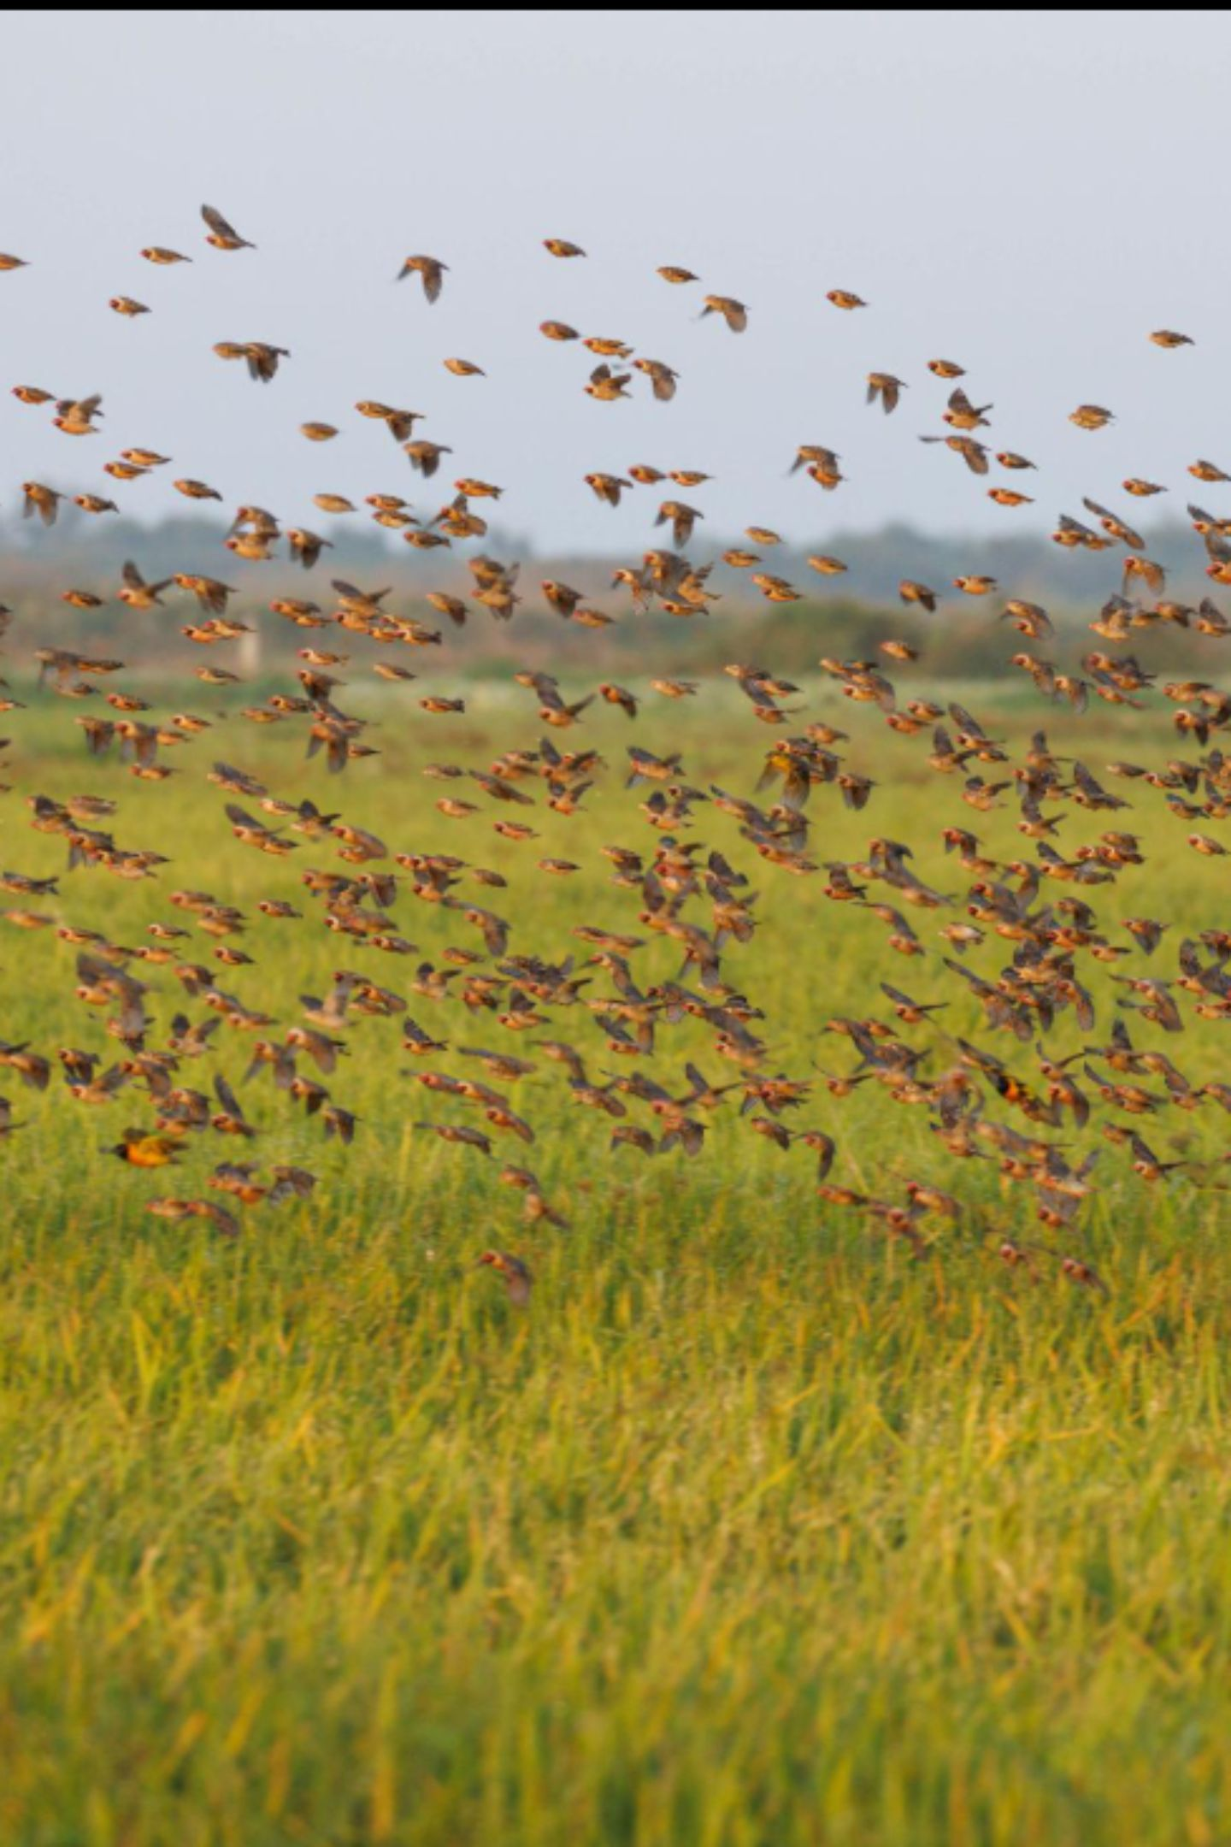
QueleaGuard
Building the intelligence foundation for adaptive Quelea crop protection
From a family rice farm to an AI research and data-engineering journey.

Slide 2
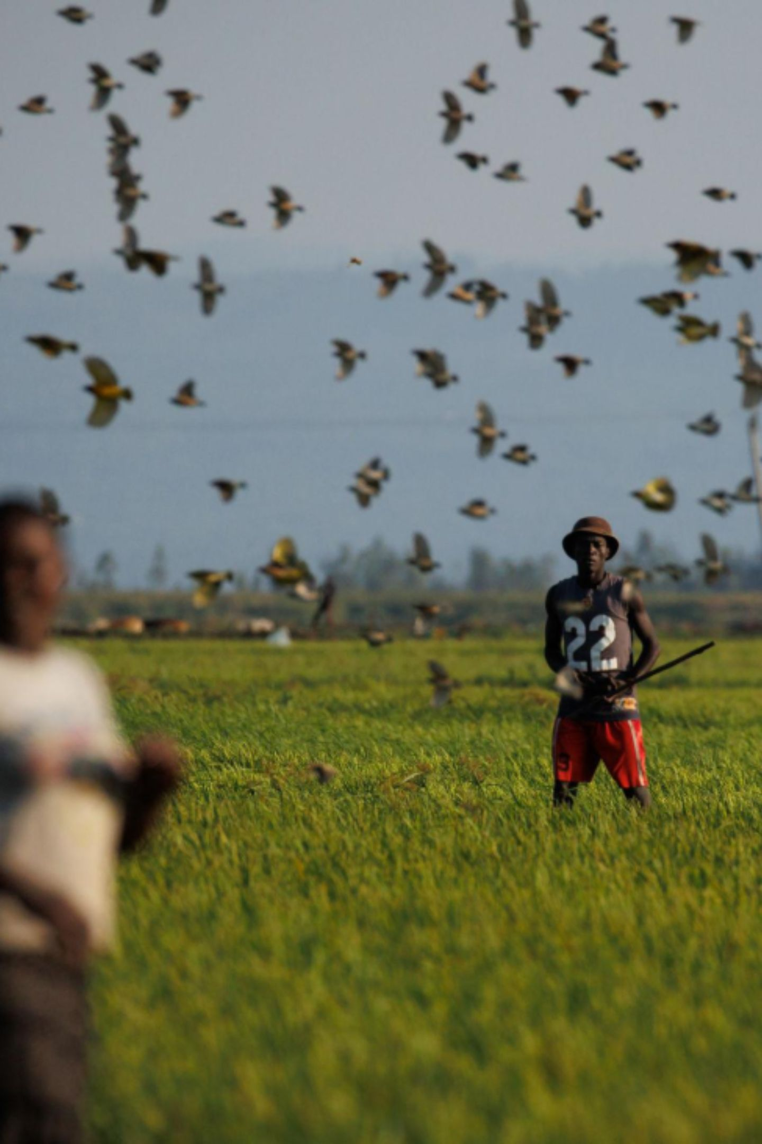
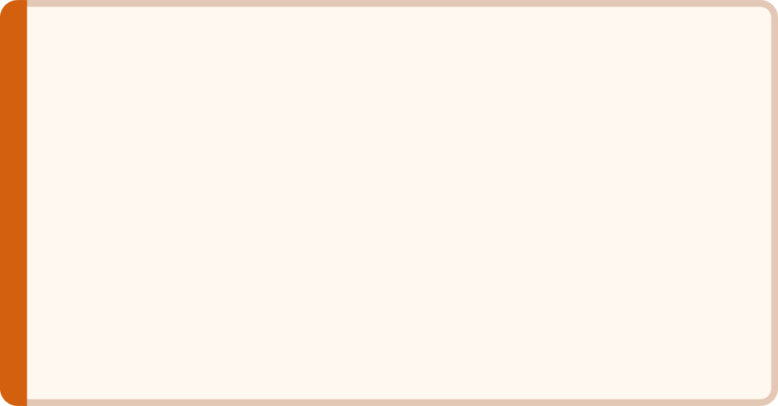

I watched my family's rice farm disappear.
Kisumu, Kenya
Potential Harvest
Rice farming for approximately 16 years
50+ bags
Actual Harvest
2024 — The Breaking Point
12 bags — premature
My family eventually stopped farming rice.
Five people guarding fields, 6 AM to 6 PM, every day

Slide 3




A farmer cannot fight a persistent bird threat with five people.
Continuous Monitoring
Unsustainable Labour
Large field areas demand coverage no human team can sustain
Manual deterrence is intensive, costly, and ultimately ineffective
Slow Reaction Time
Limited Intelligence
Flock movement outpaces any human response capability
No actionable information about bird behaviour or movement patterns
How can we continuously detect, understand and respond to Quelea activity at a scale humans cannot?

Slide 4
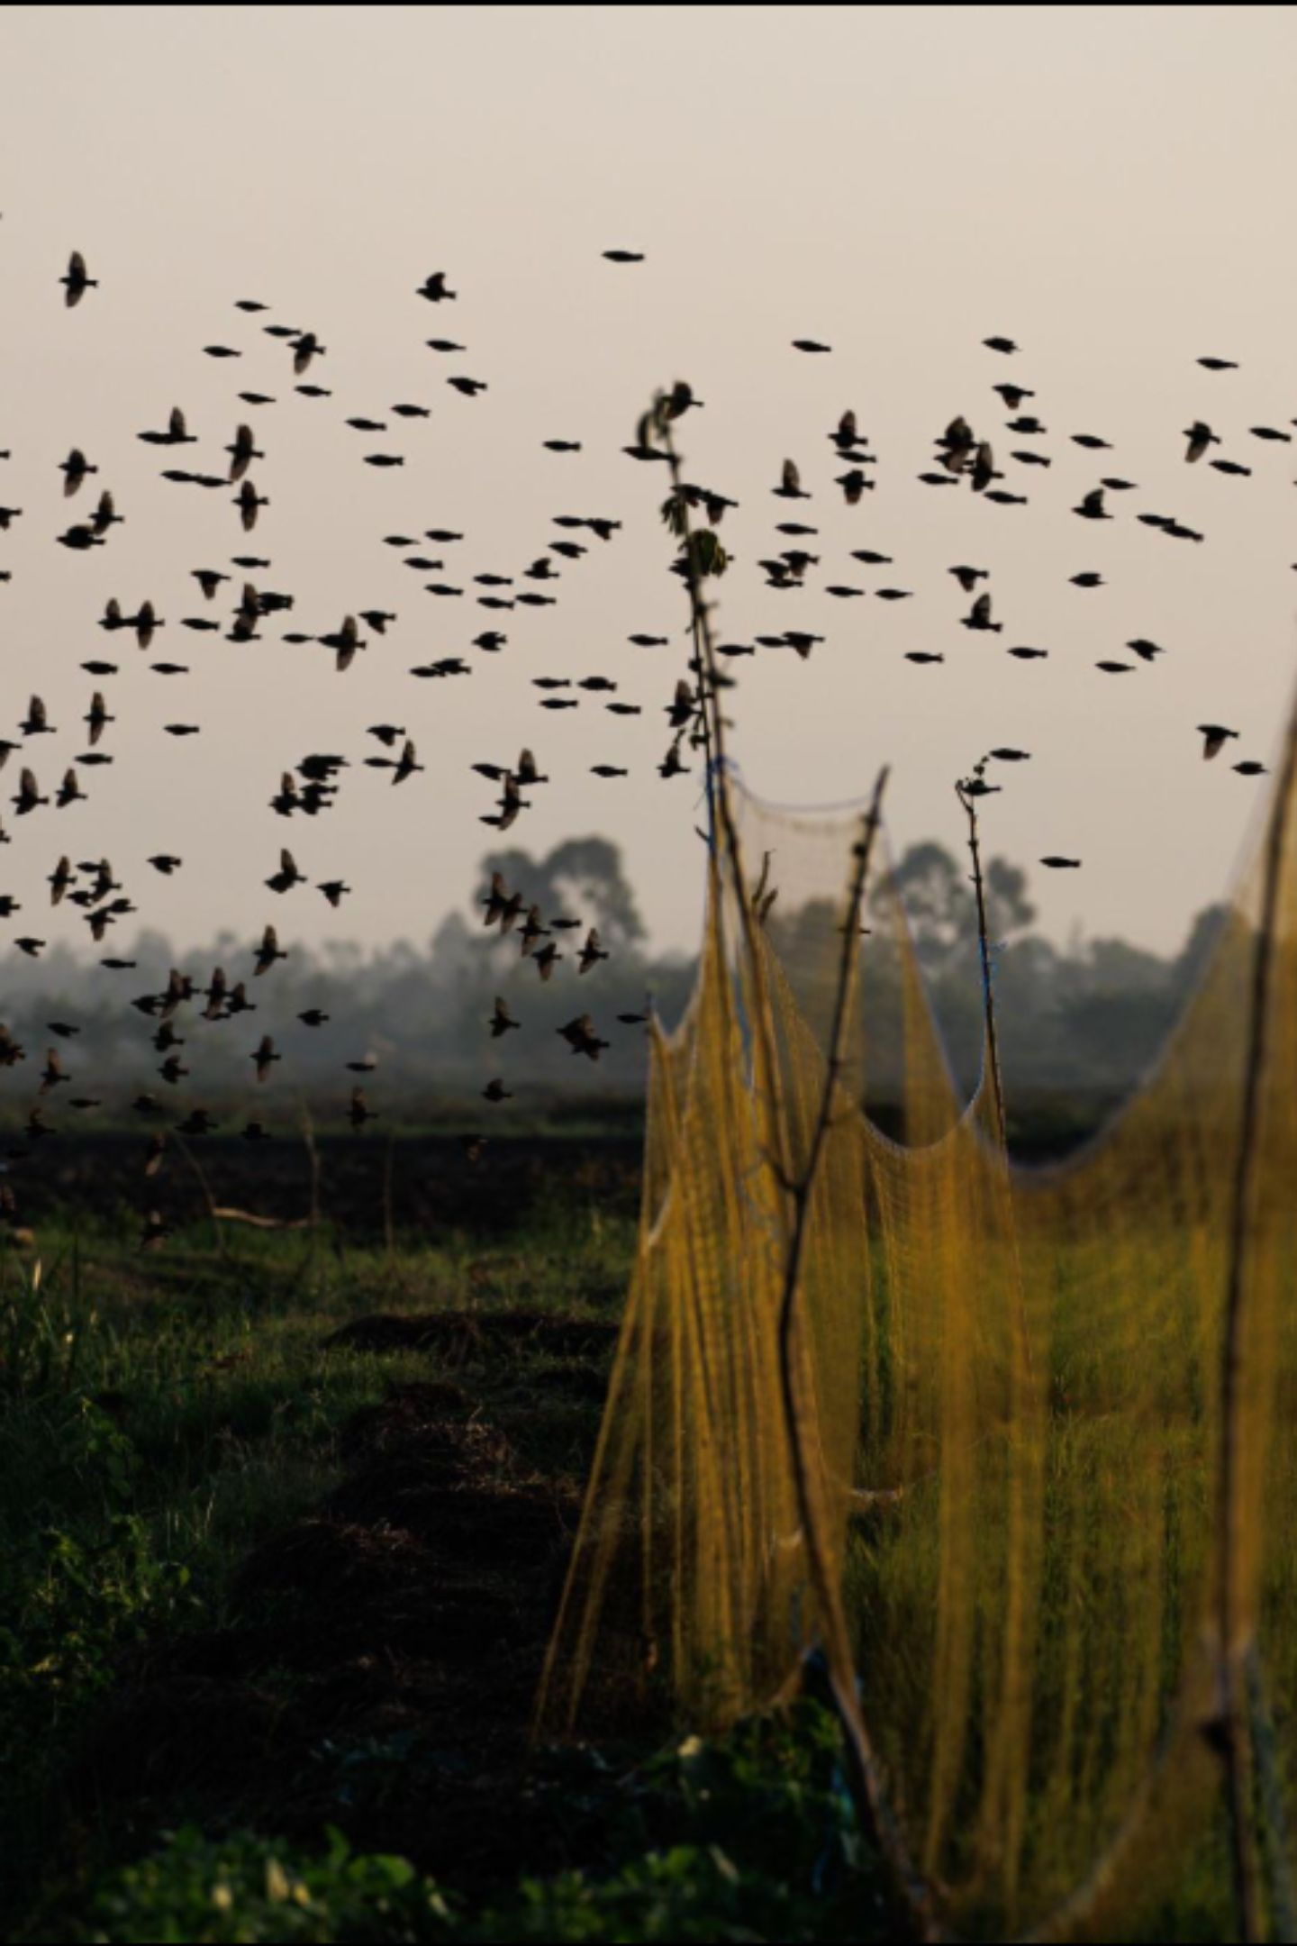


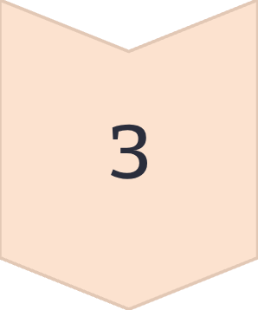
My first answer was Agri-Shield.
LONG-TERM VISION
DETECT
AI watchtowers + IoT field units + environmental sensors
RESPOND
Drones + automated deterrence + central intelligence
LEARN
Machine learning feeds back into detection and response

Slide 5
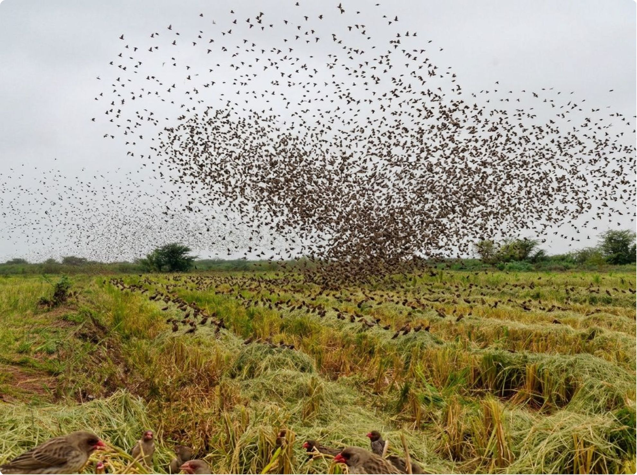
But I was trying to build the top of the system first.
1
2
3
1
Data
The irreducible foundation
2
Models
Models require data
3
Intelligence
Intelligence requires models
An intelligent system needs intelligence. So I went back to the beginning.

Slide 6
QueleaGuard became the foundation.
QueleaGuard — Now
Agri-Shield — Long-Term Vision
Data + research + intelligence foundation
Understanding Quelea occurrence, spatial context, environmental patterns, and data quality.
The autonomous crop-protection system that QueleaGuard makes possible.
Every model, every sensor, every intervention — built on the foundation we are engineering today.

Slide 7
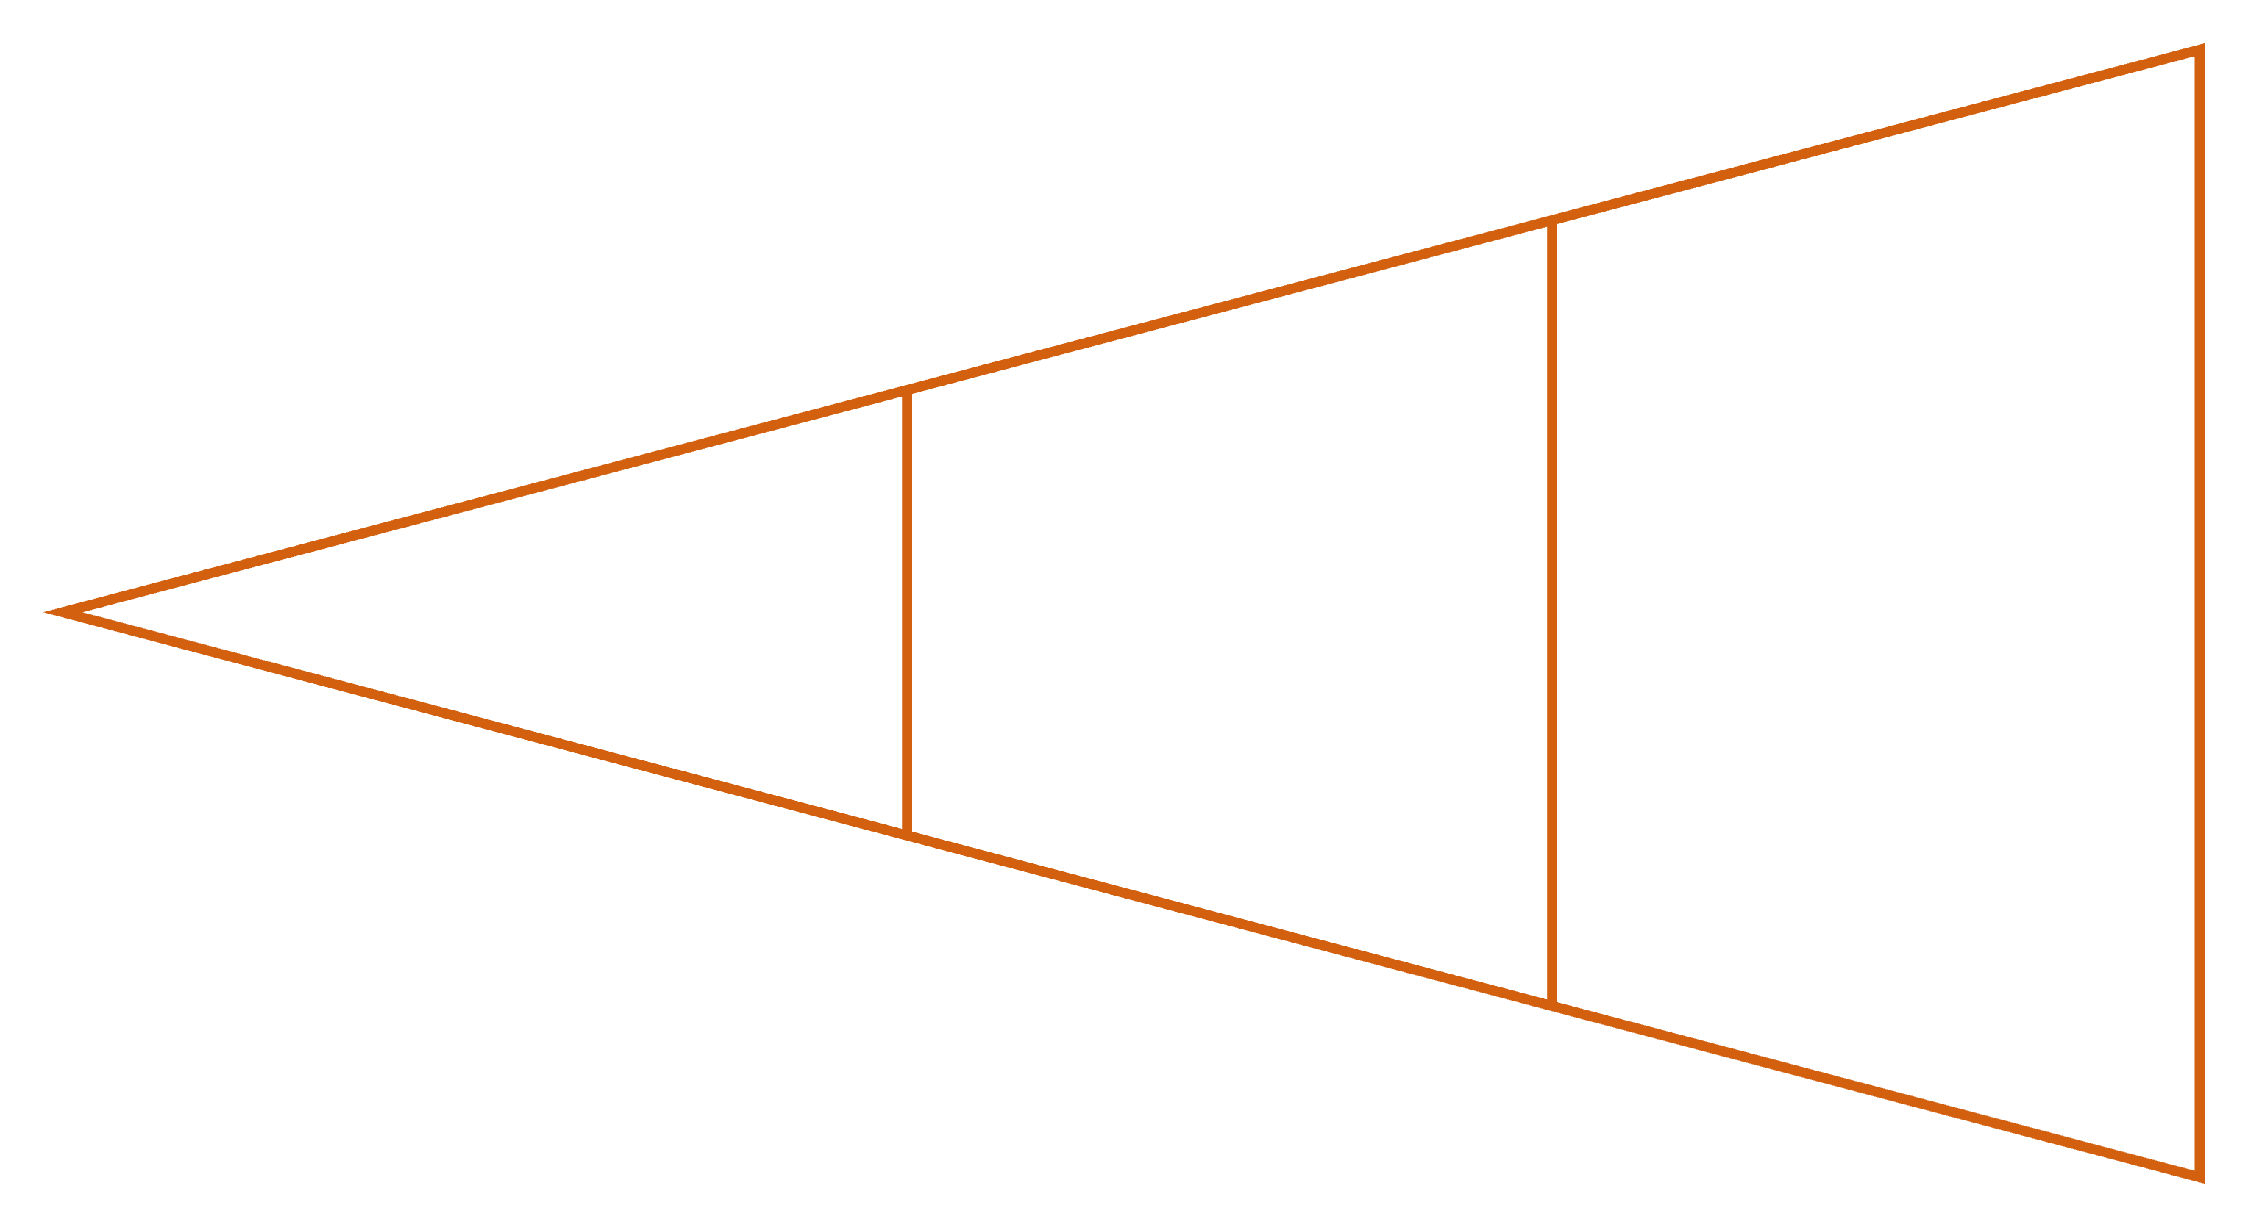
The first problem wasn't machine learning. It was data.
Raw Records
Modeling Set
Engineering
Quelea occurrence records, rainfall, vegetation, temperature, terrain, hydrology, spatial boundaries, and temporal information — all fragmented, all requiring careful engineering before a single model could be trained.

Slide 8

Five weeks of turning fragmented information into a research dataset.
01
02
03
Occurrence Data → Spatial Framework → Grid
Presence / Pseudo-absence Extraction
Environmental Data Alignment
04
05
Temporal Synchronization
Quality Control → Modelling Dataset
Now I'm going to show you exactly how we built this — live, in the repository and notebook.

Slide 9


Building the dataset was harder than building the model.
Data Scarcity
Pseudo-absences
Limited direct Quelea observations available for Kenya
No conventional absence data — methodology required careful justification
Spatial Scale
Remote Sensing
Choosing an analytical framework that reflects ecological reality
Quality and coverage issues across environmental datasets
Temporal Alignment
Data Quality
Matching observations precisely with environmental conditions
Invalid values detected, investigated, and corrected

Slide 10
The dataset became a research problem of its own.
Data availability determines what can responsibly be modelled
Spatial and temporal alignment matter as much as model selection
Presence-only observations require careful methodology
Environmental datasets are not automatically trustworthy
We chose research integrity over demo theatre.

Slide 11
What comes next?
1. Data Foundation
1
Current phase
2
2. Exploration & Modelling
Ecological relationships
3. Field Observation
3
Camera, acoustic, environmental data
4
4. Behavioural Intelligence
Movement and flock patterns
5. Intervention Data
5
Record deterrence outcomes
6
6. Adaptive Intelligence
Learn what works
7. IoT + Autonomous Systems
7
Physical response — Agri-Shield realized

