Slide 1
ADMIN GUIDE
Running the School in the Portal
Curriculum, people, applications, money, and reports — one page per job.
School of Transformation — Discipleship Training School

Slide 2

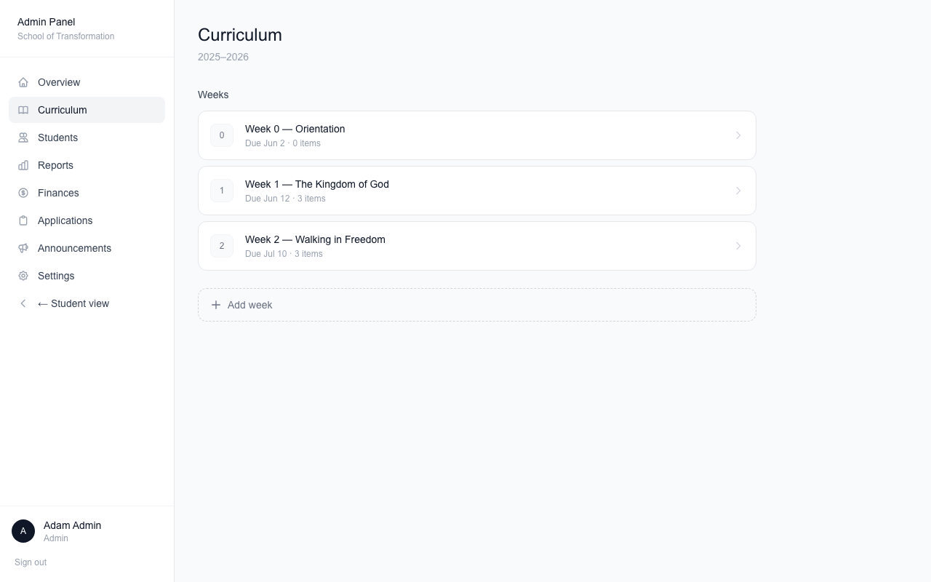


Curriculum — build the year
Add weeks, then fill each week with homework.
Add a week
Number, title, and a due date.
Four kinds of homework
Scripture reading, book reading, video, and reflection questions.
Records are protected
You cannot delete an item students already completed — edit it instead.

Slide 3

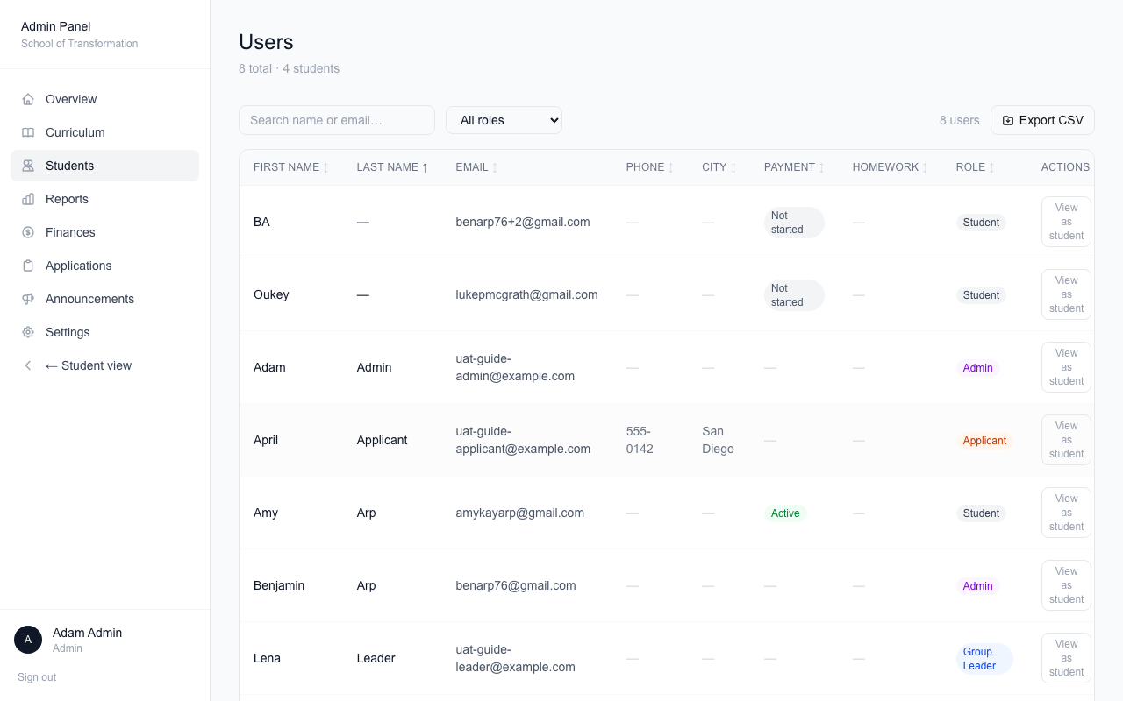



Students — manage people
Everyone with an account, in one table.
Sort, filter, export
Download the list as a spreadsheet any time.
Click a person
Edit their info, change role, assign a group, or turn the account off.
"View as" a student
See exactly what they see. A banner reminds you while you do.
Add student — two ways
Send an invite email, or create the account quietly (transfers). Transfers sign in with "Forgot password?".

Slide 4



Applications — the pipeline
Every applicant moves through the same stages.
Reference requested
→
Interview
→
Accepted
References move things forward
When the pastor submits, the application advances to Interview by itself.
Skipping a reference needs a note
"Move to interview without reference" asks why, and saves your answer.
Accepting is not enrolling
Accepted applicants pay their deposit first. They become students when you activate their year.

Slide 5

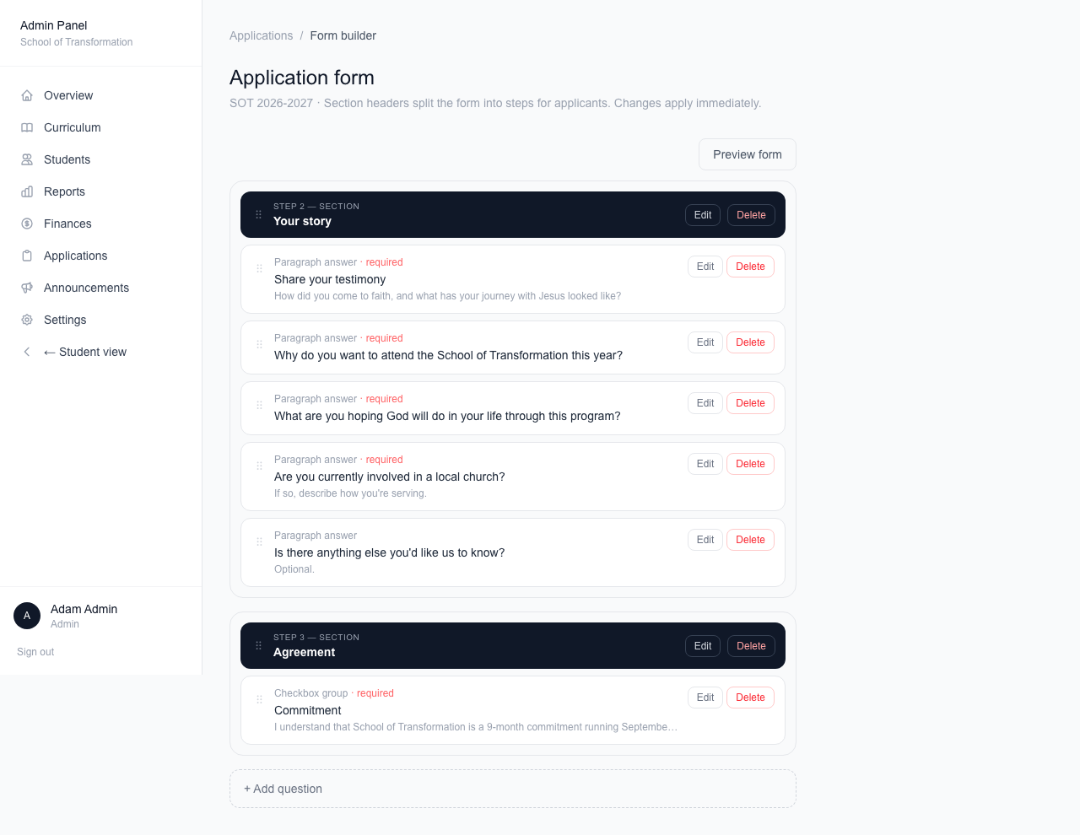



The form builder
Edit the application questions — no code needed.
Seven kinds of questions
Short answer, paragraph, yes/no, dropdown, checkboxes, notes, and section headers.
Drag to reorder
Grab the ⠿ handle. Sections are the dark bars — each one is a step for applicants.
Branching
A question can hide until an earlier answer matches — like a follow-up that only shows after a "Yes."
Preview first
See the form exactly as applicants will. Nothing in the preview is saved.

Slide 6

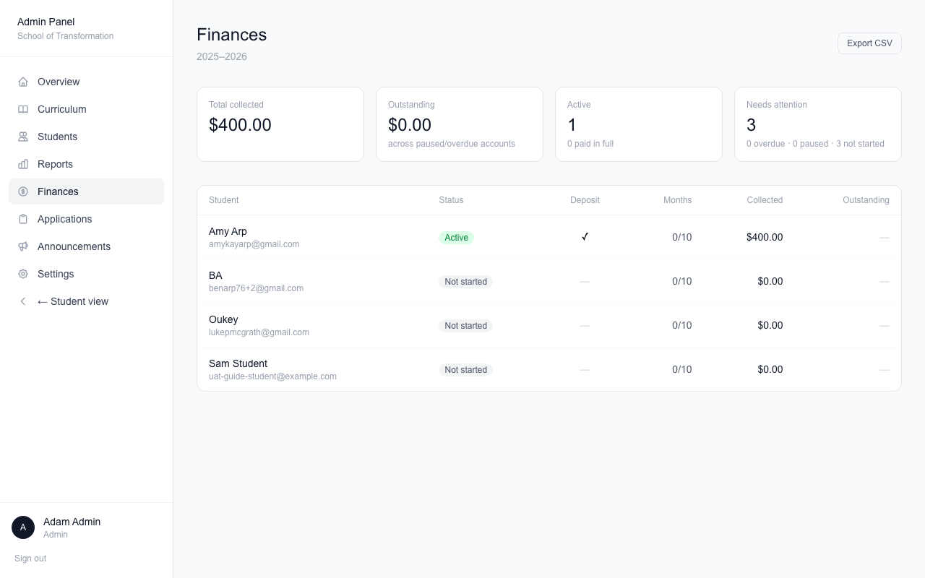


Finances — the money picture
Tuition across the whole year, in one place.
Top cards
Total collected, what is still owed, and who needs attention.
Per-student billing
Open a student's page to pause, resume, credit, cancel, or refund. Every action is recorded.
Export
Download the table for your spreadsheet.

Slide 7

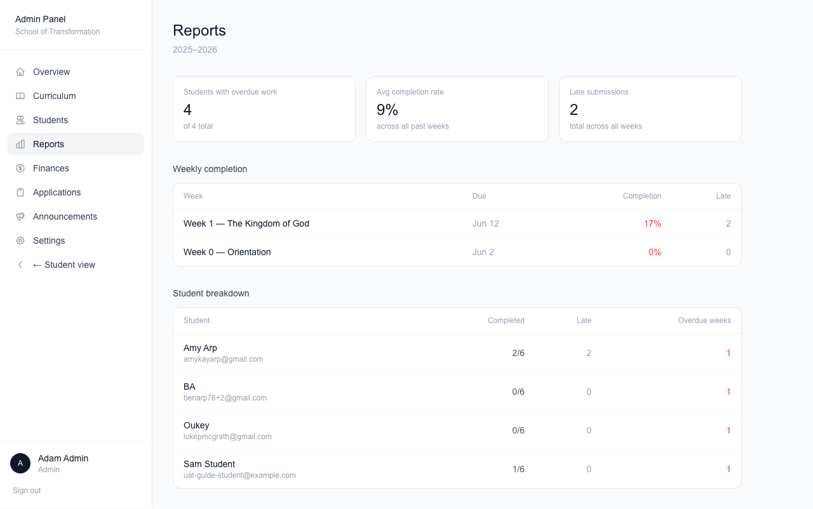


Reports — homework at a glance
Who is on track, who needs help.
The big picture
Cards show who is behind and the average completion rate.
Click a week
One row per student, one column per item — with reflection answers right in the table.
Find anyone fast
Use your browser's Find (Cmd+F) to jump to a name.

Slide 8

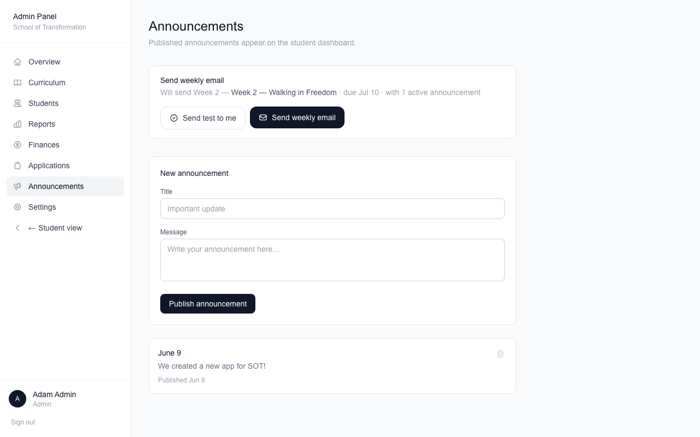


Announcements & the weekly email
Post to every dashboard
Announcements show at the top of each student’s This Week page.
The weekly email
Sends next week’s homework to all enrolled students.
Test first
Send a test to yourself to see how it looks. The portal warns you before sending twice in 5 days.

Slide 9

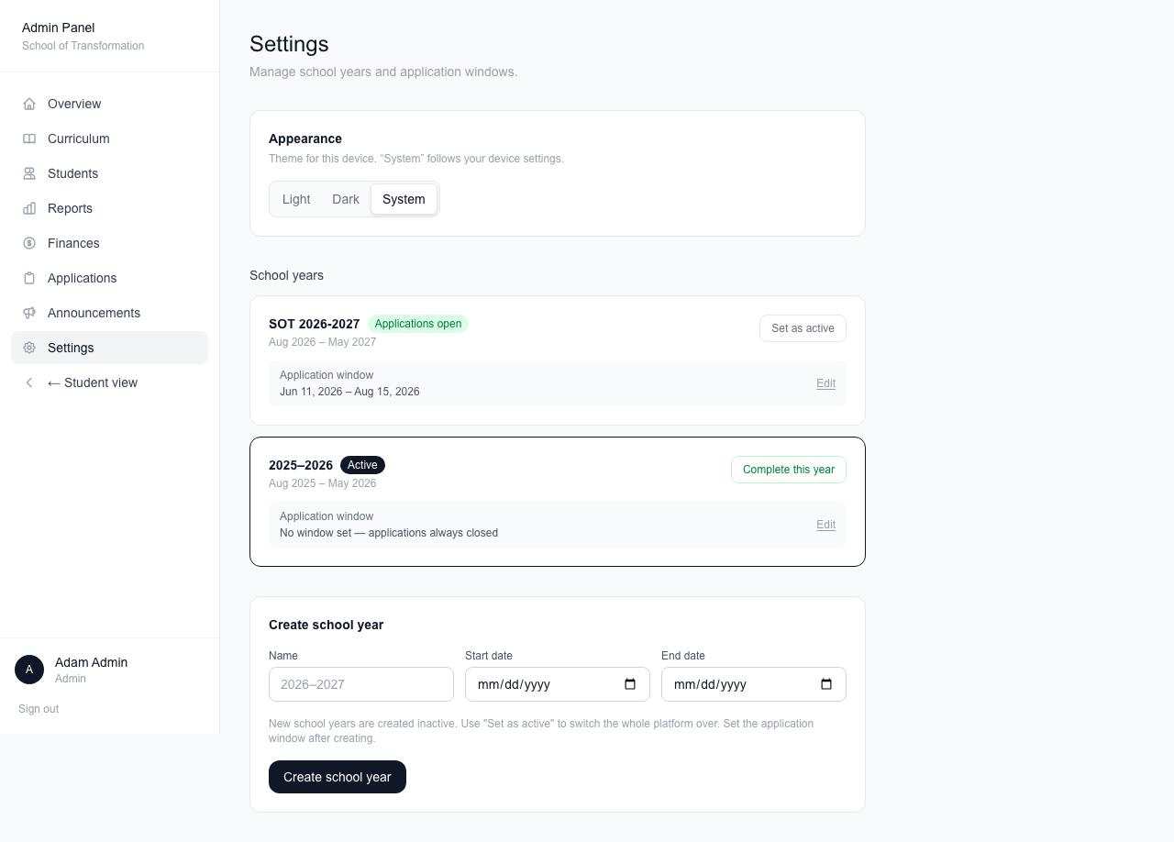


Settings — school years
Years are the big levers. Use them carefully.
Create a year & set the window
The application window controls when people can apply.
Set as active
Flips the whole portal to that year — and enrolls accepted applicants who paid their deposit.
Complete this year
Moves students to alumni at year end. There is a Reopen button if you clicked by mistake.

Slide 10
Questions?
Technical docs live in the docs/ folder of the project.
docs/uat.md has a checklist for testing every feature.

