Slide 1
APPLICANT GUIDE
Applying to the School of Transformation
How to apply, step by step. You can apply from a computer or your phone.
School of Transformation — Discipleship Training School

Slide 2

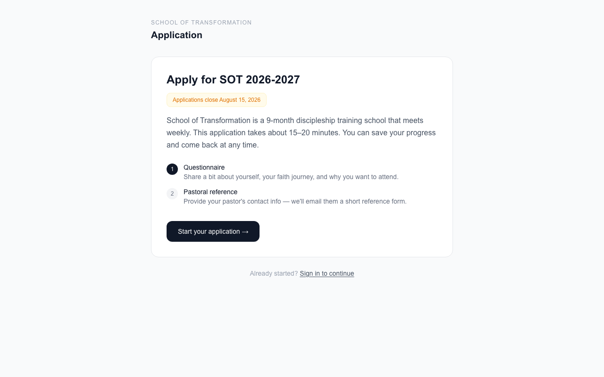


Start your application
Go to the school website and open the Apply page.
Make an account
Use your email and pick a password. Write it down somewhere safe.
Phone or computer — both work
The page fits your screen either way.
Apply during the window
If applications are closed, the page will tell you when they open.

Slide 3





Answer the questions
The application is a few short steps. A bar at the top shows your progress.
One step at a time
Fill in your name, phone, and city first. Then answer each page of questions.
Red star = required
Questions with a red star must be answered before you continue.
Your answers save by themselves
You will see "Saved automatically." Close the page any time — your work is safe.
Move back and forth
Use Back and Continue to move between steps. Nothing is lost.
Finish with Submit
On the last step, press Submit application.

Slide 4



Tell us about your pastor
After you submit, we ask for one reference from a pastor who knows you.
Type in three things
Your pastor's name, email, and church.
We email your pastor
They get a short form. It takes them just a few minutes.
Then you can relax
You don't need to do anything else. We will move your application forward when the reference arrives.

Slide 5
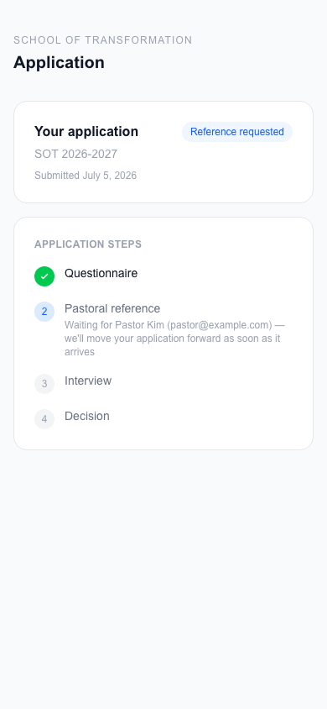
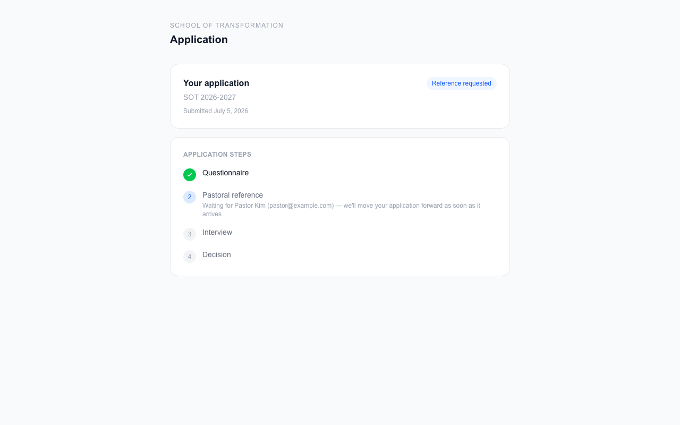
Check on your application
Any time you log in, your status page shows exactly where things stand.
On a computer
On a phone

Slide 6



What the stages mean
Reference requested
Interview
Accepted
We are waiting to hear from your pastor.
Your reference came in. We will reach out to set up a talk.
You're in! Time to set up tuition.

Slide 7


If you are accepted
Your status page will show one thing to do: set up tuition.
$400
$200
$2,400
deposit today
a month, 10 months
total for the year
Safe payment
Stripe, a trusted payment company, handles your card. We never see your card number.
Payments stop by themselves
After the 10th monthly payment, you are done. Your spot is saved once the deposit is in.

Slide 8
Questions?
Email the school office — we are happy to help with any step.
You can log in any time to see your status.

