Slide 1
GROUP LEADER GUIDE
Leading Your Group in the Portal
A window into how your students are doing — so you can encourage them well.
School of Transformation — Discipleship Training School

Slide 2

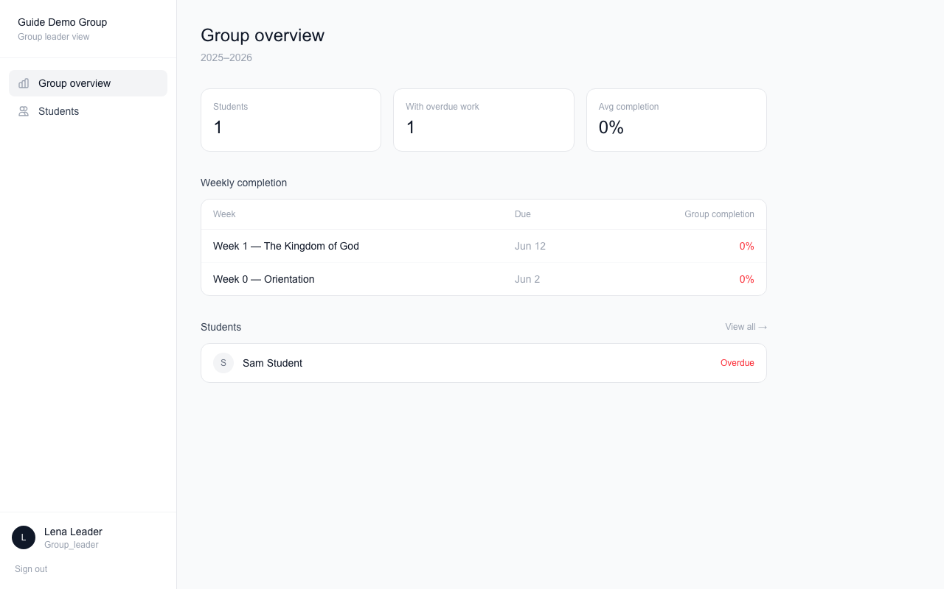


What you can see
You see your group only. A window, not a red pen.
Just your group
Only the students assigned to you.
Read-only
You can look, but nothing you do changes their work.
Private by design
Other groups are hidden from you, and yours from them.

Slide 3

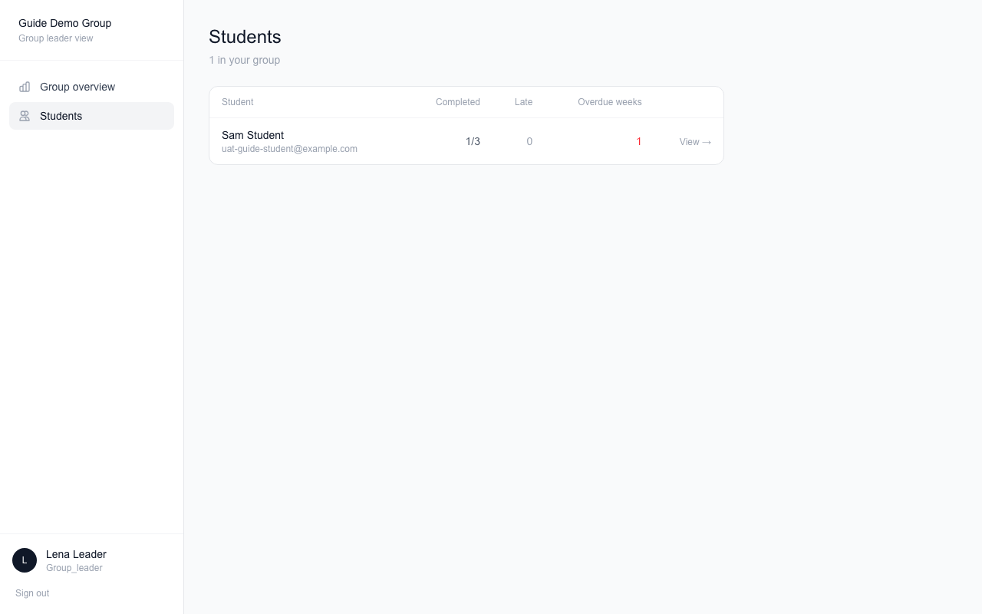


Checking on your students
Click a student to see their week-by-week progress.
Complete
They finished everything that week.
Incomplete
The week is past due and something is missing.
On time or late
Each item shows when it was done.

Slide 4



How to use it well
Look before you meet
A quick check tells you who might need a nudge or a kind word.
Encourage first
If someone is behind, reach out. Care works better than pressure.
Something looks wrong?
Have the student check they tapped the circle. Still wrong? Email the school office.

Slide 5
Questions?
Email the school office any time.
Thank you for leading — it matters.

