Slide 1
STUDENT GUIDE
Your Student Portal
Homework, payments, and settings — on your computer or your phone.
School of Transformation — Discipleship Training School

Slide 2

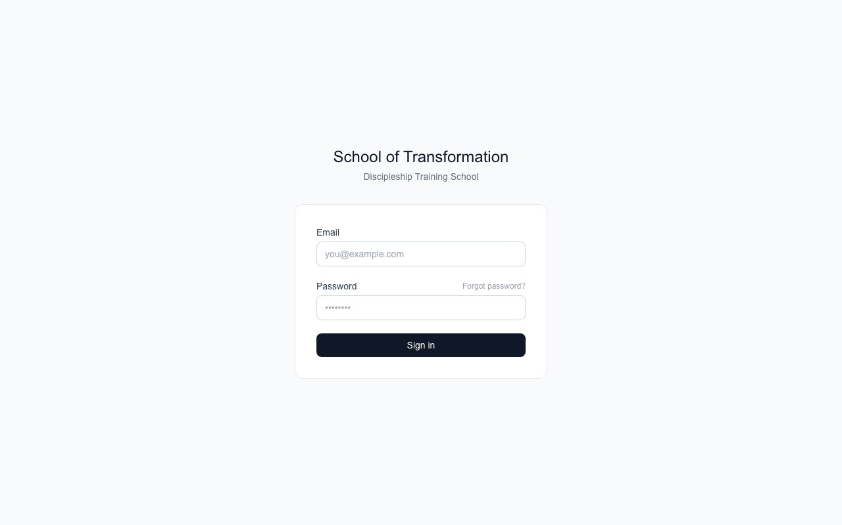

Signing in
Go to the school website and sign in with your email and password.
Forgot your password?
Click "Forgot password?" and we email you a link to make a new one.
New here from another system?
Your account is ready. Click "Forgot password?" the first time, set a password, and you are in.

Slide 3
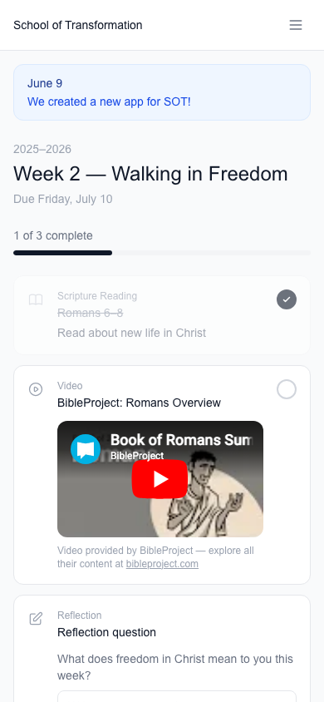

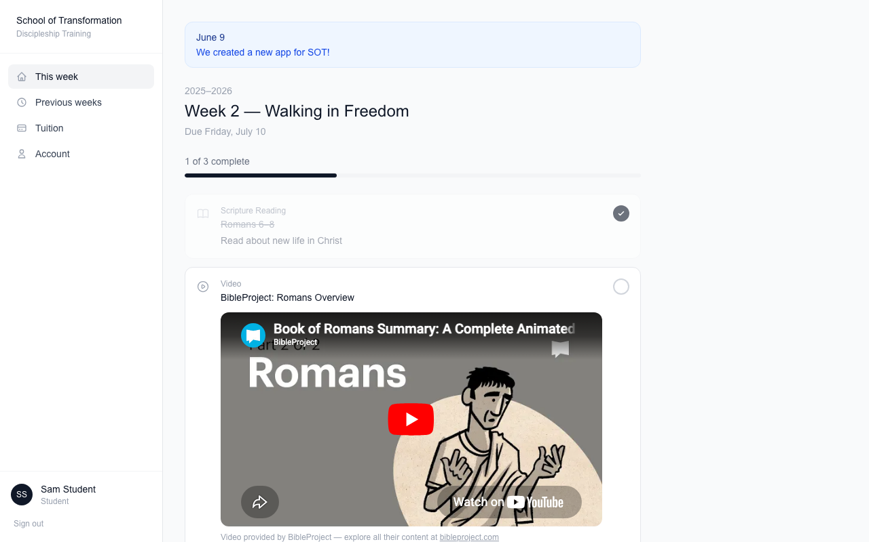

This Week — your homework
When you sign in, you land on This Week. It shows everything due.
Progress bar
Shows how much you have finished.
School notes on top
Announcements show in blue.

Slide 4




How to finish each kind of homework
Reading
Read, then tap the circle to check it off.
Videos
Watch right on the page, then check it off.
Reflection questions
Type your answer and press Save response. Saving checks it off for you.
Made a mistake?
Tap the circle again to un-check it.

Slide 5

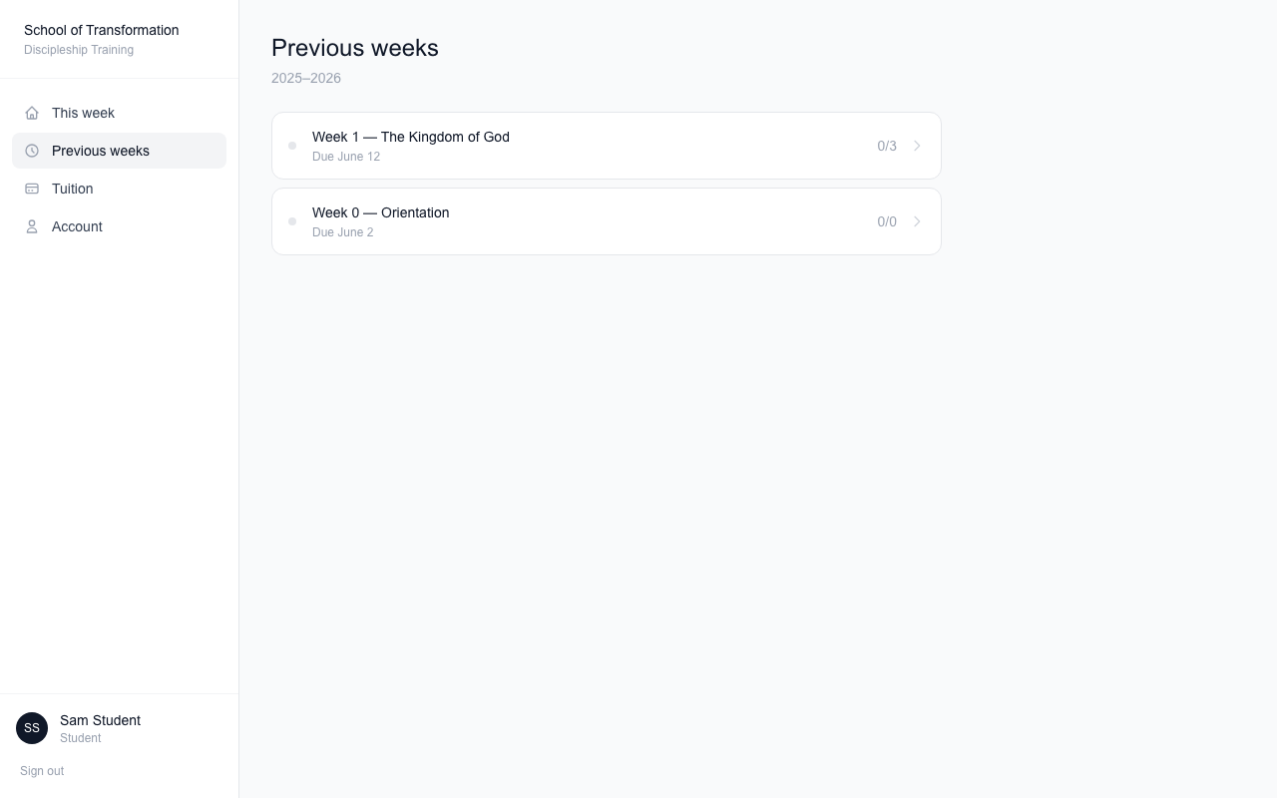

Previous weeks — catch up any time
Missed something? You can still do it.
Every past week is here
Open a week to see what you finished and what is left.
Late is better than never
You can still complete items — they are marked "Submitted late," and that is okay.

Slide 6
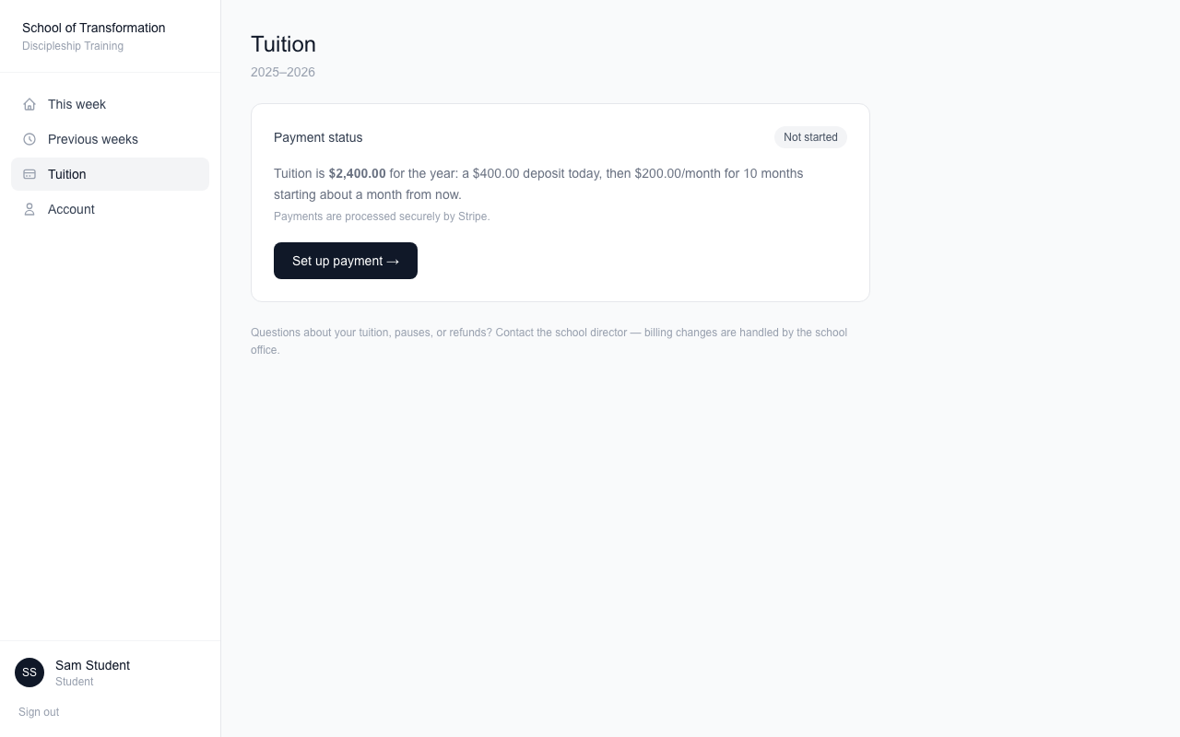



Tuition — see your payments
The Tuition tab shows where your payments stand.
What you can see
Deposit, monthly payments made (out of 10), next payment date, and the final payment date.
New card?
Click "Update card on file."
Pauses or refunds
Talk to the school office — they handle those.

Slide 7
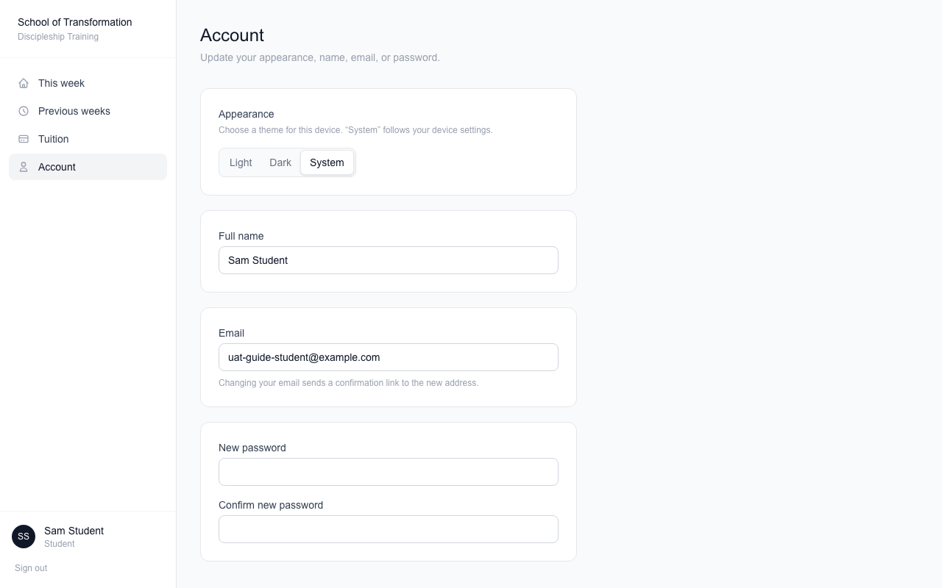


Account — your settings
Change your name, email, or password. Pick light or dark mode.
Light, Dark, or System
System matches your device. Your choice is saved on this device.
Changing your email
We send a confirming link to the new address first.

Slide 8
Questions?
Ask your group leader, or email the school office.
Weekly homework emails arrive before each week starts.

