Slide 1

TEAM 03
Restaurant
Management
Project
Team 03 - Ben, Hritik, Jai
Flask
MySQL
Stripe
K8s
web app
relational data
payments
deployment
Notes:
Good morning. We are Team 03, and this is our Restaurant Management Project.
The goal of the project was to develop a web application that allows restaurant owners to manage day-to-day online operations while providing customers with a simple self-service experience.
The system includes menu management, online ordering, reservations, user authentication, rewards and voucher functionality, and payment processing.
From an SRE perspective, we'll also discuss how the application was structured, how we approached reliability and deployment, and where there are opportunities for further production-readiness improvements.

Slide 2

What the project encompasses
Customer services
Menu browsing
Takeaway ordering
Online reservations
Stripe payment processing
Rewards and vouchers
Restaurant management
Menu administration
Customer management
Staff/admin roles
Authentication and security
Notes:
Our project is a Restaurant Management System designed to help restaurant owners manage their day-to-day online services through a single web application.
The system provides several core capabilities. Customers can browse the restaurant menu, place takeaway orders using a basket system, apply reward vouchers, complete payments through Stripe, and manage reservations.
For restaurant staff and administrators, the application provides menu management functionality, role-based access control, and customer account management. This allows staff to update menu items and maintain restaurant operations through an administrative interface.
The application also includes authentication and authorization mechanisms to ensure users only have access to features appropriate for their role.

Slide 3
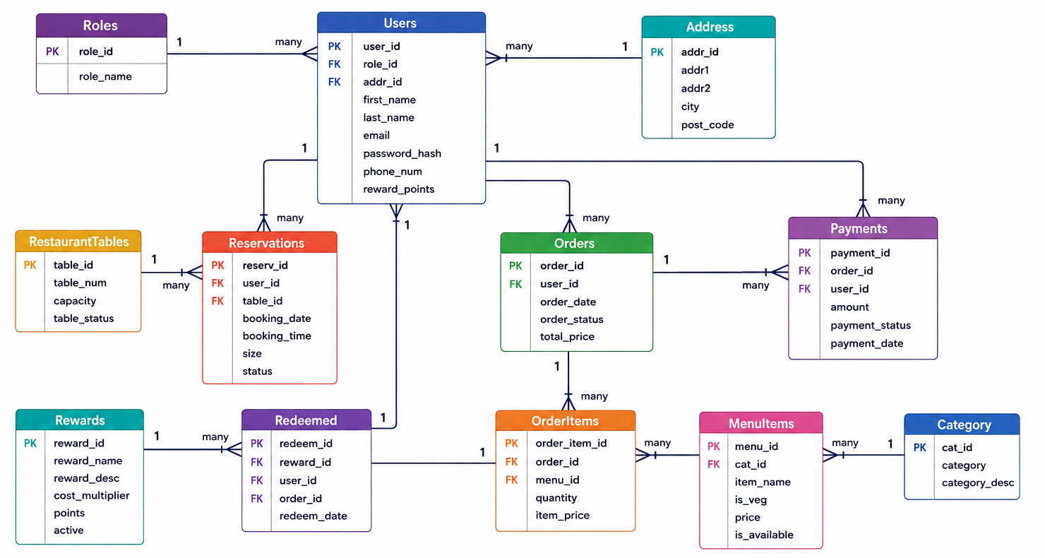
Relationship diagram: database model
Core relational entities support users, menu, orders, payments, bookings, and rewards
Notes:
This ERD shows how we organised the data for the restaurant management system. The database supports customer accounts, reservations, menu management, ordering, payments and rewards.
The Users table is the central entity because most system functionality revolves around a customer account. A user can place orders, make reservations, complete payments and redeem rewards
On the left side we have the reservation system. A user can create many reservations, and each reservation is assigned to a restaurant table. This allows us to track booking dates, times and table capacity.
The second major area is the ordering workflow. A user can place many orders. Each order contains multiple order items, which connect orders to menu items. This is a many-to-many relationship resolved through the OrderItems table. Payments are linked to orders so we can track transaction history and payment status.
The final area is the rewards system. Rewards define available vouchers or discounts, while the Redeemed table records when users actually redeem them. One reward can be redeemed many times by different customers.
In order to maintain referential integrity our database design uses foreign keys.

Slide 4

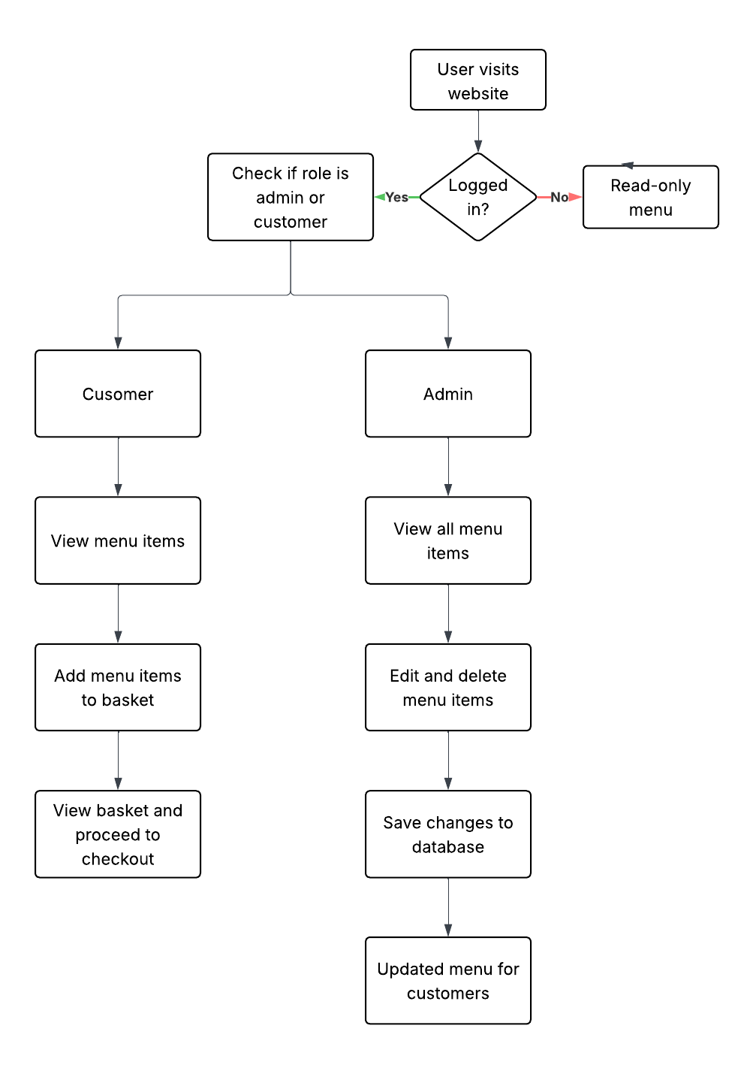
Flow diagram: admin/customer workflow
Notes:
This diagram shows the two main user journeys through our application. When a user visits the website, they can either browse the menu as a guest or log in to access additional functionality. Once authenticated, the system checks their role and presents different capabilities depending on whether they are a customer or an administrator.
For customers, the workflow focuses on the ordering process. They can browse menu items, add products to their basket, and proceed through checkout. During checkout, they can redeem reward vouchers, select delivery options, complete payment through Stripe, and view their payment history after purchases.
For administrators, the workflow focuses on managing restaurant operations. Administrators can view all menu items, add new products, edit existing items, and remove unavailable items. Any changes are saved directly to the database and become immediately visible to customers.
This role-based workflow helps keep the application simple and secure by ensuring users only see the functionality relevant to their role.

Slide 5
Project diagram: how the pieces fit together
Flask separates routes, templates, database access, and external services
Auth
Routes
Jinja HTML
templates
Customer
user
Flask app
app.py
Menu / Basket
Routes
MySQL
database
Owner /
admin
Checkout
Routes
Stripe
PaymentIntent
Docker + Kubernetes
deployment.yaml
Notes:
This diagram shows the high-level architecture of our application and how the different components interact.
Both customers and administrators access the system through the Flask application, which acts as the central entry point. Within the application, functionality is separated into route modules based on responsibility. Authentication routes handle login and account management, menu and basket routes manage menu browsing and ordering, and checkout routes handle payment processing and order completion.
These routes interact with Jinja templates to render the user interface and communicate with the MySQL database to store and retrieve application data such as users, menu items, orders, reservations, and payments.
The checkout component also integrates with Stripe through the Payment Intent API, allowing payments to be processed securely without storing card details within the application.
Finally, the application is containerised using Docker and deployed through Kubernetes, which provides a consistent deployment environment and improves scalability and maintainability.

Slide 6
Sprint diagram: delivery roadmap
Sprint 1
Foundation
Sprint 2
Core journeys
Sprint 3
Payment +
rewards
Sprint 4
Docker + Kubernetes
Schema + dummy data
Flask skeleton
Templates + routing
File Structure
Register/login
Menu + basket
Bookings flow
Vouchers
Stripe PaymentIntent
Payment history
Dockerfile creation
containerised flask application
Kubernetes deployment.yaml
Environment variables and secrets
Reliability gate
Reliability gate
Reliability gate
Reliability gate
DB connects + schema loads
Customer journeys are functional
Payment writes are verified
Application deploys successfully in Kubernetes and can be redeployed consistently
Notes:
We conducted the project using an agile framework, breaking it down into 4 sprints
"Sprint 1 focused on building the foundation of the system, including the database schema, Flask application structure, templates and routing. The goal here was to ensure the database connected successfully and the schema loaded correctly."
"Sprint 2 focused on the core customer journeys, such as registration and login, menu browsing, basket functionality and reservations. The success criteria for this sprint was that these key user journeys were functional and testable."
"Sprint 3 introduced business-critical functionality, including vouchers, Stripe payments and payment history. At this stage, we needed to ensure that orders, payments and rewards were processed correctly and recorded reliably."
"Finally, Sprint 4 focused on deployment using Docker and Kubernetes. The application was containerised and deployed using Kubernetes manifests, with the goal of achieving a repeatable and consistent deployment process.

Slide 7
Codebase map
What each layer does
c447_team03_restaurant_management_project
├── app.py
├── db.py
├── routes/
│ ├── auth.py
│ ├── menu.py
│ ├── checkout.py
│ └── dashboard.py
├── templates/
├── static/
├── database/
│ ├── schema.sql
│ └── dummy_data.sql
├── Dockerfile
└── deployment.yaml
app.py wires Flask and route blueprints
routes/ contains business flows: auth, menu, basket, checkout
templates/ and static/ define the customer-facing interface
database/schema.sql defines the relational data model
Dockerfile and deployment.yaml provide an initial deploy path
Notes:
This is the handoff point from person 1 to person 2. Emphasize that the project is understandable as layers, then the next section dives into data relationships and implementation flows.

Slide 8



CSS and Styling
Visual identity
Restaurant landing page supports a premium feel
Imagery to showcase different aspects of the restaurant which it is famous for.
CSS uses a hero section, cards, and responsive tables, sliding images to create an active responsive page.
Sticky navigation bar so that main pages are always accessible.
Notes:
Use this slide to show what the UI is trying to communicate visually: premium dining, confidence, and an ordering/booking system that feels customer-facing rather than just database-driven.

Slide 9
Code snippets: application wiring and configuration
Blueprints isolate business areas; environment variables isolate database configuration
1 from flask import Flask, render_template 2 from routes.checkout import checkout 3 from routes.auth import auth 4 from routes.dashboard import dashboard_route 5 from routes.menu import menu_bp 6 7 app = Flask(__name__) 8 app.register_blueprint(auth) 9 app.register_blueprint(dashboard_route) 10 app.register_blueprint(checkout) 11 app.register_blueprint(menu_bp)
12 app.register_blueprint(bookings_bp)
1 def get_connection(): 2 return mysql.connector.connect( 3 host=os.getenv("DB_HOST"), 4 user=os.getenv("DB_USER"), 5 password=os.getenv("DB_PASSWORD"), 6 database=os.getenv("DB_NAME"), 7 port=int(os.getenv("DB_PORT")) 8 )
Notes:
This slide shows two important implementation decisions in the project."
"On the left, app.py acts as the entry point of the application. Rather than placing all functionality in a single file, we separate the system into blueprints for authentication, menu management, checkout, bookings and administration. This creates clear service boundaries and makes the application easier to maintain and extend."
"On the right, the database connection is configured using environment variables rather than hard-coded values. Database credentials, hostnames and ports are loaded from the environment when the application starts."
"This is important because it allows different configurations to be used for development, testing and production without changing the source code. It also integrates well with Docker and Kubernetes, where environment variables and secrets are commonly used for configuration management."
"From an SRE perspective, this improves deployment consistency.

Slide 10
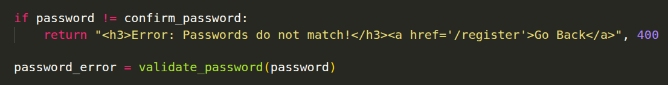
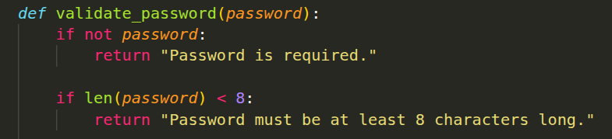
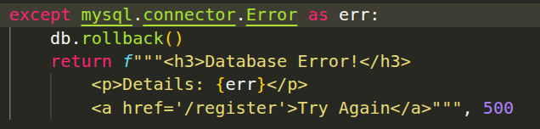
Code snippets: authentication & security
Registration stores hashed passwords and rolls back when a database error occurs
Passwords must match before registration continues
Password rules check length, uppercase, lowercase, number and special character
Only the hashed password is stored, not the plain password
A unique random salt is automatically added to each password
Rollback stops incomplete user records being saved
Parameterised SQL helps protect against SQL injection
Notes:
This code snippet shows part of the user registration workflow. Before an account is created, the system validates the submitted data and hashes the user's password before storing it in the database. This means the original password is never stored directly, reducing the risk of credential exposure if the database were compromised."
"The registration process also creates records in multiple tables, such as Address and Users. If an error occurs during this process, the transaction is rolled back. This prevents partial writes, where an address might be created without a corresponding user account."
"The use of parameterized SQL statements also helps protect against SQL injection by separating user input from the query structure."
"From a reliability and security perspective, these measures help maintain data integrity and protect user information."

Slide 11
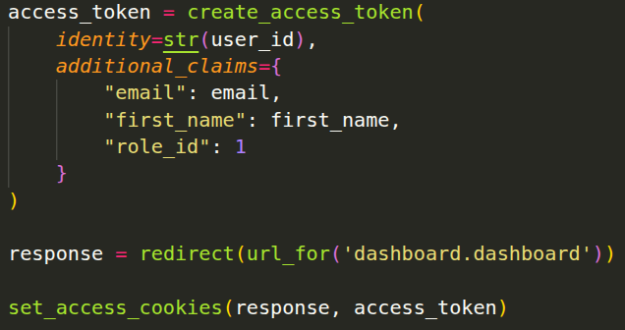

Code snippets: JWT login and protected pages
JWT is created after successful login
Token stores user ID and role information
JWT cookie keeps the user logged in securely
@jwt_required() protects private routes
Role ID helps control customer/admin access
Notes:
This code snippet shows part of the user registration workflow. Before an account is created, the system validates the submitted data and hashes the user's password before storing it in the database. This means the original password is never stored directly, reducing the risk of credential exposure if the database were compromised."
"The registration process also creates records in multiple tables, such as Address and Users. If an error occurs during this process, the transaction is rolled back. This prevents partial writes, where an address might be created without a corresponding user account."
"The use of parameterized SQL statements also helps protect against SQL injection by separating user input from the query structure."
"From a reliability and security perspective, these measures help maintain data integrity and protect user information."

Slide 12
Code snippets: checkout and payment reliability
The highest-risk flow creates a Stripe PaymentIntent, confirms success, then writes order and payment records
1 intent = stripe.PaymentIntent.create( 2 amount=amount_cents, 3 currency="gbp", 4 metadata={"integration_check": "accept_a_payment"} 5 ) 6 7 intent = stripe.PaymentIntent.retrieve(payment_intent_id) 8 if intent.status != "succeeded": 9 return jsonify({"error": "payment not successful"}), 400 10 11 # record order and payment 12 cursor.execute(order_insert_query, (...)) 13 order_id = cursor.lastrowid 14 cursor.execute(payments_log_query, (...)) 15 db.commit()
const form = document.getElementById('payment-form');
const submit = document.getElementById('submit');
const cardErrors = document.getElementById('card-errors');
Payment Practices
Payment success is important
User information never in plaintext
Stripe API for payment, checks cards and handles many issues
Wll identify valid and invalid cards for you and resolve payment.
Notes:
"This slide shows the checkout and payment workflow
The process begins by creating a Stripe PaymentIntent and then verifying that the payment was successfully completed. Only after confirmation does the application write the corresponding order and payment records to the database."
"From an SRE perspective, this workflow is important because failures here are immediately visible to customers and can have financial consequences. We need to ensure that payment and order records remain consistent and that customers are not charged without an order being created."
"Another consideration is idempotency. If a confirmation request is received multiple times, the system should recognise that the payment has already been processed and avoid creating duplicate orders or charging the customer twice."
"A useful service-level indicator for this workflow would be checkout success rate, which measures the percentage of checkout sessions that successfully complete payment and create the required records."

Slide 13
Code snippets: Docker and Kubernetes
Docker and Kube help create a smooth deployment process.
FROM python:3.12-slim
WORKDIR /app
COPY requirements.txt .
RUN pip install -r requirements.txt
COPY ./ ./
EXPOSE 5005
CMD ["python", "app.py"]
—-----------------------------------------------
apiVersion: v1
kind: Pod
metadata:
name: aura-app
labels:
app: aura-app
spec:
containers:
- name: aura-app
image: aura-app:v1
imagePullPolicy: Never
env: …
—-----------------------------------------------
echo -e "Building Docker image in Minikube..."
eval $(minikube docker-env)
docker build -t aura-app:v1 .
Automating and Reducing Toil
Dockerising the process, allowing it to be placed in a container, and run in other environments and building an image.
Configuration maps for environment variables and applying them to the image build.
Deploying image to kubernetes
Creating scripts for builds and running of the application - reducing redundancy

Slide 14
Future Improvements//Objectives
Detailed Views
While often being able to see payment and order history, no way to deep dive on to what was ordered or see a modular breakdown of the order itself. Would be ideal.
Always logged in?
Current processes relies heavily on user account for processes, makes passing information easy, however, while convenient, users would be able to make a booking without making an account.
Advanced Menu
A menu with images, that allows fo searches, filtering, sorting to let the user view the menu based on their preferences
Add Items
Admin could have the ability to add new items from the menu themselves, not just done from the database manually.
Notes:
Be transparent: this is the best SRE answer. The project has foundations, but production-grade SRE needs health checks, monitoring, secrets, idempotency, backups, and more than one replica.

Slide 15

Conclusion
The project successfully delivers a working Restaurant Management System that combines customer services, administrative controls and secure payment functionality within one Flask application.
What We Delivered
Customer registration and JWT-based authentication
Reservation amendment and cancellation
Customer menu and basket functionality
Stripe payment processing and order history
Administrative menu management
MySQL database integration
Docker and Kubernetes deployment files
Notes:
Close by repeating the story: the app solves restaurant operations, the implementation has clear layers and data relationships, and SRE concepts give a production-ready path. Invite questions.

Slide 16
DEMO

