Slide 1
Undergraduate Group 4
Justin Neal, Lee Klarich, Brian Cabigon, Tim Lewis, Jordan Benator

Slide 2

The Data
“This dataset includes all valid felony, misdemeanor, and violation crimes reported to the New York City Police Department (NYPD) from 2006 to the end of [2017].”
Includes time, location, categories, descriptions
6.5 million reports
2.06 GB uncompressed

Slide 3
Preprocessing
Cleaning mistyped years
In order to convert to datetime format, all of the dates had to be within range.
Converting date and time to datetime format
A new column is created to combine complaint_to and from columns into one, and convert the column into datetime format.
Dropping unwanted columns
All columns that were not needed for our questions were dropped. The data was then exported and the uncompressed file size was 904MB.

Slide 4
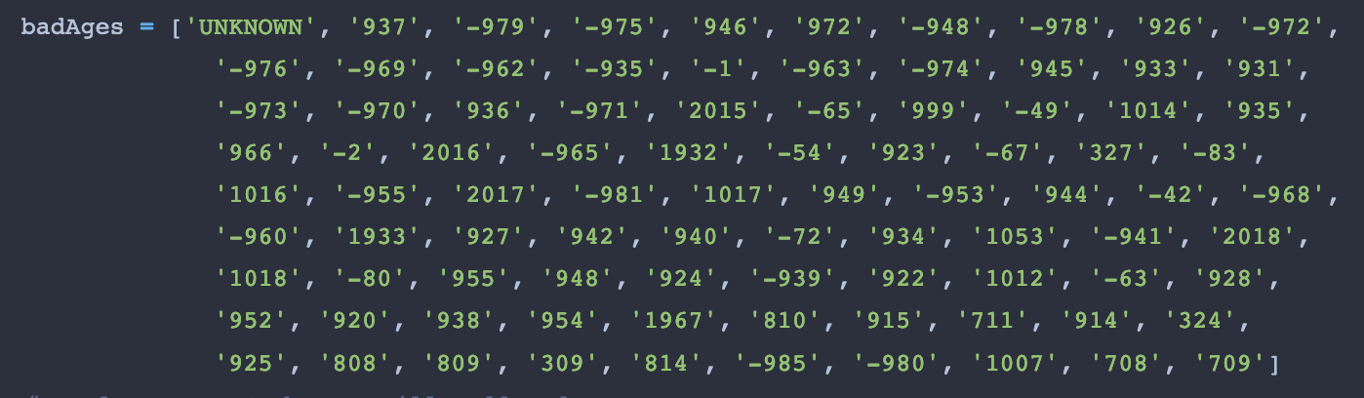
What is the average age of suspects that committed burglary?
The unique values in the suspect age group column were displayed
Bad age group values were converted to nan and dropped
Data was cleaned to only suspect age group and offense column
Data was then filtered to only contain burglaries
This was a bad question: suspect ages are not integers, they’re ranges that are strings and large ones at that; there are many missing values (4.5mil)
How to reword this question to better suit our data?

Slide 5
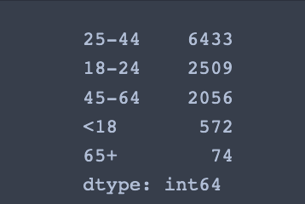
What age group commits the most burglaries?
To answer this question by getting the value counts on the suspect age group column
The age group of 25-44 commits the most burglaries

Slide 6
Is there any correlation between the time of the offense and the type of offense that was committed?
Date/time of offense is logged in a FROM and TO column. If the time of offense is precisely know, it is logged in the FROM column, and the TO column is empty. Otherwise, the event happened at some point between the time in FROM and the time in TO.
Rows were dropped if FROM was null.
Rows were dropped if FROM-TO window was greater than three hours (using datetime and timedelta).
Similar OFNS_DESCs were combined (i.e. ADMINISTRATIVE CODE and ADMINISTRATIVE CODES, INTOXICATED/IMPAIRED DRIVING and INTOXICATED & IMPAIRED DRIVING).

Slide 7
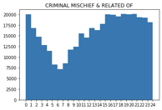
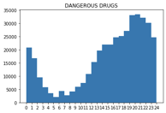
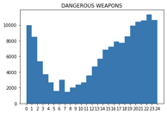
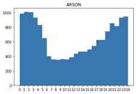
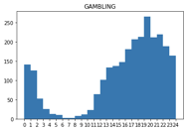
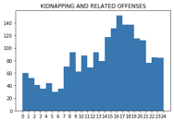
Is there any correlation between the time of the offense and the type of offense that was committed?
Plotted a histogram for each OFNS_DESC
Time of day vs. count, 24 bins
Most categories follow roughly the same sinusoidal sort of shape.
Peak around 6pm,
dip around 6am
Peak around 8pm,
dip around 5am
Peak around 10pm,
dip around 7am
Peak around 1am,
dip around 8am
Peak around 7pm,
dip around 7am
Peak around 4pm,
dip around 5am

Slide 8
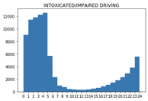
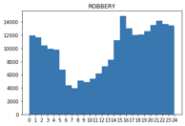
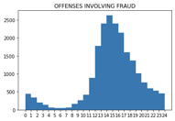
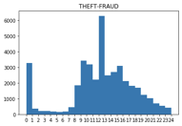
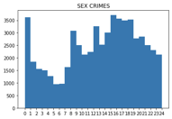
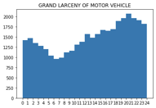
Is there any correlation between the time of the offense and the type of offense that was committed?
Crimes that didn’t follow the common pattern:
Very sharp decline from 5am to 7am following a fairly steady increase
(bars close at 4)
Roughly sinusoidal except for peak at 3pm
Extra “pointy,”
Highly concentrated around 2pm
Irregular.
Huge spike at noon
Irregular
Sinusoidal but with a much smaller amplitude

Slide 9
Is there any noted correlation to the type of offense and the location of offense?
To answer this question, crimes were plotted on a map of the 5 boroughs
All nan values for offense and coordinates were dropped
Because of the boroughs shapefile, coordinates had to be converted to spatial reference coordinates (EPSG: 2263)
To keep the plot as accurate as possible, coordinate values outside of the shapefile’s range were dropped
Due to the high number of unique offenses (71), only the top 10 crimes were plotted
The crimes were plotted using ggplot2, and the points are made transparent to see the concentration of crimes

Slide 10
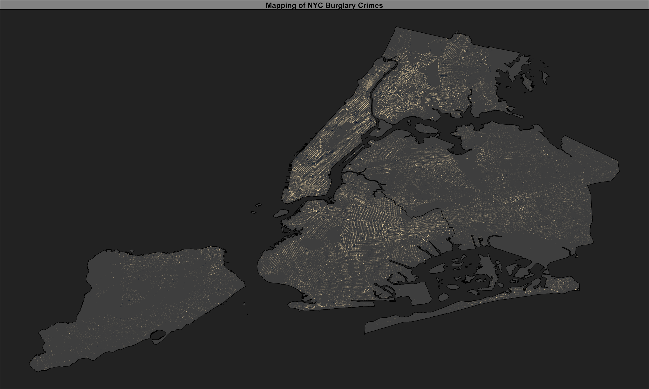
Map of Only Burglaries in NYC

Slide 11
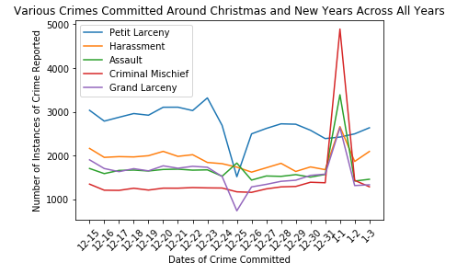
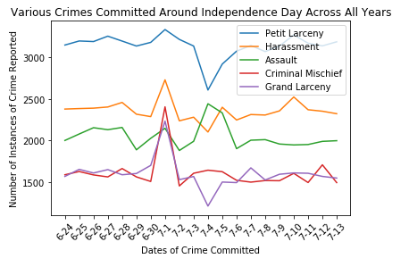
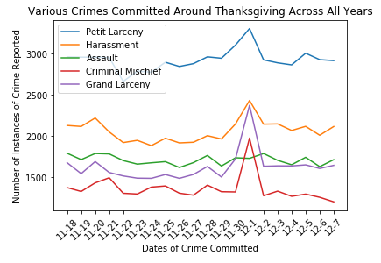
Were there any rises of specific crimes on certain holidays?

Slide 12
Are there any specific date ranges or time ranges where crime is more prevalent in one borough than the other?
Here we want to create a bar graph to compare the time/date with the boroughs to see where there is a highest amount of crimes in a certain borough during a specific timeframe.

Slide 13
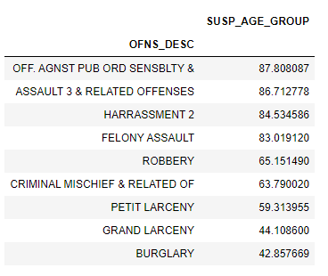
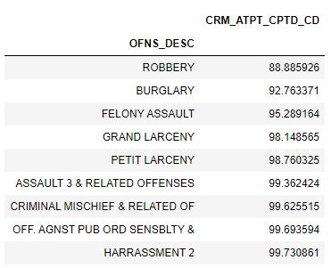
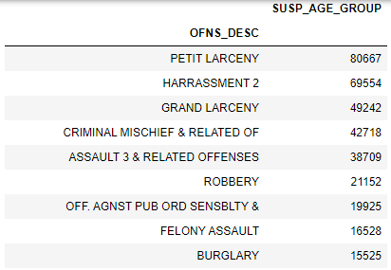
What crimes are the easiest to get away with?
% of Instances With
No Suspect Info
% of Instances Where
Crime Was Completed
List of Significant Crimes (>10k Instances)

Slide 14
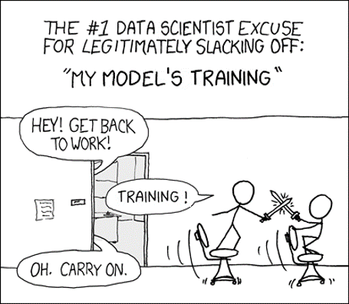
What crime will be most likely to be committed on a given day in the future?

Slide 15
The Approach
The Data:
Independent Variable -> Timeframe of crime occurrence
Dependent Variable -> Number of occurrences of the top 10 most committed crimes in NYC during a timeframe
Preprocessing -> Removed all entries with dates before 01-01-06T00:00 and after 12-31-17T23:59
The Models:
Random Forest
n_estimators = [100, 500, 1000]
Multilayer Perceptron
hidden_layer_sizes = [[200], [50, 100], [50, 100, 50]]
batch_sizes = [16, 64, 128, 256]
activation

Slide 16
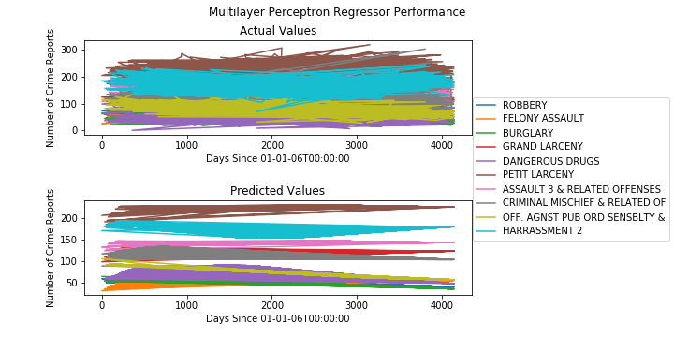
The Results: Multilayer Perceptron Regressor
Multilayer Perceptron
Random Forest Regressor

Slide 17
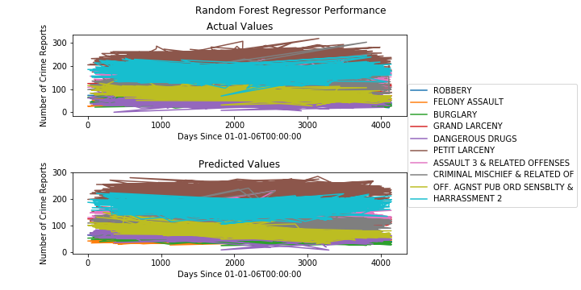
The Results: Random Forest Regressor

Slide 18
Questions?

