Slide 1


Mapping Research in Earth System Sciences (MaRESS): Developing an Application for Ecological Data Integration and AI-Assisted Information Management
Kick-Off 22.05.2025

Slide 2




Mapping Research in Earth System Sciences (MaRESS): Developing an Application for Ecological Data Integration and AI-Assisted Information Management
Kick-Off 22.05.2025
Knowledge
Map

Slide 3







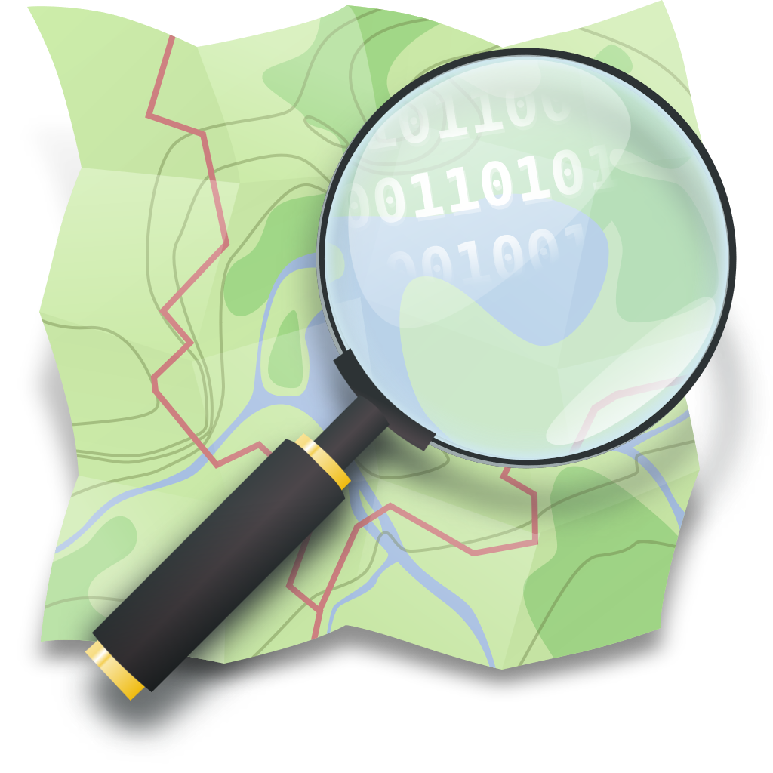












Mapping Research in Earth System Sciences (MaRESS): Developing an Application for Ecological Data Integration and AI-Assisted Information Management
Kick-Off 22.05.2025
Research Data Mapping
Geographic Mapping
MaRESS
research suit
OpenStreetMap
Knowledge
Map
AI-assistant
Semantic Mapping

Slide 4
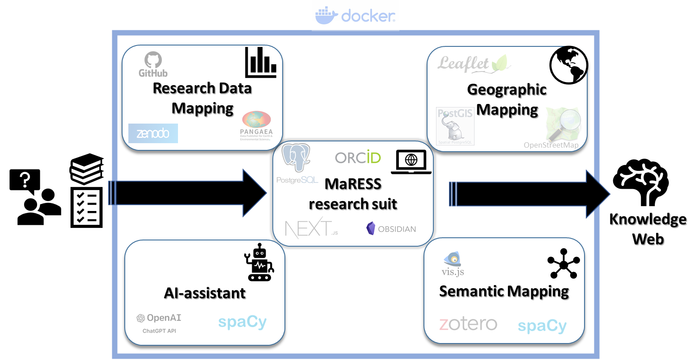
Mapping Research in Earth System Sciences (MaRESS): Developing an Application for Ecological Data Integration and AI-Assisted Information Management
01.07.2025 – 31.12.2025 (24.300 €)
WP 1: Project Setup
WP 2: Core module development (MaRESS RS)
WP 3: Semantic mapping
WP 4: Geographic mapping
WP 5: AI-Assistant
WP 6: Research data mapping
WP 7: Testing and Documentation

Slide 5
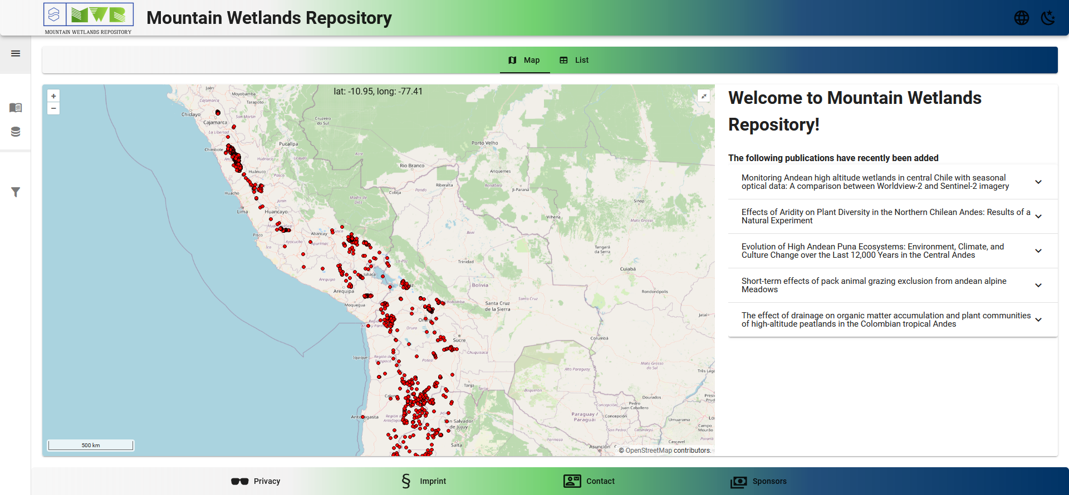
https://andes.mountain-wetlands-repository.info

Slide 6
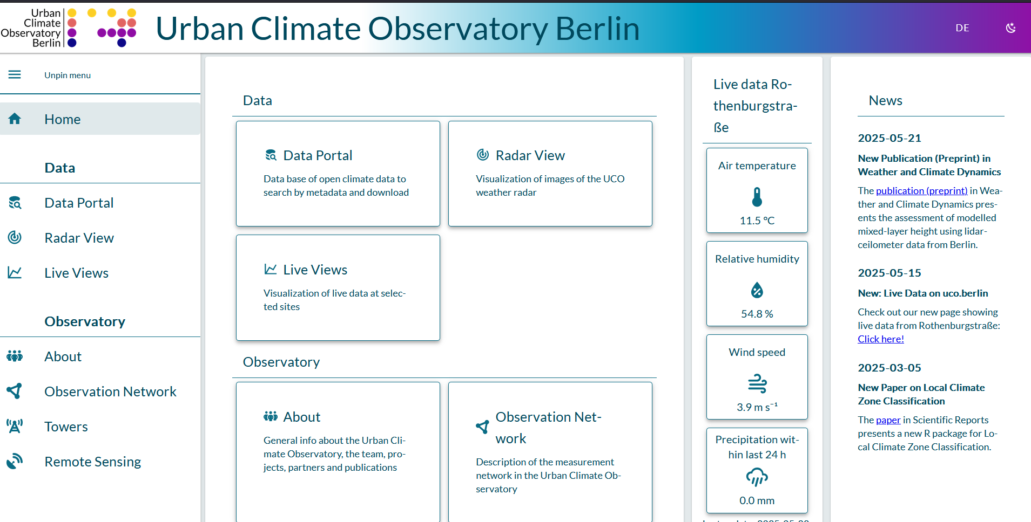
https://uco.berlin/en

Slide 7
Mapping Research in Earth System Sciences (MaRESS): Developing an Application for Ecological Data Integration and AI-Assisted Information Management
Relevance for the NFDI4Earth
MaRESS enhances data accessibility and aids ESS researchers, data curators, and educators in identifying knowledge gaps.
MaRESS integrates existing tools for data mapping, metadata integration, and user consultation to support thematic and geographic research.
MaRESS will contribute to NFDI4Earth’s concept of living documents on research trends and gaps, guiding future research and development.
Deliverables
A source code repository containing setup instructions and containers (Docker Composer) will be made publicly available including documentation, user guides, installation procedures, and example data for easy setup (Mountain wetland Repository).

Slide 8
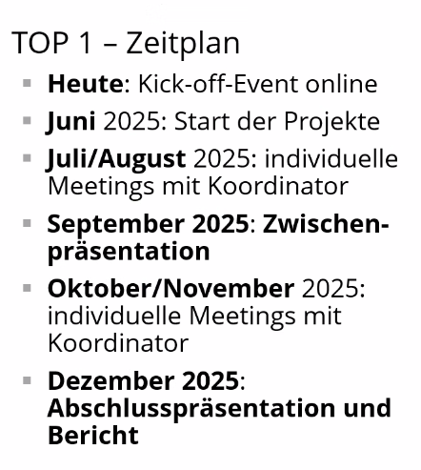
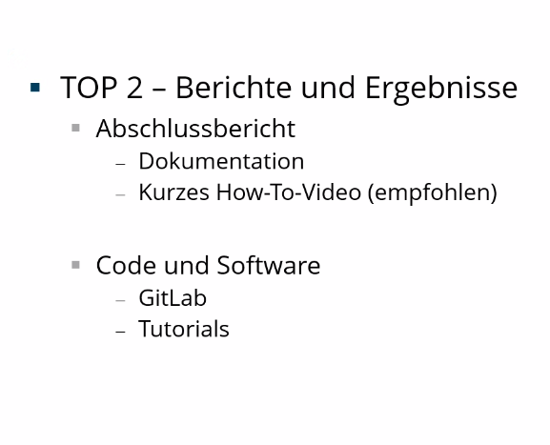
Bremen – Funding ask directly?

