Slide 1
01 LK_P050_07 metrics
D-L-D fusion Candidate A: 151 aa Human GLP1R B: 440 aa
Metric and scope | Value
Boltz2 Exact ipSAE (A/B, Type=max) | 0.919125
DeltaForge predicted Kd (nM) | 3.0368
Boltz2 Exact ipTM | 0.9356
Original population ipSAE rank | 1
Predicted-Kd rank within population top50 | 27
Candidate / receptor residues (aa) | 151 / 440
pDockQ / pDockQ2 | 0.3814 / 0.2607
Whole fusion / linker pLDDT (0-100) | 49.8 / 40.4
ECD / LigandForge pLDDT (0-100) | 66.6 / 40.8
Fusion design-to-refold DockQ | 0.1901
Free C-terminal OPM z (A) | 42.39
Extracellular free C-terminal screen | Pass
DeltaForge length scope | long_gt_140
Origin and prediction
ECD parent S11_02_089
LigandForge parent Design_280
Pair P050
AP Novo seed 608
Exact seed 101
3 recycles, 200 steps
ECD A1-53 linker A54-82 LF A83-151
Whole-fusion pLDDT remains modest. High interface confidence does not establish activation.
Complete selected sequence, N to C
MGISALEEFDRLRRASILLSLIRSGSTGSGFDAFLEKSGVKGAPAFLAVPSSNAFSPTSSEVAPDLPFVVLPYP
PPPSSSVIEVSGATIDLRVKTCVDFKQTVNFFKLRNTQLPGSCTKDNTVLFLLEGLKLGYASRYFSIGSGSGSQ
QFS
Human GLP1R Boltz2 Exact Computational predictions
1
Notes:
{
"candidate": "LK_P050_07",
"final_rank": 1,
"selection": "Exact ipSAE>0.895 and DeltaForge predicted Kd<10nM; first20 by Exact ipSAE descending",
"sequence_sha256": "8000f5c8beaabd85c535414db11b1dd318ccc9c2bba0011886cfc973fc322e70",
"sources": {
"source_table": {
"path": "local/2026-10-25_lf50-dld26-50-deltaforge_001/output/GLP1R_DLD_Top50_DeltaForge_Kd_and_Boltz2_Metrics.csv",
"sha256": "da9569bf0e8b74cce3d6792eb260d6a4b17b35e6f46e0793d49f02c0d3a0e728"
},
"native_cif": {
"path": "local/2026-10-25_linker-top100-review_001/models/LK_P050_07/boltz2.cif",
"sha256": "95fbf8fd1df93b530aa3e8891105ce33fa14c8f4927c88bc66508b78429a8cf4"
},
"scoring_pdb": {
"path": "local/2026-10-25_dld-top25-deltaforge_001/payload/structures/LK_P050_07.pdb",
"sha256": "d9b53c1f12d16d34a339b552c1949f02946de3defb87e31d4871c546eac5dd93"
},
"DeltaForge_result": {
"path": "campaigns/glp1r-r40-design/runs/2026-10-25_dld-top25-deltaforge_001/03_filtering/deltaforge_results/LK_P050_07.json",
"sha256": "494200dff525731399b30d8ee04f5fb949f6715eba38198a843dd4e65cc1fb24"
}
},
"source_ledger": "campaigns/glp1r-final-writeup/runs/2026-10-25_final20-writeup_001/04_analysis/provenance-ledger.json",
"scorer": "deltaforge_v10_2_unified_parallel / v10_2_unified_parallel_2026_05_08",
"calibration": "deltaforge_v10_boltz2_calibrated_gbr / v10_boltz2_gbr_2026_03_29",
"scope": "one complete candidate A against one receptor B; computational, no experimental Kd or activation"
}

Slide 2
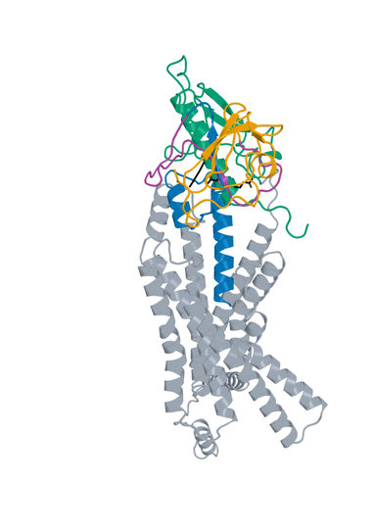
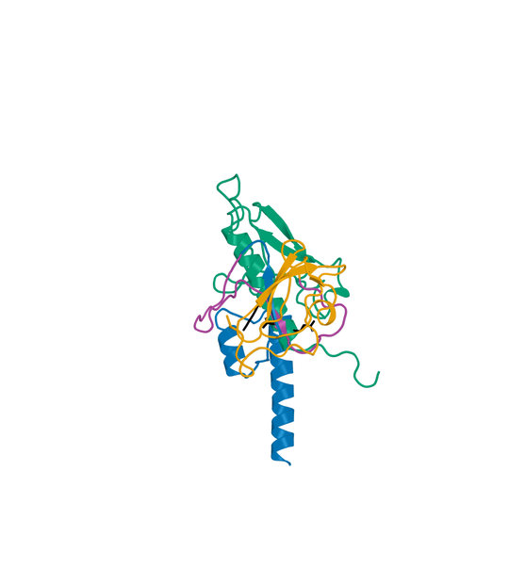
01 LK_P050_07 structure
D-L-D fusion Candidate A: 151 aa Human GLP1R B: 440 aa
Boltz2 Exact receptor complex
Boltz2 Exact interface detail
LigandForge
Linker
ECD binder
Receptor ECD
Remaining receptor
Hotspots
Receptor ECD B1–105 (UniProt 24–128). Black sticks: E34, Q37 and R40. View-specific zoom.
Complete selected sequence, N to C
MGISALEEFDRLRRASILLSLIRSGSTGSGFDAFLEKSGVKGAPAFLAVPSSNAFSPTSSEVAPDLPFVVLPYP
PPPSSSVIEVSGATIDLRVKTCVDFKQTVNFFKLRNTQLPGSCTKDNTVLFLLEGLKLGYASRYFSIGSGSGSQ
QFS
Human GLP1R Boltz2 Exact Computational predictions
2
Notes:
{
"candidate": "LK_P050_07",
"final_rank": 1,
"native_model_sha256": "95fbf8fd1df93b530aa3e8891105ce33fa14c8f4927c88bc66508b78429a8cf4",
"structure_views": {
"final_rank": 1,
"design_id": "LK_P050_07",
"sequence_sha256": "8000f5c8beaabd85c535414db11b1dd318ccc9c2bba0011886cfc973fc322e70",
"native_model_sha256": "95fbf8fd1df93b530aa3e8891105ce33fa14c8f4927c88bc66508b78429a8cf4",
"scoring_pdb_sha256": "d9b53c1f12d16d34a339b552c1949f02946de3defb87e31d4871c546eac5dd93",
"overview": {
"source_slide": 19,
"source_picture_index": 1,
"embedded_media": "ppt/media/image16.jpeg",
"image_sha256": "ae83cbaa9dac8d3734087495284e30462f740a35b08c6d2f18abbcd814f0c898",
"asset": "assets/LK_P050_07-complex.jpg"
},
"interface": {
"source_slide": 20,
"source_picture_index": 1,
"embedded_media": "ppt/media/image19.jpeg",
"image_sha256": "2ba45f31242c2b84ff21ec5e4c87f6c8a13013d6d28dcb2c19d463763dcb26d1",
"asset": "assets/LK_P050_07-interface.jpg"
},
"rendering_provenance": {
"DeltaForge_source_PDB_sha256": "d9b53c1f12d16d34a339b552c1949f02946de3defb87e31d4871c546eac5dd93",
"role_ranges_zero_based": {
"ECD": [
0,
53
],
"linker": [
53,
82
],
"LF": [
82,
151
]
},
"model_sha256": "95fbf8fd1df93b530aa3e8891105ce33fa14c8f4927c88bc66508b78429a8cf4",
"source_run": "2026-10-24_pair183-extracellular-exact_001",
"source_methods": [
"https://github.com/DunbrackLab/IPSAE",
"https://github.com/wallnerlab/DockQ",
"https://zhanggroup.org/TM-score/"
],
"saved_display_appendix": {
"parent_sources": {
"ECD-parent": {
"key": "LK_P050_07-ECD-parent",
"source_path": "local/2026-10-25_linker-parent-comparison_001/parents/S11_02_089/exact.pdb",
"source_sha256": "33a626296d1404a15d5b43fc0af2d090024dd0f999abdc0c455da40d2747c0cc",
"role": "ECD",
"ranges_zero_based": {
"ECD": [
0,
53
]
},
"sequence": "MGISALEEFDRLRRASILLSLIRSGSTGSGFDAFLEKSGVKGAPAFLAVPSSN",
"rotation": [
[
0.4601914785026544,
0.8740030154194312,
0.15602098281507715
],
[
-0.3553315001691105,
0.3423619380873384,
-0.8697860883530819
],
[
-0.8136113209777376,
0.344828970313086,
0.4681128541492088
]
],
"translation": [
2.061273489264341,
3.6943565127962046,
-2.618342795969485
],
"core_fit_CA_RMSD_A": 0.7641443086142279,
"output": "local/2026-10-25_linker-parent-views_001/build/renders-v2/LK_P050_07-ECD-parent.jpg",
"parent_or_fusion_id": "S11_02_089",
"design_id": "LK_P050_07",
"panel": "ECD-parent",
"view": [
1,
0,
0,
0,
1,
0,
0,
0,
1,
0,
0,
-401.09488161205957,
-8.021741623952924,
16.219807804331833,
-17.333378338804657,
323.14270913479584,
479.0470540893233,
-20
],
"world_height_A": 141.44769890454734,
"row_bounds_all_atoms_A": [
[
-50.79037642370106,
-44.16816263862622,
-80.2855508160684
],
[
34.746893175795215,
76.60777824728989,
45.61879413845908
]
]
},
"APNovo": {
"key": "LK_P050_07-APNovo",
"source_path": "local/2026-10-25_linker-top100-review_001/build/comparisons/LK_P050_07/reference.pdb",
"source_sha256": "ab126a8b97659ccf23cd74a36d6c911ced4ed975e8914929a8a52bdc7023787e",
"role": "fusion",
"ranges_zero_based": {
"ECD": [
0,
53
],
"linker": [
53,
82
],
"LF": [
82,
151
]
},
"sequence": "MGISALEEFDRLRRASILLSLIRSGSTGSGFDAFLEKSGVKGAPAFLAVPSSNAFSPTSSEVAPDLPFVVLPYPPPPSSSVIEVSGATIDLRVKTCVDFKQTVNFFKLRNTQLPGSCTKDNTVLFLLEGLKLGYASRYFSIGSGSGSQQFS",
"rotation": [
[
-0.6102049170476462,
-0.2425680515738584,
-0.7541953877840903
],
[
-0.7291263203266389,
0.544302593245821,
0.4148607638211814
],
[
0.30987854854386043,
0.8030537886824152,
-0.5089989076390111
]
],
"translation": [
-11.29733540444457,
-12.610899067190573,
5.484263694487203
],
"core_fit_CA_RMSD_A": 0.7641609644326763,
"output": "local/2026-10-25_linker-parent-views_001/build/renders-v2/LK_P050_07-APNovo.jpg",
"parent_or_fusion_id": "LK_P050_07-APNovo",
"design_id": "LK_P050_07",
"panel": "APNovo",
"view": [
1,
0,
0,
0,
1,
0,
0,
0,
1,
0,
0,
-401.09488161205957,
-8.021741623952924,
16.219807804331833,
-17.333378338804657,
323.14270913479584,
479.0470540893233,
-20
],
"world_height_A": 141.44769890454734,
"row_bounds_all_atoms_A": [
[
-50.79037642370106,
-44.16816263862622,
-80.2855508160684
],
[
34.746893175795215,
76.60777824728989,
45.61879413845908
]
]
},
"Exact": {
"key": "LK_P050_07-Exact",
"source_path": "local/2026-10-25_linker-top100-review_001/models/LK_P050_07/boltz2.cif",
"source_sha256": "95fbf8fd1df93b530aa3e8891105ce33fa14c8f4927c88bc66508b78429a8cf4",
"role": "fusion",
"ranges_zero_based": {
"ECD": [
0,
53
],
"linker": [
53,
82
],
"LF": [
82,
151
]
},
"sequence": "MGISALEEFDRLRRASILLSLIRSGSTGSGFDAFLEKSGVKGAPAFLAVPSSNAFSPTSSEVAPDLPFVVLPYPPPPSSSVIEVSGATIDLRVKTCVDFKQTVNFFKLRNTQLPGSCTKDNTVLFLLEGLKLGYASRYFSIGSGSGSQQFS",
"rotation": [
[
0.9999999538983602,
-1.4677749682334706e-8,
1.1116654263787495e-8
],
[
-1.4677749682334706e-8,
0.9999999994611797,
2.176987479174386e-10
],
[
1.1116654263787495e-8,
2.176987479174386e-10,
1.0000000016015171
]
],
"translation": [
7.366758048021893e-7,
1.9043830334908307e-7,
-1.3943711185682162e-7
],
"core_fit_CA_RMSD_A": 7.965805332947178e-7,
"output": "local/2026-10-25_linker-parent-views_001/build/renders-v2/LK_P050_07-Exact.jpg",
"parent_or_fusion_id": "LK_P050_07-Exact",
"design_id": "LK_P050_07",
"panel": "Exact",
"view": [
1,
0,
0,
0,
1,
0,
0,
0,
1,
0,
0,
-401.09488161205957,
-8.021741623952924,
16.219807804331833,
-17.333378338804657,
323.14270913479584,
479.0470540893233,
-20
],
"world_height_A": 141.44769890454734,
"row_bounds_all_atoms_A": [
[
-50.79037642370106,
-44.16816263862622,
-80.2855508160684
],
[
34.746893175795215,
76.60777824728989,
45.61879413845908
]
]
},
"LF-parent": {
"key": "LK_P050_07-LF-parent",
"source_path": "local/2026-10-25_linker-parent-comparison_001/parents/Design_280/exact.pdb",
"source_sha256": "cd01c89fbf40d0e577c10f20c2afa96c3deef09880d6c761314a1c5e9898bd4f",
"role": "LF",
"ranges_zero_based": {
"LF": [
0,
69
]
},
"sequence": "EVSGATIDLRVKTCVDFKQTVNFFKLRNTQLPGSCTKDNTVLFLLEGLKLGYASRYFSIGSGSGSQQFS",
"rotation": [
[
0.9716521520149124,
0.23640963200020604,
-0.0015985785293137766
],
[
-0.232382419508661,
0.9563002615331773,
0.17744913387297956
],
[
0.04347938667791329,
-0.1720473610249762,
0.9841286681075418
]
],
"translation": [
3.3985903455718525,
-6.121573941428423,
6.014485827651381
],
"core_fit_CA_RMSD_A": 1.3060904572635719,
"output": "local/2026-10-25_linker-parent-views_001/build/renders-v2/LK_P050_07-LF-parent.jpg",
"parent_or_fusion_id": "Design_280",
"design_id": "LK_P050_07",
"panel": "LF-parent",
"view": [
1,
0,
0,
0,
1,
0,
0,
0,
1,
0,
0,
-401.09488161205957,
-8.021741623952924,
16.219807804331833,
-17.333378338804657,
323.14270913479584,
479.0470540893233,
-20
],
"world_height_A": 141.44769890454734,
"row_bounds_all_atoms_A": [
[
-50.79037642370106,
-44.16816263862622,
-80.2855508160684
],
[
34.746893175795215,
76.60777824728989,
45.61879413845908
]
]
}
},
"shared_camera": [
1,
0,
0,
0,
1,
0,
0,
0,
1,
0,
0,
-401.09488161205957,
-8.021741623952924,
16.219807804331833,
-17.333378338804657,
323.14270913479584,
479.0470540893233,
-20
],
"reference": "Separate saved Exact parent complexes flank the linked Exact refold; AP Novo linked design comparison remains on the following slide. Rigid display alignment preserves native poses; all native receptor residues shown."
}
},
"display": "unchanged embedded JPEGs extracted from hash-verified delivered25-design PPTX; no resampling, cropping or new coordinate transforms",
"scale": "full complex and interface have different zooms; no matched-scale claim",
"hotspots": "black sticks; original27pocket positions for original LigandForge, R40/Q37/E34 annotations for DLD",
"colors": {
"LigandForge": "#E69F00",
"linker": "#AA4499",
"ECD_binder": "#0072B2",
"receptor_ECD": "#009E73",
"receptor_remainder": "#9AA5B1",
"hotspots": "#000000"
}
},
"source_deck": "local/2026-10-25_affinity-confidence-selection-deck_002/output/GLP1R_Selected_ipSAE_gt0p895_Kd_lt10nM_v3.pptx",
"source_deck_sha256": "ad9333fdf6c0ce7d6982e2980d6aade78af256710dbc7917f7f39e41d35aa173",
"domain_labels": "ECD A1-53 linker A54-82 LF A83-151",
"display_scope": "native Exact complex and saved interface view; same identity colors, independent zooms; no new coordinates or inferred agonism"
}

Slide 3
02 LK_P063_07 metrics
D-L-D fusion Candidate A: 140 aa Human GLP1R B: 440 aa
Metric and scope | Value
Boltz2 Exact ipSAE (A/B, Type=max) | 0.911264
DeltaForge predicted Kd (nM) | 1.3426
Boltz2 Exact ipTM | 0.8885
Original population ipSAE rank | 3
Predicted-Kd rank within population top50 | 13
Candidate / receptor residues (aa) | 140 / 440
pDockQ / pDockQ2 | 0.3717 / 0.2144
Whole fusion / linker pLDDT (0-100) | 48.6 / 43.9
ECD / LigandForge pLDDT (0-100) | 67.0 / 40.1
Fusion design-to-refold DockQ | 0.2115
Free C-terminal OPM z (A) | 60.46
Extracellular free C-terminal screen | Pass
DeltaForge length scope | platform_8_140
Origin and prediction
ECD parent S08_03_083
LigandForge parent Design_280
Pair P063
AP Novo seed 738
Exact seed 101
3 recycles, 200 steps
ECD A1-40 linker A41-71 LF A72-140
Whole-fusion pLDDT remains modest. High interface confidence does not establish activation.
Complete selected sequence, N to C
MEKKREDFKEVLKFRYSRYPSLDRFVLVNTAEESIRHLLIGMFVDPSEVLDPSPPPPPPLSLPPVPATDVVEVS
GATIDLRVKTCVDFKQTVNFFKLRNTQLPGSCTKDNTVLFLLEGLKLGYASRYFSIGSGSGSQQFS
Human GLP1R Boltz2 Exact Computational predictions
3
Notes:
{
"candidate": "LK_P063_07",
"final_rank": 2,
"selection": "Exact ipSAE>0.895 and DeltaForge predicted Kd<10nM; first20 by Exact ipSAE descending",
"sequence_sha256": "b140a1ab7270fe482da2b10c10059ed8faeaa1903da534255877c1114414d485",
"sources": {
"source_table": {
"path": "local/2026-10-25_lf50-dld26-50-deltaforge_001/output/GLP1R_DLD_Top50_DeltaForge_Kd_and_Boltz2_Metrics.csv",
"sha256": "da9569bf0e8b74cce3d6792eb260d6a4b17b35e6f46e0793d49f02c0d3a0e728"
},
"native_cif": {
"path": "local/2026-10-25_linker-top100-review_001/models/LK_P063_07/boltz2.cif",
"sha256": "bf7d45251c1117f8d3d61acb7256b8a07e9e9f305d30b8546530fea3ee6c1d82"
},
"scoring_pdb": {
"path": "local/2026-10-25_dld-top25-deltaforge_001/payload/structures/LK_P063_07.pdb",
"sha256": "a469a2fb5f07b3ed5af8e2f935fb82e41afd2e11ab7d233ddd419853c0a5e2e5"
},
"DeltaForge_result": {
"path": "campaigns/glp1r-r40-design/runs/2026-10-25_dld-top25-deltaforge_001/03_filtering/deltaforge_results/LK_P063_07.json",
"sha256": "ae5f2d0601c9fbade789cec67bc2d3d8dac7d8f3b6e3d786db9d139712b9442b"
}
},
"source_ledger": "campaigns/glp1r-final-writeup/runs/2026-10-25_final20-writeup_001/04_analysis/provenance-ledger.json",
"scorer": "deltaforge_v10_2_unified_parallel / v10_2_unified_parallel_2026_05_08",
"calibration": "deltaforge_v10_boltz2_calibrated_gbr / v10_boltz2_gbr_2026_03_29",
"scope": "one complete candidate A against one receptor B; computational, no experimental Kd or activation"
}

Slide 4
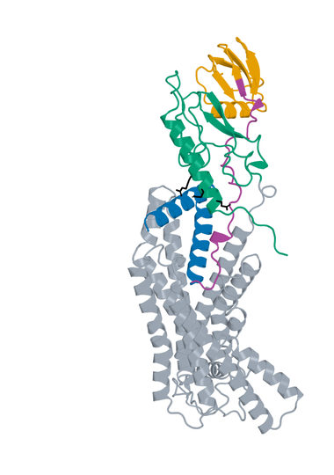
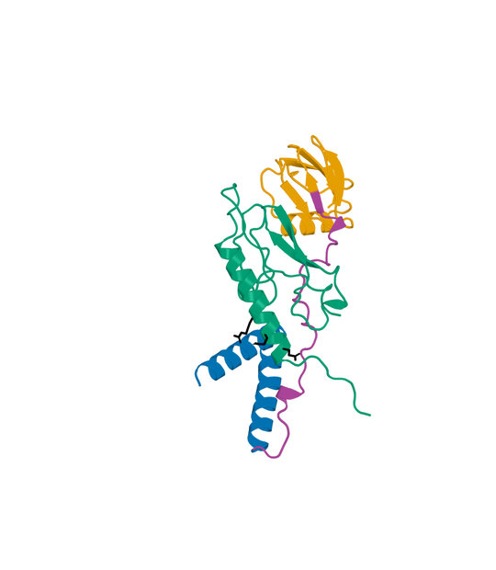
02 LK_P063_07 structure
D-L-D fusion Candidate A: 140 aa Human GLP1R B: 440 aa
Boltz2 Exact receptor complex
Boltz2 Exact interface detail
LigandForge
Linker
ECD binder
Receptor ECD
Remaining receptor
Hotspots
Receptor ECD B1–105 (UniProt 24–128). Black sticks: E34, Q37 and R40. View-specific zoom.
Complete selected sequence, N to C
MEKKREDFKEVLKFRYSRYPSLDRFVLVNTAEESIRHLLIGMFVDPSEVLDPSPPPPPPLSLPPVPATDVVEVS
GATIDLRVKTCVDFKQTVNFFKLRNTQLPGSCTKDNTVLFLLEGLKLGYASRYFSIGSGSGSQQFS
Human GLP1R Boltz2 Exact Computational predictions
4
Notes:
{
"candidate": "LK_P063_07",
"final_rank": 2,
"native_model_sha256": "bf7d45251c1117f8d3d61acb7256b8a07e9e9f305d30b8546530fea3ee6c1d82",
"structure_views": {
"final_rank": 2,
"design_id": "LK_P063_07",
"sequence_sha256": "b140a1ab7270fe482da2b10c10059ed8faeaa1903da534255877c1114414d485",
"native_model_sha256": "bf7d45251c1117f8d3d61acb7256b8a07e9e9f305d30b8546530fea3ee6c1d82",
"scoring_pdb_sha256": "a469a2fb5f07b3ed5af8e2f935fb82e41afd2e11ab7d233ddd419853c0a5e2e5",
"overview": {
"source_slide": 23,
"source_picture_index": 1,
"embedded_media": "ppt/media/image21.jpeg",
"image_sha256": "b3c273eb3d36fd482b4824c658a24a675eb10529e76705fbd205d2264f9bd735",
"asset": "assets/LK_P063_07-complex.jpg"
},
"interface": {
"source_slide": 24,
"source_picture_index": 1,
"embedded_media": "ppt/media/image24.jpeg",
"image_sha256": "2dc82a8265f627362a11e0b6ca8202a62e608d79083fc1a8e07cbe922c7bd9b3",
"asset": "assets/LK_P063_07-interface.jpg"
},
"rendering_provenance": {
"DeltaForge_source_PDB_sha256": "a469a2fb5f07b3ed5af8e2f935fb82e41afd2e11ab7d233ddd419853c0a5e2e5",
"role_ranges_zero_based": {
"ECD": [
0,
40
],
"linker": [
40,
71
],
"LF": [
71,
140
]
},
"model_sha256": "bf7d45251c1117f8d3d61acb7256b8a07e9e9f305d30b8546530fea3ee6c1d82",
"source_run": "2026-10-24_pair183-extracellular-exact_001",
"source_methods": [
"https://github.com/DunbrackLab/IPSAE",
"https://github.com/wallnerlab/DockQ",
"https://zhanggroup.org/TM-score/"
],
"saved_display_appendix": {
"parent_sources": {
"ECD-parent": {
"key": "LK_P063_07-ECD-parent",
"source_path": "local/2026-10-25_linker-parent-comparison_001/parents/S08_03_083/exact.pdb",
"source_sha256": "d20828f265dce8b2961c62530b400dd6dff7cc762eb2f9ea3633d08208b36846",
"role": "ECD",
"ranges_zero_based": {
"ECD": [
0,
40
]
},
"sequence": "MEKKREDFKEVLKFRYSRYPSLDRFVLVNTAEESIRHLLI",
"rotation": [
[
0.2828947574406797,
0.9494093760703075,
0.13635402243375871
],
[
0.007418938177479184,
0.1399909475757788,
-0.9901249690752376
],
[
-0.959122236331444,
0.28111279540521306,
0.03255909298531812
]
],
"translation": [
2.9826687458662207,
2.6578802153426135,
-3.718156967861327
],
"core_fit_CA_RMSD_A": 1.3686869252421163,
"output": "local/2026-10-25_linker-parent-views_001/build/renders-v2/LK_P063_07-ECD-parent.jpg",
"parent_or_fusion_id": "S08_03_083",
"design_id": "LK_P063_07",
"panel": "ECD-parent",
"view": [
1,
0,
0,
0,
1,
0,
0,
0,
1,
0,
0,
-390.45136026717313,
-9.355201402556244,
23.910341981222196,
-13.737335383029249,
336.1550949418093,
444.74762559253696,
-20
],
"world_height_A": 137.69421893884748,
"row_bounds_all_atoms_A": [
[
-50.80316732548407,
-33.93233172219635,
-53.03360070839306
],
[
32.09276452037158,
81.75301568464074,
25.55892994233456
]
]
},
"APNovo": {
"key": "LK_P063_07-APNovo",
"source_path": "local/2026-10-25_linker-top100-review_001/build/comparisons/LK_P063_07/reference.pdb",
"source_sha256": "0a1623dccf02cdcbb0819a5c326ea03f0397f2b1d854f4a01ae58ec8075a0fa0",
"role": "fusion",
"ranges_zero_based": {
"ECD": [
0,
40
],
"linker": [
40,
71
],
"LF": [
71,
140
]
},
"sequence": "MEKKREDFKEVLKFRYSRYPSLDRFVLVNTAEESIRHLLIGMFVDPSEVLDPSPPPPPPLSLPPVPATDVVEVSGATIDLRVKTCVDFKQTVNFFKLRNTQLPGSCTKDNTVLFLLEGLKLGYASRYFSIGSGSGSQQFS",
"rotation": [
[
0.19086517469156483,
-0.7896264693440829,
0.5831470418982718
],
[
-0.9420628626139161,
-0.31428531173077845,
-0.11722774439385009
],
[
0.27584068901630143,
-0.5269864655618974,
-0.8038638713013246
]
],
"translation": [
-11.493793466797236,
-15.670525101298306,
4.870590462400108
],
"core_fit_CA_RMSD_A": 1.3686857710182805,
"output": "local/2026-10-25_linker-parent-views_001/build/renders-v2/LK_P063_07-APNovo.jpg",
"parent_or_fusion_id": "LK_P063_07-APNovo",
"design_id": "LK_P063_07",
"panel": "APNovo",
"view": [
1,
0,
0,
0,
1,
0,
0,
0,
1,
0,
0,
-390.45136026717313,
-9.355201402556244,
23.910341981222196,
-13.737335383029249,
336.1550949418093,
444.74762559253696,
-20
],
"world_height_A": 137.69421893884748,
"row_bounds_all_atoms_A": [
[
-50.80316732548407,
-33.93233172219635,
-53.03360070839306
],
[
32.09276452037158,
81.75301568464074,
25.55892994233456
]
]
},
"Exact": {
"key": "LK_P063_07-Exact",
"source_path": "local/2026-10-25_linker-top100-review_001/models/LK_P063_07/boltz2.cif",
"source_sha256": "bf7d45251c1117f8d3d61acb7256b8a07e9e9f305d30b8546530fea3ee6c1d82",
"role": "fusion",
"ranges_zero_based": {
"ECD": [
0,
40
],
"linker": [
40,
71
],
"LF": [
71,
140
]
},
"sequence": "MEKKREDFKEVLKFRYSRYPSLDRFVLVNTAEESIRHLLIGMFVDPSEVLDPSPPPPPPLSLPPVPATDVVEVSGATIDLRVKTCVDFKQTVNFFKLRNTQLPGSCTKDNTVLFLLEGLKLGYASRYFSIGSGSGSQQFS",
"rotation": [
[
0.4406298765647474,
-0.21123770748430992,
-0.872481483895136
],
[
0.8275978285060432,
0.4720913199340724,
0.3036636198818883
],
[
0.3477457653989884,
-0.8558670823300418,
0.3828373915847818
]
],
"translation": [
-2.8214237269515863,
-3.0296103510338366,
-4.4303086160739875
],
"core_fit_CA_RMSD_A": 1.2557999921812177,
"output": "local/2026-10-25_linker-parent-views_001/build/renders-v2/LK_P063_07-Exact.jpg",
"parent_or_fusion_id": "LK_P063_07-Exact",
"design_id": "LK_P063_07",
"panel": "Exact",
"view": [
1,
0,
0,
0,
1,
0,
0,
0,
1,
0,
0,
-390.45136026717313,
-9.355201402556244,
23.910341981222196,
-13.737335383029249,
336.1550949418093,
444.74762559253696,
-20
],
"world_height_A": 137.69421893884748,
"row_bounds_all_atoms_A": [
[
-50.80316732548407,
-33.93233172219635,
-53.03360070839306
],
[
32.09276452037158,
81.75301568464074,
25.55892994233456
]
]
},
"LF-parent": {
"key": "LK_P063_07-LF-parent",
"source_path": "local/2026-10-25_linker-parent-comparison_001/parents/Design_280/exact.pdb",
"source_sha256": "cd01c89fbf40d0e577c10f20c2afa96c3deef09880d6c761314a1c5e9898bd4f",
"role": "LF",
"ranges_zero_based": {
"LF": [
0,
69
]
},
"sequence": "EVSGATIDLRVKTCVDFKQTVNFFKLRNTQLPGSCTKDNTVLFLLEGLKLGYASRYFSIGSGSGSQQFS",
"rotation": [
[
0.9716521520149124,
0.23640963200020604,
-0.0015985785293137766
],
[
-0.232382419508661,
0.9563002615331773,
0.17744913387297956
],
[
0.04347938667791329,
-0.1720473610249762,
0.9841286681075418
]
],
"translation": [
3.3985903455718525,
-6.121573941428423,
6.014485827651381
],
"core_fit_CA_RMSD_A": 1.3060904572635719,
"output": "local/2026-10-25_linker-parent-views_001/build/renders-v2/LK_P063_07-LF-parent.jpg",
"parent_or_fusion_id": "Design_280",
"design_id": "LK_P063_07",
"panel": "LF-parent",
"view": [
1,
0,
0,
0,
1,
0,
0,
0,
1,
0,
0,
-390.45136026717313,
-9.355201402556244,
23.910341981222196,
-13.737335383029249,
336.1550949418093,
444.74762559253696,
-20
],
"world_height_A": 137.69421893884748,
"row_bounds_all_atoms_A": [
[
-50.80316732548407,
-33.93233172219635,
-53.03360070839306
],
[
32.09276452037158,
81.75301568464074,
25.55892994233456
]
]
}
},
"shared_camera": [
1,
0,
0,
0,
1,
0,
0,
0,
1,
0,
0,
-390.45136026717313,
-9.355201402556244,
23.910341981222196,
-13.737335383029249,
336.1550949418093,
444.74762559253696,
-20
],
"reference": "Separate saved Exact parent complexes flank the linked Exact refold; AP Novo linked design comparison remains on the following slide. Rigid display alignment preserves native poses; all native receptor residues shown."
}
},
"display": "unchanged embedded JPEGs extracted from hash-verified delivered25-design PPTX; no resampling, cropping or new coordinate transforms",
"scale": "full complex and interface have different zooms; no matched-scale claim",
"hotspots": "black sticks; original27pocket positions for original LigandForge, R40/Q37/E34 annotations for DLD",
"colors": {
"LigandForge": "#E69F00",
"linker": "#AA4499",
"ECD_binder": "#0072B2",
"receptor_ECD": "#009E73",
"receptor_remainder": "#9AA5B1",
"hotspots": "#000000"
}
},
"source_deck": "local/2026-10-25_affinity-confidence-selection-deck_002/output/GLP1R_Selected_ipSAE_gt0p895_Kd_lt10nM_v3.pptx",
"source_deck_sha256": "ad9333fdf6c0ce7d6982e2980d6aade78af256710dbc7917f7f39e41d35aa173",
"domain_labels": "ECD A1-40 linker A41-71 LF A72-140",
"display_scope": "native Exact complex and saved interface view; same identity colors, independent zooms; no new coordinates or inferred agonism"
}

Slide 5
03 LK_P109_06 metrics
D-L-D fusion Candidate A: 113 aa Human GLP1R B: 440 aa
Metric and scope | Value
Boltz2 Exact ipSAE (A/B, Type=max) | 0.910941
DeltaForge predicted Kd (nM) | 1.3294
Boltz2 Exact ipTM | 0.8713
Original population ipSAE rank | 4
Predicted-Kd rank within population top50 | 12
Candidate / receptor residues (aa) | 113 / 440
pDockQ / pDockQ2 | 0.4192 / 0.2887
Whole fusion / linker pLDDT (0-100) | 51.8 / 52.0
ECD / LigandForge pLDDT (0-100) | 78.4 / 44.1
Fusion design-to-refold DockQ | 0.2167
Free C-terminal OPM z (A) | 42.10
Extracellular free C-terminal screen | Pass
DeltaForge length scope | core_40_119
Origin and prediction
ECD parent S08_00_099
LigandForge parent Design_280
Pair P109
AP Novo seed 1197
Exact seed 101
3 recycles, 200 steps
ECD A1-20 linker A21-44 LF A45-113
Whole-fusion pLDDT remains modest. High interface confidence does not establish activation.
Complete selected sequence, N to C
MSFFQKYLKQLYLQECLSFLGGRHRVGSGSSPPPPELAPEEVVKEVSGATIDLRVKTCVDFKQTVNFFKLRNTQ
LPGSCTKDNTVLFLLEGLKLGYASRYFSIGSGSGSQQFS
Human GLP1R Boltz2 Exact Computational predictions
5
Notes:
{
"candidate": "LK_P109_06",
"final_rank": 3,
"selection": "Exact ipSAE>0.895 and DeltaForge predicted Kd<10nM; first20 by Exact ipSAE descending",
"sequence_sha256": "afd8b79138f15686cbc7b0c99fcdc0293d6acf4b3dbc5a4ef47146111833281f",
"sources": {
"source_table": {
"path": "local/2026-10-25_lf50-dld26-50-deltaforge_001/output/GLP1R_DLD_Top50_DeltaForge_Kd_and_Boltz2_Metrics.csv",
"sha256": "da9569bf0e8b74cce3d6792eb260d6a4b17b35e6f46e0793d49f02c0d3a0e728"
},
"native_cif": {
"path": "local/2026-10-25_linker-top100-review_001/models/LK_P109_06/boltz2.cif",
"sha256": "a0e496c74c9d41a7b0d164721515cdd9ec2ae2290b85ed8940015459349c3bde"
},
"scoring_pdb": {
"path": "local/2026-10-25_dld-top25-deltaforge_001/payload/structures/LK_P109_06.pdb",
"sha256": "7484b0825ec7aec0de4c7019977550a206e37cdd9575d771296e8352dc1525be"
},
"DeltaForge_result": {
"path": "campaigns/glp1r-r40-design/runs/2026-10-25_dld-top25-deltaforge_001/03_filtering/deltaforge_results/LK_P109_06.json",
"sha256": "4f1d4b99275a1113a7ba87b1a9c4146755b4948245228af2d1392ac7d6e319dd"
}
},
"source_ledger": "campaigns/glp1r-final-writeup/runs/2026-10-25_final20-writeup_001/04_analysis/provenance-ledger.json",
"scorer": "deltaforge_v10_2_unified_parallel / v10_2_unified_parallel_2026_05_08",
"calibration": "deltaforge_v10_boltz2_calibrated_gbr / v10_boltz2_gbr_2026_03_29",
"scope": "one complete candidate A against one receptor B; computational, no experimental Kd or activation"
}

Slide 6
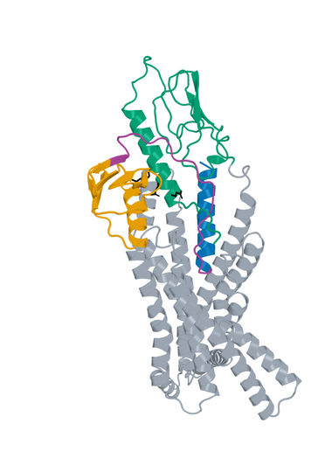
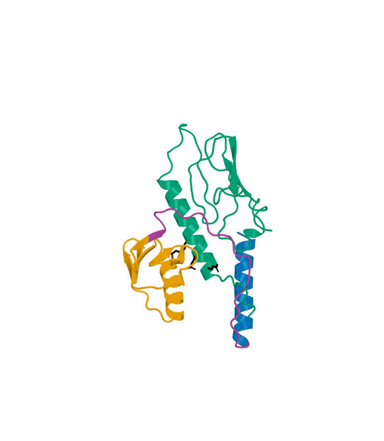
03 LK_P109_06 structure
D-L-D fusion Candidate A: 113 aa Human GLP1R B: 440 aa
Boltz2 Exact receptor complex
Boltz2 Exact interface detail
LigandForge
Linker
ECD binder
Receptor ECD
Remaining receptor
Hotspots
Receptor ECD B1–105 (UniProt 24–128). Black sticks: E34, Q37 and R40. View-specific zoom.
Complete selected sequence, N to C
MSFFQKYLKQLYLQECLSFLGGRHRVGSGSSPPPPELAPEEVVKEVSGATIDLRVKTCVDFKQTVNFFKLRNTQ
LPGSCTKDNTVLFLLEGLKLGYASRYFSIGSGSGSQQFS
Human GLP1R Boltz2 Exact Computational predictions
6
Notes:
{
"candidate": "LK_P109_06",
"final_rank": 3,
"native_model_sha256": "a0e496c74c9d41a7b0d164721515cdd9ec2ae2290b85ed8940015459349c3bde",
"structure_views": {
"final_rank": 3,
"design_id": "LK_P109_06",
"sequence_sha256": "afd8b79138f15686cbc7b0c99fcdc0293d6acf4b3dbc5a4ef47146111833281f",
"native_model_sha256": "a0e496c74c9d41a7b0d164721515cdd9ec2ae2290b85ed8940015459349c3bde",
"scoring_pdb_sha256": "7484b0825ec7aec0de4c7019977550a206e37cdd9575d771296e8352dc1525be",
"overview": {
"source_slide": 27,
"source_picture_index": 1,
"embedded_media": "ppt/media/image26.jpeg",
"image_sha256": "bc08c5af60bfc6bcfa3b154fab960fac8bf20c573573f98400c1c30216f49157",
"asset": "assets/LK_P109_06-complex.jpg"
},
"interface": {
"source_slide": 28,
"source_picture_index": 1,
"embedded_media": "ppt/media/image29.jpeg",
"image_sha256": "f4a1345c8962864e697bbda825464b94cd24f42c47888eef76fe547b4ea8de51",
"asset": "assets/LK_P109_06-interface.jpg"
},
"rendering_provenance": {
"DeltaForge_source_PDB_sha256": "7484b0825ec7aec0de4c7019977550a206e37cdd9575d771296e8352dc1525be",
"role_ranges_zero_based": {
"ECD": [
0,
20
],
"linker": [
20,
44
],
"LF": [
44,
113
]
},
"model_sha256": "a0e496c74c9d41a7b0d164721515cdd9ec2ae2290b85ed8940015459349c3bde",
"source_run": "2026-10-24_pair183-extracellular-exact_001",
"source_methods": [
"https://github.com/DunbrackLab/IPSAE",
"https://github.com/wallnerlab/DockQ",
"https://zhanggroup.org/TM-score/"
],
"saved_display_appendix": {
"parent_sources": {
"ECD-parent": {
"key": "LK_P109_06-ECD-parent",
"source_path": "local/2026-10-25_linker-parent-comparison_001/parents/S08_00_099/exact.pdb",
"source_sha256": "a10fffb3b02454090010c8d34d9df5cb042cc964e848dee91c8aeebc0aaf7235",
"role": "ECD",
"ranges_zero_based": {
"ECD": [
0,
20
]
},
"sequence": "MSFFQKYLKQLYLQECLSFL",
"rotation": [
[
0.6542986452645692,
-0.2999139375992015,
0.6942225686391867
],
[
-0.5386423909023357,
-0.829173538329741,
0.14945101560254237
],
[
0.5308085423649214,
-0.4717233093625355,
-0.7040734729494122
]
],
"translation": [
6.11155220452036,
-0.8357822013559613,
-2.650137073503127
],
"core_fit_CA_RMSD_A": 1.263299691562658,
"output": "local/2026-10-25_linker-parent-views_001/build/renders-v2/LK_P109_06-ECD-parent.jpg",
"parent_or_fusion_id": "S08_00_099",
"design_id": "LK_P109_06",
"panel": "ECD-parent",
"view": [
1,
0,
0,
0,
1,
0,
0,
0,
1,
0,
0,
-387.31532217548994,
-9.73153622054255,
19.634309299066718,
-19.50099446323492,
307.88063977194986,
466.75000457903,
-20
],
"world_height_A": 136.58828268266103,
"row_bounds_all_atoms_A": [
[
-50.79037642370106,
-37.32439103150592,
-83.93567686677497
],
[
31.327303982615962,
76.59300962963935,
44.93368794030513
]
]
},
"APNovo": {
"key": "LK_P109_06-APNovo",
"source_path": "local/2026-10-25_linker-top100-review_001/build/comparisons/LK_P109_06/reference.pdb",
"source_sha256": "137eb16d5041c2b02486140723d4308db1f9a9c68f30c62567384da2623b7da8",
"role": "fusion",
"ranges_zero_based": {
"ECD": [
0,
20
],
"linker": [
20,
44
],
"LF": [
44,
113
]
},
"sequence": "MSFFQKYLKQLYLQECLSFLGGRHRVGSGSSPPPPELAPEEVVKEVSGATIDLRVKTCVDFKQTVNFFKLRNTQLPGSCTKDNTVLFLLEGLKLGYASRYFSIGSGSGSQQFS",
"rotation": [
[
-0.427345968288976,
-0.38814908789595437,
0.8165266403826763
],
[
-0.5527881942222308,
-0.6024795937148912,
-0.5757113927322237
],
[
0.7154025045037509,
-0.6973941572300295,
0.042903010653072116
]
],
"translation": [
-11.914434493472832,
-14.548901074543778,
7.486331781083827
],
"core_fit_CA_RMSD_A": 1.263295516465016,
"output": "local/2026-10-25_linker-parent-views_001/build/renders-v2/LK_P109_06-APNovo.jpg",
"parent_or_fusion_id": "LK_P109_06-APNovo",
"design_id": "LK_P109_06",
"panel": "APNovo",
"view": [
1,
0,
0,
0,
1,
0,
0,
0,
1,
0,
0,
-387.31532217548994,
-9.73153622054255,
19.634309299066718,
-19.50099446323492,
307.88063977194986,
466.75000457903,
-20
],
"world_height_A": 136.58828268266103,
"row_bounds_all_atoms_A": [
[
-50.79037642370106,
-37.32439103150592,
-83.93567686677497
],
[
31.327303982615962,
76.59300962963935,
44.93368794030513
]
]
},
"Exact": {
"key": "LK_P109_06-Exact",
"source_path": "local/2026-10-25_linker-top100-review_001/models/LK_P109_06/boltz2.cif",
"source_sha256": "a0e496c74c9d41a7b0d164721515cdd9ec2ae2290b85ed8940015459349c3bde",
"role": "fusion",
"ranges_zero_based": {
"ECD": [
0,
20
],
"linker": [
20,
44
],
"LF": [
44,
113
]
},
"sequence": "MSFFQKYLKQLYLQECLSFLGGRHRVGSGSSPPPPELAPEEVVKEVSGATIDLRVKTCVDFKQTVNFFKLRNTQLPGSCTKDNTVLFLLEGLKLGYASRYFSIGSGSGSQQFS",
"rotation": [
[
-0.3580662748053136,
0.9277942827354044,
-0.10481547166696092
],
[
0.7211125114900967,
0.20348343855649514,
-0.6622622159771991
],
[
-0.5931148920597611,
-0.31271753971320404,
-0.741904647793
]
],
"translation": [
2.4702804606728286,
-0.6040788156052788,
0.8439426894321413
],
"core_fit_CA_RMSD_A": 0.9373087214772043,
"output": "local/2026-10-25_linker-parent-views_001/build/renders-v2/LK_P109_06-Exact.jpg",
"parent_or_fusion_id": "LK_P109_06-Exact",
"design_id": "LK_P109_06",
"panel": "Exact",
"view": [
1,
0,
0,
0,
1,
0,
0,
0,
1,
0,
0,
-387.31532217548994,
-9.73153622054255,
19.634309299066718,
-19.50099446323492,
307.88063977194986,
466.75000457903,
-20
],
"world_height_A": 136.58828268266103,
"row_bounds_all_atoms_A": [
[
-50.79037642370106,
-37.32439103150592,
-83.93567686677497
],
[
31.327303982615962,
76.59300962963935,
44.93368794030513
]
]
},
"LF-parent": {
"key": "LK_P109_06-LF-parent",
"source_path": "local/2026-10-25_linker-parent-comparison_001/parents/Design_280/exact.pdb",
"source_sha256": "cd01c89fbf40d0e577c10f20c2afa96c3deef09880d6c761314a1c5e9898bd4f",
"role": "LF",
"ranges_zero_based": {
"LF": [
0,
69
]
},
"sequence": "EVSGATIDLRVKTCVDFKQTVNFFKLRNTQLPGSCTKDNTVLFLLEGLKLGYASRYFSIGSGSGSQQFS",
"rotation": [
[
0.9716521520149124,
0.23640963200020604,
-0.0015985785293137766
],
[
-0.232382419508661,
0.9563002615331773,
0.17744913387297956
],
[
0.04347938667791329,
-0.1720473610249762,
0.9841286681075418
]
],
"translation": [
3.3985903455718525,
-6.121573941428423,
6.014485827651381
],
"core_fit_CA_RMSD_A": 1.3060904572635719,
"output": "local/2026-10-25_linker-parent-views_001/build/renders-v2/LK_P109_06-LF-parent.jpg",
"parent_or_fusion_id": "Design_280",
"design_id": "LK_P109_06",
"panel": "LF-parent",
"view": [
1,
0,
0,
0,
1,
0,
0,
0,
1,
0,
0,
-387.31532217548994,
-9.73153622054255,
19.634309299066718,
-19.50099446323492,
307.88063977194986,
466.75000457903,
-20
],
"world_height_A": 136.58828268266103,
"row_bounds_all_atoms_A": [
[
-50.79037642370106,
-37.32439103150592,
-83.93567686677497
],
[
31.327303982615962,
76.59300962963935,
44.93368794030513
]
]
}
},
"shared_camera": [
1,
0,
0,
0,
1,
0,
0,
0,
1,
0,
0,
-387.31532217548994,
-9.73153622054255,
19.634309299066718,
-19.50099446323492,
307.88063977194986,
466.75000457903,
-20
],
"reference": "Separate saved Exact parent complexes flank the linked Exact refold; AP Novo linked design comparison remains on the following slide. Rigid display alignment preserves native poses; all native receptor residues shown."
}
},
"display": "unchanged embedded JPEGs extracted from hash-verified delivered25-design PPTX; no resampling, cropping or new coordinate transforms",
"scale": "full complex and interface have different zooms; no matched-scale claim",
"hotspots": "black sticks; original27pocket positions for original LigandForge, R40/Q37/E34 annotations for DLD",
"colors": {
"LigandForge": "#E69F00",
"linker": "#AA4499",
"ECD_binder": "#0072B2",
"receptor_ECD": "#009E73",
"receptor_remainder": "#9AA5B1",
"hotspots": "#000000"
}
},
"source_deck": "local/2026-10-25_affinity-confidence-selection-deck_002/output/GLP1R_Selected_ipSAE_gt0p895_Kd_lt10nM_v3.pptx",
"source_deck_sha256": "ad9333fdf6c0ce7d6982e2980d6aade78af256710dbc7917f7f39e41d35aa173",
"domain_labels": "ECD A1-20 linker A21-44 LF A45-113",
"display_scope": "native Exact complex and saved interface view; same identity colors, independent zooms; no new coordinates or inferred agonism"
}

Slide 7
04 Design_520 metrics
Original LigandForge Candidate A: 53 aa Human GLP1R B: 409 aa
Metric and scope | Value
Boltz2 Exact ipSAE (A/B, Type=max) | 0.910807
DeltaForge predicted Kd (nM) | 3.4486
Boltz2 Exact ipTM | 0.9263
Original population ipSAE rank | 4
Predicted-Kd rank within population top50 | 14
Candidate / receptor residues (aa) | 53 / 409
Complex pLDDT (0-100) | 78.9
Generator-to-refold DockQ / TM-score | N/A
DeltaForge length scope | core_40_119
Origin and prediction
Original LigandForge v6.5.21
Generation 1
Exact seed 101
3 recycles, 200 steps
WT GLP1R 24-432
409 receptor residues
Original generator coordinates unavailable
Original generator coordinates are unavailable. This Exact prediction does not establish activation.
Complete selected sequence, N to C
QDVATDQGILTNVEAIFITNALYFTALLGFSDLCEARNAKKCVGSGSGSGLDR
Human GLP1R Boltz2 Exact Computational predictions
7
Notes:
{
"candidate": "Design_520",
"final_rank": 4,
"selection": "Exact ipSAE>0.895 and DeltaForge predicted Kd<10nM; first20 by Exact ipSAE descending",
"sequence_sha256": "ae559fd47bdf75d2732e9a5bc4287501465abf222f0ac9fc466db9ad5c4ca41e",
"sources": {
"source_table": {
"path": "local/2026-10-25_lf50-dld26-50-deltaforge_001/output/GLP1R_LigandForge_Original_Top50_DeltaForge_Kd.csv",
"sha256": "da4de8915b1ca76443882c0651920ddd9551839d0d75a5b18b8b1ff4653b0360"
},
"native_cif": {
"path": "campaigns/glp1r-ligandforge-boltz2-exact/runs/2026-10-15_ligandforge-exact_001/02_design/chunks/batch-020/kit_outputs/by_seed/Design_520/s101/Design_520_model_0.cif",
"sha256": "7fd320306aed5a85641570722ff84cd462fda1083c04fdfed46a84d7dba53376"
},
"scoring_pdb": {
"path": "local/2026-10-25_lf50-dld26-50-deltaforge_001/LF_Design_520.pdb",
"sha256": "07fe8c2c25386e5bf495c2ebb636fcbaa6c4072673b2465beed511921dbf4beb"
},
"DeltaForge_result": {
"path": "campaigns/glp1r-ligandforge-affinity/runs/2026-10-16_top5-deltaforge_001/03_filtering/deltaforge_results/Design_520.json",
"sha256": "aad99b27b0288e9425d12fae48783b51e035db03ab237f48150664ab3007a5c3"
}
},
"source_ledger": "campaigns/glp1r-final-writeup/runs/2026-10-25_final20-writeup_001/04_analysis/provenance-ledger.json",
"scorer": "deltaforge_v10_2_unified_parallel / v10_2_unified_parallel_2026_05_08",
"calibration": "deltaforge_v10_boltz2_calibrated_gbr / v10_boltz2_gbr_2026_03_29",
"scope": "one complete candidate A against one receptor B; computational, no experimental Kd or activation"
}

Slide 8
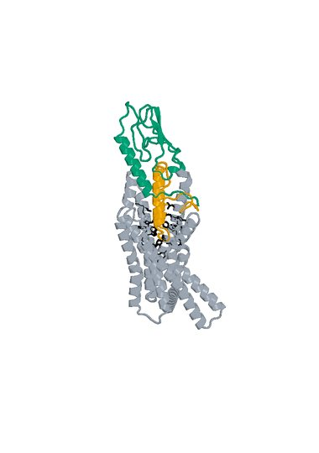
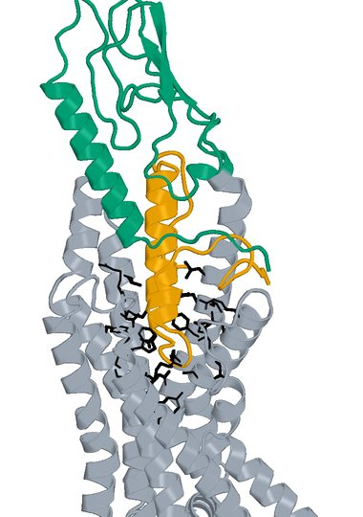
04 Design_520 structure
Original LigandForge Candidate A: 53 aa Human GLP1R B: 409 aa
Boltz2 Exact receptor complex
Boltz2 Exact interface detail
LigandForge
Receptor ECD
Remaining receptor
Hotspots
Receptor ECD B1–105 (UniProt 24–128). Black sticks: 27 submitted pocket positions. View-specific zoom.
Complete selected sequence, N to C
QDVATDQGILTNVEAIFITNALYFTALLGFSDLCEARNAKKCVGSGSGSGLDR
Human GLP1R Boltz2 Exact Computational predictions
8
Notes:
{
"candidate": "Design_520",
"final_rank": 4,
"native_model_sha256": "7fd320306aed5a85641570722ff84cd462fda1083c04fdfed46a84d7dba53376",
"structure_views": {
"final_rank": 4,
"design_id": "Design_520",
"sequence_sha256": "ae559fd47bdf75d2732e9a5bc4287501465abf222f0ac9fc466db9ad5c4ca41e",
"native_model_sha256": "7fd320306aed5a85641570722ff84cd462fda1083c04fdfed46a84d7dba53376",
"scoring_pdb_sha256": "07fe8c2c25386e5bf495c2ebb636fcbaa6c4072673b2465beed511921dbf4beb",
"overview": {
"source_slide": 5,
"source_picture_index": 0,
"embedded_media": "ppt/media/image.jpeg",
"image_sha256": "0d41f35b8444dc0116696ad1c5c711f6d4a71d6ac6a6cb585d1bd8dbe6be43ff",
"asset": "assets/Design_520-complex.jpg"
},
"interface": {
"source_slide": 5,
"source_picture_index": 1,
"embedded_media": "ppt/media/image2.jpeg",
"image_sha256": "7b5497f9e371f15fec80f1199583afef8944f775c3a4f9d2fe275df07139cb0a",
"asset": "assets/Design_520-interface.jpg"
},
"rendering_provenance": {
"source_PDB": "campaigns/glp1r-ligandforge-affinity/runs/2026-10-15_top100-affinity_001/01_staging/payload/pdb_inputs/Design_520.pdb",
"PDB_SHA256": "07fe8c2c25386e5bf495c2ebb636fcbaa6c4072673b2465beed511921dbf4beb",
"model_SHA256": "7fd320306aed5a85641570722ff84cd462fda1083c04fdfed46a84d7dba53376",
"source_render_script": "local/2026-10-25_affinity-confidence-selection-deck_002/render_originals.py",
"alignment": "rigid core CA B117-400 fitting; original full/interface zooms reused",
"camera_version": "saved original full and interface frames from final90-slide deck"
},
"display": "unchanged embedded JPEGs extracted from hash-verified delivered25-design PPTX; no resampling, cropping or new coordinate transforms",
"scale": "full complex and interface have different zooms; no matched-scale claim",
"hotspots": "black sticks; original27pocket positions for original LigandForge, R40/Q37/E34 annotations for DLD",
"colors": {
"LigandForge": "#E69F00",
"linker": "#AA4499",
"ECD_binder": "#0072B2",
"receptor_ECD": "#009E73",
"receptor_remainder": "#9AA5B1",
"hotspots": "#000000"
}
},
"source_deck": "local/2026-10-25_affinity-confidence-selection-deck_002/output/GLP1R_Selected_ipSAE_gt0p895_Kd_lt10nM_v3.pptx",
"source_deck_sha256": "ad9333fdf6c0ce7d6982e2980d6aade78af256710dbc7917f7f39e41d35aa173",
"domain_labels": "LigandForge A1-53",
"display_scope": "native Exact complex and saved interface view; same identity colors, independent zooms; no new coordinates or inferred agonism"
}

Slide 9
05 LK_P088_08 metrics
D-L-D fusion Candidate A: 153 aa Human GLP1R B: 440 aa
Metric and scope | Value
Boltz2 Exact ipSAE (A/B, Type=max) | 0.907721
DeltaForge predicted Kd (nM) | 0.7182
Boltz2 Exact ipTM | 0.8830
Original population ipSAE rank | 5
Predicted-Kd rank within population top50 | 1
Candidate / receptor residues (aa) | 153 / 440
pDockQ / pDockQ2 | 0.2252 / 0.1339
Whole fusion / linker pLDDT (0-100) | 45.8 / 39.8
ECD / LigandForge pLDDT (0-100) | 56.6 / 40.4
Fusion design-to-refold DockQ | 0.1394
Free C-terminal OPM z (A) | 34.03
Extracellular free C-terminal screen | Pass
DeltaForge length scope | long_gt_140
Origin and prediction
ECD parent S11_03_093
LigandForge parent Design_280
Pair P088
AP Novo seed 989
Exact seed 101
3 recycles, 200 steps
LF A1-69 linker A70-101 ECD A102-153
Whole-fusion pLDDT remains modest. High interface confidence does not establish activation.
Complete selected sequence, N to C
EVSGATIDLRVKTCVDFKQTVNFFKLRNTQLPGSCTKDNTVLFLLEGLKLGYASRYFSIGSGSGSQQFSSSSST
VTRRVPPPVNLLPWGPPSGQPFPRGLGMISELQELRRLFESSYPPYFSRLLWSSYLAASVGQSDLSPTIGLGKA
LSASK
Human GLP1R Boltz2 Exact Computational predictions
9
Notes:
{
"candidate": "LK_P088_08",
"final_rank": 5,
"selection": "Exact ipSAE>0.895 and DeltaForge predicted Kd<10nM; first20 by Exact ipSAE descending",
"sequence_sha256": "00df1a9681ade9f2d68bf7e6084ab615f661498a6b613a69c5c8e573bb9fc5b8",
"sources": {
"source_table": {
"path": "local/2026-10-25_lf50-dld26-50-deltaforge_001/output/GLP1R_DLD_Top50_DeltaForge_Kd_and_Boltz2_Metrics.csv",
"sha256": "da9569bf0e8b74cce3d6792eb260d6a4b17b35e6f46e0793d49f02c0d3a0e728"
},
"native_cif": {
"path": "local/2026-10-25_linker-top100-review_001/models/LK_P088_08/boltz2.cif",
"sha256": "f96dc2a804c24cfdd89333ea654759c4338d783d7cd824bf3eac52c9b1e596cb"
},
"scoring_pdb": {
"path": "local/2026-10-25_dld-top25-deltaforge_001/payload/structures/LK_P088_08.pdb",
"sha256": "cd9a4b745d9b42a929bcc916ea5e4a624933d81ddf3c5a07f4b7eb7aca8b6cb0"
},
"DeltaForge_result": {
"path": "campaigns/glp1r-r40-design/runs/2026-10-25_dld-top25-deltaforge_001/03_filtering/deltaforge_results/LK_P088_08.json",
"sha256": "100facae74ec7dc951739cd0b09f1238ff337e4833607c56369d2e17f3cb7119"
}
},
"source_ledger": "campaigns/glp1r-final-writeup/runs/2026-10-25_final20-writeup_001/04_analysis/provenance-ledger.json",
"scorer": "deltaforge_v10_2_unified_parallel / v10_2_unified_parallel_2026_05_08",
"calibration": "deltaforge_v10_boltz2_calibrated_gbr / v10_boltz2_gbr_2026_03_29",
"scope": "one complete candidate A against one receptor B; computational, no experimental Kd or activation"
}

Slide 10
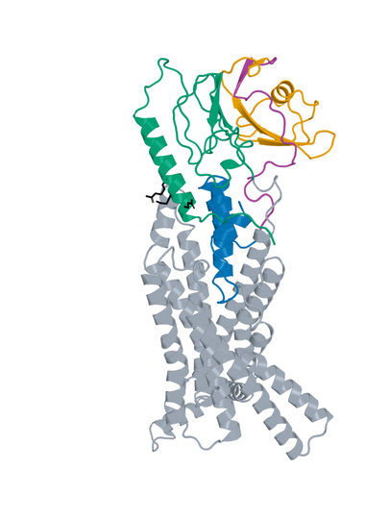
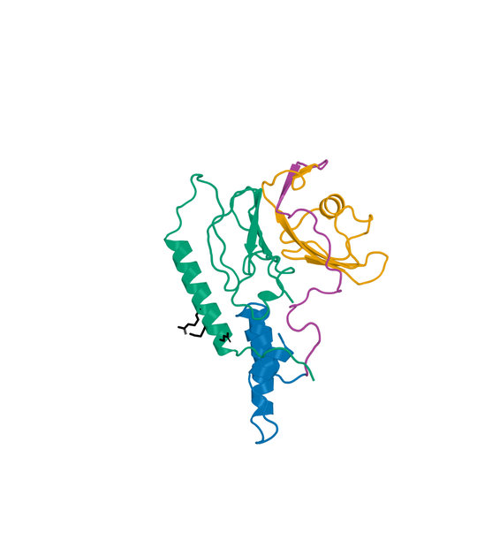
05 LK_P088_08 structure
D-L-D fusion Candidate A: 153 aa Human GLP1R B: 440 aa
Boltz2 Exact receptor complex
Boltz2 Exact interface detail
LigandForge
Linker
ECD binder
Receptor ECD
Remaining receptor
Hotspots
Receptor ECD B1–105 (UniProt 24–128). Black sticks: E34, Q37 and R40. View-specific zoom.
Complete selected sequence, N to C
EVSGATIDLRVKTCVDFKQTVNFFKLRNTQLPGSCTKDNTVLFLLEGLKLGYASRYFSIGSGSGSQQFSSSSST
VTRRVPPPVNLLPWGPPSGQPFPRGLGMISELQELRRLFESSYPPYFSRLLWSSYLAASVGQSDLSPTIGLGKA
LSASK
Human GLP1R Boltz2 Exact Computational predictions
10
Notes:
{
"candidate": "LK_P088_08",
"final_rank": 5,
"native_model_sha256": "f96dc2a804c24cfdd89333ea654759c4338d783d7cd824bf3eac52c9b1e596cb",
"structure_views": {
"final_rank": 5,
"design_id": "LK_P088_08",
"sequence_sha256": "00df1a9681ade9f2d68bf7e6084ab615f661498a6b613a69c5c8e573bb9fc5b8",
"native_model_sha256": "f96dc2a804c24cfdd89333ea654759c4338d783d7cd824bf3eac52c9b1e596cb",
"scoring_pdb_sha256": "cd9a4b745d9b42a929bcc916ea5e4a624933d81ddf3c5a07f4b7eb7aca8b6cb0",
"overview": {
"source_slide": 31,
"source_picture_index": 1,
"embedded_media": "ppt/media/image31.jpeg",
"image_sha256": "c5f68a62714485e6548265199c5ef43bce2f3449a066f13eff4cd6ee589526b3",
"asset": "assets/LK_P088_08-complex.jpg"
},
"interface": {
"source_slide": 32,
"source_picture_index": 1,
"embedded_media": "ppt/media/image34.jpeg",
"image_sha256": "084db82addb26fab4b3f691a724f5c9af71d0166e429920f2f8a089dfb3da14b",
"asset": "assets/LK_P088_08-interface.jpg"
},
"rendering_provenance": {
"DeltaForge_source_PDB_sha256": "cd9a4b745d9b42a929bcc916ea5e4a624933d81ddf3c5a07f4b7eb7aca8b6cb0",
"role_ranges_zero_based": {
"LF": [
0,
69
],
"linker": [
69,
101
],
"ECD": [
101,
153
]
},
"model_sha256": "f96dc2a804c24cfdd89333ea654759c4338d783d7cd824bf3eac52c9b1e596cb",
"source_run": "2026-10-24_pair183-extracellular-exact_001",
"source_methods": [
"https://github.com/DunbrackLab/IPSAE",
"https://github.com/wallnerlab/DockQ",
"https://zhanggroup.org/TM-score/"
],
"saved_display_appendix": {
"parent_sources": {
"ECD-parent": {
"key": "LK_P088_08-ECD-parent",
"source_path": "local/2026-10-25_linker-parent-comparison_001/parents/S11_03_093/exact.pdb",
"source_sha256": "c0071a5b08b94bbbe0964635d3ac84d6493fa532d71c3d8df45a43af5bf9530f",
"role": "ECD",
"ranges_zero_based": {
"ECD": [
0,
52
]
},
"sequence": "MISELQELRRLFESSYPPYFSRLLWSSYLAASVGQSDLSPTIGLGKALSASK",
"rotation": [
[
0.9342944777723321,
0.14286028709039078,
0.3266264654724491
],
[
0.15147565109104444,
0.6703022835162495,
-0.7264640567385907
],
[
-0.3227213212938822,
0.7282073068624637,
0.6046198082395369
]
],
"translation": [
3.575589604465687,
2.3222595348218267,
-1.0851632777065894
],
"core_fit_CA_RMSD_A": 1.2030914990255273,
"output": "local/2026-10-25_linker-parent-views_001/build/renders-v2/LK_P088_08-ECD-parent.jpg",
"parent_or_fusion_id": "S11_03_093",
"design_id": "LK_P088_08",
"panel": "ECD-parent",
"view": [
1,
0,
0,
0,
1,
0,
0,
0,
1,
0,
0,
-389.66313753667623,
-9.47863813322478,
19.45151017851778,
-22.163677636567378,
327.649394715077,
451.67688035827547,
-20
],
"world_height_A": 137.4162490704589,
"row_bounds_all_atoms_A": [
[
-50.828799843201054,
-37.68350453096272,
-69.17742045816664
],
[
31.871523576751493,
76.58652488799828,
24.850065185031884
]
]
},
"APNovo": {
"key": "LK_P088_08-APNovo",
"source_path": "local/2026-10-25_linker-top100-review_001/build/comparisons/LK_P088_08/reference.pdb",
"source_sha256": "aa543895e50ca59f41aae8f151cf5a2acfbc244e219aab42c9b59c06772a90c0",
"role": "fusion",
"ranges_zero_based": {
"LF": [
0,
69
],
"linker": [
69,
101
],
"ECD": [
101,
153
]
},
"sequence": "EVSGATIDLRVKTCVDFKQTVNFFKLRNTQLPGSCTKDNTVLFLLEGLKLGYASRYFSIGSGSGSQQFSSSSSTVTRRVPPPVNLLPWGPPSGQPFPRGLGMISELQELRRLFESSYPPYFSRLLWSSYLAASVGQSDLSPTIGLGKALSASK",
"rotation": [
[
-0.04825957313482121,
-0.8071815236543092,
0.5883273022862383
],
[
-0.1503756419666642,
-0.5764287254141207,
-0.8031918198200318
],
[
0.9874503132584387,
-0.12723179065451173,
-0.09356225602142842
]
],
"translation": [
-12.84581927372312,
-16.32511285233152,
6.538445092283405
],
"core_fit_CA_RMSD_A": 1.203088366617288,
"output": "local/2026-10-25_linker-parent-views_001/build/renders-v2/LK_P088_08-APNovo.jpg",
"parent_or_fusion_id": "LK_P088_08-APNovo",
"design_id": "LK_P088_08",
"panel": "APNovo",
"view": [
1,
0,
0,
0,
1,
0,
0,
0,
1,
0,
0,
-389.66313753667623,
-9.47863813322478,
19.45151017851778,
-22.163677636567378,
327.649394715077,
451.67688035827547,
-20
],
"world_height_A": 137.4162490704589,
"row_bounds_all_atoms_A": [
[
-50.828799843201054,
-37.68350453096272,
-69.17742045816664
],
[
31.871523576751493,
76.58652488799828,
24.850065185031884
]
]
},
"Exact": {
"key": "LK_P088_08-Exact",
"source_path": "local/2026-10-25_linker-top100-review_001/models/LK_P088_08/boltz2.cif",
"source_sha256": "f96dc2a804c24cfdd89333ea654759c4338d783d7cd824bf3eac52c9b1e596cb",
"role": "fusion",
"ranges_zero_based": {
"LF": [
0,
69
],
"linker": [
69,
101
],
"ECD": [
101,
153
]
},
"sequence": "EVSGATIDLRVKTCVDFKQTVNFFKLRNTQLPGSCTKDNTVLFLLEGLKLGYASRYFSIGSGSGSQQFSSSSSTVTRRVPPPVNLLPWGPPSGQPFPRGLGMISELQELRRLFESSYPPYFSRLLWSSYLAASVGQSDLSPTIGLGKALSASK",
"rotation": [
[
0.7787306125455387,
-0.5684698373973176,
0.265369035158207
],
[
0.6265611476432604,
0.726055362517795,
-0.2833102415303346
],
[
-0.03161930708963023,
0.3868922874617704,
0.9215826184622142
]
],
"translation": [
-0.46889058533144734,
-4.159379850060773,
-4.030035256592501
],
"core_fit_CA_RMSD_A": 0.9470129928171446,
"output": "local/2026-10-25_linker-parent-views_001/build/renders-v2/LK_P088_08-Exact.jpg",
"parent_or_fusion_id": "LK_P088_08-Exact",
"design_id": "LK_P088_08",
"panel": "Exact",
"view": [
1,
0,
0,
0,
1,
0,
0,
0,
1,
0,
0,
-389.66313753667623,
-9.47863813322478,
19.45151017851778,
-22.163677636567378,
327.649394715077,
451.67688035827547,
-20
],
"world_height_A": 137.4162490704589,
"row_bounds_all_atoms_A": [
[
-50.828799843201054,
-37.68350453096272,
-69.17742045816664
],
[
31.871523576751493,
76.58652488799828,
24.850065185031884
]
]
},
"LF-parent": {
"key": "LK_P088_08-LF-parent",
"source_path": "local/2026-10-25_linker-parent-comparison_001/parents/Design_280/exact.pdb",
"source_sha256": "cd01c89fbf40d0e577c10f20c2afa96c3deef09880d6c761314a1c5e9898bd4f",
"role": "LF",
"ranges_zero_based": {
"LF": [
0,
69
]
},
"sequence": "EVSGATIDLRVKTCVDFKQTVNFFKLRNTQLPGSCTKDNTVLFLLEGLKLGYASRYFSIGSGSGSQQFS",
"rotation": [
[
0.9716521520149124,
0.23640963200020604,
-0.0015985785293137766
],
[
-0.232382419508661,
0.9563002615331773,
0.17744913387297956
],
[
0.04347938667791329,
-0.1720473610249762,
0.9841286681075418
]
],
"translation": [
3.3985903455718525,
-6.121573941428423,
6.014485827651381
],
"core_fit_CA_RMSD_A": 1.3060904572635719,
"output": "local/2026-10-25_linker-parent-views_001/build/renders-v2/LK_P088_08-LF-parent.jpg",
"parent_or_fusion_id": "Design_280",
"design_id": "LK_P088_08",
"panel": "LF-parent",
"view": [
1,
0,
0,
0,
1,
0,
0,
0,
1,
0,
0,
-389.66313753667623,
-9.47863813322478,
19.45151017851778,
-22.163677636567378,
327.649394715077,
451.67688035827547,
-20
],
"world_height_A": 137.4162490704589,
"row_bounds_all_atoms_A": [
[
-50.828799843201054,
-37.68350453096272,
-69.17742045816664
],
[
31.871523576751493,
76.58652488799828,
24.850065185031884
]
]
}
},
"shared_camera": [
1,
0,
0,
0,
1,
0,
0,
0,
1,
0,
0,
-389.66313753667623,
-9.47863813322478,
19.45151017851778,
-22.163677636567378,
327.649394715077,
451.67688035827547,
-20
],
"reference": "Separate saved Exact parent complexes flank the linked Exact refold; AP Novo linked design comparison remains on the following slide. Rigid display alignment preserves native poses; all native receptor residues shown."
}
},
"display": "unchanged embedded JPEGs extracted from hash-verified delivered25-design PPTX; no resampling, cropping or new coordinate transforms",
"scale": "full complex and interface have different zooms; no matched-scale claim",
"hotspots": "black sticks; original27pocket positions for original LigandForge, R40/Q37/E34 annotations for DLD",
"colors": {
"LigandForge": "#E69F00",
"linker": "#AA4499",
"ECD_binder": "#0072B2",
"receptor_ECD": "#009E73",
"receptor_remainder": "#9AA5B1",
"hotspots": "#000000"
}
},
"source_deck": "local/2026-10-25_affinity-confidence-selection-deck_002/output/GLP1R_Selected_ipSAE_gt0p895_Kd_lt10nM_v3.pptx",
"source_deck_sha256": "ad9333fdf6c0ce7d6982e2980d6aade78af256710dbc7917f7f39e41d35aa173",
"domain_labels": "LF A1-69 linker A70-101 ECD A102-153",
"display_scope": "native Exact complex and saved interface view; same identity colors, independent zooms; no new coordinates or inferred agonism"
}

Slide 11
06 LK_P050_03 metrics
D-L-D fusion Candidate A: 149 aa Human GLP1R B: 440 aa
Metric and scope | Value
Boltz2 Exact ipSAE (A/B, Type=max) | 0.905966
DeltaForge predicted Kd (nM) | 3.2797
Boltz2 Exact ipTM | 0.9204
Original population ipSAE rank | 6
Predicted-Kd rank within population top50 | 31
Candidate / receptor residues (aa) | 149 / 440
pDockQ / pDockQ2 | 0.4071 / 0.2529
Whole fusion / linker pLDDT (0-100) | 52.0 / 41.1
ECD / LigandForge pLDDT (0-100) | 67.1 / 44.7
Fusion design-to-refold DockQ | 0.2066
Free C-terminal OPM z (A) | 38.34
Extracellular free C-terminal screen | Pass
DeltaForge length scope | long_gt_140
Origin and prediction
ECD parent S11_02_089
LigandForge parent Design_280
Pair P050
AP Novo seed 604
Exact seed 101
3 recycles, 200 steps
ECD A1-53 linker A54-80 LF A81-149
Whole-fusion pLDDT remains modest. High interface confidence does not establish activation.
Complete selected sequence, N to C
MGISALEEFDRLRRASILLSLIRSGSTGSGFDAFLEKSGVKGAPAFLAVPSSNGFDFVPSPTSSAPPLLCQGTE
PAENTREVSGATIDLRVKTCVDFKQTVNFFKLRNTQLPGSCTKDNTVLFLLEGLKLGYASRYFSIGSGSGSQQF
S
Human GLP1R Boltz2 Exact Computational predictions
11
Notes:
{
"candidate": "LK_P050_03",
"final_rank": 6,
"selection": "Exact ipSAE>0.895 and DeltaForge predicted Kd<10nM; first20 by Exact ipSAE descending",
"sequence_sha256": "3f52e9ffe4a9aa4e25918074b0463245934a22fc87c9def620a853f340dd3ba9",
"sources": {
"source_table": {
"path": "local/2026-10-25_lf50-dld26-50-deltaforge_001/output/GLP1R_DLD_Top50_DeltaForge_Kd_and_Boltz2_Metrics.csv",
"sha256": "da9569bf0e8b74cce3d6792eb260d6a4b17b35e6f46e0793d49f02c0d3a0e728"
},
"native_cif": {
"path": "local/2026-10-25_linker-top100-review_001/models/LK_P050_03/boltz2.cif",
"sha256": "3501ffce18d848606153666f7594ee3d1d85e2ee6a1013f2d0ba58f4c5eadd01"
},
"scoring_pdb": {
"path": "local/2026-10-25_dld-top25-deltaforge_001/payload/structures/LK_P050_03.pdb",
"sha256": "d93360b3c50b852e9269bba6b1707f687b0257ac127e970d1704a0ce605dddcc"
},
"DeltaForge_result": {
"path": "campaigns/glp1r-r40-design/runs/2026-10-25_dld-top25-deltaforge_001/03_filtering/deltaforge_results/LK_P050_03.json",
"sha256": "f98ec71067dc4d34d23d94b3e0bebe182ee6b945e26c0ca94b4222daec7651c8"
}
},
"source_ledger": "campaigns/glp1r-final-writeup/runs/2026-10-25_final20-writeup_001/04_analysis/provenance-ledger.json",
"scorer": "deltaforge_v10_2_unified_parallel / v10_2_unified_parallel_2026_05_08",
"calibration": "deltaforge_v10_boltz2_calibrated_gbr / v10_boltz2_gbr_2026_03_29",
"scope": "one complete candidate A against one receptor B; computational, no experimental Kd or activation"
}

Slide 12
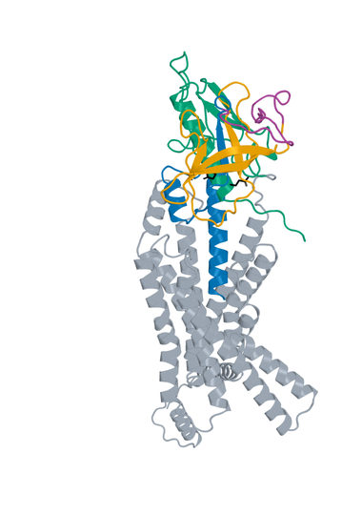
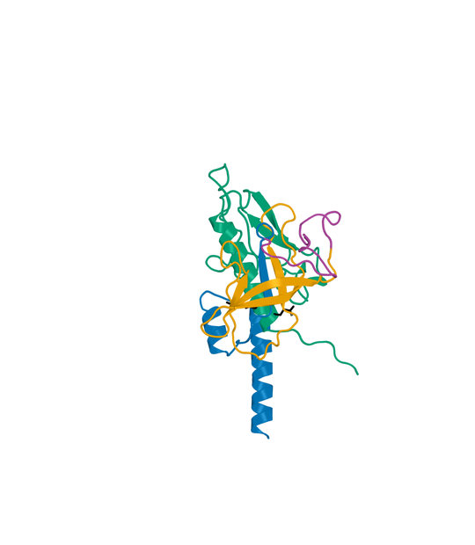
06 LK_P050_03 structure
D-L-D fusion Candidate A: 149 aa Human GLP1R B: 440 aa
Boltz2 Exact receptor complex
Boltz2 Exact interface detail
LigandForge
Linker
ECD binder
Receptor ECD
Remaining receptor
Hotspots
Receptor ECD B1–105 (UniProt 24–128). Black sticks: E34, Q37 and R40. View-specific zoom.
Complete selected sequence, N to C
MGISALEEFDRLRRASILLSLIRSGSTGSGFDAFLEKSGVKGAPAFLAVPSSNGFDFVPSPTSSAPPLLCQGTE
PAENTREVSGATIDLRVKTCVDFKQTVNFFKLRNTQLPGSCTKDNTVLFLLEGLKLGYASRYFSIGSGSGSQQF
S
Human GLP1R Boltz2 Exact Computational predictions
12
Notes:
{
"candidate": "LK_P050_03",
"final_rank": 6,
"native_model_sha256": "3501ffce18d848606153666f7594ee3d1d85e2ee6a1013f2d0ba58f4c5eadd01",
"structure_views": {
"final_rank": 6,
"design_id": "LK_P050_03",
"sequence_sha256": "3f52e9ffe4a9aa4e25918074b0463245934a22fc87c9def620a853f340dd3ba9",
"native_model_sha256": "3501ffce18d848606153666f7594ee3d1d85e2ee6a1013f2d0ba58f4c5eadd01",
"scoring_pdb_sha256": "d93360b3c50b852e9269bba6b1707f687b0257ac127e970d1704a0ce605dddcc",
"overview": {
"source_slide": 35,
"source_picture_index": 1,
"embedded_media": "ppt/media/image36.jpeg",
"image_sha256": "2ee98d4cdb3de366c85de422cad0ae63f3813d754efd902f8ff89297cf876610",
"asset": "assets/LK_P050_03-complex.jpg"
},
"interface": {
"source_slide": 36,
"source_picture_index": 1,
"embedded_media": "ppt/media/image39.jpeg",
"image_sha256": "541197164aacfc7af9ba3ba456b4b1642e727122ccb6d0057d30fba456ab570b",
"asset": "assets/LK_P050_03-interface.jpg"
},
"rendering_provenance": {
"DeltaForge_source_PDB_sha256": "d93360b3c50b852e9269bba6b1707f687b0257ac127e970d1704a0ce605dddcc",
"role_ranges_zero_based": {
"ECD": [
0,
53
],
"linker": [
53,
80
],
"LF": [
80,
149
]
},
"model_sha256": "3501ffce18d848606153666f7594ee3d1d85e2ee6a1013f2d0ba58f4c5eadd01",
"source_run": "2026-10-24_pair183-extracellular-exact_001",
"source_methods": [
"https://github.com/DunbrackLab/IPSAE",
"https://github.com/wallnerlab/DockQ",
"https://zhanggroup.org/TM-score/"
],
"saved_display_appendix": {
"parent_sources": {
"ECD-parent": {
"key": "LK_P050_03-ECD-parent",
"source_path": "local/2026-10-25_linker-parent-comparison_001/parents/S11_02_089/exact.pdb",
"source_sha256": "33a626296d1404a15d5b43fc0af2d090024dd0f999abdc0c455da40d2747c0cc",
"role": "ECD",
"ranges_zero_based": {
"ECD": [
0,
53
]
},
"sequence": "MGISALEEFDRLRRASILLSLIRSGSTGSGFDAFLEKSGVKGAPAFLAVPSSN",
"rotation": [
[
0.4601914785026544,
0.8740030154194312,
0.15602098281507715
],
[
-0.3553315001691105,
0.3423619380873384,
-0.8697860883530819
],
[
-0.8136113209777376,
0.344828970313086,
0.4681128541492088
]
],
"translation": [
2.061273489264341,
3.6943565127962046,
-2.618342795969485
],
"core_fit_CA_RMSD_A": 0.7641443086142279,
"output": "local/2026-10-25_linker-parent-views_001/build/renders-v2/LK_P050_03-ECD-parent.jpg",
"parent_or_fusion_id": "S11_02_089",
"design_id": "LK_P050_03",
"panel": "ECD-parent",
"view": [
1,
0,
0,
0,
1,
0,
0,
0,
1,
0,
0,
-401.09371690895415,
-8.021886142584709,
16.391122804162897,
-17.88703277562545,
329.61411770915964,
472.57331610874866,
-20
],
"world_height_A": 141.44728816738333,
"row_bounds_all_atoms_A": [
[
-50.79037642370106,
-43.82516413507821,
-74.36663197541993
],
[
34.746604138531644,
76.607409743404,
38.592566424169036
]
]
},
"APNovo": {
"key": "LK_P050_03-APNovo",
"source_path": "local/2026-10-25_linker-top100-review_001/build/comparisons/LK_P050_03/reference.pdb",
"source_sha256": "8dee8ef02946bbe964a88a56cd54fba23f5de38095f7ab903d0abea27614f4fe",
"role": "fusion",
"ranges_zero_based": {
"ECD": [
0,
53
],
"linker": [
53,
80
],
"LF": [
80,
149
]
},
"sequence": "MGISALEEFDRLRRASILLSLIRSGSTGSGFDAFLEKSGVKGAPAFLAVPSSNGFDFVPSPTSSAPPLLCQGTEPAENTREVSGATIDLRVKTCVDFKQTVNFFKLRNTQLPGSCTKDNTVLFLLEGLKLGYASRYFSIGSGSGSQQFS",
"rotation": [
[
-0.02008677705699924,
-0.9683384035430427,
0.24883197709851146
],
[
0.9284672501262587,
-0.11038843410126642,
-0.35463061674728635
],
[
0.37087064519087964,
0.22390898462981168,
0.9012878100755778
]
],
"translation": [
-11.297315927706691,
-12.610895978742942,
5.484243640285899
],
"core_fit_CA_RMSD_A": 0.76418359980095,
"output": "local/2026-10-25_linker-parent-views_001/build/renders-v2/LK_P050_03-APNovo.jpg",
"parent_or_fusion_id": "LK_P050_03-APNovo",
"design_id": "LK_P050_03",
"panel": "APNovo",
"view": [
1,
0,
0,
0,
1,
0,
0,
0,
1,
0,
0,
-401.09371690895415,
-8.021886142584709,
16.391122804162897,
-17.88703277562545,
329.61411770915964,
472.57331610874866,
-20
],
"world_height_A": 141.44728816738333,
"row_bounds_all_atoms_A": [
[
-50.79037642370106,
-43.82516413507821,
-74.36663197541993
],
[
34.746604138531644,
76.607409743404,
38.592566424169036
]
]
},
"Exact": {
"key": "LK_P050_03-Exact",
"source_path": "local/2026-10-25_linker-top100-review_001/models/LK_P050_03/boltz2.cif",
"source_sha256": "3501ffce18d848606153666f7594ee3d1d85e2ee6a1013f2d0ba58f4c5eadd01",
"role": "fusion",
"ranges_zero_based": {
"ECD": [
0,
53
],
"linker": [
53,
80
],
"LF": [
80,
149
]
},
"sequence": "MGISALEEFDRLRRASILLSLIRSGSTGSGFDAFLEKSGVKGAPAFLAVPSSNGFDFVPSPTSSAPPLLCQGTEPAENTREVSGATIDLRVKTCVDFKQTVNFFKLRNTQLPGSCTKDNTVLFLLEGLKLGYASRYFSIGSGSGSQQFS",
"rotation": [
[
0.9674924007878847,
-0.04103856114900317,
0.2495482184879858
],
[
0.09483079127015781,
0.9736183925505794,
-0.20754376865752988
],
[
-0.2344474354510826,
0.22446190468606808,
0.9458600738495875
]
],
"translation": [
-0.6699929089959085,
0.06164257389051819,
-0.5104734701198772
],
"core_fit_CA_RMSD_A": 0.6544718565429345,
"output": "local/2026-10-25_linker-parent-views_001/build/renders-v2/LK_P050_03-Exact.jpg",
"parent_or_fusion_id": "LK_P050_03-Exact",
"design_id": "LK_P050_03",
"panel": "Exact",
"view": [
1,
0,
0,
0,
1,
0,
0,
0,
1,
0,
0,
-401.09371690895415,
-8.021886142584709,
16.391122804162897,
-17.88703277562545,
329.61411770915964,
472.57331610874866,
-20
],
"world_height_A": 141.44728816738333,
"row_bounds_all_atoms_A": [
[
-50.79037642370106,
-43.82516413507821,
-74.36663197541993
],
[
34.746604138531644,
76.607409743404,
38.592566424169036
]
]
},
"LF-parent": {
"key": "LK_P050_03-LF-parent",
"source_path": "local/2026-10-25_linker-parent-comparison_001/parents/Design_280/exact.pdb",
"source_sha256": "cd01c89fbf40d0e577c10f20c2afa96c3deef09880d6c761314a1c5e9898bd4f",
"role": "LF",
"ranges_zero_based": {
"LF": [
0,
69
]
},
"sequence": "EVSGATIDLRVKTCVDFKQTVNFFKLRNTQLPGSCTKDNTVLFLLEGLKLGYASRYFSIGSGSGSQQFS",
"rotation": [
[
0.9716521520149124,
0.23640963200020604,
-0.0015985785293137766
],
[
-0.232382419508661,
0.9563002615331773,
0.17744913387297956
],
[
0.04347938667791329,
-0.1720473610249762,
0.9841286681075418
]
],
"translation": [
3.3985903455718525,
-6.121573941428423,
6.014485827651381
],
"core_fit_CA_RMSD_A": 1.3060904572635719,
"output": "local/2026-10-25_linker-parent-views_001/build/renders-v2/LK_P050_03-LF-parent.jpg",
"parent_or_fusion_id": "Design_280",
"design_id": "LK_P050_03",
"panel": "LF-parent",
"view": [
1,
0,
0,
0,
1,
0,
0,
0,
1,
0,
0,
-401.09371690895415,
-8.021886142584709,
16.391122804162897,
-17.88703277562545,
329.61411770915964,
472.57331610874866,
-20
],
"world_height_A": 141.44728816738333,
"row_bounds_all_atoms_A": [
[
-50.79037642370106,
-43.82516413507821,
-74.36663197541993
],
[
34.746604138531644,
76.607409743404,
38.592566424169036
]
]
}
},
"shared_camera": [
1,
0,
0,
0,
1,
0,
0,
0,
1,
0,
0,
-401.09371690895415,
-8.021886142584709,
16.391122804162897,
-17.88703277562545,
329.61411770915964,
472.57331610874866,
-20
],
"reference": "Separate saved Exact parent complexes flank the linked Exact refold; AP Novo linked design comparison remains on the following slide. Rigid display alignment preserves native poses; all native receptor residues shown."
}
},
"display": "unchanged embedded JPEGs extracted from hash-verified delivered25-design PPTX; no resampling, cropping or new coordinate transforms",
"scale": "full complex and interface have different zooms; no matched-scale claim",
"hotspots": "black sticks; original27pocket positions for original LigandForge, R40/Q37/E34 annotations for DLD",
"colors": {
"LigandForge": "#E69F00",
"linker": "#AA4499",
"ECD_binder": "#0072B2",
"receptor_ECD": "#009E73",
"receptor_remainder": "#9AA5B1",
"hotspots": "#000000"
}
},
"source_deck": "local/2026-10-25_affinity-confidence-selection-deck_002/output/GLP1R_Selected_ipSAE_gt0p895_Kd_lt10nM_v3.pptx",
"source_deck_sha256": "ad9333fdf6c0ce7d6982e2980d6aade78af256710dbc7917f7f39e41d35aa173",
"domain_labels": "ECD A1-53 linker A54-80 LF A81-149",
"display_scope": "native Exact complex and saved interface view; same identity colors, independent zooms; no new coordinates or inferred agonism"
}

Slide 13
07 Design_973 metrics
Original LigandForge Candidate A: 65 aa Human GLP1R B: 409 aa
Metric and scope | Value
Boltz2 Exact ipSAE (A/B, Type=max) | 0.903800
DeltaForge predicted Kd (nM) | 0.6192
Boltz2 Exact ipTM | 0.9481
Original population ipSAE rank | 8
Predicted-Kd rank within population top50 | 1
Candidate / receptor residues (aa) | 65 / 409
Complex pLDDT (0-100) | 76.8
Generator-to-refold DockQ / TM-score | N/A
DeltaForge length scope | core_40_119
Origin and prediction
Original LigandForge v6.5.21
Generation 1
Exact seed 101
3 recycles, 200 steps
WT GLP1R 24-432
409 receptor residues
Original generator coordinates unavailable
Original generator coordinates are unavailable. This Exact prediction does not establish activation.
Complete selected sequence, N to C
SKCTLHALETSFTVDPKGRFKIIAEEFSRTILGCKLLENAKFLYVVGFTEAVNLSGSGSGSPFDR
Human GLP1R Boltz2 Exact Computational predictions
13
Notes:
{
"candidate": "Design_973",
"final_rank": 7,
"selection": "Exact ipSAE>0.895 and DeltaForge predicted Kd<10nM; first20 by Exact ipSAE descending",
"sequence_sha256": "d58d873a366590fcf1713fc2585c8eb724259d7d5e878f81b37a650dda2e3149",
"sources": {
"source_table": {
"path": "local/2026-10-25_lf50-dld26-50-deltaforge_001/output/GLP1R_LigandForge_Original_Top50_DeltaForge_Kd.csv",
"sha256": "da4de8915b1ca76443882c0651920ddd9551839d0d75a5b18b8b1ff4653b0360"
},
"native_cif": {
"path": "campaigns/glp1r-ligandforge-boltz2-exact/runs/2026-10-15_ligandforge-exact_001/02_design/chunks/batch-038/kit_outputs/by_seed/Design_973/s101/Design_973_model_0.cif",
"sha256": "2f7a42d2398a58ae72f865082414e8bdeb86aaf5ff428f9d3caa8abf2f0ba554"
},
"scoring_pdb": {
"path": "local/2026-10-25_lf50-dld26-50-deltaforge_001/LF_Design_973.pdb",
"sha256": "1ac777d39b5ba7521aaaf2b08830ab6b3907f5dde3336ba94396301931d3cfbe"
},
"DeltaForge_result": {
"path": "campaigns/glp1r-r40-design/runs/2026-10-25_lf50-dld26-50-deltaforge_001/03_filtering/deltaforge_results/LF_Design_973.json",
"sha256": "430bd3acb36a1cc0941a4cf34e01b1b7c6e2a32d3fe3d2397eb24cea94b6a87c"
}
},
"source_ledger": "campaigns/glp1r-final-writeup/runs/2026-10-25_final20-writeup_001/04_analysis/provenance-ledger.json",
"scorer": "deltaforge_v10_2_unified_parallel / v10_2_unified_parallel_2026_05_08",
"calibration": "deltaforge_v10_boltz2_calibrated_gbr / v10_boltz2_gbr_2026_03_29",
"scope": "one complete candidate A against one receptor B; computational, no experimental Kd or activation"
}

Slide 14
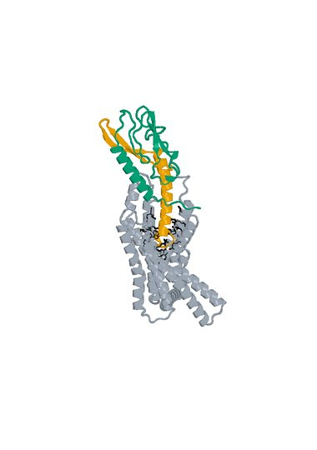
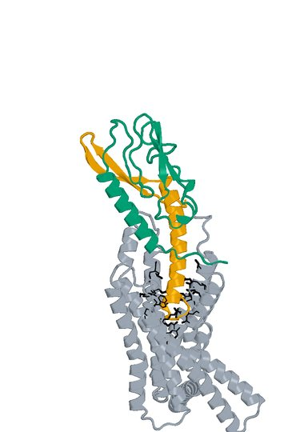
07 Design_973 structure
Original LigandForge Candidate A: 65 aa Human GLP1R B: 409 aa
Boltz2 Exact receptor complex
Boltz2 Exact interface detail
LigandForge
Receptor ECD
Remaining receptor
Hotspots
Receptor ECD B1–105 (UniProt 24–128). Black sticks: 27 submitted pocket positions. View-specific zoom.
Complete selected sequence, N to C
SKCTLHALETSFTVDPKGRFKIIAEEFSRTILGCKLLENAKFLYVVGFTEAVNLSGSGSGSPFDR
Human GLP1R Boltz2 Exact Computational predictions
14
Notes:
{
"candidate": "Design_973",
"final_rank": 7,
"native_model_sha256": "2f7a42d2398a58ae72f865082414e8bdeb86aaf5ff428f9d3caa8abf2f0ba554",
"structure_views": {
"final_rank": 7,
"design_id": "Design_973",
"sequence_sha256": "d58d873a366590fcf1713fc2585c8eb724259d7d5e878f81b37a650dda2e3149",
"native_model_sha256": "2f7a42d2398a58ae72f865082414e8bdeb86aaf5ff428f9d3caa8abf2f0ba554",
"scoring_pdb_sha256": "1ac777d39b5ba7521aaaf2b08830ab6b3907f5dde3336ba94396301931d3cfbe",
"overview": {
"source_slide": 7,
"source_picture_index": 0,
"embedded_media": "ppt/media/image3.jpeg",
"image_sha256": "9677a5abd446b645c3179422a5a88f48843ab30c42858cea56a0c16149a3db7d",
"asset": "assets/Design_973-complex.jpg"
},
"interface": {
"source_slide": 7,
"source_picture_index": 1,
"embedded_media": "ppt/media/image4.jpeg",
"image_sha256": "39fb8600c74015cb611ed6230cd42f6a8237807bf0cb8286d23911b4a5a36617",
"asset": "assets/Design_973-interface.jpg"
},
"rendering_provenance": {
"source_PDB": "campaigns/glp1r-ligandforge-affinity/runs/2026-10-15_top100-affinity_001/01_staging/payload/pdb_inputs/Design_973.pdb",
"PDB_SHA256": "1ac777d39b5ba7521aaaf2b08830ab6b3907f5dde3336ba94396301931d3cfbe",
"model_SHA256": "2f7a42d2398a58ae72f865082414e8bdeb86aaf5ff428f9d3caa8abf2f0ba554",
"source_render_script": "local/2026-10-25_affinity-confidence-selection-deck_002/render_originals.py",
"alignment": "rigid core CA B117-400 fitting; original full/interface zooms reused",
"camera_version": "saved original full and interface frames from final90-slide deck"
},
"display": "unchanged embedded JPEGs extracted from hash-verified delivered25-design PPTX; no resampling, cropping or new coordinate transforms",
"scale": "full complex and interface have different zooms; no matched-scale claim",
"hotspots": "black sticks; original27pocket positions for original LigandForge, R40/Q37/E34 annotations for DLD",
"colors": {
"LigandForge": "#E69F00",
"linker": "#AA4499",
"ECD_binder": "#0072B2",
"receptor_ECD": "#009E73",
"receptor_remainder": "#9AA5B1",
"hotspots": "#000000"
}
},
"source_deck": "local/2026-10-25_affinity-confidence-selection-deck_002/output/GLP1R_Selected_ipSAE_gt0p895_Kd_lt10nM_v3.pptx",
"source_deck_sha256": "ad9333fdf6c0ce7d6982e2980d6aade78af256710dbc7917f7f39e41d35aa173",
"domain_labels": "LigandForge A1-65",
"display_scope": "native Exact complex and saved interface view; same identity colors, independent zooms; no new coordinates or inferred agonism"
}

Slide 15
08 LK_P157_08 metrics
D-L-D fusion Candidate A: 139 aa Human GLP1R B: 440 aa
Metric and scope | Value
Boltz2 Exact ipSAE (A/B, Type=max) | 0.902451
DeltaForge predicted Kd (nM) | 3.2426
Boltz2 Exact ipTM | 0.8879
Original population ipSAE rank | 7
Predicted-Kd rank within population top50 | 30
Candidate / receptor residues (aa) | 139 / 440
pDockQ / pDockQ2 | 0.3145 / 0.1314
Whole fusion / linker pLDDT (0-100) | 54.2 / 46.3
ECD / LigandForge pLDDT (0-100) | 57.5 / 56.2
Fusion design-to-refold DockQ | 0.1548
Free C-terminal OPM z (A) | 76.82
Extracellular free C-terminal screen | Pass
DeltaForge length scope | platform_8_140
Origin and prediction
ECD parent S10_02_023
LigandForge parent Design_414
Pair P157
AP Novo seed 1679
Exact seed 101
3 recycles, 200 steps
ECD A1-50 linker A51-85 LF A86-139
Whole-fusion pLDDT remains modest. High interface confidence does not establish activation.
Complete selected sequence, N to C
MSIDYSSLVTHSPTGVAEATEFLYRYYQLREIPLETFIAVASALYHSSLLGGTDSLGKGSYDDKLNALPFSPEA
EAAAQKDVEAGKTKEGSSCVRGGSRTELFSKEPDKGVSFVSGSGVEYVCFAFFVVGSGSGSTYVS
Human GLP1R Boltz2 Exact Computational predictions
15
Notes:
{
"candidate": "LK_P157_08",
"final_rank": 8,
"selection": "Exact ipSAE>0.895 and DeltaForge predicted Kd<10nM; first20 by Exact ipSAE descending",
"sequence_sha256": "a6b21c268973d6aca8428dc32538891704af6a07a7a357b3de8a1856d194cc78",
"sources": {
"source_table": {
"path": "local/2026-10-25_lf50-dld26-50-deltaforge_001/output/GLP1R_DLD_Top50_DeltaForge_Kd_and_Boltz2_Metrics.csv",
"sha256": "da9569bf0e8b74cce3d6792eb260d6a4b17b35e6f46e0793d49f02c0d3a0e728"
},
"native_cif": {
"path": "local/2026-10-25_linker-top100-review_001/models/LK_P157_08/boltz2.cif",
"sha256": "f9efc503df7abaf13c7f3bbea2af38254a6c142412d6ad515e3f59ce28a7bf7b"
},
"scoring_pdb": {
"path": "local/2026-10-25_dld-top25-deltaforge_001/payload/structures/LK_P157_08.pdb",
"sha256": "80c7ec071ec58a7464df6de072e9017cfbebd6871775205cf042ad116cb3169b"
},
"DeltaForge_result": {
"path": "campaigns/glp1r-r40-design/runs/2026-10-25_dld-top25-deltaforge_001/03_filtering/deltaforge_results/LK_P157_08.json",
"sha256": "6dfcf6988909ebafe8c3f60fdc4bba56f3a390d47877cf5cb96e5ce0bf9eab1c"
}
},
"source_ledger": "campaigns/glp1r-final-writeup/runs/2026-10-25_final20-writeup_001/04_analysis/provenance-ledger.json",
"scorer": "deltaforge_v10_2_unified_parallel / v10_2_unified_parallel_2026_05_08",
"calibration": "deltaforge_v10_boltz2_calibrated_gbr / v10_boltz2_gbr_2026_03_29",
"scope": "one complete candidate A against one receptor B; computational, no experimental Kd or activation"
}

Slide 16
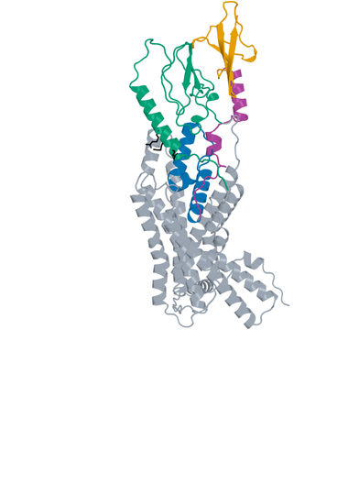
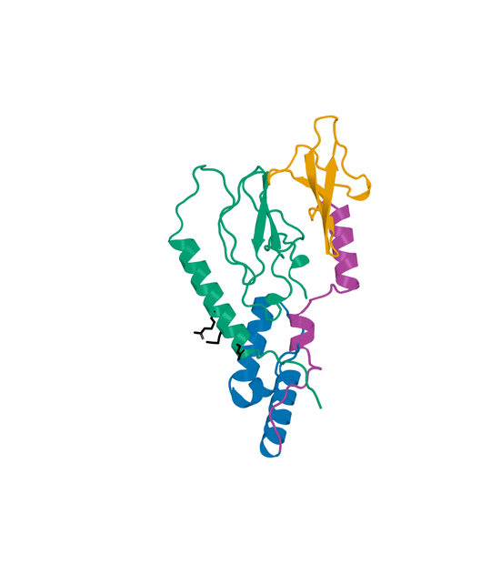
08 LK_P157_08 structure
D-L-D fusion Candidate A: 139 aa Human GLP1R B: 440 aa
Boltz2 Exact receptor complex
Boltz2 Exact interface detail
LigandForge
Linker
ECD binder
Receptor ECD
Remaining receptor
Hotspots
Receptor ECD B1–105 (UniProt 24–128). Black sticks: E34, Q37 and R40. View-specific zoom.
Complete selected sequence, N to C
MSIDYSSLVTHSPTGVAEATEFLYRYYQLREIPLETFIAVASALYHSSLLGGTDSLGKGSYDDKLNALPFSPEA
EAAAQKDVEAGKTKEGSSCVRGGSRTELFSKEPDKGVSFVSGSGVEYVCFAFFVVGSGSGSTYVS
Human GLP1R Boltz2 Exact Computational predictions
16
Notes:
{
"candidate": "LK_P157_08",
"final_rank": 8,
"native_model_sha256": "f9efc503df7abaf13c7f3bbea2af38254a6c142412d6ad515e3f59ce28a7bf7b",
"structure_views": {
"final_rank": 8,
"design_id": "LK_P157_08",
"sequence_sha256": "a6b21c268973d6aca8428dc32538891704af6a07a7a357b3de8a1856d194cc78",
"native_model_sha256": "f9efc503df7abaf13c7f3bbea2af38254a6c142412d6ad515e3f59ce28a7bf7b",
"scoring_pdb_sha256": "80c7ec071ec58a7464df6de072e9017cfbebd6871775205cf042ad116cb3169b",
"overview": {
"source_slide": 39,
"source_picture_index": 1,
"embedded_media": "ppt/media/image41.jpeg",
"image_sha256": "d9b43a1c987e009cb35b54e8838a26195faad0c12fdac416189f7410dcfdf8d4",
"asset": "assets/LK_P157_08-complex.jpg"
},
"interface": {
"source_slide": 40,
"source_picture_index": 1,
"embedded_media": "ppt/media/image44.jpeg",
"image_sha256": "7f4802b3bae5ac977e1090964fac0f280945f83405ea0205a06b9cda48f8589a",
"asset": "assets/LK_P157_08-interface.jpg"
},
"rendering_provenance": {
"DeltaForge_source_PDB_sha256": "80c7ec071ec58a7464df6de072e9017cfbebd6871775205cf042ad116cb3169b",
"role_ranges_zero_based": {
"ECD": [
0,
50
],
"linker": [
50,
85
],
"LF": [
85,
139
]
},
"model_sha256": "f9efc503df7abaf13c7f3bbea2af38254a6c142412d6ad515e3f59ce28a7bf7b",
"source_run": "2026-10-24_pair183-extracellular-exact_001",
"source_methods": [
"https://github.com/DunbrackLab/IPSAE",
"https://github.com/wallnerlab/DockQ",
"https://zhanggroup.org/TM-score/"
],
"saved_display_appendix": {
"parent_sources": {
"ECD-parent": {
"key": "LK_P157_08-ECD-parent",
"source_path": "local/2026-10-25_linker-parent-comparison_001/parents/S10_02_023/exact.pdb",
"source_sha256": "2508cebf214f1a9c1e086a92a31c37e01c012a2322b14ef76c39c626097ba4e1",
"role": "ECD",
"ranges_zero_based": {
"ECD": [
0,
50
]
},
"sequence": "MSIDYSSLVTHSPTGVAEATEFLYRYYQLREIPLETFIAVASALYHSSLL",
"rotation": [
[
0.8335087407643238,
-0.39265340690040285,
0.3886984054353062
],
[
0.5008578600742943,
0.8339815894650616,
-0.23155145976513491
],
[
-0.23324782609576644,
0.3876828299115498,
0.8917945021593576
]
],
"translation": [
8.385546657308538,
2.4163998526141652,
0.004941400857824796
],
"core_fit_CA_RMSD_A": 1.217786115571315,
"output": "local/2026-10-25_linker-parent-views_001/build/renders-v2/LK_P157_08-ECD-parent.jpg",
"parent_or_fusion_id": "S10_02_023",
"design_id": "LK_P157_08",
"panel": "ECD-parent",
"view": [
1,
0,
0,
0,
1,
0,
0,
0,
1,
0,
0,
-507.3095352567785,
-6.376931567667942,
-2.0601005723102688,
-28.59967148261473,
432.7783445215128,
581.8407259920441,
-20
],
"world_height_A": 178.90471727288462,
"row_bounds_all_atoms_A": [
[
-48.11688215885607,
-84.51245920875259,
-88.1308622178804
],
[
35.36301902352019,
80.39225806413205,
30.93151925265094
]
]
},
"APNovo": {
"key": "LK_P157_08-APNovo",
"source_path": "local/2026-10-25_linker-top100-review_001/build/comparisons/LK_P157_08/reference.pdb",
"source_sha256": "1c5f7448c4ab0e480b667edf4290c591f8f6c8deb1ae2abfd20226f9155901d2",
"role": "fusion",
"ranges_zero_based": {
"ECD": [
0,
50
],
"linker": [
50,
85
],
"LF": [
85,
139
]
},
"sequence": "MSIDYSSLVTHSPTGVAEATEFLYRYYQLREIPLETFIAVASALYHSSLLGGTDSLGKGSYDDKLNALPFSPEAEAAAQKDVEAGKTKEGSSCVRGGSRTELFSKEPDKGVSFVSGSGVEYVCFAFFVVGSGSGSTYVS",
"rotation": [
[
-0.7590215848581261,
-0.5573000516979638,
-0.3366049340766919
],
[
-0.2982839234592314,
0.7572167747989567,
-0.5810760771694303
],
[
0.5787166311051646,
-0.3406454807596051,
-0.7409775101855072
]
],
"translation": [
-8.600133253058988,
-9.094514631402003,
7.976175800326624
],
"core_fit_CA_RMSD_A": 1.2177906682619632,
"output": "local/2026-10-25_linker-parent-views_001/build/renders-v2/LK_P157_08-APNovo.jpg",
"parent_or_fusion_id": "LK_P157_08-APNovo",
"design_id": "LK_P157_08",
"panel": "APNovo",
"view": [
1,
0,
0,
0,
1,
0,
0,
0,
1,
0,
0,
-507.3095352567785,
-6.376931567667942,
-2.0601005723102688,
-28.59967148261473,
432.7783445215128,
581.8407259920441,
-20
],
"world_height_A": 178.90471727288462,
"row_bounds_all_atoms_A": [
[
-48.11688215885607,
-84.51245920875259,
-88.1308622178804
],
[
35.36301902352019,
80.39225806413205,
30.93151925265094
]
]
},
"Exact": {
"key": "LK_P157_08-Exact",
"source_path": "local/2026-10-25_linker-top100-review_001/models/LK_P157_08/boltz2.cif",
"source_sha256": "f9efc503df7abaf13c7f3bbea2af38254a6c142412d6ad515e3f59ce28a7bf7b",
"role": "fusion",
"ranges_zero_based": {
"ECD": [
0,
50
],
"linker": [
50,
85
],
"LF": [
85,
139
]
},
"sequence": "MSIDYSSLVTHSPTGVAEATEFLYRYYQLREIPLETFIAVASALYHSSLLGGTDSLGKGSYDDKLNALPFSPEAEAAAQKDVEAGKTKEGSSCVRGGSRTELFSKEPDKGVSFVSGSGVEYVCFAFFVVGSGSGSTYVS",
"rotation": [
[
0.658490631195463,
-0.7422531204738463,
0.12429951767260916
],
[
0.726318044734305,
0.5835192287583562,
-0.3632731816233436
],
[
0.19710952038179252,
0.32949297037094594,
0.9233537862902714
]
],
"translation": [
-2.2098559492908,
-0.32983189599570295,
-0.44176885100609775
],
"core_fit_CA_RMSD_A": 1.2700312102494828,
"output": "local/2026-10-25_linker-parent-views_001/build/renders-v2/LK_P157_08-Exact.jpg",
"parent_or_fusion_id": "LK_P157_08-Exact",
"design_id": "LK_P157_08",
"panel": "Exact",
"view": [
1,
0,
0,
0,
1,
0,
0,
0,
1,
0,
0,
-507.3095352567785,
-6.376931567667942,
-2.0601005723102688,
-28.59967148261473,
432.7783445215128,
581.8407259920441,
-20
],
"world_height_A": 178.90471727288462,
"row_bounds_all_atoms_A": [
[
-48.11688215885607,
-84.51245920875259,
-88.1308622178804
],
[
35.36301902352019,
80.39225806413205,
30.93151925265094
]
]
},
"LF-parent": {
"key": "LK_P157_08-LF-parent",
"source_path": "local/2026-10-25_linker-parent-comparison_001/parents/Design_414/exact.pdb",
"source_sha256": "4efa049c1b3f058a2871c338e555e4ad79d0df44606310a1dfcb9828fe2a0074",
"role": "LF",
"ranges_zero_based": {
"LF": [
0,
54
]
},
"sequence": "KTKEGSSCVRGGSRTELFSKEPDKGVSFVSGSGVEYVCFAFFVVGSGSGSTYVS",
"rotation": [
[
0.12626881177197014,
0.9609470968470932,
0.24624547694553023
],
[
0.41286839251037577,
0.17480287230721459,
-0.8938588306656392
],
[
-0.9019955139723059,
0.2145334625184785,
-0.37467255736932614
]
],
"translation": [
2.419797397266432,
-3.0196765864797523,
3.40792817263803
],
"core_fit_CA_RMSD_A": 1.0971377619951301,
"output": "local/2026-10-25_linker-parent-views_001/build/renders-v2/LK_P157_08-LF-parent.jpg",
"parent_or_fusion_id": "Design_414",
"design_id": "LK_P157_08",
"panel": "LF-parent",
"view": [
1,
0,
0,
0,
1,
0,
0,
0,
1,
0,
0,
-507.3095352567785,
-6.376931567667942,
-2.0601005723102688,
-28.59967148261473,
432.7783445215128,
581.8407259920441,
-20
],
"world_height_A": 178.90471727288462,
"row_bounds_all_atoms_A": [
[
-48.11688215885607,
-84.51245920875259,
-88.1308622178804
],
[
35.36301902352019,
80.39225806413205,
30.93151925265094
]
]
}
},
"shared_camera": [
1,
0,
0,
0,
1,
0,
0,
0,
1,
0,
0,
-507.3095352567785,
-6.376931567667942,
-2.0601005723102688,
-28.59967148261473,
432.7783445215128,
581.8407259920441,
-20
],
"reference": "Separate saved Exact parent complexes flank the linked Exact refold; AP Novo linked design comparison remains on the following slide. Rigid display alignment preserves native poses; all native receptor residues shown."
}
},
"display": "unchanged embedded JPEGs extracted from hash-verified delivered25-design PPTX; no resampling, cropping or new coordinate transforms",
"scale": "full complex and interface have different zooms; no matched-scale claim",
"hotspots": "black sticks; original27pocket positions for original LigandForge, R40/Q37/E34 annotations for DLD",
"colors": {
"LigandForge": "#E69F00",
"linker": "#AA4499",
"ECD_binder": "#0072B2",
"receptor_ECD": "#009E73",
"receptor_remainder": "#9AA5B1",
"hotspots": "#000000"
}
},
"source_deck": "local/2026-10-25_affinity-confidence-selection-deck_002/output/GLP1R_Selected_ipSAE_gt0p895_Kd_lt10nM_v3.pptx",
"source_deck_sha256": "ad9333fdf6c0ce7d6982e2980d6aade78af256710dbc7917f7f39e41d35aa173",
"domain_labels": "ECD A1-50 linker A51-85 LF A86-139",
"display_scope": "native Exact complex and saved interface view; same identity colors, independent zooms; no new coordinates or inferred agonism"
}

Slide 17
09 LK_P069_04 metrics
D-L-D fusion Candidate A: 154 aa Human GLP1R B: 440 aa
Metric and scope | Value
Boltz2 Exact ipSAE (A/B, Type=max) | 0.901831
DeltaForge predicted Kd (nM) | 1.2465
Boltz2 Exact ipTM | 0.8970
Original population ipSAE rank | 9
Predicted-Kd rank within population top50 | 11
Candidate / receptor residues (aa) | 154 / 440
pDockQ / pDockQ2 | 0.2443 / 0.1578
Whole fusion / linker pLDDT (0-100) | 47.1 / 40.5
ECD / LigandForge pLDDT (0-100) | 61.4 / 40.1
Fusion design-to-refold DockQ | 0.1204
Free C-terminal OPM z (A) | 48.54
Extracellular free C-terminal screen | Pass
DeltaForge length scope | long_gt_140
Origin and prediction
ECD parent S10_02_023
LigandForge parent Design_280
Pair P069
AP Novo seed 795
Exact seed 101
3 recycles, 200 steps
ECD A1-50 linker A51-85 LF A86-154
Whole-fusion pLDDT remains modest. High interface confidence does not establish activation.
Complete selected sequence, N to C
MSIDYSSLVTHSPTGVAEATEFLYRYYQLREIPLETFIAVASALYHSSLLGGLGEFSDNGLPPVAPLPPGLPVP
DLPQDEESDIKEVSGATIDLRVKTCVDFKQTVNFFKLRNTQLPGSCTKDNTVLFLLEGLKLGYASRYFSIGSGS
GSQQFS
Human GLP1R Boltz2 Exact Computational predictions
17
Notes:
{
"candidate": "LK_P069_04",
"final_rank": 9,
"selection": "Exact ipSAE>0.895 and DeltaForge predicted Kd<10nM; first20 by Exact ipSAE descending",
"sequence_sha256": "eac1abc7772075c04cdccc8ea3450645db2201bbcb5c4688152dd71deecf0693",
"sources": {
"source_table": {
"path": "local/2026-10-25_lf50-dld26-50-deltaforge_001/output/GLP1R_DLD_Top50_DeltaForge_Kd_and_Boltz2_Metrics.csv",
"sha256": "da9569bf0e8b74cce3d6792eb260d6a4b17b35e6f46e0793d49f02c0d3a0e728"
},
"native_cif": {
"path": "local/2026-10-25_linker-top100-review_001/models/LK_P069_04/boltz2.cif",
"sha256": "54a9810d3ee59227525a958e2f805ebc56a7d62119dee48fb1d16c141ec808c6"
},
"scoring_pdb": {
"path": "local/2026-10-25_dld-top25-deltaforge_001/payload/structures/LK_P069_04.pdb",
"sha256": "4c929315bb090f2d7c37c8f337b315073e2b18e7ece616adb0af0077567d3124"
},
"DeltaForge_result": {
"path": "campaigns/glp1r-r40-design/runs/2026-10-25_dld-top25-deltaforge_001/03_filtering/deltaforge_results/LK_P069_04.json",
"sha256": "8df5d311d7886994c66d0bd81427a9da5972211062fb04b534edbadaafef5fdc"
}
},
"source_ledger": "campaigns/glp1r-final-writeup/runs/2026-10-25_final20-writeup_001/04_analysis/provenance-ledger.json",
"scorer": "deltaforge_v10_2_unified_parallel / v10_2_unified_parallel_2026_05_08",
"calibration": "deltaforge_v10_boltz2_calibrated_gbr / v10_boltz2_gbr_2026_03_29",
"scope": "one complete candidate A against one receptor B; computational, no experimental Kd or activation"
}

Slide 18
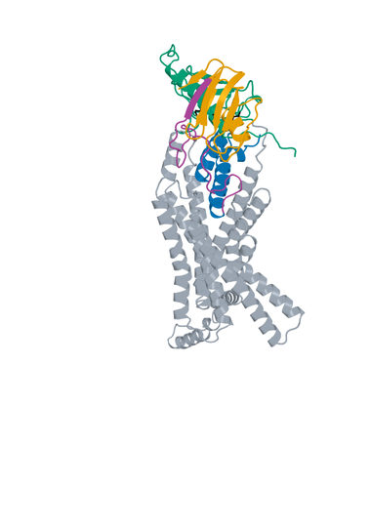
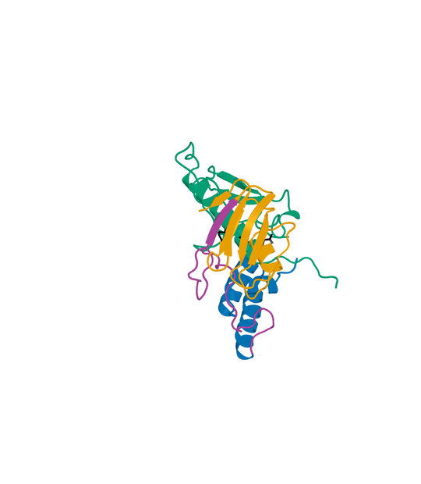
09 LK_P069_04 structure
D-L-D fusion Candidate A: 154 aa Human GLP1R B: 440 aa
Boltz2 Exact receptor complex
Boltz2 Exact interface detail
LigandForge
Linker
ECD binder
Receptor ECD
Remaining receptor
Hotspots
Receptor ECD B1–105 (UniProt 24–128). Black sticks: E34, Q37 and R40. View-specific zoom.
Complete selected sequence, N to C
MSIDYSSLVTHSPTGVAEATEFLYRYYQLREIPLETFIAVASALYHSSLLGGLGEFSDNGLPPVAPLPPGLPVP
DLPQDEESDIKEVSGATIDLRVKTCVDFKQTVNFFKLRNTQLPGSCTKDNTVLFLLEGLKLGYASRYFSIGSGS
GSQQFS
Human GLP1R Boltz2 Exact Computational predictions
18
Notes:
{
"candidate": "LK_P069_04",
"final_rank": 9,
"native_model_sha256": "54a9810d3ee59227525a958e2f805ebc56a7d62119dee48fb1d16c141ec808c6",
"structure_views": {
"final_rank": 9,
"design_id": "LK_P069_04",
"sequence_sha256": "eac1abc7772075c04cdccc8ea3450645db2201bbcb5c4688152dd71deecf0693",
"native_model_sha256": "54a9810d3ee59227525a958e2f805ebc56a7d62119dee48fb1d16c141ec808c6",
"scoring_pdb_sha256": "4c929315bb090f2d7c37c8f337b315073e2b18e7ece616adb0af0077567d3124",
"overview": {
"source_slide": 43,
"source_picture_index": 1,
"embedded_media": "ppt/media/image46.jpeg",
"image_sha256": "5a0186410678df8393141c70bb4df9a1c1a4541dc60d8deec502ae94df16ad56",
"asset": "assets/LK_P069_04-complex.jpg"
},
"interface": {
"source_slide": 44,
"source_picture_index": 1,
"embedded_media": "ppt/media/image49.jpeg",
"image_sha256": "618520b2f5b4301dff2f79223cbfe42eaa60434a67624ccc42fd458583958a45",
"asset": "assets/LK_P069_04-interface.jpg"
},
"rendering_provenance": {
"DeltaForge_source_PDB_sha256": "4c929315bb090f2d7c37c8f337b315073e2b18e7ece616adb0af0077567d3124",
"role_ranges_zero_based": {
"ECD": [
0,
50
],
"linker": [
50,
85
],
"LF": [
85,
154
]
},
"model_sha256": "54a9810d3ee59227525a958e2f805ebc56a7d62119dee48fb1d16c141ec808c6",
"source_run": "2026-10-24_pair183-extracellular-exact_001",
"source_methods": [
"https://github.com/DunbrackLab/IPSAE",
"https://github.com/wallnerlab/DockQ",
"https://zhanggroup.org/TM-score/"
],
"saved_display_appendix": {
"parent_sources": {
"ECD-parent": {
"key": "LK_P069_04-ECD-parent",
"source_path": "local/2026-10-25_linker-parent-comparison_001/parents/S10_02_023/exact.pdb",
"source_sha256": "2508cebf214f1a9c1e086a92a31c37e01c012a2322b14ef76c39c626097ba4e1",
"role": "ECD",
"ranges_zero_based": {
"ECD": [
0,
50
]
},
"sequence": "MSIDYSSLVTHSPTGVAEATEFLYRYYQLREIPLETFIAVASALYHSSLL",
"rotation": [
[
0.8335087407643238,
-0.39265340690040285,
0.3886984054353062
],
[
0.5008578600742943,
0.8339815894650616,
-0.23155145976513491
],
[
-0.23324782609576644,
0.3876828299115498,
0.8917945021593576
]
],
"translation": [
8.385546657308538,
2.4163998526141652,
0.004941400857824796
],
"core_fit_CA_RMSD_A": 1.217786115571315,
"output": "local/2026-10-25_linker-parent-views_001/build/renders-v2/LK_P069_04-ECD-parent.jpg",
"parent_or_fusion_id": "S10_02_023",
"design_id": "LK_P069_04",
"panel": "ECD-parent",
"view": [
1,
0,
0,
0,
1,
0,
0,
0,
1,
0,
0,
-496.5170109924999,
-9.737458183446575,
-3.962820530700938,
-23.665971687061514,
417.052120461681,
575.9819015233188,
-20
],
"world_height_A": 175.09869083739844,
"row_bounds_all_atoms_A": [
[
-50.80222034950911,
-84.51216594940016,
-88.1308622178804
],
[
31.327303982615962,
76.58652488799828,
40.79891884375738
]
]
},
"APNovo": {
"key": "LK_P069_04-APNovo",
"source_path": "local/2026-10-25_linker-top100-review_001/build/comparisons/LK_P069_04/reference.pdb",
"source_sha256": "dc72d205ca3ea9f352b7fc720fb39d856626915765a6a66c5d4306600a9ff29b",
"role": "fusion",
"ranges_zero_based": {
"ECD": [
0,
50
],
"linker": [
50,
85
],
"LF": [
85,
154
]
},
"sequence": "MSIDYSSLVTHSPTGVAEATEFLYRYYQLREIPLETFIAVASALYHSSLLGGLGEFSDNGLPPVAPLPPGLPVPDLPQDEESDIKEVSGATIDLRVKTCVDFKQTVNFFKLRNTQLPGSCTKDNTVLFLLEGLKLGYASRYFSIGSGSGSQQFS",
"rotation": [
[
-0.8228670841493066,
0.5008125701617328,
-0.26847082184812265
],
[
-0.565585172948194,
-0.7674181483605701,
0.3019649682248582
],
[
-0.05480153263622789,
0.40032016982010177,
0.9147352466809231
]
],
"translation": [
-8.92016011650685,
-11.435930962673236,
10.142207680983107
],
"core_fit_CA_RMSD_A": 1.2177891484904904,
"output": "local/2026-10-25_linker-parent-views_001/build/renders-v2/LK_P069_04-APNovo.jpg",
"parent_or_fusion_id": "LK_P069_04-APNovo",
"design_id": "LK_P069_04",
"panel": "APNovo",
"view": [
1,
0,
0,
0,
1,
0,
0,
0,
1,
0,
0,
-496.5170109924999,
-9.737458183446575,
-3.962820530700938,
-23.665971687061514,
417.052120461681,
575.9819015233188,
-20
],
"world_height_A": 175.09869083739844,
"row_bounds_all_atoms_A": [
[
-50.80222034950911,
-84.51216594940016,
-88.1308622178804
],
[
31.327303982615962,
76.58652488799828,
40.79891884375738
]
]
},
"Exact": {
"key": "LK_P069_04-Exact",
"source_path": "local/2026-10-25_linker-top100-review_001/models/LK_P069_04/boltz2.cif",
"source_sha256": "54a9810d3ee59227525a958e2f805ebc56a7d62119dee48fb1d16c141ec808c6",
"role": "fusion",
"ranges_zero_based": {
"ECD": [
0,
50
],
"linker": [
50,
85
],
"LF": [
85,
154
]
},
"sequence": "MSIDYSSLVTHSPTGVAEATEFLYRYYQLREIPLETFIAVASALYHSSLLGGLGEFSDNGLPPVAPLPPGLPVPDLPQDEESDIKEVSGATIDLRVKTCVDFKQTVNFFKLRNTQLPGSCTKDNTVLFLLEGLKLGYASRYFSIGSGSGSQQFS",
"rotation": [
[
0.7774263845495244,
-0.6288804111934234,
0.01084821273662051
],
[
0.6054828629244833,
0.7529491374211084,
0.25779475362851567
],
[
-0.17029022649880599,
-0.19384808771865103,
0.9661388275518243
]
],
"translation": [
0.773261535403515,
-1.905948553053367,
-0.7879479020521534
],
"core_fit_CA_RMSD_A": 1.0601763359580567,
"output": "local/2026-10-25_linker-parent-views_001/build/renders-v2/LK_P069_04-Exact.jpg",
"parent_or_fusion_id": "LK_P069_04-Exact",
"design_id": "LK_P069_04",
"panel": "Exact",
"view": [
1,
0,
0,
0,
1,
0,
0,
0,
1,
0,
0,
-496.5170109924999,
-9.737458183446575,
-3.962820530700938,
-23.665971687061514,
417.052120461681,
575.9819015233188,
-20
],
"world_height_A": 175.09869083739844,
"row_bounds_all_atoms_A": [
[
-50.80222034950911,
-84.51216594940016,
-88.1308622178804
],
[
31.327303982615962,
76.58652488799828,
40.79891884375738
]
]
},
"LF-parent": {
"key": "LK_P069_04-LF-parent",
"source_path": "local/2026-10-25_linker-parent-comparison_001/parents/Design_280/exact.pdb",
"source_sha256": "cd01c89fbf40d0e577c10f20c2afa96c3deef09880d6c761314a1c5e9898bd4f",
"role": "LF",
"ranges_zero_based": {
"LF": [
0,
69
]
},
"sequence": "EVSGATIDLRVKTCVDFKQTVNFFKLRNTQLPGSCTKDNTVLFLLEGLKLGYASRYFSIGSGSGSQQFS",
"rotation": [
[
0.9716521520149124,
0.23640963200020604,
-0.0015985785293137766
],
[
-0.232382419508661,
0.9563002615331773,
0.17744913387297956
],
[
0.04347938667791329,
-0.1720473610249762,
0.9841286681075418
]
],
"translation": [
3.3985903455718525,
-6.121573941428423,
6.014485827651381
],
"core_fit_CA_RMSD_A": 1.3060904572635719,
"output": "local/2026-10-25_linker-parent-views_001/build/renders-v2/LK_P069_04-LF-parent.jpg",
"parent_or_fusion_id": "Design_280",
"design_id": "LK_P069_04",
"panel": "LF-parent",
"view": [
1,
0,
0,
0,
1,
0,
0,
0,
1,
0,
0,
-496.5170109924999,
-9.737458183446575,
-3.962820530700938,
-23.665971687061514,
417.052120461681,
575.9819015233188,
-20
],
"world_height_A": 175.09869083739844,
"row_bounds_all_atoms_A": [
[
-50.80222034950911,
-84.51216594940016,
-88.1308622178804
],
[
31.327303982615962,
76.58652488799828,
40.79891884375738
]
]
}
},
"shared_camera": [
1,
0,
0,
0,
1,
0,
0,
0,
1,
0,
0,
-496.5170109924999,
-9.737458183446575,
-3.962820530700938,
-23.665971687061514,
417.052120461681,
575.9819015233188,
-20
],
"reference": "Separate saved Exact parent complexes flank the linked Exact refold; AP Novo linked design comparison remains on the following slide. Rigid display alignment preserves native poses; all native receptor residues shown."
}
},
"display": "unchanged embedded JPEGs extracted from hash-verified delivered25-design PPTX; no resampling, cropping or new coordinate transforms",
"scale": "full complex and interface have different zooms; no matched-scale claim",
"hotspots": "black sticks; original27pocket positions for original LigandForge, R40/Q37/E34 annotations for DLD",
"colors": {
"LigandForge": "#E69F00",
"linker": "#AA4499",
"ECD_binder": "#0072B2",
"receptor_ECD": "#009E73",
"receptor_remainder": "#9AA5B1",
"hotspots": "#000000"
}
},
"source_deck": "local/2026-10-25_affinity-confidence-selection-deck_002/output/GLP1R_Selected_ipSAE_gt0p895_Kd_lt10nM_v3.pptx",
"source_deck_sha256": "ad9333fdf6c0ce7d6982e2980d6aade78af256710dbc7917f7f39e41d35aa173",
"domain_labels": "ECD A1-50 linker A51-85 LF A86-154",
"display_scope": "native Exact complex and saved interface view; same identity colors, independent zooms; no new coordinates or inferred agonism"
}

Slide 19
10 LK_P024_03 metrics
D-L-D fusion Candidate A: 128 aa Human GLP1R B: 440 aa
Metric and scope | Value
Boltz2 Exact ipSAE (A/B, Type=max) | 0.901677
DeltaForge predicted Kd (nM) | 3.7889
Boltz2 Exact ipTM | 0.8706
Original population ipSAE rank | 10
Predicted-Kd rank within population top50 | 33
Candidate / receptor residues (aa) | 128 / 440
pDockQ / pDockQ2 | 0.3381 / 0.2317
Whole fusion / linker pLDDT (0-100) | 57.3 / 51.5
ECD / LigandForge pLDDT (0-100) | 69.3 / 49.8
Fusion design-to-refold DockQ | 0.2143
Free C-terminal OPM z (A) | 39.32
Extracellular free C-terminal screen | Pass
DeltaForge length scope | platform_8_140
Origin and prediction
ECD parent S11_00_040
LigandForge parent Design_613
Pair P024
AP Novo seed 344
Exact seed 101
3 recycles, 200 steps
ECD A1-48 linker A49-66 LF A67-128
Whole-fusion pLDDT remains modest. High interface confidence does not establish activation.
Complete selected sequence, N to C
MRALAQASTGSSALETLHRMRVEAFFQQQLRSGTLSDGAVEAYSRLVGGGHRVEPPVRPPPVSLPGRTCTSAYG
VPYSDGHFQRPVPSENGLNTQGVTDVSGRETDESTDVFVVISCQGSGSGSTRFN
Human GLP1R Boltz2 Exact Computational predictions
19
Notes:
{
"candidate": "LK_P024_03",
"final_rank": 10,
"selection": "Exact ipSAE>0.895 and DeltaForge predicted Kd<10nM; first20 by Exact ipSAE descending",
"sequence_sha256": "8dc9b6cdcee3e7e71a77d1467efe1238ae3ac5e5f038f9f11c9d2bddd853a214",
"sources": {
"source_table": {
"path": "local/2026-10-25_lf50-dld26-50-deltaforge_001/output/GLP1R_DLD_Top50_DeltaForge_Kd_and_Boltz2_Metrics.csv",
"sha256": "da9569bf0e8b74cce3d6792eb260d6a4b17b35e6f46e0793d49f02c0d3a0e728"
},
"native_cif": {
"path": "local/2026-10-25_linker-top100-review_001/models/LK_P024_03/boltz2.cif",
"sha256": "4fc14c3d8396a86eafcb4fcc7dfea43f4735fa0f1a97b442e4e297d2c289df24"
},
"scoring_pdb": {
"path": "local/2026-10-25_dld-top25-deltaforge_001/payload/structures/LK_P024_03.pdb",
"sha256": "dfb21db83d1128f2f2827422ca25d2545fcaf850845839b44f89539a3731148b"
},
"DeltaForge_result": {
"path": "campaigns/glp1r-r40-design/runs/2026-10-25_dld-top25-deltaforge_001/03_filtering/deltaforge_results/LK_P024_03.json",
"sha256": "3d5214c50e078aeb5312a53fa6cde425c0b0961cb21d46ca9d7f9c5cc41a04ff"
}
},
"source_ledger": "campaigns/glp1r-final-writeup/runs/2026-10-25_final20-writeup_001/04_analysis/provenance-ledger.json",
"scorer": "deltaforge_v10_2_unified_parallel / v10_2_unified_parallel_2026_05_08",
"calibration": "deltaforge_v10_boltz2_calibrated_gbr / v10_boltz2_gbr_2026_03_29",
"scope": "one complete candidate A against one receptor B; computational, no experimental Kd or activation"
}

Slide 20
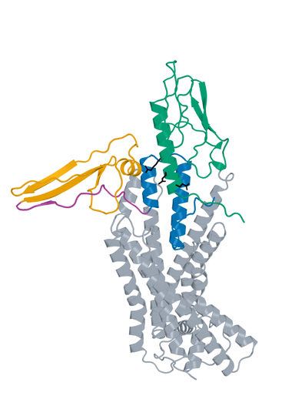
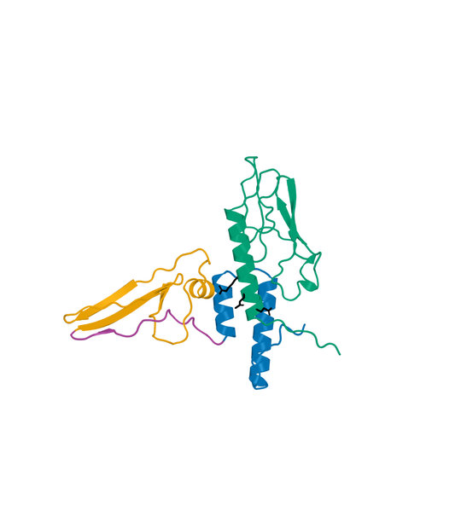
10 LK_P024_03 structure
D-L-D fusion Candidate A: 128 aa Human GLP1R B: 440 aa
Boltz2 Exact receptor complex
Boltz2 Exact interface detail
LigandForge
Linker
ECD binder
Receptor ECD
Remaining receptor
Hotspots
Receptor ECD B1–105 (UniProt 24–128). Black sticks: E34, Q37 and R40. View-specific zoom.
Complete selected sequence, N to C
MRALAQASTGSSALETLHRMRVEAFFQQQLRSGTLSDGAVEAYSRLVGGGHRVEPPVRPPPVSLPGRTCTSAYG
VPYSDGHFQRPVPSENGLNTQGVTDVSGRETDESTDVFVVISCQGSGSGSTRFN
Human GLP1R Boltz2 Exact Computational predictions
20
Notes:
{
"candidate": "LK_P024_03",
"final_rank": 10,
"native_model_sha256": "4fc14c3d8396a86eafcb4fcc7dfea43f4735fa0f1a97b442e4e297d2c289df24",
"structure_views": {
"final_rank": 10,
"design_id": "LK_P024_03",
"sequence_sha256": "8dc9b6cdcee3e7e71a77d1467efe1238ae3ac5e5f038f9f11c9d2bddd853a214",
"native_model_sha256": "4fc14c3d8396a86eafcb4fcc7dfea43f4735fa0f1a97b442e4e297d2c289df24",
"scoring_pdb_sha256": "dfb21db83d1128f2f2827422ca25d2545fcaf850845839b44f89539a3731148b",
"overview": {
"source_slide": 47,
"source_picture_index": 1,
"embedded_media": "ppt/media/image51.jpeg",
"image_sha256": "52f28117130120e202328231f728d9ad2a559e8f7db2230aeff36f3d8dab1490",
"asset": "assets/LK_P024_03-complex.jpg"
},
"interface": {
"source_slide": 48,
"source_picture_index": 1,
"embedded_media": "ppt/media/image54.jpeg",
"image_sha256": "933650b7828ab6c40e0267a497b2a9e6751d6a22403ff6b2274558f27398bac4",
"asset": "assets/LK_P024_03-interface.jpg"
},
"rendering_provenance": {
"DeltaForge_source_PDB_sha256": "dfb21db83d1128f2f2827422ca25d2545fcaf850845839b44f89539a3731148b",
"role_ranges_zero_based": {
"ECD": [
0,
48
],
"linker": [
48,
66
],
"LF": [
66,
128
]
},
"model_sha256": "4fc14c3d8396a86eafcb4fcc7dfea43f4735fa0f1a97b442e4e297d2c289df24",
"source_run": "2026-10-24_pair183-extracellular-exact_001",
"source_methods": [
"https://github.com/DunbrackLab/IPSAE",
"https://github.com/wallnerlab/DockQ",
"https://zhanggroup.org/TM-score/"
],
"saved_display_appendix": {
"parent_sources": {
"ECD-parent": {
"key": "LK_P024_03-ECD-parent",
"source_path": "local/2026-10-25_linker-parent-comparison_001/parents/S11_00_040/exact.pdb",
"source_sha256": "4bfc65133e93d780ad1aad718e7827d6ba1fbc82b0da11aa257ac90f30f0817a",
"role": "ECD",
"ranges_zero_based": {
"ECD": [
0,
48
]
},
"sequence": "MRALAQASTGSSALETLHRMRVEAFFQQQLRSGTLSDGAVEAYSRLVG",
"rotation": [
[
0.587952351171614,
0.715101864548231,
0.3780758143062162
],
[
-0.39070231621004226,
0.6603173030814564,
-0.641352313308964
],
[
-0.7082822407611347,
0.22936958443860261,
0.6676270711911929
]
],
"translation": [
1.9905973047053234,
4.0568865236184095,
-1.5660281006508652
],
"core_fit_CA_RMSD_A": 1.0669233376856848,
"output": "local/2026-10-25_linker-parent-views_001/build/renders-v2/LK_P024_03-ECD-parent.jpg",
"parent_or_fusion_id": "S11_00_040",
"design_id": "LK_P024_03",
"panel": "ECD-parent",
"view": [
1,
0,
0,
0,
1,
0,
0,
0,
1,
0,
0,
-392.5082070036389,
-8.248592311390137,
25.075248512381208,
-6.306773769403417,
330.2384691083017,
454.77794489897616,
-20
],
"world_height_A": 138.41957408848964,
"row_bounds_all_atoms_A": [
[
-49.95177578696983,
-33.21960602912013,
-53.576511664740664
],
[
33.45459116418956,
83.37010305388254,
40.96296412593383
]
]
},
"APNovo": {
"key": "LK_P024_03-APNovo",
"source_path": "local/2026-10-25_linker-top100-review_001/build/comparisons/LK_P024_03/reference.pdb",
"source_sha256": "ed0602f99a2d58ae79dae7f789a8b8292eddddd7ab2be6738980512c46b26749",
"role": "fusion",
"ranges_zero_based": {
"ECD": [
0,
48
],
"linker": [
48,
66
],
"LF": [
66,
128
]
},
"sequence": "MRALAQASTGSSALETLHRMRVEAFFQQQLRSGTLSDGAVEAYSRLVGGGHRVEPPVRPPPVSLPGRTCTSAYGVPYSDGHFQRPVPSENGLNTQGVTDVSGRETDESTDVFVVISCQGSGSGSTRFN",
"rotation": [
[
-0.9539850013056439,
0.15755770932714164,
-0.2551238732175687
],
[
0.1619842265098122,
0.9867863884917113,
0.003705200803774615
],
[
0.2523365843892744,
-0.03779134168460274,
-0.966901263858027
]
],
"translation": [
-14.944810937477325,
-12.126725604374272,
3.2817343794175633
],
"core_fit_CA_RMSD_A": 1.0668990455407001,
"output": "local/2026-10-25_linker-parent-views_001/build/renders-v2/LK_P024_03-APNovo.jpg",
"parent_or_fusion_id": "LK_P024_03-APNovo",
"design_id": "LK_P024_03",
"panel": "APNovo",
"view": [
1,
0,
0,
0,
1,
0,
0,
0,
1,
0,
0,
-392.5082070036389,
-8.248592311390137,
25.075248512381208,
-6.306773769403417,
330.2384691083017,
454.77794489897616,
-20
],
"world_height_A": 138.41957408848964,
"row_bounds_all_atoms_A": [
[
-49.95177578696983,
-33.21960602912013,
-53.576511664740664
],
[
33.45459116418956,
83.37010305388254,
40.96296412593383
]
]
},
"Exact": {
"key": "LK_P024_03-Exact",
"source_path": "local/2026-10-25_linker-top100-review_001/models/LK_P024_03/boltz2.cif",
"source_sha256": "4fc14c3d8396a86eafcb4fcc7dfea43f4735fa0f1a97b442e4e297d2c289df24",
"role": "fusion",
"ranges_zero_based": {
"ECD": [
0,
48
],
"linker": [
48,
66
],
"LF": [
66,
128
]
},
"sequence": "MRALAQASTGSSALETLHRMRVEAFFQQQLRSGTLSDGAVEAYSRLVGGGHRVEPPVRPPPVSLPGRTCTSAYGVPYSDGHFQRPVPSENGLNTQGVTDVSGRETDESTDVFVVISCQGSGSGSTRFN",
"rotation": [
[
0.6706716461501987,
0.6302667971094862,
0.3911052336731897
],
[
0.5102478490527496,
-0.00930919091059379,
-0.8599770093367702
],
[
-0.5383740657655967,
0.7763228308163823,
-0.327835648225002
]
],
"translation": [
0.13932472550518682,
2.5169201887088413,
2.5886366232108458
],
"core_fit_CA_RMSD_A": 1.2820873342981451,
"output": "local/2026-10-25_linker-parent-views_001/build/renders-v2/LK_P024_03-Exact.jpg",
"parent_or_fusion_id": "LK_P024_03-Exact",
"design_id": "LK_P024_03",
"panel": "Exact",
"view": [
1,
0,
0,
0,
1,
0,
0,
0,
1,
0,
0,
-392.5082070036389,
-8.248592311390137,
25.075248512381208,
-6.306773769403417,
330.2384691083017,
454.77794489897616,
-20
],
"world_height_A": 138.41957408848964,
"row_bounds_all_atoms_A": [
[
-49.95177578696983,
-33.21960602912013,
-53.576511664740664
],
[
33.45459116418956,
83.37010305388254,
40.96296412593383
]
]
},
"LF-parent": {
"key": "LK_P024_03-LF-parent",
"source_path": "local/2026-10-25_linker-parent-comparison_001/parents/Design_613/exact.pdb",
"source_sha256": "45f959dfc2844f56fce4f564ccd71a5db6030b5f721bd2fbcec9c3c0d1be388f",
"role": "LF",
"ranges_zero_based": {
"LF": [
0,
62
]
},
"sequence": "RTCTSAYGVPYSDGHFQRPVPSENGLNTQGVTDVSGRETDESTDVFVVISCQGSGSGSTRFN",
"rotation": [
[
0.551438133075445,
0.6946548793138909,
0.4619205502504471
],
[
0.08183602926948264,
0.5060018083778517,
-0.8586414483630882
],
[
-0.8301920581921252,
0.5112893754196808,
0.2221808673488601
]
],
"translation": [
0.3216919312394033,
-4.358870021686835,
2.6901840786592857
],
"core_fit_CA_RMSD_A": 1.08576555051361,
"output": "local/2026-10-25_linker-parent-views_001/build/renders-v2/LK_P024_03-LF-parent.jpg",
"parent_or_fusion_id": "Design_613",
"design_id": "LK_P024_03",
"panel": "LF-parent",
"view": [
1,
0,
0,
0,
1,
0,
0,
0,
1,
0,
0,
-392.5082070036389,
-8.248592311390137,
25.075248512381208,
-6.306773769403417,
330.2384691083017,
454.77794489897616,
-20
],
"world_height_A": 138.41957408848964,
"row_bounds_all_atoms_A": [
[
-49.95177578696983,
-33.21960602912013,
-53.576511664740664
],
[
33.45459116418956,
83.37010305388254,
40.96296412593383
]
]
}
},
"shared_camera": [
1,
0,
0,
0,
1,
0,
0,
0,
1,
0,
0,
-392.5082070036389,
-8.248592311390137,
25.075248512381208,
-6.306773769403417,
330.2384691083017,
454.77794489897616,
-20
],
"reference": "Separate saved Exact parent complexes flank the linked Exact refold; AP Novo linked design comparison remains on the following slide. Rigid display alignment preserves native poses; all native receptor residues shown."
}
},
"display": "unchanged embedded JPEGs extracted from hash-verified delivered25-design PPTX; no resampling, cropping or new coordinate transforms",
"scale": "full complex and interface have different zooms; no matched-scale claim",
"hotspots": "black sticks; original27pocket positions for original LigandForge, R40/Q37/E34 annotations for DLD",
"colors": {
"LigandForge": "#E69F00",
"linker": "#AA4499",
"ECD_binder": "#0072B2",
"receptor_ECD": "#009E73",
"receptor_remainder": "#9AA5B1",
"hotspots": "#000000"
}
},
"source_deck": "local/2026-10-25_affinity-confidence-selection-deck_002/output/GLP1R_Selected_ipSAE_gt0p895_Kd_lt10nM_v3.pptx",
"source_deck_sha256": "ad9333fdf6c0ce7d6982e2980d6aade78af256710dbc7917f7f39e41d35aa173",
"domain_labels": "ECD A1-48 linker A49-66 LF A67-128",
"display_scope": "native Exact complex and saved interface view; same identity colors, independent zooms; no new coordinates or inferred agonism"
}

Slide 21
11 Design_994 metrics
Original LigandForge Candidate A: 70 aa Human GLP1R B: 409 aa
Metric and scope | Value
Boltz2 Exact ipSAE (A/B, Type=max) | 0.900959
DeltaForge predicted Kd (nM) | 2.7380
Boltz2 Exact ipTM | 0.9553
Original population ipSAE rank | 11
Predicted-Kd rank within population top50 | 12
Candidate / receptor residues (aa) | 70 / 409
Complex pLDDT (0-100) | 74.4
Generator-to-refold DockQ / TM-score | N/A
DeltaForge length scope | core_40_119
Origin and prediction
Original LigandForge v6.5.21
Generation 1
Exact seed 101
3 recycles, 200 steps
WT GLP1R 24-432
409 receptor residues
Original generator coordinates unavailable
Original generator coordinates are unavailable. This Exact prediction does not establish activation.
Complete selected sequence, N to C
TIDGYKHLFEISDVIEAEGGELQLKRQEYESAIGFKLCRLNAESVYNVKKLSGLRPVGCKGSGSGSYVNL
Human GLP1R Boltz2 Exact Computational predictions
21
Notes:
{
"candidate": "Design_994",
"final_rank": 11,
"selection": "Exact ipSAE>0.895 and DeltaForge predicted Kd<10nM; first20 by Exact ipSAE descending",
"sequence_sha256": "799f19539f7ce40757ac276419bda54c2548f8cdfffae59f8d86bc67fa50aa17",
"sources": {
"source_table": {
"path": "local/2026-10-25_lf50-dld26-50-deltaforge_001/output/GLP1R_LigandForge_Original_Top50_DeltaForge_Kd.csv",
"sha256": "da4de8915b1ca76443882c0651920ddd9551839d0d75a5b18b8b1ff4653b0360"
},
"native_cif": {
"path": "campaigns/glp1r-ligandforge-boltz2-exact/runs/2026-10-15_ligandforge-exact_001/02_design/chunks/batch-039/kit_outputs/by_seed/Design_994/s101/Design_994_model_0.cif",
"sha256": "23fffdccdb4b68471c9b243b9ef27714eb55e616644fe4e2f98483c3879579c6"
},
"scoring_pdb": {
"path": "local/2026-10-25_lf50-dld26-50-deltaforge_001/LF_Design_994.pdb",
"sha256": "195a001cf363948c1aea8e3d2c9802985e9597371143a7269596f0fd83555e92"
},
"DeltaForge_result": {
"path": "campaigns/glp1r-r40-design/runs/2026-10-25_lf50-dld26-50-deltaforge_001/03_filtering/deltaforge_results/LF_Design_994.json",
"sha256": "f90dad182faa41a5a1c3a24080b13a0516510571fb445cc3a7a360ef9d298327"
}
},
"source_ledger": "campaigns/glp1r-final-writeup/runs/2026-10-25_final20-writeup_001/04_analysis/provenance-ledger.json",
"scorer": "deltaforge_v10_2_unified_parallel / v10_2_unified_parallel_2026_05_08",
"calibration": "deltaforge_v10_boltz2_calibrated_gbr / v10_boltz2_gbr_2026_03_29",
"scope": "one complete candidate A against one receptor B; computational, no experimental Kd or activation"
}

Slide 22
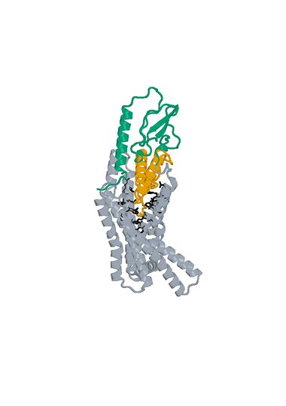
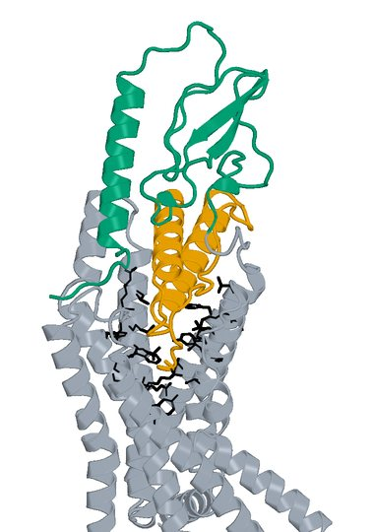
11 Design_994 structure
Original LigandForge Candidate A: 70 aa Human GLP1R B: 409 aa
Boltz2 Exact receptor complex
Boltz2 Exact interface detail
LigandForge
Receptor ECD
Remaining receptor
Hotspots
Receptor ECD B1–105 (UniProt 24–128). Black sticks: 27 submitted pocket positions. View-specific zoom.
Complete selected sequence, N to C
TIDGYKHLFEISDVIEAEGGELQLKRQEYESAIGFKLCRLNAESVYNVKKLSGLRPVGCKGSGSGSYVNL
Human GLP1R Boltz2 Exact Computational predictions
22
Notes:
{
"candidate": "Design_994",
"final_rank": 11,
"native_model_sha256": "23fffdccdb4b68471c9b243b9ef27714eb55e616644fe4e2f98483c3879579c6",
"structure_views": {
"final_rank": 11,
"design_id": "Design_994",
"sequence_sha256": "799f19539f7ce40757ac276419bda54c2548f8cdfffae59f8d86bc67fa50aa17",
"native_model_sha256": "23fffdccdb4b68471c9b243b9ef27714eb55e616644fe4e2f98483c3879579c6",
"scoring_pdb_sha256": "195a001cf363948c1aea8e3d2c9802985e9597371143a7269596f0fd83555e92",
"overview": {
"source_slide": 9,
"source_picture_index": 0,
"embedded_media": "ppt/media/image5.jpeg",
"image_sha256": "64f857730b8faa419488a95fc67fe847d66dd2f4921b8489f6c9ed19bc05e4e0",
"asset": "assets/Design_994-complex.jpg"
},
"interface": {
"source_slide": 9,
"source_picture_index": 1,
"embedded_media": "ppt/media/image6.jpeg",
"image_sha256": "73959ec100cea70f9de894043dcd50dd3d4d275bd31ce21bfaba2f1da3faed7c",
"asset": "assets/Design_994-interface.jpg"
},
"rendering_provenance": {
"source_PDB": "campaigns/glp1r-ligandforge-affinity/runs/2026-10-15_top100-affinity_001/01_staging/payload/pdb_inputs/Design_994.pdb",
"PDB_SHA256": "195a001cf363948c1aea8e3d2c9802985e9597371143a7269596f0fd83555e92",
"model_SHA256": "23fffdccdb4b68471c9b243b9ef27714eb55e616644fe4e2f98483c3879579c6",
"source_render_script": "local/2026-10-25_affinity-confidence-selection-deck_002/render_originals.py",
"alignment": "rigid core CA B117-400 fitting; original full/interface zooms reused",
"camera_version": "saved original full and interface frames from final90-slide deck"
},
"display": "unchanged embedded JPEGs extracted from hash-verified delivered25-design PPTX; no resampling, cropping or new coordinate transforms",
"scale": "full complex and interface have different zooms; no matched-scale claim",
"hotspots": "black sticks; original27pocket positions for original LigandForge, R40/Q37/E34 annotations for DLD",
"colors": {
"LigandForge": "#E69F00",
"linker": "#AA4499",
"ECD_binder": "#0072B2",
"receptor_ECD": "#009E73",
"receptor_remainder": "#9AA5B1",
"hotspots": "#000000"
}
},
"source_deck": "local/2026-10-25_affinity-confidence-selection-deck_002/output/GLP1R_Selected_ipSAE_gt0p895_Kd_lt10nM_v3.pptx",
"source_deck_sha256": "ad9333fdf6c0ce7d6982e2980d6aade78af256710dbc7917f7f39e41d35aa173",
"domain_labels": "LigandForge A1-70",
"display_scope": "native Exact complex and saved interface view; same identity colors, independent zooms; no new coordinates or inferred agonism"
}

Slide 23
12 LK_P012_08 metrics
D-L-D fusion Candidate A: 125 aa Human GLP1R B: 440 aa
Metric and scope | Value
Boltz2 Exact ipSAE (A/B, Type=max) | 0.900529
DeltaForge predicted Kd (nM) | 1.4449
Boltz2 Exact ipTM | 0.9175
Original population ipSAE rank | 11
Predicted-Kd rank within population top50 | 14
Candidate / receptor residues (aa) | 125 / 440
pDockQ / pDockQ2 | 0.2348 / 0.1121
Whole fusion / linker pLDDT (0-100) | 47.9 / 41.6
ECD / LigandForge pLDDT (0-100) | 67.4 / 38.2
Fusion design-to-refold DockQ | 0.2160
Free C-terminal OPM z (A) | 34.03
Extracellular free C-terminal screen | Pass
DeltaForge length scope | platform_8_140
Origin and prediction
ECD parent S08_00_042
LigandForge parent Design_991
Pair P012
AP Novo seed 229
Exact seed 101
3 recycles, 200 steps
ECD A1-39 linker A40-60 LF A61-125
Whole-fusion pLDDT remains modest. High interface confidence does not establish activation.
Complete selected sequence, N to C
MADSISEVSEGVHLILAAQALELPPFVVAARLEEARAKRGGAPSFLPPPNVTSGYVNGGGAFHLTGLAARCGAV
WRGVFCQFGNGVKGEGSVTGGSLNTFYILTVAPTSANILTSGSGSGSLEGS
Human GLP1R Boltz2 Exact Computational predictions
23
Notes:
{
"candidate": "LK_P012_08",
"final_rank": 12,
"selection": "Exact ipSAE>0.895 and DeltaForge predicted Kd<10nM; first20 by Exact ipSAE descending",
"sequence_sha256": "a8fa1d10358030cab72dca008ae0844ce42d6d4bafa0bd4d7d2b64643ef440c7",
"sources": {
"source_table": {
"path": "local/2026-10-25_lf50-dld26-50-deltaforge_001/output/GLP1R_DLD_Top50_DeltaForge_Kd_and_Boltz2_Metrics.csv",
"sha256": "da9569bf0e8b74cce3d6792eb260d6a4b17b35e6f46e0793d49f02c0d3a0e728"
},
"native_cif": {
"path": "local/2026-10-25_linker-top100-review_001/models/LK_P012_08/boltz2.cif",
"sha256": "05354a48a6723a5e62d6a6d0700be933508e8986daad01fb8900ad828620a74d"
},
"scoring_pdb": {
"path": "local/2026-10-25_dld-top25-deltaforge_001/payload/structures/LK_P012_08.pdb",
"sha256": "970fc5302535823051074742639b19f84f496d87c9928ba0760abc7cfa16a295"
},
"DeltaForge_result": {
"path": "campaigns/glp1r-r40-design/runs/2026-10-25_dld-top25-deltaforge_001/03_filtering/deltaforge_results/LK_P012_08.json",
"sha256": "20e4273cd4e3c8cf407fe103deb973c6c1873cba3e9ca7021503f52c9ac7b3ff"
}
},
"source_ledger": "campaigns/glp1r-final-writeup/runs/2026-10-25_final20-writeup_001/04_analysis/provenance-ledger.json",
"scorer": "deltaforge_v10_2_unified_parallel / v10_2_unified_parallel_2026_05_08",
"calibration": "deltaforge_v10_boltz2_calibrated_gbr / v10_boltz2_gbr_2026_03_29",
"scope": "one complete candidate A against one receptor B; computational, no experimental Kd or activation"
}

Slide 24
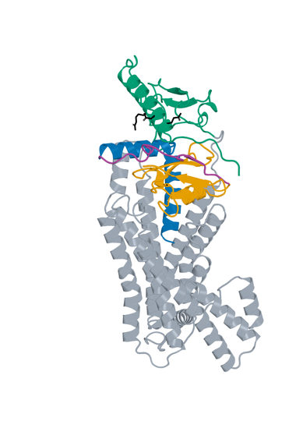
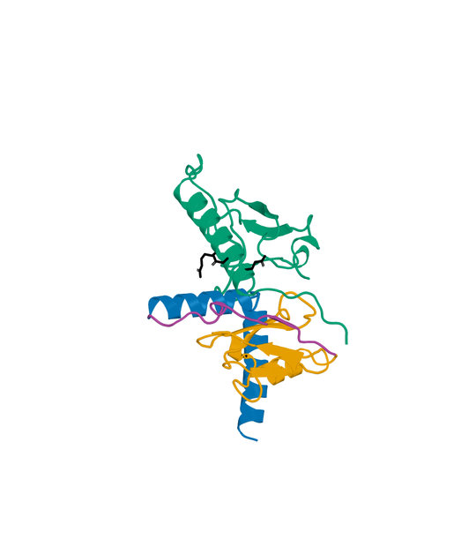
12 LK_P012_08 structure
D-L-D fusion Candidate A: 125 aa Human GLP1R B: 440 aa
Boltz2 Exact receptor complex
Boltz2 Exact interface detail
LigandForge
Linker
ECD binder
Receptor ECD
Remaining receptor
Hotspots
Receptor ECD B1–105 (UniProt 24–128). Black sticks: E34, Q37 and R40. View-specific zoom.
Complete selected sequence, N to C
MADSISEVSEGVHLILAAQALELPPFVVAARLEEARAKRGGAPSFLPPPNVTSGYVNGGGAFHLTGLAARCGAV
WRGVFCQFGNGVKGEGSVTGGSLNTFYILTVAPTSANILTSGSGSGSLEGS
Human GLP1R Boltz2 Exact Computational predictions
24
Notes:
{
"candidate": "LK_P012_08",
"final_rank": 12,
"native_model_sha256": "05354a48a6723a5e62d6a6d0700be933508e8986daad01fb8900ad828620a74d",
"structure_views": {
"final_rank": 12,
"design_id": "LK_P012_08",
"sequence_sha256": "a8fa1d10358030cab72dca008ae0844ce42d6d4bafa0bd4d7d2b64643ef440c7",
"native_model_sha256": "05354a48a6723a5e62d6a6d0700be933508e8986daad01fb8900ad828620a74d",
"scoring_pdb_sha256": "970fc5302535823051074742639b19f84f496d87c9928ba0760abc7cfa16a295",
"overview": {
"source_slide": 51,
"source_picture_index": 1,
"embedded_media": "ppt/media/image56.jpeg",
"image_sha256": "bb7ee298896ad90a97c99d74115de8573e8f68dcd80f1f803995ccefdabd1bfd",
"asset": "assets/LK_P012_08-complex.jpg"
},
"interface": {
"source_slide": 52,
"source_picture_index": 1,
"embedded_media": "ppt/media/image59.jpeg",
"image_sha256": "c450099cc95198b482c5dce663b5007b118c4a798d0107df90765ecf956d2d45",
"asset": "assets/LK_P012_08-interface.jpg"
},
"rendering_provenance": {
"DeltaForge_source_PDB_sha256": "970fc5302535823051074742639b19f84f496d87c9928ba0760abc7cfa16a295",
"role_ranges_zero_based": {
"ECD": [
0,
39
],
"linker": [
39,
60
],
"LF": [
60,
125
]
},
"model_sha256": "05354a48a6723a5e62d6a6d0700be933508e8986daad01fb8900ad828620a74d",
"source_run": "2026-10-24_pair183-extracellular-exact_001",
"source_methods": [
"https://github.com/DunbrackLab/IPSAE",
"https://github.com/wallnerlab/DockQ",
"https://zhanggroup.org/TM-score/"
],
"saved_display_appendix": {
"parent_sources": {
"ECD-parent": {
"key": "LK_P012_08-ECD-parent",
"source_path": "local/2026-10-25_linker-parent-comparison_001/parents/S08_00_042/exact.pdb",
"source_sha256": "586dbe8949136305e5e0d5d43c665bd5ed5d95548b9f5bc863aed4430cf0b282",
"role": "ECD",
"ranges_zero_based": {
"ECD": [
0,
39
]
},
"sequence": "MADSISEVSEGVHLILAAQALELPPFVVAARLEEARAKR",
"rotation": [
[
-0.1115210831342317,
0.9835902168408683,
-0.1418215514822947
],
[
0.6850233413445608,
-0.02730086207089444,
-0.7280093576971334
],
[
-0.7199347331369061,
-0.17833945967167697,
-0.6707376398307572
]
],
"translation": [
3.8607485500063383,
4.630699048501577,
-3.485280759986309
],
"core_fit_CA_RMSD_A": 1.029119308080871,
"output": "local/2026-10-25_linker-parent-views_001/build/renders-v2/LK_P012_08-ECD-parent.jpg",
"parent_or_fusion_id": "S08_00_042",
"design_id": "LK_P012_08",
"panel": "ECD-parent",
"view": [
1,
0,
0,
0,
1,
0,
0,
0,
1,
0,
0,
-375.1807890577328,
-6.0423595806129775,
17.833570216119554,
-17.22229832419229,
309.92548266224577,
440.4360954532198,
-20
],
"world_height_A": 132.30899150873904,
"row_bounds_all_atoms_A": [
[
-43.157771701907166,
-41.320925538249966,
-67.47760471967932
],
[
31.07305254068121,
76.98806597048907,
33.03300807129474
]
]
},
"APNovo": {
"key": "LK_P012_08-APNovo",
"source_path": "local/2026-10-25_linker-top100-review_001/build/comparisons/LK_P012_08/reference.pdb",
"source_sha256": "531e3b07d4ac1b3b4abe4ea8f6aa7b2cc594709ab59bffc278de38f1aff3fd8b",
"role": "fusion",
"ranges_zero_based": {
"ECD": [
0,
39
],
"linker": [
39,
60
],
"LF": [
60,
125
]
},
"sequence": "MADSISEVSEGVHLILAAQALELPPFVVAARLEEARAKRGGAPSFLPPPNVTSGYVNGGGAFHLTGLAARCGAVWRGVFCQFGNGVKGEGSVTGGSLNTFYILTVAPTSANILTSGSGSGSLEGS",
"rotation": [
[
0.5312599578036306,
-0.8089077733482348,
0.2518553238768293
],
[
-0.49887658403582336,
-0.5389603751446335,
-0.6787075301108718
],
[
0.684751798850054,
0.23492539943640278,
-0.6898731672315037
]
],
"translation": [
-13.506761469234021,
-7.866028786133306,
5.680318718429358
],
"core_fit_CA_RMSD_A": 1.0290974972677107,
"output": "local/2026-10-25_linker-parent-views_001/build/renders-v2/LK_P012_08-APNovo.jpg",
"parent_or_fusion_id": "LK_P012_08-APNovo",
"design_id": "LK_P012_08",
"panel": "APNovo",
"view": [
1,
0,
0,
0,
1,
0,
0,
0,
1,
0,
0,
-375.1807890577328,
-6.0423595806129775,
17.833570216119554,
-17.22229832419229,
309.92548266224577,
440.4360954532198,
-20
],
"world_height_A": 132.30899150873904,
"row_bounds_all_atoms_A": [
[
-43.157771701907166,
-41.320925538249966,
-67.47760471967932
],
[
31.07305254068121,
76.98806597048907,
33.03300807129474
]
]
},
"Exact": {
"key": "LK_P012_08-Exact",
"source_path": "local/2026-10-25_linker-top100-review_001/models/LK_P012_08/boltz2.cif",
"source_sha256": "05354a48a6723a5e62d6a6d0700be933508e8986daad01fb8900ad828620a74d",
"role": "fusion",
"ranges_zero_based": {
"ECD": [
0,
39
],
"linker": [
39,
60
],
"LF": [
60,
125
]
},
"sequence": "MADSISEVSEGVHLILAAQALELPPFVVAARLEEARAKRGGAPSFLPPPNVTSGYVNGGGAFHLTGLAARCGAVWRGVFCQFGNGVKGEGSVTGGSLNTFYILTVAPTSANILTSGSGSGSLEGS",
"rotation": [
[
0.16970661815816923,
0.9854237568841433,
-0.011816291558553682
],
[
0.6209101221361255,
-0.11622689653465379,
-0.7752172840507594
],
[
-0.7652909807457919,
0.12422264831330398,
-0.6315841224510725
]
],
"translation": [
0.2197726165738132,
2.274811098129649,
-2.1532297212823908
],
"core_fit_CA_RMSD_A": 1.1311960594416401,
"output": "local/2026-10-25_linker-parent-views_001/build/renders-v2/LK_P012_08-Exact.jpg",
"parent_or_fusion_id": "LK_P012_08-Exact",
"design_id": "LK_P012_08",
"panel": "Exact",
"view": [
1,
0,
0,
0,
1,
0,
0,
0,
1,
0,
0,
-375.1807890577328,
-6.0423595806129775,
17.833570216119554,
-17.22229832419229,
309.92548266224577,
440.4360954532198,
-20
],
"world_height_A": 132.30899150873904,
"row_bounds_all_atoms_A": [
[
-43.157771701907166,
-41.320925538249966,
-67.47760471967932
],
[
31.07305254068121,
76.98806597048907,
33.03300807129474
]
]
},
"LF-parent": {
"key": "LK_P012_08-LF-parent",
"source_path": "local/2026-10-25_linker-parent-comparison_001/parents/Design_991/exact.pdb",
"source_sha256": "4f8a662dc2ed593fd5dee32e1629c724986d9aed7a1595f5fe62f82875a40b30",
"role": "LF",
"ranges_zero_based": {
"LF": [
0,
65
]
},
"sequence": "AFHLTGLAARCGAVWRGVFCQFGNGVKGEGSVTGGSLNTFYILTVAPTSANILTSGSGSGSLEGS",
"rotation": [
[
0.18609119756738046,
0.8911453867842396,
0.4137994593682368
],
[
-0.12071599924220555,
0.4387022197578485,
-0.8904875356810176
],
[
-0.975088565786745,
0.11575964260876503,
0.18921412162218942
]
],
"translation": [
1.169208298701557,
-3.634658331489863,
3.72688275909145
],
"core_fit_CA_RMSD_A": 1.015400445473429,
"output": "local/2026-10-25_linker-parent-views_001/build/renders-v2/LK_P012_08-LF-parent.jpg",
"parent_or_fusion_id": "Design_991",
"design_id": "LK_P012_08",
"panel": "LF-parent",
"view": [
1,
0,
0,
0,
1,
0,
0,
0,
1,
0,
0,
-375.1807890577328,
-6.0423595806129775,
17.833570216119554,
-17.22229832419229,
309.92548266224577,
440.4360954532198,
-20
],
"world_height_A": 132.30899150873904,
"row_bounds_all_atoms_A": [
[
-43.157771701907166,
-41.320925538249966,
-67.47760471967932
],
[
31.07305254068121,
76.98806597048907,
33.03300807129474
]
]
}
},
"shared_camera": [
1,
0,
0,
0,
1,
0,
0,
0,
1,
0,
0,
-375.1807890577328,
-6.0423595806129775,
17.833570216119554,
-17.22229832419229,
309.92548266224577,
440.4360954532198,
-20
],
"reference": "Separate saved Exact parent complexes flank the linked Exact refold; AP Novo linked design comparison remains on the following slide. Rigid display alignment preserves native poses; all native receptor residues shown."
}
},
"display": "unchanged embedded JPEGs extracted from hash-verified delivered25-design PPTX; no resampling, cropping or new coordinate transforms",
"scale": "full complex and interface have different zooms; no matched-scale claim",
"hotspots": "black sticks; original27pocket positions for original LigandForge, R40/Q37/E34 annotations for DLD",
"colors": {
"LigandForge": "#E69F00",
"linker": "#AA4499",
"ECD_binder": "#0072B2",
"receptor_ECD": "#009E73",
"receptor_remainder": "#9AA5B1",
"hotspots": "#000000"
}
},
"source_deck": "local/2026-10-25_affinity-confidence-selection-deck_002/output/GLP1R_Selected_ipSAE_gt0p895_Kd_lt10nM_v3.pptx",
"source_deck_sha256": "ad9333fdf6c0ce7d6982e2980d6aade78af256710dbc7917f7f39e41d35aa173",
"domain_labels": "ECD A1-39 linker A40-60 LF A61-125",
"display_scope": "native Exact complex and saved interface view; same identity colors, independent zooms; no new coordinates or inferred agonism"
}

Slide 25
13 LK_P062_00 metrics
D-L-D fusion Candidate A: 146 aa Human GLP1R B: 440 aa
Metric and scope | Value
Boltz2 Exact ipSAE (A/B, Type=max) | 0.900237
DeltaForge predicted Kd (nM) | 1.1314
Boltz2 Exact ipTM | 0.8780
Original population ipSAE rank | 12
Predicted-Kd rank within population top50 | 10
Candidate / receptor residues (aa) | 146 / 440
pDockQ / pDockQ2 | 0.2581 / 0.1250
Whole fusion / linker pLDDT (0-100) | 55.9 / 49.4
ECD / LigandForge pLDDT (0-100) | 61.5 / 55.0
Fusion design-to-refold DockQ | 0.1047
Free C-terminal OPM z (A) | 49.68
Extracellular free C-terminal screen | Pass
DeltaForge length scope | long_gt_140
Origin and prediction
ECD parent S10_04_045
LigandForge parent Design_280
Pair P062
AP Novo seed 721
Exact seed 101
3 recycles, 200 steps
ECD A1-46 linker A47-77 LF A78-146
Whole-fusion pLDDT remains modest. High interface confidence does not establish activation.
Complete selected sequence, N to C
MTDIGEEIKALVALTEGVPPENRPFAVELAQRLSPWFSLYSRLSSRGGVGSGHPLEPITIVRPPPVPELEPITG
PVTEVSGATIDLRVKTCVDFKQTVNFFKLRNTQLPGSCTKDNTVLFLLEGLKLGYASRYFSIGSGSGSQQFS
Human GLP1R Boltz2 Exact Computational predictions
25
Notes:
{
"candidate": "LK_P062_00",
"final_rank": 13,
"selection": "Exact ipSAE>0.895 and DeltaForge predicted Kd<10nM; first20 by Exact ipSAE descending",
"sequence_sha256": "d25de47402eaf8301bd45d56bf0ab83b327eb81914b61bab0977a3e01daa140d",
"sources": {
"source_table": {
"path": "local/2026-10-25_lf50-dld26-50-deltaforge_001/output/GLP1R_DLD_Top50_DeltaForge_Kd_and_Boltz2_Metrics.csv",
"sha256": "da9569bf0e8b74cce3d6792eb260d6a4b17b35e6f46e0793d49f02c0d3a0e728"
},
"native_cif": {
"path": "local/2026-10-25_linker-top100-review_001/models/LK_P062_00/boltz2.cif",
"sha256": "dce45c8b68d53fc8283de14d7c4b58921b395dc5b766260bc32bf5e75240d8f3"
},
"scoring_pdb": {
"path": "local/2026-10-25_dld-top25-deltaforge_001/payload/structures/LK_P062_00.pdb",
"sha256": "f7d9595940d943470113693a9381f7b685598b8ba2b8ab0f1feddd5d3092ab4e"
},
"DeltaForge_result": {
"path": "campaigns/glp1r-r40-design/runs/2026-10-25_dld-top25-deltaforge_001/03_filtering/deltaforge_results/LK_P062_00.json",
"sha256": "bf2aa21dd94c3b0383884bceb43e35c81230f2f7d8150386a634d0647b68a822"
}
},
"source_ledger": "campaigns/glp1r-final-writeup/runs/2026-10-25_final20-writeup_001/04_analysis/provenance-ledger.json",
"scorer": "deltaforge_v10_2_unified_parallel / v10_2_unified_parallel_2026_05_08",
"calibration": "deltaforge_v10_boltz2_calibrated_gbr / v10_boltz2_gbr_2026_03_29",
"scope": "one complete candidate A against one receptor B; computational, no experimental Kd or activation"
}

Slide 26
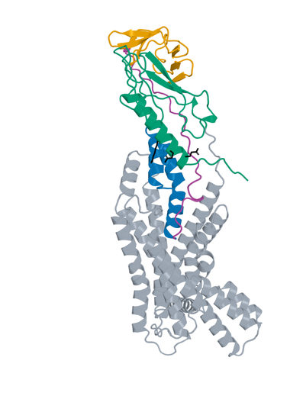
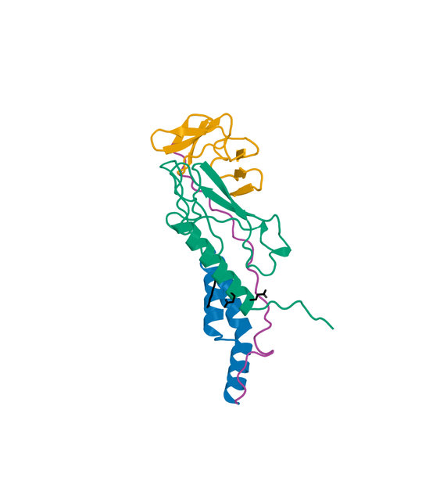
13 LK_P062_00 structure
D-L-D fusion Candidate A: 146 aa Human GLP1R B: 440 aa
Boltz2 Exact receptor complex
Boltz2 Exact interface detail
LigandForge
Linker
ECD binder
Receptor ECD
Remaining receptor
Hotspots
Receptor ECD B1–105 (UniProt 24–128). Black sticks: E34, Q37 and R40. View-specific zoom.
Complete selected sequence, N to C
MTDIGEEIKALVALTEGVPPENRPFAVELAQRLSPWFSLYSRLSSRGGVGSGHPLEPITIVRPPPVPELEPITG
PVTEVSGATIDLRVKTCVDFKQTVNFFKLRNTQLPGSCTKDNTVLFLLEGLKLGYASRYFSIGSGSGSQQFS
Human GLP1R Boltz2 Exact Computational predictions
26
Notes:
{
"candidate": "LK_P062_00",
"final_rank": 13,
"native_model_sha256": "dce45c8b68d53fc8283de14d7c4b58921b395dc5b766260bc32bf5e75240d8f3",
"structure_views": {
"final_rank": 13,
"design_id": "LK_P062_00",
"sequence_sha256": "d25de47402eaf8301bd45d56bf0ab83b327eb81914b61bab0977a3e01daa140d",
"native_model_sha256": "dce45c8b68d53fc8283de14d7c4b58921b395dc5b766260bc32bf5e75240d8f3",
"scoring_pdb_sha256": "f7d9595940d943470113693a9381f7b685598b8ba2b8ab0f1feddd5d3092ab4e",
"overview": {
"source_slide": 55,
"source_picture_index": 1,
"embedded_media": "ppt/media/image61.jpeg",
"image_sha256": "c21182e654299ca5d2bceae0ad1fb995071aae7a761cb58783c9f4e690af8518",
"asset": "assets/LK_P062_00-complex.jpg"
},
"interface": {
"source_slide": 56,
"source_picture_index": 1,
"embedded_media": "ppt/media/image64.jpeg",
"image_sha256": "6a132dd2aa1a127dcd16132ba436cc697491089348d6c19360464d1a9a59e6fb",
"asset": "assets/LK_P062_00-interface.jpg"
},
"rendering_provenance": {
"DeltaForge_source_PDB_sha256": "f7d9595940d943470113693a9381f7b685598b8ba2b8ab0f1feddd5d3092ab4e",
"role_ranges_zero_based": {
"ECD": [
0,
46
],
"linker": [
46,
77
],
"LF": [
77,
146
]
},
"model_sha256": "dce45c8b68d53fc8283de14d7c4b58921b395dc5b766260bc32bf5e75240d8f3",
"source_run": "2026-10-24_pair183-extracellular-exact_001",
"source_methods": [
"https://github.com/DunbrackLab/IPSAE",
"https://github.com/wallnerlab/DockQ",
"https://zhanggroup.org/TM-score/"
],
"saved_display_appendix": {
"parent_sources": {
"ECD-parent": {
"key": "LK_P062_00-ECD-parent",
"source_path": "local/2026-10-25_linker-parent-comparison_001/parents/S10_04_045/exact.pdb",
"source_sha256": "d856a93e192b48e2a32d5571ecf6527fc3c48d52690ec2f3257f8def3feecf50",
"role": "ECD",
"ranges_zero_based": {
"ECD": [
0,
46
]
},
"sequence": "MTDIGEEIKALVALTEGVPPENRPFAVELAQRLSPWFSLYSRLSSR",
"rotation": [
[
-0.7659009152032654,
0.44457328975867383,
-0.46448936063786195
],
[
0.6319833925829315,
0.3876304664207044,
-0.671073477369938
],
[
-0.11829112395071917,
-0.8075254084960974,
-0.5778494372454919
]
],
"translation": [
3.337034305635745,
1.7437276682553975,
-4.640213931658266
],
"core_fit_CA_RMSD_A": 1.5804245054744916,
"output": "local/2026-10-25_linker-parent-views_001/build/renders-v2/LK_P062_00-ECD-parent.jpg",
"parent_or_fusion_id": "S10_04_045",
"design_id": "LK_P062_00",
"panel": "ECD-parent",
"view": [
1,
0,
0,
0,
1,
0,
0,
0,
1,
0,
0,
-402.6122762241926,
-9.659566563778899,
18.97552561204033,
-24.92050513421202,
334.71367607558113,
470.5108763728041,
-20
],
"world_height_A": 141.98281412554877,
"row_bounds_all_atoms_A": [
[
-50.82540039270206,
-45.01588145073406,
-77.8191052828235
],
[
31.50626726514426,
82.96693267481471,
27.97809501439946
]
]
},
"APNovo": {
"key": "LK_P062_00-APNovo",
"source_path": "local/2026-10-25_linker-top100-review_001/build/comparisons/LK_P062_00/reference.pdb",
"source_sha256": "9fc05641c81826b66198aef1949f40fe20d9b279d52557dfe99dc861811856c3",
"role": "fusion",
"ranges_zero_based": {
"ECD": [
0,
46
],
"linker": [
46,
77
],
"LF": [
77,
146
]
},
"sequence": "MTDIGEEIKALVALTEGVPPENRPFAVELAQRLSPWFSLYSRLSSRGGVGSGHPLEPITIVRPPPVPELEPITGPVTEVSGATIDLRVKTCVDFKQTVNFFKLRNTQLPGSCTKDNTVLFLLEGLKLGYASRYFSIGSGSGSQQFS",
"rotation": [
[
-0.7464841219590426,
0.6174605750755569,
0.24799973106733475
],
[
0.5591867037501492,
0.38011585550119964,
0.7367646622595139
],
[
0.360654513484602,
0.6886613241019546,
-0.6290261974618905
]
],
"translation": [
-12.814681317967693,
-11.580958322308518,
6.066300588185621
],
"core_fit_CA_RMSD_A": 1.5804148260981623,
"output": "local/2026-10-25_linker-parent-views_001/build/renders-v2/LK_P062_00-APNovo.jpg",
"parent_or_fusion_id": "LK_P062_00-APNovo",
"design_id": "LK_P062_00",
"panel": "APNovo",
"view": [
1,
0,
0,
0,
1,
0,
0,
0,
1,
0,
0,
-402.6122762241926,
-9.659566563778899,
18.97552561204033,
-24.92050513421202,
334.71367607558113,
470.5108763728041,
-20
],
"world_height_A": 141.98281412554877,
"row_bounds_all_atoms_A": [
[
-50.82540039270206,
-45.01588145073406,
-77.8191052828235
],
[
31.50626726514426,
82.96693267481471,
27.97809501439946
]
]
},
"Exact": {
"key": "LK_P062_00-Exact",
"source_path": "local/2026-10-25_linker-top100-review_001/models/LK_P062_00/boltz2.cif",
"source_sha256": "dce45c8b68d53fc8283de14d7c4b58921b395dc5b766260bc32bf5e75240d8f3",
"role": "fusion",
"ranges_zero_based": {
"ECD": [
0,
46
],
"linker": [
46,
77
],
"LF": [
77,
146
]
},
"sequence": "MTDIGEEIKALVALTEGVPPENRPFAVELAQRLSPWFSLYSRLSSRGGVGSGHPLEPITIVRPPPVPELEPITGPVTEVSGATIDLRVKTCVDFKQTVNFFKLRNTQLPGSCTKDNTVLFLLEGLKLGYASRYFSIGSGSGSQQFS",
"rotation": [
[
0.2948000701186402,
0.6043207322610122,
0.7401954927176178
],
[
0.26588702788232466,
0.6921517236125538,
-0.670991869508256
],
[
-0.91782187756883,
0.3946168289979468,
0.043365292829296465
]
],
"translation": [
-3.315992808690771,
-3.8289024203864486,
-0.9966176897091257
],
"core_fit_CA_RMSD_A": 1.090003921006582,
"output": "local/2026-10-25_linker-parent-views_001/build/renders-v2/LK_P062_00-Exact.jpg",
"parent_or_fusion_id": "LK_P062_00-Exact",
"design_id": "LK_P062_00",
"panel": "Exact",
"view": [
1,
0,
0,
0,
1,
0,
0,
0,
1,
0,
0,
-402.6122762241926,
-9.659566563778899,
18.97552561204033,
-24.92050513421202,
334.71367607558113,
470.5108763728041,
-20
],
"world_height_A": 141.98281412554877,
"row_bounds_all_atoms_A": [
[
-50.82540039270206,
-45.01588145073406,
-77.8191052828235
],
[
31.50626726514426,
82.96693267481471,
27.97809501439946
]
]
},
"LF-parent": {
"key": "LK_P062_00-LF-parent",
"source_path": "local/2026-10-25_linker-parent-comparison_001/parents/Design_280/exact.pdb",
"source_sha256": "cd01c89fbf40d0e577c10f20c2afa96c3deef09880d6c761314a1c5e9898bd4f",
"role": "LF",
"ranges_zero_based": {
"LF": [
0,
69
]
},
"sequence": "EVSGATIDLRVKTCVDFKQTVNFFKLRNTQLPGSCTKDNTVLFLLEGLKLGYASRYFSIGSGSGSQQFS",
"rotation": [
[
0.9716521520149124,
0.23640963200020604,
-0.0015985785293137766
],
[
-0.232382419508661,
0.9563002615331773,
0.17744913387297956
],
[
0.04347938667791329,
-0.1720473610249762,
0.9841286681075418
]
],
"translation": [
3.3985903455718525,
-6.121573941428423,
6.014485827651381
],
"core_fit_CA_RMSD_A": 1.3060904572635719,
"output": "local/2026-10-25_linker-parent-views_001/build/renders-v2/LK_P062_00-LF-parent.jpg",
"parent_or_fusion_id": "Design_280",
"design_id": "LK_P062_00",
"panel": "LF-parent",
"view": [
1,
0,
0,
0,
1,
0,
0,
0,
1,
0,
0,
-402.6122762241926,
-9.659566563778899,
18.97552561204033,
-24.92050513421202,
334.71367607558113,
470.5108763728041,
-20
],
"world_height_A": 141.98281412554877,
"row_bounds_all_atoms_A": [
[
-50.82540039270206,
-45.01588145073406,
-77.8191052828235
],
[
31.50626726514426,
82.96693267481471,
27.97809501439946
]
]
}
},
"shared_camera": [
1,
0,
0,
0,
1,
0,
0,
0,
1,
0,
0,
-402.6122762241926,
-9.659566563778899,
18.97552561204033,
-24.92050513421202,
334.71367607558113,
470.5108763728041,
-20
],
"reference": "Separate saved Exact parent complexes flank the linked Exact refold; AP Novo linked design comparison remains on the following slide. Rigid display alignment preserves native poses; all native receptor residues shown."
}
},
"display": "unchanged embedded JPEGs extracted from hash-verified delivered25-design PPTX; no resampling, cropping or new coordinate transforms",
"scale": "full complex and interface have different zooms; no matched-scale claim",
"hotspots": "black sticks; original27pocket positions for original LigandForge, R40/Q37/E34 annotations for DLD",
"colors": {
"LigandForge": "#E69F00",
"linker": "#AA4499",
"ECD_binder": "#0072B2",
"receptor_ECD": "#009E73",
"receptor_remainder": "#9AA5B1",
"hotspots": "#000000"
}
},
"source_deck": "local/2026-10-25_affinity-confidence-selection-deck_002/output/GLP1R_Selected_ipSAE_gt0p895_Kd_lt10nM_v3.pptx",
"source_deck_sha256": "ad9333fdf6c0ce7d6982e2980d6aade78af256710dbc7917f7f39e41d35aa173",
"domain_labels": "ECD A1-46 linker A47-77 LF A78-146",
"display_scope": "native Exact complex and saved interface view; same identity colors, independent zooms; no new coordinates or inferred agonism"
}

Slide 27
14 Design_440 metrics
Original LigandForge Candidate A: 54 aa Human GLP1R B: 409 aa
Metric and scope | Value
Boltz2 Exact ipSAE (A/B, Type=max) | 0.900081
DeltaForge predicted Kd (nM) | 4.3955
Boltz2 Exact ipTM | 0.9633
Original population ipSAE rank | 13
Predicted-Kd rank within population top50 | 19
Candidate / receptor residues (aa) | 54 / 409
Complex pLDDT (0-100) | 79.0
Generator-to-refold DockQ / TM-score | N/A
DeltaForge length scope | core_40_119
Origin and prediction
Original LigandForge v6.5.21
Generation 1
Exact seed 101
3 recycles, 200 steps
WT GLP1R 24-432
409 receptor residues
Original generator coordinates unavailable
Original generator coordinates are unavailable. This Exact prediction does not establish activation.
Complete selected sequence, N to C
PNYFGFTGFLCIVGDINIGRKAEEFQFFGAIKGGGIEFVCKSDVGSGSGSILFN
Human GLP1R Boltz2 Exact Computational predictions
27
Notes:
{
"candidate": "Design_440",
"final_rank": 14,
"selection": "Exact ipSAE>0.895 and DeltaForge predicted Kd<10nM; first20 by Exact ipSAE descending",
"sequence_sha256": "6c59785b808d0f88b202feec60fb02b1916c40b1d343c3525c2990c255ce2819",
"sources": {
"source_table": {
"path": "local/2026-10-25_lf50-dld26-50-deltaforge_001/output/GLP1R_LigandForge_Original_Top50_DeltaForge_Kd.csv",
"sha256": "da4de8915b1ca76443882c0651920ddd9551839d0d75a5b18b8b1ff4653b0360"
},
"native_cif": {
"path": "campaigns/glp1r-ligandforge-boltz2-exact/runs/2026-10-15_ligandforge-exact_001/02_design/chunks/batch-017/kit_outputs/by_seed/Design_440/s101/Design_440_model_0.cif",
"sha256": "472cb2faf83cc57ac6a6924c72a44f06f02ec0d85e3226147c08b51bc594cb21"
},
"scoring_pdb": {
"path": "local/2026-10-25_lf50-dld26-50-deltaforge_001/LF_Design_440.pdb",
"sha256": "700bc40ed25e70ba088da4728f31148ae15d80d859a0f2923c3252627429a0d6"
},
"DeltaForge_result": {
"path": "campaigns/glp1r-r40-design/runs/2026-10-25_lf50-dld26-50-deltaforge_001/03_filtering/deltaforge_results/LF_Design_440.json",
"sha256": "83fceacca3c499f99601e106db9f6d290d1f501b807f8d9f9e1eff4010602ce2"
}
},
"source_ledger": "campaigns/glp1r-final-writeup/runs/2026-10-25_final20-writeup_001/04_analysis/provenance-ledger.json",
"scorer": "deltaforge_v10_2_unified_parallel / v10_2_unified_parallel_2026_05_08",
"calibration": "deltaforge_v10_boltz2_calibrated_gbr / v10_boltz2_gbr_2026_03_29",
"scope": "one complete candidate A against one receptor B; computational, no experimental Kd or activation"
}

Slide 28
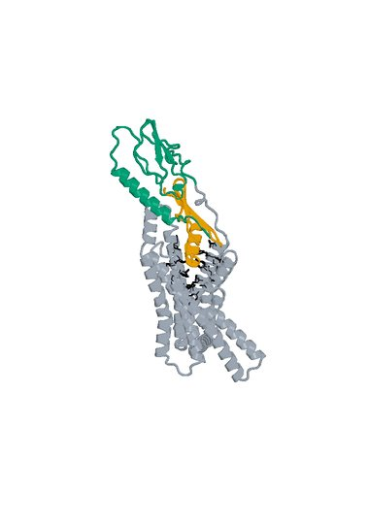
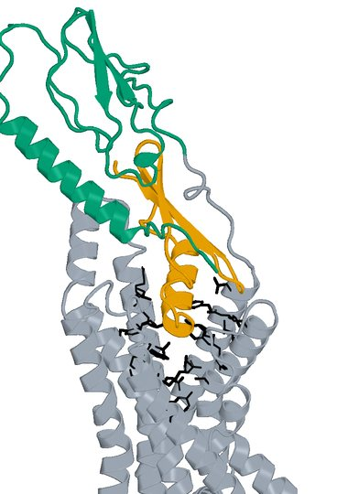
14 Design_440 structure
Original LigandForge Candidate A: 54 aa Human GLP1R B: 409 aa
Boltz2 Exact receptor complex
Boltz2 Exact interface detail
LigandForge
Receptor ECD
Remaining receptor
Hotspots
Receptor ECD B1–105 (UniProt 24–128). Black sticks: 27 submitted pocket positions. View-specific zoom.
Complete selected sequence, N to C
PNYFGFTGFLCIVGDINIGRKAEEFQFFGAIKGGGIEFVCKSDVGSGSGSILFN
Human GLP1R Boltz2 Exact Computational predictions
28
Notes:
{
"candidate": "Design_440",
"final_rank": 14,
"native_model_sha256": "472cb2faf83cc57ac6a6924c72a44f06f02ec0d85e3226147c08b51bc594cb21",
"structure_views": {
"final_rank": 14,
"design_id": "Design_440",
"sequence_sha256": "6c59785b808d0f88b202feec60fb02b1916c40b1d343c3525c2990c255ce2819",
"native_model_sha256": "472cb2faf83cc57ac6a6924c72a44f06f02ec0d85e3226147c08b51bc594cb21",
"scoring_pdb_sha256": "700bc40ed25e70ba088da4728f31148ae15d80d859a0f2923c3252627429a0d6",
"overview": {
"source_slide": 11,
"source_picture_index": 0,
"embedded_media": "ppt/media/image7.jpeg",
"image_sha256": "c9653e6d617d72eef65aa3c68c5314dee3e83266532d643cbed23514dc898fad",
"asset": "assets/Design_440-complex.jpg"
},
"interface": {
"source_slide": 11,
"source_picture_index": 1,
"embedded_media": "ppt/media/image8.jpeg",
"image_sha256": "2842718bd60440d956712fb73495810fd326b6ffe5a57710363239fa9a4d107f",
"asset": "assets/Design_440-interface.jpg"
},
"rendering_provenance": {
"source_PDB": "campaigns/glp1r-ligandforge-affinity/runs/2026-10-15_top100-affinity_001/01_staging/payload/pdb_inputs/Design_440.pdb",
"PDB_SHA256": "700bc40ed25e70ba088da4728f31148ae15d80d859a0f2923c3252627429a0d6",
"model_SHA256": "472cb2faf83cc57ac6a6924c72a44f06f02ec0d85e3226147c08b51bc594cb21",
"source_render_script": "local/2026-10-25_affinity-confidence-selection-deck_002/render_originals.py",
"alignment": "rigid core CA B117-400 fitting; original full/interface zooms reused",
"camera_version": "saved original full and interface frames from final90-slide deck"
},
"display": "unchanged embedded JPEGs extracted from hash-verified delivered25-design PPTX; no resampling, cropping or new coordinate transforms",
"scale": "full complex and interface have different zooms; no matched-scale claim",
"hotspots": "black sticks; original27pocket positions for original LigandForge, R40/Q37/E34 annotations for DLD",
"colors": {
"LigandForge": "#E69F00",
"linker": "#AA4499",
"ECD_binder": "#0072B2",
"receptor_ECD": "#009E73",
"receptor_remainder": "#9AA5B1",
"hotspots": "#000000"
}
},
"source_deck": "local/2026-10-25_affinity-confidence-selection-deck_002/output/GLP1R_Selected_ipSAE_gt0p895_Kd_lt10nM_v3.pptx",
"source_deck_sha256": "ad9333fdf6c0ce7d6982e2980d6aade78af256710dbc7917f7f39e41d35aa173",
"domain_labels": "LigandForge A1-54",
"display_scope": "native Exact complex and saved interface view; same identity colors, independent zooms; no new coordinates or inferred agonism"
}

Slide 29
15 LK_P141_07 metrics
D-L-D fusion Candidate A: 121 aa Human GLP1R B: 440 aa
Metric and scope | Value
Boltz2 Exact ipSAE (A/B, Type=max) | 0.899774
DeltaForge predicted Kd (nM) | 1.6270
Boltz2 Exact ipTM | 0.8838
Original population ipSAE rank | 14
Predicted-Kd rank within population top50 | 17
Candidate / receptor residues (aa) | 121 / 440
pDockQ / pDockQ2 | 0.4125 / 0.2650
Whole fusion / linker pLDDT (0-100) | 59.9 / 61.7
ECD / LigandForge pLDDT (0-100) | 71.4 / 54.1
Fusion design-to-refold DockQ | 0.2736
Free C-terminal OPM z (A) | 76.38
Extracellular free C-terminal screen | Pass
DeltaForge length scope | platform_8_140
Origin and prediction
ECD parent S09_03_086
LigandForge parent Design_280
Pair P141
AP Novo seed 1518
Exact seed 101
3 recycles, 200 steps
ECD A1-32 linker A33-52 LF A53-121
Whole-fusion pLDDT remains modest. High interface confidence does not establish activation.
Complete selected sequence, N to C
MVSIGSTGFDGLLQLDEELRNLFLQRLVLGRLGSGLPPPPPPVDVIPPSEVKEVSGATIDLRVKTCVDFKQTVN
FFKLRNTQLPGSCTKDNTVLFLLEGLKLGYASRYFSIGSGSGSQQFS
Human GLP1R Boltz2 Exact Computational predictions
29
Notes:
{
"candidate": "LK_P141_07",
"final_rank": 15,
"selection": "Exact ipSAE>0.895 and DeltaForge predicted Kd<10nM; first20 by Exact ipSAE descending",
"sequence_sha256": "f16d400b253e38395bd82e22ebc6e5de8863a953f494c6219be2e224ae30c46c",
"sources": {
"source_table": {
"path": "local/2026-10-25_lf50-dld26-50-deltaforge_001/output/GLP1R_DLD_Top50_DeltaForge_Kd_and_Boltz2_Metrics.csv",
"sha256": "da9569bf0e8b74cce3d6792eb260d6a4b17b35e6f46e0793d49f02c0d3a0e728"
},
"native_cif": {
"path": "local/2026-10-25_linker-top100-review_001/models/LK_P141_07/boltz2.cif",
"sha256": "057c941f900347a58c03754e4ed3405a7187730b30c880c5e8fa4ca13920b391"
},
"scoring_pdb": {
"path": "local/2026-10-25_dld-top25-deltaforge_001/payload/structures/LK_P141_07.pdb",
"sha256": "6cd56c4f82f7f8db0c47931f50c2f85bc7cd0fe1513fb44df4ca27ff60f0de02"
},
"DeltaForge_result": {
"path": "campaigns/glp1r-r40-design/runs/2026-10-25_dld-top25-deltaforge_001/03_filtering/deltaforge_results/LK_P141_07.json",
"sha256": "6676183e5d74c20062985940808e9ec4a7cf41d8f2e2e02cf075b760c68e380b"
}
},
"source_ledger": "campaigns/glp1r-final-writeup/runs/2026-10-25_final20-writeup_001/04_analysis/provenance-ledger.json",
"scorer": "deltaforge_v10_2_unified_parallel / v10_2_unified_parallel_2026_05_08",
"calibration": "deltaforge_v10_boltz2_calibrated_gbr / v10_boltz2_gbr_2026_03_29",
"scope": "one complete candidate A against one receptor B; computational, no experimental Kd or activation"
}

Slide 30
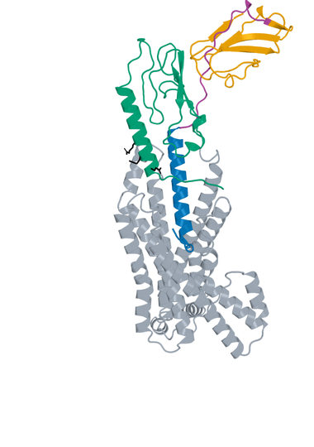
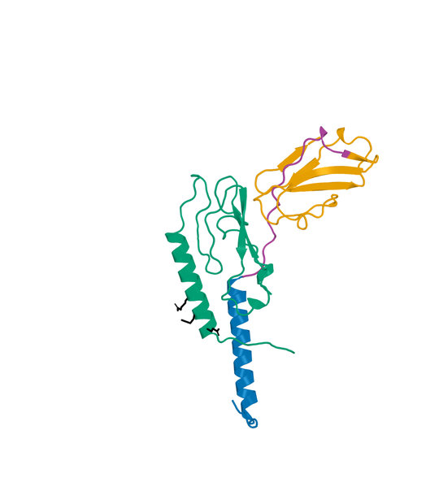
15 LK_P141_07 structure
D-L-D fusion Candidate A: 121 aa Human GLP1R B: 440 aa
Boltz2 Exact receptor complex
Boltz2 Exact interface detail
LigandForge
Linker
ECD binder
Receptor ECD
Remaining receptor
Hotspots
Receptor ECD B1–105 (UniProt 24–128). Black sticks: E34, Q37 and R40. View-specific zoom.
Complete selected sequence, N to C
MVSIGSTGFDGLLQLDEELRNLFLQRLVLGRLGSGLPPPPPPVDVIPPSEVKEVSGATIDLRVKTCVDFKQTVN
FFKLRNTQLPGSCTKDNTVLFLLEGLKLGYASRYFSIGSGSGSQQFS
Human GLP1R Boltz2 Exact Computational predictions
30
Notes:
{
"candidate": "LK_P141_07",
"final_rank": 15,
"native_model_sha256": "057c941f900347a58c03754e4ed3405a7187730b30c880c5e8fa4ca13920b391",
"structure_views": {
"final_rank": 15,
"design_id": "LK_P141_07",
"sequence_sha256": "f16d400b253e38395bd82e22ebc6e5de8863a953f494c6219be2e224ae30c46c",
"native_model_sha256": "057c941f900347a58c03754e4ed3405a7187730b30c880c5e8fa4ca13920b391",
"scoring_pdb_sha256": "6cd56c4f82f7f8db0c47931f50c2f85bc7cd0fe1513fb44df4ca27ff60f0de02",
"overview": {
"source_slide": 59,
"source_picture_index": 1,
"embedded_media": "ppt/media/image66.jpeg",
"image_sha256": "6b08b7034659a9a4fe985bc04712a773f6e930e37a2bd7f5f791edd89d6126ab",
"asset": "assets/LK_P141_07-complex.jpg"
},
"interface": {
"source_slide": 60,
"source_picture_index": 1,
"embedded_media": "ppt/media/image69.jpeg",
"image_sha256": "1fc99fc7b5debeb989ad2ddfcb4c85bb3490848b3a67ebb67ed1ad805799d6f2",
"asset": "assets/LK_P141_07-interface.jpg"
},
"rendering_provenance": {
"DeltaForge_source_PDB_sha256": "6cd56c4f82f7f8db0c47931f50c2f85bc7cd0fe1513fb44df4ca27ff60f0de02",
"role_ranges_zero_based": {
"ECD": [
0,
32
],
"linker": [
32,
52
],
"LF": [
52,
121
]
},
"model_sha256": "057c941f900347a58c03754e4ed3405a7187730b30c880c5e8fa4ca13920b391",
"source_run": "2026-10-24_pair183-extracellular-exact_001",
"source_methods": [
"https://github.com/DunbrackLab/IPSAE",
"https://github.com/wallnerlab/DockQ",
"https://zhanggroup.org/TM-score/"
],
"saved_display_appendix": {
"parent_sources": {
"ECD-parent": {
"key": "LK_P141_07-ECD-parent",
"source_path": "local/2026-10-25_linker-parent-comparison_001/parents/S09_03_086/exact.pdb",
"source_sha256": "175108ef3bc179b82adfa75b41565eaa66f1f1ba783f392bc468013d898e1deb",
"role": "ECD",
"ranges_zero_based": {
"ECD": [
0,
32
]
},
"sequence": "MVSIGSTGFDGLLQLDEELRNLFLQRLVLGRL",
"rotation": [
[
0.2309916525890099,
0.9715843167883049,
0.05164012752946334
],
[
0.6783570864777069,
-0.12277540695293698,
-0.7244017647467462
],
[
-0.6974772290949753,
0.20236121237692806,
-0.6874411834197737
]
],
"translation": [
6.1236782492205615,
1.8014812624173393,
-3.603368378360269
],
"core_fit_CA_RMSD_A": 1.0518887169865072,
"output": "local/2026-10-25_linker-parent-views_001/build/renders-v2/LK_P141_07-ECD-parent.jpg",
"parent_or_fusion_id": "S09_03_086",
"design_id": "LK_P141_07",
"panel": "ECD-parent",
"view": [
1,
0,
0,
0,
1,
0,
0,
0,
1,
0,
0,
-436.8714256770552,
-6.942141291724319,
12.832198331403418,
-32.261276511870626,
360.5203728790387,
513.2224784750717,
-20
],
"world_height_A": 154.0644388948754,
"row_bounds_all_atoms_A": [
[
-50.79037642370106,
-57.20002111603428,
-93.61232930988712
],
[
36.906093840252424,
82.86441777884112,
29.08977628614586
]
]
},
"APNovo": {
"key": "LK_P141_07-APNovo",
"source_path": "local/2026-10-25_linker-top100-review_001/build/comparisons/LK_P141_07/reference.pdb",
"source_sha256": "49a7ace5605da29958329285c231d3a27542311f2692bf7da4b0fcb743984de9",
"role": "fusion",
"ranges_zero_based": {
"ECD": [
0,
32
],
"linker": [
32,
52
],
"LF": [
52,
121
]
},
"sequence": "MVSIGSTGFDGLLQLDEELRNLFLQRLVLGRLGSGLPPPPPPVDVIPPSEVKEVSGATIDLRVKTCVDFKQTVNFFKLRNTQLPGSCTKDNTVLFLLEGLKLGYASRYFSIGSGSGSQQFS",
"rotation": [
[
0.231129521755296,
0.7473325103830195,
0.6229552395853997
],
[
0.5339710640451969,
-0.632679893028012,
0.5608842319368179
],
[
0.8132982570092686,
0.20300318471532297,
-0.5452849120246892
]
],
"translation": [
-10.589328661633946,
-13.59453477913015,
8.389515573406804
],
"core_fit_CA_RMSD_A": 1.0518649660608899,
"output": "local/2026-10-25_linker-parent-views_001/build/renders-v2/LK_P141_07-APNovo.jpg",
"parent_or_fusion_id": "LK_P141_07-APNovo",
"design_id": "LK_P141_07",
"panel": "APNovo",
"view": [
1,
0,
0,
0,
1,
0,
0,
0,
1,
0,
0,
-436.8714256770552,
-6.942141291724319,
12.832198331403418,
-32.261276511870626,
360.5203728790387,
513.2224784750717,
-20
],
"world_height_A": 154.0644388948754,
"row_bounds_all_atoms_A": [
[
-50.79037642370106,
-57.20002111603428,
-93.61232930988712
],
[
36.906093840252424,
82.86441777884112,
29.08977628614586
]
]
},
"Exact": {
"key": "LK_P141_07-Exact",
"source_path": "local/2026-10-25_linker-top100-review_001/models/LK_P141_07/boltz2.cif",
"source_sha256": "057c941f900347a58c03754e4ed3405a7187730b30c880c5e8fa4ca13920b391",
"role": "fusion",
"ranges_zero_based": {
"ECD": [
0,
32
],
"linker": [
32,
52
],
"LF": [
52,
121
]
},
"sequence": "MVSIGSTGFDGLLQLDEELRNLFLQRLVLGRLGSGLPPPPPPVDVIPPSEVKEVSGATIDLRVKTCVDFKQTVNFFKLRNTQLPGSCTKDNTVLFLLEGLKLGYASRYFSIGSGSGSQQFS",
"rotation": [
[
0.8513331309120266,
0.16701335569941955,
0.4973312277945721
],
[
0.17809101349476109,
0.7996812729700107,
-0.573405068774103
],
[
-0.493472825585048,
0.5767289934116029,
0.6510516376787141
]
],
"translation": [
-4.813532820341685,
0.3512594498022992,
-0.8178737943182991
],
"core_fit_CA_RMSD_A": 1.2092542756129305,
"output": "local/2026-10-25_linker-parent-views_001/build/renders-v2/LK_P141_07-Exact.jpg",
"parent_or_fusion_id": "LK_P141_07-Exact",
"design_id": "LK_P141_07",
"panel": "Exact",
"view": [
1,
0,
0,
0,
1,
0,
0,
0,
1,
0,
0,
-436.8714256770552,
-6.942141291724319,
12.832198331403418,
-32.261276511870626,
360.5203728790387,
513.2224784750717,
-20
],
"world_height_A": 154.0644388948754,
"row_bounds_all_atoms_A": [
[
-50.79037642370106,
-57.20002111603428,
-93.61232930988712
],
[
36.906093840252424,
82.86441777884112,
29.08977628614586
]
]
},
"LF-parent": {
"key": "LK_P141_07-LF-parent",
"source_path": "local/2026-10-25_linker-parent-comparison_001/parents/Design_280/exact.pdb",
"source_sha256": "cd01c89fbf40d0e577c10f20c2afa96c3deef09880d6c761314a1c5e9898bd4f",
"role": "LF",
"ranges_zero_based": {
"LF": [
0,
69
]
},
"sequence": "EVSGATIDLRVKTCVDFKQTVNFFKLRNTQLPGSCTKDNTVLFLLEGLKLGYASRYFSIGSGSGSQQFS",
"rotation": [
[
0.9716521520149124,
0.23640963200020604,
-0.0015985785293137766
],
[
-0.232382419508661,
0.9563002615331773,
0.17744913387297956
],
[
0.04347938667791329,
-0.1720473610249762,
0.9841286681075418
]
],
"translation": [
3.3985903455718525,
-6.121573941428423,
6.014485827651381
],
"core_fit_CA_RMSD_A": 1.3060904572635719,
"output": "local/2026-10-25_linker-parent-views_001/build/renders-v2/LK_P141_07-LF-parent.jpg",
"parent_or_fusion_id": "Design_280",
"design_id": "LK_P141_07",
"panel": "LF-parent",
"view": [
1,
0,
0,
0,
1,
0,
0,
0,
1,
0,
0,
-436.8714256770552,
-6.942141291724319,
12.832198331403418,
-32.261276511870626,
360.5203728790387,
513.2224784750717,
-20
],
"world_height_A": 154.0644388948754,
"row_bounds_all_atoms_A": [
[
-50.79037642370106,
-57.20002111603428,
-93.61232930988712
],
[
36.906093840252424,
82.86441777884112,
29.08977628614586
]
]
}
},
"shared_camera": [
1,
0,
0,
0,
1,
0,
0,
0,
1,
0,
0,
-436.8714256770552,
-6.942141291724319,
12.832198331403418,
-32.261276511870626,
360.5203728790387,
513.2224784750717,
-20
],
"reference": "Separate saved Exact parent complexes flank the linked Exact refold; AP Novo linked design comparison remains on the following slide. Rigid display alignment preserves native poses; all native receptor residues shown."
}
},
"display": "unchanged embedded JPEGs extracted from hash-verified delivered25-design PPTX; no resampling, cropping or new coordinate transforms",
"scale": "full complex and interface have different zooms; no matched-scale claim",
"hotspots": "black sticks; original27pocket positions for original LigandForge, R40/Q37/E34 annotations for DLD",
"colors": {
"LigandForge": "#E69F00",
"linker": "#AA4499",
"ECD_binder": "#0072B2",
"receptor_ECD": "#009E73",
"receptor_remainder": "#9AA5B1",
"hotspots": "#000000"
}
},
"source_deck": "local/2026-10-25_affinity-confidence-selection-deck_002/output/GLP1R_Selected_ipSAE_gt0p895_Kd_lt10nM_v3.pptx",
"source_deck_sha256": "ad9333fdf6c0ce7d6982e2980d6aade78af256710dbc7917f7f39e41d35aa173",
"domain_labels": "ECD A1-32 linker A33-52 LF A53-121",
"display_scope": "native Exact complex and saved interface view; same identity colors, independent zooms; no new coordinates or inferred agonism"
}

Slide 31
16 LK_P002_05 metrics
D-L-D fusion Candidate A: 104 aa Human GLP1R B: 440 aa
Metric and scope | Value
Boltz2 Exact ipSAE (A/B, Type=max) | 0.899462
DeltaForge predicted Kd (nM) | 0.8130
Boltz2 Exact ipTM | 0.9370
Original population ipSAE rank | 16
Predicted-Kd rank within population top50 | 4
Candidate / receptor residues (aa) | 104 / 440
pDockQ / pDockQ2 | 0.1832 / 0.1014
Whole fusion / linker pLDDT (0-100) | 43.8 / 38.2
ECD / LigandForge pLDDT (0-100) | 51.5 / 37.1
Fusion design-to-refold DockQ | 0.0893
Free C-terminal OPM z (A) | 42.07
Extracellular free C-terminal screen | Pass
DeltaForge length scope | core_40_119
Origin and prediction
ECD parent S10_03_014
LigandForge parent Design_913
Pair P002
AP Novo seed 126
Exact seed 101
3 recycles, 200 steps
LF A1-36 linker A37-57 ECD A58-104
Whole-fusion pLDDT remains modest. High interface confidence does not establish activation.
Complete selected sequence, N to C
NLPRIECSSNKGNVQEDSDVIGGRGSGSGSGSCGIFGKTSTSGPQPVIILPVPVLPGMLPQLFLTHMLSVMVGT
GSLDSGLVSAFRGSPLVSEAILGFLKQYLS
Human GLP1R Boltz2 Exact Computational predictions
31
Notes:
{
"candidate": "LK_P002_05",
"final_rank": 16,
"selection": "Exact ipSAE>0.895 and DeltaForge predicted Kd<10nM; first20 by Exact ipSAE descending",
"sequence_sha256": "8dcbb7d8cdc0f0dedcabe96c99dedf901c32eddadf2c8d7dec2e96f528f8b01a",
"sources": {
"source_table": {
"path": "local/2026-10-25_lf50-dld26-50-deltaforge_001/output/GLP1R_DLD_Top50_DeltaForge_Kd_and_Boltz2_Metrics.csv",
"sha256": "da9569bf0e8b74cce3d6792eb260d6a4b17b35e6f46e0793d49f02c0d3a0e728"
},
"native_cif": {
"path": "local/2026-10-25_linker-top100-review_001/models/LK_P002_05/boltz2.cif",
"sha256": "b42fd0d87e7deba61c440007ffdbe63e077f7982ac2d552a73dd74fd7a92bd52"
},
"scoring_pdb": {
"path": "local/2026-10-25_dld-top25-deltaforge_001/payload/structures/LK_P002_05.pdb",
"sha256": "2cdbeaadafb5b0d2c96000faac08312915566af30e7bc4b1c57d5ce84f861e5d"
},
"DeltaForge_result": {
"path": "campaigns/glp1r-r40-design/runs/2026-10-25_dld-top25-deltaforge_001/03_filtering/deltaforge_results/LK_P002_05.json",
"sha256": "80f0480127c0e61dce92b002b5e845ec638a8b8f5193fdbe07401b41051eff24"
}
},
"source_ledger": "campaigns/glp1r-final-writeup/runs/2026-10-25_final20-writeup_001/04_analysis/provenance-ledger.json",
"scorer": "deltaforge_v10_2_unified_parallel / v10_2_unified_parallel_2026_05_08",
"calibration": "deltaforge_v10_boltz2_calibrated_gbr / v10_boltz2_gbr_2026_03_29",
"scope": "one complete candidate A against one receptor B; computational, no experimental Kd or activation"
}

Slide 32
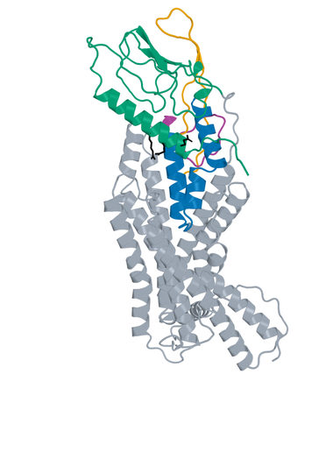
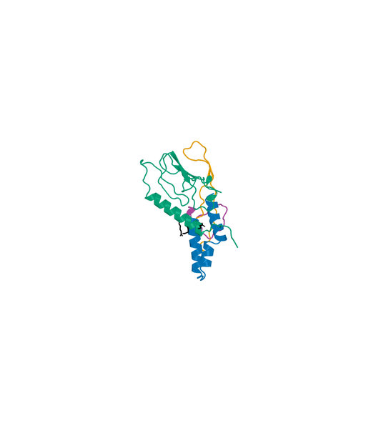
16 LK_P002_05 structure
D-L-D fusion Candidate A: 104 aa Human GLP1R B: 440 aa
Boltz2 Exact receptor complex
Boltz2 Exact interface detail
LigandForge
Linker
ECD binder
Receptor ECD
Remaining receptor
Hotspots
Receptor ECD B1–105 (UniProt 24–128). Black sticks: E34, Q37 and R40. View-specific zoom.
Complete selected sequence, N to C
NLPRIECSSNKGNVQEDSDVIGGRGSGSGSGSCGIFGKTSTSGPQPVIILPVPVLPGMLPQLFLTHMLSVMVGT
GSLDSGLVSAFRGSPLVSEAILGFLKQYLS
Human GLP1R Boltz2 Exact Computational predictions
32
Notes:
{
"candidate": "LK_P002_05",
"final_rank": 16,
"native_model_sha256": "b42fd0d87e7deba61c440007ffdbe63e077f7982ac2d552a73dd74fd7a92bd52",
"structure_views": {
"final_rank": 16,
"design_id": "LK_P002_05",
"sequence_sha256": "8dcbb7d8cdc0f0dedcabe96c99dedf901c32eddadf2c8d7dec2e96f528f8b01a",
"native_model_sha256": "b42fd0d87e7deba61c440007ffdbe63e077f7982ac2d552a73dd74fd7a92bd52",
"scoring_pdb_sha256": "2cdbeaadafb5b0d2c96000faac08312915566af30e7bc4b1c57d5ce84f861e5d",
"overview": {
"source_slide": 63,
"source_picture_index": 1,
"embedded_media": "ppt/media/image71.jpeg",
"image_sha256": "a6ef51884c0033dbfe8c76d76cdce96264eaf168a1f406e242fc5765f9f847e0",
"asset": "assets/LK_P002_05-complex.jpg"
},
"interface": {
"source_slide": 64,
"source_picture_index": 1,
"embedded_media": "ppt/media/image74.jpeg",
"image_sha256": "f7a707322447674a001ae1bc0379ec678731aba70fd089ad27ebb7ceac0db786",
"asset": "assets/LK_P002_05-interface.jpg"
},
"rendering_provenance": {
"DeltaForge_source_PDB_sha256": "2cdbeaadafb5b0d2c96000faac08312915566af30e7bc4b1c57d5ce84f861e5d",
"role_ranges_zero_based": {
"LF": [
0,
36
],
"linker": [
36,
57
],
"ECD": [
57,
104
]
},
"model_sha256": "b42fd0d87e7deba61c440007ffdbe63e077f7982ac2d552a73dd74fd7a92bd52",
"source_run": "2026-10-24_pair183-extracellular-exact_001",
"source_methods": [
"https://github.com/DunbrackLab/IPSAE",
"https://github.com/wallnerlab/DockQ",
"https://zhanggroup.org/TM-score/"
],
"saved_display_appendix": {
"parent_sources": {
"ECD-parent": {
"key": "LK_P002_05-ECD-parent",
"source_path": "local/2026-10-25_linker-parent-comparison_001/parents/S10_03_014/exact.pdb",
"source_sha256": "a29d8795d918604fd505028a39cbe0c0a957b1f21303e806fb14da3da6fb71a1",
"role": "ECD",
"ranges_zero_based": {
"ECD": [
0,
47
]
},
"sequence": "MLPQLFLTHMLSVMVGTGSLDSGLVSAFRGSPLVSEAILGFLKQYLS",
"rotation": [
[
0.5132657303712289,
0.802348200493987,
0.3046238559445271
],
[
0.27356394832520525,
0.1834770465965434,
-0.9441922167657513
],
[
-0.813462381674996,
0.5679556118857318,
-0.12532104650128595
]
],
"translation": [
5.798520956491389,
1.9183349698289165,
-2.2144394768574935
],
"core_fit_CA_RMSD_A": 1.321877300575366,
"output": "local/2026-10-25_linker-parent-views_001/build/renders-v2/LK_P002_05-ECD-parent.jpg",
"parent_or_fusion_id": "S10_03_014",
"design_id": "LK_P002_05",
"panel": "ECD-parent",
"view": [
1,
0,
0,
0,
1,
0,
0,
0,
1,
0,
0,
-391.526075984692,
-4.100799816898441,
6.098821556600491,
-23.716392787073072,
324.7431677140239,
458.3089842553601,
-20
],
"world_height_A": 138.07322169402755,
"row_bounds_all_atoms_A": [
[
-40.24597695663007,
-55.93778929041328,
-75.49930105774118
],
[
32.044377322833185,
68.13543240361426,
28.066515483595033
]
]
},
"APNovo": {
"key": "LK_P002_05-APNovo",
"source_path": "local/2026-10-25_linker-top100-review_001/build/comparisons/LK_P002_05/reference.pdb",
"source_sha256": "61aa5bd6d87a50776e8fc7903ba8e96683c2845d9061d15969bcf9153b1201ff",
"role": "fusion",
"ranges_zero_based": {
"LF": [
0,
36
],
"linker": [
36,
57
],
"ECD": [
57,
104
]
},
"sequence": "NLPRIECSSNKGNVQEDSDVIGGRGSGSGSGSCGIFGKTSTSGPQPVIILPVPVLPGMLPQLFLTHMLSVMVGTGSLDSGLVSAFRGSPLVSEAILGFLKQYLS",
"rotation": [
[
-0.6852813047556858,
0.7282503294570313,
-0.006397215930574629
],
[
-0.6826821305070201,
-0.6454114223326464,
-0.3426209885851357
],
[
-0.25364267691255016,
-0.23042452354372855,
0.9394519571930537
]
],
"translation": [
1.5423288290363004,
2.180468072259787,
0.5939777841794465
],
"core_fit_CA_RMSD_A": 1.3218535426776041,
"output": "local/2026-10-25_linker-parent-views_001/build/renders-v2/LK_P002_05-APNovo.jpg",
"parent_or_fusion_id": "LK_P002_05-APNovo",
"design_id": "LK_P002_05",
"panel": "APNovo",
"view": [
1,
0,
0,
0,
1,
0,
0,
0,
1,
0,
0,
-391.526075984692,
-4.100799816898441,
6.098821556600491,
-23.716392787073072,
324.7431677140239,
458.3089842553601,
-20
],
"world_height_A": 138.07322169402755,
"row_bounds_all_atoms_A": [
[
-40.24597695663007,
-55.93778929041328,
-75.49930105774118
],
[
32.044377322833185,
68.13543240361426,
28.066515483595033
]
]
},
"Exact": {
"key": "LK_P002_05-Exact",
"source_path": "local/2026-10-25_linker-top100-review_001/models/LK_P002_05/boltz2.cif",
"source_sha256": "b42fd0d87e7deba61c440007ffdbe63e077f7982ac2d552a73dd74fd7a92bd52",
"role": "fusion",
"ranges_zero_based": {
"LF": [
0,
36
],
"linker": [
36,
57
],
"ECD": [
57,
104
]
},
"sequence": "NLPRIECSSNKGNVQEDSDVIGGRGSGSGSGSCGIFGKTSTSGPQPVIILPVPVLPGMLPQLFLTHMLSVMVGTGSLDSGLVSAFRGSPLVSEAILGFLKQYLS",
"rotation": [
[
0.5697582971076258,
-0.5781567109301733,
0.5840464805417547
],
[
0.7684283598166612,
0.6267597409511083,
-0.12919027641932535
],
[
-0.2913646093473279,
0.5224051498735651,
0.8013735625116354
]
],
"translation": [
1.659781925605781,
0.764565976879009,
0.15792056888463235
],
"core_fit_CA_RMSD_A": 1.3583403662805678,
"output": "local/2026-10-25_linker-parent-views_001/build/renders-v2/LK_P002_05-Exact.jpg",
"parent_or_fusion_id": "LK_P002_05-Exact",
"design_id": "LK_P002_05",
"panel": "Exact",
"view": [
1,
0,
0,
0,
1,
0,
0,
0,
1,
0,
0,
-391.526075984692,
-4.100799816898441,
6.098821556600491,
-23.716392787073072,
324.7431677140239,
458.3089842553601,
-20
],
"world_height_A": 138.07322169402755,
"row_bounds_all_atoms_A": [
[
-40.24597695663007,
-55.93778929041328,
-75.49930105774118
],
[
32.044377322833185,
68.13543240361426,
28.066515483595033
]
]
},
"LF-parent": {
"key": "LK_P002_05-LF-parent",
"source_path": "local/2026-10-25_linker-parent-comparison_001/parents/Design_913/exact.pdb",
"source_sha256": "694e9737dcd0c59ef6ec5edbda6a6b11d8948452bcf32539f69ff2c436e981ad",
"role": "LF",
"ranges_zero_based": {
"LF": [
0,
36
]
},
"sequence": "NLPRIECSSNKGNVQEDSDVIGGRGSGSGSGSCGIF",
"rotation": [
[
0.5023875172333341,
0.6499866978808164,
0.5701964908473975
],
[
0.3859135083431191,
-0.7586923289173857,
0.5248397315597675
],
[
0.773742579125837,
-0.04362634136124832,
-0.6319962007027522
]
],
"translation": [
8.096017249115981,
2.628795246866223,
1.589326521039868
],
"core_fit_CA_RMSD_A": 1.4255496439705337,
"output": "local/2026-10-25_linker-parent-views_001/build/renders-v2/LK_P002_05-LF-parent.jpg",
"parent_or_fusion_id": "Design_913",
"design_id": "LK_P002_05",
"panel": "LF-parent",
"view": [
1,
0,
0,
0,
1,
0,
0,
0,
1,
0,
0,
-391.526075984692,
-4.100799816898441,
6.098821556600491,
-23.716392787073072,
324.7431677140239,
458.3089842553601,
-20
],
"world_height_A": 138.07322169402755,
"row_bounds_all_atoms_A": [
[
-40.24597695663007,
-55.93778929041328,
-75.49930105774118
],
[
32.044377322833185,
68.13543240361426,
28.066515483595033
]
]
}
},
"shared_camera": [
1,
0,
0,
0,
1,
0,
0,
0,
1,
0,
0,
-391.526075984692,
-4.100799816898441,
6.098821556600491,
-23.716392787073072,
324.7431677140239,
458.3089842553601,
-20
],
"reference": "Separate saved Exact parent complexes flank the linked Exact refold; AP Novo linked design comparison remains on the following slide. Rigid display alignment preserves native poses; all native receptor residues shown."
}
},
"display": "unchanged embedded JPEGs extracted from hash-verified delivered25-design PPTX; no resampling, cropping or new coordinate transforms",
"scale": "full complex and interface have different zooms; no matched-scale claim",
"hotspots": "black sticks; original27pocket positions for original LigandForge, R40/Q37/E34 annotations for DLD",
"colors": {
"LigandForge": "#E69F00",
"linker": "#AA4499",
"ECD_binder": "#0072B2",
"receptor_ECD": "#009E73",
"receptor_remainder": "#9AA5B1",
"hotspots": "#000000"
}
},
"source_deck": "local/2026-10-25_affinity-confidence-selection-deck_002/output/GLP1R_Selected_ipSAE_gt0p895_Kd_lt10nM_v3.pptx",
"source_deck_sha256": "ad9333fdf6c0ce7d6982e2980d6aade78af256710dbc7917f7f39e41d35aa173",
"domain_labels": "LF A1-36 linker A37-57 ECD A58-104",
"display_scope": "native Exact complex and saved interface view; same identity colors, independent zooms; no new coordinates or inferred agonism"
}

Slide 33
17 LK_P012_04 metrics
D-L-D fusion Candidate A: 130 aa Human GLP1R B: 440 aa
Metric and scope | Value
Boltz2 Exact ipSAE (A/B, Type=max) | 0.899333
DeltaForge predicted Kd (nM) | 2.1528
Boltz2 Exact ipTM | 0.8851
Original population ipSAE rank | 17
Predicted-Kd rank within population top50 | 22
Candidate / receptor residues (aa) | 130 / 440
pDockQ / pDockQ2 | 0.2455 / 0.1128
Whole fusion / linker pLDDT (0-100) | 46.2 / 36.0
ECD / LigandForge pLDDT (0-100) | 70.6 / 35.7
Fusion design-to-refold DockQ | 0.2180
Free C-terminal OPM z (A) | 33.84
Extracellular free C-terminal screen | Pass
DeltaForge length scope | platform_8_140
Origin and prediction
ECD parent S08_00_042
LigandForge parent Design_991
Pair P012
AP Novo seed 225
Exact seed 101
3 recycles, 200 steps
ECD A1-39 linker A40-65 LF A66-130
Whole-fusion pLDDT remains modest. High interface confidence does not establish activation.
Complete selected sequence, N to C
MADSISEVSEGVHLILAAQALELPPFVVAARLEEARAKRPGSSLLPLPEDTSDVASGSISYPGASAFHLTGLAA
RCGAVWRGVFCQFGNGVKGEGSVTGGSLNTFYILTVAPTSANILTSGSGSGSLEGS
Human GLP1R Boltz2 Exact Computational predictions
33
Notes:
{
"candidate": "LK_P012_04",
"final_rank": 17,
"selection": "Exact ipSAE>0.895 and DeltaForge predicted Kd<10nM; first20 by Exact ipSAE descending",
"sequence_sha256": "dbbc237dccc285527f5d99d62ad5158c233c2b751f987bc25776a166dbf16745",
"sources": {
"source_table": {
"path": "local/2026-10-25_lf50-dld26-50-deltaforge_001/output/GLP1R_DLD_Top50_DeltaForge_Kd_and_Boltz2_Metrics.csv",
"sha256": "da9569bf0e8b74cce3d6792eb260d6a4b17b35e6f46e0793d49f02c0d3a0e728"
},
"native_cif": {
"path": "local/2026-10-25_linker-top100-review_001/models/LK_P012_04/boltz2.cif",
"sha256": "1d47cee516c18104b88f5b283af8be679b4a8c5f2c472cbd34a48b119664eacf"
},
"scoring_pdb": {
"path": "local/2026-10-25_dld-top25-deltaforge_001/payload/structures/LK_P012_04.pdb",
"sha256": "fa1a5cc220f038b3a600579b7d83ec75b07b002432a35db4fdb020eb8d503754"
},
"DeltaForge_result": {
"path": "campaigns/glp1r-r40-design/runs/2026-10-25_dld-top25-deltaforge_001/03_filtering/deltaforge_results/LK_P012_04.json",
"sha256": "c26ee6aeae2fc63264a153a3580f74326459e90134678c43e07eb5e99218daa0"
}
},
"source_ledger": "campaigns/glp1r-final-writeup/runs/2026-10-25_final20-writeup_001/04_analysis/provenance-ledger.json",
"scorer": "deltaforge_v10_2_unified_parallel / v10_2_unified_parallel_2026_05_08",
"calibration": "deltaforge_v10_boltz2_calibrated_gbr / v10_boltz2_gbr_2026_03_29",
"scope": "one complete candidate A against one receptor B; computational, no experimental Kd or activation"
}

Slide 34
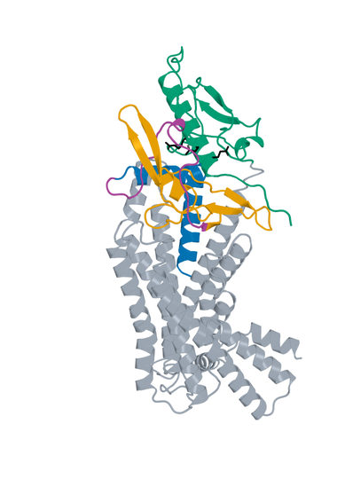
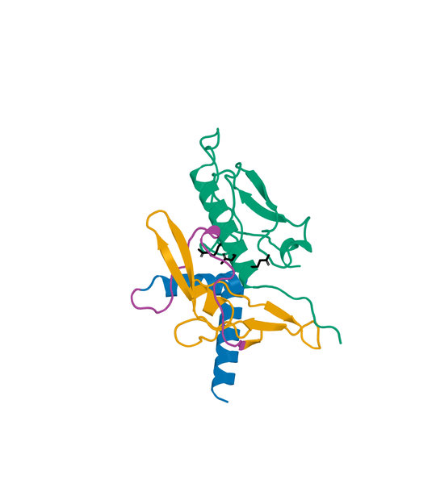
17 LK_P012_04 structure
D-L-D fusion Candidate A: 130 aa Human GLP1R B: 440 aa
Boltz2 Exact receptor complex
Boltz2 Exact interface detail
LigandForge
Linker
ECD binder
Receptor ECD
Remaining receptor
Hotspots
Receptor ECD B1–105 (UniProt 24–128). Black sticks: E34, Q37 and R40. View-specific zoom.
Complete selected sequence, N to C
MADSISEVSEGVHLILAAQALELPPFVVAARLEEARAKRPGSSLLPLPEDTSDVASGSISYPGASAFHLTGLAA
RCGAVWRGVFCQFGNGVKGEGSVTGGSLNTFYILTVAPTSANILTSGSGSGSLEGS
Human GLP1R Boltz2 Exact Computational predictions
34
Notes:
{
"candidate": "LK_P012_04",
"final_rank": 17,
"native_model_sha256": "1d47cee516c18104b88f5b283af8be679b4a8c5f2c472cbd34a48b119664eacf",
"structure_views": {
"final_rank": 17,
"design_id": "LK_P012_04",
"sequence_sha256": "dbbc237dccc285527f5d99d62ad5158c233c2b751f987bc25776a166dbf16745",
"native_model_sha256": "1d47cee516c18104b88f5b283af8be679b4a8c5f2c472cbd34a48b119664eacf",
"scoring_pdb_sha256": "fa1a5cc220f038b3a600579b7d83ec75b07b002432a35db4fdb020eb8d503754",
"overview": {
"source_slide": 67,
"source_picture_index": 1,
"embedded_media": "ppt/media/image76.jpeg",
"image_sha256": "09a7e7132b263f08434ff8d03ad7177864ce9782ae04d9ff659f9994621fcd34",
"asset": "assets/LK_P012_04-complex.jpg"
},
"interface": {
"source_slide": 68,
"source_picture_index": 1,
"embedded_media": "ppt/media/image79.jpeg",
"image_sha256": "1e791f44a9688ff2cacea43806fe72c19aa1fc21c5285e1c28a9f798baf775d0",
"asset": "assets/LK_P012_04-interface.jpg"
},
"rendering_provenance": {
"DeltaForge_source_PDB_sha256": "fa1a5cc220f038b3a600579b7d83ec75b07b002432a35db4fdb020eb8d503754",
"role_ranges_zero_based": {
"ECD": [
0,
39
],
"linker": [
39,
65
],
"LF": [
65,
130
]
},
"model_sha256": "1d47cee516c18104b88f5b283af8be679b4a8c5f2c472cbd34a48b119664eacf",
"source_run": "2026-10-24_pair183-extracellular-exact_001",
"source_methods": [
"https://github.com/DunbrackLab/IPSAE",
"https://github.com/wallnerlab/DockQ",
"https://zhanggroup.org/TM-score/"
],
"saved_display_appendix": {
"parent_sources": {
"ECD-parent": {
"key": "LK_P012_04-ECD-parent",
"source_path": "local/2026-10-25_linker-parent-comparison_001/parents/S08_00_042/exact.pdb",
"source_sha256": "586dbe8949136305e5e0d5d43c665bd5ed5d95548b9f5bc863aed4430cf0b282",
"role": "ECD",
"ranges_zero_based": {
"ECD": [
0,
39
]
},
"sequence": "MADSISEVSEGVHLILAAQALELPPFVVAARLEEARAKR",
"rotation": [
[
-0.1115210831342317,
0.9835902168408683,
-0.1418215514822947
],
[
0.6850233413445608,
-0.02730086207089444,
-0.7280093576971334
],
[
-0.7199347331369061,
-0.17833945967167697,
-0.6707376398307572
]
],
"translation": [
3.8607485500063383,
4.630699048501577,
-3.485280759986309
],
"core_fit_CA_RMSD_A": 1.029119308080871,
"output": "local/2026-10-25_linker-parent-views_001/build/renders-v2/LK_P012_04-ECD-parent.jpg",
"parent_or_fusion_id": "S08_00_042",
"design_id": "LK_P012_04",
"panel": "ECD-parent",
"view": [
1,
0,
0,
0,
1,
0,
0,
0,
1,
0,
0,
-375.1807890577328,
-5.002128421134614,
17.833570216119554,
-17.175677811680774,
309.8794116896058,
440.4821664258598,
-20
],
"world_height_A": 132.30899150873904,
"row_bounds_all_atoms_A": [
[
-43.157771701907166,
-41.320925538249966,
-67.47705517980779
],
[
33.15351485963794,
76.98806597048907,
33.12569955644624
]
]
},
"APNovo": {
"key": "LK_P012_04-APNovo",
"source_path": "local/2026-10-25_linker-top100-review_001/build/comparisons/LK_P012_04/reference.pdb",
"source_sha256": "a28114f0471487cfd13ff82f062f86142af68e4070b08c9a7fa5f2ac9aea5286",
"role": "fusion",
"ranges_zero_based": {
"ECD": [
0,
39
],
"linker": [
39,
65
],
"LF": [
65,
130
]
},
"sequence": "MADSISEVSEGVHLILAAQALELPPFVVAARLEEARAKRPGSSLLPLPEDTSDVASGSISYPGASAFHLTGLAARCGAVWRGVFCQFGNGVKGEGSVTGGSLNTFYILTVAPTSANILTSGSGSGSLEGS",
"rotation": [
[
-0.09915685079725645,
0.8544598327933244,
-0.5099669319562379
],
[
0.8906040883162778,
0.30479648126498904,
0.3375254710281015
],
[
0.4438381234346256,
-0.4207107406735995,
-0.7912081101743214
]
],
"translation": [
-13.506788035084089,
-7.8660219789783525,
5.680271597502018
],
"core_fit_CA_RMSD_A": 1.0291648057613971,
"output": "local/2026-10-25_linker-parent-views_001/build/renders-v2/LK_P012_04-APNovo.jpg",
"parent_or_fusion_id": "LK_P012_04-APNovo",
"design_id": "LK_P012_04",
"panel": "APNovo",
"view": [
1,
0,
0,
0,
1,
0,
0,
0,
1,
0,
0,
-375.1807890577328,
-5.002128421134614,
17.833570216119554,
-17.175677811680774,
309.8794116896058,
440.4821664258598,
-20
],
"world_height_A": 132.30899150873904,
"row_bounds_all_atoms_A": [
[
-43.157771701907166,
-41.320925538249966,
-67.47705517980779
],
[
33.15351485963794,
76.98806597048907,
33.12569955644624
]
]
},
"Exact": {
"key": "LK_P012_04-Exact",
"source_path": "local/2026-10-25_linker-top100-review_001/models/LK_P012_04/boltz2.cif",
"source_sha256": "1d47cee516c18104b88f5b283af8be679b4a8c5f2c472cbd34a48b119664eacf",
"role": "fusion",
"ranges_zero_based": {
"ECD": [
0,
39
],
"linker": [
39,
65
],
"LF": [
65,
130
]
},
"sequence": "MADSISEVSEGVHLILAAQALELPPFVVAARLEEARAKRPGSSLLPLPEDTSDVASGSISYPGASAFHLTGLAARCGAVWRGVFCQFGNGVKGEGSVTGGSLNTFYILTVAPTSANILTSGSGSGSLEGS",
"rotation": [
[
0.5825679708976139,
0.33114486366381435,
0.7422651814706942
],
[
0.5603649116407095,
0.4978592325664821,
-0.6619119016330877
],
[
-0.5887323328260705,
0.8015480512736581,
0.10447487055025073
]
],
"translation": [
-0.17376120162587583,
2.8125459139970967,
-0.4877737043914099
],
"core_fit_CA_RMSD_A": 1.330883533826814,
"output": "local/2026-10-25_linker-parent-views_001/build/renders-v2/LK_P012_04-Exact.jpg",
"parent_or_fusion_id": "LK_P012_04-Exact",
"design_id": "LK_P012_04",
"panel": "Exact",
"view": [
1,
0,
0,
0,
1,
0,
0,
0,
1,
0,
0,
-375.1807890577328,
-5.002128421134614,
17.833570216119554,
-17.175677811680774,
309.8794116896058,
440.4821664258598,
-20
],
"world_height_A": 132.30899150873904,
"row_bounds_all_atoms_A": [
[
-43.157771701907166,
-41.320925538249966,
-67.47705517980779
],
[
33.15351485963794,
76.98806597048907,
33.12569955644624
]
]
},
"LF-parent": {
"key": "LK_P012_04-LF-parent",
"source_path": "local/2026-10-25_linker-parent-comparison_001/parents/Design_991/exact.pdb",
"source_sha256": "4f8a662dc2ed593fd5dee32e1629c724986d9aed7a1595f5fe62f82875a40b30",
"role": "LF",
"ranges_zero_based": {
"LF": [
0,
65
]
},
"sequence": "AFHLTGLAARCGAVWRGVFCQFGNGVKGEGSVTGGSLNTFYILTVAPTSANILTSGSGSGSLEGS",
"rotation": [
[
0.18609119756738046,
0.8911453867842396,
0.4137994593682368
],
[
-0.12071599924220555,
0.4387022197578485,
-0.8904875356810176
],
[
-0.975088565786745,
0.11575964260876503,
0.18921412162218942
]
],
"translation": [
1.169208298701557,
-3.634658331489863,
3.72688275909145
],
"core_fit_CA_RMSD_A": 1.015400445473429,
"output": "local/2026-10-25_linker-parent-views_001/build/renders-v2/LK_P012_04-LF-parent.jpg",
"parent_or_fusion_id": "Design_991",
"design_id": "LK_P012_04",
"panel": "LF-parent",
"view": [
1,
0,
0,
0,
1,
0,
0,
0,
1,
0,
0,
-375.1807890577328,
-5.002128421134614,
17.833570216119554,
-17.175677811680774,
309.8794116896058,
440.4821664258598,
-20
],
"world_height_A": 132.30899150873904,
"row_bounds_all_atoms_A": [
[
-43.157771701907166,
-41.320925538249966,
-67.47705517980779
],
[
33.15351485963794,
76.98806597048907,
33.12569955644624
]
]
}
},
"shared_camera": [
1,
0,
0,
0,
1,
0,
0,
0,
1,
0,
0,
-375.1807890577328,
-5.002128421134614,
17.833570216119554,
-17.175677811680774,
309.8794116896058,
440.4821664258598,
-20
],
"reference": "Separate saved Exact parent complexes flank the linked Exact refold; AP Novo linked design comparison remains on the following slide. Rigid display alignment preserves native poses; all native receptor residues shown."
}
},
"display": "unchanged embedded JPEGs extracted from hash-verified delivered25-design PPTX; no resampling, cropping or new coordinate transforms",
"scale": "full complex and interface have different zooms; no matched-scale claim",
"hotspots": "black sticks; original27pocket positions for original LigandForge, R40/Q37/E34 annotations for DLD",
"colors": {
"LigandForge": "#E69F00",
"linker": "#AA4499",
"ECD_binder": "#0072B2",
"receptor_ECD": "#009E73",
"receptor_remainder": "#9AA5B1",
"hotspots": "#000000"
}
},
"source_deck": "local/2026-10-25_affinity-confidence-selection-deck_002/output/GLP1R_Selected_ipSAE_gt0p895_Kd_lt10nM_v3.pptx",
"source_deck_sha256": "ad9333fdf6c0ce7d6982e2980d6aade78af256710dbc7917f7f39e41d35aa173",
"domain_labels": "ECD A1-39 linker A40-65 LF A66-130",
"display_scope": "native Exact complex and saved interface view; same identity colors, independent zooms; no new coordinates or inferred agonism"
}

Slide 35
18 Design_787 metrics
Original LigandForge Candidate A: 49 aa Human GLP1R B: 409 aa
Metric and scope | Value
Boltz2 Exact ipSAE (A/B, Type=max) | 0.899274
DeltaForge predicted Kd (nM) | 5.3824
Boltz2 Exact ipTM | 0.9546
Original population ipSAE rank | 14
Predicted-Kd rank within population top50 | 20
Candidate / receptor residues (aa) | 49 / 409
Complex pLDDT (0-100) | 78.6
Generator-to-refold DockQ / TM-score | N/A
DeltaForge length scope | core_40_119
Origin and prediction
Original LigandForge v6.5.21
Generation 1
Exact seed 101
3 recycles, 200 steps
WT GLP1R 24-432
409 receptor residues
Original generator coordinates unavailable
Original generator coordinates are unavailable. This Exact prediction does not establish activation.
Complete selected sequence, N to C
GTLALTHCVFAADRAEIFGQRGKEDLQTGKAASEGTELTGSGSGSLCDI
Human GLP1R Boltz2 Exact Computational predictions
35
Notes:
{
"candidate": "Design_787",
"final_rank": 18,
"selection": "Exact ipSAE>0.895 and DeltaForge predicted Kd<10nM; first20 by Exact ipSAE descending",
"sequence_sha256": "e11fb509424a5ca3dd92ee2cacc0e8ae58c837c5042c87262252daca0a0735e6",
"sources": {
"source_table": {
"path": "local/2026-10-25_lf50-dld26-50-deltaforge_001/output/GLP1R_LigandForge_Original_Top50_DeltaForge_Kd.csv",
"sha256": "da4de8915b1ca76443882c0651920ddd9551839d0d75a5b18b8b1ff4653b0360"
},
"native_cif": {
"path": "campaigns/glp1r-ligandforge-boltz2-exact/runs/2026-10-15_ligandforge-exact_001/02_design/chunks/batch-031/kit_outputs/by_seed/Design_787/s101/Design_787_model_0.cif",
"sha256": "816d2168df76e72a1b6331b8b6977e40dd10424e3a8b21e45874bfac455c907e"
},
"scoring_pdb": {
"path": "local/2026-10-25_lf50-dld26-50-deltaforge_001/LF_Design_787.pdb",
"sha256": "18a8ac6f85f1f1a8b05eb12e1356eed1050e50ec10b8a5d10afb50b4c04c0b3d"
},
"DeltaForge_result": {
"path": "campaigns/glp1r-r40-design/runs/2026-10-25_lf50-dld26-50-deltaforge_001/03_filtering/deltaforge_results/LF_Design_787.json",
"sha256": "89429dc7ef5108a67902a75255a505b600a3953cca075b5f2321c19f0d40605d"
}
},
"source_ledger": "campaigns/glp1r-final-writeup/runs/2026-10-25_final20-writeup_001/04_analysis/provenance-ledger.json",
"scorer": "deltaforge_v10_2_unified_parallel / v10_2_unified_parallel_2026_05_08",
"calibration": "deltaforge_v10_boltz2_calibrated_gbr / v10_boltz2_gbr_2026_03_29",
"scope": "one complete candidate A against one receptor B; computational, no experimental Kd or activation"
}

Slide 36
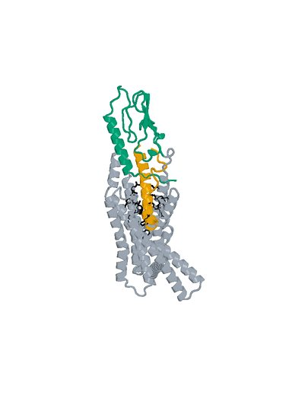
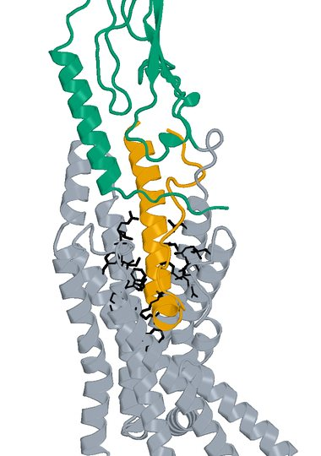
18 Design_787 structure
Original LigandForge Candidate A: 49 aa Human GLP1R B: 409 aa
Boltz2 Exact receptor complex
Boltz2 Exact interface detail
LigandForge
Receptor ECD
Remaining receptor
Hotspots
Receptor ECD B1–105 (UniProt 24–128). Black sticks: 27 submitted pocket positions. View-specific zoom.
Complete selected sequence, N to C
GTLALTHCVFAADRAEIFGQRGKEDLQTGKAASEGTELTGSGSGSLCDI
Human GLP1R Boltz2 Exact Computational predictions
36
Notes:
{
"candidate": "Design_787",
"final_rank": 18,
"native_model_sha256": "816d2168df76e72a1b6331b8b6977e40dd10424e3a8b21e45874bfac455c907e",
"structure_views": {
"final_rank": 18,
"design_id": "Design_787",
"sequence_sha256": "e11fb509424a5ca3dd92ee2cacc0e8ae58c837c5042c87262252daca0a0735e6",
"native_model_sha256": "816d2168df76e72a1b6331b8b6977e40dd10424e3a8b21e45874bfac455c907e",
"scoring_pdb_sha256": "18a8ac6f85f1f1a8b05eb12e1356eed1050e50ec10b8a5d10afb50b4c04c0b3d",
"overview": {
"source_slide": 13,
"source_picture_index": 0,
"embedded_media": "ppt/media/image9.jpeg",
"image_sha256": "668d030a4f77dfbc2c880a17bb8bff410c274af3ea7d30de16834dc7782dc49e",
"asset": "assets/Design_787-complex.jpg"
},
"interface": {
"source_slide": 13,
"source_picture_index": 1,
"embedded_media": "ppt/media/image10.jpeg",
"image_sha256": "be02593da32e79c3a9144e08f07a2eb135c9b029d971ee2db3674176a4d94caf",
"asset": "assets/Design_787-interface.jpg"
},
"rendering_provenance": {
"source_PDB": "campaigns/glp1r-ligandforge-affinity/runs/2026-10-15_top100-affinity_001/01_staging/payload/pdb_inputs/Design_787.pdb",
"PDB_SHA256": "18a8ac6f85f1f1a8b05eb12e1356eed1050e50ec10b8a5d10afb50b4c04c0b3d",
"model_SHA256": "816d2168df76e72a1b6331b8b6977e40dd10424e3a8b21e45874bfac455c907e",
"source_render_script": "local/2026-10-25_affinity-confidence-selection-deck_002/render_originals.py",
"alignment": "rigid core CA B117-400 fitting; original full/interface zooms reused",
"camera_version": "saved original full and interface frames from final90-slide deck"
},
"display": "unchanged embedded JPEGs extracted from hash-verified delivered25-design PPTX; no resampling, cropping or new coordinate transforms",
"scale": "full complex and interface have different zooms; no matched-scale claim",
"hotspots": "black sticks; original27pocket positions for original LigandForge, R40/Q37/E34 annotations for DLD",
"colors": {
"LigandForge": "#E69F00",
"linker": "#AA4499",
"ECD_binder": "#0072B2",
"receptor_ECD": "#009E73",
"receptor_remainder": "#9AA5B1",
"hotspots": "#000000"
}
},
"source_deck": "local/2026-10-25_affinity-confidence-selection-deck_002/output/GLP1R_Selected_ipSAE_gt0p895_Kd_lt10nM_v3.pptx",
"source_deck_sha256": "ad9333fdf6c0ce7d6982e2980d6aade78af256710dbc7917f7f39e41d35aa173",
"domain_labels": "LigandForge A1-49",
"display_scope": "native Exact complex and saved interface view; same identity colors, independent zooms; no new coordinates or inferred agonism"
}

Slide 37
19 Design_15 metrics
Original LigandForge Candidate A: 50 aa Human GLP1R B: 409 aa
Metric and scope | Value
Boltz2 Exact ipSAE (A/B, Type=max) | 0.898565
DeltaForge predicted Kd (nM) | 4.2907
Boltz2 Exact ipTM | 0.9471
Original population ipSAE rank | 15
Predicted-Kd rank within population top50 | 18
Candidate / receptor residues (aa) | 50 / 409
Complex pLDDT (0-100) | 69.4
Generator-to-refold DockQ / TM-score | N/A
DeltaForge length scope | core_40_119
Origin and prediction
Original LigandForge v6.5.21
Generation 1
Exact seed 101
3 recycles, 200 steps
WT GLP1R 24-432
409 receptor residues
Original generator coordinates unavailable
Original generator coordinates are unavailable. This Exact prediction does not establish activation.
Complete selected sequence, N to C
AQCTKTYAIGYDVYLKLTYLGFRRADGAGNDDDVCAGNVGGSGSGSFFVA
Human GLP1R Boltz2 Exact Computational predictions
37
Notes:
{
"candidate": "Design_15",
"final_rank": 19,
"selection": "Exact ipSAE>0.895 and DeltaForge predicted Kd<10nM; first20 by Exact ipSAE descending",
"sequence_sha256": "e7fac62187212f65b2a764763628350b1c757d258eb4147ac26ba5021bebe78e",
"sources": {
"source_table": {
"path": "local/2026-10-25_lf50-dld26-50-deltaforge_001/output/GLP1R_LigandForge_Original_Top50_DeltaForge_Kd.csv",
"sha256": "da4de8915b1ca76443882c0651920ddd9551839d0d75a5b18b8b1ff4653b0360"
},
"native_cif": {
"path": "campaigns/glp1r-ligandforge-boltz2-exact/runs/2026-10-15_ligandforge-exact_001/02_design/chunks/batch-000/kit_outputs/by_seed/Design_15/s101/Design_15_model_0.cif",
"sha256": "bcd1d04d8dee32c20c86771c363c15c14fdc4fb96e6e093c512124f54408a169"
},
"scoring_pdb": {
"path": "local/2026-10-25_lf50-dld26-50-deltaforge_001/LF_Design_15.pdb",
"sha256": "71fa77b7cdcd0a9762fb5d17a3502ae4c828c88fdf0e39cb6050f417908e3409"
},
"DeltaForge_result": {
"path": "campaigns/glp1r-r40-design/runs/2026-10-25_lf50-dld26-50-deltaforge_001/03_filtering/deltaforge_results/LF_Design_15.json",
"sha256": "7ed4e2cc425b7b1caa05f18d8db808e0c48025d679934871a845d9e338f7e80d"
}
},
"source_ledger": "campaigns/glp1r-final-writeup/runs/2026-10-25_final20-writeup_001/04_analysis/provenance-ledger.json",
"scorer": "deltaforge_v10_2_unified_parallel / v10_2_unified_parallel_2026_05_08",
"calibration": "deltaforge_v10_boltz2_calibrated_gbr / v10_boltz2_gbr_2026_03_29",
"scope": "one complete candidate A against one receptor B; computational, no experimental Kd or activation"
}

Slide 38
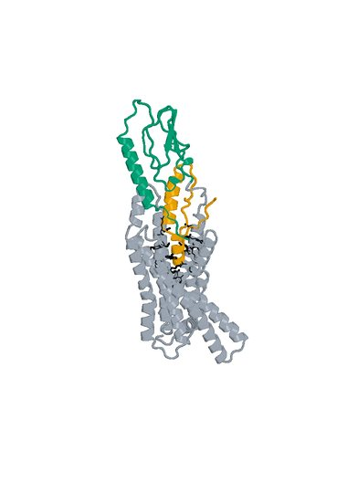
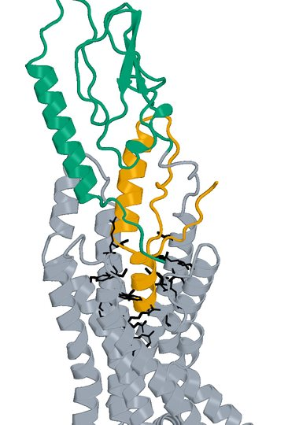
19 Design_15 structure
Original LigandForge Candidate A: 50 aa Human GLP1R B: 409 aa
Boltz2 Exact receptor complex
Boltz2 Exact interface detail
LigandForge
Receptor ECD
Remaining receptor
Hotspots
Receptor ECD B1–105 (UniProt 24–128). Black sticks: 27 submitted pocket positions. View-specific zoom.
Complete selected sequence, N to C
AQCTKTYAIGYDVYLKLTYLGFRRADGAGNDDDVCAGNVGGSGSGSFFVA
Human GLP1R Boltz2 Exact Computational predictions
38
Notes:
{
"candidate": "Design_15",
"final_rank": 19,
"native_model_sha256": "bcd1d04d8dee32c20c86771c363c15c14fdc4fb96e6e093c512124f54408a169",
"structure_views": {
"final_rank": 19,
"design_id": "Design_15",
"sequence_sha256": "e7fac62187212f65b2a764763628350b1c757d258eb4147ac26ba5021bebe78e",
"native_model_sha256": "bcd1d04d8dee32c20c86771c363c15c14fdc4fb96e6e093c512124f54408a169",
"scoring_pdb_sha256": "71fa77b7cdcd0a9762fb5d17a3502ae4c828c88fdf0e39cb6050f417908e3409",
"overview": {
"source_slide": 15,
"source_picture_index": 0,
"embedded_media": "ppt/media/image11.jpeg",
"image_sha256": "49f1adfd8bf832e8f94f1fe1600fb84e181bb5846bedf44d500c77ad533ab7ee",
"asset": "assets/Design_15-complex.jpg"
},
"interface": {
"source_slide": 15,
"source_picture_index": 1,
"embedded_media": "ppt/media/image12.jpeg",
"image_sha256": "4d8ffcb63674af4bfdd4d8e96495d4fdcc231b4f6dc2bc46c609e711f45294e0",
"asset": "assets/Design_15-interface.jpg"
},
"rendering_provenance": {
"source_PDB": "campaigns/glp1r-ligandforge-affinity/runs/2026-10-15_top100-affinity_001/01_staging/payload/pdb_inputs/Design_15.pdb",
"PDB_SHA256": "71fa77b7cdcd0a9762fb5d17a3502ae4c828c88fdf0e39cb6050f417908e3409",
"model_SHA256": "bcd1d04d8dee32c20c86771c363c15c14fdc4fb96e6e093c512124f54408a169",
"source_render_script": "local/2026-10-25_affinity-confidence-selection-deck_002/render_originals.py",
"alignment": "rigid core CA B117-400 fitting; original full/interface zooms reused",
"camera_version": "saved original full and interface frames from final90-slide deck"
},
"display": "unchanged embedded JPEGs extracted from hash-verified delivered25-design PPTX; no resampling, cropping or new coordinate transforms",
"scale": "full complex and interface have different zooms; no matched-scale claim",
"hotspots": "black sticks; original27pocket positions for original LigandForge, R40/Q37/E34 annotations for DLD",
"colors": {
"LigandForge": "#E69F00",
"linker": "#AA4499",
"ECD_binder": "#0072B2",
"receptor_ECD": "#009E73",
"receptor_remainder": "#9AA5B1",
"hotspots": "#000000"
}
},
"source_deck": "local/2026-10-25_affinity-confidence-selection-deck_002/output/GLP1R_Selected_ipSAE_gt0p895_Kd_lt10nM_v3.pptx",
"source_deck_sha256": "ad9333fdf6c0ce7d6982e2980d6aade78af256710dbc7917f7f39e41d35aa173",
"domain_labels": "LigandForge A1-50",
"display_scope": "native Exact complex and saved interface view; same identity colors, independent zooms; no new coordinates or inferred agonism"
}

Slide 39
20 LK_P093_03 metrics
D-L-D fusion Candidate A: 159 aa Human GLP1R B: 440 aa
Metric and scope | Value
Boltz2 Exact ipSAE (A/B, Type=max) | 0.898297
DeltaForge predicted Kd (nM) | 0.8232
Boltz2 Exact ipTM | 0.8864
Original population ipSAE rank | 19
Predicted-Kd rank within population top50 | 5
Candidate / receptor residues (aa) | 159 / 440
pDockQ / pDockQ2 | 0.4014 / 0.1735
Whole fusion / linker pLDDT (0-100) | 52.4 / 42.3
ECD / LigandForge pLDDT (0-100) | 68.2 / 43.1
Fusion design-to-refold DockQ | 0.2733
Free C-terminal OPM z (A) | 63.98
Extracellular free C-terminal screen | Pass
DeltaForge length scope | long_gt_140
Origin and prediction
ECD parent S10_02_067
LigandForge parent Design_280
Pair P093
AP Novo seed 1034
Exact seed 101
3 recycles, 200 steps
ECD A1-60 linker A61-90 LF A91-159
Whole-fusion pLDDT remains modest. High interface confidence does not establish activation.
Complete selected sequence, N to C
SSSSSVPAPSIDYLGAFREHGANAEVAEFLYRYLREIKGKSEKEAILLLTAAASIANLVAGISSSVPDPRTPPP
PPPPVPVEPLDPSSLTEVSGATIDLRVKTCVDFKQTVNFFKLRNTQLPGSCTKDNTVLFLLEGLKLGYASRYFS
IGSGSGSQQFS
Human GLP1R Boltz2 Exact Computational predictions
39
Notes:
{
"candidate": "LK_P093_03",
"final_rank": 20,
"selection": "Exact ipSAE>0.895 and DeltaForge predicted Kd<10nM; first20 by Exact ipSAE descending",
"sequence_sha256": "ddaad34132315edb9525884bb57cf70c07f16c0b611a51a9dea9902ffba6d6e1",
"sources": {
"source_table": {
"path": "local/2026-10-25_lf50-dld26-50-deltaforge_001/output/GLP1R_DLD_Top50_DeltaForge_Kd_and_Boltz2_Metrics.csv",
"sha256": "da9569bf0e8b74cce3d6792eb260d6a4b17b35e6f46e0793d49f02c0d3a0e728"
},
"native_cif": {
"path": "local/2026-10-25_linker-top100-review_001/models/LK_P093_03/boltz2.cif",
"sha256": "ff5831a2a7632820d3e465ce3445e724379a6db0ce217efbba99701e140f8de9"
},
"scoring_pdb": {
"path": "local/2026-10-25_dld-top25-deltaforge_001/payload/structures/LK_P093_03.pdb",
"sha256": "12df24d378b79870f19f5a6a3bb38a43b4e53f9fd9673d39f9430e91854160c5"
},
"DeltaForge_result": {
"path": "campaigns/glp1r-r40-design/runs/2026-10-25_dld-top25-deltaforge_001/03_filtering/deltaforge_results/LK_P093_03.json",
"sha256": "619d3310f0b051f66af2870afca14edc32fd10f02dc808ac6e943a406946c6c5"
}
},
"source_ledger": "campaigns/glp1r-final-writeup/runs/2026-10-25_final20-writeup_001/04_analysis/provenance-ledger.json",
"scorer": "deltaforge_v10_2_unified_parallel / v10_2_unified_parallel_2026_05_08",
"calibration": "deltaforge_v10_boltz2_calibrated_gbr / v10_boltz2_gbr_2026_03_29",
"scope": "one complete candidate A against one receptor B; computational, no experimental Kd or activation"
}

Slide 40
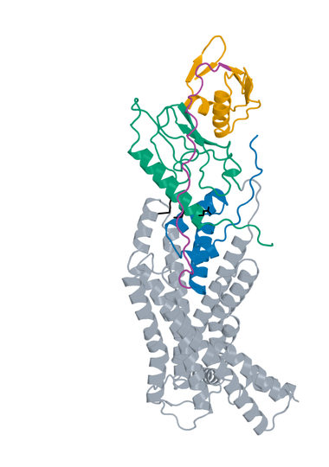
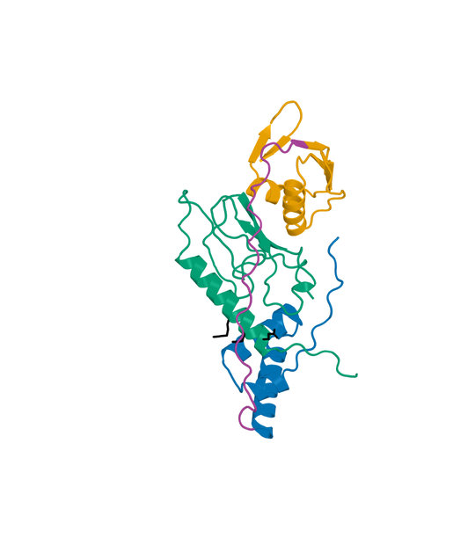
20 LK_P093_03 structure
D-L-D fusion Candidate A: 159 aa Human GLP1R B: 440 aa
Boltz2 Exact receptor complex
Boltz2 Exact interface detail
LigandForge
Linker
ECD binder
Receptor ECD
Remaining receptor
Hotspots
Receptor ECD B1–105 (UniProt 24–128). Black sticks: E34, Q37 and R40. View-specific zoom.
Complete selected sequence, N to C
SSSSSVPAPSIDYLGAFREHGANAEVAEFLYRYLREIKGKSEKEAILLLTAAASIANLVAGISSSVPDPRTPPP
PPPPVPVEPLDPSSLTEVSGATIDLRVKTCVDFKQTVNFFKLRNTQLPGSCTKDNTVLFLLEGLKLGYASRYFS
IGSGSGSQQFS
Human GLP1R Boltz2 Exact Computational predictions
40
Notes:
{
"candidate": "LK_P093_03",
"final_rank": 20,
"native_model_sha256": "ff5831a2a7632820d3e465ce3445e724379a6db0ce217efbba99701e140f8de9",
"structure_views": {
"final_rank": 20,
"design_id": "LK_P093_03",
"sequence_sha256": "ddaad34132315edb9525884bb57cf70c07f16c0b611a51a9dea9902ffba6d6e1",
"native_model_sha256": "ff5831a2a7632820d3e465ce3445e724379a6db0ce217efbba99701e140f8de9",
"scoring_pdb_sha256": "12df24d378b79870f19f5a6a3bb38a43b4e53f9fd9673d39f9430e91854160c5",
"overview": {
"source_slide": 71,
"source_picture_index": 1,
"embedded_media": "ppt/media/image81.jpeg",
"image_sha256": "6d4c6efeb36f111c559fe5e945b35220d1af8ab2792cdc15ffa7960cd11afac9",
"asset": "assets/LK_P093_03-complex.jpg"
},
"interface": {
"source_slide": 72,
"source_picture_index": 1,
"embedded_media": "ppt/media/image84.jpeg",
"image_sha256": "dd8a040742f37c3cab84ab7d66b344f21501c9092203b18266cb3a9a0a0ddf5a",
"asset": "assets/LK_P093_03-interface.jpg"
},
"rendering_provenance": {
"DeltaForge_source_PDB_sha256": "12df24d378b79870f19f5a6a3bb38a43b4e53f9fd9673d39f9430e91854160c5",
"role_ranges_zero_based": {
"ECD": [
0,
60
],
"linker": [
60,
90
],
"LF": [
90,
159
]
},
"model_sha256": "ff5831a2a7632820d3e465ce3445e724379a6db0ce217efbba99701e140f8de9",
"source_run": "2026-10-24_pair183-extracellular-exact_001",
"source_methods": [
"https://github.com/DunbrackLab/IPSAE",
"https://github.com/wallnerlab/DockQ",
"https://zhanggroup.org/TM-score/"
],
"saved_display_appendix": {
"parent_sources": {
"ECD-parent": {
"key": "LK_P093_03-ECD-parent",
"source_path": "local/2026-10-25_linker-parent-comparison_001/parents/S10_02_067/exact.pdb",
"source_sha256": "5d20357cffb341ad42261fed52bba0fe029c3cfac209f0c18185895d92f793b1",
"role": "ECD",
"ranges_zero_based": {
"ECD": [
0,
60
]
},
"sequence": "SSSSSVPAPSIDYLGAFREHGANAEVAEFLYRYLREIKGKSEKEAILLLTAAASIANLVA",
"rotation": [
[
0.7346910201760881,
0.6760329209030145,
0.056644241508141846
],
[
-0.02230991168992169,
0.10752802185318266,
-0.9939517147939192
],
[
-0.6780349328968671,
0.7289836524581155,
0.09408208876612556
]
],
"translation": [
2.4853528433389727,
3.2831066280470536,
-1.7593082523946915
],
"core_fit_CA_RMSD_A": 1.1234692372145,
"output": "local/2026-10-25_linker-parent-views_001/build/renders-v2/LK_P093_03-ECD-parent.jpg",
"parent_or_fusion_id": "S10_02_067",
"design_id": "LK_P093_03",
"panel": "ECD-parent",
"view": [
1,
0,
0,
0,
1,
0,
0,
0,
1,
0,
0,
-392.8369751174828,
-9.046398759659198,
27.499215990529954,
-12.838164716121653,
337.64153912521135,
448.0324111097542,
-20
],
"world_height_A": 138.53551546622424,
"row_bounds_all_atoms_A": [
[
-50.79037642370106,
-32.53097942368704,
-53.03360070839306
],
[
32.69757890438267,
87.52941140474695,
27.357271276149753
]
]
},
"APNovo": {
"key": "LK_P093_03-APNovo",
"source_path": "local/2026-10-25_linker-top100-review_001/build/comparisons/LK_P093_03/reference.pdb",
"source_sha256": "776e6e98ae5d4de8308dba9c9bf07cce03fbc388235b9a0875e27d0103d5028c",
"role": "fusion",
"ranges_zero_based": {
"ECD": [
0,
60
],
"linker": [
60,
90
],
"LF": [
90,
159
]
},
"sequence": "SSSSSVPAPSIDYLGAFREHGANAEVAEFLYRYLREIKGKSEKEAILLLTAAASIANLVAGISSSVPDPRTPPPPPPPVPVEPLDPSSLTEVSGATIDLRVKTCVDFKQTVNFFKLRNTQLPGSCTKDNTVLFLLEGLKLGYASRYFSIGSGSGSQQFS",
"rotation": [
[
-0.6425835535546871,
0.07591260590380156,
-0.7624458014803762
],
[
-0.7349909841616555,
0.22010510090817892,
0.6413595221942319
],
[
0.21650545742830118,
0.9725178484249533,
-0.08564080627943582
]
],
"translation": [
-12.821974904768428,
-14.15868606391479,
6.426890187240096
],
"core_fit_CA_RMSD_A": 1.1234868176477835,
"output": "local/2026-10-25_linker-parent-views_001/build/renders-v2/LK_P093_03-APNovo.jpg",
"parent_or_fusion_id": "LK_P093_03-APNovo",
"design_id": "LK_P093_03",
"panel": "APNovo",
"view": [
1,
0,
0,
0,
1,
0,
0,
0,
1,
0,
0,
-392.8369751174828,
-9.046398759659198,
27.499215990529954,
-12.838164716121653,
337.64153912521135,
448.0324111097542,
-20
],
"world_height_A": 138.53551546622424,
"row_bounds_all_atoms_A": [
[
-50.79037642370106,
-32.53097942368704,
-53.03360070839306
],
[
32.69757890438267,
87.52941140474695,
27.357271276149753
]
]
},
"Exact": {
"key": "LK_P093_03-Exact",
"source_path": "local/2026-10-25_linker-top100-review_001/models/LK_P093_03/boltz2.cif",
"source_sha256": "ff5831a2a7632820d3e465ce3445e724379a6db0ce217efbba99701e140f8de9",
"role": "fusion",
"ranges_zero_based": {
"ECD": [
0,
60
],
"linker": [
60,
90
],
"LF": [
90,
159
]
},
"sequence": "SSSSSVPAPSIDYLGAFREHGANAEVAEFLYRYLREIKGKSEKEAILLLTAAASIANLVAGISSSVPDPRTPPPPPPPVPVEPLDPSSLTEVSGATIDLRVKTCVDFKQTVNFFKLRNTQLPGSCTKDNTVLFLLEGLKLGYASRYFSIGSGSGSQQFS",
"rotation": [
[
0.6195375947327921,
0.5687121599852967,
0.5410542113957062
],
[
0.44001816267686245,
0.31918571900864023,
-0.8393476628132843
],
[
-0.6500439991265128,
0.7580811242687195,
-0.05249611003710475
]
],
"translation": [
-3.839328507008922,
-1.5386777075261495,
-2.1375359959929163
],
"core_fit_CA_RMSD_A": 0.9767459015355532,
"output": "local/2026-10-25_linker-parent-views_001/build/renders-v2/LK_P093_03-Exact.jpg",
"parent_or_fusion_id": "LK_P093_03-Exact",
"design_id": "LK_P093_03",
"panel": "Exact",
"view": [
1,
0,
0,
0,
1,
0,
0,
0,
1,
0,
0,
-392.8369751174828,
-9.046398759659198,
27.499215990529954,
-12.838164716121653,
337.64153912521135,
448.0324111097542,
-20
],
"world_height_A": 138.53551546622424,
"row_bounds_all_atoms_A": [
[
-50.79037642370106,
-32.53097942368704,
-53.03360070839306
],
[
32.69757890438267,
87.52941140474695,
27.357271276149753
]
]
},
"LF-parent": {
"key": "LK_P093_03-LF-parent",
"source_path": "local/2026-10-25_linker-parent-comparison_001/parents/Design_280/exact.pdb",
"source_sha256": "cd01c89fbf40d0e577c10f20c2afa96c3deef09880d6c761314a1c5e9898bd4f",
"role": "LF",
"ranges_zero_based": {
"LF": [
0,
69
]
},
"sequence": "EVSGATIDLRVKTCVDFKQTVNFFKLRNTQLPGSCTKDNTVLFLLEGLKLGYASRYFSIGSGSGSQQFS",
"rotation": [
[
0.9716521520149124,
0.23640963200020604,
-0.0015985785293137766
],
[
-0.232382419508661,
0.9563002615331773,
0.17744913387297956
],
[
0.04347938667791329,
-0.1720473610249762,
0.9841286681075418
]
],
"translation": [
3.3985903455718525,
-6.121573941428423,
6.014485827651381
],
"core_fit_CA_RMSD_A": 1.3060904572635719,
"output": "local/2026-10-25_linker-parent-views_001/build/renders-v2/LK_P093_03-LF-parent.jpg",
"parent_or_fusion_id": "Design_280",
"design_id": "LK_P093_03",
"panel": "LF-parent",
"view": [
1,
0,
0,
0,
1,
0,
0,
0,
1,
0,
0,
-392.8369751174828,
-9.046398759659198,
27.499215990529954,
-12.838164716121653,
337.64153912521135,
448.0324111097542,
-20
],
"world_height_A": 138.53551546622424,
"row_bounds_all_atoms_A": [
[
-50.79037642370106,
-32.53097942368704,
-53.03360070839306
],
[
32.69757890438267,
87.52941140474695,
27.357271276149753
]
]
}
},
"shared_camera": [
1,
0,
0,
0,
1,
0,
0,
0,
1,
0,
0,
-392.8369751174828,
-9.046398759659198,
27.499215990529954,
-12.838164716121653,
337.64153912521135,
448.0324111097542,
-20
],
"reference": "Separate saved Exact parent complexes flank the linked Exact refold; AP Novo linked design comparison remains on the following slide. Rigid display alignment preserves native poses; all native receptor residues shown."
}
},
"display": "unchanged embedded JPEGs extracted from hash-verified delivered25-design PPTX; no resampling, cropping or new coordinate transforms",
"scale": "full complex and interface have different zooms; no matched-scale claim",
"hotspots": "black sticks; original27pocket positions for original LigandForge, R40/Q37/E34 annotations for DLD",
"colors": {
"LigandForge": "#E69F00",
"linker": "#AA4499",
"ECD_binder": "#0072B2",
"receptor_ECD": "#009E73",
"receptor_remainder": "#9AA5B1",
"hotspots": "#000000"
}
},
"source_deck": "local/2026-10-25_affinity-confidence-selection-deck_002/output/GLP1R_Selected_ipSAE_gt0p895_Kd_lt10nM_v3.pptx",
"source_deck_sha256": "ad9333fdf6c0ce7d6982e2980d6aade78af256710dbc7917f7f39e41d35aa173",
"domain_labels": "ECD A1-60 linker A61-90 LF A91-159",
"display_scope": "native Exact complex and saved interface view; same identity colors, independent zooms; no new coordinates or inferred agonism"
}

