Slide 1
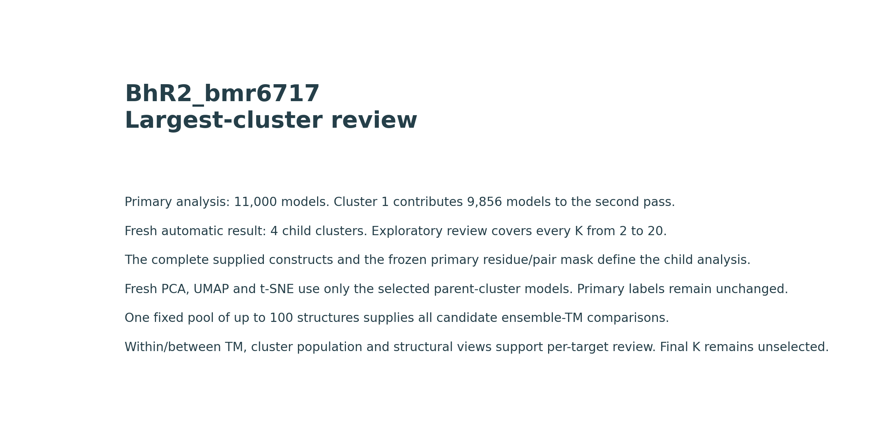
Two-level analysis. Child labels identify subsets of primary Cluster 1. The candidate cuts remain exploratory and await per-target review.
Notes:
Target: BhR2_bmr6717
Source figure: 01-scope.png
Two-level analysis. Child labels identify subsets of primary Cluster 1. The candidate cuts remain exploratory and await per-target review.

Slide 2
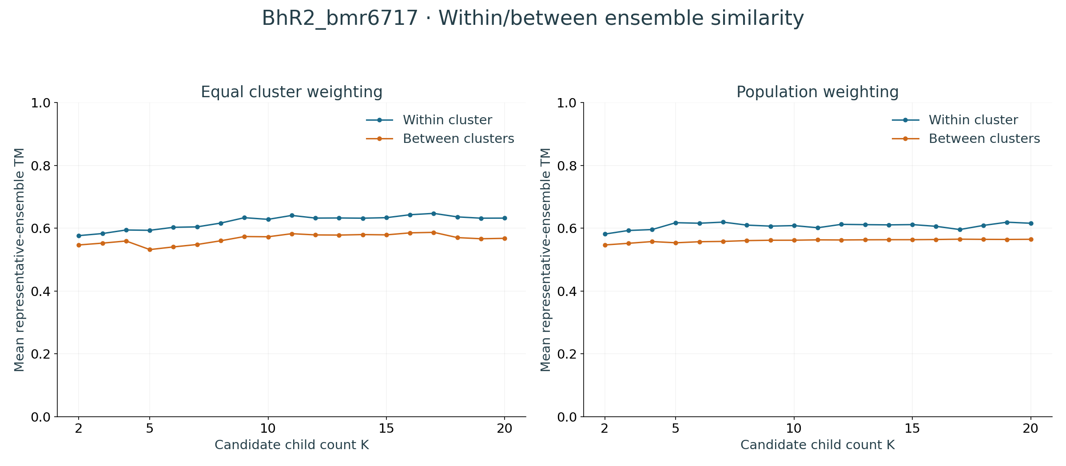
All K values reuse the same fixed representative pool and TM matrix. Population weights reflect finest-group sizes. These are representative estimates, not all-model TM distributions.
Notes:
Target: BhR2_bmr6717
Source figure: 02-tm-tradeoffs.png
All K values reuse the same fixed representative pool and TM matrix. Population weights reflect finest-group sizes. These are representative estimates, not all-model TM distributions.

Slide 3
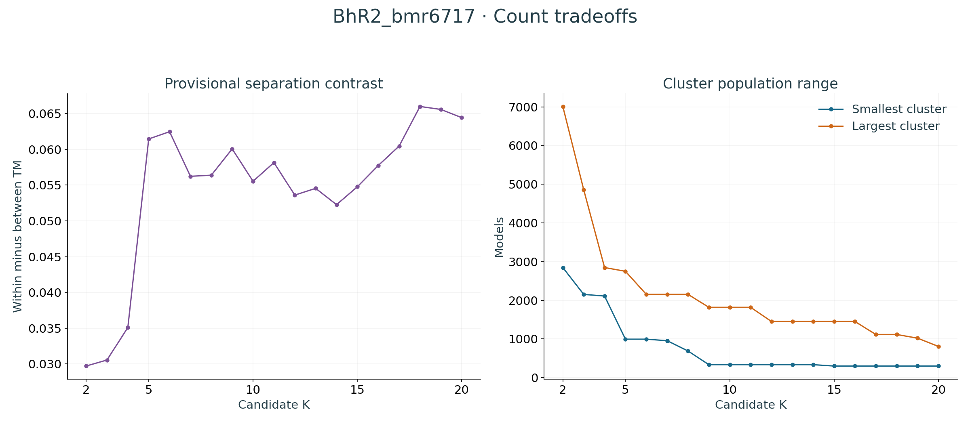
Contrast provides a provisional ranking. Increasing K can overpartition the ensemble, so this score does not determine an ideal state count. Review small groups and their structures.
Notes:
Target: BhR2_bmr6717
Source figure: 03-contrast-populations.png
Contrast provides a provisional ranking. Increasing K can overpartition the ensemble, so this score does not determine an ideal state count. Review small groups and their structures.

Slide 4
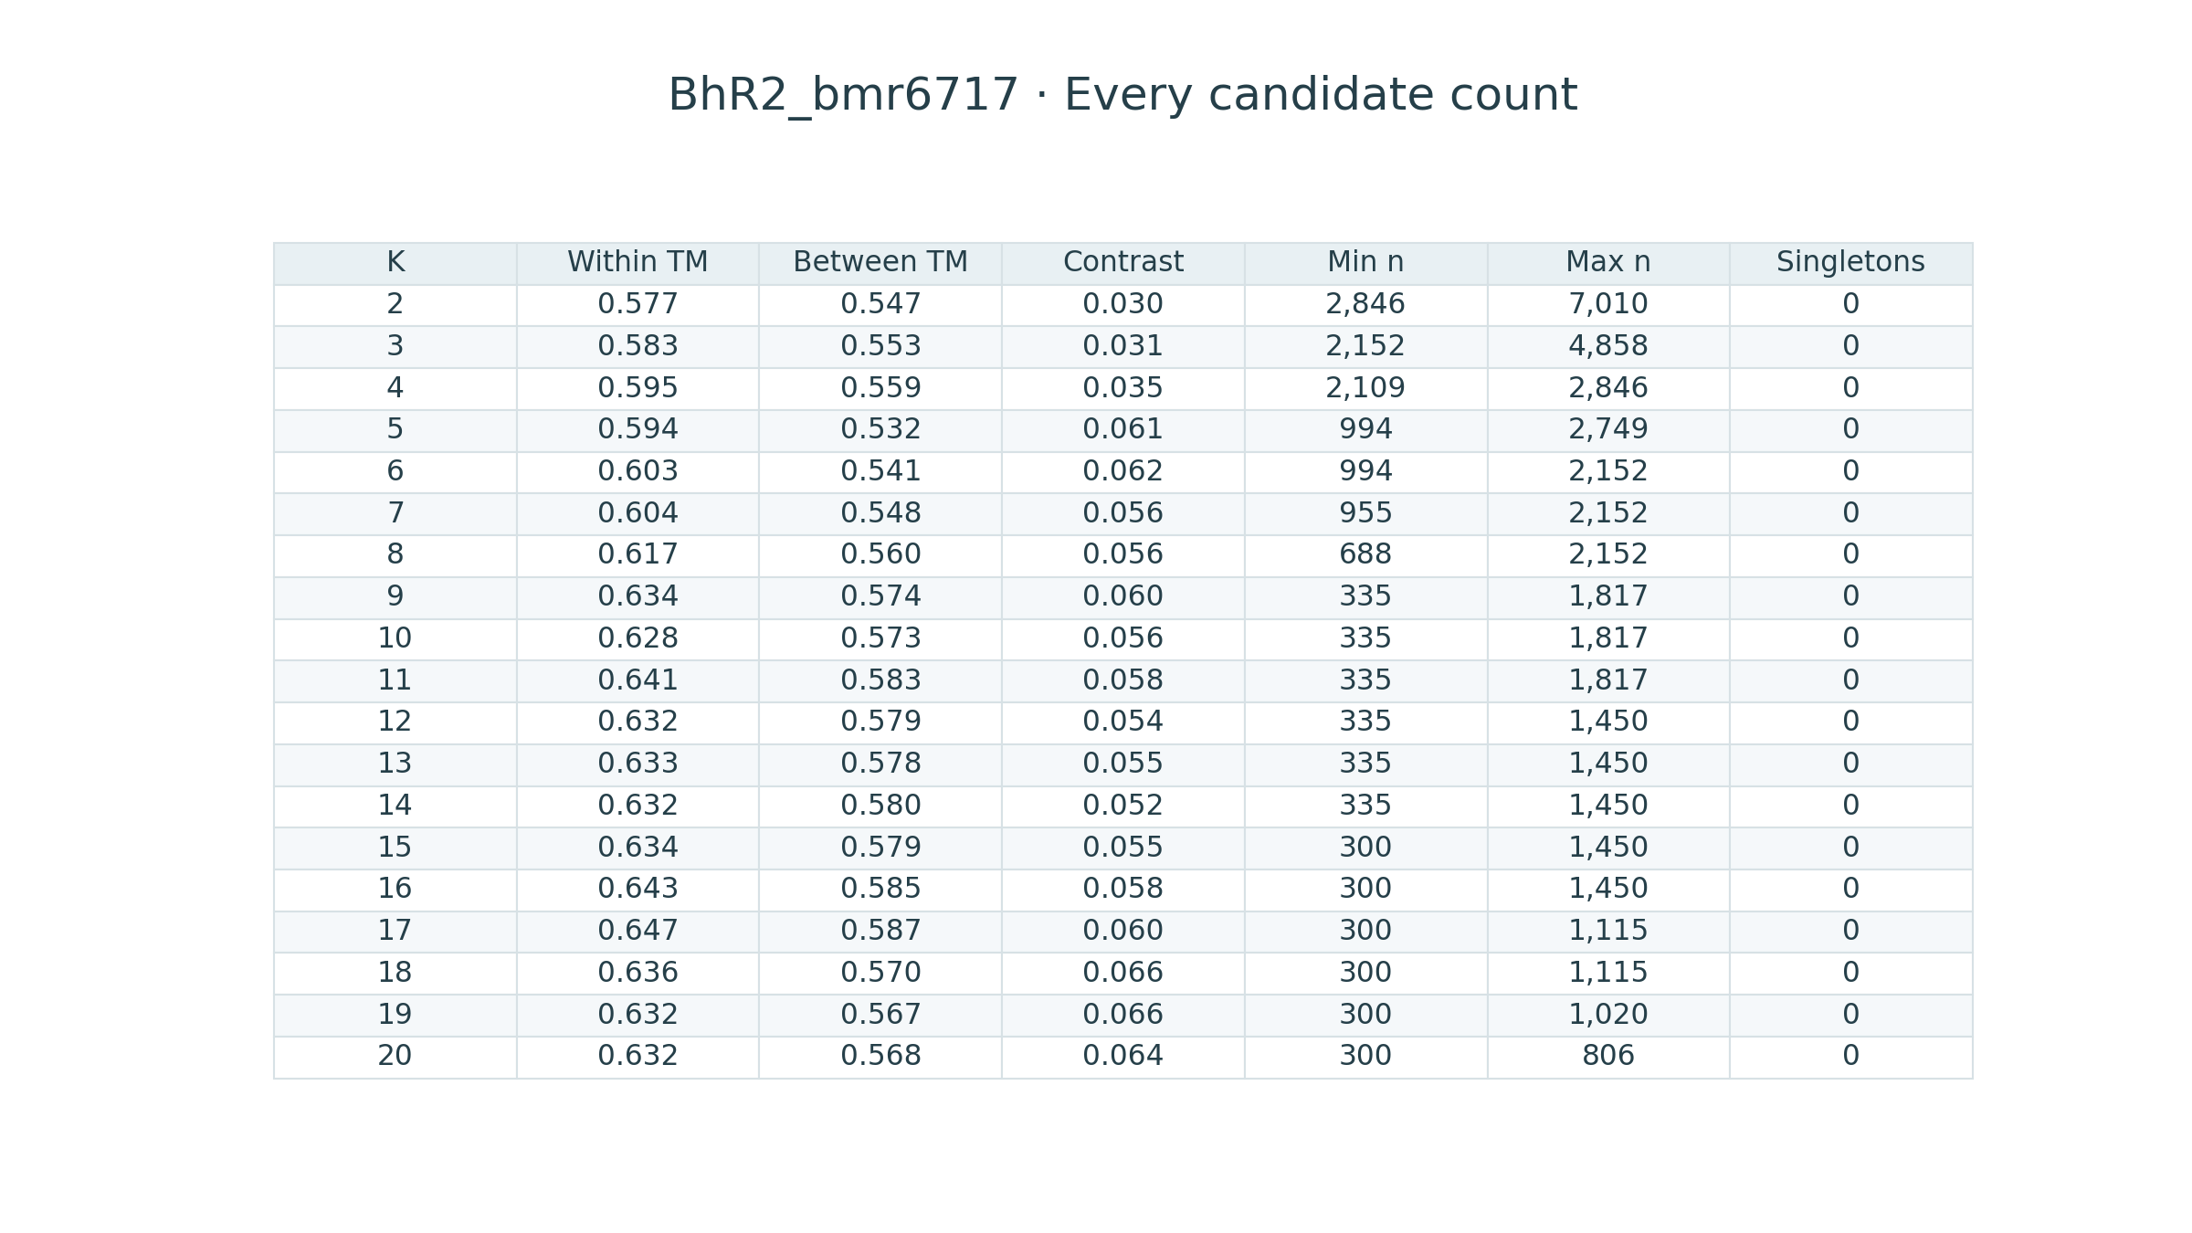
Equal-cluster TM estimates exclude self pairs. Unavailable within-cluster values occur when representative support is insufficient. The full CSV preserves every value and population count.
Notes:
Target: BhR2_bmr6717
Source figure: 04-all-counts.png
Equal-cluster TM estimates exclude self pairs. Unavailable within-cluster values occur when representative support is insufficient. The full CSV preserves every value and population count.

Slide 5
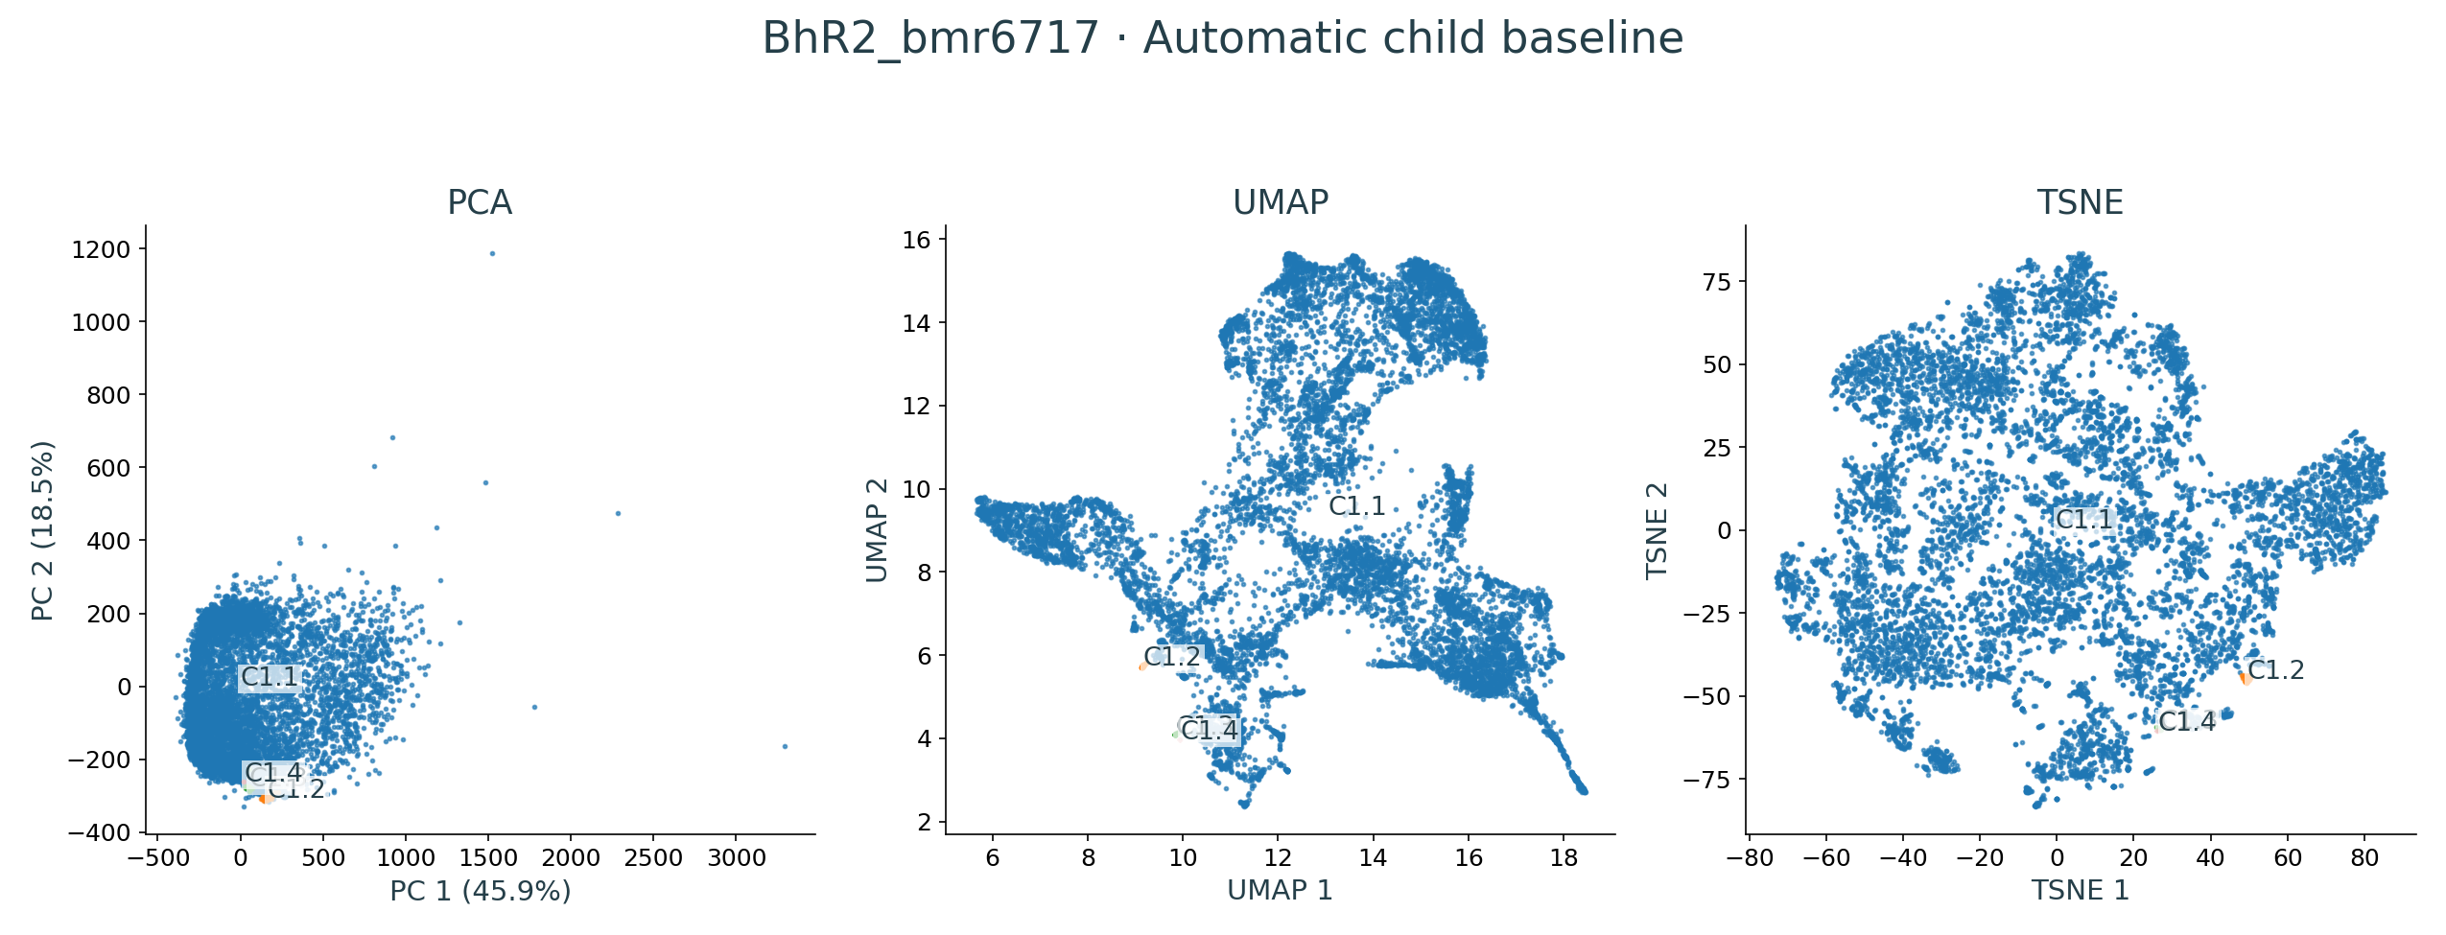
Automatic child baseline: 4 child clusters among 9,856 selected models. The three projections share these labels. All K=2–20 views are available in the interactive atlas.
Notes:
Target: BhR2_bmr6717
Source figure: projections-whole.png
Automatic child baseline: 4 child clusters among 9,856 selected models. The three projections share these labels. All K=2–20 views are available in the interactive atlas.

Slide 6
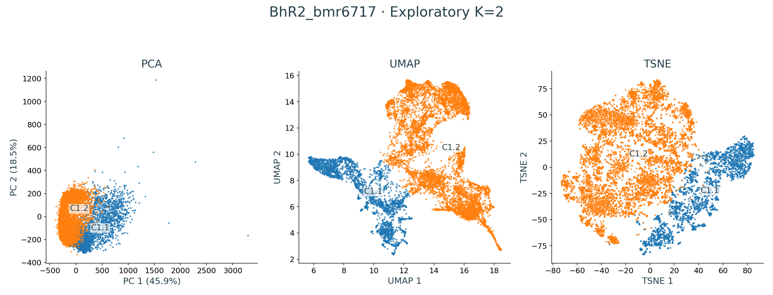
Exploratory K=2: 2 child clusters among 9,856 selected models. The three projections share these labels. All K=2–20 views are available in the interactive atlas.
Notes:
Target: BhR2_bmr6717
Source figure: projections-k2.png
Exploratory K=2: 2 child clusters among 9,856 selected models. The three projections share these labels. All K=2–20 views are available in the interactive atlas.

Slide 7
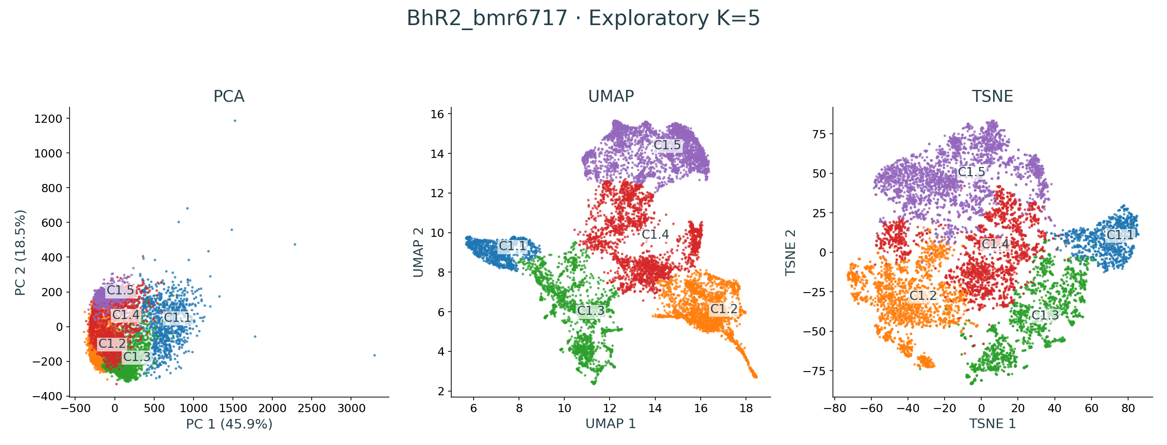
Exploratory K=5: 5 child clusters among 9,856 selected models. The three projections share these labels. All K=2–20 views are available in the interactive atlas.
Notes:
Target: BhR2_bmr6717
Source figure: projections-k5.png
Exploratory K=5: 5 child clusters among 9,856 selected models. The three projections share these labels. All K=2–20 views are available in the interactive atlas.

Slide 8
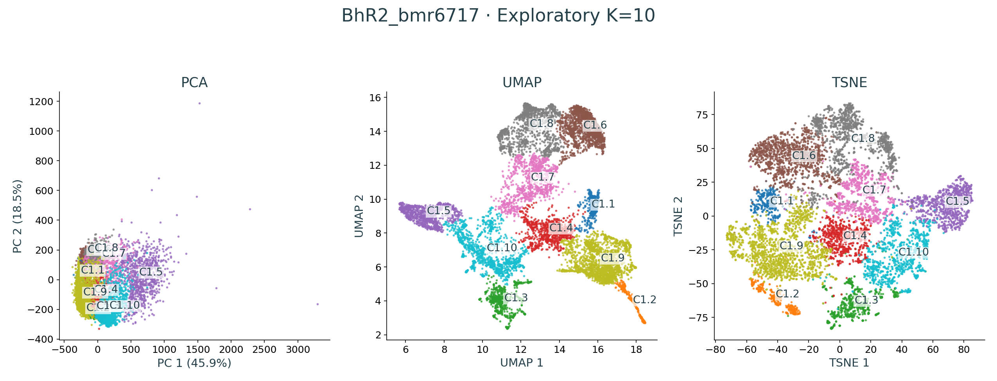
Exploratory K=10: 10 child clusters among 9,856 selected models. The three projections share these labels. All K=2–20 views are available in the interactive atlas.
Notes:
Target: BhR2_bmr6717
Source figure: projections-k10.png
Exploratory K=10: 10 child clusters among 9,856 selected models. The three projections share these labels. All K=2–20 views are available in the interactive atlas.

Slide 9
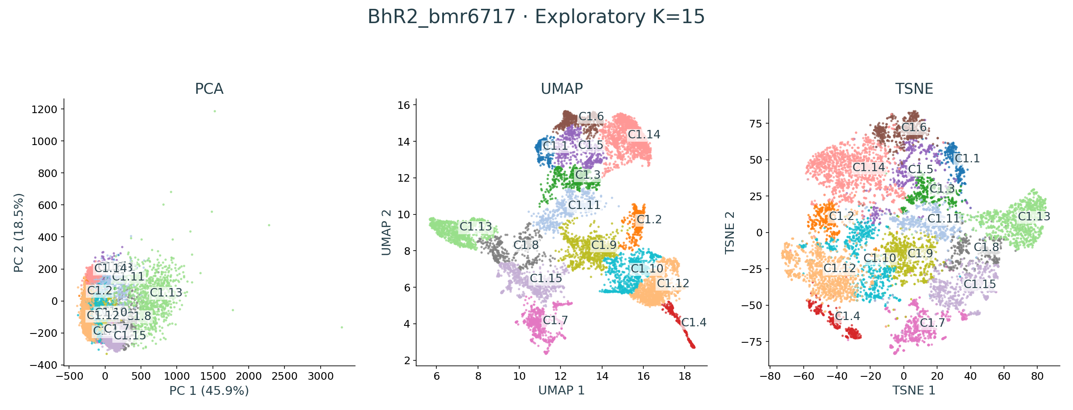
Exploratory K=15: 15 child clusters among 9,856 selected models. The three projections share these labels. All K=2–20 views are available in the interactive atlas.
Notes:
Target: BhR2_bmr6717
Source figure: projections-k15.png
Exploratory K=15: 15 child clusters among 9,856 selected models. The three projections share these labels. All K=2–20 views are available in the interactive atlas.

Slide 10
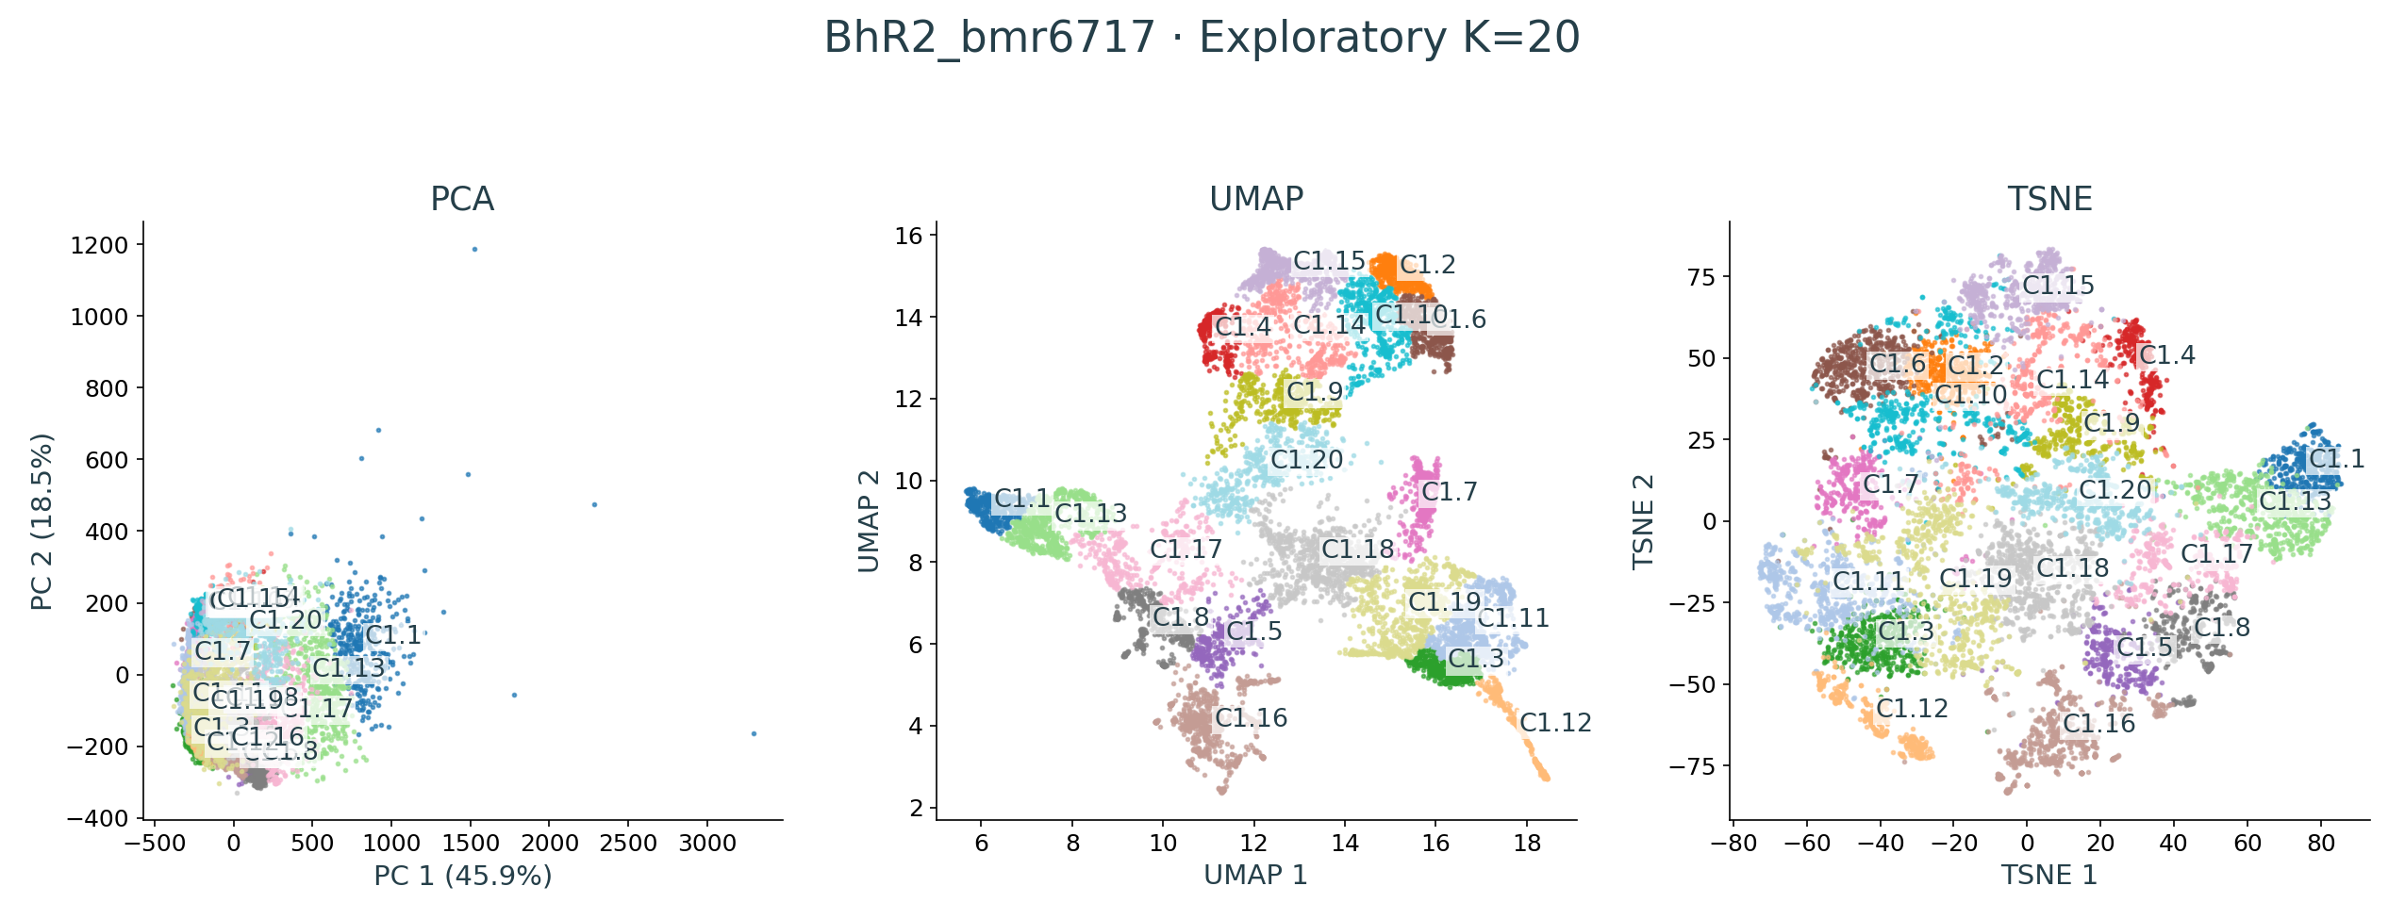
Exploratory K=20: 20 child clusters among 9,856 selected models. The three projections share these labels. All K=2–20 views are available in the interactive atlas.
Notes:
Target: BhR2_bmr6717
Source figure: projections-k20.png
Exploratory K=20: 20 child clusters among 9,856 selected models. The three projections share these labels. All K=2–20 views are available in the interactive atlas.

Slide 11
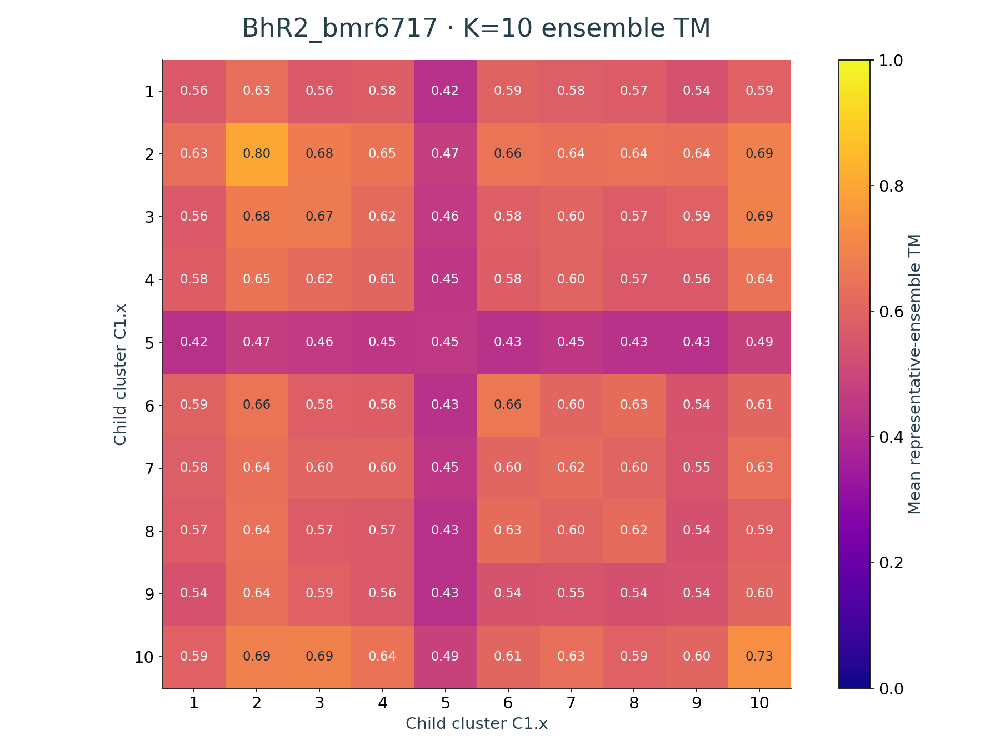
Off-diagonal cells show weighted mean TM between representative ensembles. Diagonal cells show within-ensemble TM excluding self pairs. Blank estimates have insufficient representative support. The model pool is identical across K.
Notes:
Target: BhR2_bmr6717
Source figure: tm-K10.png
Off-diagonal cells show weighted mean TM between representative ensembles. Diagonal cells show within-ensemble TM excluding self pairs. Blank estimates have insufficient representative support. The model pool is identical across K.

Slide 12
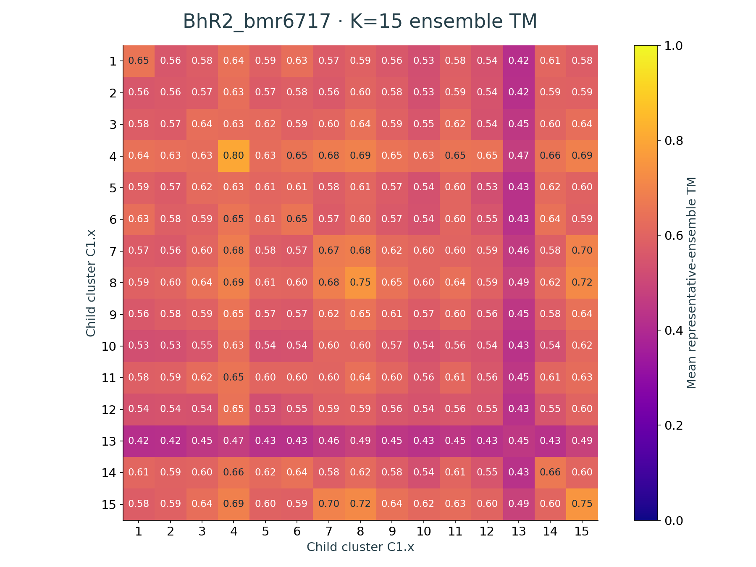
Off-diagonal cells show weighted mean TM between representative ensembles. Diagonal cells show within-ensemble TM excluding self pairs. Blank estimates have insufficient representative support. The model pool is identical across K.
Notes:
Target: BhR2_bmr6717
Source figure: tm-K15.png
Off-diagonal cells show weighted mean TM between representative ensembles. Diagonal cells show within-ensemble TM excluding self pairs. Blank estimates have insufficient representative support. The model pool is identical across K.

Slide 13
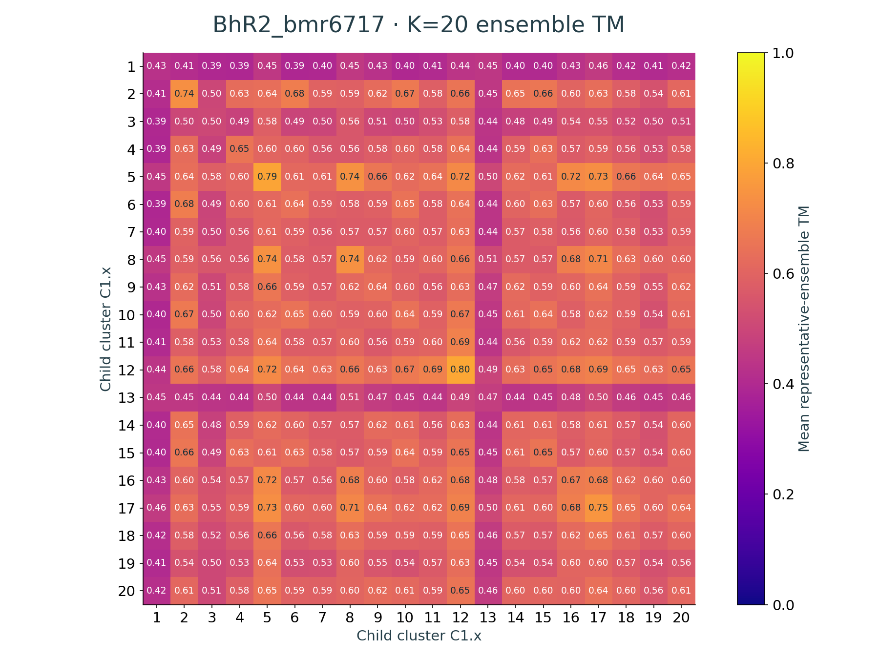
Off-diagonal cells show weighted mean TM between representative ensembles. Diagonal cells show within-ensemble TM excluding self pairs. Blank estimates have insufficient representative support. The model pool is identical across K.
Notes:
Target: BhR2_bmr6717
Source figure: tm-K20.png
Off-diagonal cells show weighted mean TM between representative ensembles. Diagonal cells show within-ensemble TM excluding self pairs. Blank estimates have insufficient representative support. The model pool is identical across K.

