Slide 1
SR215 bmr6366 largest child
11 AIS methods · 10,120 selected models
Notes:
{"target": "SR215 bmr6366 largest child", "comparison": "AFCluster vs AFSample2 vs AFSample3 vs BioEMU vs MD", "sampling_provenance": {"methods": {"AFCluster": 418, "AFSample2": 980, "AFSample3": 998, "BioEMU": 1990, "MD": 994}, "unassigned_or_reference_count": 4740, "source": "Exact clustering membership and configured model_origin rules"}, "sections": [{"title": "Sampling methods analyzed", "x": 48, "y": 88, "lines": [[["AFCluster", null], [": 418 analyzed models.", null]], [["AFSample2", "https://github.com/wallnerlab/AFsample2"], [": 980 analyzed models.", null]], [["AFSample3", "https://github.com/wallnerlab/afsample3/tree/507e8fd492379cb3996d1ba2e04794e8ce2191df"], [": 998 analyzed models.", null]], [["BioEMU", "https://github.com/microsoft/bioemu"], [": 1,990 analyzed models.", null]], [["MD", null], [": 994 analyzed models.", null]]]}, {"title": "Shared structural feature input", "x": 48, "y": 267, "lines": [[["Align sequences; retain residue positions shared", null]], [["by all models. For each structure, calculate the", null]], [["Cα–Cα distance matrix and flatten its upper", null]], [["triangle, excluding the diagonal: R(R−1)/2 values.", null]], [["Screen terminal variance; remove flagged rows/columns.", null]], [["Keep ≥75% of each chain; chains ≤15 residues stay intact.", null]]]}, {"title": "Two-dimensional projections", "x": 48, "y": 446, "lines": [[["PCA: scikit-learn 1.7.1", "https://scikit-learn.org/stable/modules/generated/sklearn.decomposition.PCA.html"], ["; centered SVD.", null]], [["t-SNE: scikit-learn 1.7.1", "https://scikit-learn.org/stable/modules/generated/sklearn.manifold.TSNE.html"], ["; Barnes–Hut,", null]], [["perplexity 30; the workflow uses Python t-SNE.", null]], [["UMAP: umap-learn 0.5.11", "https://github.com/lmcinnes/umap"], ["; neighbors 15,", null]], [["min_dist 0.1; Euclidean distance. Random seed 42.", null]]]}, {"title": "Clusters and displayed representatives", "x": 664, "y": 88, "lines": [[["Preserve UMAP components; seeds 42/7/123.", null]], [["Ward splits: feature silhouette ≥0.15; ARI ≥0.80.", null]], [["Show up to 5 AFSample3 models per cluster", null]], [["by mean pLDDT. BioEMU has no confidence scores", null]], [["and is excluded from representative selection.", null]], [["Both BioEMU filter groups remain in clustering.", null]]]}, {"title": "Medoid TM-similarity grid", "x": 664, "y": 267, "lines": [[["Among the displayed models in each cluster, the", null]], [["medoid minimizes mean pairwise aligned Cα RMSD", null]], [["over shared, chain-corresponded residues.", null]], [["US-align", "https://github.com/pylelab/USalign"], [" scores each medoid pair in both directions;", null]], [["average-length normalization and directional mean", null]], [["give a symmetric grid (0–1; higher is more similar).", null]]]}, {"title": "Bonsai of the selected ensembles", "x": 664, "y": 446, "lines": [[["Bonsai / Bonsai Scout", "https://github.com/dhdegroot/Bonsai-data-representation/tree/b16ef6f0a164610327022c7d0b92de82b3596aad"], [": native engine b16ef6f.", null]], [["15 representatives; 14 nonzero PCA axes.", null]], [["Variance scaling off; tree paths encode distance.", null]], [["Native edge cuts select 2 groups by silhouette.", null]], [["B labels apply only to selected representatives.", null]], [["Circular views and dendrogram; root is arbitrary.", null]]]}], "references": [["PCA / scikit-learn: Pedregosa et al., 2011", "https://jmlr.org/papers/v12/pedregosa11a.html"], ["t-SNE: van der Maaten & Hinton, 2008", "https://www.jmlr.org/papers/v9/vandermaaten08a.html"], ["UMAP: McInnes, Healy & Melville, 2018", "https://arxiv.org/abs/1802.03426"]], "dataset_scope": "Only nine confidence-producing methods are ranked; BioEMU/BioEMU2 remain in every structural analysis. Unscored-only clusters retain their structural medoid.", "bonsai_source": " (native engine b16ef6f)", "bonsai_url": "https://github.com/dhdegroot/Bonsai-data-representation/tree/b16ef6f0a164610327022c7d0b92de82b3596aad"}

Slide 2
Methodology
Sampling methods analyzed
Clusters and displayed representatives
11 AIS methods; 10,120 selected models.
AFSample2; AFSample3; Boltz2; OpenDDE.
BioEMU; BioEMU2; AFCluster; SPEACH_AF.
AlphaFlow MD; AlphaFlow PDB; ESMFlow PDB.
Preserve UMAP components; seeds 42/7/123.
Ward splits: feature silhouette ≥0.15; ARI ≥0.80.
Up to 5 models per cluster by mean pLDDT.
8,130 selected models have native confidence.
BioEMU/BioEMU2 stay unscored in clustering.
Unscored-only clusters use structural medoids.
Shared structural feature input
Medoid TM-similarity grid
Second pass: only primary Cluster 1 models.
Use the frozen parent residue/pair mask.
139 retained residues; 9,591 Cα distance pairs.
Fresh PCA, UMAP and t-SNE fit this subset.
Primary labels and native structures are preserved.
Final child-count review remains open.
Among the displayed models in each cluster, the
medoid minimizes mean pairwise aligned Cα RMSD
over shared, chain-corresponded residues.
US-align scores each medoid pair in both directions;
average-length normalization and directional mean
give a symmetric grid (0–1; higher is more similar).
Two-dimensional projections
Bonsai of the selected ensembles
PCA: scikit-learn 1.7.1; centered SVD.
t-SNE: scikit-learn 1.7.1; Barnes–Hut,
perplexity 30; the workflow uses Python t-SNE.
UMAP: umap-learn 0.5.11; neighbors 15,
min_dist 0.1; Euclidean distance. Random seed 42.
Bonsai / Bonsai Scout: native engine b16ef6f.
15 representatives; 14 nonzero PCA axes.
Variance scaling off; tree paths encode distance.
Native edge cuts select 2 groups by silhouette.
B labels apply only to selected representatives.
Circular views and dendrogram; root is arbitrary.
PCA / scikit-learn: Pedregosa et al., 2011
t-SNE: van der Maaten & Hinton, 2008
UMAP: McInnes, Healy & Melville, 2018
Only nine confidence-producing methods are ranked; BioEMU/BioEMU2 remain in every structural analysis. Unscored-only clusters retain their structural medoid.
Notes:
{"target": "SR215 bmr6366 largest child", "comparison": "AFCluster vs AFSample2 vs AFSample3 vs BioEMU vs MD", "sampling_provenance": {"methods": {"AFCluster": 418, "AFSample2": 980, "AFSample3": 998, "BioEMU": 1990, "MD": 994}, "unassigned_or_reference_count": 4740, "source": "Exact clustering membership and configured model_origin rules"}, "sections": [{"title": "Sampling methods analyzed", "x": 48, "y": 88, "lines": [[["AFCluster", null], [": 418 analyzed models.", null]], [["AFSample2", "https://github.com/wallnerlab/AFsample2"], [": 980 analyzed models.", null]], [["AFSample3", "https://github.com/wallnerlab/afsample3/tree/507e8fd492379cb3996d1ba2e04794e8ce2191df"], [": 998 analyzed models.", null]], [["BioEMU", "https://github.com/microsoft/bioemu"], [": 1,990 analyzed models.", null]], [["MD", null], [": 994 analyzed models.", null]]]}, {"title": "Shared structural feature input", "x": 48, "y": 267, "lines": [[["Align sequences; retain residue positions shared", null]], [["by all models. For each structure, calculate the", null]], [["Cα–Cα distance matrix and flatten its upper", null]], [["triangle, excluding the diagonal: R(R−1)/2 values.", null]], [["Screen terminal variance; remove flagged rows/columns.", null]], [["Keep ≥75% of each chain; chains ≤15 residues stay intact.", null]]]}, {"title": "Two-dimensional projections", "x": 48, "y": 446, "lines": [[["PCA: scikit-learn 1.7.1", "https://scikit-learn.org/stable/modules/generated/sklearn.decomposition.PCA.html"], ["; centered SVD.", null]], [["t-SNE: scikit-learn 1.7.1", "https://scikit-learn.org/stable/modules/generated/sklearn.manifold.TSNE.html"], ["; Barnes–Hut,", null]], [["perplexity 30; the workflow uses Python t-SNE.", null]], [["UMAP: umap-learn 0.5.11", "https://github.com/lmcinnes/umap"], ["; neighbors 15,", null]], [["min_dist 0.1; Euclidean distance. Random seed 42.", null]]]}, {"title": "Clusters and displayed representatives", "x": 664, "y": 88, "lines": [[["Preserve UMAP components; seeds 42/7/123.", null]], [["Ward splits: feature silhouette ≥0.15; ARI ≥0.80.", null]], [["Show up to 5 AFSample3 models per cluster", null]], [["by mean pLDDT. BioEMU has no confidence scores", null]], [["and is excluded from representative selection.", null]], [["Both BioEMU filter groups remain in clustering.", null]]]}, {"title": "Medoid TM-similarity grid", "x": 664, "y": 267, "lines": [[["Among the displayed models in each cluster, the", null]], [["medoid minimizes mean pairwise aligned Cα RMSD", null]], [["over shared, chain-corresponded residues.", null]], [["US-align", "https://github.com/pylelab/USalign"], [" scores each medoid pair in both directions;", null]], [["average-length normalization and directional mean", null]], [["give a symmetric grid (0–1; higher is more similar).", null]]]}, {"title": "Bonsai of the selected ensembles", "x": 664, "y": 446, "lines": [[["Bonsai / Bonsai Scout", "https://github.com/dhdegroot/Bonsai-data-representation/tree/b16ef6f0a164610327022c7d0b92de82b3596aad"], [": native engine b16ef6f.", null]], [["15 representatives; 14 nonzero PCA axes.", null]], [["Variance scaling off; tree paths encode distance.", null]], [["Native edge cuts select 2 groups by silhouette.", null]], [["B labels apply only to selected representatives.", null]], [["Circular views and dendrogram; root is arbitrary.", null]]]}], "references": [["PCA / scikit-learn: Pedregosa et al., 2011", "https://jmlr.org/papers/v12/pedregosa11a.html"], ["t-SNE: van der Maaten & Hinton, 2008", "https://www.jmlr.org/papers/v9/vandermaaten08a.html"], ["UMAP: McInnes, Healy & Melville, 2018", "https://arxiv.org/abs/1802.03426"]], "dataset_scope": "Only nine confidence-producing methods are ranked; BioEMU/BioEMU2 remain in every structural analysis. Unscored-only clusters retain their structural medoid.", "bonsai_source": " (native engine b16ef6f)", "bonsai_url": "https://github.com/dhdegroot/Bonsai-data-representation/tree/b16ef6f0a164610327022c7d0b92de82b3596aad"}

Slide 3
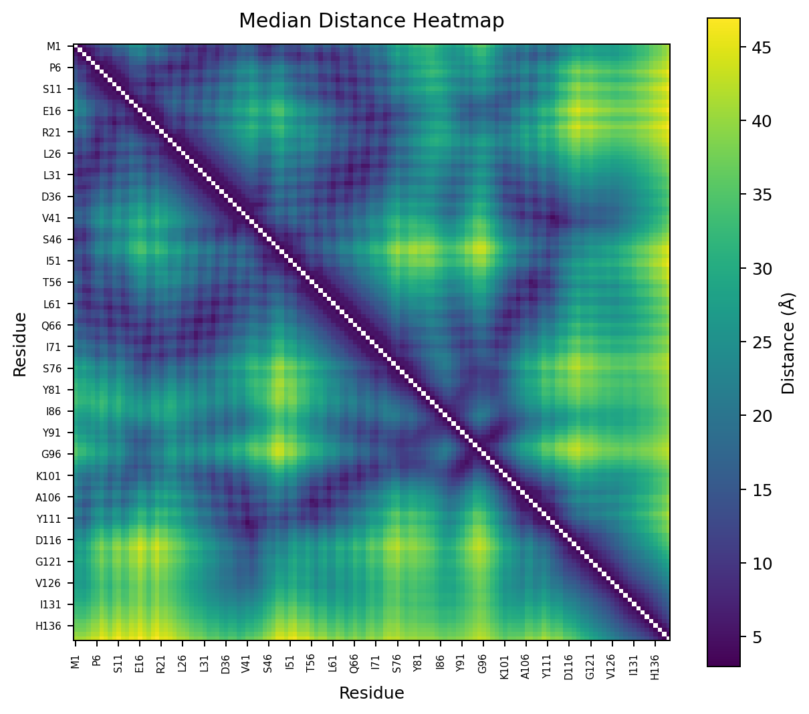
Figure 1. Median Cα distance between shared residues across the model ensemble.
Notes:
Target: SR215_bmr6366_largest_child
Source figure: visualize_distogram/median_matrix.png
Figure 1. Median Cα distance between shared residues across the model ensemble.

Slide 4
Figure 2. Variance of Cα distances between shared residues across the model ensemble. Colored outlines and membership strips delineate the detected rigid cores, including discontinuous sequence segments.
Notes:
Target: SR215_bmr6366_largest_child
Source figure: annotated variance evidence
Figure 2. Variance of Cα distances between shared residues across the model ensemble. Colored outlines and membership strips delineate the detected rigid cores, including discontinuous sequence segments.

Slide 5
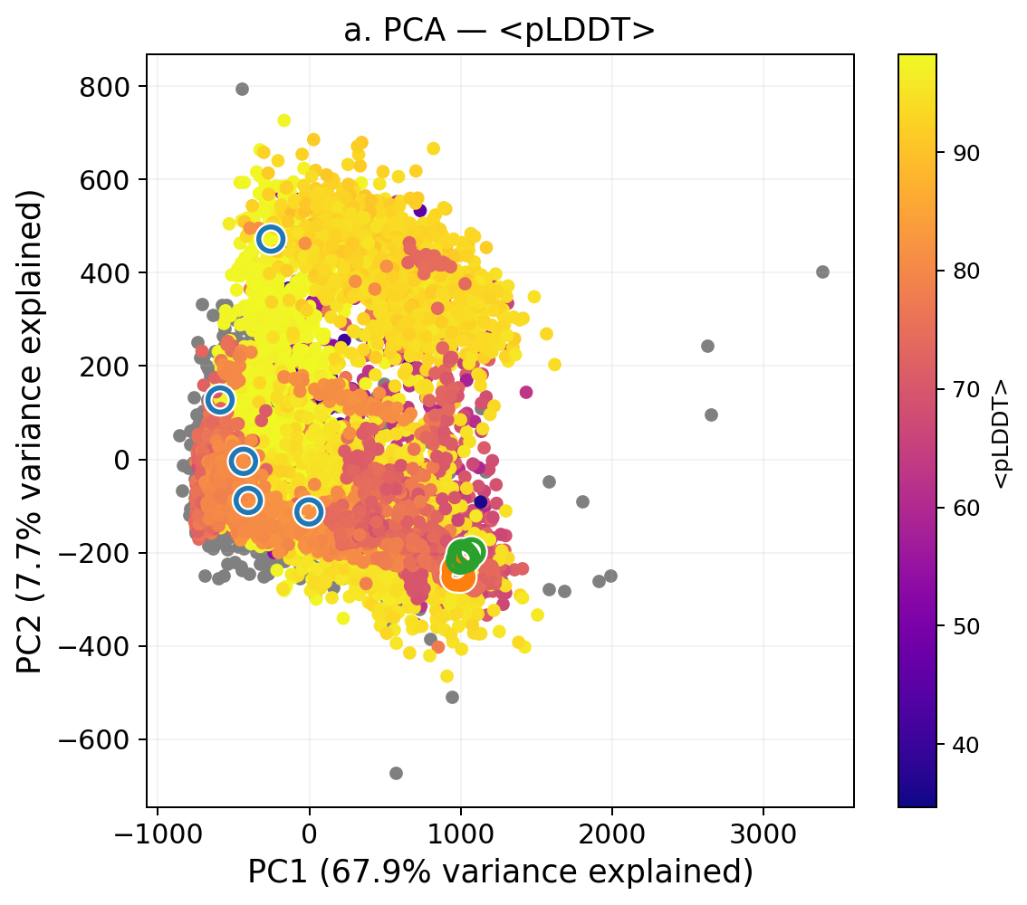
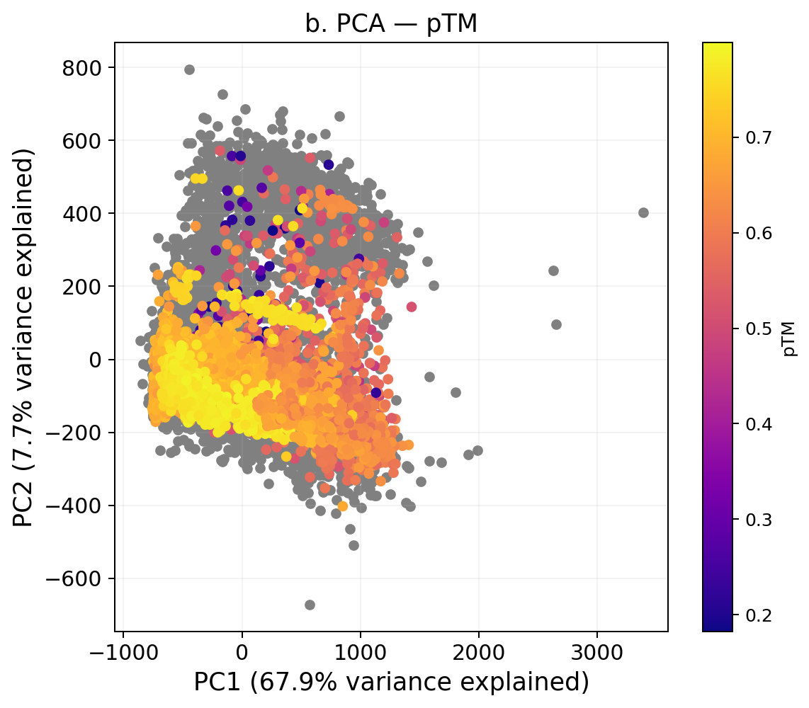
Figure 3. PCA embedding of shared-residue distograms, colored by confidence metrics. a: <pLDDT>; b: pTM. Cluster-colored outlines in panel a identify the selected representative models from each structure cluster ensemble. Gray models do not have this value calculable.
Notes:
Target: SR215_bmr6366_largest_child
Confidence panels: [{"scheme_key":"db_mean_plddt","scheme_name":"<pLDDT>","image":"[private source path] <pLDDT>","width":1134,"height":1000},{"scheme_key":"db_ptm","scheme_name":"pTM","image":"[private source path] pTM","width":1142,"height":1000}]

Slide 6
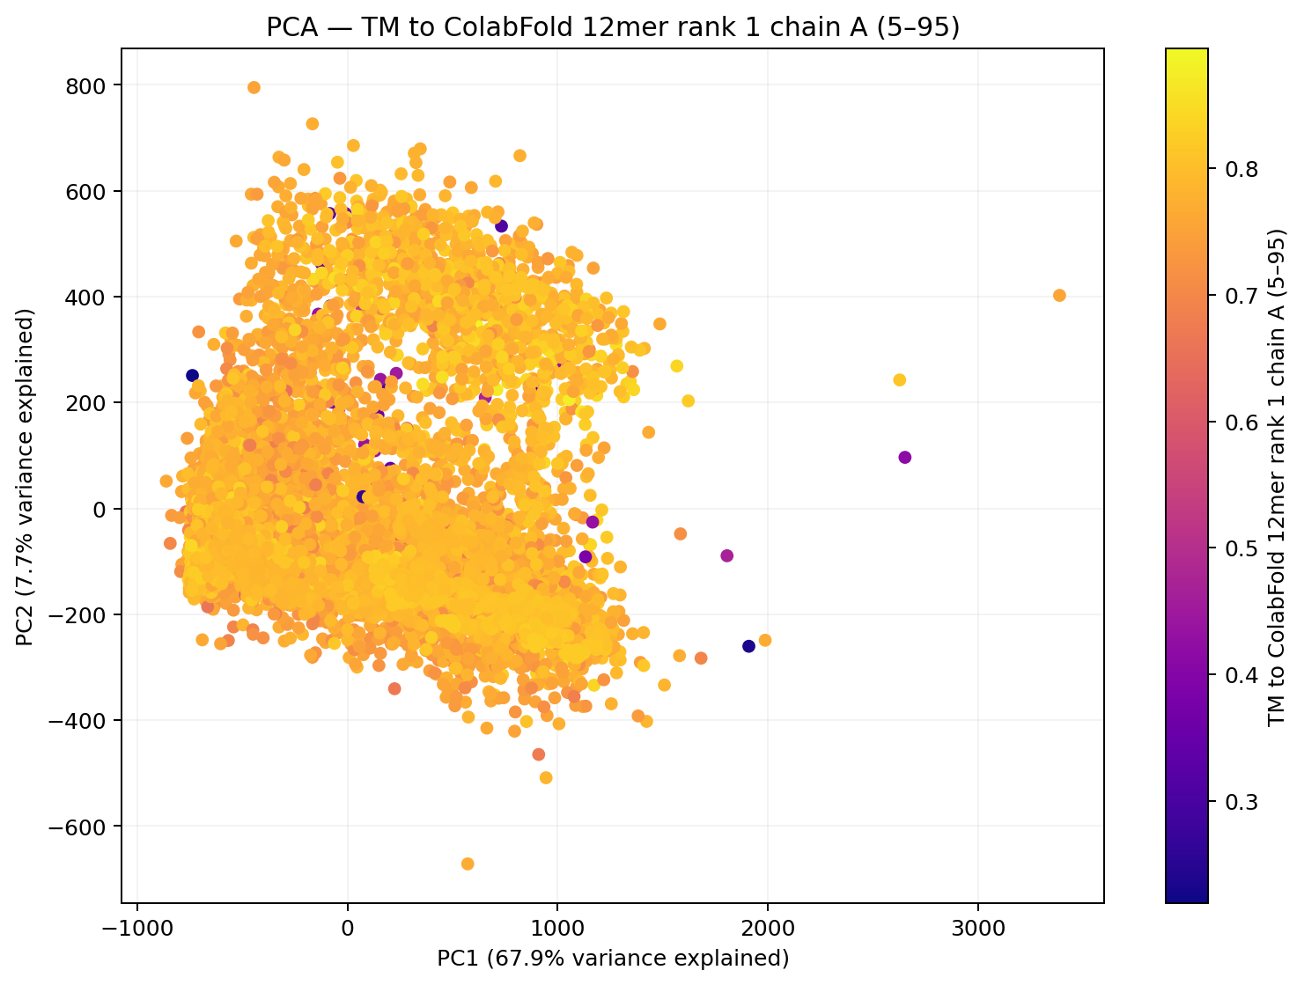
Figure 4. PCA embedding of shared-residue distograms, colored by TM to ColabFold 12mer rank 1 chain A (5–95).
Notes:
Target: SR215_bmr6366_largest_child
Source figure: clustering/pca/pca_db_tm_colabfold12_rank1_chainA_res5_95_2c023cd6.png
Figure 4. PCA embedding of shared-residue distograms, colored by TM to ColabFold 12mer rank 1 chain A (5–95).

Slide 7
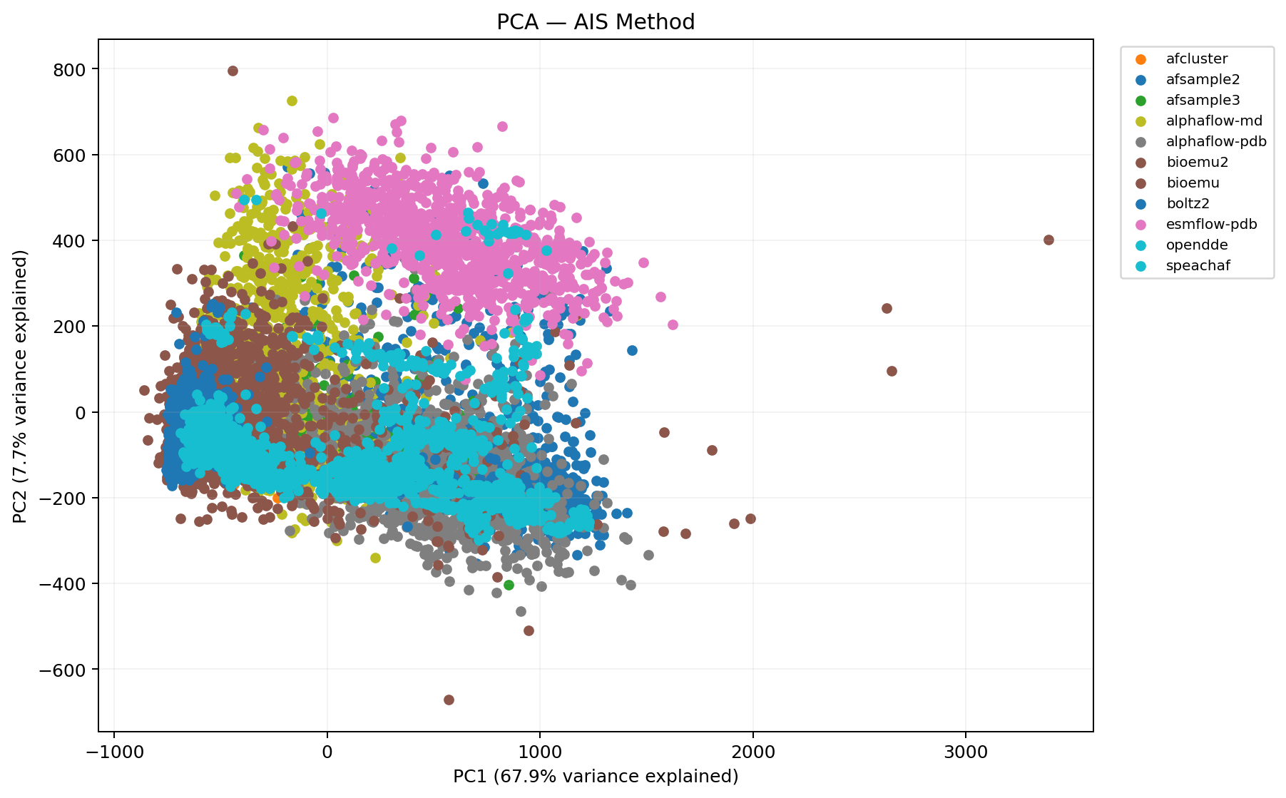
Figure 5. PCA embedding of shared-residue distograms, colored by AIS Method.
Notes:
Target: SR215_bmr6366_largest_child
Source figure: clustering/pca/pca_dbcat_ais_method_ae4ac7fd.png
Figure 5. PCA embedding of shared-residue distograms, colored by AIS Method.

Slide 8
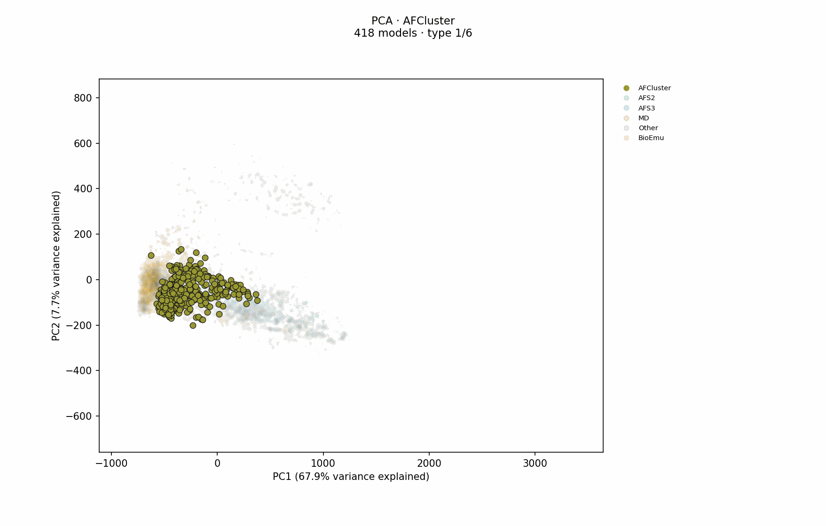
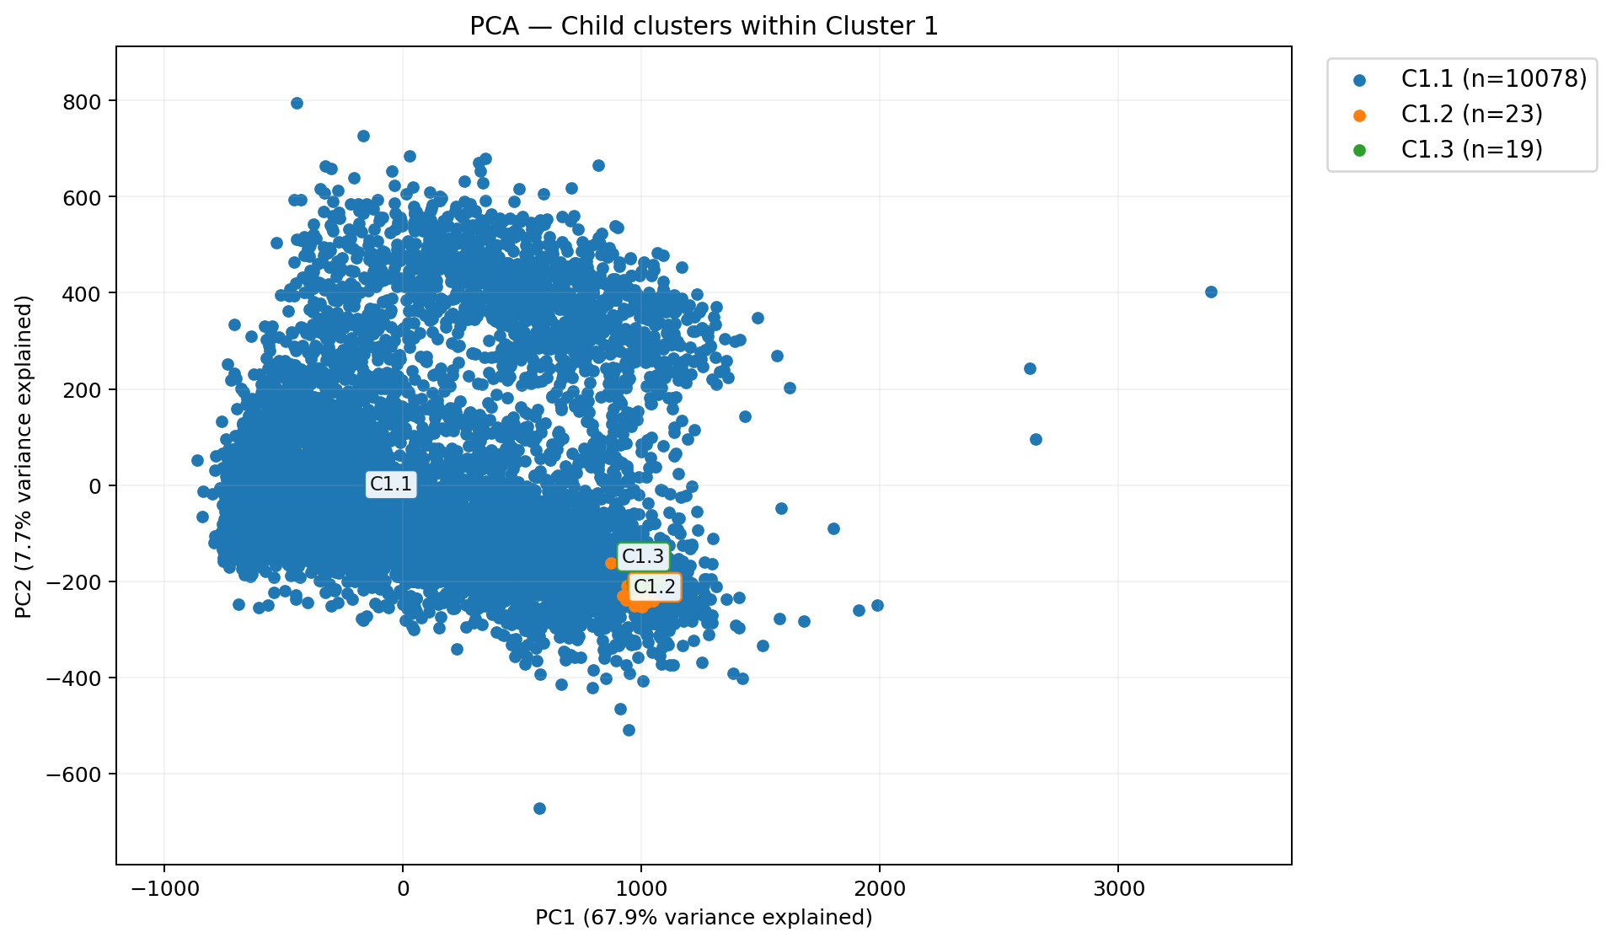
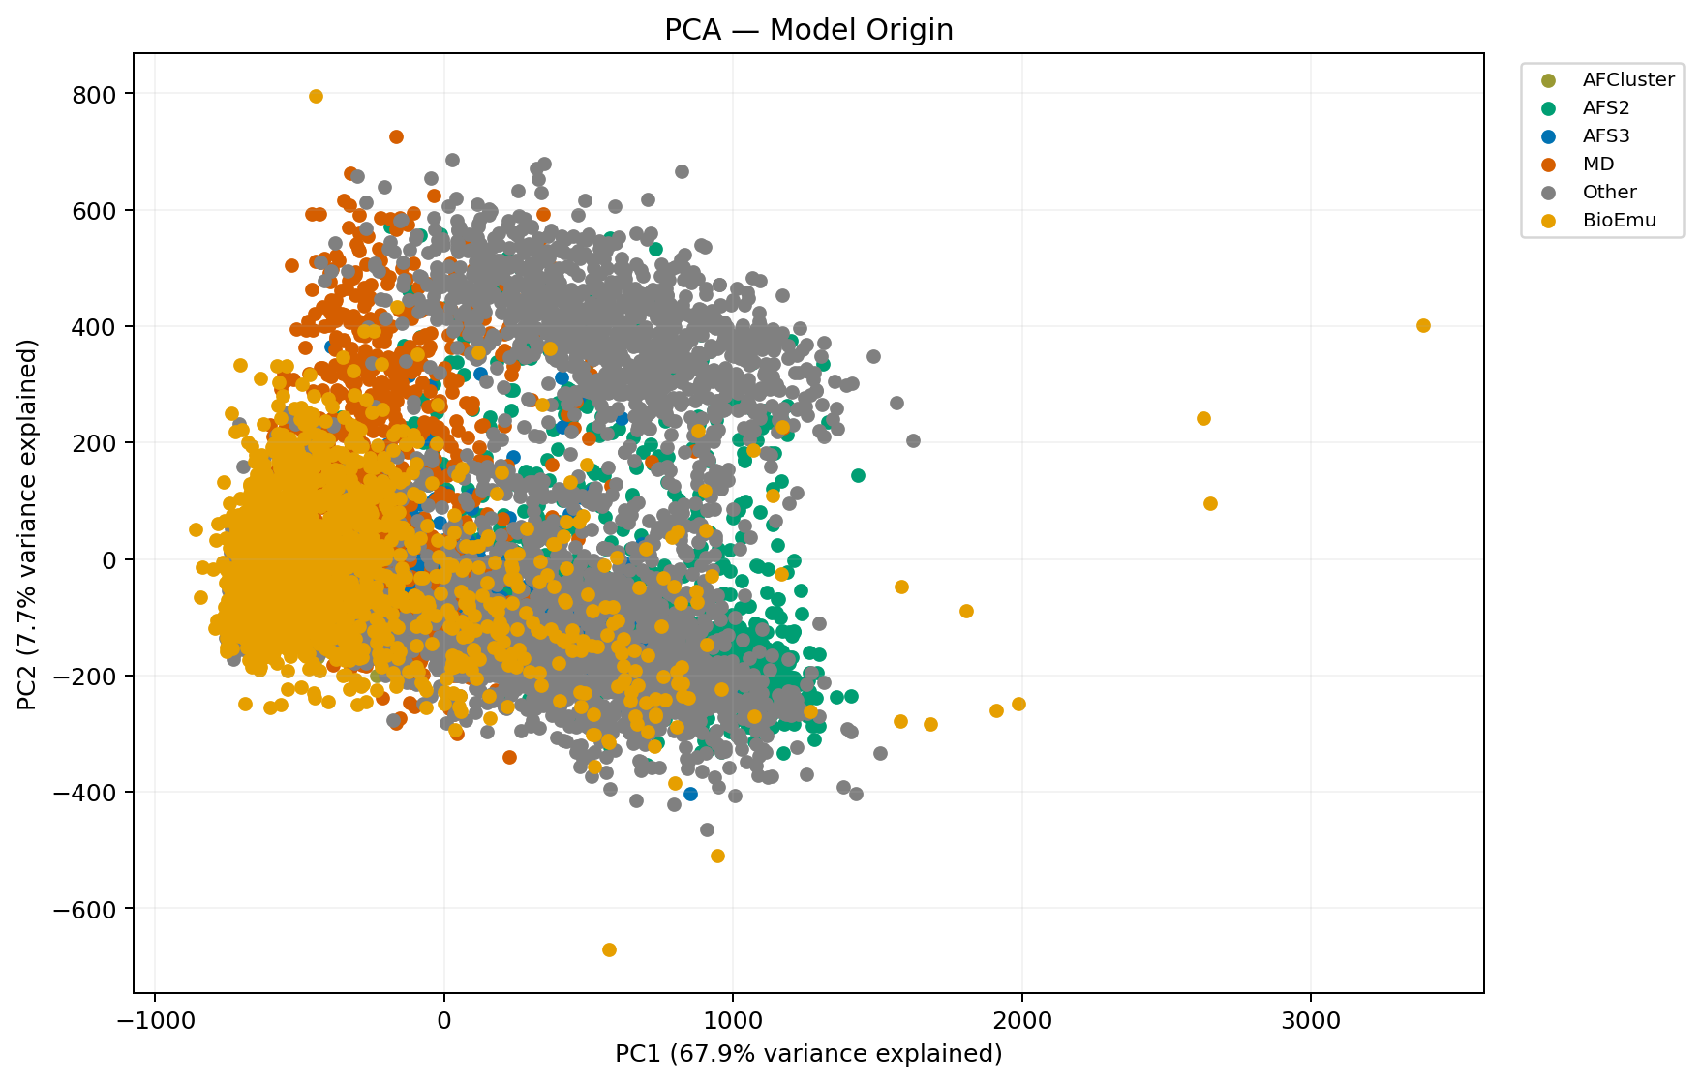
a. Cluster labels
b. Model types
Figure 6. PCA projection of shared-residue distograms. a: cluster labels assigned from UMAP; cluster colors are consistent across projections. b: model type labels; each model type uses its consistent color across workflow runs.
Notes:
Target: SR215_bmr6366_largest_child
Confidence panels: [{"scheme_key":"workflow_umap_knn_clusters","scheme_name":"Child clusters within Cluster 1","image":"[private source path] Cluster labels","width":1913,"height":1119},{"scheme_key":"config::model_origin","scheme_name":"Model Origin","image":"[private source path] Model types","width":1757,"height":1119,"model_type_gif":"[private source path]

Slide 9
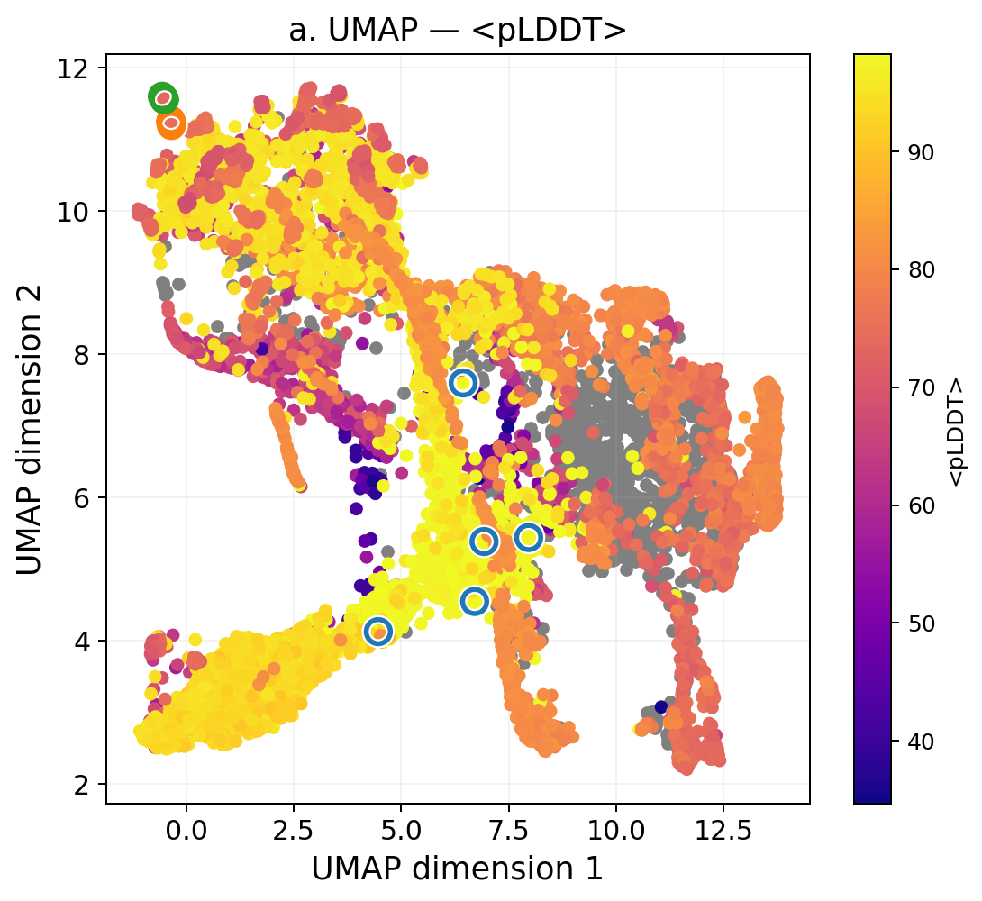
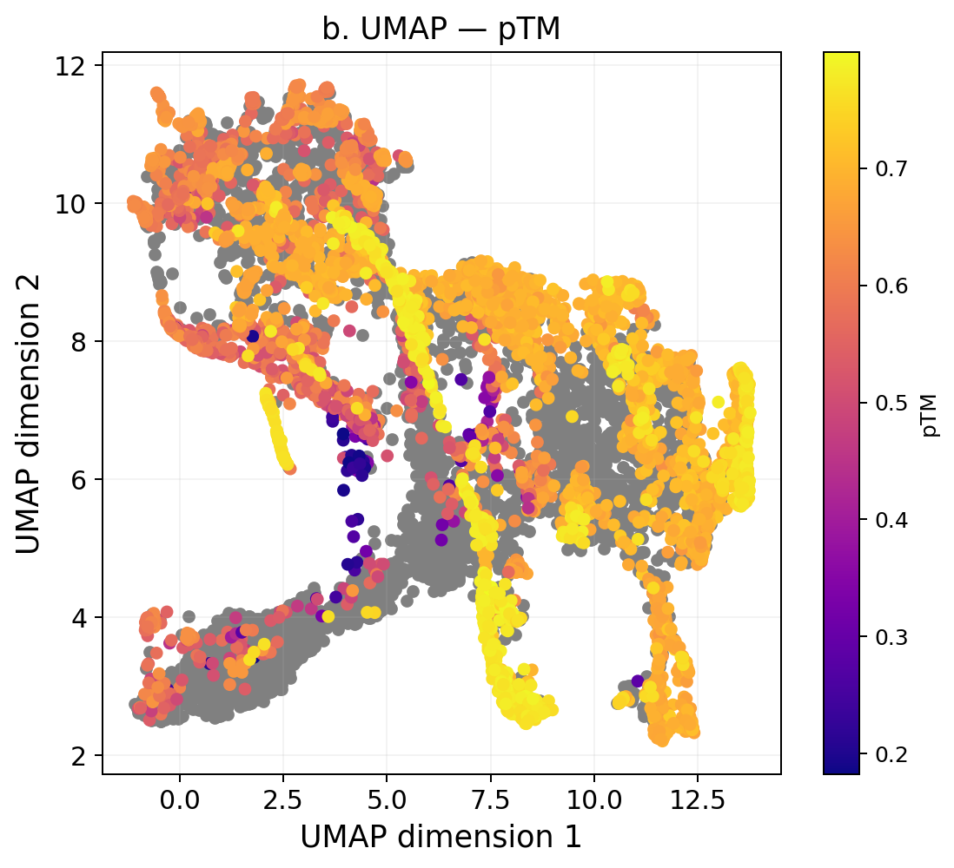
Figure 7. UMAP embedding of shared-residue distograms, colored by confidence metrics. a: <pLDDT>; b: pTM. Cluster-colored outlines in panel a identify the selected representative models from each structure cluster ensemble. Gray models do not have this value calculable.
Notes:
Target: SR215_bmr6366_largest_child
Confidence panels: [{"scheme_key":"db_mean_plddt","scheme_name":"<pLDDT>","image":"[private source path] <pLDDT>","width":1090,"height":1000},{"scheme_key":"db_ptm","scheme_name":"pTM","image":"[private source path] pTM","width":1098,"height":1000}]

Slide 10
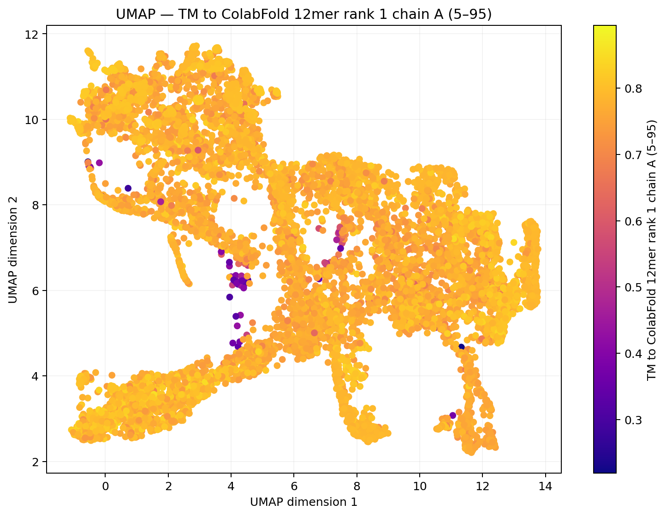
Figure 8. UMAP embedding of shared-residue distograms, colored by TM to ColabFold 12mer rank 1 chain A (5–95).
Notes:
Target: SR215_bmr6366_largest_child
Source figure: clustering/umap/umap_db_tm_colabfold12_rank1_chainA_res5_95_2c023cd6.png
Figure 8. UMAP embedding of shared-residue distograms, colored by TM to ColabFold 12mer rank 1 chain A (5–95).

Slide 11
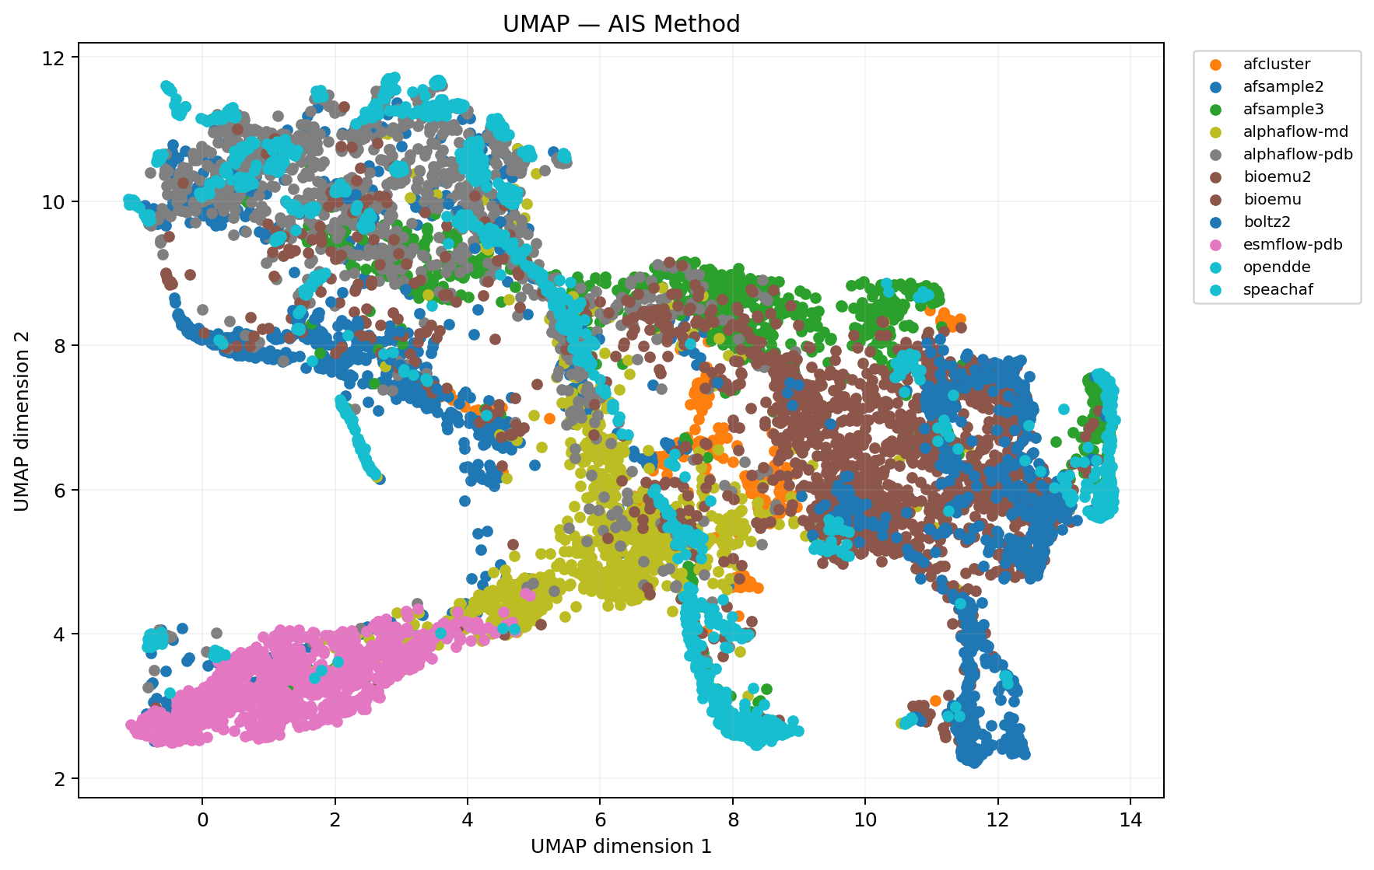
Figure 9. UMAP embedding of shared-residue distograms, colored by AIS Method.
Notes:
Target: SR215_bmr6366_largest_child
Source figure: clustering/umap/umap_dbcat_ais_method_ae4ac7fd.png
Figure 9. UMAP embedding of shared-residue distograms, colored by AIS Method.

Slide 12
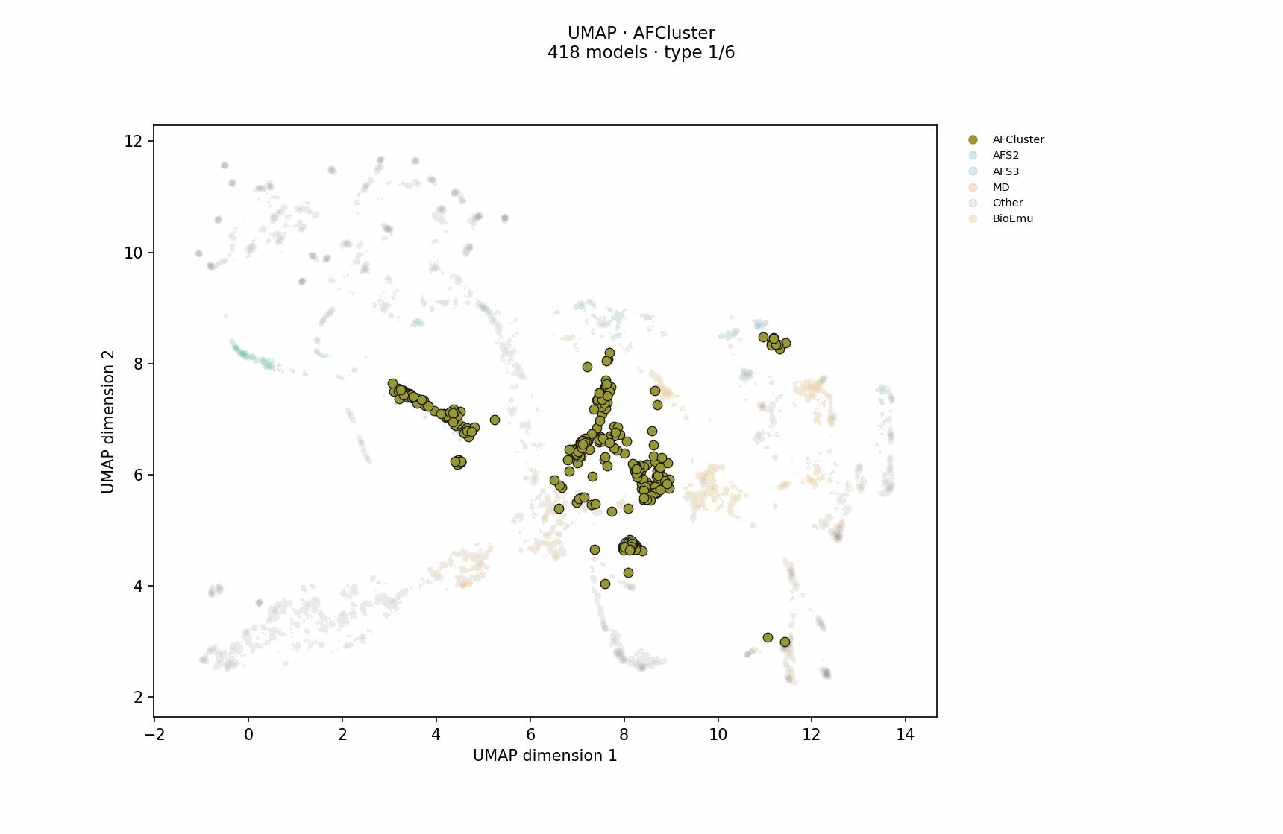
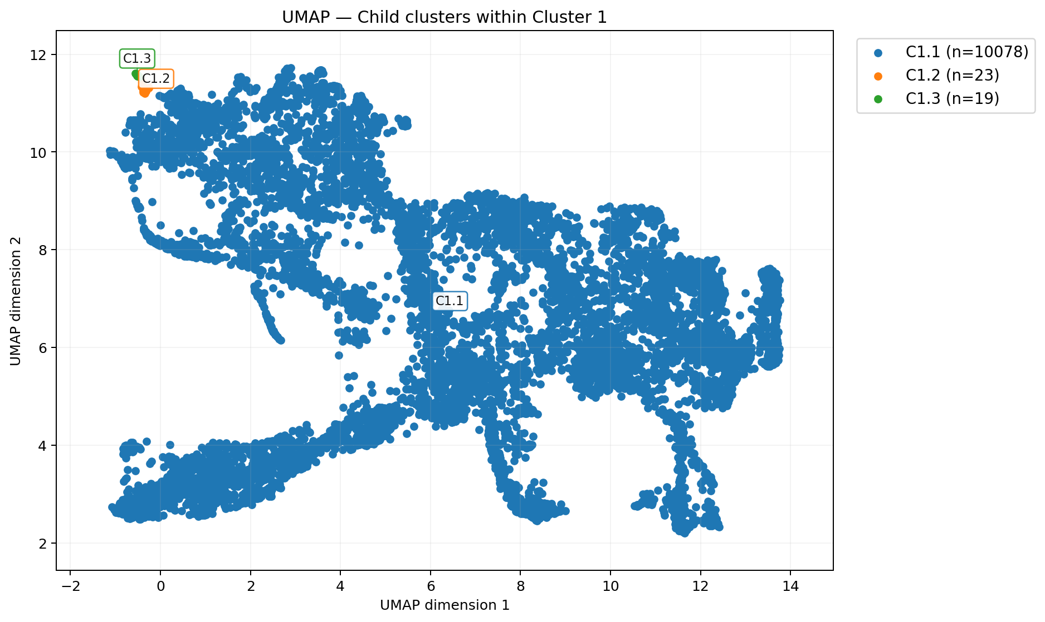
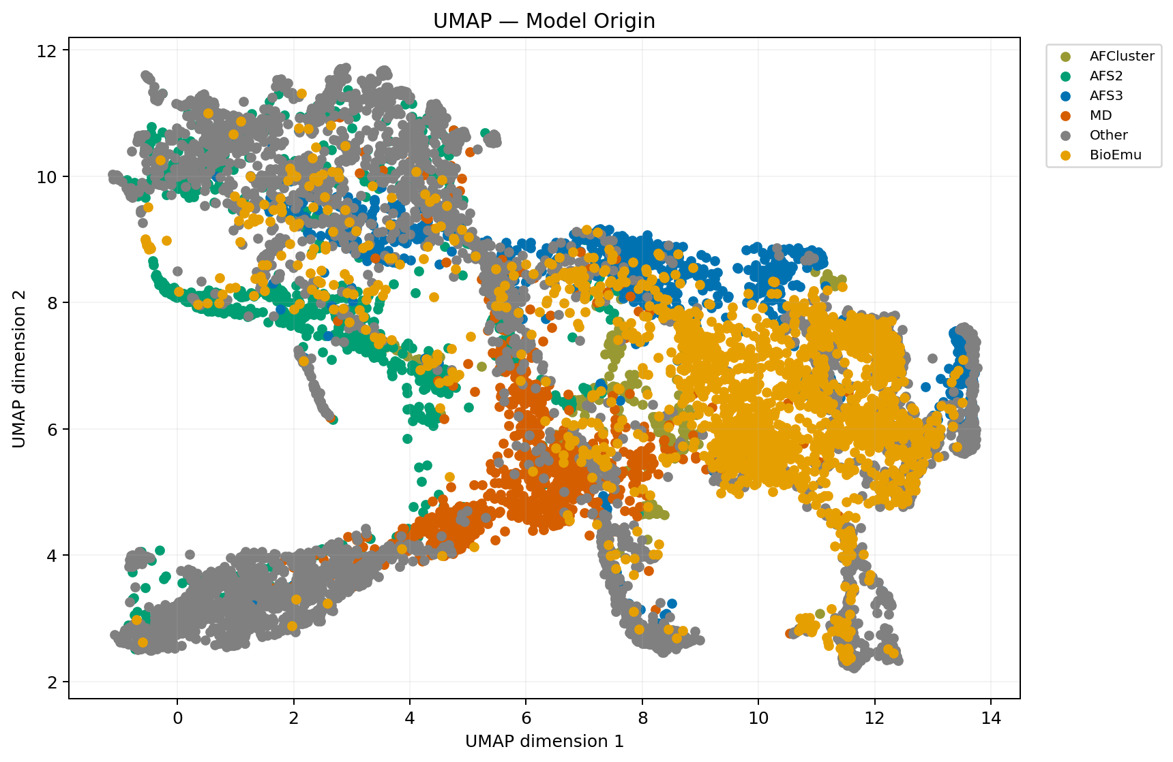
a. Cluster labels
b. Model types
Figure 10. UMAP projection of shared-residue distograms. a: cluster labels assigned from UMAP; cluster colors are consistent across projections. b: model type labels; each model type uses its consistent color across workflow runs.
Notes:
Target: SR215_bmr6366_largest_child
Confidence panels: [{"scheme_key":"workflow_umap_knn_clusters","scheme_name":"Child clusters within Cluster 1","image":"[private source path] Cluster labels","width":1876,"height":1119},{"scheme_key":"config::model_origin","scheme_name":"Model Origin","image":"[private source path] Model types","width":1720,"height":1119,"model_type_gif":"[private source path]

Slide 13
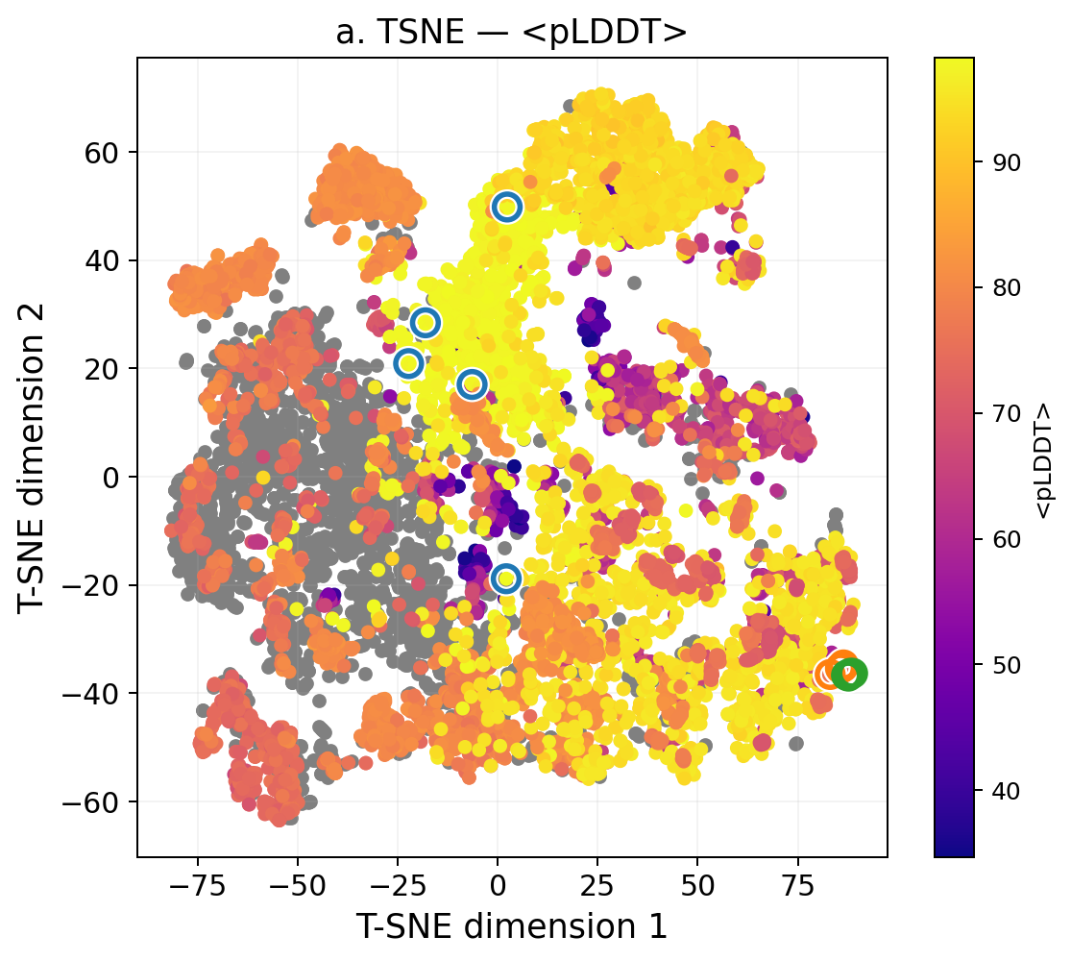
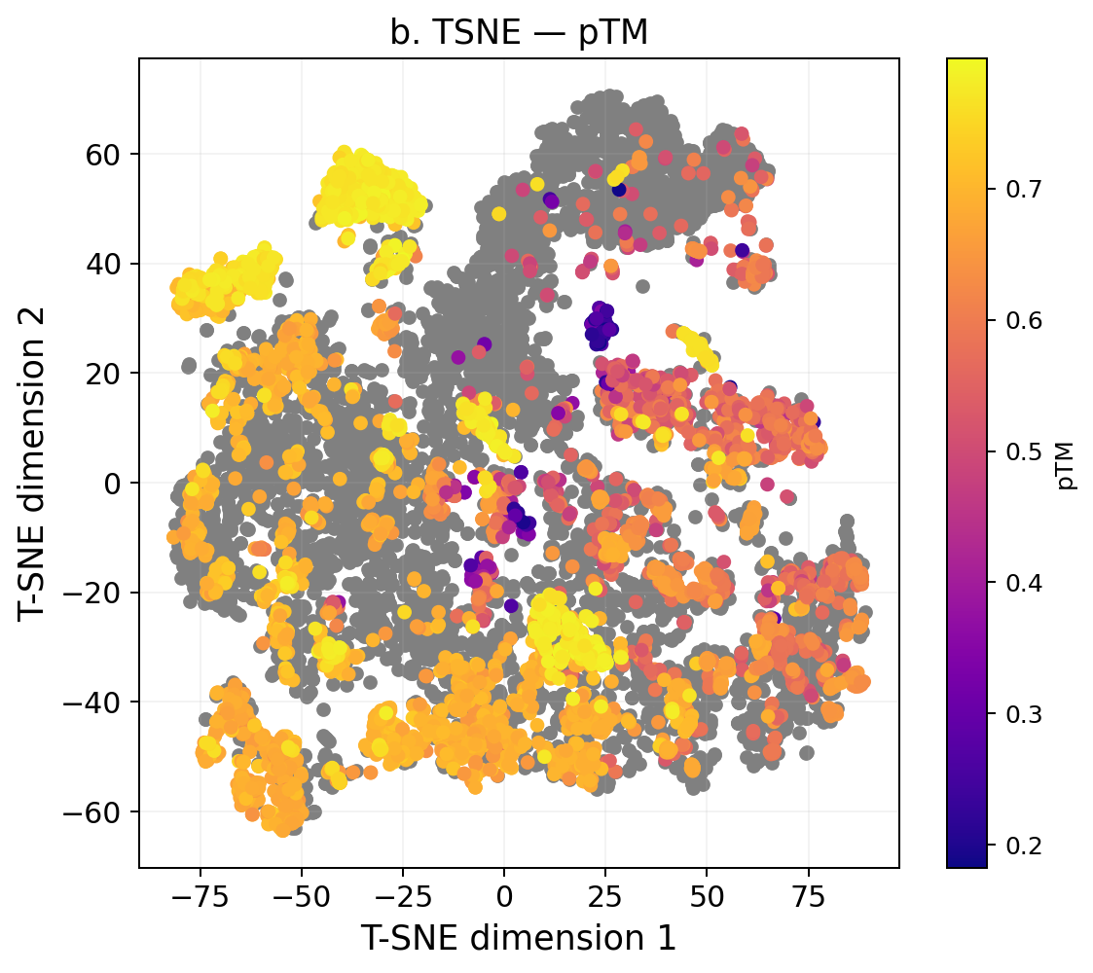
Figure 11. t-SNE embedding of shared-residue distograms, colored by confidence metrics. a: <pLDDT>; b: pTM. Cluster-colored outlines in panel a identify the selected representative models from each structure cluster ensemble. Gray models do not have this value calculable.
Notes:
Target: SR215_bmr6366_largest_child
Confidence panels: [{"scheme_key":"db_mean_plddt","scheme_name":"<pLDDT>","image":"[private source path] <pLDDT>","width":1115,"height":1000},{"scheme_key":"db_ptm","scheme_name":"pTM","image":"[private source path] pTM","width":1123,"height":1000}]

Slide 14
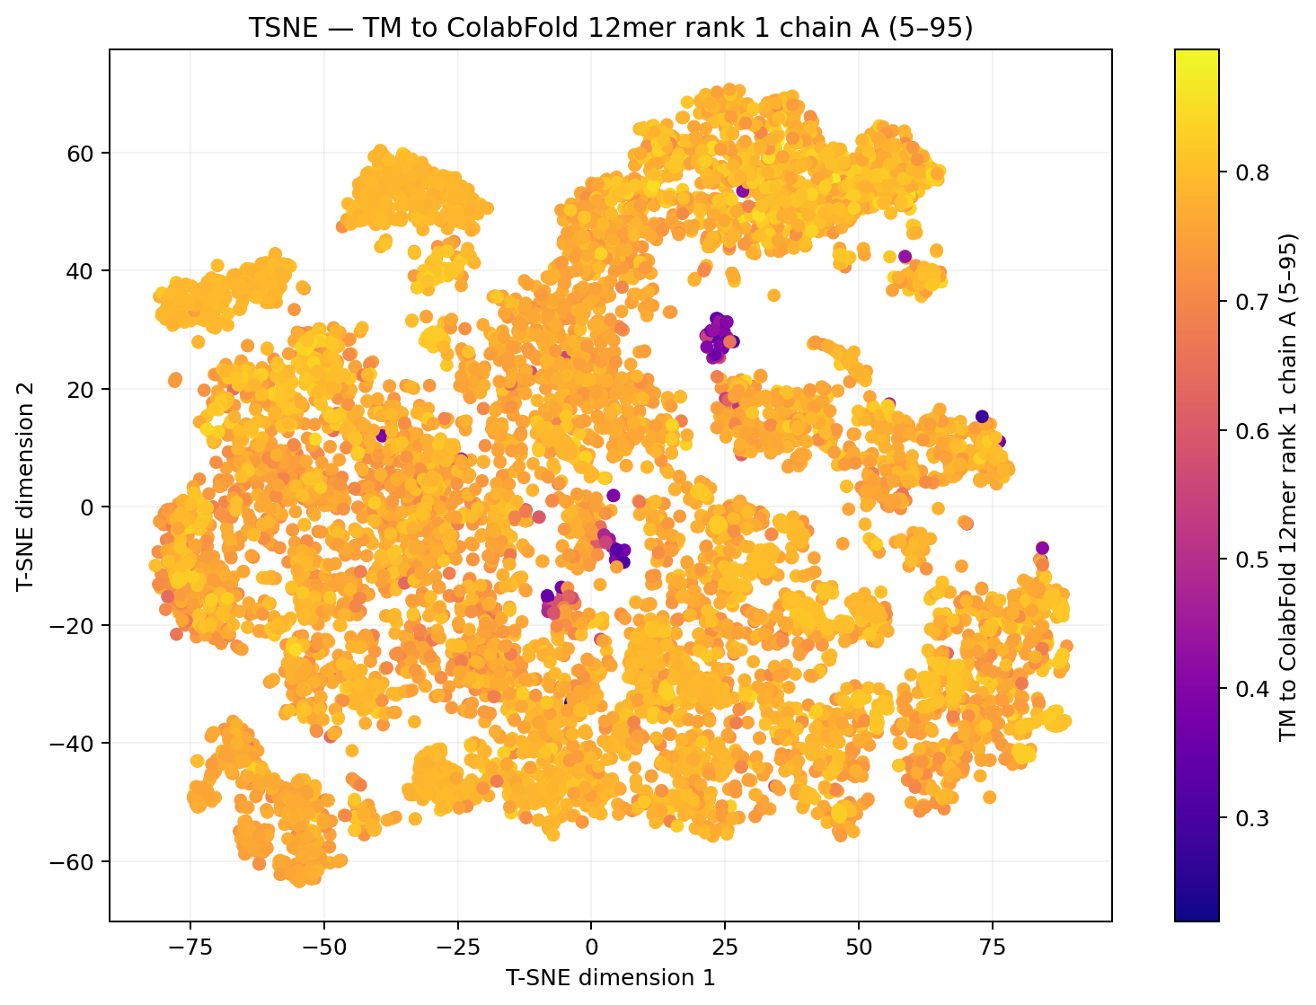
Figure 12. t-SNE embedding of shared-residue distograms, colored by TM to ColabFold 12mer rank 1 chain A (5–95).
Notes:
Target: SR215_bmr6366_largest_child
Source figure: clustering/tsne/tsne_db_tm_colabfold12_rank1_chainA_res5_95_2c023cd6.png
Figure 12. t-SNE embedding of shared-residue distograms, colored by TM to ColabFold 12mer rank 1 chain A (5–95).

Slide 15
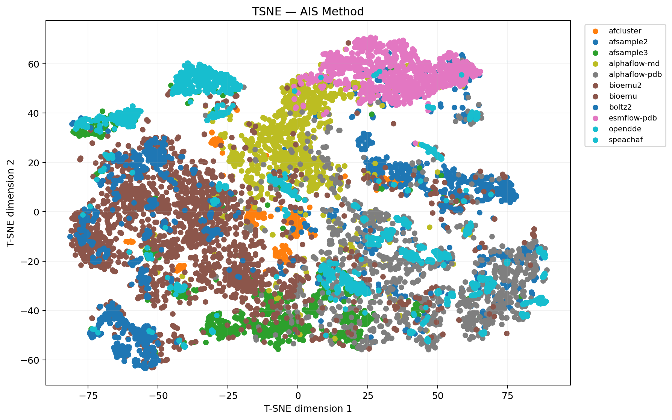
Figure 13. t-SNE embedding of shared-residue distograms, colored by AIS Method.
Notes:
Target: SR215_bmr6366_largest_child
Source figure: clustering/tsne/tsne_dbcat_ais_method_ae4ac7fd.png
Figure 13. t-SNE embedding of shared-residue distograms, colored by AIS Method.

Slide 16
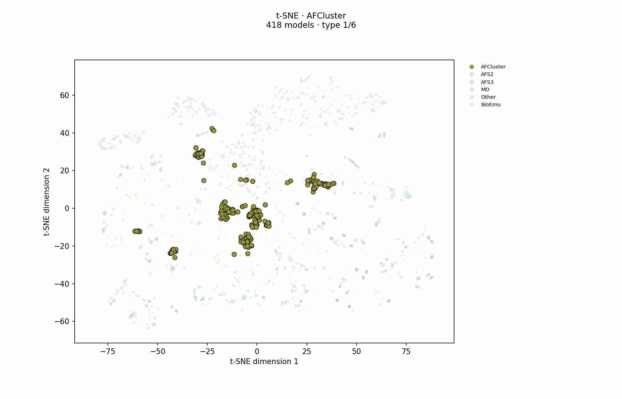
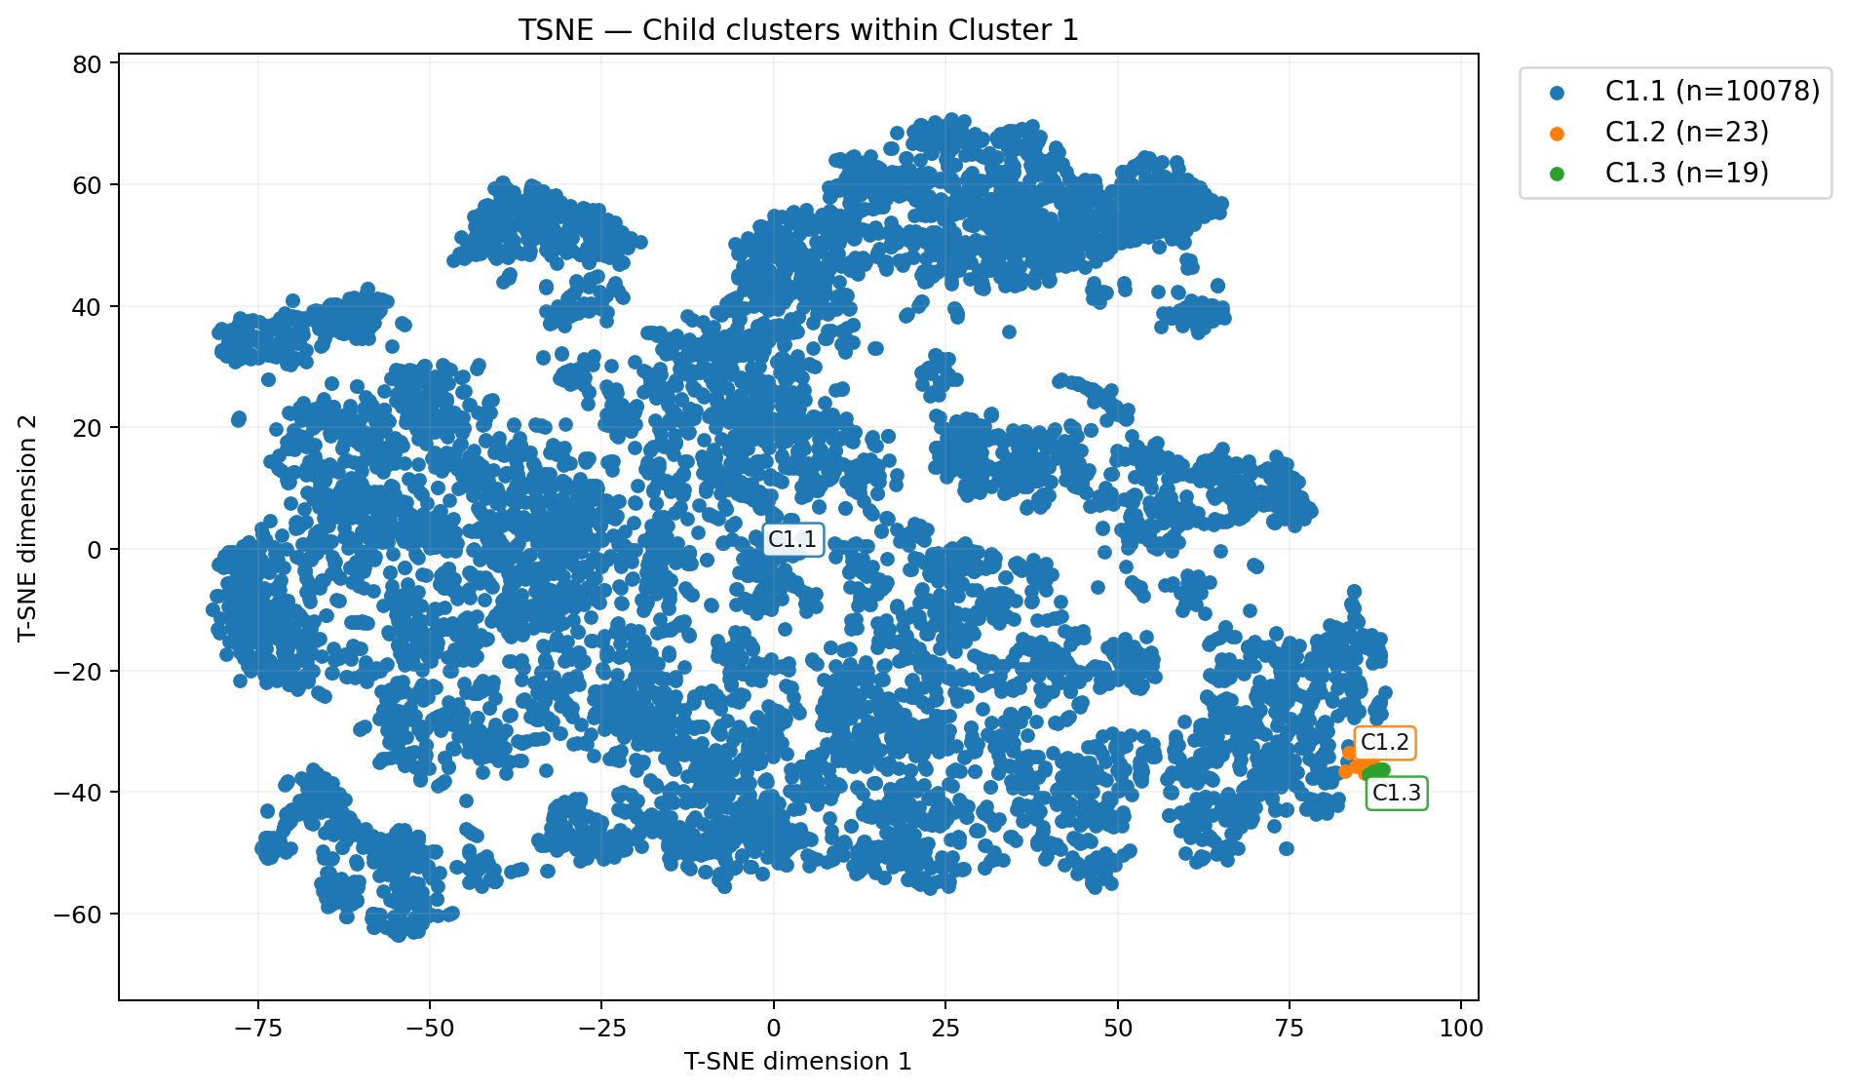
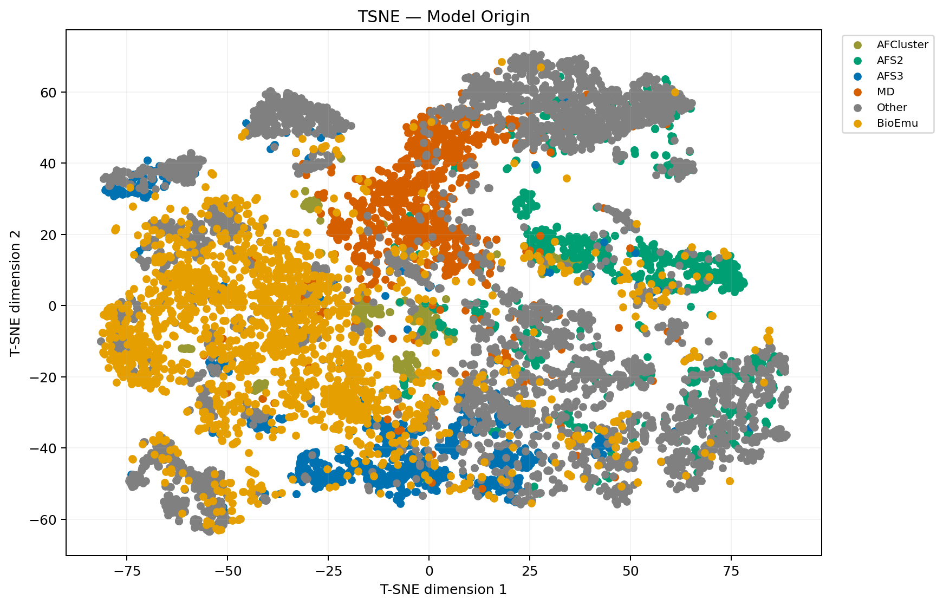
a. Cluster labels
b. Model types
Figure 14. t-SNE projection of shared-residue distograms. a: cluster labels assigned from UMAP; cluster colors are consistent across projections. b: model type labels; each model type uses its consistent color across workflow runs.
Notes:
Target: SR215_bmr6366_largest_child
Confidence panels: [{"scheme_key":"workflow_umap_knn_clusters","scheme_name":"Child clusters within Cluster 1","image":"[private source path] Cluster labels","width":1897,"height":1119},{"scheme_key":"config::model_origin","scheme_name":"Model Origin","image":"[private source path] Model types","width":1741,"height":1119,"model_type_gif":"[private source path]

Slide 17
a. C1.1
b. C1.2
c. C1.3
Figure 15. Cluster ensembles (up to 5 models each), aligned to each full-cluster Cα RMSD medoid. Eligible models ranked by <pLDDT>; representative selection follows the recorded source scope.
Notes:
{"ensemble_panels":[{"image":"[private source path] C1.1","crop":{"left":0.18833333333333332,"top":0.14818181818181816,"right":0.3133333333333334,"bottom":0.06090909090909095},"display_width":896.9999999999999,"display_height":870,"cluster_label":"C1.1","selected_count":5},{"image":"[private source path] C1.2","crop":{"left":0.18833333333333332,"top":0.14818181818181816,"right":0.3133333333333334,"bottom":0.06090909090909095},"display_width":896.9999999999999,"display_height":870,"cluster_label":"C1.2","selected_count":5},{"image":"[private source path] C1.3","crop":{"left":0.18833333333333332,"top":0.14818181818181816,"right":0.3133333333333334,"bottom":0.06090909090909095},"display_width":896.9999999999999,"display_height":870,"cluster_label":"C1.3","selected_count":5}],"caption":"Figure 15. Cluster ensembles (up to 5 models each), aligned to each full-cluster Cα RMSD medoid. Eligible models ranked by <pLDDT>; representative selection follows the recorded source scope."}

Slide 18
Cluster confidence distributions
C1.1
C1.2
C1.3
Figure 16. Cluster confidence distributions. Colored outlines show eligible cluster members with confidence scores; black dots mark the displayed models. Eligible models ranked by <pLDDT>; representative selection follows the recorded source scope.
Notes:
{"confidence_grid":{"metric":"mean_plddt","metric_label":"<pLDDT>","y_bounds":[30,100],"major_unit":5,"violin_series":[{"cluster_label":"C1.1","color":"#1f77b4","x":[-0.003568043003088309,-0.004370660245512912,-0.005254158860551778,-0.0062227176918501275,-0.007276499636751431,-0.008402834462061567,-0.009568434465392177,-0.010716572839453624,-0.011771845120155758,-0.012652415732154303,-0.01328663208974423,-0.013628917932057859,-0.013669853759236864,-0.013437336194898744,-0.012988809549461426,-0.012397478994135755,-0.01173703841364068,-0.011069316890535592,-0.010437638616346176,-0.009866376792610407,-0.009365077492694256,-0.008934360874397319,-0.008570894060868988,-0.008269898277245485,-0.008025304053693552,-0.007829018427498353,-0.007671193535537315,-0.007542723579322264,-0.007439828832523827,-0.0073692432680163775,-0.007351910308510127,-0.0074235257677924636,-0.007631525838480403,-0.008029564048402207,-0.008671430320168465,-0.009606290233516685,-0.010876117940990393,-0.012514798523915764,-0.014547345220487633,-0.016987621116699384,-0.019834010996089575,-0.02306421973734104,-0.02663192408290295,-0.03046845795123976,-0.03449151030213258,-0.03862010263211673,-0.042791855518217924,-0.04697630147403401,-0.051178249454675924,-0.05542851738686608,-0.059764713048003,-0.06420972444633553,-0.06875744295907688,-0.07337255622008676,-0.07800496197723672,-0.08261250137432925,-0.0871817740607693,-0.09173772014438396,-0.09633775914376524,-0.10105279152204331,-0.1059421633531705,-0.11103106809079433,-0.1162972362557644,-0.12167094520293002,-0.12704999341363368,-0.13232959289499754,-0.13744506807345722,-0.1424215653343405,-0.14741967202155823,-0.15276080342286835,-0.15891463157174662,-0.16643568329228775,-0.1758485934255972,-0.1874993383076446,-0.20140787145265743,-0.2171687880731436,-0.2339444577697379,-0.25057674271690483,-0.2658121112682285,-0.2785993601733462,-0.288390378478834,-0.2953615574853779,-0.30048071022111095,-0.30537083205572524,-0.3119639747295309,-0.32199085773122355,-0.3364069659142051,-0.35490059220640974,-0.37564340425969844,-0.3954106781124894,-0.41010986942688216,-0.41563014250822866,-0.4088041728439857,-0.38820929945812194,-0.3545645174167669,-0.31060128191439695,-0.2604555837022673,-0.2087786041414574,-0.1598348654103035,-0.11682847259630001,-0.08159255873992566,-0.054646032900069946,-0.035517979248268695,-0.023193955336597252,-0.016549931941141932,-0.014686185533722489,-0.017126154527658196,-0.023882937761960616,-0.035411827410076854,-0.052466839279727534,-0.07587499924842044,-0.10624596394573255,-0.1436518798579945,-0.18733913998124443,-0.23555638606425602,-0.28558330737997867,-0.33400801600228763,-0.3772271616431229,-0.41205410996467917,-0.43625601856726165,-0.44884113061262565,-0.45,-0.44074347186266394,-0.422412297578891,-0.39628643649680134,-0.3634599975035001,-0.32499787947874326,-0.282233855577131,0.282233855577131,0.32499787947874326,0.3634599975035001,0.39628643649680134,0.422412297578891,0.44074347186266394,0.45,0.44884113061262565,0.43625601856726165,0.41205410996467917,0.3772271616431229,0.33400801600228763,0.28558330737997867,0.23555638606425602,0.18733913998124443,0.1436518798579945,0.10624596394573255,0.07587499924842044,0.052466839279727534,0.035411827410076854,0.023882937761960616,0.017126154527658196,0.014686185533722489,0.016549931941141932,0.023193955336597252,0.035517979248268695,0.054646032900069946,0.08159255873992566,0.11682847259630001,0.1598348654103035,0.2087786041414574,0.2604555837022673,0.31060128191439695,0.3545645174167669,0.38820929945812194,0.4088041728439857,0.41563014250822866,0.41010986942688216,0.3954106781124894,0.37564340425969844,0.35490059220640974,0.3364069659142051,0.32199085773122355,0.3119639747295309,0.30537083205572524,0.30048071022111095,0.2953615574853779,0.288390378478834,0.2785993601733462,0.2658121112682285,0.25057674271690483,0.2339444577697379,0.2171687880731436,0.20140787145265743,0.1874993383076446,0.1758485934255972,0.16643568329228775,0.15891463157174662,0.15276080342286835,0.14741967202155823,0.1424215653343405,0.13744506807345722,0.13232959289499754,0.12704999341363368,0.12167094520293002,0.1162972362557644,0.11103106809079433,0.1059421633531705,0.10105279152204331,0.09633775914376524,0.09173772014438396,0.0871817740607693,0.08261250137432925,0.07800496197723672,0.07337255622008676,0.06875744295907688,0.06420972444633553,0.059764713048003,0.05542851738686608,0.051178249454675924,0.04697630147403401,0.042791855518217924,0.03862010263211673,0.03449151030213258,0.03046845795123976,0.02663192408290295,0.02306421973734104,0.019834010996089575,0.016987621116699384,0.014547345220487633,0.012514798523915764,0.010876117940990393,0.009606290233516685,0.008671430320168465,0.008029564048402207,0.007631525838480403,0.0074235257677924636,0.007351910308510127,0.0073692432680163775,0.007439828832523827,0.007542723579322264,0.007671193535537315,0.007829018427498353,0.008025304053693552,0.008269898277245485,0.008570894060868988,0.008934360874397319,0.009365077492694256,0.009866376792610407,0.010437638616346176,0.011069316890535592,0.01173703841364068,0.012397478994135755,0.012988809549461426,0.013437336194898744,0.013669853759236864,0.013628917932057859,0.01328663208974423,0.012652415732154303,0.011771845120155758,0.010716572839453624,0.009568434465392177,0.008402834462061567,0.007276499636751431,0.0062227176918501275,0.005254158860551778,0.004370660245512912,0.003568043003088309,-0.003568043003088309],"y":[34.70697841726619,35.20735579745058,35.70773317763497,36.20811055781936,36.70848793800375,37.20886531818814,37.70924269837253,38.20962007855692,38.709997458741306,39.210374838925695,39.710752219110084,40.21112959929447,40.71150697947886,41.21188435966325,41.712261739847634,42.21263912003202,42.71301650021641,43.2133938804008,43.71377126058519,44.21414864076958,44.71452602095397,45.21490340113836,45.71528078132275,46.215658161507136,46.716035541691525,47.216412921875914,47.7167903020603,48.21716768224469,48.71754506242908,49.21792244261347,49.71829982279786,50.21867720298225,50.71905458316664,51.21943196335103,51.71980934353542,52.220186723719806,52.720564103904195,53.220941484088584,53.72131886427297,54.22169624445736,54.72207362464175,55.22245100482614,55.72282838501053,56.22320576519492,56.72358314537931,57.2239605255637,57.72433790574809,58.224715285932476,58.725092666116865,59.225470046301254,59.72584742648564,60.22622480667003,60.72660218685442,61.22697956703881,61.7273569472232,62.22773432740759,62.72811170759197,63.22848908777636,63.72886646796075,64.22924384814513,64.72962122832953,65.22999860851391,65.73037598869831,66.23075336888269,66.73113074906709,67.23150812925147,67.73188550943587,68.23226288962024,68.73264026980465,69.23301764998902,69.73339503017343,70.2337724103578,70.7341497905422,71.23452717072658,71.73490455091098,72.23528193109536,72.73565931127976,73.23603669146414,73.73641407164854,74.23679145183291,74.73716883201732,75.23754621220169,75.73792359238608,76.23830097257047,76.73867835275486,77.23905573293925,77.73943311312364,78.23981049330803,78.74018787349242,79.2405652536768,79.7409426338612,80.24132001404558,80.74169739422997,81.24207477441436,81.74245215459875,82.24282953478314,82.74320691496753,83.24358429515192,83.74396167533631,84.2443390555207,84.74471643570509,85.24509381588948,85.74547119607386,86.24584857625825,86.74622595644264,87.24660333662703,87.74698071681142,88.24735809699581,88.7477354771802,89.24811285736459,89.74849023754898,90.24886761773337,90.74924499791774,91.24962237810215,91.74999975828652,92.25037713847092,92.7507545186553,93.2511318988397,93.75150927902408,94.25188665920848,94.75226403939286,95.25264141957726,95.75301879976163,96.25339617994604,96.75377356013041,97.25415094031482,97.75452832049919,98.2549057006836,98.2549057006836,97.75452832049919,97.25415094031482,96.75377356013041,96.25339617994604,95.75301879976163,95.25264141957726,94.75226403939286,94.25188665920848,93.75150927902408,93.2511318988397,92.7507545186553,92.25037713847092,91.74999975828652,91.24962237810215,90.74924499791774,90.24886761773337,89.74849023754898,89.24811285736459,88.7477354771802,88.24735809699581,87.74698071681142,87.24660333662703,86.74622595644264,86.24584857625825,85.74547119607386,85.24509381588948,84.74471643570509,84.2443390555207,83.74396167533631,83.24358429515192,82.74320691496753,82.24282953478314,81.74245215459875,81.24207477441436,80.74169739422997,80.24132001404558,79.7409426338612,79.2405652536768,78.74018787349242,78.23981049330803,77.73943311312364,77.23905573293925,76.73867835275486,76.23830097257047,75.73792359238608,75.23754621220169,74.73716883201732,74.23679145183291,73.73641407164854,73.23603669146414,72.73565931127976,72.23528193109536,71.73490455091098,71.23452717072658,70.7341497905422,70.2337724103578,69.73339503017343,69.23301764998902,68.73264026980465,68.23226288962024,67.73188550943587,67.23150812925147,66.73113074906709,66.23075336888269,65.73037598869831,65.22999860851391,64.72962122832953,64.22924384814513,63.72886646796075,63.22848908777636,62.72811170759197,62.22773432740759,61.7273569472232,61.22697956703881,60.72660218685442,60.22622480667003,59.72584742648564,59.225470046301254,58.725092666116865,58.224715285932476,57.72433790574809,57.2239605255637,56.72358314537931,56.22320576519492,55.72282838501053,55.22245100482614,54.72207362464175,54.22169624445736,53.72131886427297,53.220941484088584,52.720564103904195,52.220186723719806,51.71980934353542,51.21943196335103,50.71905458316664,50.21867720298225,49.71829982279786,49.21792244261347,48.71754506242908,48.21716768224469,47.7167903020603,47.216412921875914,46.716035541691525,46.215658161507136,45.71528078132275,45.21490340113836,44.71452602095397,44.21414864076958,43.71377126058519,43.2133938804008,42.71301650021641,42.21263912003202,41.712261739847634,41.21188435966325,40.71150697947886,40.21112959929447,39.710752219110084,39.210374838925695,38.709997458741306,38.20962007855692,37.70924269837253,37.20886531818814,36.70848793800375,36.20811055781936,35.70773317763497,35.20735579745058,34.70697841726619,34.70697841726619],"scored_count":8088,"cluster_size":10078},{"cluster_label":"C1.2","color":"#ff7f0e","x":[0.9773259368787024,0.9773910444137945,0.9775852474449892,0.9779052192752882,0.9783455208804731,0.9788987547007177,0.9795557713519919,0.9803059211875808,0.9811373410506768,0.982037265445259,0.9829923507572517,0.9839890010937516,0.9850136847572815,0.9860532312890774,0.9870951003309899,0.9881276151819008,0.9891401557618391,0.9901233076401039,0.9910689657290532,0.9919703930967124,0.9928222370257318,0.9936205058768965,0.9943625114550494,0.9950467823968653,0.9956729545962634,0.9962416448654668,0.9967543139245695,0.9972131244589706,0.9976207994297547,0.9979804851192541,0.9982956225959039,0.998569830440091,0.9988068007321171,0.9990102095038463,0.9991836421281004,0.9993305334866964,0.9994541222327463,0.9995574180509598,0.9996431805195546,0.999713907981481,0.9997718347290268,0.9998189347794723,0.9998569305535444,0.9998873048457456,0.9999113145794437,0.9999300049544598,0.9999442227072309,0.999954627302204,0.9999616989492387,0.9999657423894253,0.9999668854075419,0.9999650710127961,0.9999600421825922,0.9999513179916577,0.9999381598584316,0.9999195265423901,0.9998940164329623,0.9998597955985489,0.9998145100313127,0.9997551805506213,0.9996780789381831,0.9995785840952827,0.9994510173619017,0.9992884566430011,0.999082529670664,0.9988231876098012,0.9984984613009975,0.9980942037293123,0.9975938238036526,0.9969780182051173,0.9962245098759239,0.9953078036168774,0.9941989711658629,0.9928654799488209,0.9912710813169541,0.9893757753835255,0.9871358704140777,0.9845041549640335,0.9814302004591542,0.9778608105504654,0.9737406312408379,0.9690129324020431,0.9636205668476417,0.9575071076189717,0.9506181576588278,0.9429028187351639,0.9343152985475216,0.9248166266796527,0.9143764417902465,0.9029748045459772,0.8906039837171649,0.8772701570104753,0.862994964031277,0.8478168466431066,0.8317921122565137,0.8149956584830818,0.7975213032740176,0.7794816731416948,0.7610076132134054,0.7422470964213144,0.7233636246814247,0.7045341319164824,0.6859464165821805,0.6677961492281597,0.6502835177826856,0.6336095889006739,0.617972477100323,0.6035634238504449,0.5905628956899249,0.579136813442922,0.5694330233948028,0.5615781158640871,0.5556746870947462,0.551799127146199,0.55,0.5502970631104138,0.5526809528969595,0.5571135410834608,0.5635289452342553,0.5718351562127695,0.5819162264191833,0.5936349462804357,0.6068359231610665,0.6213489670719108,0.6369926815352127,0.6535781557994504,0.6709126561901553,0.6888032194785593,1.3111967805214406,1.3290873438098447,1.3464218442005496,1.3630073184647873,1.3786510329280892,1.3931640768389335,1.4063650537195644,1.4180837735808167,1.4281648437872305,1.4364710547657447,1.442886458916539,1.4473190471030404,1.4497029368895862,1.45,1.448200872853801,1.4443253129052538,1.4384218841359129,1.4305669766051972,1.420863186557078,1.409437104310075,1.3964365761495552,1.382027522899677,1.3663904110993261,1.3497164822173144,1.3322038507718403,1.3140535834178195,1.2954658680835176,1.2766363753185752,1.2577529035786856,1.2389923867865946,1.2205183268583053,1.2024786967259824,1.1850043415169182,1.1682078877434863,1.1521831533568934,1.137005035968723,1.1227298429895247,1.1093960162828351,1.0970251954540227,1.0856235582097535,1.0751833733203473,1.0656847014524784,1.057097181264836,1.049381842341172,1.0424928923810282,1.0363794331523581,1.0309870675979569,1.0262593687591621,1.0221391894495346,1.0185697995408458,1.0154958450359663,1.0128641295859222,1.0106242246164745,1.008728918683046,1.007134520051179,1.005801028834137,1.0046921963831226,1.003775490124076,1.0030219817948827,1.0024061761963474,1.0019057962706877,1.0015015386990025,1.0011768123901987,1.000917470329336,1.0007115433569989,1.0005489826380982,1.0004214159047173,1.000321921061817,1.0002448194493787,1.0001854899686873,1.0001402044014511,1.0001059835670378,1.0000804734576099,1.0000618401415684,1.0000486820083423,1.000039957817408,1.000034928987204,1.0000331145924581,1.0000342576105747,1.0000383010507612,1.000045372697796,1.000055777292769,1.00006999504554,1.0000886854205562,1.0001126951542543,1.0001430694464555,1.0001810652205279,1.0002281652709732,1.000286092018519,1.0003568194804453,1.0004425819490403,1.0005458777672536,1.0006694665133036,1.0008163578718996,1.0009897904961538,1.0011931992678829,1.001430169559909,1.0017043774040961,1.0020195148807458,1.0023792005702452,1.0027868755410294,1.0032456860754306,1.003758355134533,1.0043270454037367,1.0049532176031348,1.0056374885449506,1.0063794941231035,1.0071777629742682,1.0080296069032877,1.0089310342709468,1.009876692359896,1.0108598442381609,1.011872384818099,1.01290489966901,1.0139467687109225,1.0149863152427185,1.0160109989062482,1.0170076492427482,1.017962734554741,1.018862658949323,1.0196940788124191,1.020444228648008,1.0211012452992823,1.021654479119527,1.0220947807247118,1.0224147525550107,1.0226089555862055,1.0226740631212976,0.9773259368787024],"y":[62.658848920863306,62.76452463668289,62.87020035250248,62.975876068322066,63.08155178414165,63.18722749996124,63.29290321578082,63.398578931600404,63.50425464741999,63.60993036323958,63.715606079059164,63.82128179487875,63.92695751069834,64.03263322651792,64.1383089423375,64.24398465815709,64.34966037397668,64.45533608979626,64.56101180561585,64.66668752143543,64.77236323725502,64.87803895307461,64.9837146688942,65.08939038471378,65.19506610053337,65.30074181635295,65.40641753217254,65.51209324799213,65.61776896381171,65.7234446796313,65.82912039545089,65.93479611127047,66.04047182709004,66.14614754290963,66.25182325872922,66.3574989745488,66.46317469036839,66.56885040618798,66.67452612200756,66.78020183782715,66.88587755364674,66.99155326946632,67.09722898528591,67.2029047011055,67.30858041692508,67.41425613274467,67.51993184856426,67.62560756438384,67.73128328020343,67.83695899602301,67.9426347118426,68.04831042766219,68.15398614348177,68.25966185930136,68.36533757512095,68.47101329094052,68.5766890067601,68.68236472257969,68.78804043839928,68.89371615421886,68.99939187003845,69.10506758585804,69.21074330167762,69.31641901749721,69.4220947333168,69.52777044913638,69.63344616495597,69.73912188077556,69.84479759659514,69.95047331241473,70.05614902823432,70.1618247440539,70.26750045987349,70.37317617569308,70.47885189151265,70.58452760733223,70.69020332315182,70.7958790389714,70.901554754791,71.00723047061058,71.11290618643017,71.21858190224975,71.32425761806934,71.42993333388893,71.53560904970851,71.6412847655281,71.74696048134768,71.85263619716727,71.95831191298686,72.06398762880644,72.16966334462603,72.27533906044562,72.3810147762652,72.48669049208479,72.59236620790438,72.69804192372396,72.80371763954355,72.90939335536314,73.01506907118271,73.1207447870023,73.22642050282188,73.33209621864147,73.43777193446105,73.54344765028064,73.64912336610023,73.75479908191981,73.8604747977394,73.96615051355899,74.07182622937857,74.17750194519816,74.28317766101775,74.38885337683733,74.49452909265692,74.6002048084765,74.70588052429609,74.81155624011568,74.91723195593525,75.02290767175484,75.12858338757442,75.23425910339401,75.3399348192136,75.44561053503318,75.55128625085277,75.65696196667236,75.76263768249194,75.86831339831153,75.97398911413111,76.0796648299507,76.0796648299507,75.97398911413111,75.86831339831153,75.76263768249194,75.65696196667236,75.55128625085277,75.44561053503318,75.3399348192136,75.23425910339401,75.12858338757442,75.02290767175484,74.91723195593525,74.81155624011568,74.70588052429609,74.6002048084765,74.49452909265692,74.38885337683733,74.28317766101775,74.17750194519816,74.07182622937857,73.96615051355899,73.8604747977394,73.75479908191981,73.64912336610023,73.54344765028064,73.43777193446105,73.33209621864147,73.22642050282188,73.1207447870023,73.01506907118271,72.90939335536314,72.80371763954355,72.69804192372396,72.59236620790438,72.48669049208479,72.3810147762652,72.27533906044562,72.16966334462603,72.06398762880644,71.95831191298686,71.85263619716727,71.74696048134768,71.6412847655281,71.53560904970851,71.42993333388893,71.32425761806934,71.21858190224975,71.11290618643017,71.00723047061058,70.901554754791,70.7958790389714,70.69020332315182,70.58452760733223,70.47885189151265,70.37317617569308,70.26750045987349,70.1618247440539,70.05614902823432,69.95047331241473,69.84479759659514,69.73912188077556,69.63344616495597,69.52777044913638,69.4220947333168,69.31641901749721,69.21074330167762,69.10506758585804,68.99939187003845,68.89371615421886,68.78804043839928,68.68236472257969,68.5766890067601,68.47101329094052,68.36533757512095,68.25966185930136,68.15398614348177,68.04831042766219,67.9426347118426,67.83695899602301,67.73128328020343,67.62560756438384,67.51993184856426,67.41425613274467,67.30858041692508,67.2029047011055,67.09722898528591,66.99155326946632,66.88587755364674,66.78020183782715,66.67452612200756,66.56885040618798,66.46317469036839,66.3574989745488,66.25182325872922,66.14614754290963,66.04047182709004,65.93479611127047,65.82912039545089,65.7234446796313,65.61776896381171,65.51209324799213,65.40641753217254,65.30074181635295,65.19506610053337,65.08939038471378,64.9837146688942,64.87803895307461,64.77236323725502,64.66668752143543,64.56101180561585,64.45533608979626,64.34966037397668,64.24398465815709,64.1383089423375,64.03263322651792,63.92695751069834,63.82128179487875,63.715606079059164,63.60993036323958,63.50425464741999,63.398578931600404,63.29290321578082,63.18722749996124,63.08155178414165,62.975876068322066,62.87020035250248,62.76452463668289,62.658848920863306,62.658848920863306],"scored_count":23,"cluster_size":23},{"cluster_label":"C1.3","color":"#2ca02c","x":[1.8894992005842168,1.887948688699527,1.8864538862197526,1.8850056110955997,1.8835935320481698,1.8822062472831178,1.88083137841519,1.8794556788258956,1.8780651554631906,1.8766452028888982,1.8751807481904017,1.8736564052007378,1.8720566363187015,1.8703659200900093,1.8685689226042625,1.8666506706820762,1.86459672477333,1.8623933494623002,1.8600276794784472,1.857487879143069,1.8547632932414957,1.8518445873967655,1.848723876133144,1.8453948369542308,1.84185280891917,1.8380948743794567,1.8341199227350957,1.8299286952804796,1.8255238104337423,1.8209097688759273,1.816092938365176,1.8110815182324858,1.80588548380743,1.8005165112604307,1.7949878835804924,1.7893143786305075,1.7835121404340573,1.7775985350446926,1.7715919925299608,1.7655118367645892,1.7593781048692085,1.7532113582512834,1.7470324873013927,1.7408625118711814,1.7347223797070817,1.7286327650368392,1.7226138695039448,1.7166852276177198,1.7108655188360358,1.7051723883229517,1.6996222783268866,1.6942302720077564,1.689009951404545,1.6839732710812663,1.6791304488198415,1.6744898745459789,1.6700580384809234,1.6658394793095104,1.661836752946813,1.65805042227298,1.6544790679916,1.651119320553279,1.6479659128746287,1.6450117533765134,1.6422480186650756,1.6396642649870858,1.6372485574089812,1.634987615497573,1.6328669741216733,1.630871157848162,1.6289838672745915,1.627188175523913,1.6254667330256607,1.6238019786228242,1.6221763549745782,1.6205725261725552,1.6189735954526236,1.6173633208650928,1.6157263267643989,1.6140483089943372,1.6123162316771111,1.6105185135639049,1.6086452019711932,1.6066881324109574,1.604641072124009,1.6024998458438502,1.6002624422538658,1.597929099752527,1.5955023703098892,1.5929871603828976,1.5903907480565098,1.5877227757914376,1.5849952183859113,1.5822223259973982,1.5794205423183592,1.5766083982562535,1.5738063817296044,1.5710367844565938,1.5683235268770455,1.5656919626103014,1.563168664106341,1.5607811913924428,1.5585578460490237,1.556527412761956,1.5547188909915588,1.5531612194663704,1.5518829963496383,1.550912198035011,1.5502758996020622,1.55,1.55010895502686,1.5506255211305442,1.5515705129763415,1.5529625776030231,1.554817987826813,1.5571504573508372,1.559970979799151,1.563287693621724,1.5671057745136983,1.5714273566623063,1.576251483783305,1.5815740905405073,1.5873880145623551,1.5936830388851213,1.600445964268103,1.6076607104493892,1.6153084450468356,1.6233677384635168,2.3766322615364834,2.3846915549531644,2.392339289550611,2.399554035731897,2.4063169611148787,2.412611985437645,2.4184259094594927,2.423748516216695,2.4285726433376937,2.4328942254863017,2.436712306378276,2.440029020200849,2.4428495426491628,2.4451820121731873,2.447037422396977,2.4484294870236583,2.449374478869456,2.44989104497314,2.45,2.4497241003979378,2.449087801964989,2.4481170036503617,2.4468387805336294,2.445281109008441,2.4434725872380443,2.4414421539509763,2.4392188086075572,2.4368313358936593,2.4343080373896986,2.4316764731229545,2.428963215543406,2.4261936182703954,2.4233916017437465,2.420579457681641,2.417777674002602,2.4150047816140887,2.4122772242085624,2.40960925194349,2.4070128396171024,2.404497629690111,2.402070900247473,2.399737557746134,2.3975001541561496,2.395358927875991,2.3933118675890426,2.391354798028807,2.389481486436095,2.387683768322889,2.385951691005663,2.3842736732356014,2.382636679134907,2.3810264045473764,2.3794274738274446,2.3778236450254218,2.376198021377176,2.374533266974339,2.372811824476087,2.3710161327254085,2.369128842151838,2.3671330258783265,2.365012384502427,2.3627514425910188,2.360335735012914,2.3577519813349244,2.3549882466234866,2.352034087125371,2.348880679446721,2.3455209320084,2.34194957772702,2.338163247053187,2.3341605206904896,2.3299419615190766,2.3255101254540214,2.3208695511801585,2.3160267289187337,2.310990048595455,2.3057697279922436,2.3003777216731134,2.2948276116770483,2.289134481163964,2.28331477238228,2.277386130496055,2.271367234963161,2.265277620292918,2.2591374881288186,2.252967512698607,2.2467886417487164,2.2406218951307912,2.2344881632354108,2.228408007470039,2.2224014649553077,2.2164878595659427,2.2106856213694925,2.2050121164195073,2.1994834887395696,2.19411451619257,2.188918481767514,2.183907061634824,2.1790902311240727,2.1744761895662577,2.1700713047195204,2.1658800772649043,2.1619051256205433,2.1581471910808303,2.154605163045769,2.151276123866856,2.1481554126032347,2.1452367067585043,2.142512120856931,2.139972320521553,2.1376066505376996,2.13540327522667,2.1333493293179235,2.1314310773957375,2.1296340799099904,2.1279433636812985,2.126343594799262,2.1248192518095985,2.1233547971111015,2.1219348445368094,2.1205443211741044,2.11916862158481,2.1177937527168824,2.11640646795183,2.1149943889044,2.1135461137802474,2.112051311300473,2.1105007994157834,1.8894992005842168],"y":[72.87030930482021,72.87771703531435,72.88512476580848,72.89253249630261,72.89994022679674,72.90734795729088,72.91475568778502,72.92216341827915,72.92957114877328,72.93697887926741,72.94438660976155,72.95179434025569,72.95920207074982,72.96660980124395,72.97401753173808,72.98142526223222,72.98883299272636,72.9962407232205,73.00364845371462,73.01105618420875,73.01846391470289,73.02587164519703,73.03327937569117,73.04068710618529,73.04809483667943,73.05550256717356,73.0629102976677,73.07031802816184,73.07772575865596,73.0851334891501,73.09254121964423,73.09994895013837,73.1073566806325,73.11476441112664,73.12217214162077,73.1295798721149,73.13698760260904,73.14439533310318,73.15180306359731,73.15921079409144,73.16661852458557,73.17402625507971,73.18143398557385,73.18884171606798,73.1962494465621,73.20365717705624,73.21106490755038,73.21847263804452,73.22588036853865,73.23328809903278,73.24069582952691,73.24810356002105,73.25551129051519,73.26291902100932,73.27032675150345,73.27773448199758,73.28514221249172,73.29254994298586,73.29995767348,73.30736540397412,73.31477313446825,73.32218086496239,73.32958859545653,73.33699632595066,73.34440405644479,73.35181178693892,73.35921951743306,73.3666272479272,73.37403497842134,73.38144270891546,73.3888504394096,73.39625816990373,73.40366590039787,73.411073630892,73.41848136138613,73.42588909188026,73.4332968223744,73.44070455286854,73.44811228336268,73.4555200138568,73.46292774435094,73.47033547484507,73.47774320533921,73.48515093583335,73.49255866632747,73.4999663968216,73.50737412731574,73.51478185780988,73.52218958830402,73.52959731879814,73.53700504929228,73.54441277978641,73.55182051028055,73.55922824077469,73.56663597126882,73.57404370176295,73.58145143225708,73.58885916275122,73.59626689324536,73.6036746237395,73.61108235423362,73.61849008472775,73.62589781522189,73.63330554571603,73.64071327621016,73.64812100670429,73.65552873719842,73.66293646769256,73.6703441981867,73.67775192868083,73.68515965917496,73.6925673896691,73.69997512016323,73.70738285065737,73.7147905811515,73.72219831164563,73.72960604213976,73.7370137726339,73.74442150312804,73.75182923362217,73.7592369641163,73.76664469461043,73.77405242510457,73.78146015559871,73.78886788609285,73.79627561658697,73.8036833470811,73.81109107757524,73.81109107757524,73.8036833470811,73.79627561658697,73.78886788609285,73.78146015559871,73.77405242510457,73.76664469461043,73.7592369641163,73.75182923362217,73.74442150312804,73.7370137726339,73.72960604213976,73.72219831164563,73.7147905811515,73.70738285065737,73.69997512016323,73.6925673896691,73.68515965917496,73.67775192868083,73.6703441981867,73.66293646769256,73.65552873719842,73.64812100670429,73.64071327621016,73.63330554571603,73.62589781522189,73.61849008472775,73.61108235423362,73.6036746237395,73.59626689324536,73.58885916275122,73.58145143225708,73.57404370176295,73.56663597126882,73.55922824077469,73.55182051028055,73.54441277978641,73.53700504929228,73.52959731879814,73.52218958830402,73.51478185780988,73.50737412731574,73.4999663968216,73.49255866632747,73.48515093583335,73.47774320533921,73.47033547484507,73.46292774435094,73.4555200138568,73.44811228336268,73.44070455286854,73.4332968223744,73.42588909188026,73.41848136138613,73.411073630892,73.40366590039787,73.39625816990373,73.3888504394096,73.38144270891546,73.37403497842134,73.3666272479272,73.35921951743306,73.35181178693892,73.34440405644479,73.33699632595066,73.32958859545653,73.32218086496239,73.31477313446825,73.30736540397412,73.29995767348,73.29254994298586,73.28514221249172,73.27773448199758,73.27032675150345,73.26291902100932,73.25551129051519,73.24810356002105,73.24069582952691,73.23328809903278,73.22588036853865,73.21847263804452,73.21106490755038,73.20365717705624,73.1962494465621,73.18884171606798,73.18143398557385,73.17402625507971,73.16661852458557,73.15921079409144,73.15180306359731,73.14439533310318,73.13698760260904,73.1295798721149,73.12217214162077,73.11476441112664,73.1073566806325,73.09994895013837,73.09254121964423,73.0851334891501,73.07772575865596,73.07031802816184,73.0629102976677,73.05550256717356,73.04809483667943,73.04068710618529,73.03327937569117,73.02587164519703,73.01846391470289,73.01105618420875,73.00364845371462,72.9962407232205,72.98883299272636,72.98142526223222,72.97401753173808,72.96660980124395,72.95920207074982,72.95179434025569,72.94438660976155,72.93697887926741,72.92957114877328,72.92216341827915,72.91475568778502,72.90734795729088,72.89994022679674,72.89253249630261,72.88512476580848,72.87771703531435,72.87030930482021,72.87030930482021],"scored_count":19,"cluster_size":19}],"selected":[{"model":"SR215_bmr6366__AlphaFlowMD__0593","source_path":"[private source path] 16. Cluster confidence distributions. Colored outlines show eligible cluster members with confidence scores; black dots mark the displayed models. Eligible models ranked by <pLDDT>; representative selection follows the recorded source scope."}

Slide 19
Selected-model medoid TM-scores
Rows and columns identify the same clusters
TM-score
Cluster groups
 | C1.1 | C1.2 | C1.3
C1.1 | 1.00 | 0.71 | 0.71
C1.2 | 0.71 | 1.00 | 0.94
C1.3 | 0.71 | 0.94 | 1.00
1.0
0.9
0.8
0.7
0.6
0.5
0.4
0.3
0.2
0.1
0.0
Group 1: C1.2, C1.3
All pairs ≥ 0.80
Groups may overlap
Figure 17. Whole-chain TM-scores between medoids of the selected models in each cluster.
Average-length normalization, mean of both directions. Higher scores indicate greater structural similarity.
Notes:
Target: SR215_bmr6366_largest_child
Each representative minimizes mean chain-corresponded, rigid-fit Cα RMSD among only that cluster's selected models (up to five). Ties use selection order.
These selected-ensemble medoids can differ from the full-cluster medoids used to align the structure slides. Those alignments and models are unchanged.
TM-scores use protein Cα US-align, all chains of the first model, multimer mode for complexes, average-length normalization and the mean of both input directions. No -fast approximation. Diagonal self-similarities are 1.
Cells display two decimal places. The JSON and CSV retain all reported score precision.
Method: https://github.com/pylelab/USalign
Source data: [private source path]
{"identifier":"SR215_bmr6366_largest_child","terminal_detection":{"schema_version":1,"method":"terminal_distance_variance_and_domain_boundaries_v3","settings":{"enabled":true,"minimum_models":3,"minimum_segment_residues":3,"maximum_terminal_fraction":0.49,"minimum_distance_sd_angstrom":2,"minimum_high_variance_fraction":0.6,"robust_mad_multiplier":3,"neighbor_exclusion":3,"rigid_segment_sd_angstrom":1,"minimum_remaining_residues":10,"comparison_scope":"all_residues","preserve_rigid_segments":false,"exclude_unassigned_terminals":true,"minimum_chain_residues_for_trimming":16,"maximum_excluded_fraction":0.25},"model_count":11000,"segments":[],"excluded_indices":[],"retained_indices":[0,1,2,3,4,5,6,7,8,9,10,11,12,13,14,15,16,17,18,19,20,21,22,23,24,25,26,27,28,29,30,31,32,33,34,35,36,37,38,39,40,41,42,43,44,45,46,47,48,49,50,51,52,53,54,55,56,57,58,59,60,61,62,63,64,65,66,67,68,69,70,71,72,73,74,75,76,77,78,79,80,81,82,83,84,85,86,87,88,89,90,91,92,93,94,95,96,97,98,99,100,101,102,103,104,105,106,107,108,109,110,111,112,113,114,115,116,117,118,119,120,121,122,123,124,125,126,127,128,129,130,131,132,133,134,135,136,137,138],"chains":[{"chain":"A","sd_cutoff_angstrom":12.120008940759796,"indices":[0,1,2,3,4,5,6,7,8,9,10,11,12,13,14,15,16,17,18,19,20,21,22,23,24,25,26,27,28,29,30,31,32,33,34,35,36,37,38,39,40,41,42,43,44,45,46,47,48,49,50,51,52,53,54,55,56,57,58,59,60,61,62,63,64,65,66,67,68,69,70,71,72,73,74,75,76,77,78,79,80,81,82,83,84,85,86,87,88,89,90,91,92,93,94,95,96,97,98,99,100,101,102,103,104,105,106,107,108,109,110,111,112,113,114,115,116,117,118,119,120,121,122,123,124,125,126,127,128,129,130,131,132,133,134,135,136,137,138],"high_variance_fractions":[0.08148148148148149,0.08208955223880597,0.08270676691729323,0.08333333333333333,0.09090909090909091,0.09090909090909091,0.09090909090909091,0.08333333333333333,0.08333333333333333,0.09090909090909091,0.09090909090909091,0.08333333333333333,0.08333333333333333,0.09090909090909091,0.09090909090909091,0.09090909090909091,0.09090909090909091,0.09090909090909091,0.09090909090909091,0.09848484848484848,0.09848484848484848,0.09848484848484848,0.09848484848484848,0.09848484848484848,0.09848484848484848,0.09848484848484848,0.09848484848484848,0.09848484848484848,0.09090909090909091,0.09090909090909091,0.09090909090909091,0.09090909090909091,0.08333333333333333,0.07575757575757576,0.07575757575757576,0.06818181818181818,0.05303030303030303,0.045454545454545456,0.03787878787878788,0.030303030303030304,0.030303030303030304,0.022727272727272728,0.030303030303030304,0.045454545454545456,0.045454545454545456,0.06060606060606061,0.045454545454545456,0.05303030303030303,0.045454545454545456,0.05303030303030303,0.06818181818181818,0.06818181818181818,0.06818181818181818,0.06060606060606061,0.06818181818181818,0.05303030303030303,0.06060606060606061,0.06818181818181818,0.06818181818181818,0.06818181818181818,0.07575757575757576,0.07575757575757576,0.07575757575757576,0.07575757575757576,0.08333333333333333,0.08333333333333333,0.08333333333333333,0.09090909090909091,0.09090909090909091,0.09090909090909091,0.09090909090909091,0.09848484848484848,0.09848484848484848,0.09090909090909091,0.09090909090909091,0.09090909090909091,0.09090909090909091,0.09090909090909091,0.09848484848484848,0.09848484848484848,0.10606060606060606,0.11363636363636363,0.12121212121212122,0.12878787878787878,0.15151515151515152,0.16666666666666666,0.18181818181818182,0.17424242424242425,0.15151515151515152,0.12121212121212122,0.10606060606060606,0.09848484848484848,0.09848484848484848,0.09090909090909091,0.09090909090909091,0.08333333333333333,0.08333333333333333,0.08333333333333333,0.08333333333333333,0.07575757575757576,0.07575757575757576,0.06818181818181818,0.05303030303030303,0.045454545454545456,0.03787878787878788,0.03787878787878788,0.045454545454545456,0.03787878787878788,0.022727272727272728,0.022727272727272728,0.022727272727272728,0.015151515151515152,0.007575757575757576,0.007575757575757576,0,0.007575757575757576,0.015151515151515152,0.022727272727272728,0.022727272727272728,0.03787878787878788,0.03787878787878788,0.03787878787878788,0.045454545454545456,0.06060606060606061,0.06818181818181818,0.08333333333333333,0.19696969696969696,0.3939393939393939,0.5151515151515151,0.5757575757575758,0.6439393939393939,0.6666666666666666,0.7045454545454546,0.7575757575757576,0.7878787878787878,0.8106060606060606,0.8345864661654135,0.835820895522388,0.8444444444444444],"decisions":[]}],"input_residue_keys":[["A","1"],["A","2"],["A","3"],["A","4"],["A","5"],["A","6"],["A","7"],["A","8"],["A","9"],["A","10"],["A","11"],["A","12"],["A","13"],["A","14"],["A","15"],["A","16"],["A","17"],["A","18"],["A","19"],["A","20"],["A","21"],["A","22"],["A","23"],["A","24"],["A","25"],["A","26"],["A","27"],["A","28"],["A","29"],["A","30"],["A","31"],["A","32"],["A","33"],["A","34"],["A","35"],["A","36"],["A","37"],["A","38"],["A","39"],["A","40"],["A","41"],["A","42"],["A","43"],["A","44"],["A","45"],["A","46"],["A","47"],["A","48"],["A","49"],["A","50"],["A","51"],["A","52"],["A","53"],["A","54"],["A","55"],["A","56"],["A","57"],["A","58"],["A","59"],["A","60"],["A","61"],["A","62"],["A","63"],["A","64"],["A","65"],["A","66"],["A","67"],["A","68"],["A","69"],["A","70"],["A","71"],["A","72"],["A","73"],["A","74"],["A","75"],["A","76"],["A","77"],["A","78"],["A","79"],["A","80"],["A","81"],["A","82"],["A","83"],["A","84"],["A","85"],["A","86"],["A","87"],["A","88"],["A","89"],["A","90"],["A","91"],["A","92"],["A","93"],["A","94"],["A","95"],["A","96"],["A","97"],["A","98"],["A","99"],["A","100"],["A","101"],["A","102"],["A","103"],["A","104"],["A","105"],["A","106"],["A","107"],["A","108"],["A","109"],["A","110"],["A","111"],["A","112"],["A","113"],["A","114"],["A","115"],["A","116"],["A","117"],["A","118"],["A","119"],["A","120"],["A","121"],["A","122"],["A","123"],["A","124"],["A","125"],["A","126"],["A","127"],["A","128"],["A","129"],["A","130"],["A","131"],["A","132"],["A","133"],["A","134"],["A","135"],["A","136"],["A","137"],["A","138"],["A","139"]],"interpretation":"High-variance terminal candidates; biological disorder is not established.","terminal_anchor_domains":[{"chain":"A","cores":[{"key":"domain_1","chain":"A","indices":[14,15,16,17,18,19,20,21,22,23,24,25,26,27,28,29,30,31,32,33,34,35,36,37,38,39],"segments":[[14,39]],"residue_keys":[["A","15"],["A","16"],["A","17"],["A","18"],["A","19"],["A","20"],["A","21"],["A","22"],["A","23"],["A","24"],["A","25"],["A","26"],["A","27"],["A","28"],["A","29"],["A","30"],["A","31"],["A","32"],["A","33"],["A","34"],["A","35"],["A","36"],["A","37"],["A","38"],["A","39"],["A","40"]],"within_variance_median_angstrom2":0.13599558026980366,"within_variance_q90_angstrom2":0.47362714382444676},{"key":"domain_2","chain":"A","indices":[48,49,50,51,52,53,54,55,56,57,58,59,60,61,62,63,64,65,66,67,68,69,70,71],"segments":[[48,71]],"residue_keys":[["A","49"],["A","50"],["A","51"],["A","52"],["A","53"],["A","54"],["A","55"],["A","56"],["A","57"],["A","58"],["A","59"],["A","60"],["A","61"],["A","62"],["A","63"],["A","64"],["A","65"],["A","66"],["A","67"],["A","68"],["A","69"],["A","70"],["A","71"],["A","72"]],"within_variance_median_angstrom2":0.08198802778335254,"within_variance_q90_angstrom2":1.0584933004614423}],"input_indices":[0,1,2,3,4,5,6,7,8,9,10,11,12,13,14,15,16,17,18,19,20,21,22,23,24,25,26,27,28,29,30,31,32,33,34,35,36,37,38,39,40,41,42,43,44,45,46,47,48,49,50,51,52,53,54,55,56,57,58,59,60,61,62,63,64,65,66,67,68,69,70,71,72,73,74,75,76,77,78,79,80,81,82,83,84,85,86,87,88,89,90,91,92,93,94,95,96,97,98,99,100,101,102,103,104,105,106,107,108,109,110,111,112,113,114,115,116,117,118,119,120,121,122,123,124,125,126,127,128,129,130,131,132,133,134,135,136,137,138],"settings":{"distance_sd_cutoff_angstrom":1,"minimum_core_residues":20,"minimum_core_coverage":0.7,"minimum_inter_core_variance_ratio":4,"minimum_inter_core_sd_angstrom":1,"minimum_models":3}}],"domain_evidence":{"method":"average_linkage_distance_sd_per_chain_v2","settings":{"distance_sd_cutoff_angstrom":1,"minimum_core_residues":20,"minimum_core_coverage":0.7,"minimum_inter_core_variance_ratio":4,"minimum_inter_core_sd_angstrom":1,"minimum_models":3},"core_coverage":0.3597122302158273,"cores":[{"key":"domain_1","chain":"A","indices":[14,15,16,17,18,19,20,21,22,23,24,25,26,27,28,29,30,31,32,33,34,35,36,37,38,39],"segments":[[14,39]],"residue_keys":[["A","15"],["A","16"],["A","17"],["A","18"],["A","19"],["A","20"],["A","21"],["A","22"],["A","23"],["A","24"],["A","25"],["A","26"],["A","27"],["A","28"],["A","29"],["A","30"],["A","31"],["A","32"],["A","33"],["A","34"],["A","35"],["A","36"],["A","37"],["A","38"],["A","39"],["A","40"]],"within_variance_median_angstrom2":0.13599558026980366,"within_variance_q90_angstrom2":0.47362714382444676},{"key":"domain_2","chain":"A","indices":[48,49,50,51,52,53,54,55,56,57,58,59,60,61,62,63,64,65,66,67,68,69,70,71],"segments":[[48,71]],"residue_keys":[["A","49"],["A","50"],["A","51"],["A","52"],["A","53"],["A","54"],["A","55"],["A","56"],["A","57"],["A","58"],["A","59"],["A","60"],["A","61"],["A","62"],["A","63"],["A","64"],["A","65"],["A","66"],["A","67"],["A","68"],["A","69"],["A","70"],["A","71"],["A","72"]],"within_variance_median_angstrom2":0.08198802778335254,"within_variance_q90_angstrom2":1.0584933004614423}],"unassigned_indices":[0,1,2,3,4,5,6,7,8,9,10,11,12,13,40,41,42,43,44,45,46,47,72,73,74,75,76,77,78,79,80,81,82,83,84,85,86,87,88,89,90,91,92,93,94,95,96,97,98,99,100,101,102,103,104,105,106,107,108,109,110,111,112,113,114,115,116,117,118,119,120,121,122,123,124,125,126,127,128,129,130,131,132,133,134,135,136,137,138]},"retention_budget_decisions":[{"chain":"A","reason":"Abstained: combined N/C exclusions exceed the 25% per-chain sequence budget.","proposed_indices":[0,1,2,3,4,5,6,7,8,9,10,11,12,13,72,73,74,75,76,77,78,79,80,81,82,83,84,85,86,87,88,89,90,91,92,93,94,95,96,97,98,99,100,101,102,103,104,105,106,107,108,109,110,111,112,113,114,115,116,117,118,119,120,121,122,123,124,125,126,127,128,129,130,131,132,133,134,135,136,137,138],"maximum_excluded_residues":34,"retained_chain_residues":139}],"input_feature_count":9591,"retained_feature_count":9591,"pair_mask_sha256":"7719cd31748aee2e8dbf1d9b1e7271bc7fe6875d1e088f76bdb6eb0a0a881415","reference_positions":[0,1,2,3,4,5,6,7,8,9,10,11,12,13,14,15,16,17,18,19,20,21,22,23,24,25,26,27,28,29,30,31,32,33,34,35,36,37,38,39,40,41,42,43,44,45,46,47,48,49,50,51,52,53,54,55,56,57,58,59,60,61,62,63,64,65,66,67,68,69,70,71,72,73,74,75,76,77,78,79,80,81,82,83,84,85,86,87,88,89,90,91,92,93,94,95,96,97,98,99,100,101,102,103,104,105,106,107,108,109,110,111,112,113,114,115,116,117,118,119,120,121,122,123,124,125,126,127,128,129,130,131,132,133,134,135,136,137,138],"retained_reference_positions":[0,1,2,3,4,5,6,7,8,9,10,11,12,13,14,15,16,17,18,19,20,21,22,23,24,25,26,27,28,29,30,31,32,33,34,35,36,37,38,39,40,41,42,43,44,45,46,47,48,49,50,51,52,53,54,55,56,57,58,59,60,61,62,63,64,65,66,67,68,69,70,71,72,73,74,75,76,77,78,79,80,81,82,83,84,85,86,87,88,89,90,91,92,93,94,95,96,97,98,99,100,101,102,103,104,105,106,107,108,109,110,111,112,113,114,115,116,117,118,119,120,121,122,123,124,125,126,127,128,129,130,131,132,133,134,135,136,137,138],"residue_labels":["M1","L2","L3","I4","T5","P6","D7","E8","L9","K10","S11","Y12","S13","V14","F15","E16","S17","V18","K19","T20","R21","P22","D23","E24","L25","L26","K27","Q28","D29","I30","L31","E32","A33","T34","A35","D36","I37","I38","L39","K40","V41","G42","H43","D44","F45","S46","D47","A48","E49","Y50","I51","P52","L53","P54","E55","T56","V57","R58","L59","A60","L61","L62","K63","L64","S65","Q66","F67","Y68","A69","L70","I71","N72","G73","D74","E75","S76","I77","I78","K79","G80","Y81","T82","T83","E84","K85","I86","G87","D88","Y89","S90","Y91","T92","L93","G94","D95","G96","S97","S98","L99","Q100","K101","P102","D103","V104","Y105","A106","L107","I108","K109","D110","Y111","V112","K113","P114","A115","D116","P117","D118","L119","E120","G121","I122","E123","A124","K125","V126","R127","M128","R129","S130","I131","L132","E133","H134","H135","H136","H137","H138","H139"],"mask_scope":"frozen_prediction_predecessor","comparison_model_count":10120},"alignment_inputs":[],"medoid_population":"selected_models_only","medoid_metric":"whole_complex_chain_corresponded_ca_rmsd","outlier_rejection":false,"tm_metric":"mean_bidirectional_average_length_normalized_usalign","alignment_mode":"monomer","normalization":"average_structure_length","executable":"[private source path] * US-align (Version 20241108) *\n * Universal Structure Alignment of Proteins and Nucleic Acids *\n * Reference: C Zhang, M Shine, AM Pyle, Y Zhang. (2022) Nat Methods*\n * C Zhang, AM Pyle (2022) iScience. *\n * Please email comments and suggestions to zhang@zhanggroup.org *\n ********************************************************************","options":["-mol","prot","-ter","1","-a","T"],"medoids":[{"cluster_label":"C1.1","color":"#1f77b4","model":"SR215_bmr6366__AlphaFlowMD__0519","source_path":"[private source path]

Slide 20
Bonsai · selected cluster ensembles (native engine b16ef6f)
B1
B2
Figure 18. Bonsai of 15 representatives; 14 nonzero PCs, variance scaling off. a: equal-angle; b: equal-daylight; c: dendrogram. Bonsai-derived groups: native edge cuts, k=2 (tree-distance silhouette 0.911). Cx.y retains original identity; B groups apply only to selected models. Other slides retain UMAP labels. Paths encode distance; root is arbitrary.
Notes:
Bonsai: [{"points":[{"model":"SR215_bmr6366__AlphaFlowMD__0593","vertex":2,"x":0.33009802591514864,"y":0.6627811332539967,"radius_pixels":9.001028747788695,"sector":0,"sector_count":1},{"model":"SR215_bmr6366__AlphaFlowMD__0519","vertex":8,"x":0.4851255947833877,"y":0.8737727460861892,"radius_pixels":9.001028747788695,"sector":0,"sector_count":1},{"model":"SR215_bmr6366__AlphaFlowMD__0579","vertex":4,"x":0.3147214609031032,"y":0.8225519354921395,"radius_pixels":9.001028747788695,"sector":0,"sector_count":1},{"model":"SR215_bmr6366__AlphaFlowMD__0657","vertex":9,"x":0.6863260251304161,"y":0.9029069767441861,"radius_pixels":9.001028747788695,"sector":0,"sector_count":1},{"model":"SR215_bmr6366__AlphaFlowMD__0721","vertex":6,"x":0.39446951993194773,"y":0.8351689084840774,"radius_pixels":9.001028747788695,"sector":0,"sector_count":1},{"model":"SR215_bmr6366__SPEACHAF__0286","vertex":15,"x":0.50385757998121,"y":0.15910854191627188,"radius_pixels":9.001028747788695,"sector":0,"sector_count":1},{"model":"SR215_bmr6366__SPEACHAF__0961","vertex":18,"x":0.5011283680650291,"y":0.15678294573643403,"radius_pixels":9.001028747788695,"sector":0,"sector_count":1},{"model":"SR215_bmr6366__SPEACHAF__0336","vertex":16,"x":0.5031059523998411,"y":0.15929880426026624,"radius_pixels":9.001028747788695,"sector":0,"sector_count":1},{"model":"SR215_bmr6366__SPEACHAF__0386","vertex":13,"x":0.5041827341684615,"y":0.15967236379140248,"radius_pixels":9.001028747788695,"sector":0,"sector_count":1},{"model":"SR215_bmr6366__SPEACHAF__0436","vertex":11,"x":0.503864437949626,"y":0.15989024906652138,"radius_pixels":9.001028747788695,"sector":0,"sector_count":1},{"model":"SR215_bmr6366__SPEACHAF__0246","vertex":22,"x":0.49866557197920647,"y":0.157894857039165,"radius_pixels":9.001028747788695,"sector":0,"sector_count":1},{"model":"SR215_bmr6366__SPEACHAF__0146","vertex":24,"x":0.4946517468897071,"y":0.1574042449373295,"radius_pixels":9.001028747788695,"sector":0,"sector_count":1},{"model":"SR215_bmr6366__SPEACHAF__0096","vertex":21,"x":0.4990555481308462,"y":0.15791719835951312,"radius_pixels":9.001028747788695,"sector":0,"sector_count":1},{"model":"SR215_bmr6366__SPEACHAF__0446","vertex":19,"x":0.5001545768129627,"y":0.15822626980102739,"radius_pixels":9.001028747788695,"sector":0,"sector_count":1},{"model":"SR215_bmr6366__SPEACHAF__0396","vertex":23,"x":0.4982530567526442,"y":0.15784443507063625,"radius_pixels":9.001028747788695,"sector":0,"sector_count":1}],"labels":[],"group_labels":[{"group":"B1","box":[0.20635669144080815,0.702517735360955,0.6779395592247933,0.7592231617175441]},{"group":"B2","box":[0.23403460163325177,0.0931649729100015,0.7673493129926554,0.14987039926659063]}],"image":"[private source path] [B1]","x":0.6530777811580974,"y":0.9029069767441861},{"model":"SR215_bmr6366__AlphaFlowMD__0579","text":"C1.3 [B1]","x":0.6530777811580974,"y":0.8496124031007752},{"model":"SR215_bmr6366__AlphaFlowMD__0721","text":"C1.5 [B1]","x":0.6530777811580974,"y":0.7963178294573644},{"model":"SR215_bmr6366__AlphaFlowMD__0519","text":"C1.2 [B1]","x":0.6530777811580974,"y":0.7430232558139535},{"model":"SR215_bmr6366__AlphaFlowMD__0657","text":"C1.4 [B1]","x":0.6530777811580974,"y":0.6897286821705426},{"model":"SR215_bmr6366__SPEACHAF__0436","text":"C2.5 [B2]","x":0.6530777811580974,"y":0.6364341085271317},{"model":"SR215_bmr6366__SPEACHAF__0386","text":"C2.4 [B2]","x":0.6530777811580974,"y":0.5831395348837208},{"model":"SR215_bmr6366__SPEACHAF__0286","text":"C2.1 [B2]","x":0.6530777811580974,"y":0.52984496124031},{"model":"SR215_bmr6366__SPEACHAF__0961","text":"C2.2 [B2]","x":0.6530777811580974,"y":0.47655038759689916},{"model":"SR215_bmr6366__SPEACHAF__0336","text":"C2.3 [B2]","x":0.6530777811580974,"y":0.4232558139534884},{"model":"SR215_bmr6366__SPEACHAF__0096","text":"C3.3 [B2]","x":0.6530777811580974,"y":0.3699612403100775},{"model":"SR215_bmr6366__SPEACHAF__0446","text":"C3.4 [B2]","x":0.6530777811580974,"y":0.3166666666666667},{"model":"SR215_bmr6366__SPEACHAF__0246","text":"C3.1 [B2]","x":0.6530777811580974,"y":0.2633720930232557},{"model":"SR215_bmr6366__SPEACHAF__0146","text":"C3.2 [B2]","x":0.6530777811580974,"y":0.21007751937984492},{"model":"SR215_bmr6366__SPEACHAF__0396","text":"C3.5 [B2]","x":0.6530777811580974,"y":0.15678294573643403}],"group_labels":[],"image":"[private source path] dendrogram","layout":"ly_dendrogram_ladderized","sha256":"2029e8c576d4fe647b98912a18630a28c3323348689cc996160fadfadbac2cbf"}]

Slide 21
TM-similar cluster ensembles
a. Group 1: C1.2, C1.3
C1.2
C1.3
Figure 19. Maximal groups whose every cluster-medoid pair has TM-score > 0.8 (group 1: 10 models, TM 0.9391–0.9391). All displayed representatives are pooled and aligned to the pooled Cα RMSD medoid using the recorded alignment residues, without outlier rejection. Detected terminal exclusions also apply to fitting. Colors match PCA, UMAP and t-SNE clusters; saved camera orientation is reused. Groups may overlap.
Notes:
{
"method": "PyMOL extra_fit, method=align, CA atoms, cycles=0 (no outlier rejection)",
"statistics": "sqrt(mean_model(sum_xyz((CA_model - mean_model(CA))**2))) after extra_fit",
"plddt": "Mean atom pLDDT within each residue in each model, then equal-weight mean over every represented model.",
"putty": {
"transform": 7,
"radius_scale": 2.0,
"scale_min": -1.0,
"scale_max": -1.0,
"cartoon_sampling": 1,
"color_bins": [
[
0,
50,
"#ff7d45"
],
[
50,
70,
"#ffdb13"
],
[
70,
90,
"#65cbf3"
],
[
90,
101,
"#0053d6"
]
]
},
"groups": [
{
"id": 1,
"clusters": [
"C1.2",
"C1.3"
],
"model_count": 10,
"residue_count": 139,
"min_pair_tm": 0.93907,
"max_pair_tm": 0.93907,
"alignment_ca_keys": [
[
"A",
"1"
],
[
"A",
"10"
],
[
"A",
"100"
],
[
"A",
"101"
],
[
"A",
"102"
],
[
"A",
"103"
],
[
"A",
"104"
],
[
"A",
"105"
],
[
"A",
"106"
],
[
"A",
"107"
],
[
"A",
"108"
],
[
"A",
"109"
],
[
"A",
"11"
],
[
"A",
"110"
],
[
"A",
"111"
],
[
"A",
"112"
],
[
"A",
"113"
],
[
"A",
"114"
],
[
"A",
"115"
],
[
"A",
"116"
],
[
"A",
"117"
],
[
"A",
"118"
],
[
"A",
"119"
],
[
"A",
"12"
],
[
"A",
"120"
],
[
"A",
"121"
],
[
"A",
"122"
],
[
"A",
"123"
],
[
"A",
"124"
],
[
"A",
"125"
],
[
"A",
"126"
],
[
"A",
"127"
],
[
"A",
"128"
],
[
"A",
"129"
],
[
"A",
"13"
],
[
"A",
"130"
],
[
"A",
"131"
],
[
"A",
"132"
],
[
"A",
"133"
],
[
"A",
"134"
],
[
"A",
"135"
],
[
"A",
"136"
],
[
"A",
"137"
],
[
"A",
"138"
],
[
"A",
"139"
],
[
"A",
"14"
],
[
"A",
"15"
],
[
"A",
"16"
],
[
"A",
"17"
],
[
"A",
"18"
],
[
"A",
"19"
],
[
"A",
"2"
],
[
"A",
"20"
],
[
"A",
"21"
],
[
"A",
"22"
],
[
"A",
"23"
],
[
"A",
"24"
],
[
"A",
"25"
],
[
"A",
"26"
],
[
"A",
"27"
],
[
"A",
"28"
],
[
"A",
"29"
],
[
"A",
"3"
],
[
"A",
"30"
],
[
"A",
"31"
],
[
"A",
"32"
],
[
"A",
"33"
],
[
"A",
"34"
],
[
"A",
"35"
],
[
"A",
"36"
],
[
"A",
"37"
],
[
"A",
"38"
],
[
"A",
"39"
],
[
"A",
"4"
],
[
"A",
"40"
],
[
"A",
"41"
],
[
"A",
"42"
],
[
"A",
"43"
],
[
"A",
"44"
],
[
"A",
"45"
],
[
"A",
"46"
],
[
"A",
"47"
],
[
"A",
"48"
],
[
"A",
"49"
],
[
"A",
"5"
],
[
"A",
"50"
],
[
"A",
"51"
],
[
"A",
"52"
],
[
"A",
"53"
],
[
"A",
"54"
],
[
"A",
"55"
],
[
"A",
"56"
],
[
"A",
"57"
],
[
"A",
"58"
],
[
"A",
"59"
],
[
"A",
"6"
],
[
"A",
"60"
],
[
"A",
"61"
],
[
"A",
"62"
],
[
"A",
"63"
],
[
"A",
"64"
],
[
"A",
"65"
],
[
"A",
"66"
],
[
"A",
"67"
],
[
"A",
"68"
],
[
"A",
"69"
],
[
"A",
"7"
],
[
"A",
"70"
],
[
"A",
"71"
],
[
"A",
"72"
],
[
"A",
"73"
],
[
"A",
"74"
],
[
"A",
"75"
],
[
"A",
"76"
],
[
"A",
"77"
],
[
"A",
"78"
],
[
"A",
"79"
],
[
"A",
"8"
],
[
"A",
"80"
],
[
"A",
"81"
],
[
"A",
"82"
],
[
"A",
"83"
],
[
"A",
"84"
],
[
"A",
"85"
],
[
"A",
"86"
],
[
"A",
"87"
],
[
"A",
"88"
],
[
"A",
"89"
],
[
"A",
"9"
],
[
"A",
"90"
],
[
"A",
"91"
],
[
"A",
"92"
],
[
"A",
"93"
],
[
"A",
"94"
],
[
"A",
"95"
],
[
"A",
"96"
],
[
"A",
"97"
],
[
"A",
"98"
],
[
"A",
"99"
]
],
"medoid_model": "SR215_bmr6366__SPEACHAF__0396",
"medoid_mean_ca_rmsd_angstrom": 1.0516751584389838,
"rendering": {
"ray_max_passes": 25,
"max_threads": 2,
"cartoon_transparency": 0.35
},
"rmsf_range_angstrom": [
0.13412310860422622,
3.410440913165308
],
"mean_plddt_range": [
38.319,
95.276
],
"fits": [
{
"model": "SR215_bmr6366__SPEACHAF__0286",
"ca_rmsd_angstrom": 1.4334687928570788
},
{
"model": "SR215_bmr6366__SPEACHAF__0961",
"ca_rmsd_angstrom": 2.4119167540439075
},
{
"model": "SR215_bmr6366__SPEACHAF__0336",
"ca_rmsd_angstrom": 1.0741410851584459
},
{
"model": "SR215_bmr6366__SPEACHAF__0386",
"ca_rmsd_angstrom": 1.3390788596009817
},
{
"model": "SR215_bmr6366__SPEACHAF__0436",
"ca_rmsd_angstrom": 1.4162447793469266
},
{
"model": "SR215_bmr6366__SPEACHAF__0246",
"ca_rmsd_angstrom": 0.31929413434246817
},
{
"model": "SR215_bmr6366__SPEACHAF__0146",
"ca_rmsd_angstrom": 1.088218795960197
},
{
"model": "SR215_bmr6366__SPEACHAF__0096",
"ca_rmsd_angstrom": 0.5671721623156359
},
{
"model": "SR215_bmr6366__SPEACHAF__0446",
"ca_rmsd_angstrom": 0.867216780086776
},
{
"model": "SR215_bmr6366__SPEACHAF__0396",
"ca_rmsd_angstrom": 0.0
}
],
"view": [
0.5500845909118652,
-0.4321903586387634,
0.7145757079124451,
0.6746689081192017,
-0.2742937207221985,
-0.6852626800537109,
0.49216753244400024,
0.8590543866157532,
0.14070065319538116,
0.0,
0.0,
-402.6197814941406,
6.9449920654296875,
4.0215911865234375,
-3.463350296020508,
317.4284973144531,
487.8110656738281,
20.0
],
"cluster_colors": {
"C1.2": "#ff7f0e",
"C1.3": "#2ca02c"
},
"chain_colors": {
"SR215_bmr6366__SPEACHAF__0286": {
"A": "#FF7F0E"
},
"SR215_bmr6366__SPEACHAF__0961": {
"A": "#FF7F0E"
},
"SR215_bmr6366__SPEACHAF__0336": {
"A": "#FF7F0E"
},
"SR215_bmr6366__SPEACHAF__0386": {
"A": "#FF7F0E"
},
"SR215_bmr6366__SPEACHAF__0436": {
"A": "#FF7F0E"
},
"SR215_bmr6366__SPEACHAF__0246": {
"A": "#2CA02C"
},
"SR215_bmr6366__SPEACHAF__0146": {
"A": "#2CA02C"
},
"SR215_bmr6366__SPEACHAF__0096": {
"A": "#2CA02C"
},
"SR215_bmr6366__SPEACHAF__0446": {
"A": "#2CA02C"
},
"SR215_bmr6366__SPEACHAF__0396": {
"A": "#2CA02C"
}
},
"models": [
{
"model": "SR215_bmr6366__SPEACHAF__0286",
"cluster_label": "C1.2",
"color": "#ff7f0e",
"rank": 1,
"confidence": 76.0796648299507,
"pdb_sha256": "bd769442e6f7975ca2a421ee809161c75b91c766c313660729bb96f0e9124490"
},
{
"model": "SR215_bmr6366__SPEACHAF__0961",
"cluster_label": "C1.2",
"color": "#ff7f0e",
"rank": 2,
"confidence": 76.0151686100731,
"pdb_sha256": "7c68685c7de3c6c57e8a64229789493063bc0d64a65e3789e9ffa04975c0a49f"
},
{
"model": "SR215_bmr6366__SPEACHAF__0336",
"cluster_label": "C1.2",
"color": "#ff7f0e",
"rank": 3,
"confidence": 75.74314386238935,
"pdb_sha256": "c33869d29bde3d535d3b0cf580e5d46e00b782fdd94d15af1bdc99d90850a39c"
},
{
"model": "SR215_bmr6366__SPEACHAF__0386",
"cluster_label": "C1.2",
"color": "#ff7f0e",
"rank": 4,
"confidence": 75.41161758187529,
"pdb_sha256": "232c2df36107b5a431d40340a518c55b2267a941ceabffa55af86c908dab00b7"
},
{
"model": "SR215_bmr6366__SPEACHAF__0436",
"cluster_label": "C1.2",
"color": "#ff7f0e",
"rank": 5,
"confidence": 75.27176395825573,
"pdb_sha256": "81e4409ab822261e5d97e18bc56a14b83ed2f8d93d4e68a59864eaeee005819d"
},
{
"model": "SR215_bmr6366__SPEACHAF__0246",
"cluster_label": "C1.3",
"color": "#2ca02c",
"rank": 1,
"confidence": 73.81109107757524,
"pdb_sha256": "0ae17058b9f07ef3bff65298b45b4e2100c7323f73648acbc5cbf3ebd7166366"
},
{
"model": "SR215_bmr6366__SPEACHAF__0146",
"cluster_label": "C1.3",
"color": "#2ca02c",
"rank": 2,
"confidence": 73.78808335429989,
"pdb_sha256": "e2cf9b630139936666f79fc9411d1c54e055d2c5e8d8ec66711d06ac989104bd"
},
{
"model": "SR215_bmr6366__SPEACHAF__0096",
"cluster_label": "C1.3",
"color": "#2ca02c",
"rank": 3,
"confidence": 73.78522460541097,
"pdb_sha256": "23b53c204cbd7a89f56b1608ccdc304c4611d1714fc4157a2b18915dc2ec208b"
},
{
"model": "SR215_bmr6366__SPEACHAF__0446",
"cluster_label": "C1.3",
"color": "#2ca02c",
"rank": 4,
"confidence": 73.76921783228985,
"pdb_sha256": "10b0d0236fbe757635dcfd6284139bc0fb1fc588791b9995fa4a9ecfb12aa845"
},
{
"model": "SR215_bmr6366__SPEACHAF__0396",
"cluster_label": "C1.3",
"color": "#2ca02c",
"rank": 5,
"confidence": 73.7507612268607,
"pdb_sha256": "2d4bf32a9a9c5277c4e8053386cde3da4e3ea11ad49721a3728af711a3649c01"
}
],
"directory": "group-01",
"files": {
"residue_statistics.csv": {
"bytes": 8161,
"sha256": "c8e5599967f484604c6c66559b9ba398d2aa8ec2ecdfd70062e04b4ffd20fbb1"
},
"aligned_models.pdb": {
"bytes": 900204,
"sha256": "c8c6c35ea6c3e480d38fd75c9bb8685cf0107f4c7f7c79b4cf62bc85df9a5b08"
},
"ensemble.pse": {
"bytes": 1953499,
"sha256": "2f7b7da66a8b10c04900a72827c4987f640e1b7d52fa7aab75db564699f139d7"
},
"ensemble.png": {
"bytes": 115362,
"sha256": "f3505971ea6d4f6e5a7f819238670a58fed9e5856a40b67968909219873ad698"
},
"medoid.pdb": {
"bytes": 90002,
"sha256": "234e517debea8d322dbe6d8eade095ef6a6d1ac9308e3a72d66e12252e8fffb5"
}
}
}
]
}

Slide 22
Pooled group 1 · one model per frame
Whole-structure fit
Complete structures, one model per frame. Same fit and fixed camera as the corresponding ensemble slide; each chain repeats its own N-to-C rainbow. Maximum-RMSD endpoints with minimum-transition path search. Five frames at 30 fps per model (~0.167 s). GIF loop reset is excluded from the path objective. The PDF shows the first frame.
Notes:
{"source_slide":21,"panels":[{"alt":"Pooled group 1 | whole_structure","gif":"[private source path] C-alpha RMSD; no additional fitting","metric_scope":"whole structure","input_order_cost":11.820873356719268}]}

