Slide 1
Smart Snake
Project Architecture
Ben Axline, Albert Zhao, Eric Davis

Slide 2
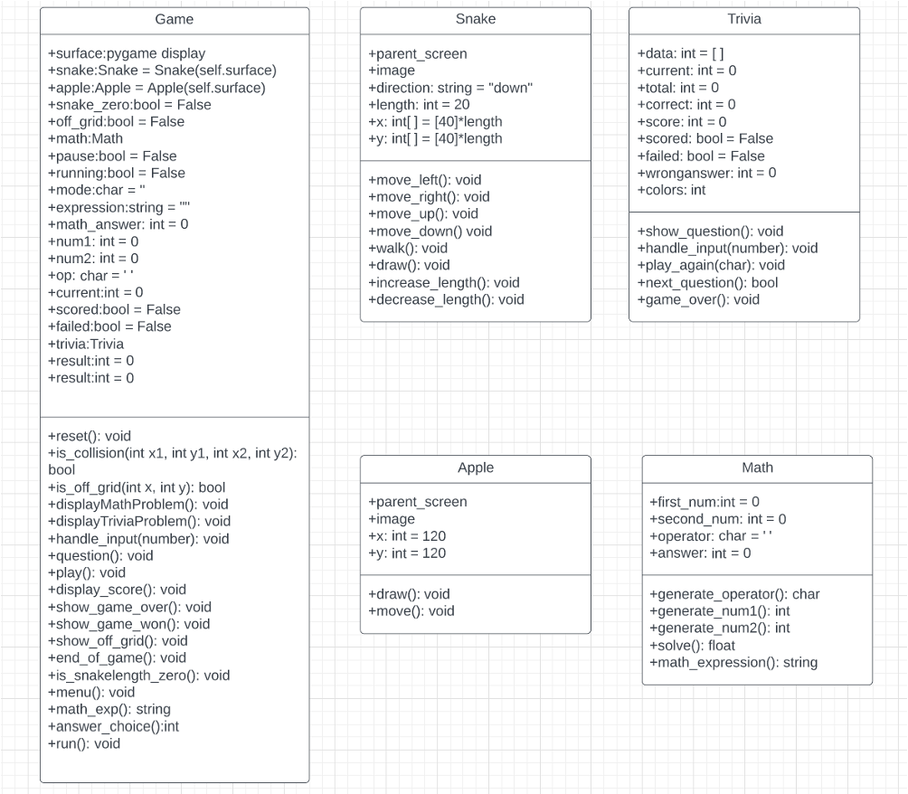
UML Diagram

Slide 3
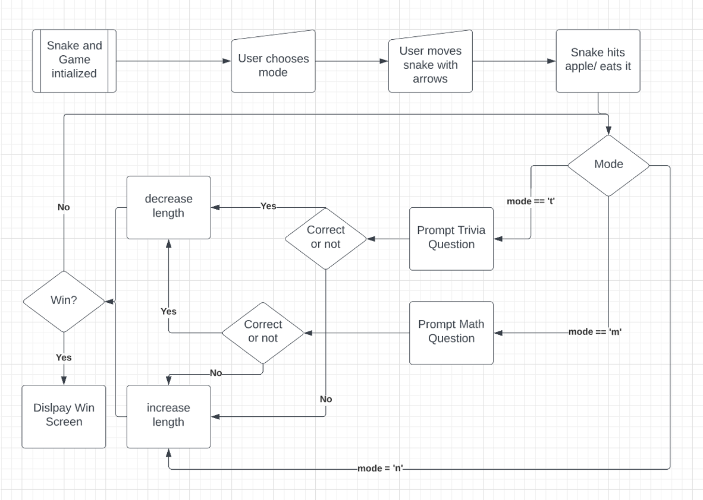
DataFlow

Slide 4


Interaction
Our game is quite simple to interact with. The only keys required are the arrows to move the snake, and then the numbers to either answer a trivia question, or answer a math question.

