Slide 1
Creating Multi-Intelligent User Experiences through
Digital Media
Benay Dara-Abrams, Ph.D.
C5 2007
January 26, 2007

Slide 2

Understanding Goals
By the end of the workshop, participants will understand:
Theory of Multiple Intelligences
Personal profile of multiple intelligences
Methods to reach variety of people through activating multiple intelligences

Slide 3
Multi-Intelligent User Experiences
Enabling Technologies
Methodologies
Theory of
Multiple
Intelligences
Constructivist
Learning Theory
Adult
Learning
Theory
Theoretical Foundation
Cognitive and Educational Psychology

Slide 4
Agenda
Theory of Multiple Intelligences
Self-assessment – MI profiles
Reflection and Discussion
Methodologies
Digital Media examples
Storyboard development
Presentation of storyboards

Slide 5

Theory of Multiple Intelligences
Psychology, Biology, Anthropology Evidence
Howard Gardner, Ph.D. – published 1983
Each individual possesses eight (or more) different intelligences
Intelligences both biological and learned
Individual variation – which more developed

Slide 6


Linguistic & Logical-Mathematical
Linguistic
Sensitive to spoken and written language, meanings, and relationship of words. Interested in vocabulary, grammar, poetry, essays, and plays.
Logical-Mathematical
Abstract thought, counting, organization,
logical structure. Interested in critical thinking activities,
breaking words into smaller parts and reassembling them.

Slide 7


Spatial &
Bodily-Kinesthetic
Spatial
Keen observation, visual thinking, metaphors. Interested in graphs, charts, color codes, guided imagery, pictures, posters, mind maps.
Bodily-Kinesthetic
Control of one's body and objects, good sense of timing. Interested in sports, hands-on learning, games, skits, plays.

Slide 8


Intrapersonal & Interpersonal
Intrapersonal
Strong sense of self, able to understand and access own feelings. Likes poetry, meditation, guided imagery, journal writing.
Interpersonal
Sensitive to others' moods, feelings, motivations; outgoing. Likes to talk with people, enjoys discussion groups, good at problem solving.

Slide 9


Musical & Naturalist
Musical
Naturalist
Sensitive to rhythm, pitch, intonation, music.
Likes poems, plays, jazz chants, rap music, songs,
musically guided imagery.
Sensitive to nature, environment; can distinguish between types of rocks, flowers, birds. Loves to be outdoors, tend plants and animals.

Slide 10
Constructivist Learning Theory
Based on research of Piaget
Learning - result of individual’s mental construction
Individuals learn by actively constructing their own understanding
Incorporate new information into base of knowledge already constructed in their minds
Discovery learning - “True learning is based on discovery guided by mentoring rather than transmission of knowledge” John Dewey

Slide 11
Adult Learning
Learn throughout their lives
Transitional stages – cause for learning
Diverse learning approaches
Problem-centered and relevant
Immediacy of application
Past experiences
Self-concept
Self-directed

Slide 12
Self-Assessment
Rate yourself on each intelligence
  Assign number - 1 (lowest) to 10 (highest)
  Each intelligence a different number
  Tie between two intelligences okay
Learning Strengths Inventory
  Check statements that describe you
  Ignore statements that don’t fit for you
Learning Issues Inventory

Slide 13
Methodologies
Entry Point Framework
Multiple Representations
Analogies and Metaphors
Teaching for Understanding Framework

Slide 14
Entry Point Framework
Narrative – introduce through story-telling
Numerical – engage through computation
Logical – deduction to learn new concepts
Existential/Foundational – ask questions
Aesthetic – engage senses through artworks
Hands-On – experiential, manipulation
Interpersonal – cooperative learning

Slide 15
Multiple Representations
Family of representations
Activate different intelligences
Present new concepts in multiple ways
Content presentation activates more than one intelligence

Slide 16
Explanation Variants
Intelligence | Explanation Variant | Technology
Linguistic | Prose, Textual Explanation | HTML, Word
Logic-Math | Bulleted List | HTML list
Spatial | Diagrams, Graphics, Movies | Flash, iMovie, PowerPoint
Musical | Sound Effects, Sound Track | Flash, Audio
Intrapersonal | Self-Guided Problem Analysis, Journals | HTML forms with script
Interpersonal | Discussions – problems, cases, questions | Threaded discussion
Naturalist | Categories and Metaphors | HTML lists, Flash
Bodily-Kinesthetic | Hands-on Exercises Simulations | Scripts Virtual Environments

Slide 17
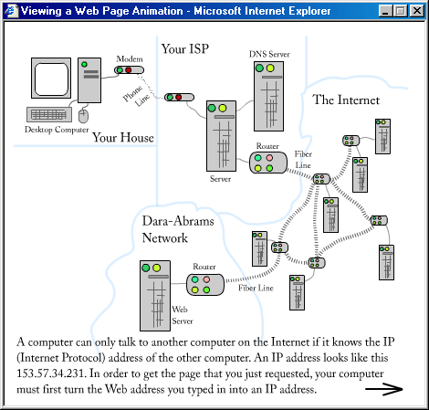
Spatial and Musical

Slide 18
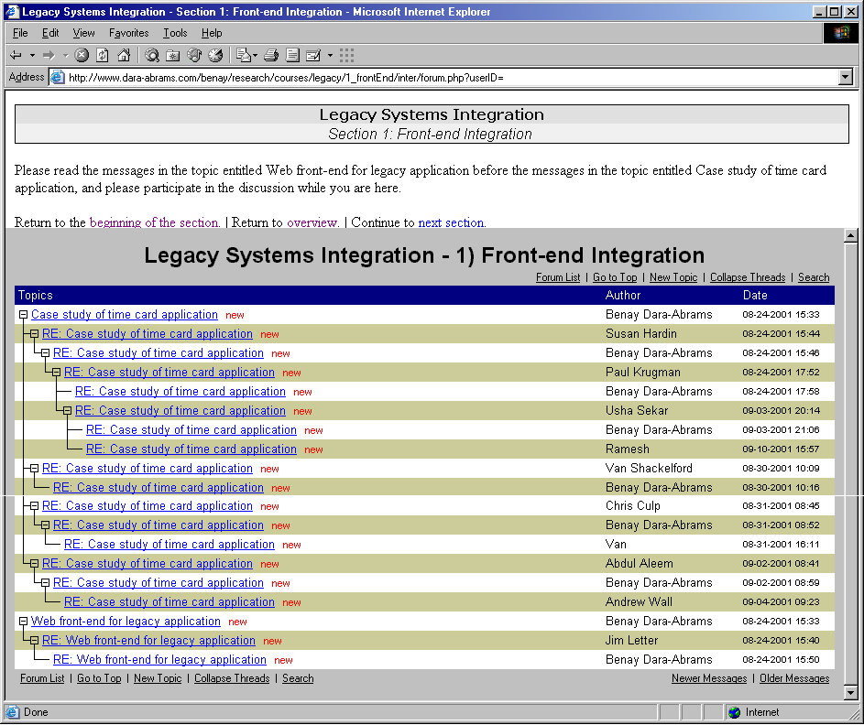
Interpersonal

Slide 19
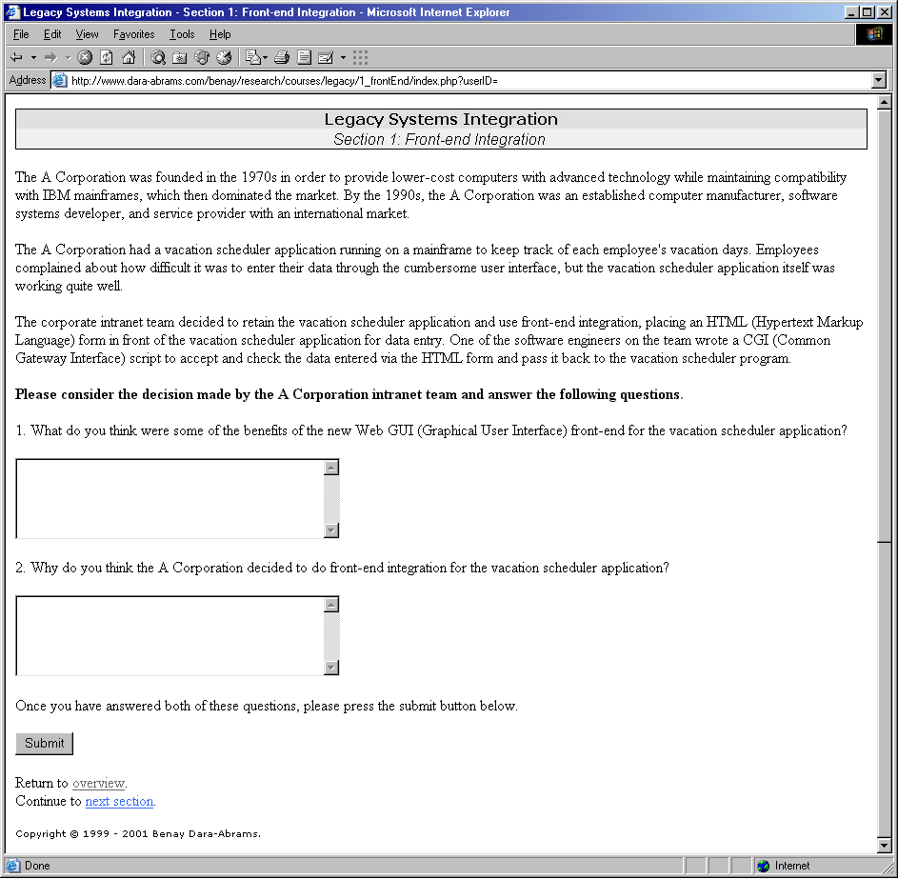
Intrapersonal

Slide 20
Analogies and Metaphors
Start from people’s experiences
Identify known concepts
Determine familiar features
Connect new concepts to known
Move from familiar features to new ones

Slide 21
Teaching for Understanding
Throughlines
UnderstandingGoals
Generative Topics
Teaching for Understanding (TfU) Framework
Performances of Understanding
Ongoing Assessment
http://learnweb.harvard.edu/ent/workshop/ccdt_framework.cfm

Slide 22
Storyboard Ideas
Instructions for setting up and using new features on cell phones
Collaborative learning course for university students
Online service to help people make decisions about their retirement – financial, health, residence

