Slide 1


Block-Surance
Last Minute Insurance on Demand (LMID)

Slide 2

Millennial’s on Insurance
Identifying Crowd and its needs
Seek value for money
Most do not own a car
Most drive with out insurance
Most still study (University etc.)

Slide 3
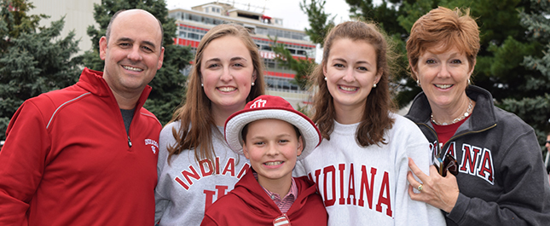
Family’s on Insurance
Identifying Crowd and its needs
Seek to decrease spending's
Most own two or more cars
Oldest own an insurance
Younger drivers are occasionally driving

Slide 4
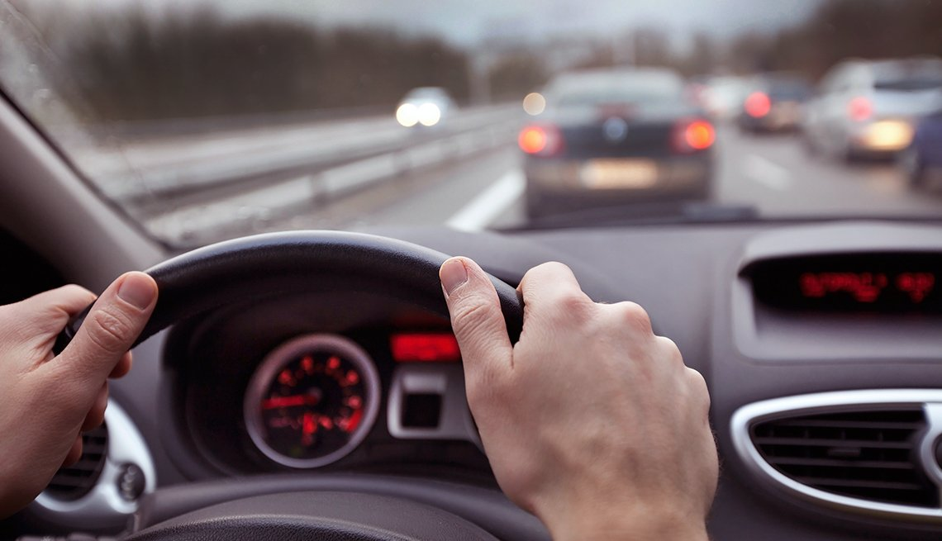
Family’s on Insurance
Identifying Insured Family’s
Young second driver cost is as high +50% cost
Looking for constant benefits or discounts
Family shares one company

Slide 5


Situations
Return of students during holidays
Few hours of driving occasionally
Barely experienced
Parent car borrowing
Driver unable to drive (Alcohol)
Any age group and gender
Cant be reported as it happens (Claim)
Usually happens in no operating hours

Slide 6
Tokenization To Business Model
Token per hour, use on demand
Scaled on cars specification
Original cost of second driver becoming optional to non existent
Allowance at 20% of insurance cost ( €400 * 20% = 80 Tokens )
Additional tokens charged at ( 1 Euro = 1 Token )
Public Historical ledger ( Proving Transparency of Claims)

Slide 7
Scaling
Due to power outputs and risk assessment
Token follow the scale above
Higher Cost per Hour
Less incentive to Drive

Slide 8
Running Scenario
Maria Georgiou -> Giorgos Georgiou
Amount: 24 Tokens
Description: 24 hours / Mazda3.
Maria Georgiou -> Giorgos Georgiou
Amount: 6 Tokens
Description: 6 hours / Mazda3.
System -> Maria Georgiou
Amount: 80 Tokens
Description: Given for Mazda3
Maria Georgiou -> Giorgos Georgiou
Amount: 48 Tokens
Description: 48 hours / Mazda3.
Maria Georgiou -> Giorgos Georgiou
Amount: 2 Tokens
Description: 2 hours / Mazda3.
Sytem -> Maria Georgiou
Amount: 0 Tokens
Description: Given for Mazda3

Slide 9
Running Scenario
Sytem -> Maria Georgiou
Amount: 48 Tokens
Description: Purchased for Mazda3
Sytem -> Maria Georgiou
Amount: 0 Tokens
Description: Given for Mazda3
Maria Georgiou -> Giorgos Georgiou
Amount: 48 Tokens
Description: 48 hours / Mazda3.
Sytem -> Maria Georgiou
Amount: 0 Tokens
Description: Given for Mazda3

Slide 10
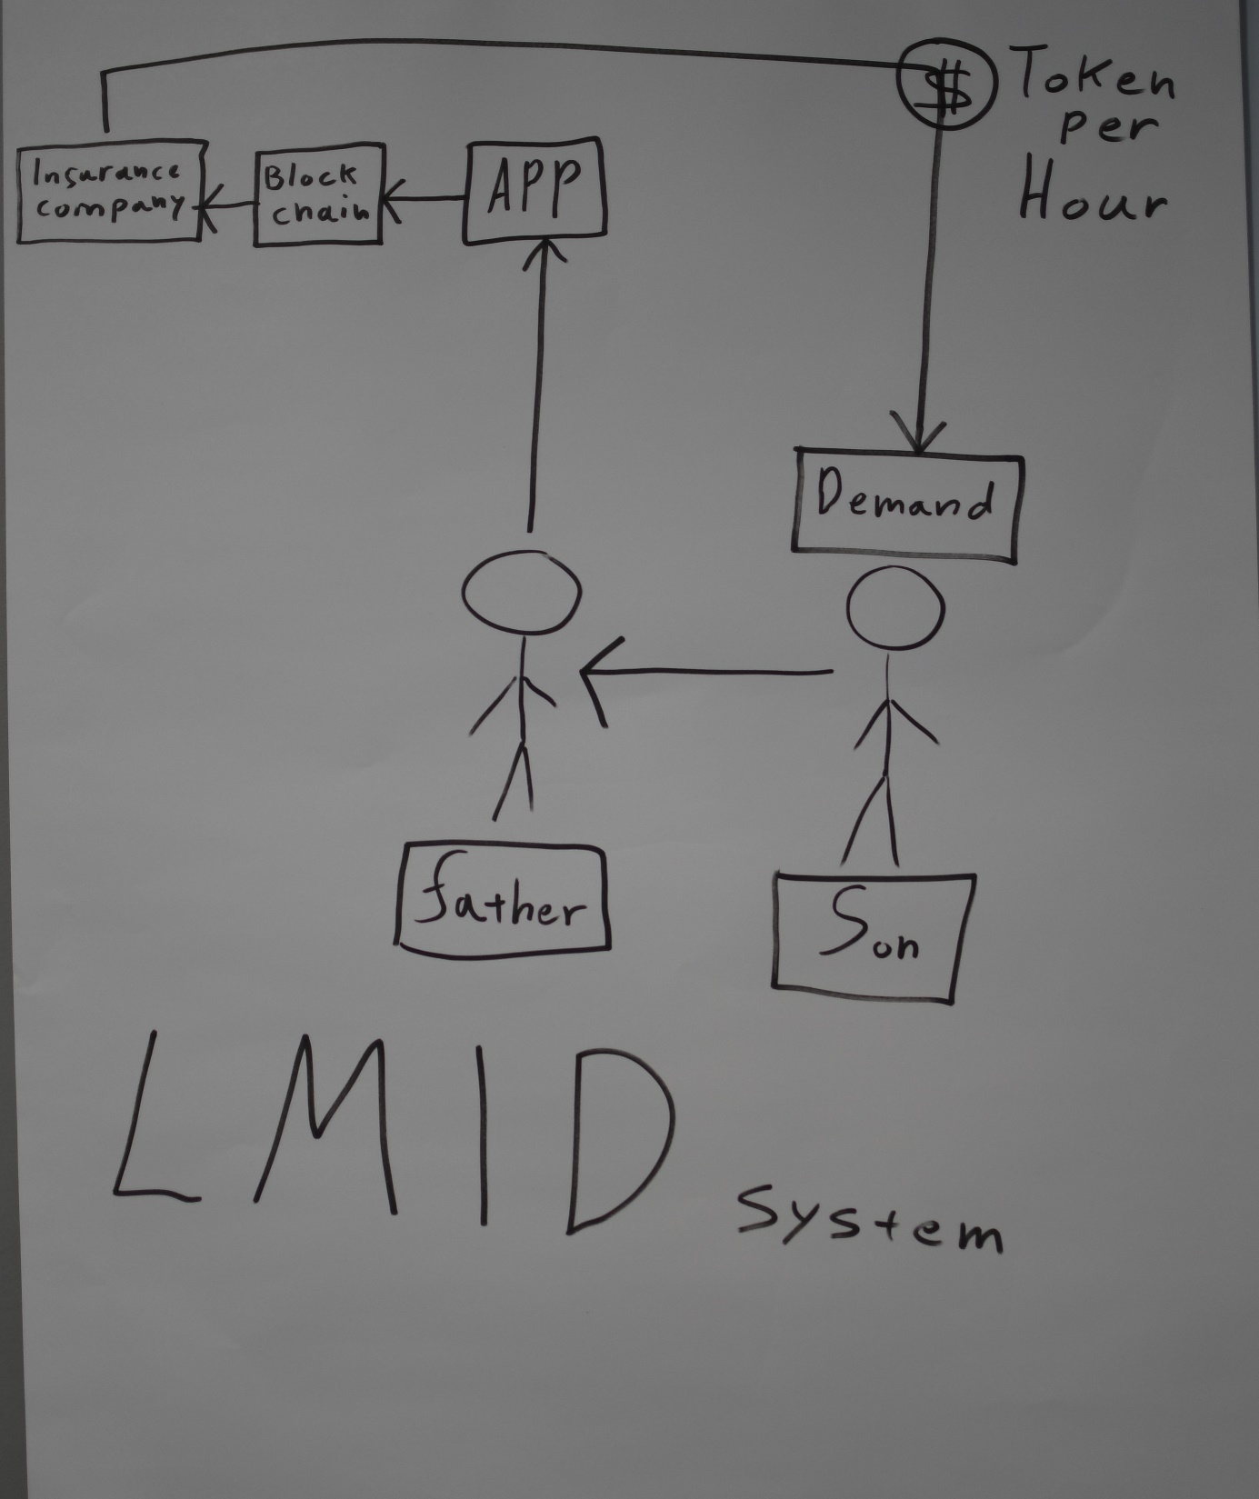
Real Life Scenario
A Son asking his Father
If he can borrow his car
Father assigns temporary insurance
For 5 hours to his son through tokens

Slide 11
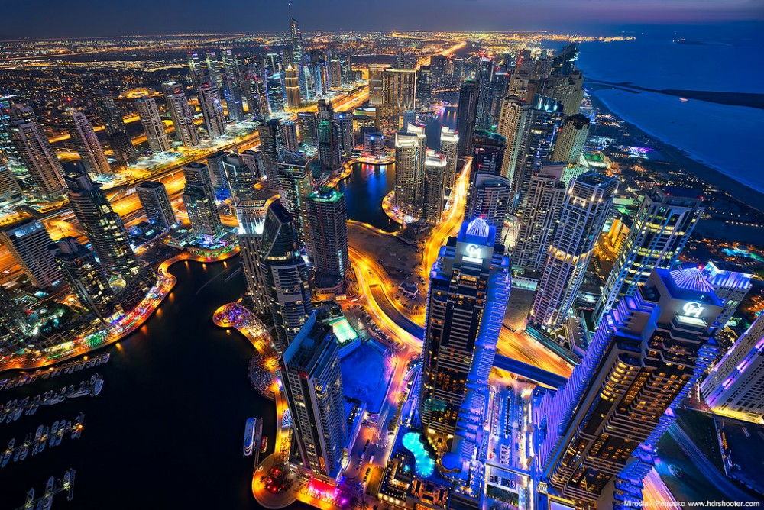
Insurance Future Vision
Gaining customers at critical age
No need for system adjustments
Futuristic outlook of the company’s path
Path to mobility and crypto payments
Deducting friction of time and disputes
Next step Medical, Home, Life and Travel. Infinite expansions on the system.
First steps to keyless world, just your phone !!!

